Slide 1



Environmental Impact Analysis of a Local Company
Chemical & Pharmaceutical
Formulations Company
AADARSHA | UID 26BCD10375
TIFAYAT | UID 26BCD10389
Notes:
Say: Our project studies how a local chemical and pharmaceutical company affects the environment, using sample data from January to June. Environmental impact means the effect a company's work has on nature - air, water and land. A chemical and pharmaceutical company mixes chemicals to make medicines, so it uses many resources and makes waste that needs care.

Slide 2
What is this project about?
Our goal in one line: watch resources, understand the trend, and improve
1
Monitoring focus – What we keep an eye on
The 3-step cycle
Electricity, water, waste, recycling and estimated greenhouse-gas emissions (gases like CO₂ that trap heat and warm the Earth).
MONITOR
2
Data source – Where the numbers come from
An Excel sheet with sample monthly data, January to June.
▼
ANALYZE
3
Analysis – What we do with the numbers
Compare month by month to spot patterns: is it going up or down?
▼
IMPROVE
4
Outcome – What we get at the end
Simple, practical ideas to make the company more eco-friendly.
In simple words: We watch how much electricity, water and waste a company uses, compare month by month, then suggest ways to do better. Monitor = collect numbers, Analyze = understand them, Improve = take action.
Notes:
Say: We follow three steps - Monitor, Analyze, Improve. 1) Monitoring focus: we watch electricity, water, waste, recycling and estimated greenhouse-gas emissions (gases like CO2 that trap heat and warm the Earth). 2) Data source: an Excel sheet of sample monthly data, January to June - made as an example, not real company records. 3) Analysis: we compare months to see if each number goes up or down. 4) Outcome: practical ideas the company can use. Monitor = collect numbers; Analyze = understand them; Improve = act, then repeat.

Slide 3
Key Terms in Simple Words
Short meanings you can use while explaining
Greenhouse gas (GHG)
tCO₂e
kWh
Gases like CO₂ that trap heat and warm the Earth.
Tonnes of CO₂ equivalent: one number that stands for all greenhouse gases.
Kilowatt-hour: the amount of electricity used.
Released when fuel is burned to make electricity.
Our emissions: 9.6 → 7.6
A 1,000-watt machine running 1 hour = 1 kWh.
m³
Recycling rate
Hazardous waste
Cubic metre: 1,000 litres of water.
The share of all waste that is recycled.
Waste that is dangerous to people or nature.
520 m³ = 520,000 litres.
Recycled ÷ total waste × 100
Chemical waste needs safe, separate handling.
In simple words: Learn these six words first and the rest of the presentation becomes easy to follow.
Notes:
Say: Before the numbers, here are six words we use. Greenhouse gas: gases like CO2 that trap heat. tCO2e: tonnes of CO2 equivalent - one number for all greenhouse gases together. kWh: unit of electricity. Cubic metre: 1,000 litres of water. Recycling rate: recycled waste divided by total waste, times 100. Hazardous waste: dangerous waste like chemical waste that needs special handling.

Slide 4
Company Profile & Risks
A chemical & pharmaceutical company uses a lot of resources, so risks need care
1
2
3
4
5
ELECTRICITY USE
WATER USE
WASTE STREAMS
HAZARDOUS WASTE
ENVIRONMENTAL RISK
Power for machines, lights, ventilation and testing equipment.
Water for cleaning and production processes.
Packaging, paper, general and process waste.
Chemical waste that is unsafe to throw away normally.
Poor management can hurt people, nature and operations.
More power used = more emissions.
Wasting water strains local supply.
Needs to be sorted and tracked.
Needs separate, safe handling.
Prevention costs less than damage.
Responsible management of resources and waste reduces risk and protects our community.
In simple words: These five areas are where a chemical company can harm nature if it is careless. Using less power and water, and handling chemical waste safely, lowers that risk.
Notes:
Say: These are five places where the company affects the environment. Electricity: machines, lights and testing equipment use power; more power means more emissions. Water: used for cleaning and production; wasting it strains local supply. Waste streams: packaging, paper, general and process waste - sort it so recyclables are not thrown away. Hazardous waste: chemical waste can harm people, soil and water, so it needs separate, safe handling. Environmental risk: if managed badly, it can hurt people, nature and the company itself. Bottom line: responsible management reduces risk and protects the community.

Slide 5

How we did it: Methodology & Tools
Four simple steps, from raw numbers to useful ideas
1
Collect
2
Calculate
3
Compare
4
Report
Excel sample data
➜
Excel formulas
➜
Charts
➜
Word report
January–June numbers for electricity, water, waste and recycling.
Formulas work out disposal and recycling rates automatically.
Bar charts show how each month performed.
We write the analysis and recommendations in a report.
Note
Emissions are simplified estimates, not based on verified company emissions factors.
In simple words: We typed the numbers in Excel, let formulas do the maths, drew charts to compare months, and wrote the results in a report. The emission numbers are only estimates.
Notes:
Say: Methodology means the method we followed, in four steps. Collect: January-June numbers go into Excel. Calculate: Excel formulas work out disposal and recycling rates automatically. Compare: charts make differences between months easy to see. Report: we write the analysis and recommendations in a Word report. Note: emissions are simplified estimates, not based on verified company emission factors, so treat this as a learning example.

Slide 6
January vs June: The Numbers
Each pair of bars shows the same measure in two months
Energy used
Water used
Total waste
Recycled waste
Estimated emissions
kWh
m³
kg
kg
tCO₂e
How to read: Green = January, teal = June. For energy, water, waste and emissions, lower is better. For recycled waste, higher is better.
In simple words: Each pair of bars compares January and June. A shorter bar is good for energy, water, waste and emissions. A taller bar is good for recycled waste.
Notes:
Say: Each small graph compares one thing in January (green) and June (teal). Energy: 12,000 to 9,500 kWh - down, good. Water: 520 to 430 cubic metres - down, good. Total waste: 820 to 640 kg - down, good. Recycled waste: 180 to 250 kg - UP, and that is good because more waste is being recycled. Emissions: 9.6 to 7.6 tCO2e - down, good. Rule: for energy, water, waste and emissions lower is better; for recycled waste higher is better.

Slide 7
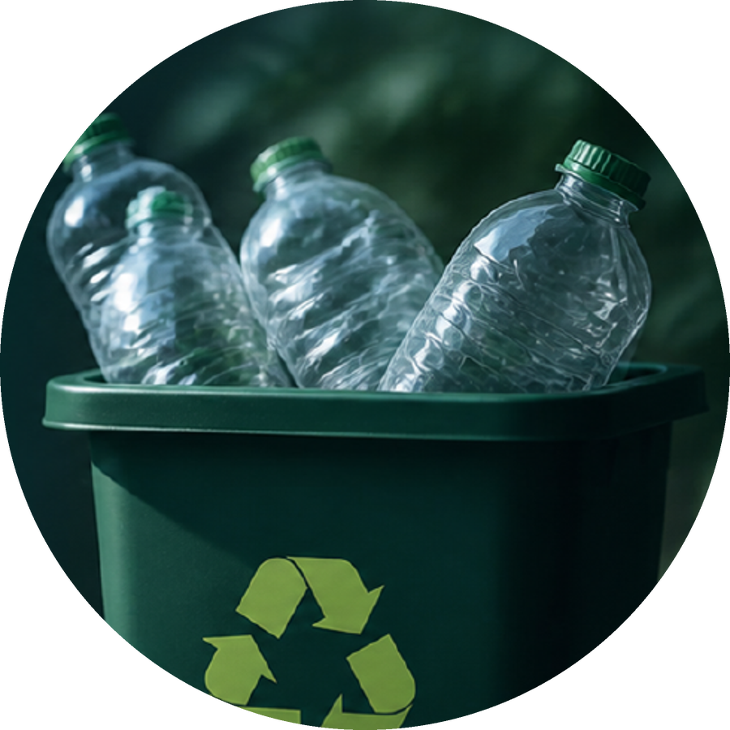
Key Findings
What changed from January to June
20.8%
17.3%
22.0%
less energy
less water
less total waste
12,000 → 9,500 kWh
520 → 430 m³
820 → 640 kg
20.8%
38.9%
39.1%
lower emissions
more recycled waste
recycling rate
9.6 → 7.6 tCO₂e
180 → 250 kg
up from 22.0%
In simple words: Percent change = (old − new) ÷ old × 100. In short: the company used about 20% less energy, water and waste, and recycled a lot more.
Notes:
Say: Percent change = (old - new) / old x 100. Energy: (12,000-9,500)/12,000 = 20.8% less. Water: (520-430)/520 = 17.3% less. Total waste: (820-640)/820 = 22.0% less. Emissions: (9.6-7.6)/9.6 = 20.8% lower - less energy means fewer greenhouse gases. Recycled waste: (250-180)/180 = 38.9% more. Recycling rate: January 180/820 = 22.0%, June 250/640 = 39.1% - so of every 100 kg of waste, about 39 kg is now recycled instead of about 22 kg. Summary: the company used fewer resources and recycled more.

Slide 8
All Five Numbers Improved
Percent change from January to June (bigger bar = bigger improvement)
Recycling rate
share of waste that is recycled
January
June
22.0%
39.1%
180 ÷ 820
250 ÷ 640
kg recycled ÷ total
kg recycled ÷ total
In simple words: Every bar shows an improvement. The biggest win is recycling: about 39% more waste recycled, so the recycling rate rose from 22% to 39%.
Notes:
Say: This slide puts all five changes on one graph so you can compare them. Energy 20.8% less, water 17.3% less, waste 22.0% less, emissions 20.8% lower - all good because lower is better. Recycled waste is 38.9% more - good because higher is better here. The biggest improvement is recycling. On the right: recycling rate is recycled waste divided by total waste. In January 180 kg out of 820 kg = 22.0%. In June 250 kg out of 640 kg = 39.1%. So almost 4 of every 10 kg of waste is now recycled.

Slide 9
Recommendations & Conclusion
What the company can do next
Be efficient
Watch utilities
CONCLUSION
1
2
Use smarter operations to save energy and water.
Keep checking usage and investigate sudden spikes.
Sample data shows better resource use and fewer emissions.
A real assessment needs verified records and proper emissions factors.
Separate waste
Train staff
3
4
Keep recyclable, general and hazardous waste apart.
Teach safe handling of chemicals.
Responsible actions today protect resources, reduce impact, and build a cleaner, healthier future for all.
Use authorized handlers
Set targets
5
6
Hand waste to approved handlers and keep records.
Choose realistic monthly environmental goals.
In simple words: These are easy steps any company can follow: use less, watch for problems, sort waste, train people, keep records and set goals. Our data is a sample, so a real study needs real records.
Notes:
Say: Six easy steps. 1) Be efficient: switch off idle machines, fix leaks. 2) Watch utilities: check usage and investigate sudden spikes - they can mean a leak or fault. 3) Separate waste: recyclable, general and hazardous in different bins. 4) Train staff to handle chemicals safely. 5) Use authorized waste handlers and keep records as proof. 6) Set realistic monthly targets, like 5% less water. Conclusion: our sample data shows better resource use and fewer emissions, but a real assessment needs verified records and proper emission factors.

Slide 10

Thank You
Environmental Impact Analysis
AADARSHA | UID 26BCD10375
TIFAYAT | UID 26BCD10389
Notes:
Say: Thank you for listening. We are happy to answer your questions. Likely questions: Is this real data? No, it is sample classroom data. Why is more recycled waste good? Because more waste is being reused instead of dumped. Why only six months? Enough to show a trend for a student project.

