Slide 1
Feature Selection in Supervised Machine Learning
Jeff Arena
July 14, 2020

Slide 2

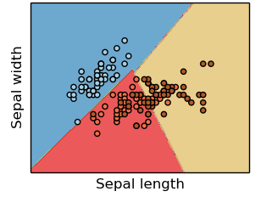
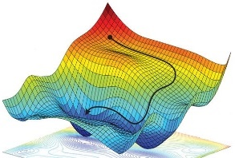


Necessary Components of a Supervised Machine Learning Approach
Training Data
Feature
Selection
Cost Function
Training Algorithm
Model Type
p
s
IrVi
IrSe
Set of labeled example data
Method to select data characteristics critical information
The form of model which will be trained to make decisions
Metric by which a prospective models should be judged
Algorithm to minimize the cost function by tuning model parameters
Description
- Tabular data
- Time-series
- Images
- Videos
- ASCII text
- Intuition
- Expert knowledge
- Statistics
- Learned features
- Regression
- Nearest neighbor
- Decision tree
- SVM
- Neural Network
- Squared error
- Absolute error
- Cross-entropy
- Accuracy
- Gradient descent
- Gradient-free opt.
- Analytic solution
Examples
Supervised machine learning approaches require each of these components
* image sources: scikit-learn (for “model type”) and https://reconsider.news/2018/05/09/ai-researchers-allege-machine-learning-alchemy (for “training algorithm”)

Slide 3
Necessary Components of a Supervised Machine Learning Approach
Training Data
Feature
Selection
Cost Function
Training Algorithm
Model Type
p
s
IrVi
IrSe
Set of labeled example data
Method to select data characteristics critical information
The form of model which will be trained to make decisions
Metric by which a prospective models should be judged
Algorithm to minimize the cost function by tuning model parameters
Description
- Tabular data
- Time-series
- Images
- Videos
- ASCII text
- Intuition
- Expert knowledge
- Statistics
- Learned features
- Regression
- Nearest neighbor
- Decision tree
- SVM
- Neural Network
- Squared error
- Absolute error
- Cross-entropy
- Accuracy
- Gradient descent
- Gradient-free opt.
- Analytic solution
Examples
Focus
Supervised machine learning approaches require each of these components
* image sources: scikit-learn (for “model type”) and https://reconsider.news/2018/05/09/ai-researchers-allege-machine-learning-alchemy (for “training algorithm”)

Slide 4
What is Feature Selection?
Feature selection: the process of choosing measurable attributes (features) of a dataset the purpose of classification or estimation
Example feature selection questions:
Hospital triage: What patient attributes should motivate the fastest medical attention?
- Potential features: symptoms, preexisting conditions, age, etc.
Virus test allocation: What attributes of an individual make them the best candidates for testing?
- Potential features: job, symptoms, preexisting conditions, time since symptom onset, etc.
Hotspot prediction: What aspects of an environment best predict its potential as a virus hotspot?
- Potential features: population density, average age, population flow, etc.
Feature selection involves finding sufficiently descriptive attributes for the dataset

Slide 5

The Connection Between Features and Dimensionality Reduction
Good features capture the ‘essence’ of a dataset in a small amount of measurements
Need a good real world example of the importance of feature selection…
Cats/dogs at night and day time? (That might require discussion of NNs)
Phonemes?
Audio metaphor – Jimmy Fallon’s name that tune? (this I like)
Ask students what portions of a song are most helpful in guessing its title
Ask students how they might quantify those features

Slide 6
Outline
Introduction
Manual Feature Investigation
Correlation Analysis
Features of Non-scalar Training Data

Slide 7


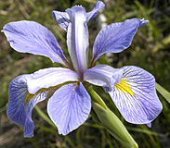
Example: Fisher’s Iris Data Set
In 1936, a British scientist Ronald Fisher made measurements of different flower species from the Gaspé Peninsula and used the data to develop a species classifier
Fisher’s Iris Dataset†
Iris versicolor
Entry # | Sepal Length | Sepal Width | Pedal Length | Pedal Width | Species
1 | 6.7 | 3.1 | 4.7 | 1.5 | Iris versicolor
2 | 4.9 | 3.1 | 1.5 | 0.2 | Iris setosa
3 | 7.4 | 2.8 | 6.1 | 1.9 | Iris virginica
4 | 5.1 | 3.8 | 1.5 | 0.3 | Iris setosa
150 | 6.9 | 3.1 | 5.4 | 2.1 | Iris virginica
Iris setosa
…
Features (4 per entry)
Iris virginica
Fisher measured four attributes (features) from each flower: sepal length, sepal width, pedal length, and pedal width
Fisher’s data provides a useful example for machine learning classifiers
†Fisher’s length units were centimeters
Expert feature selection is useful, but might be expensive and/or difficult to translate into an algorithm
Manual feature extraction takes time and may offer traps to the unsuspecting analyst
Spurious relationships (related to confounding variables or sampling bias)
The higher the feature count, the greater the potential for overfitting

Slide 8
What Do Descriptive Features Look Like?
View Distributions on Single Feature
Viewing Distributions on Two Features
Difficult to separate classes based on only sepal width
Plotting 2 features reveals more class separation
We can view the distribution of features to get a sense of how well classes are separated
Descriptive features allow different classes to be separated from one another in the feature space
Show 1D example of feature distributions
Build to 2D feature space

Slide 9
Manually Investigating Features
High-dimensional spaces can be difficult to visualize, but for sets of 2 features, a scatter plot can be useful to assess the performance of a featureset
Displaying Projections of the Feature Space
Displaying Univariate and Bivariate Distributions in Feature Space

Slide 10
Manually Investigating Features (cont’d)
Displaying Univariate and Bivariate Distributions in Feature Space
Tip:
After deriving features for your week 2 dataset, using the ‘pairplot’ function in the ‘seaborn’ package may be helpful in determining if your features are useful.
Plotting 2D projections of the feature space can reveal potential difficulties with class separability

Slide 11
Outline
Introduction
Manual Feature Investigation
Correlation Analysis
Non-scalar Features

Slide 12
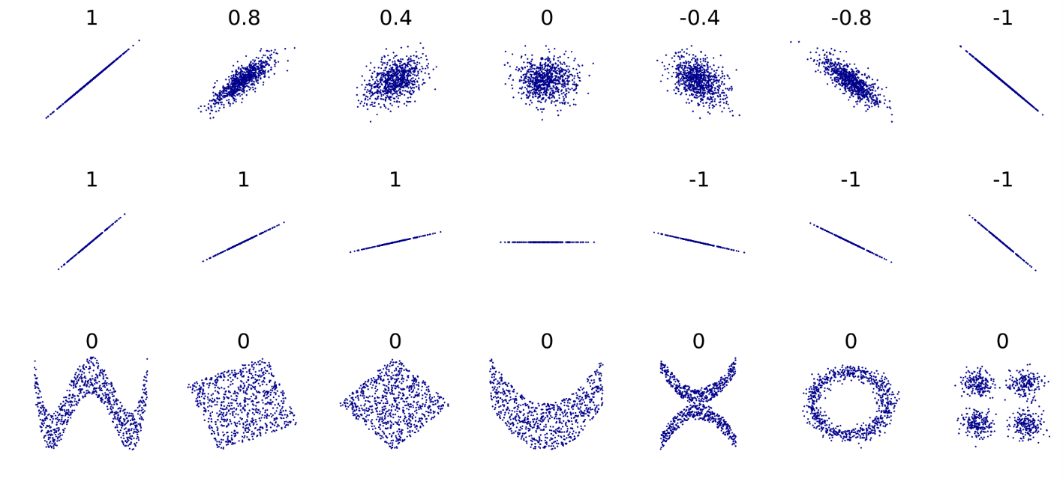
Estimating Feature Descriptiveness Using Correlaton
Pearson correlation coefficient measures the extent that two variables “vary together”
Highly-correlated feature values are less independent, and less useful as separate features
Correlation Coefficient in Example Point Clouds
Values near 1 or -1 indicate that the two variables are linearly related
undefined
Values are independent of relationship slope
(undefined if one feature doesn’t vary)
Value of 0 implies no linear dependence, not independence
Finding high degrees of correlation in feature values indicates that one of those features might be redundant
Independent features will have a low (near zero) correlation value (the converse is not true, however)

Slide 13
Defining the Pearson Correlation Coefficient
Pearson correlation coefficient
Note: this calculation is built into the pandas library via the ‘DataFrame.corr()’ method
Notes:
Start with concrete and move into abstract, try to lead to abstract (generalized)
Potentially another outline slide

Slide 14
Pearson Correlation Coefficient Example: Iris Data Set
Iris Dataset:
Pearson Correlation Coefficients
Iris Dataset:
Feature Distributions
Highly-correlated features like petal length and pedal width reveal similar information (almost redundant)
Uncorrelated features like sepal length and sepal width are useful together to identify Iris setosa species

Slide 15
Pearson Correlation Coefficient Example: Iris Data Set
Iris Dataset:
Pearson Correlation Coefficients
Iris Dataset:
Feature Distributions
Highly-correlated features like petal length and pedal width reveal similar information (almost redundant)
Uncorrelated features like sepal length and sepal width are useful together to identify Iris setosa species

Slide 16
Outline
Introduction
Manual Feature Investigation
Correlation Analysis
Non-scalar Features

Slide 17
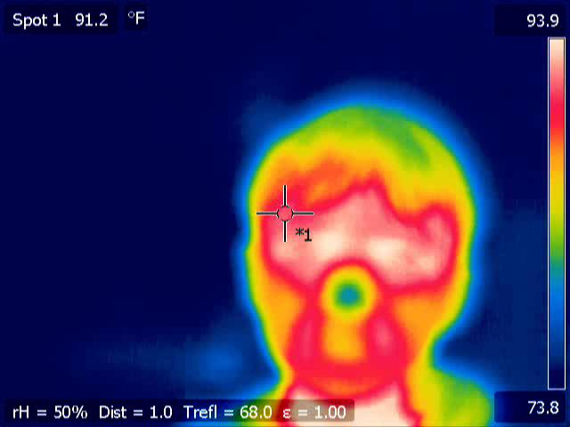
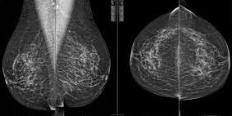
What If Training Examples Do Not Have a ‘Small’ Set of Scalar Features?
Many 1D signals and 2D signal (image) raw data sources are of high dimension
Example High-Dimensional Raw Data Sources
ECG Signal
Infrared Facial Image
Mammogram Image
200 samples/sec * 60 sec =
12,000 signal values
640 x 480 pixel array =
~300,000 signal values
299 x 299 pixel array =
~90,000 signal values
Naively training a machine learning model on high-dimensional data sources can lead to an enormous featurespace and may not capture intuitive dependencies between signal values
Show a picture of a face in infrared, an MRI image and a generic signal
Explain that we can try to engineer features that express important differences as a smaller set of numbers
This may require domain expertise or investigation
Explain why we can’t just take all values in a signal and train on each one as a different feature (computationally challenging, and great potential for overfitting)

Slide 18
Hand-engineered Featuresets for Training
One solution: hand-engineered featuresets to reduce data dimensionality
ECG Signal
Infrared Facial Image
Mammogram Image
Raw Training Data
Possible Manually
Determined
Featureset
Average magnitude
Spectral centroid
Maximum frequency value
Spectral flatness
Maximum temperature
Average temperature
Extent of temperatures exceeding threshold
Spectral Analysis
Maximum density
Average density
High-density feature size
Spectral Analysis
One method of dimensionality reduction is hand-engineered featuresets
Domain expertise can save significant time over manual investigation

Slide 19
Example Hand-engineered Featureset: ECG Signal
Raw Training Data
ECG Signal
Example Featureset:
Feature | Value | Description
mean peak signal (µV) | 693 | mean magnitude of periodic peaks (time domain)
mean peak-to-peak time (s) | 1.3 | time interval between peaks (time domain)
spectral centroid (Hz) | 15.3 | center of signal frequency content (frequency domain)
spectral flatness | 0.158 | Indicator of signal’s spectral spread (frequency domain)
ECG Spectral Content

Slide 20
Benefits and Drawbacks of Hand-engineered Featuresets
Benefits:
Permits analysts to apply intuition in selecting important features for training
Reduces dimensionality of raw training data, increasing training efficiency and reducing potential for overfitting
Can allows expert-knowledge to be incorporated into featureset
Drawbacks:
Can require significant amount of time or expert knowledge to discover useful features
May omit features present in data, but not known to analyst/experts
Requires all applied expert knowledge to be directly translatable into features

Slide 21
Summary
Feature selection is an integral part of the machine learning process, requiring data scientists to find attributes of each example that capture their ‘essence’ in the context of the classification problem
Viewing the distribution of feature values in a dataset can help determine if the selected features are able to separate different classes
The Pearson correlation coefficient provides a useful tool to quantify the independence of feature values within a dataset
One method for reducing dimensionality of high-dimensional training data is hand-engineered feature selection, which comes with benefits and drawbacks

