Slide 1
Introduction to Neural Networks
Jeff Arena
July 15, 2020

Slide 2

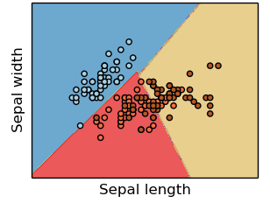
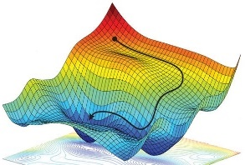


Necessary Components of a Supervised Machine Learning Approach
Training Data
Feature
Selection
Cost Function
Training Algorithm
Model Type
p
s
IrVi
IrSe
Set of labeled samples
Method to select data characteristics critical information
The form of model which will be trained to make decisions
Metric by which a prospective models should be judged
Algorithm to minimize the cost function by tuning model parameters
Description
- Tabular data
- Time-series
- Images
- Videos
- Text samples
- Intuition
- Expert knowledge
- Statistics
- Learned features
- Regression
- Nearest neighbor
- Decision tree
- SVM
- Neural Network
- Squared error
- Absolute error
- Cross-entropy
- Accuracy
- Gradient descent
- Gradient-free opt.
- Analytic solution
Examples
Supervised machine learning approaches require each of these components
* image sources: scikit-learn (for “model type”) and https://reconsider.news/2018/05/09/ai-researchers-allege-machine-learning-alchemy (for “training algorithm”)

Slide 3
Necessary Components of a Supervised Machine Learning Approach
Training Data
Feature
Selection
Cost Function
Training Algorithm
Model Type
p
s
IrVi
IrSe
Set of labeled samples
Method to select data characteristics critical information
The form of model which will be trained to make decisions
Metric by which a prospective models should be judged
Algorithm to minimize the cost function by tuning model parameters
Description
- Tabular data
- Time-series
- Images
- Videos
- Text samples
- Intuition
- Expert knowledge
- Statistics
- Learned features
- Regression
- Nearest neighbor
- Decision tree
- SVM
- Neural Network
- Squared error
- Absolute error
- Cross-entropy
- Accuracy
- Gradient descent
- Gradient-free opt.
- Analytic solution
Examples
Focus
Supervised machine learning approaches require each of these components
* image sources: scikit-learn (for “model type”) and https://reconsider.news/2018/05/09/ai-researchers-allege-machine-learning-alchemy (for “training algorithm”)

Slide 4
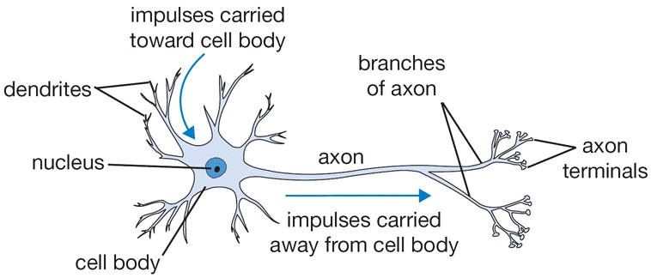
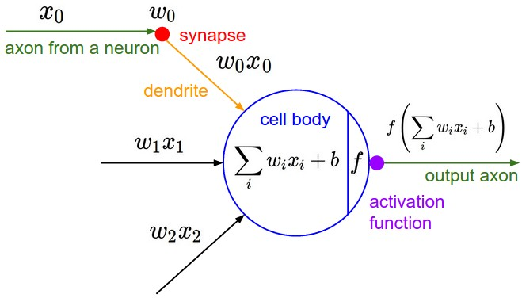
What Is an Artificial Neural Network?
An artificial neural network takes its inspiration from the network of nerve cells in the brain
If the brain can learn using with connections between neurons, why can’t a network of artificial neurons do the same?
Biological Neuron (Nerve Cell)
Artificial Neuron
Neural networks get their name from a loose analogy to neurons in the brain
The goal of neural networks: combine many simple units (artificial neurons) to complete a complex task (learning from data)
Images from course website for Stanford CS231n (Convolutional Neural Networks for Visual Recognition)
Notes:
<Neural network machine learning is based on the observation that many simple units working together can learn complicated things (like language, image recognition, etc.)>
<Mention theory that humans store information through connections between neurons (10^11 neurons in the brain, ~10^4 synapses per neuron, ~10^15 connections!)>
Potentially ask students how many connections they think are in the human brain

Slide 5
Why Are Neural Networks Popular Today?
The idea of a neural network learning from data has been around since at least the 1960s†
Since then, 3 trends have continued to improve the outlook for neural networks
Data Quantity
Data creation and aggregation has been accelerated by booming social media platforms
90% of the world’s data has been created in the last 2 years, most of it unstructured††
Compute Power
- Moore’s law has continued, coupled with GPU usage in training (~2000s*) increased speeds
Algorithm Improvements
- Backpropagation training (1986), convolutional neural networks (LeCun,1989), ReLU activation functions (2004)
The success and popularity of neural networks has been fueled by increases in data quantity, compute power, and algorithm performance
†In a 1969 paper, Marvin Minsky and Seymour Papert described the research of extending neural networks to multiple layers as “sterile”
†† Data in the form of photos, video, documents, tweets, metadata now numbers in the 100s of exabytes *NVIDIA released CUDA, a programming interface for GPUs, in 2007
Notes:
Focus on 3 improvements data quantity, compute power, and algorithm improvements
Maybe in your words say: CNNs have exceeded human performance on image classification

Slide 6
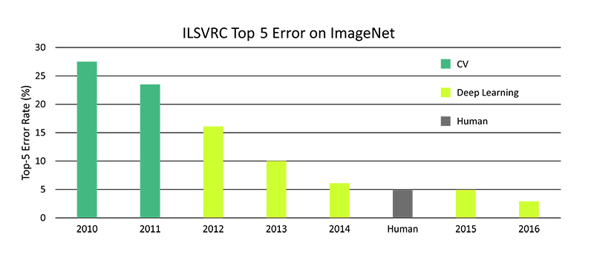
Imagenet Large-scale Visual Recognition Challenge (ILSVRC)
Every year since 2010, the ImageNet project runs a challenge where software programs attempt to classify and detect object in scenes
AlexNet (a CNN) wins challenge by ~10% margin
†
Microsoft’s CNN
exceeds human capability
Neural network-based algorithms showed dramatic improvement in classification accuracy over existing computer vision methods in the Imagenet Large-scale Visual Recognition Challenge
†Computer Vision
Notes:
Focus on 3 improvements data quantity, compute power, and algorithm improvements
Maybe in your words say: CNNs have exceeded human performance on image classification

Slide 7
Outline
Introduction
The Artificial Neuron
Networked Artificial Neurons
Common Neural Network Types

Slide 8
Anatomy of a Single Artificial Neuron
Artificial Neuron
Inputs
Output
Weights
Symbol:
Quantity: one value per input
Activation Function
Symbol:
Nonlinear function of one input
Bias
Symbol:
Quantity: 1 (scalar)
A single artificial neuron is composed of a set of weights, a bias, and and a non-linear activation function
Notes:
- Look at course material on edX and coursera course videos introducing neural network to aid in introduction
- Consider doing some historical research on nn types

Slide 9
Why Do We Need Activation Functions?
Applying multiple linear transformations to an input vector in sequence, is equivalent to applying a single linear transformation†
Effectively, all neural networks we made would be reduceable to a single layer
“Deep” Network (without activation functions)
Equivalent Single-Layer Network
N-layers deep
Without non-linear activation functions, deep neural networks would be reducible to single layer networks
†This is easier to understand if you can see that each layer can be represented as performing matrix multiplication plus vector addition
Notes:
- Look at course material on edX and coursera course videos introducing neural network to aid in introduction
- Consider doing some historical research on nn types

Slide 10
Artificial Neuron Intuition: 2D Neuron
Artificial Neuron
Neuron Response to Input
Inputs
Output
Geometric
Intuition
Decision Boundary
A single artificial neuron can represent a linear decision boundary (i.e. a line in 2D space, a plane in 3D space, or a hyperplane in ND space)
The value input to a neuron’s activation function is proportional to the distance from the decision boundary

Slide 11
Artificial Neuron Example: The ‘AND’ Function
Problem: use a single neuron to learn the ‘AND’ function
‘AND’ Function
Artificial Neuron

Slide 12
Artificial Neuron Example: The ‘AND’ Function
Problem: use a single neuron to learn the ‘AND’ function
‘AND’ Function
Artificial Neuron
Decision Boundary
A single artificial neuron can represent the ‘AND’ function because different classes of ‘sample’ can be separated by a line

Slide 13
Single Neuron Shortcoming: The ‘XOR’ Function
‘XOR’ Function
Artificial Neuron

Slide 14
Single Neuron Shortcoming: The ‘XOR’ Function
‘XOR’ Function
Artificial Neuron
No single line can separate
true labels from false labels
Data is not “linearly separable”
A single artificial neuron cannot learn to represent data that is not linearly separable

Slide 15
Other Examples of Data That is Not Linearly Separable
Half Moons†
(class separation possible)
Circles††
(class separation possible)
Other*
(separation not obvious)
Many datasets require more than one neuron to classify samples
†Data from sklearn.make_moons() ††Data from sklearn.make_circles() *Data from sklearn.make_s_curve()

Slide 16
Outline
Introduction
The Artificial Neuron
Networked Artificial Neurons
Common Neural Network Types

Slide 17
Anatomy of a Fully Connected Neural Networks
Example Neural Network
Weights
Symbol:
Quantity: neuron input
Biases
Symbol:
Quantity: 1 value per neuron
Activation Functions
Symbol:
Quantity: one function per neuron
A neural network results from connecting single neurons together
Notes:
- Look at course material on edX and coursera course videos introducing neural network to aid in introduction
- Consider doing some historical research on nn types

Slide 18
Multiple Neurons: Learning ‘XOR’
‘AND’ Function
‘XOR’ Function
‘OR’ Function
Multiple neurons can combine to represent non-linearly separable data
Notes:
- Look at course material on edX and coursera course videos introducing neural network to aid in introduction
- Consider doing some historical research on nn types

Slide 19
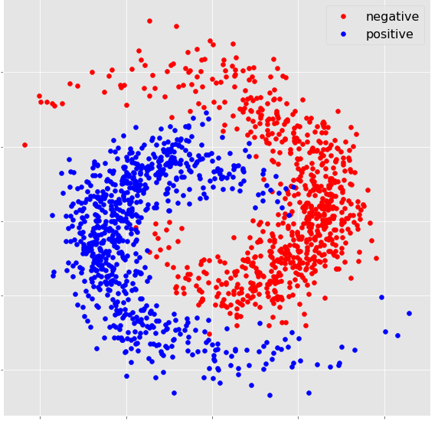
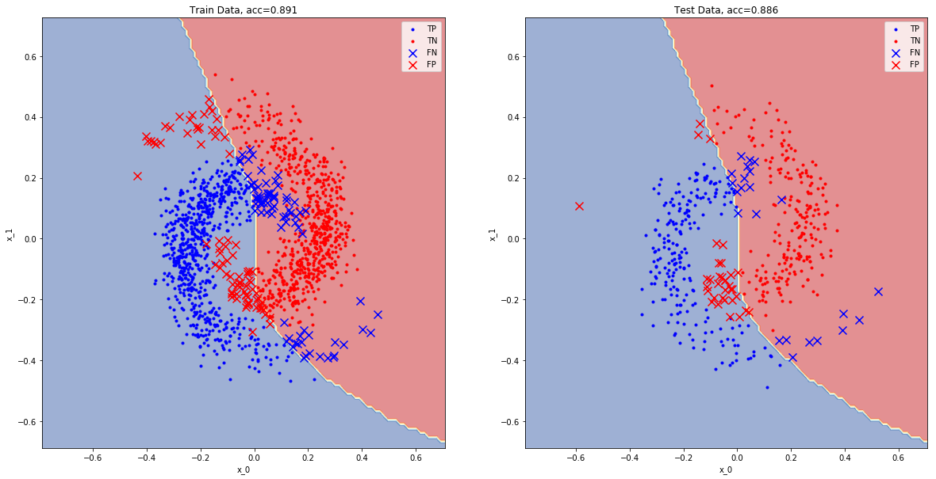
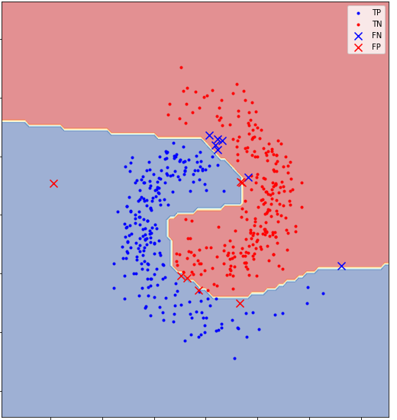
Multiple Neurons Intuition
Using multiple neurons allows the network to represent more complicated (“less linear”) patterns
1-Hidden Layer Classifier†
• 88.6% test accuracy
5-Hidden Layers Classifier†
• 97.2% test accuracy
Example Data
Deeper networks can represent more complex decision boundaries, but come with the risk of longer training time or overfitting
Finding the “best” network structure for a given problem can require trial & error
†Neural networks trained with 10 neurons per layer and a ReLU activation function See http://playground.tensorflow.org/ for a useful visualization of 2D neural network training
Notes:
- Look at course material on edX and coursera course videos introducing neural network to aid in introduction
- Consider doing some historical research on nn types

Slide 20
Outline
Introduction
The Artificial Neuron
Artificial Neuron Networks
Common Neural Network Types

Slide 21
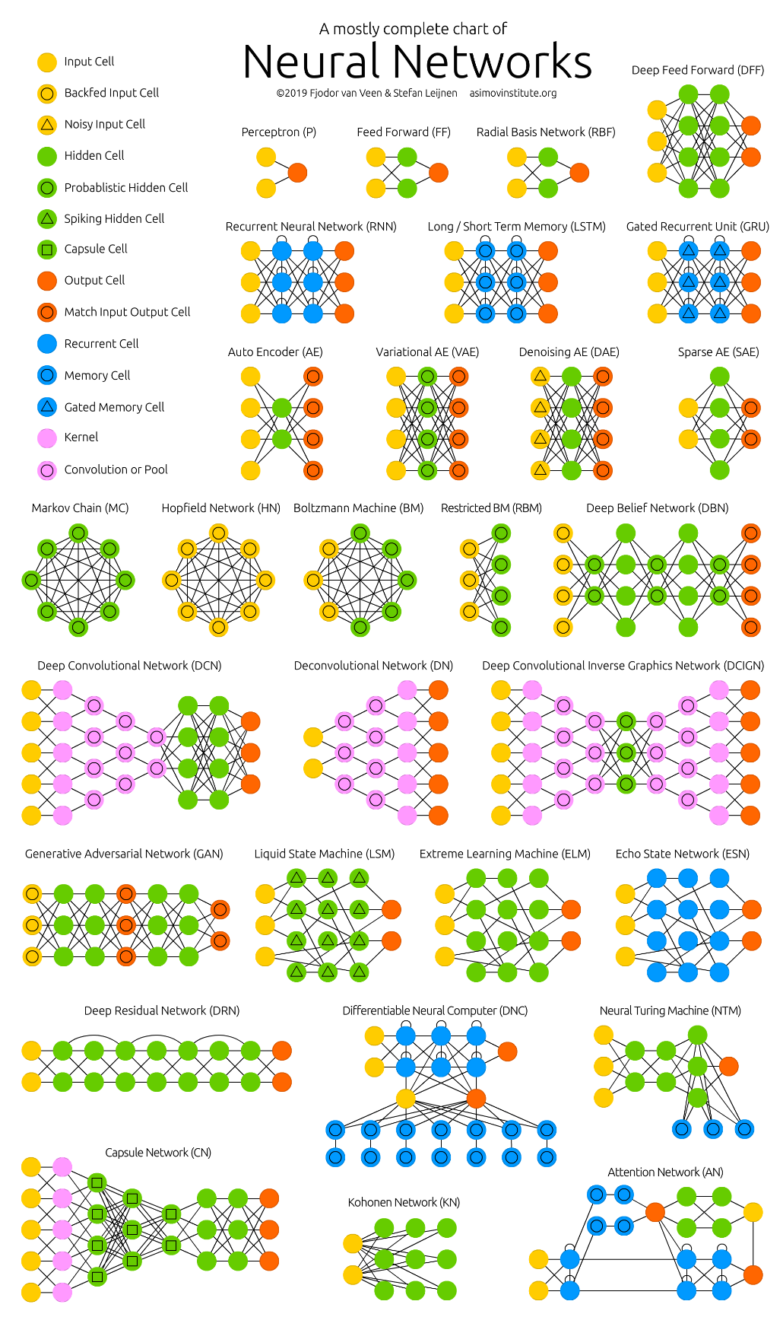
Network Architectures
Look at the below guide† (from AsimovInstitute.org) for a broad set of potential neural network architectures
Many network types exist that are specially designed for specific applications
In this course, we will focus on only 2 types of neural network – deep feed forward networks, and deep convolutional networks
†Taken from asimovinstitute.org

Slide 22
Fully-Connected Feed-Forward Networks
Network Example
Fully-connected feed-forward networks are the most general type of neural network, and result when every neuron in adjacent layers are connected and pass outputs in a single direction

Slide 23
Summary
Neural networks are loosely modeled after the structure of neurons in the brain, and attempt to represent complex functions by composing many simple building blocks (neurons)
A single neuron can only represent simple (i.e. linear) decision boundaries in the input space
Many neurons networked together can represent more complicated decision boundaries
Selecting the appropriate size and complexity of a neural network to solve a given problem requires judgement on the part of the analyst
Many neural network structures have been proposed to solve problems in different domains; these include fully connected neural networks, convolutional neural networks, and recurrent neural networks

Slide 24
Convolutional Neural Networks
Convolutional neural networks are designed to identify objects in images
<bumper>

