Slide 1
Week 2 Project: Sleep Analysis Challenge
Jeff Arena
July 13, 2020

Slide 2
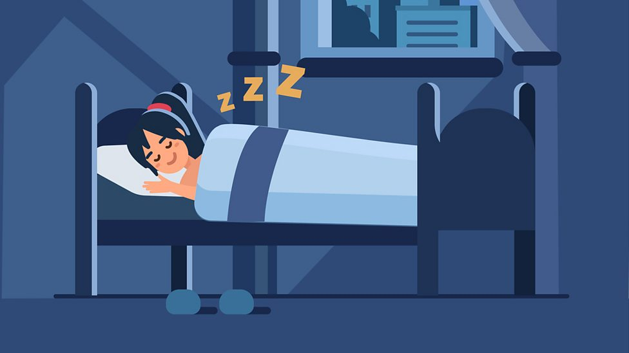
The Importance of Sleep
While many questions remain as to the precise reason humans sleep, there is broad consensus that sleep quality is important to overall health and well-being
Inadequate sleep is associated with numerous negative outcomes including:
impaired memory and learning
obesity
irritability
cardiovascular dysfunction
hypotension
diminished immune function
depression
reduced quality of life
Identifying sleep disorders can be accomplished by through expert monitoring of video, audio, and polysomnography† collected in a laboratory or hospital
Experts can analyze recorded data to determine which sleep states a patients attain during their sleep, which in turn can aid in diagnosing and treating sleep disorders
BBC.com
†A suite of sensors used to monitor physiological signals from brain waves to muscle activity during sleep
For more background information, check out the challenge webpage at https://physionet.org/content/challenge-2018/1.0.0/

Slide 3
You Snooze You Win Challenge: Sleep States
The 2018 PhysioNet / Computing in Cardiology challenge asked participants to classify subject sleep states based on recorded physiological signals
Using 1-minute segments of polysomnography† that have been labeled based on sleep state, the goal of the challenge is to train a classifier to identify sleep states
Sleep States For Classification
† Data collected by Massachusetts General Hospital’s (MGH) Computational Clinical Neurophysiology Laboratory (CCNL) and the Clinical Data Animation Laboratory (CDAC)

Slide 4
You Snooze You Win Challenge: Recorded Data
Available data about study subjects includes 7 physiological signals of varying types
Example Signal Data: Arousal
Sleep States For Classification
Signal | Description
02-M1 | Posterior brain activity
E1-M2 | Left eye activity
Chin1-Chin2 | Chin movement
ABD | Abdominal movement
Chest | Chest Movement
Airflow | Respiratory airflow
ECG | Cardiac activity

Slide 5
You Snooze You Win Challenge: Submission and Scoring
Submissions:
Submit your models by predicting the classes of samples in provided (unlabeled) test data, pickling the predictions in a pandas dataframe object, and submitting the pickled file
Dataframes should have 1000 rows (1 per sample) and 5-columns (one per class) with the ith row containing the prediction scores for that sample in the test set.
Contents of the ith row of the submitted dataframe should be likelihood scores for each class (i.e. they should each fall in the interval from 0-1, with 1 being most likely)
Scoring:
Submissions will be scored based on:
An aggregate area under the curve ROC curve for each class
Matthews Correlation Coefficient for binary classification between arousal and non-arousal (all other) states
Creativity

