Slide 1
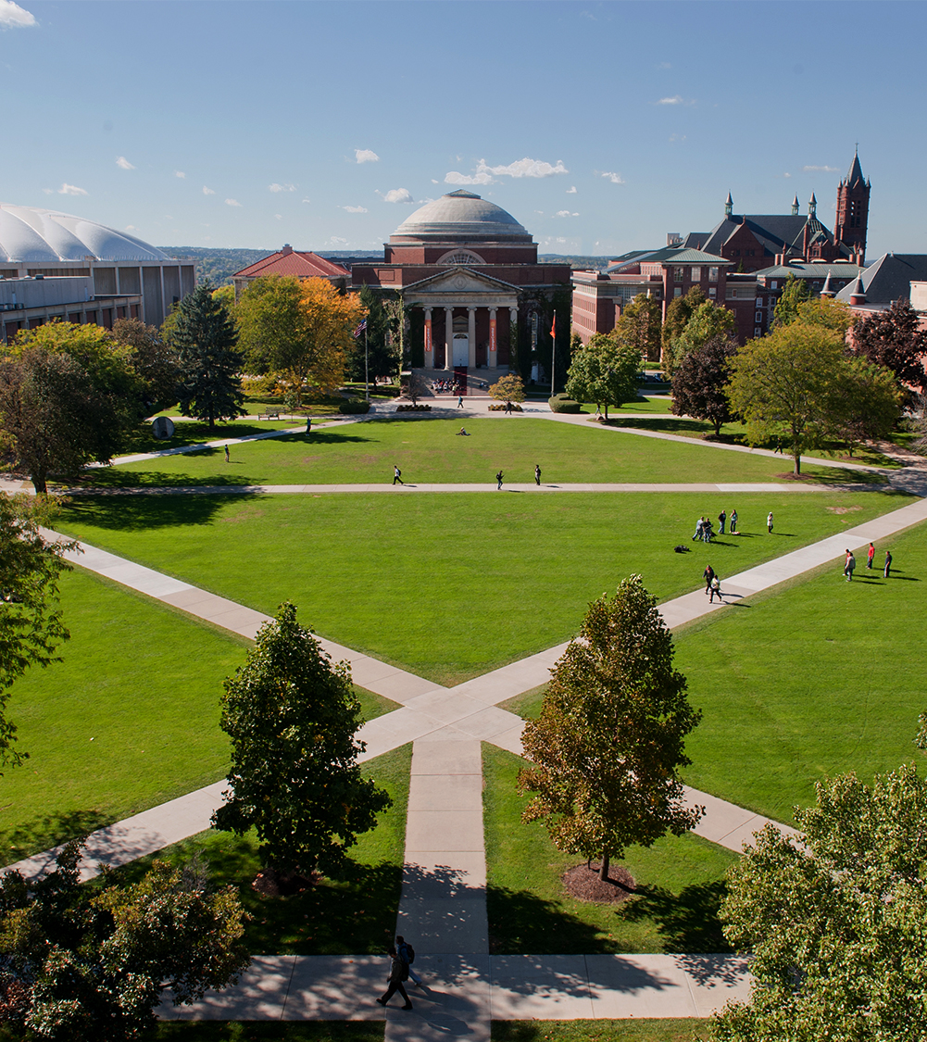
Applied Data Science Portfolio Milestone
School of Information Sciences
Tiffannie Mac Donald
March 30, 2021
M.S. in Applied Data Science

Slide 2
Outline
Introduction to Me
Learning Objectives
7 Objectives as Set by Syracuse University
Explained Through Various Projects Completed In Program
Journey Continuation

Slide 3
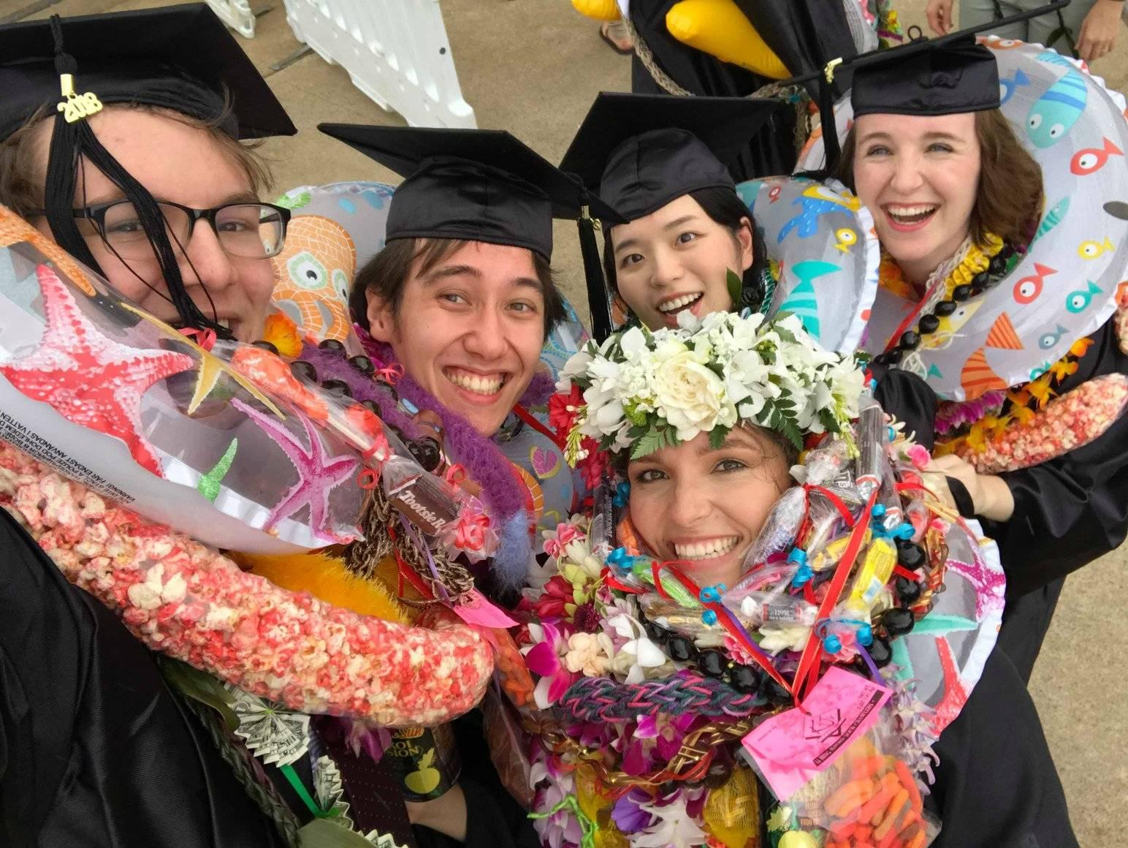
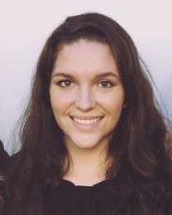
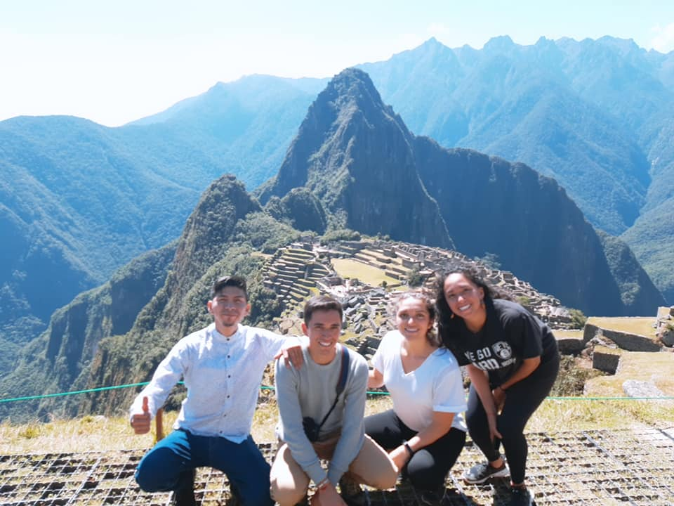
About Me
Born in El Monte, California, lived in Kansas City, and now in Gilbert, AZ
Studied Computer Science in College at BYU-Hawaii
Interests & Hobbies
Plants
Music
Being Outside
I love learning about technology and AI

Slide 4
Learning Objectives
Describe a broad overview of major practice areas in Data Science
Collect & Organize Data
Identify Patterns in Data via Visualization, Statistical Analysis, and Data Mining
Develop Alternative Strategies Based on the Data
Develop a Plan of Action to Implement the Business Decisions Derived from the Analyses
Demonstrate Communication Skills Regarding Data and its Analysis for Managers, IT Professionals, Programmers, Statisticians, and Other Relevant Professionals in Their Organization
Synthesize the Ethical Dimensions of Data Practice (e.g., Privacy)

Slide 5
Learning Objective # 1
Describe a broad overview of the major practice areas of data science.
Retrospective: traditional business intelligence and reporting
“What Happened?”
Diagnostic: analytic dashboard
“Why did it happen?”
Descriptive: Real-time dashboard
“What is happening now?”
Predictive: machine learning and forecasting
“What is likely to happen?”
Prescriptive: prescribing solutions and taking action
“What can we do about it?”
Picture taken from IST – 722 Asynch Week 01

Slide 6
Learning Objective # 1
Describe a broad overview of the major practice areas of data science.
Descriptive Analytics
Relies on fundamental statistics metrics such as mean, median, standard deviation, quartiles, etc. The goal with Descriptive statistics is to showcase and visualize trends over time.
Predictive Analytics
Forecasting and predicting values of missing fields (supervised learning), classifying unlabeled data (unsupervised learning), and looking at impact of data changes on future trends (semi-supervised learning)
Prescriptive Analytics
Provides possible solutions and showcases the impact pursuing various solutions on future trends. It is considered the goal of any data science project: to provide possible solutions

Slide 7
Learning Objective # 1
Describe a broad overview of the major practice areas of data science.
IST – 707
Python IDE (Jupyter)
Provide Insight on Forest Fires and How to Prevent Them
Key Areas:
Data Mining & Statistical Analysis
Gathering, Cleaning, and Transforming Data
Supervised Learning (ML)
Data Visualization
Presenting Results

Slide 8
Learning Objective # 2
Collect and organize data
IST – 718 (Advanced Big Data Analytics)
Python IDE
10 Different Datasets including the use of API’s
Gain a comprehensive look at all factors that may contribute or affect the legitimacy of a UFO sighting.
UFO dataset from the NUFORC which was found on Kaggle.
A total of 10 datasets were read in, explored, cleaned, visualized, and combined to come to provide insight into UFO sightings.
We included weather data, alien related movie releases via the TMDB movie API, drug and alcohol consumption, population, and airport and military base information.

Slide 9
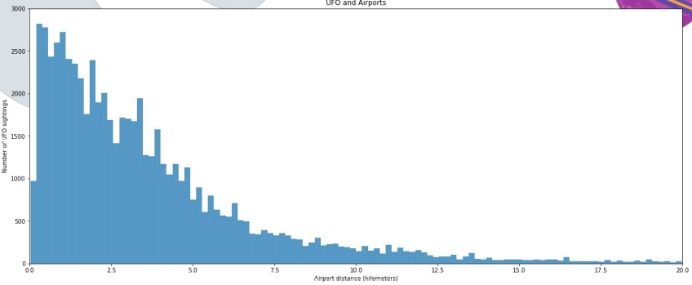
Learning Objective # 2
Collect and organize data
Using “feature importance” most common feature that was most important across the models was the distance of the sighting to an airport.
Recommendations for increasing the likelihood that you could witness a UFO sighting included spending time outside during the summer in a big city (somewhere in California since the most sightings were reported there). If you wanted to really increase your chances, go out on the fourth of July while intoxicated.

Slide 10
Learning Objective # 3
Identify patterns in data via visualization, statistical analysis, and data mining
IST 736 (Advanced Text Mining) & IST 718 (Advanced Data Analytics)
Visualization in Python for IST 718
Classification of News Articles in R
Mapping Sightings in Python
News Article Topic Classification
Is it possible to avoid bias by consuming media from multiple news sources?
Can we perform topic classification for each news article?

Slide 11
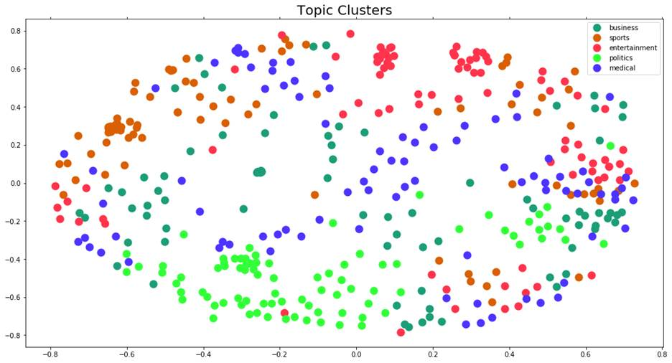
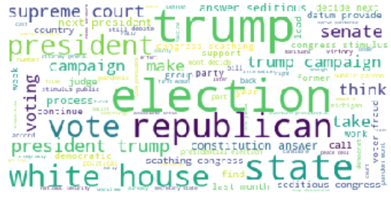
Learning Objective # 3
Identify patterns in data via visualization, statistical analysis, and data mining
R and various R Packages such as WordCloud
When considering articles about business, sports, entertainment, politics, and medicine, this method was able to correctly determine a topic in over 90% of cases and was able to generate high level key words surrounding the topics.

Slide 12
Learning Objective # 4
Develop alternative strategies based on the data
IST – 707 (Data Analytics)
Python IDE (Jupyter)
utilizing a combination of meteorological data and spatial coordinates were used to provide insight about forest fires in Montesinho Park, located in the northeast region of Portugal.
Results were mediocre
Forest Fire Prediction was inaccurate with ML models

Slide 13
Learning Objective # 4
Develop alternative strategies based on the data
Issue:
Fire Prediction Models performed poorly
Action:
Use various models for prediction rather than only using a single decision tree
Result:
We found many ways how not to conduct analysis going forward. To better predict the fires, lessen the damage, and control the significance of fires going forward, we concluded that better data collection is required.
It was suggested to collect points in times when the park is the most populated because having this insight can create better parameters for future research.

Slide 14
Learning Objective # 5
Develop a plan of action to implement the business decisions derived from the analyses
All Projects have met this requirement
IST – 652 (Scripting for Analytics)
Python/Jupyter Notebook IDE
Studying AirBnb User Demographic Data and Preference Data
Propose Suggestions for Future AirBnB Campaigns

Slide 15
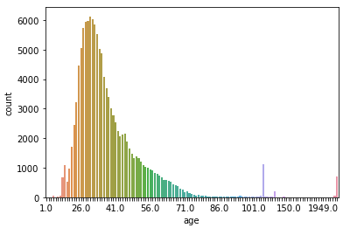
Learning Objective # 5
Develop a plan of action to implement the business decisions derived from the analyses
Market more to American women in their late 20’s to early 30’s as these are the greatest number of bookings.
Invest in ads running during working hours as users browse while bored at work

Slide 16
Learning Objective # 6
Demonstrate communication skills regarding data and its analysis for managers, IT professionals, programmers, statisticians, and other relevant professionals in their organization
All Projects have met this requirement
IST 718 (Advanced Data Analytics)
Going through 10 datasets and explaining their significance and providing a somewhat legitimate answer to this extraterrestrial phenomenon was no small feat.
This learning objective was demonstrated we were able to analyze the mounds of data we collected and were able to effectively communicate solid reasons as to why those particular events/attributes could and could not have resulted in a UFO sighting.

Slide 17
Learning Objective # 7
Synthesize the ethical dimensions of data science practice
Most Exposure was in IST 623 (Information Security)
Yahoo Data Breach. We serve as Data Guardians
IST 736 (Advanced Text Mining)
The results and outcome of our analysis is a direct result of the information we use, and if we are collecting biased data, our results will be biased and therefore pose ethical dilemmas.
IST 718 Advanced Data Analytics
self-driving vehicle mock test where we were to decide the outcome of various scenarios involving either breaking the law, hurting pedestrians, or hurting the driver.
opened our eyes to our own internal biases

Slide 18
Where to go from here…

Slide 19
Journey Continuation
I have accepted a position as a Solutions Analyst for Deloitte in their Strategy and Analytics industry sector. I will be using all the skills I have been able to learn about in this program.

Slide 20
Final Thoughts

Slide 21
Wrap Up
Going through the Master’s of Science in Applied Data Science program has been a challenging yet rewarding experience
I will continue to be curious and use the techniques I have learned to approach questions and problems in my work
It has been a incredible!

Slide 22
Thank you!

