Slide 1
homework KNN - IRIS
410410541張恩祈
410411234黃芮瑀
410411473林亭萱
410411770吳念澄

Slide 2
model 設定的參數
model = KNeighborsClassifier(n_neighbors=5,weights=weights,metric=metric,algorithm=algorithm)
weights_list = ['uniform', 'distance']
algorithm_list = ['auto', 'ball_tree', 'kd_tree', 'brute']
metric_list = ['euclidean', 'manhattan', 'chebyshev', 'minkowski']

Slide 3
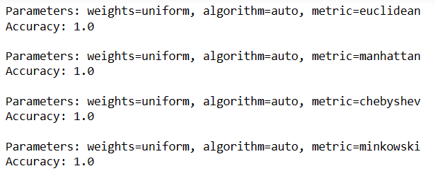
accuracy

Slide 4
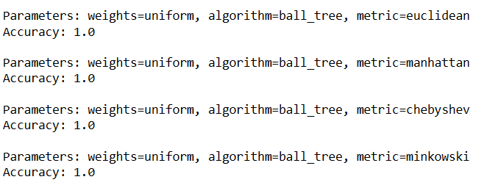
accuracy

Slide 5
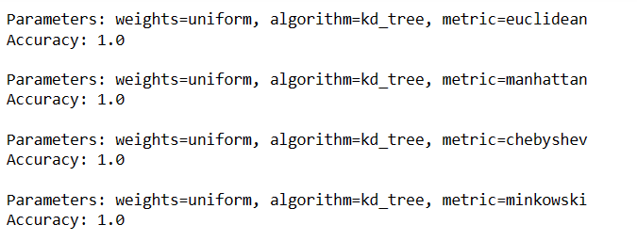
accuracy

Slide 6
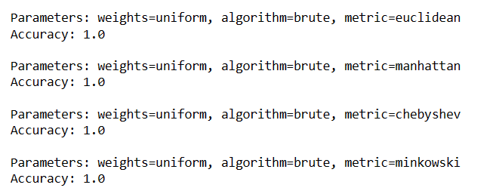
accuracy

Slide 7
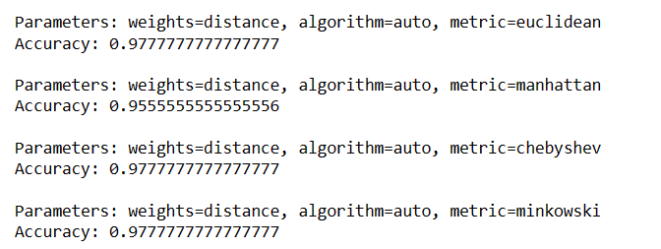
accuracy

Slide 8
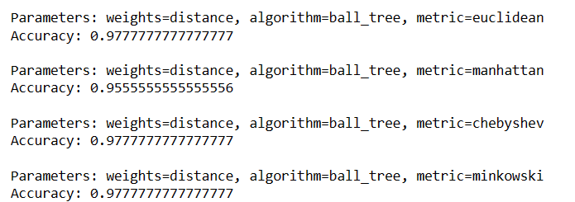
accuracy

Slide 9
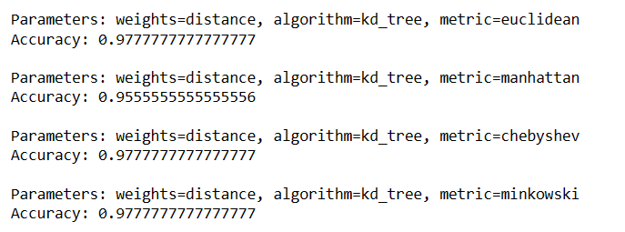
accuracy

Slide 10
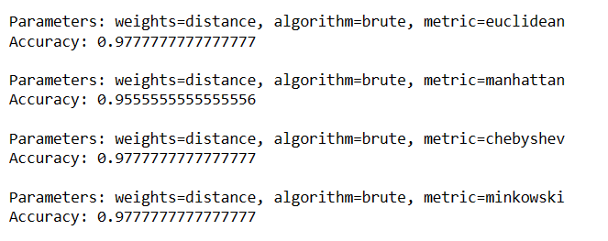
accuracy

