Slide 1
AIMS Application
Apprentice Internship Management System

Slide 2
AIMS Overview
AIMS is a mobile app and web portal designed to ease the pain points associated with (student / intern) workforce management
Features:
Account Registration
Program Calendar
Clock In / Clock Out
Raise Hand
Scorecard Surveys
User Profile

Slide 3


Account Registration
Organizations & Groups are provisioned on the Admin Web Portal
Users Register to join an Organization via the Mobile App or Website
Web Admin grants them the appropriate role in the appropriate group(s).

Slide 4
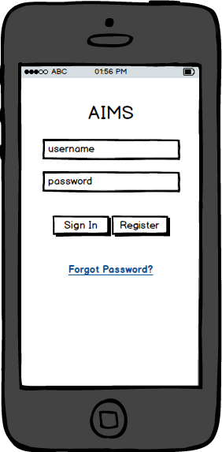
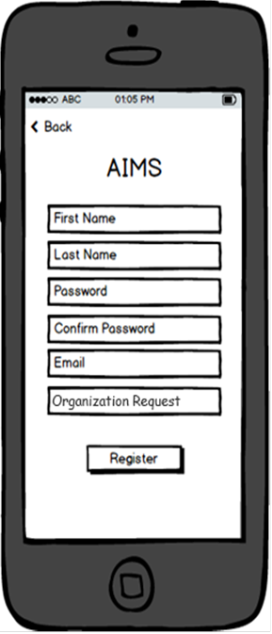
Account Registration
Organizations & Groups are provisioned on the Admin Web Portal
Users Register to join an Organization via the Mobile App or Website
Web Admin grants them the appropriate role in the appropriate group(s).

Slide 5
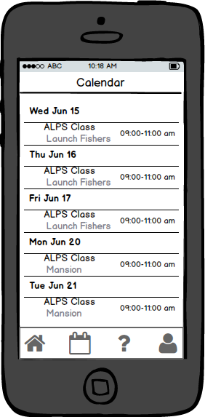
Program Calendar
Admins can create events via the Admin Web Portal.
Users can view events via the mobile app.

Slide 6
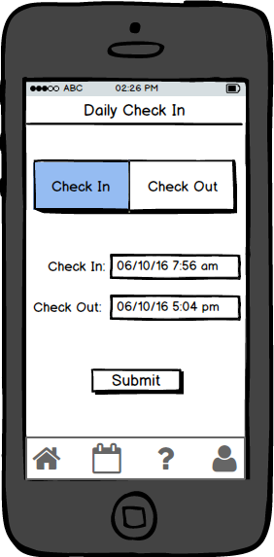
Clock in / Clock out
Admins can create group geo-fences to monitor.
Admins can query reports about geo-fence entry / exits.
Users can also manually clock in / clock out via the Mobile App.

Slide 7
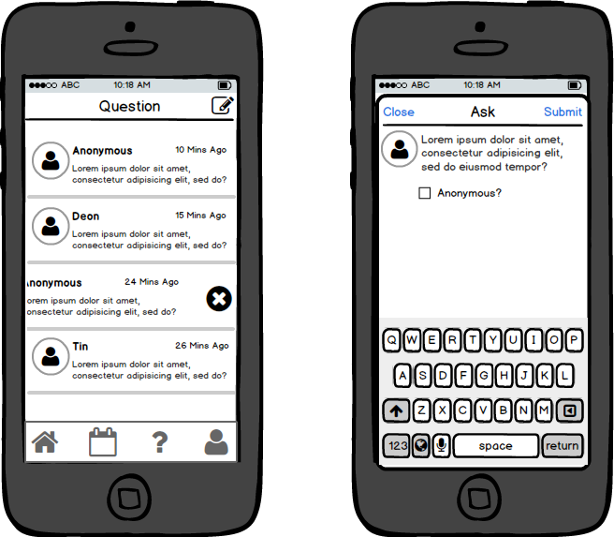
Raise Hand
Users can raise a question to the admin(s), anonymously if desired.
Admins can view a feed of questions to be addresses.

Slide 8
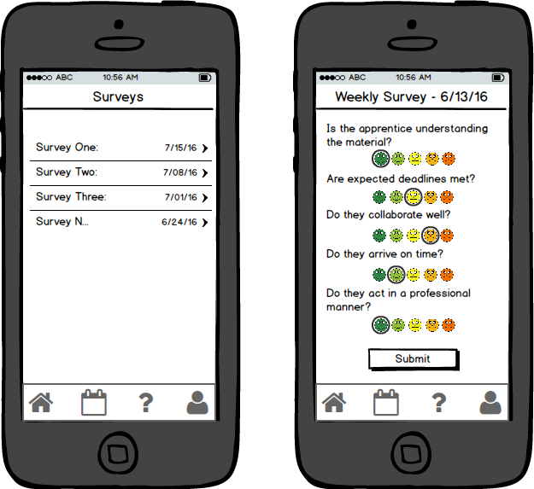
Scorecard Surveys
Admins can create Scorecard Surveys and issue push notifications for Users or other Admins to fill them out.
Admins & Users can fill out the surveys via the Mobile App.
Admins can mine the Survey data via the Admin Web Portal.

Slide 9
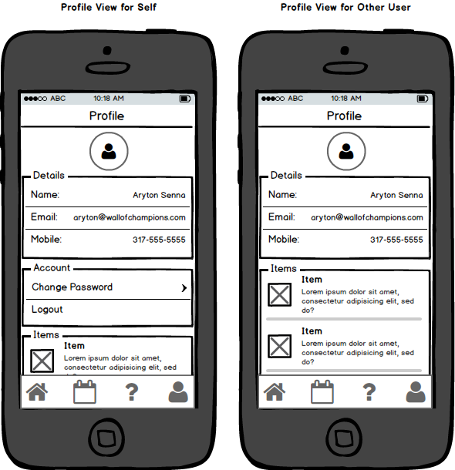
User Profile
Users can build and view profiles with various accomplishment items listed.
Examples:
EFA Gold Badge Earned 8/1/16
7 Habits of Highly Effective People Read 8/15/16
Drug Test Passed 9/6/16
BSEE Rose-Hulman 12/10/97
Microsoft MS-TA Software Developer Certification Earned 09/01/16

Slide 10
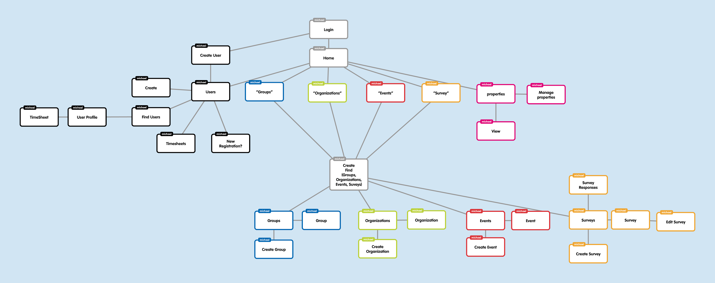
Admin Web Portal
System Admins and Group Admins will utilize the Admin Web Portal to setup, configure, and mine information.

Slide 11
Use Case
System admin via web portal
Creates Salesforce Organization
Creates IT Department Group
Salesforce Apprentice Manager
Installs the Mobile App
Registers to join the Salesforce Organization
System admin via web portal
Grants manager Admin permissions
Adds Apprentice as a User
Adds Apprentice Director as Admin
Salesforce IT Department hires an Apprentice from Eleven Fifty Academy for a 3 month internship.
The Organization, Group, Admins and Users are provisioned.

Slide 12
Use Case
Apprentice Director via web portal
Creates and pushes a survey to ask manager how the apprentice is doing
Creates and pushes a survey to ask the apprentice how the internship is going
Via Mobile App
Manager receives notification of survey, then submits answers
Apprentice receives notification of survey, then submits answers
Apprentice Director via web portal
Views survey responses and addresses any issues
Salesforce IT Department hires an Apprentice from Eleven Fifty Academy for a 3 month internship.
The Apprentice Director would like to ensure everything is going smoothly.

Slide 13
Use Case
Admin via Web Portal
Configures geo-fence around work location
Via Mobile App
The intern manually clocks in / clocks out every day
The mobile app sends geo-fence events to the backend every time the fence is crossed.
Admin via Web Portal
Views manual check ins and cross-references it with geo-fence events
Salesforce IT Department hires an Apprentice from Eleven Fifty Academy for a 3 month internship.
The Manager would like to ensure the Intern’s timesheets are correct.

Slide 14
Use Case
User via Mobile App
Utilizes the raise hand feature to ask the question (anonymously if desired)
Admin via Mobile App
Receives a notification that a question is pending from one of his interns
Salesforce IT Department hires an Apprentice from Eleven Fifty Academy for a 3 month internship.
The intern has a question to ask.

