Slide 1
CSE 545 F2020, Week 10 Heap: data structures and Fastbins
Tiffany Bao tbao@asu.edu
Notes:
https://sourceware.org/glibc/wiki/MallocInternals
https://sploitfun.wordpress.com/2015/02/10/understanding-glibc-malloc/
https://www.bencode.net/posts/2019-10-19-heap-overflow/
https://azeria-labs.com/heap-exploitation-part-2-glibc-heap-free-bins/

Slide 2
Announcement
Assignment 4 will be released
Guest lectures about fuzzing
CTF is coming!

Slide 3
Outline
Arena, Chunk, and Bins
In class: Fastbin and its vulnerabilities

Slide 4
Arena, Chunk, and bins

Slide 5
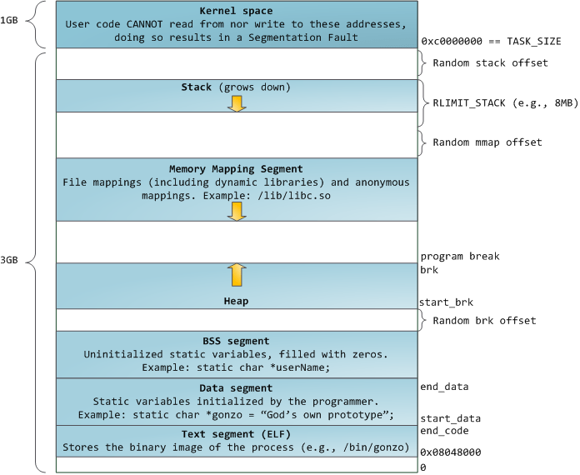
size
0x20
size
0x30
size
…
size
0x410
chunk
chunk
…

Slide 6
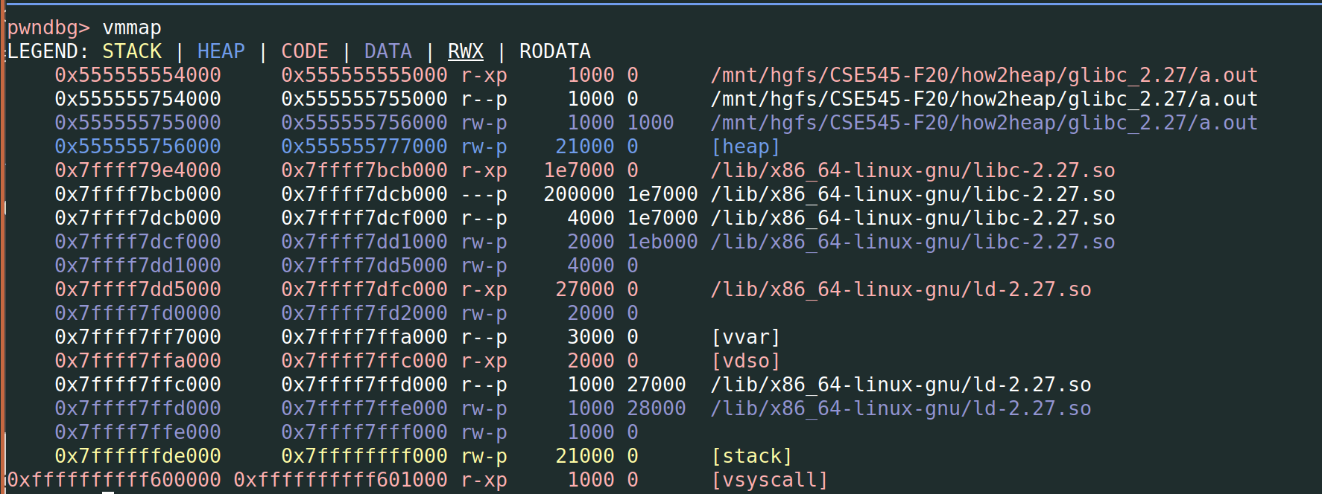
Arena
Notes:
https://sploitfun.wordpress.com/2015/02/10/understanding-glibc-malloc/

Slide 7
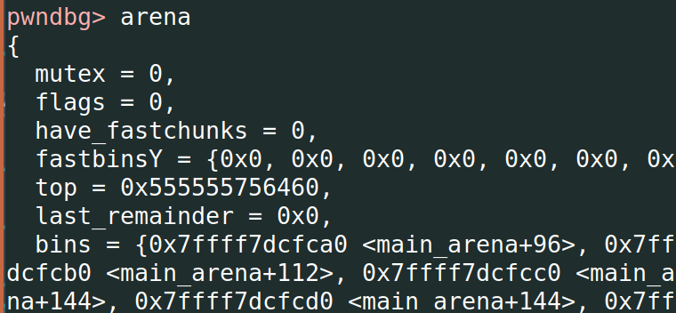
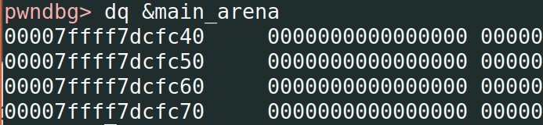
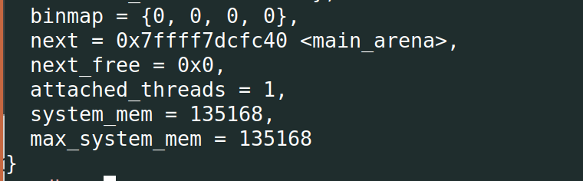
Arena
main_arena: Stores in the data segment of libc.so

Slide 8
From one Arena to Per-thread Arena
dlmalloc -> ptmalloc2 (threading support)
More about per-thread arenas: https://sourceware.org/glibc/wiki/MallocInternals
Notes:
During early days of linux, dlmalloc was used as the default memory allocator. But later due to ptmalloc2’s threading support, it became the default memory allocator for linux. Threading support helps in improving memory allocator performance and hence application performance. In dlmalloc when two threads call malloc at the same time ONLY one thread can enter the critical section, since freelist data structure is shared among all the available threads. Hence memory allocation takes time in multi threaded applications, resulting in performance degradation. While in ptmalloc2, when two threads call malloc at the same time memory is allocated immediately since each thread maintains a separate heap segment and hence freelist data structures maintaining those heaps are also separate. This act of maintaining separate heap and freelist data structures for each thread is called per thread arena.

Slide 9
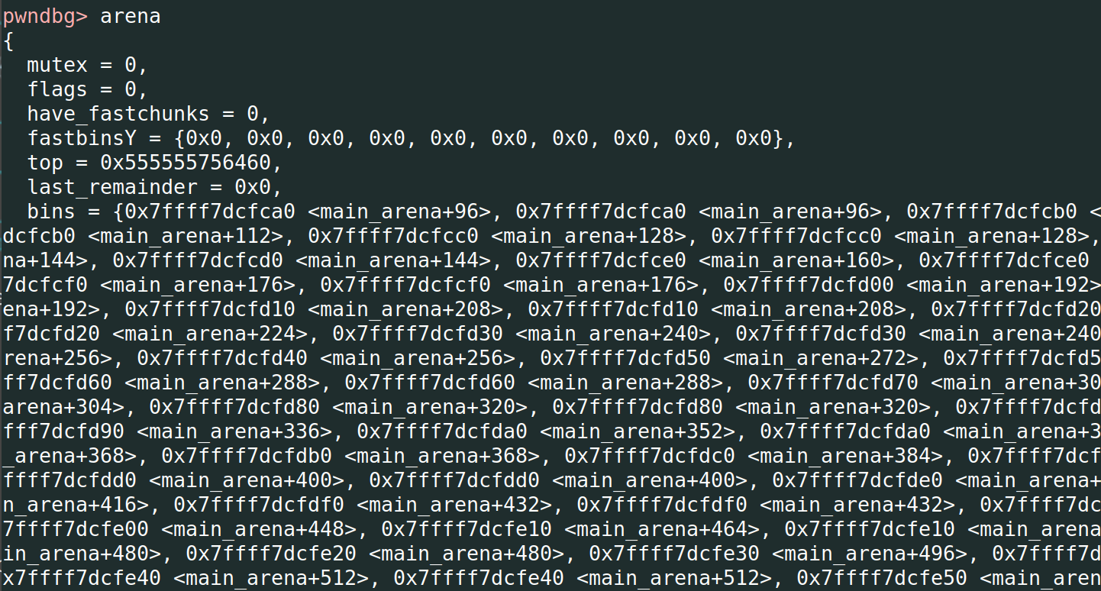
Arena -> bins

Slide 10
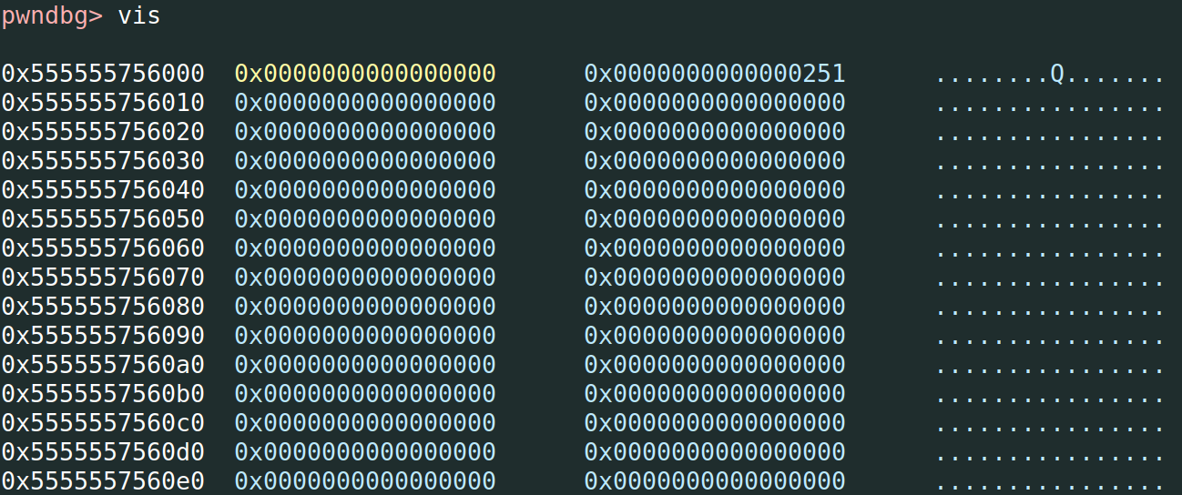
Arena -> bins

Slide 11
bins
Tcache Bins (glibc v2.26)
Fast Bins (glibc v2.3)
Unsorted Bin (glibc v2.3)
Small Bins
Large Bins

Slide 12
Arena -> bins

Slide 13
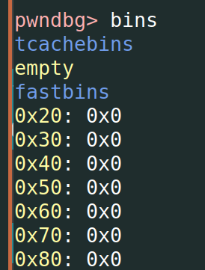
ARENA -> fastbinsY
fastbinsY:
Fast bin. Similar to tcache, each bin stores chunks with the same size.
For x64: from 0x20 to 0x80, 7 bins in total.
Notes:
why 10 fastbins in arena: it is configurable. The default setup uses only 7 (up to 64*sizeof(size_t)/4 = 64 * 8 / 4 = 0x80 for x64). The range for this parameter is 0 to 80*sizeof(size_t)/4.
Reference: https://man7.org/linux/man-pages/man3/mallopt.3.html

Slide 14
ARENA -> BINS
126 bins in arena->bins
1st bin: Unsorted bin --- only one unsorted bin
Bin 2 - 63 (62 in total): Small bins, for chunks < 1024 bytes.
The data structure is similar to tcache bins and fastbins.
Bin number | 2 | 3 | … | 63
Chunk size | 0x20 | 0x30 |  | 0x3f0 (1008)

Slide 15
ARENA -> BINS
126 bins in arena->bins
Bin 64 - 126 (63 in total): Large bins, for chunks over 1024 bytes
Bin number (Large Bin Idx) | 64 (1) | 65 (2) | … | 95 (32)
Chunk size range | [0x400, 0x440) | [0x440, 0x480) |  | [0xbc0, 0xc00)
Bin number (Large Bin Idx) | 96 (33) | …
Chunk size range | [0xc00, 0xe00)
Notes:
32 bins of size 64 16 bins of size 512 8 bins of size 4096 4 bins of size 32768 2 bins of size 262144 1 bin of size what's left

Slide 16
ARENA -> Large BINS
Bin Idx (#Total) | 1-32 (32) | 33-48 (16) | 49-56 (8) | 57-60 (4) | 61-62 (2) | 63 (1)
Size Range | [x, x+64) | [x, x+512) | [x, x+4096) | [x, x+32768) | [x, x+262144) | Remaining bytes
Notes:
32 bins of size 64 16 bins of size 512 8 bins of size 4096 4 bins of size 32768 2 bins of size 262144 1 bin of size what's left

Slide 17
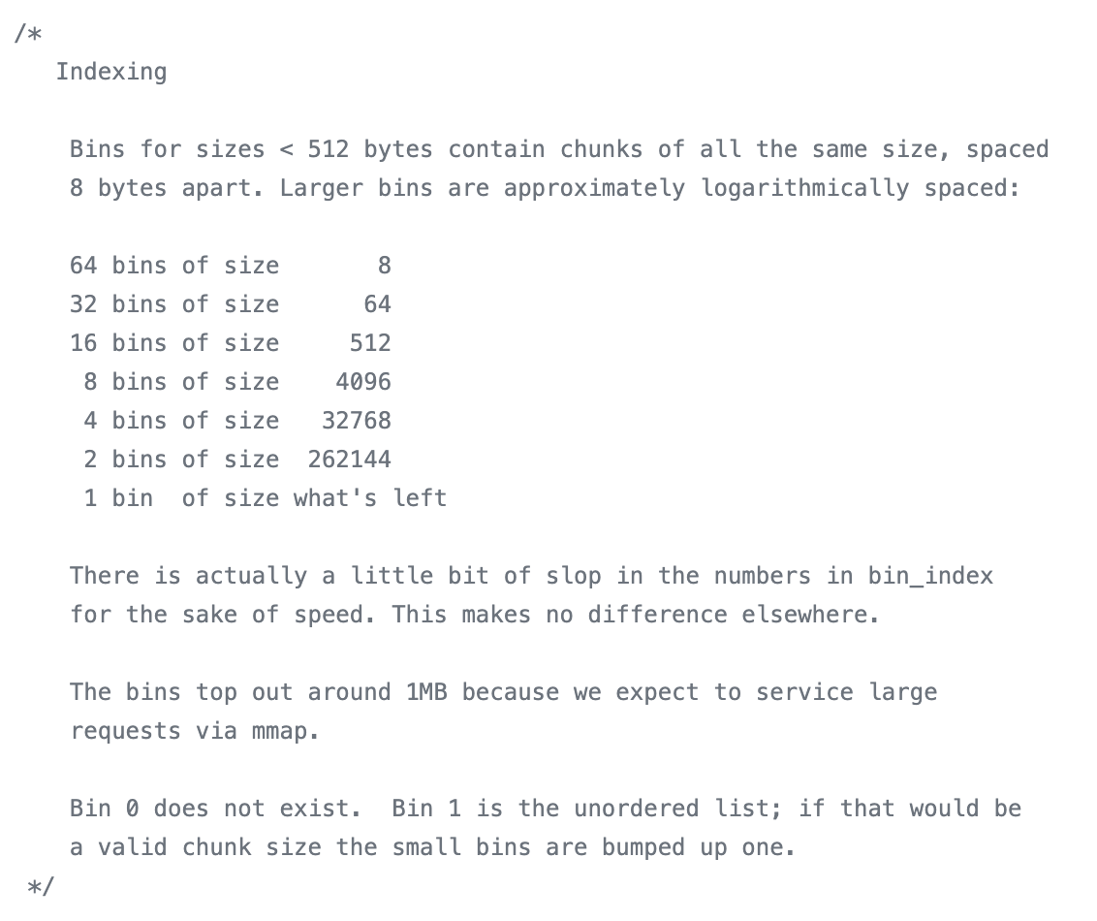
https://elixir.bootlin.com/glibc/glibc-2.27/source/malloc/malloc.c
Notes:
https://elixir.bootlin.com/glibc/glibc-2.27/source/malloc/malloc.c

Slide 18
Free
Recycle to tcache: If there is room in the tcache, store there.
Recycle to fastbin: If the chunk is small enough, store to fastbin.
If the chunk was mmap'd, munmap it.
Coalesce: If this chunk is adjacent to another free chunk, coalesce.
Put to unsorted bin: Store in the unsorted bin, unless it's the top chunk.
Notes:
https://sourceware.org/glibc/wiki/MallocInternals
https://sploitfun.wordpress.com/2015/02/10/understanding-glibc-malloc/
https://www.bencode.net/posts/2019-10-19-heap-overflow/
https://xz.aliyun.com/t/2582

Slide 19
Free
Return to OS: If the chunk is large enough, coalesce fastbins and see if the top chunk is large enough to give some memory back to the system. (Might be deferred, for performance reasons, and happen during a malloc or other call.)
Notes:
https://sourceware.org/glibc/wiki/MallocInternals

Slide 20
Malloc
Recycle from tcache: If there is a suitable (exact match only) chunk in the tcache, return the tcache chunk.
If the request is very large, use mmap() to request memory directly from the operating system.
(get the arena heap lock)
Recycle from fastbin: Return a suitable fastbin chunk if exists. Pre-fill tcache as you go.
Recycle from smallbin: Return a suitable smallbin chunk if exists. Pre-fill tcache as you go.
Notes:
If there is a suitable (exact match only) chunk in the tcache, return the tcache chunk.
If the request is large enough, mmap() is used to request memory directly from the operating system. Note that the threshold for mmap'ing is dynamic, unless overridden by M_MMAP_THRESHOLD (see mallopt() documentation), and there may be a limit to how many such mappings there can be at one time.
If the appropriate fastbin has a chunk in it, use that. If additional chunks are available, also pre-fill the tcache.
If the appropriate smallbin has a chunk in it, use that, possibly pre-filling the tcache here also.
If the request is "large", take a moment to take everything in the fastbins and move them to the unsorted bin, coalescing them as you go.
Start taking chunks off the unsorted list, and moving them to small/large bins, coalescing as you go (note that this is the only place in the code that puts chunks into the small/large bins). If a chunk of the right size is seen, use that.
If the request is "large", search the appropriate large bin, and successively larger bins, until a large-enough chunk is found.
If we still have chunks in the fastbins (this may happen for "small" requests), consolidate those and repeat the previous two steps.
Split off part of the "top" chunk, possibly enlarging "top" beforehand.

Slide 21
Malloc
Resolve all the deferred frees (fastbins -> unsorted bin): Take everything in the fastbins and move them to the unsorted bin, coalescing them as you go. (prev_inuse and pre_size)
Resolve all the deferred frees (unsorted bin -> small/large bins): Go over the chunks from unsorted bin and put them to small/large bins until we find a chunk with the exact size.
The only place that puts chunks into the small/large bins
Notes:
If there is a suitable (exact match only) chunk in the tcache, return the tcache chunk.
If the request is large enough, mmap() is used to request memory directly from the operating system. Note that the threshold for mmap'ing is dynamic, unless overridden by M_MMAP_THRESHOLD (see mallopt() documentation), and there may be a limit to how many such mappings there can be at one time.
If the appropriate fastbin has a chunk in it, use that. If additional chunks are available, also pre-fill the tcache.
If the appropriate smallbin has a chunk in it, use that, possibly pre-filling the tcache here also.
If the request is "large", take a moment to take everything in the fastbins and move them to the unsorted bin, coalescing them as you go.
Start taking chunks off the unsorted list, and moving them to small/large bins, coalescing as you go (note that this is the only place in the code that puts chunks into the small/large bins). If a chunk of the right size is seen, use that.
If the request is "large", search the appropriate large bin, and successively larger bins, until a large-enough chunk is found.
If we still have chunks in the fastbins (this may happen for "small" requests), consolidate those and repeat the previous two steps.
Split off part of the "top" chunk, possibly enlarging "top" beforehand.

Slide 22
Malloc
Find a large-enough chunk for large request: If the request is "large", search the appropriate large bin, and successively larger bins, until a large-enough chunk is found.
Use top: Split off part of the "top" chunk, possibly enlarging "top" beforehand.
Notes:
If there is a suitable (exact match only) chunk in the tcache, return the tcache chunk.
If the request is large enough, mmap() is used to request memory directly from the operating system. Note that the threshold for mmap'ing is dynamic, unless overridden by M_MMAP_THRESHOLD (see mallopt() documentation), and there may be a limit to how many such mappings there can be at one time.
If the appropriate fastbin has a chunk in it, use that. If additional chunks are available, also pre-fill the tcache.
If the appropriate smallbin has a chunk in it, use that, possibly pre-filling the tcache here also.
If the request is "large", take a moment to take everything in the fastbins and move them to the unsorted bin, coalescing them as you go.
Start taking chunks off the unsorted list, and moving them to small/large bins, coalescing as you go (note that this is the only place in the code that puts chunks into the small/large bins). If a chunk of the right size is seen, use that.
If the request is "large", search the appropriate large bin, and successively larger bins, until a large-enough chunk is found.
If we still have chunks in the fastbins (this may happen for "small" requests), consolidate those and repeat the previous two steps.
Split off part of the "top" chunk, possibly enlarging "top" beforehand.

Slide 23
chunks --- in Tcache bin
0x0000000000000000
0x0000000000000000
8 bytes
chunk size
flags
chunk size
flags
data
fd pointer
data
Allocated
Freed

Slide 24
chunks --- in Fastbin
0x0000000000000000
0x0000000000000000
8 bytes
chunk size
flags
chunk size
flags
data
fd pointer
data
Allocated
Freed

Slide 25
chunks - in small bin and unsorted bin
prev size
prev size
8 bytes
chunk size
flags
chunk size
flags
data
fd pointer
data
bk pointer
In-use
Freed

Slide 26
chunks - in large bin
8 bytes
chunk size
flags
chunk size
flags
data
fd pointer
data
bk pointer
fd size
bk size
In-use
Freed

Slide 27
freelist of unsorted, small, and large bins
siz0x20
arena -> bins
FD
BK
-> Forward
<- Backward
chunk
chunk
…

Slide 28
Fastbins

Slide 29
Arena -> bins

Slide 30
Free
Recycle to tcache: If there is room in the tcache, store there.
Recycle to fastbin: If the chunk is small enough, store to fastbin.
If the chunk was mmap'd, munmap it.
Coalesce: If this chunk is adjacent to another free chunk, coalesce.
Put to unsorted bin: Store in the unsorted bin, unless it's the top chunk.
Notes:
https://sourceware.org/glibc/wiki/MallocInternals
https://sploitfun.wordpress.com/2015/02/10/understanding-glibc-malloc/
https://www.bencode.net/posts/2019-10-19-heap-overflow/
https://xz.aliyun.com/t/2582

Slide 31
Check what a fastbin looks like

Slide 32
Fastbin
size
0x20
size
0x30
size
…
size
0x80
chunk
chunk
…

Slide 33
Vulnerabilities - use after free
size
0x20
size
0x30
size
…
size
0x80
chunk
chunk
…

