Slide 1
CSE 545 F2020, Week 5 Software Vulnerabilities I
Tiffany Bao tbao@asu.edu

Slide 2
IN-class Lab
nc asu-cse545.com 9000
binary: https://www.tiffanybao.com//courses/cse545/labs/stack
md5: addffe3117320a175868a01e069e651c
Command:
Mac: md5 [stack]
Linux: md5sum [stack]

Slide 3
Remember what I said…
“This program is secure”

Slide 4
Is it really secure?

Slide 5
Agenda
Linux File Permissions
Command Line Injection
Directory Traversal
Stack Overflow

Slide 6
Linux File Permissions

Slide 7
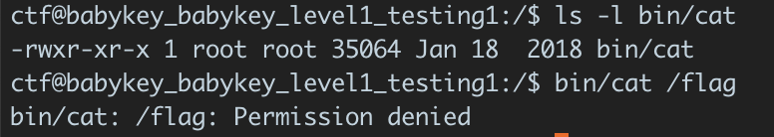
Why can I read /flag via babykey_xxx
setuid

Slide 8
setuid
Can a normal user use setuid to escalate to root?
Why does root want to degrade to non-previledged user?
We know root + setuid is dangerous. Why do we still use it?

Slide 9
Reference
“Setuid Demystified”, https://people.eecs.berkeley.edu/~daw/papers/setuid-usenix02.pdf

Slide 10
Command Line Injection

Slide 11
Example
void check(char id[15]){
char command[50] = {};
sprintf(command, "cat records/%s", id);
system(command);
}

Slide 12
Example
void check(char id[15]){
char command[50] = {};
sprintf(command, "cat records/%s", id);
system(command);
}

Slide 13
Example
id: “tiffanyb”
void check(char id[15]){
char command[50] = {};
sprintf(command, "cat records/%s", id);
system(command); ”cat records/tiffanyb”
}

Slide 14
Example
id: “tiffanyb; cat secret”
void check(char id[15]){
char command[50] = {};
sprintf(command, "cat records/%s", id);
system(command); ”cat records/tiffanyb; cat secret”
}

Slide 15
DEMO

Slide 16
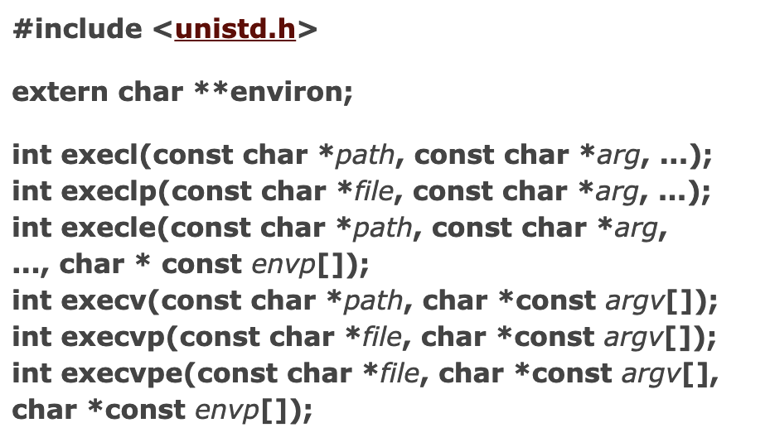
DEFENSE
Avoid using system
Use the exec family
execl(“/bin/ls”, “/bin/ls”, “-l”, “/home/ctf”, NULL);
https://man7.org/linux/man-pages/man3/exec.3.html

Slide 17
Defense
Vulnerable to command line injection
Immune to command line injection
void check(char id[15]){
char command[50] = {};
sprintf(command,
"cat records/%s", id);
system(command);
}
void check(char id[15]){
char path[50] = {};
sprintf(path, "records/%s", id);
execl(”/bin/cat”,”/bin/cat",
path, NULL);
}

Slide 18
Is the code secure now?

Slide 19
directory traversal

Slide 20
Defense
Vulnerable to command line injection
Immune to command line injection
void check(char id[15]){
char command[50] = {};
sprintf(command,
"cat records/%s", id);
system(command);
}
void check(char id[15]){
char path[50] = {};
sprintf(path, "records/%s", id);
execl(”/bin/cat”,”/bin/cat",
path, (char*) NULL);
}

Slide 21
Example
void check(char id[15]){
char path[50] = {};
sprintf(path, "records/%s", id);
execl("/bin/cat", "/bin/cat", path, NULL);
}

Slide 22
Example
id: tiffanyb
void check(char id[15]){
char path[50] = {};
sprintf(path, "records/%s", id);
execl("/bin/cat", "/bin/cat", path, NULL);
// path: records/tiffanyb
}

Slide 23
Example
id: ../secret
void check(char id[15]){
char path[50] = {};
sprintf(path, "records/%s", id);
execl("/bin/cat", "/bin/cat", path, NULL);
// path: records/../secret
}

Slide 24
demo

Slide 25
Defense
Check path
Set correct permission

Slide 26
Defense
Vulnerable to directory traversal
Immune to directory traversal
void check(char id[15]){
char path[50] = {};
sprintf(path, "records/%s", id);
if (valid_path(path) != 0)
execl("/bin/cat", "/bin/cat", path, NULL);
}
void check(char id[15]){
char path[50] = {};
sprintf(path, "records/%s", id);
execl("/bin/cat", "/bin/cat", path, NULL);
}

Slide 27
Stack overflow

Slide 28
How stack works
saved rip …
…
low address
void foo(){
int x = 0;
int y = 1;
printf(”%d\n”, x + y);
}
void bar(){
foo();
printf(”bye\n”);
}
rsp ->
high address
rbp ->

Slide 29
How stack works
…
saved rip (return address)
…
low address
void foo(){
int x = 0;
int y = 1;
printf(”%d\n”, x + y);
}
void bar(){
foo();
printf(”bye\n”);
}
<+0>: push rbp
<+1>: mov rbp,rsp
<+4>: sub rsp,0x50
rsp ->
high address
rbp ->

Slide 30
How stack works
…
saved rbp
saved rip (return address)
…
low address
void foo(){
int x = 0;
int y = 1;
printf(”%d\n”, x + y);
}
void bar(){
foo();
printf(”bye\n”);
}
<+0>: push rbp
<+1>: mov rbp,rsp
<+4>: sub rsp,0x50
rsp ->
high address
rbp ->

Slide 31
How stack works
…
saved rbp
saved rip (return address)
…
low address
void foo(){
int x = 0;
int y = 1;
printf(”%d\n”, x + y);
}
void bar(){
foo();
printf(”bye\n”);
}
<+0>: push rbp
<+1>: mov rbp,rsp
<+4>: sub rsp,0x50
rbp ->
rsp ->
high address

Slide 32
How stack works
…
saved rbp
saved rip (return address)
…
low address
rsp ->
void foo(){
int x = 0;
int y = 1;
printf(”%d\n”, x + y);
}
void bar(){
foo();
printf(”bye\n”);
}
<+0>: push rbp
<+1>: mov rbp,rsp
<+4>: sub rsp,0x50
rbp ->
high address

Slide 33
How stack works
…
saved rbp
saved rip (return address)
…
low address
void foo(){
int x = 0;
int y = 1;
printf(”%d\n”, x + y);
}
void bar(){
foo();
printf(”bye\n”);
}
mov rsp, rbp
pop rbp
<+182>: leave
<+183>: ret
rsp ->
rbp ->
high address

Slide 34
How stack works
…
saved rbp
saved rip (return address)
…
low address
void foo(){
int x = 0;
int y = 1;
printf(”%d\n”, x + y);
}
void bar(){
foo();
printf(”bye\n”);
}
mov rsp, rbp
pop rbp
<+182>: leave
<+183>: ret
rsp ->
high address
rbp ->

Slide 35
How stack works
…
saved rbp
saved rip (return address)
…
low address
void foo(){
int x = 0;
int y = 1;
printf(”%d\n”, x + y);
}
void bar(){
foo();
printf(”bye\n”);
}
<+182>: leave
<+183>: ret
rip
rsp ->
high address
rbp ->

Slide 36
How stack works
…
saved rbp
saved rip (return address)
…
low address
void foo(){
int x = 0;
int y = 1;
printf(”%d\n”, x + y);
}
void bar(){
foo();
printf(”bye\n”);
}
<+182>: leave
<+183>: ret
Overwrite
rip
rsp ->
high address
rbp ->

Slide 37
Example
void check(char id[15]){
char path[50] = {};
int res;
sprintf(path, "records/%s", id);
if (valid_path(path) != 0){
res = execl("/usr/bin/cat", "/usr/bin/cat", path, NULL);
if (res == 0) printf("Check pass!\n");
else printf("Check failed\n");
}
}
int main(){
char *id = NULL;
size_t size = 0;
ssize_t len = 0;
len = getline(&id, &size, stdin);
id[len - 1] = 0;
check(id);
}

Slide 38
Stack
…
char path[50]
…
int res
saved rbp
saved rip (return address)
…
rsp ->
void check(char id[15]){
char path[50] = {};
int res;
sprintf(path, "records/%s", id);
if (valid_path(path) != 0){
res = execl("/usr/bin/cat", "/usr/bin/cat", path, NULL);
if (res == 0)
printf("Check pass!\n");
else printf("Check failed\n");
}
}
rbp ->
rbp + 8 ->

Slide 39
Stack
…
char path[50]
…
int res
saved rbp
saved rip (return address)
…
rsp ->
void check(char id[15]){
char path[50] = {};
int res;
sprintf(path, "records/%s", id);
if (valid_path(path) != 0){
res = execl("/usr/bin/cat", "/usr/bin/cat", path, NULL);
if (res == 0)
printf("Check pass!\n");
else printf("Check failed\n");
}
}
Overwrite
rbp ->
rbp + 8 ->

Slide 40
Task
…
char path[50]
…
int res
saved rbp
saved rip (return address)
…
rsp ->
void check(char id[15]){
char path[50] = {};
int res;
sprintf(path, "records/%s", id);
if (valid_path(path) != 0){
res = execl("/usr/bin/cat", "/usr/bin/cat", path, NULL);
if (res == 0)
printf("Check pass!\n");
else printf("Check failed\n");
}
}
Overwrite
rbp ->
rbp + 8 ->
0xdeadbeefdeadbeef

Slide 41
Task
…
char path[50]
…
int res
saved rbp
saved rip (return address)
…
rsp ->
Check the address of path
Check the address of saved rip
Overwrite path until the saved rip
sprintf(path, "records/%s", id);
Overwrite
rbp ->
rbp + 8 ->
0xdeadbeefdeadbeef

Slide 42
How to take advantage of the vulnerability?

