Slide 1
CSE 545 F2020, Week 8 The world of Heap: I
Tiffany Bao tbao@asu.edu

Slide 2
Announcement
Nothing special
Assignment 1, 2’s grades are released
Assignment 3 is ongoing

Slide 3
In-class Lab

Slide 4
Heap is fun!
nc asu-cse545.com 8888
binary: https://www.tiffanybao.com//courses/cse545/labs/week8/use_after_free
source: https://www.tiffanybao.com//courses/cse545/labs/week8/use_after_free.c

Slide 5
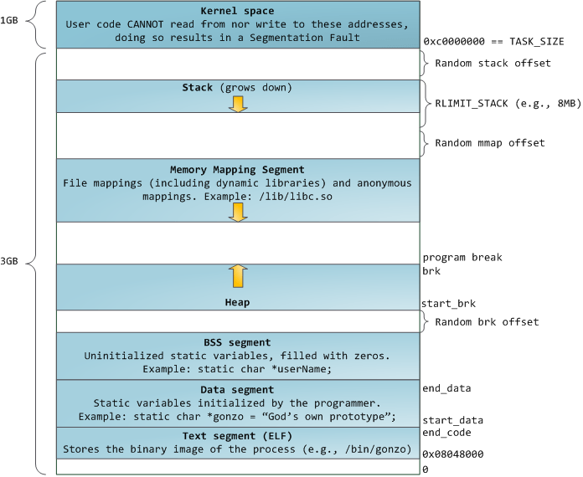
Heap
char *s = malloc(10);
dynamically allocated
https://sploitfun.wordpress.com/2015/02/11/syscalls-used-by-malloc/
Notes:
how to manage it?
memory allocator

Slide 6
Memory Allocator
dlmalloc (Doug Lea malloc)
ptmalloc (Wolfram Gloger, pthreads malloc, a fork of dlmalloc with threading-related improvements)
glibc malloc
jemalloc – FreeBSD and Firefox
tcmalloc – Google
mimalloc - Microsoft Research
…

Slide 7
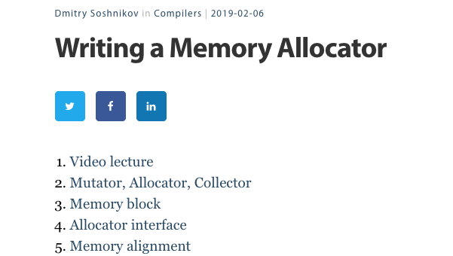
http://dmitrysoshnikov.com/compilers/writing-a-memory-allocator/

Slide 8
why there are so many allocators?
Adaptive to new techniques (e.g, multithreading)
Performance!

Slide 9
Our Content
glibc memory allocator
glibc 2.27 (used by Ubuntu 18.04)

Slide 10
want a copy of glibc 2.27?
https://www.tiffanybao.com/courses/cse545/schedule

Slide 11
This week: Overview
tcache
Notes:
The order is different

Slide 12
tcache: Data Structure
Notes:
per thread cache
glibc 2.26

Slide 13
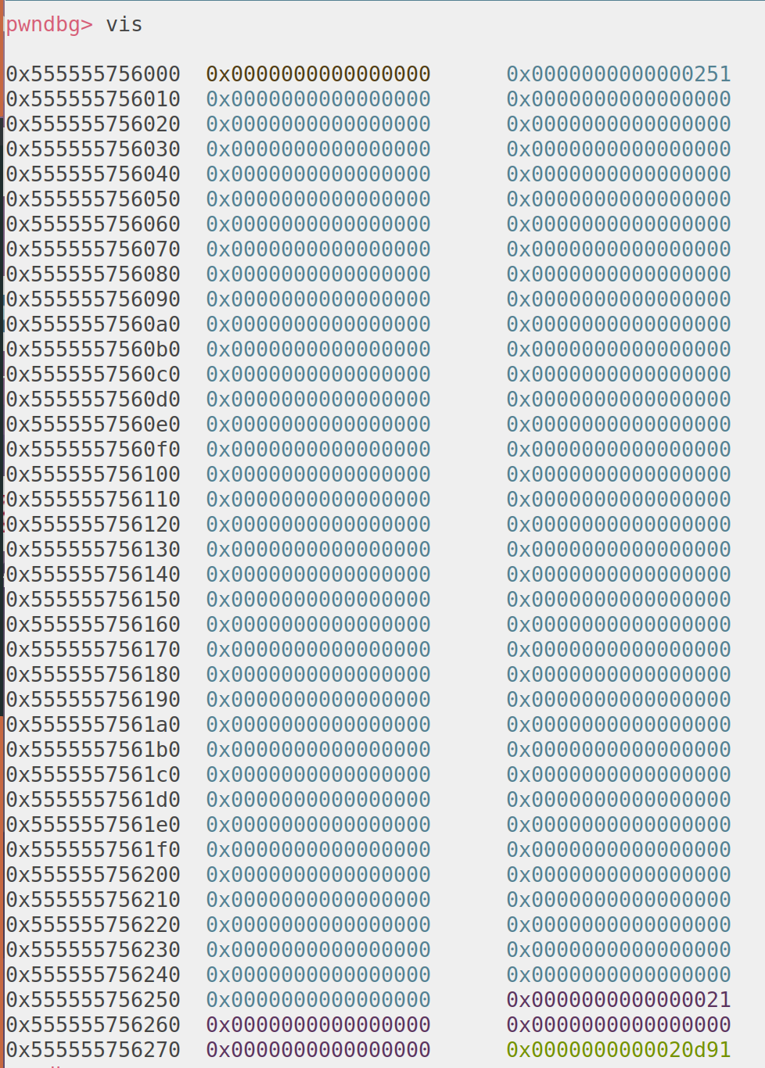
tcache
chunk
Notes:
https://azeria-labs.com/heap-exploitation-part-2-glibc-heap-free-bins/
fast bin in arena

Slide 14
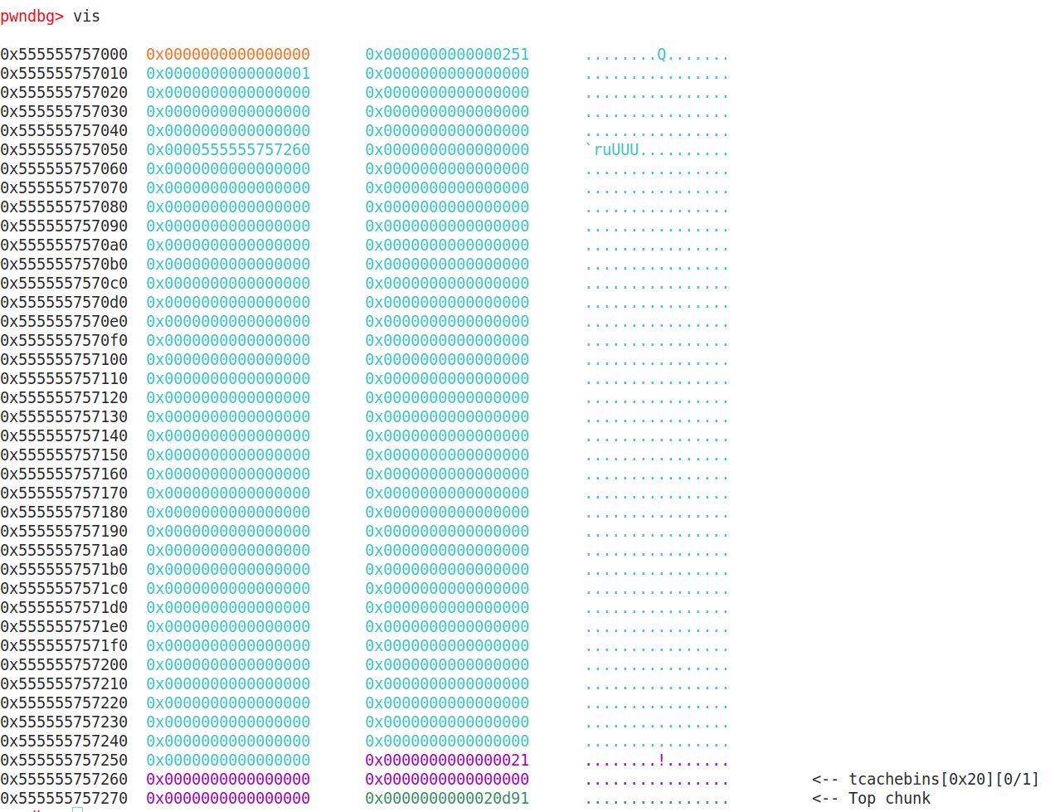
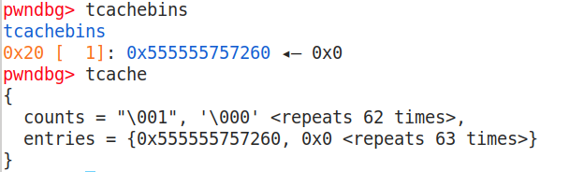

Slide 15
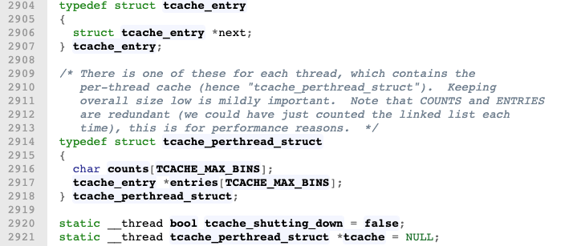
tcache structure
https://elixir.bootlin.com/glibc/glibc-2.27/source/malloc/malloc.c

Slide 16
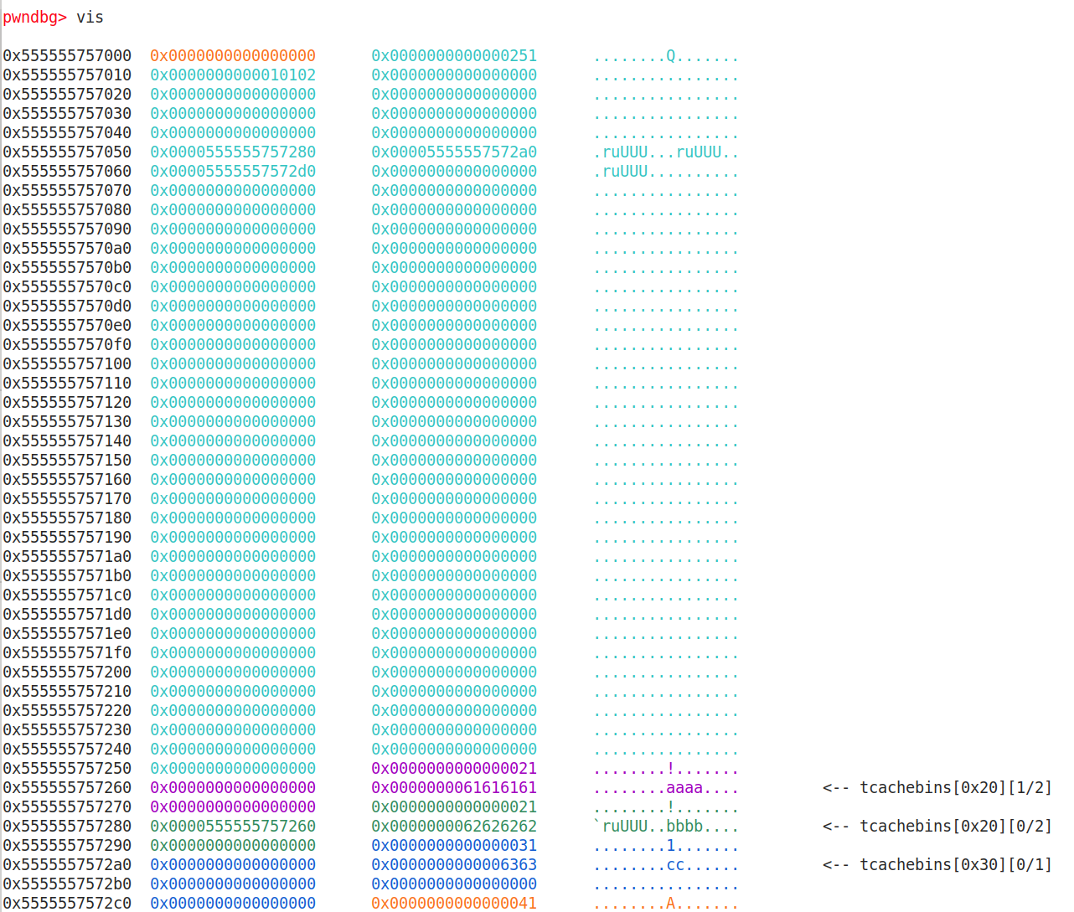
counts
entries
(a list of struct tcache_entry)
chunk

Slide 17
counts
entries
(a list of struct tcache_entry)
chunk

Slide 18
counts
entries
(a list of struct tcache_entry)
chunk

Slide 19
size
0x20
size
0x30
size
…
size
0x410
counts
size
0x20
size
0x30
size
…
size
0x410
entries
(a list of struct tcache_entry)
Each entry is also called a bin
chunk
chunk
…

Slide 20
64
size
0x20
size
0x30
size
…
size
0x410
counts
size
0x20
size
0x30
size
…
size
0x410
entries
(a list of struct tcache_entry)
chunk
7
chunk
…

Slide 21
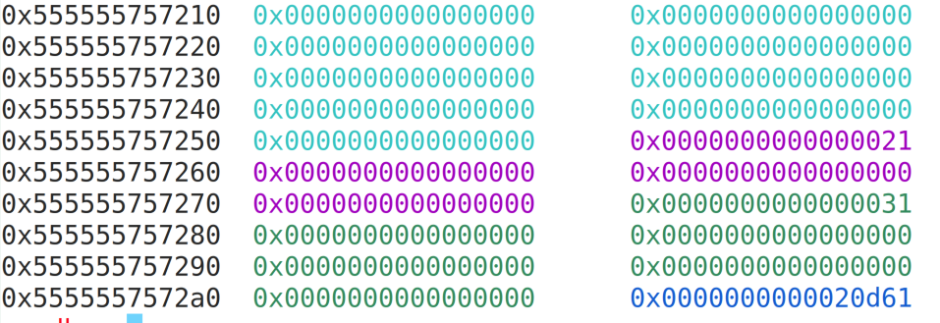
chunk
chunk size
flags
flags:
The last 3 bits in the metadata

Slide 22
Chunk
8 bytes
chunk size
flags
chunk size
flags
data
fd pointer
data
Allocated
Freed

Slide 23
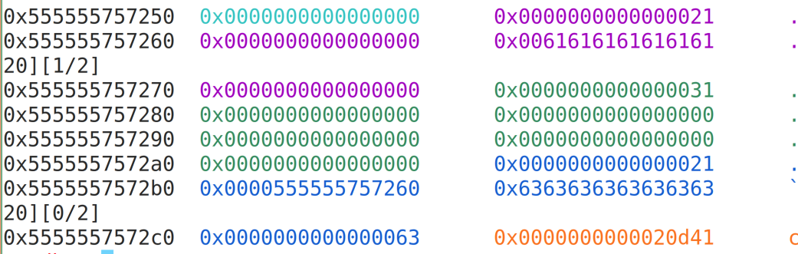
freed chunk example

Slide 24
Memory allocation / Free
Memory Free:
If tcache bins has space, goes to the tcache bin.
Adding to the head of the chain (why?)
Memory Allocation:
If there’s available chunks in the tcache bin, use it
Always use the first chunk in the chain

Slide 25
Use After Free

Slide 26

size
0x20
size
0x30
size
…
size
0x410
counts
size
0x20
size
0x30
size
…
size
0x410
entries
(a list of struct tcache_entry)
Each entry is also called a bin
chunk
chunk
…

Slide 27
size
0x20
size
0x30
size
…
size
0x410
counts
size
0x20
size
0x30
size
…
size
0x410
entries
(a list of struct tcache_entry)
Each entry is also called a bin
chunk
chunk
…
victim

Slide 28
size
0x20
size
0x30
size
…
size
0x410
counts
size
0x20
size
0x30
size
…
size
0x410
entries
(a list of struct tcache_entry)
Each entry is also called a bin
chunk
malloc(8)
malloc(8)
chunk
…
victim

Slide 29
Use After Free
Core idea:
Free a memory chunk
After a chunk is freed, metadata will be saved on the chunk
Edit the chunk -> change the metadata on heap
Link the victim memory onto a bin (tcachebin)
Get access to the victim memory by heap allocation
Read or write victim memory
Arbitrary Read / Write

Slide 30
Arbitrary read/write
Once arbitrary read/write exists:
Overwrite GOT table
Overwrite saved return address
Overwrite function pointer
glibc function (e.g, __malloc_hook)
Arbitrary read will help us know the base of libc
Arbitrary execution

Slide 31
Arbitrary execution
To execute malicious code:
Malicious function
Shellcode
ROP chain

