Slide 1
The Zoo of Software Security Techniques
Computer Security: Techniques and Tactics
Acknowledgements:
CMU 17654: Analysis of Software Artifacts, Jonathan Aldrich
CMU 18732: Secure Software Systems, Lujo Baurer
Stanford CS357: Techniques for Program Analysis and Verification, David Dill

Slide 2
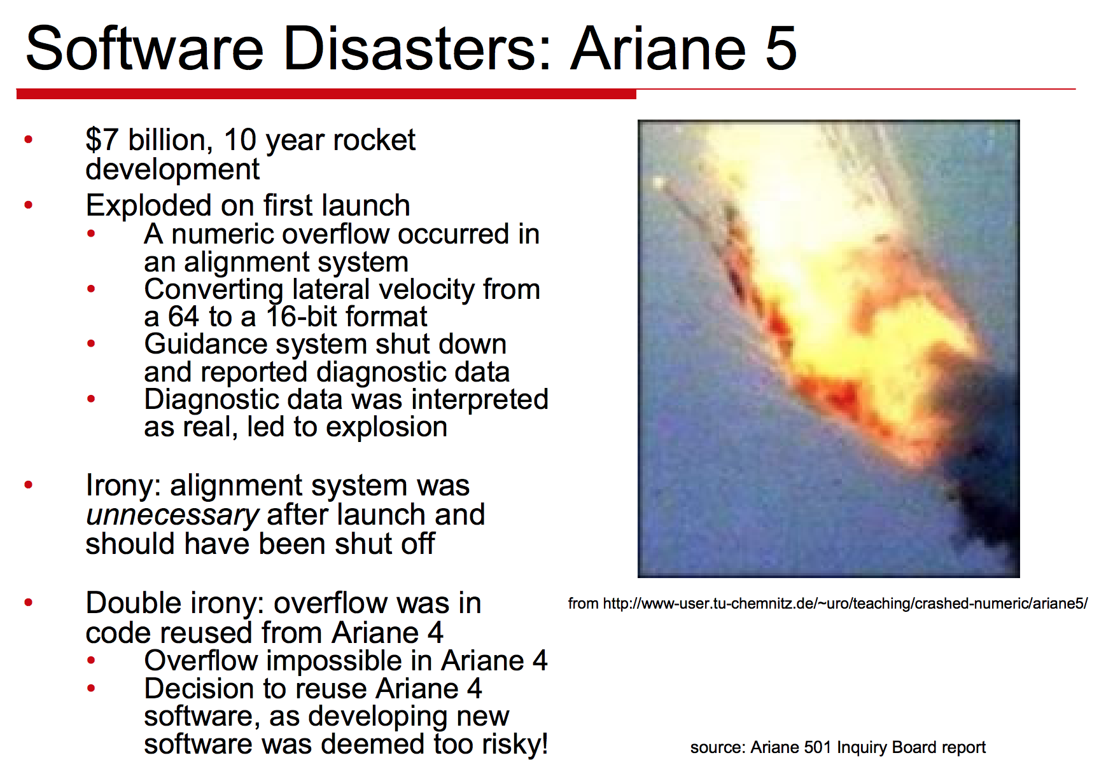

Slide 3
Software (In)Security
This Software is Secure.
Prove the correctness.
Show an counter-example.

Slide 4
Overview
Human Inspection & Testing
Program Specification and Verification
Hoare Logic
Program Verification
Static Analysis
Dataflow Analysis
Model Checking
Testing
Fuzzing
Taint Analysis
Symbolic Execution
(Defense/Mitigation)
Notes:
Sometimes dynamic analysis is under testing.

Slide 5
Inspection
https://www.xkcd.com/371/

Slide 6
Inspection is Actually Powerful
Raytheon
Reduced "rework" from 41% of cost to 20% of cost
Reduced effort to fix integration problems by 80%
IBM
1 hour of inspection saved 20 hours of testing
Saved 82 hours of rework if defects in released product
IBM Santa Teresa Lab
3.5 hours to find bug with inspection
HP
System use 0.21 defects/hour
Black box 0.28 defects/hour
White box 0.32 defects/hour
Reading/inspect 1.06 defects/hour

Slide 7
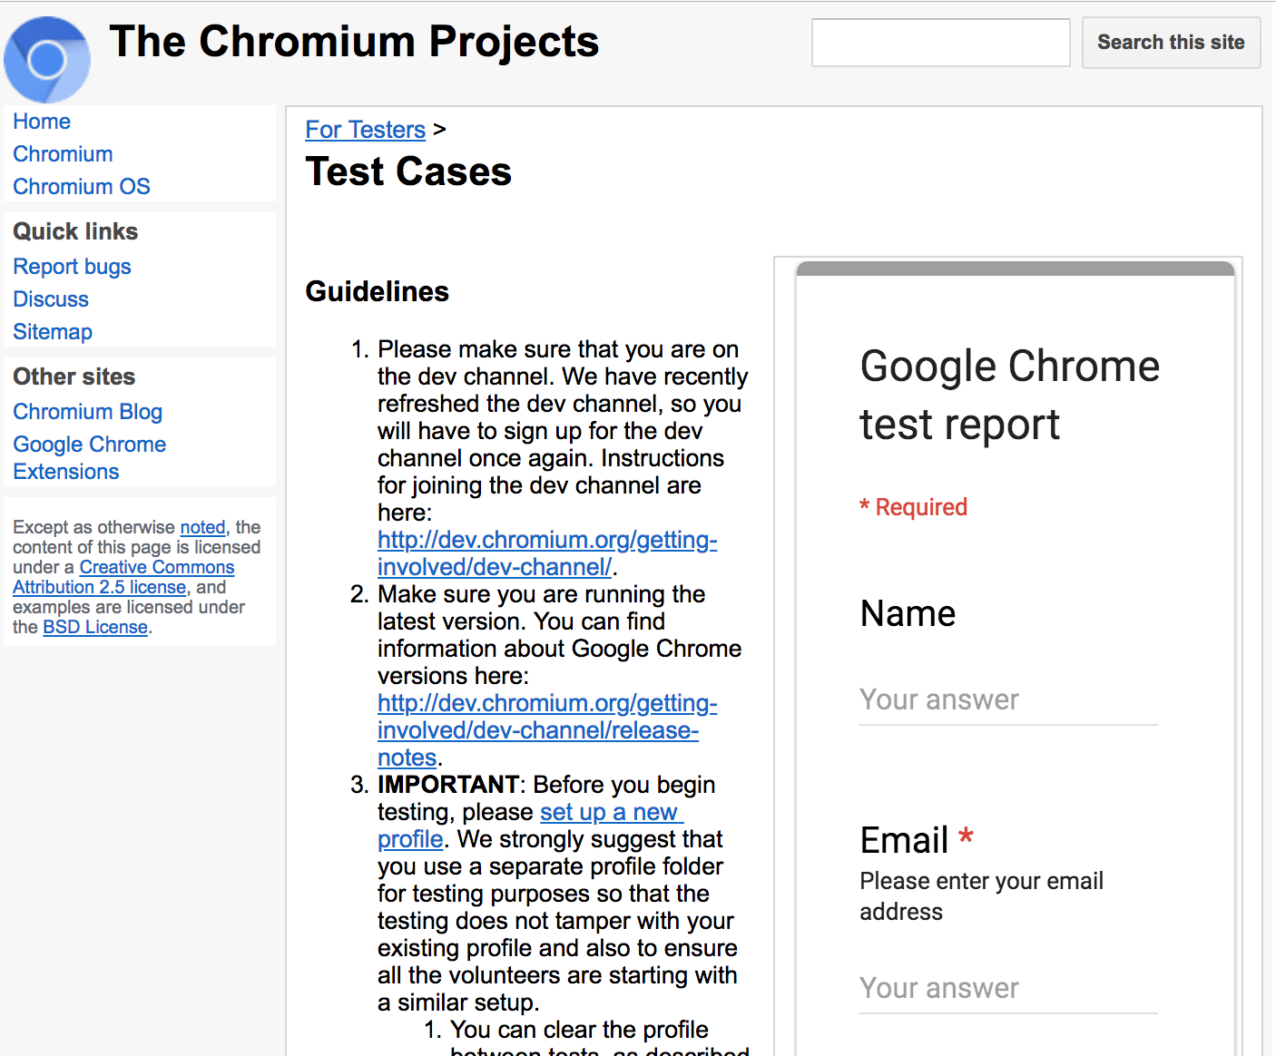
Testing
Direct execution of code on test data in a controlled environment

Slide 8
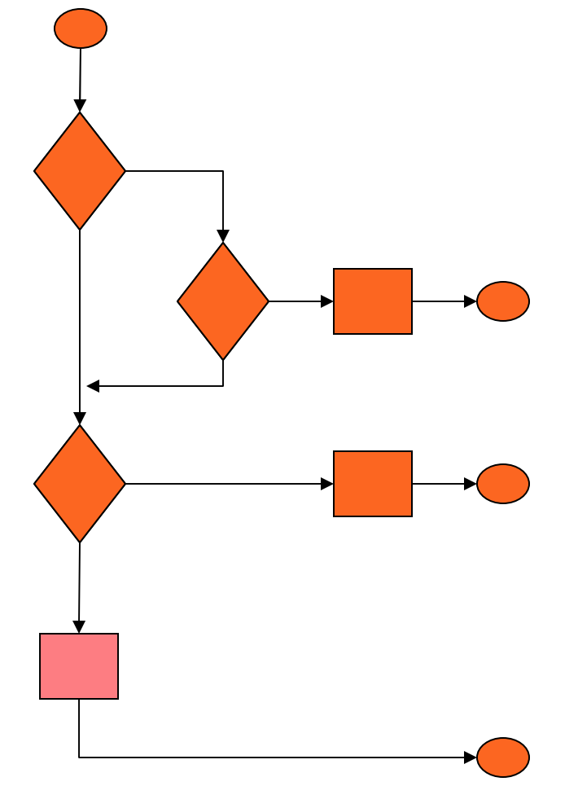
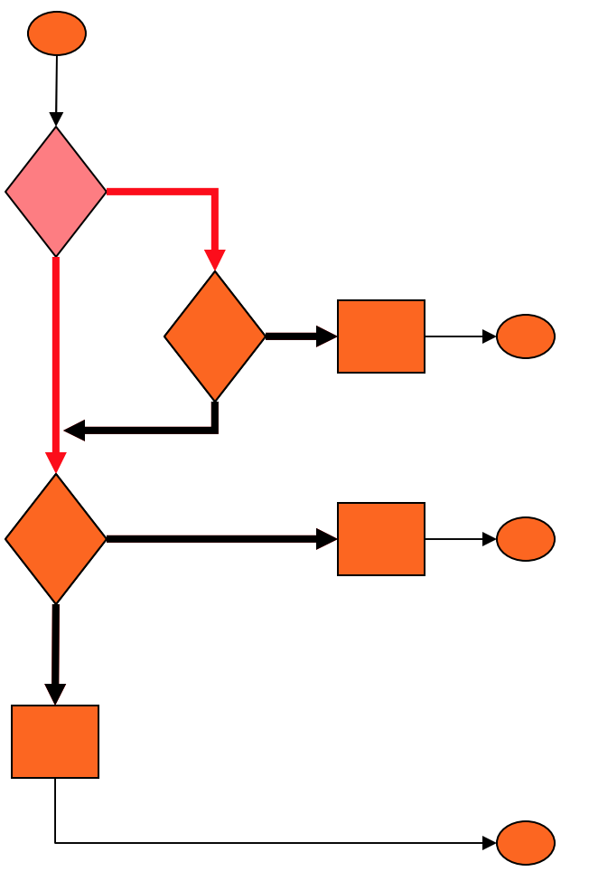
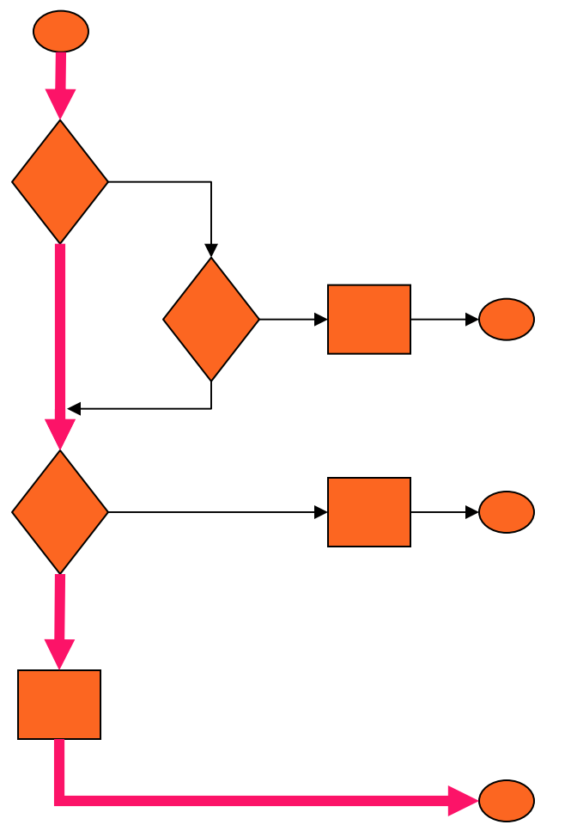
Testing
Direct execution of code on test data in a controlled environment
Heavily used in real life
Black-box testing: care about the coverage on input domain
White-box testing: care about the coverage on program
Statement/code
Coverage
Branch
Coverage
Path
Coverage
Notes:
TODO: Advantage of different metrics

Slide 9
Overview
Human Inspection & Testing
Program Specification and Verification
Program Verification
Hoare Logic
Static Analysis
Dataflow Analysis
Model Checking
Testing
Fuzzing
Taint Analysis
Symbolic Execution
(Defense/Mitigation)
Notes:
Sometimes dynamic analysis is under testing.

Slide 10
Program Verification
Prove that a program S satisfies a property Q.
In security specification: Q is a security property.
How to prove?
Wait a moment, something is wrong

Slide 11
Program Verification
S: y = x * x;
Q: y > 0;
Does S satisfy Q?
Depends on x. <---- precondition

Slide 12
Program Verification
{P}S{Q}
(Hoare triples or Hoare notation)
Whenever S is executed in a state satisfying P
And if the execution of S terminates
The state in which S’s execution terminates satisfies Q
P: Precondition
Q: Postcondition

Slide 13
Example
{X = 1} X:=X+1 {X = 2}, True or False?
{X = 1} X:=X+1 {X = 3}, True or False?
{X = 1} WHILE T DO X := X {Y = 2}, True or False?

Slide 14
/*@ requires len >= 0 && array.length == len
@ ensures \result ==
@ (\sum int j; 0 <= j && j < len; array[j])
@*/
float sum(int array[], int len) {
float sum = 0.0;
int i = 0;
while (i < len) {
sum = sum + array[i];
i = i + 1;
}
return sum;
}
Notation from the Java Modeling Language (JML)
(A representation Language)

Slide 15
Weakest Precondition
The most “general” precondition given a S and Q
{x = 5 && y = 10} z := x / y { z < 1 }
{x < y && y > 0} z := x / y { z < 1 }
{y ≠ 0 && x / y < 1} z := x / y { z < 1 }
Which one is the weakest precondition?
wp(S, Q)
y ≠ 0 && x / y < 1
x = 5 && y = 10
x = 5 && y = 10

Slide 16
Program Verification
Prove {P}S{Q} is True
{P}S{Q} holds if and only if P -> wp(S, Q)
wp(S, Q)
P

Slide 17
Program Verification
Prove {P}S{Q} is True
{P}S{Q} holds if and only if P -> wp(S, Q)
Now our goal is to find wp(S, Q).

Slide 18
Finding wp(S, Q) by Hoare Logic
High-level idea: using rules for different statements in S.
e.g., Assignment rule
wp(x := E, Q) = [E/x] Q
[E/x] Q (Substitution Notation): Replacing all occurrences of x in Q by E
Exercise: wp(x := 3*y + z, x * y - z > 0 )

Slide 19
Finding wp(S, Q) by Hoare Logic
wp(x := 3*y + z, x * y - z > 0 )
= [3 * y + z / x] (x * y - z > 0)
= ( 3 * y + z ) * y - z > 0
= 3y² + yz - z > 0

Slide 20
Using Hoare Logic to Prove Correctness (Security)
Requires a lot of work (deduction, or pre-defined precondition)
Can be unsound
E.g. loop never terminates
Finding loop invariant

Slide 21
Overview
Human Inspection & Testing
Program Specification and Verification
Hoare Logic
Program Verification
Static Analysis
Dataflow Analysis
Model Checking
Testing
Fuzzing
Taint Analysis
Symbolic Execution
(Defense/Mitigation)
Notes:
Sometimes dynamic analysis is under testing.

Slide 22
Dataflow Analysis: Motivation
Tracking value flow through program
Checking whether values satisfy a specific property
E.g. Zero analysis: could a variable be 0?
Property is a specification of Hoare logic
Hoare logic allows any property to be expressed
Specialization allows automation and soundness

Slide 23
Example: Zero Analysis
x := 10;
y := x;
z := 0;
if (y > -1) {
x := x / y;
y := y-1;
z := 5;
}
Could x be 0? Could y be 0? Could z be 0?
Notes:
Hard for program verification

Slide 24
Example: Zero Analysis
σ = [ ] ← maps variables to an abstract value: Z, NZ, MZ (abstract interpretation)
x := 10;
y := x;
z := 0;
if (y > -1) {
x := x / y;
y := y-1;
z := 5;
}
Could x be 0? Could y be 0? Could z be 0?
Notes:
Hard for program verification

Slide 25
Example: Zero Analysis
σ = [ ] ← maps variable to an abstract value: Z, NZ, MZ
x := 10; σ = [x -> 10]
y := x;
z := 0;
if (y > -1) {
x := x / y;
y := y-1;
z := 5;
}
Could x be 0? Could y be 0? Could z be 0?
Notes:
Hard for program verification

Slide 26
Example: Zero Analysis
σ = [ ] ← maps variable to an abstract value: Z, NZ, MZ
x := 10; σ = [x -> NZ]
y := x;
z := 0;
if (y > -1) {
x := x / y;
y := y-1;
z := 5;
}
Could x be 0? Could y be 0? Could z be 0?
Notes:
Hard for program verification

Slide 27
Example: Zero Analysis
σ = [ ] ← maps variable to an abstract value: Z, NZ, MZ
x := 10; σ = [x -> NZ]
y := x; σ = [x -> NZ, y -> NZ]
z := 0; σ = [x -> NZ, y -> NZ, z -> Z]
if (y > -1) { σ = [x -> NZ, y -> NZ, z -> Z]
x := x / y;
y := y-1;
z := 5;
} σ = [x -> NZ, y -> NZ, z -> Z]
Could x be 0? Could y be 0? Could z be 0?
Notes:
Hard for program verification

Slide 28
Example: Zero Analysis
σ = [ ] ← maps variable to an abstract value: Z, NZ, MZ
x := 10; σ = [x -> NZ]
y := x; σ = [x -> NZ, y -> NZ]
z := 0; σ = [x -> NZ, y -> NZ, z -> Z]
if (y > -1) { σ = [x -> NZ, y -> NZ, z -> Z]
x := x / y; σ = [x -> NZ, y -> NZ, z -> Z]
y := y-1;
z := 5;
} σ = [x -> NZ, y -> NZ, z -> Z]
Could x be 0? Could y be 0? Could z be 0?
Notes:
Hard for program verification

Slide 29
Example: Zero Analysis
σ = [ ] ← maps variable to an abstract value: Z, NZ, MZ
x := 10; σ = [x -> NZ]
y := x; σ = [x -> NZ, y -> NZ]
z := 0; σ = [x -> NZ, y -> NZ, z -> Z]
if (y > -1) { σ = [x -> NZ, y -> NZ, z -> Z]
x := x / y; σ = [x -> NZ, y -> NZ, z -> Z]
y := y-1; σ = [x -> NZ, y -> MZ, z -> Z]
z := 5;
} σ = [x -> NZ, y -> NZ, z -> Z]
Could x be 0? Could y be 0? Could z be 0?
Notes:
Hard for program verification

Slide 30
Example: Zero Analysis
σ = [ ] ← maps variable to an abstract value: Z, NZ, MZ
x := 10; σ = [x -> NZ]
y := x; σ = [x -> NZ, y -> NZ]
z := 0; σ = [x -> NZ, y -> NZ, z -> Z]
if (y > -1) { σ = [x -> NZ, y -> NZ, z -> Z]
x := x / y; σ = [x -> NZ, y -> NZ, z -> Z]
y := y-1; σ = [x -> NZ, y -> MZ, z -> Z]
z := 5; σ = [x -> NZ, y -> MZ, z -> NZ]
} σ = [x -> NZ, y -> NZ, z -> Z]
Could x be 0? Could y be 0? Could z be 0?
Notes:
Hard for program verification

Slide 31
Example: Zero Analysis
σ = [ ] ← maps variable to an abstract value: Z, NZ, MZ
x := 10; σ = [x -> NZ]
y := x; σ = [x -> NZ, y -> NZ]
z := 0; σ = [x -> NZ, y -> NZ, z -> Z]
if (y > -1) { σ = [x -> NZ, y -> NZ, z -> Z]
x := x / y; σ = [x -> NZ, y -> NZ, z -> Z]
y := y-1; σ = [x -> NZ, y -> MZ, z -> Z]
z := 5; σ = [x -> NZ, y -> MZ, z -> NZ]
} σ = [x -> NZ, y -> MZ, z -> MZ]
Could x be 0? Could y be 0? Could z be 0?
Notes:
Hard for program verification

Slide 32
Model Checking
x=0, y=0, z=0,…
x := 10;
y := x;
z := 0;
if (y > -1) {
x := x / y;
y := y-1;
z := 5;
}
x := 10;
y := x;
z := 0;
y > -1
y <= -1
x := x / y;
y := y-1;
z := 5;

Slide 33
Model Checking
x=0, y=0, z=0,…
x := 10;
y := x;
z := 0;
[x -> NZ, y -> NZ, z -> Z]
y > -1
y <= -1
[x -> NZ, y -> NZ, z -> Z]
x := x / y;
y := y-1;
z := 5;
[x -> NZ, y -> MZ, z -> MZ]
x := x / y;
y := y-1;
z := 5;

Slide 34
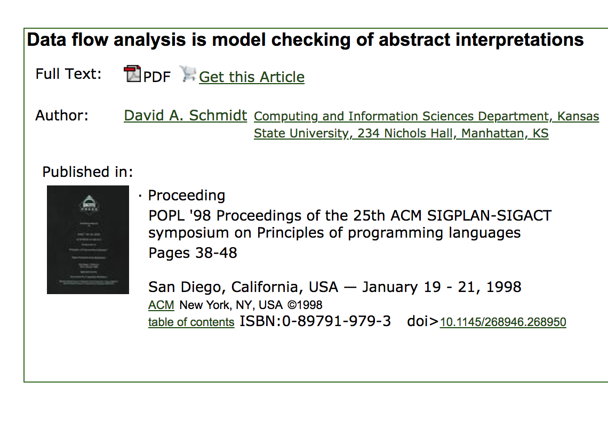
Model Checking
Notes:
Equivalent

Slide 35
Model Checking
Current abstract interpretation is insufficient for y and z
x=0, y=0, z=0,…
x := 10;
y := x;
z := 0;
[x -> NZ, y -> NZ, z -> Z]
y > -1
y <= -1
[x -> NZ, y -> NZ, z -> Z]
x := x / y;
y := y-1;
z := 5;
[x -> NZ, y -> MZ, z -> MZ]
x := x / y;
y := y-1;
z := 5;

Slide 36
Predicate Abstraction
x := 10;
y := x;
z := 0;
x := 10;
y := x;
z := 0;
if (y > -1) {
x := x / y;
y := y-1;
z := 5;
}
assert(y == 0)
if y > -1
Yes
No
x := x / y;
y := y-1;
z := 5;
assert y == 0

Slide 37
Predicate Abstraction
x := 10;
y := x;
z := 0;
if y > -1
Yes
No
x := x / y;
y := y-1;
z := 5;
assert
y == 0
y == 0
y != 0

Slide 38
Predicate Abstraction – Adding Transaction
x := 10;
y := x;
z := 0;
if y > -1
?
Yes
No
x := x / y;
y := y-1;
z := 5;
y <= -1
assert
y == 0
y == 0
y != 0

Slide 39
Predicate Abstraction – Adding Transaction
x := 10;
y := x;
z := 0;
if y > -1
Yes
No
x := x / y;
y := y-1;
z := 5;
assert
y == 0
y == 0
y != 0

Slide 40
Predicate Abstraction – Find Counterexample
x := 10;
y := x;
z := 0;
if y > -1
Yes
No
x := x / y;
y := y-1;
z := 5;
assert
y == 0
y == 0
y != 0

Slide 41
Predicate Abstraction – Validate Counterexample
x := 10;
y := x;
z := 0;
x := 10;
y := x;
z := 0;
if y > -1
Yes
No
y <= -1
x := x / y;
y := y-1;
z := 5;
assert
y == 0
y != 0

Slide 42
Predicate Abstraction – Refinement
P : y == 0
Q : y <= -1
x := 10;
y := x;
z := 0;
if y > -1
Yes
No
x := x / y;
y := y-1;
z := 5;
assert
y == 0
P && Q
¬ P && Q
P && ¬Q
¬P && ¬Q

Slide 43
Predicate Abstraction – Second Iteration
P : y == 0
Q : y <= -1
x := 10;
y := x;
z := 0;
if y > -1
Yes
No
x := x / y;
y := y-1;
z := 5;
assert
y == 0
¬ P && Q
P && ¬Q
¬P && ¬Q

Slide 44
Predicate Abstraction – Second Iteration
P : y == 0
Q : y <= -1
x := 10;
y := x;
z := 0;
if y > -1
Yes
No
x := x / y;
y := y-1;
z := 5;
assert
y == 0
¬ P && Q
P && ¬Q
¬P && ¬Q

Slide 45
Predicate Abstraction – Second Iteration
P : y == 0
Q : y <= -1
x := 10;
y := x;
z := 0;
Counterexample!
if y > -1
Yes
No
x := x / y;
y := y-1;
z := 5;
assert
y == 0
¬ P && Q
P && ¬Q
¬P && ¬Q

Slide 46
What if there is a loop
P : y == 0
Q : y <= -1
x := 10;
y := x;
z := 0;
if y > -1
No
Yes
assert
y == 0
x := x / y;
y := y-1;
z := 5;
¬ P && Q
P && ¬Q
¬P && ¬Q

Slide 47
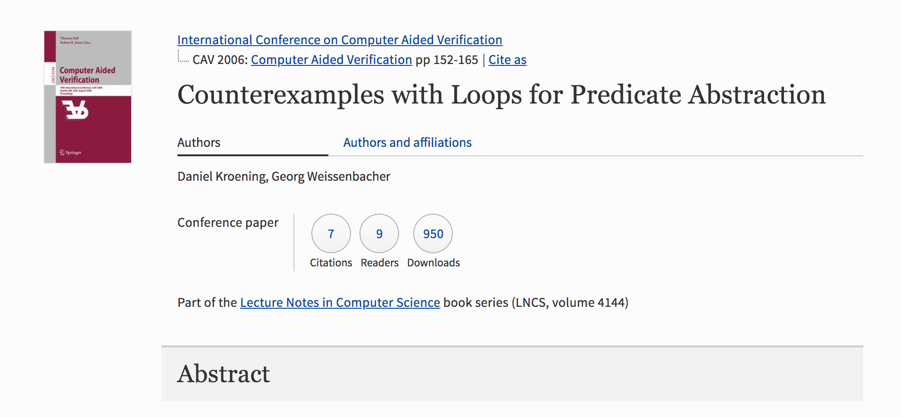
What if there is a loop

Slide 48
Quiz
Which of the following will give us a counterexample while checking whether a program satisfies a property?
Predicate abstraction
Program verification
Dataflow analysis
All of the above

