Slide 1
CSE 545 F2020, Week 9 The world of Heap: II
Tiffany Bao tbao@asu.edu

Slide 2
Announcement
Assignment 3 due: 10/31/2020, in 2 days

Slide 3
Announcement
Next week: Less Content due to Election Day

Slide 4
In-class Lab

Slide 5
Heap is fun!
nc asu-cse545.com 9999
binary: https://www.tiffanybao.com//courses/cse545/labs/week9/double_free
source: https://www.tiffanybao.com//courses/cse545/labs/week9/double_free.c

Slide 6
Outline
Tcache -- Continued!
Double Free Vulnerability
Heap Overflow Vulnerability

Slide 7
Double Free

Slide 8

size
0x20
size
0x30
size
…
size
0x410
counts
size
0x20
size
0x30
size
…
size
0x410
entries
(a list of struct tcache_entry)
Each entry is also called a bin
chunk
…
malloc(8)
malloc(8)
victim

Slide 9
void act_edit(int n, char *s){
if (used[n] == FREED)
return;
fprintf(stderr, "Editing pointer %d: %p\n", n, ptrs[n]);
int l1 = strlen(ptrs[n]);
int l2 = strlen(s);
int l;
if (l1 < l2) l = l2;
else l = l1;
memcpy(ptrs[n], s, l);
}

Slide 10
Core idea:
Free chunk1
size
0x20
size
0x30
size
…
size
0x410
chunk1
…

Slide 11
Core idea:
Free chunk1
Free chunk1
size
0x20
size
0x30
size
…
size
0x410
chunk1
chunk1
…

Slide 12
Core idea:
Free chunk1
Free chunk1
Malloc to chunk1
size
0x20
size
0x30
size
…
size
0x410
chunk1
chunk1
In use

Slide 13
Core idea:
Free chunk1
Free chunk1
Malloc to chunk1
Edit chunk1 -> victim
size
0x20
size
0x30
size
…
size
0x410
chunk1
victim
chunk1
In use

Slide 14
Core idea:
Free chunk1
Free chunk1
Malloc to chunk1
Edit chunk1 -> victim
Similar to use after free:
Malloc to chunk1
Malloc to victim
Arbitrary Read/Write
size
0x20
size
0x30
size
…
size
0x410
chunk1
victim
chunk1
In use

Slide 15
Arbitrary read/write
Once arbitrary read/write exists:
Overwrite GOT table
Overwrite saved return address
Overwrite function pointer
glibc function (e.g, __malloc_hook)
Arbitrary read will help us know the base of libc
Arbitrary execution

Slide 16
Arbitrary execution
To execute malicious code:
Malicious function
Shellcode
ROP chain

Slide 17
Heap Overflow

Slide 18
Core idea:
Free chunk1
Free chunk1
Malloc to chunk1
Edit chunk1 -> victim
Similar to use after free:
Malloc to chunk1
Malloc to victim
Arbitrary Read/Write
size
0x20
size
0x30
size
…
size
0x410
chunk1
victim
chunk1
In use

Slide 19
Core idea:
Overflow chunk0 ->
Edit chunk1 -> victim
Similar to use after free:
Malloc to chunk1
Malloc to victim
Arbitrary Read/Write
size
0x20
size
0x30
size
…
size
0x410
chunk1
victim
chunk0
chunk1

Slide 20
Core idea:
Allocate chunk0
Allocate chunk1
free chunk1
Overflow chunk0 -> victim
Similar to use after free:
Malloc to chunk1
Malloc to victim
Arbitrary Read/Write
size
0x20
size
0x30
size
…
size
0x410
chunk1
victim
chunk0
chunk1

Slide 21
In-class Lab

Slide 22
Heap is fun!
nc asu-cse545.com 8888
binary: https://www.tiffanybao.com//courses/cse545/labs/week8/use_after_free
source: https://www.tiffanybao.com//courses/cse545/labs/week8/use_after_free.c

Slide 23
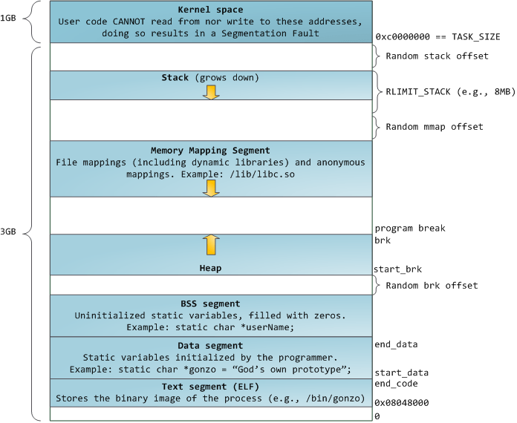
Heap
char *s = malloc(10);
dynamically allocated
https://sploitfun.wordpress.com/2015/02/11/syscalls-used-by-malloc/
Notes:
how to manage it?
memory allocator

Slide 24
Memory Allocator
dlmalloc (Doug Lea malloc)
ptmalloc (Wolfram Gloger, pthreads malloc, a fork of dlmalloc with threading-related improvements)
glibc malloc
jemalloc – FreeBSD and Firefox
tcmalloc – Google
mimalloc - Microsoft Research
…

Slide 25
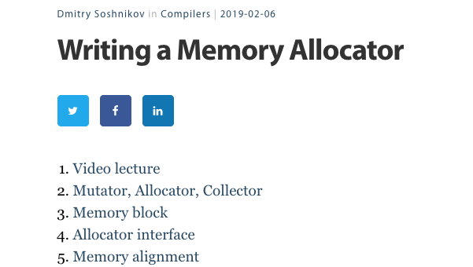
http://dmitrysoshnikov.com/compilers/writing-a-memory-allocator/

Slide 26
why there are so many allocators?
Adaptive to new techniques (e.g, multithreading)
Performance!

Slide 27
Our Content
glibc memory allocator
glibc 2.27 (used by Ubuntu 18.04)

Slide 28
want a copy of glibc 2.27?
https://www.tiffanybao.com/courses/cse545/schedule

Slide 29
This week: Overview
tcache
Notes:
The order is different

Slide 30
tcache: Data Structure
Notes:
per thread cache
glibc 2.26

Slide 31
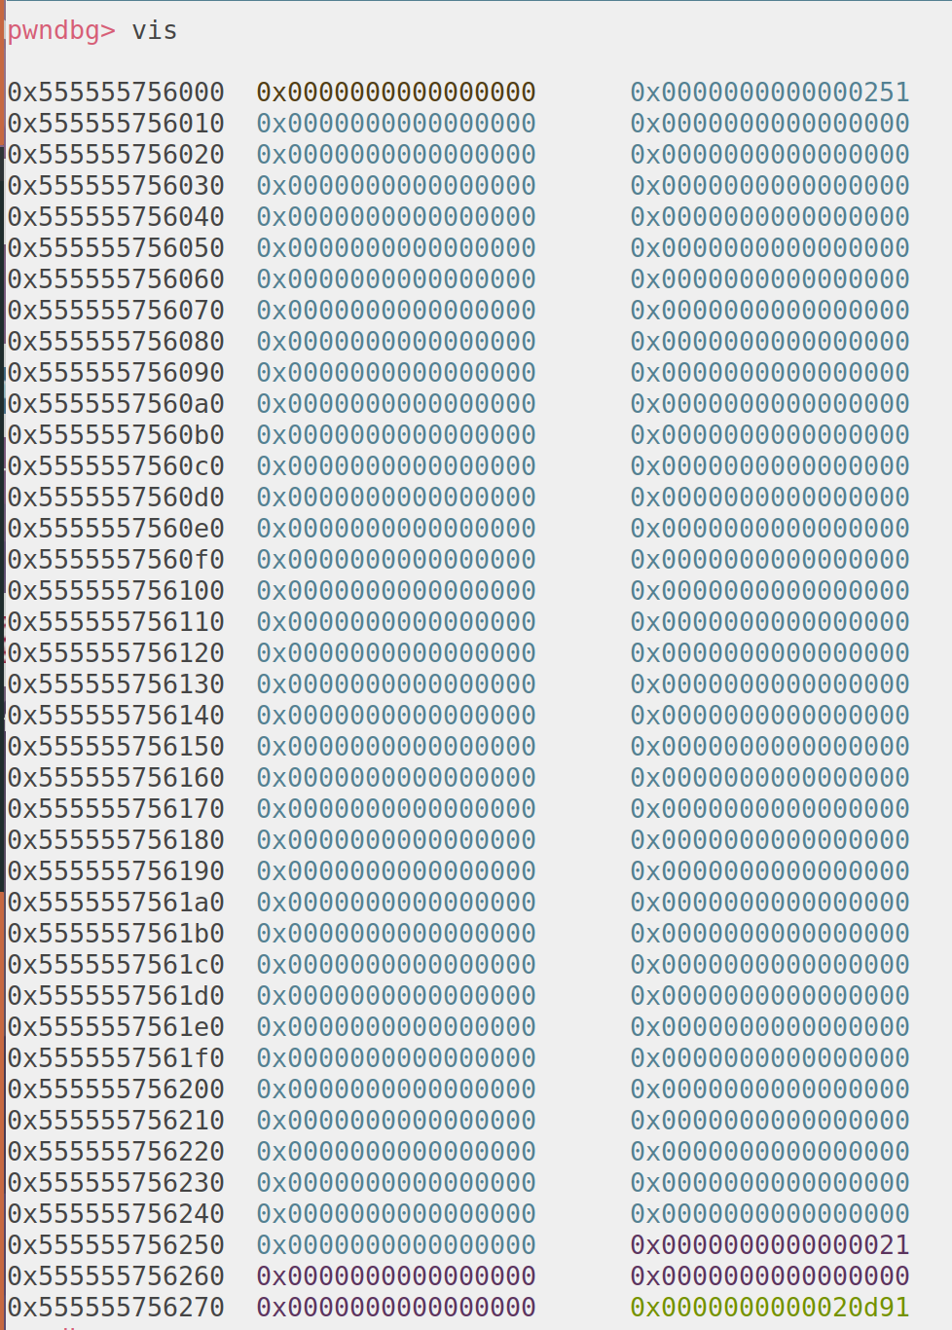
tcache
chunk
Notes:
https://azeria-labs.com/heap-exploitation-part-2-glibc-heap-free-bins/
fast bin in arena

Slide 32
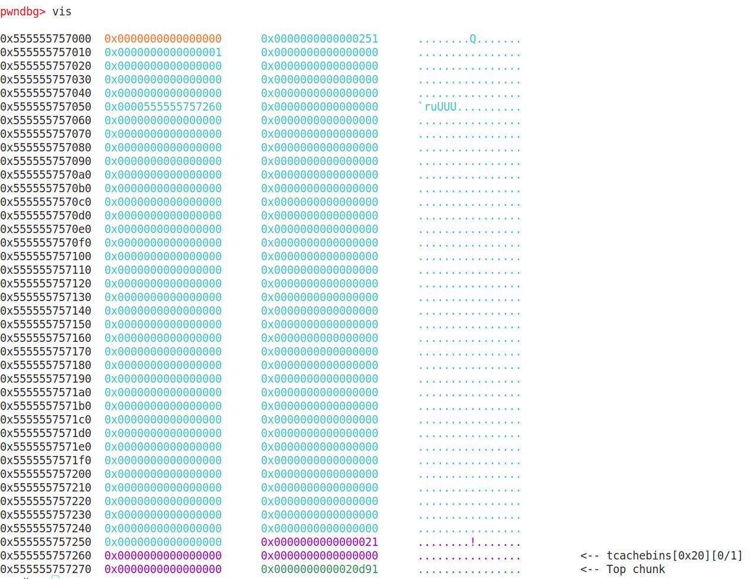
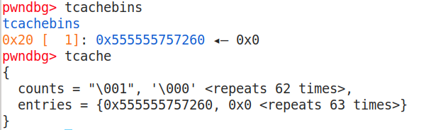

Slide 33
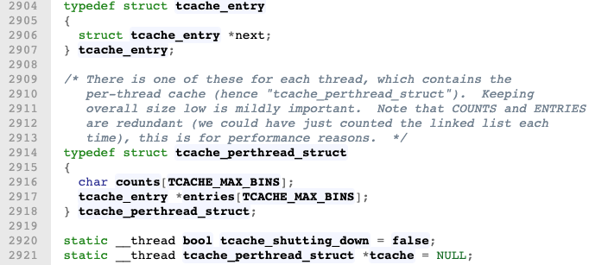
tcache structure
https://elixir.bootlin.com/glibc/glibc-2.27/source/malloc/malloc.c

Slide 34
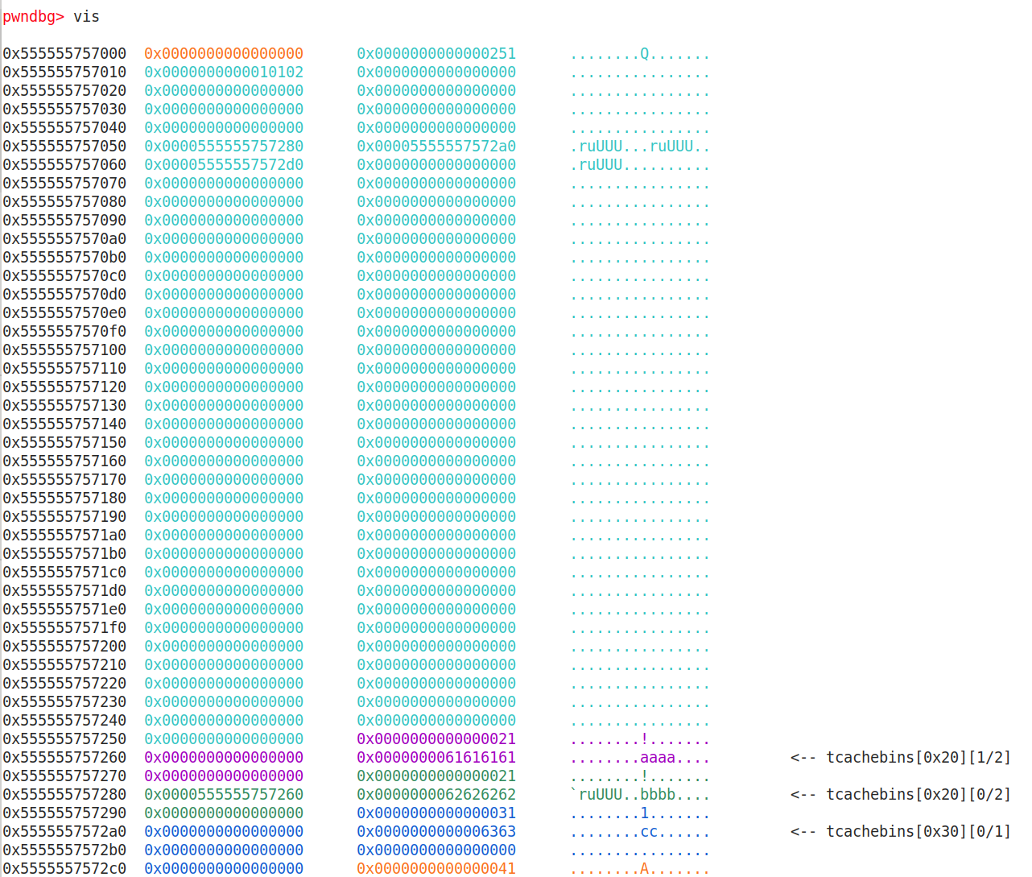
counts
entries
(a list of struct tcache_entry)
chunk

Slide 35
counts
entries
(a list of struct tcache_entry)
chunk

Slide 36
counts
entries
(a list of struct tcache_entry)
chunk

Slide 37
size
0x20
size
0x30
size
…
size
0x410
counts
size
0x20
size
0x30
size
…
size
0x410
entries
(a list of struct tcache_entry)
Each entry is also called a bin
chunk
chunk
…

Slide 38
64
size
0x20
size
0x30
size
…
size
0x410
counts
size
0x20
size
0x30
size
…
size
0x410
entries
(a list of struct tcache_entry)
chunk
7
chunk
…

Slide 39
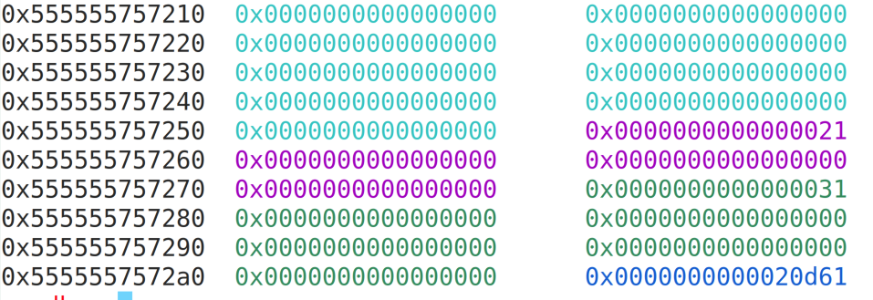
chunk
chunk size
flags
flags:
The last 3 bits in the metadata

Slide 40
Chunk
8 bytes
chunk size
flags
chunk size
flags
data
fd pointer
data
Allocated
Freed

Slide 41
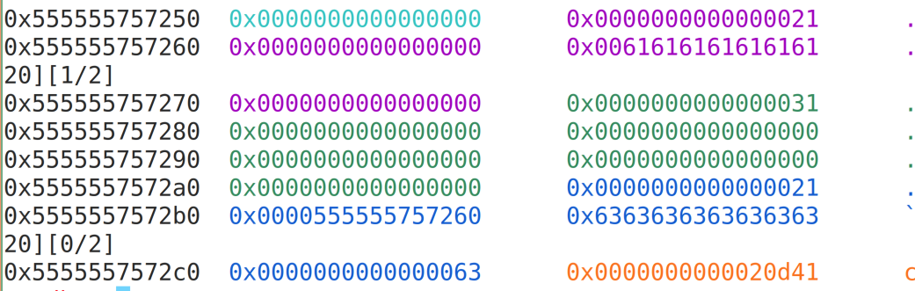
freed chunk example

Slide 42
Memory allocation / Free
Memory Free:
If tcache bins has space, goes to the tcache bin.
Adding to the head of the chain (why?)
Memory Allocation:
If there’s available chunks in the tcache bin, use it
Always use the first chunk in the chain

Slide 43
Use After Free

Slide 44
size
0x20
size
0x30
size
…
size
0x410
counts
size
0x20
size
0x30
size
…
size
0x410
entries
(a list of struct tcache_entry)
Each entry is also called a bin
chunk
chunk
…

Slide 45
size
0x20
size
0x30
size
…
size
0x410
counts
size
0x20
size
0x30
size
…
size
0x410
entries
(a list of struct tcache_entry)
Each entry is also called a bin
chunk
chunk
…
victim

Slide 46
size
0x20
size
0x30
size
…
size
0x410
counts
size
0x20
size
0x30
size
…
size
0x410
entries
(a list of struct tcache_entry)
Each entry is also called a bin
chunk
malloc(8)
malloc(8)
chunk
…
victim

Slide 47
Use After Free
Core idea:
Free a memory chunk
After a chunk is freed, metadata will be saved on the chunk
Edit the chunk -> change the metadata on heap
Link the victim memory onto a bin (tcachebin)
Get access to the victim memory by heap allocation
Read or write victim memory
Arbitrary Read / Write

Slide 48
Arbitrary read/write
Once arbitrary read/write exists:
Overwrite GOT table
Overwrite saved return address
Overwrite function pointer
glibc function (e.g, __malloc_hook)
Arbitrary read will help us know the base of libc
Arbitrary execution

Slide 49
Arbitrary execution
To execute malicious code:
Malicious function
Shellcode
ROP chain

