Slide 1
CSE 545 F2020, Week 11 Heap: Fastbins & others
Tiffany Bao tbao@asu.edu
Notes:
https://sourceware.org/glibc/wiki/MallocInternals
https://sploitfun.wordpress.com/2015/02/10/understanding-glibc-malloc/
https://www.bencode.net/posts/2019-10-19-heap-overflow/
https://azeria-labs.com/heap-exploitation-part-2-glibc-heap-free-bins/

Slide 2
Announcement
Assignment 4 is ongoing, ddl: Oct 25th
Next lecture: Fuzzing
TODO: Install Docker container
CTF: 10 challenges, 5-7 days

Slide 3
Choose from the following menu:
0. [exit]
1. [m]alloc with size, e.g. m 2
2. [f]ree with index, e.g, f 1
3. [e]dit allocated chunk's content, e.g, e 2
4. [l]ist all pointers, e.g, l

Slide 4
tcache

Slide 5
tcache
Use After Free
Double Free
Overflow

Slide 6
tcache
Use After Free
fastbin
unsorted bin
Double Free
small bin
Overflow
large bin
Arena

Slide 7
Off-by-null
tcache
Use After Free
fastbin
…
unsorted bin
Double Free
small bin
Overflow
large bin
…
Arena

Slide 8
tcache poisoning
Off-by-null
tcache
fastbin reverse
Use After Free
fastbin
unsorted bin
house of spirit
Double Free
…
…
small bin
house of force
Overflow
large bin
…
…
Arena

Slide 9
Outline
Fastbin use-after-free (UAF) vulnerabilities
Fastbin double-free vulnerabilities
Leaking libc address
via unsorted bin
via program’s data segment
How to debug
fastbin reverse

Slide 10
Fastbin Use After Free

Slide 11
Tcache Bin
metadata
metadata
…
…
data
data
00000
fd pointer
fd pointer
Fast Bin
metadata
metadata
metadata
data
data
data
fd pointer
fd pointer
00000

Slide 12
Fast Bin
metadata
metadata
metadata
data
data
data
fd pointer
fd pointer
000000
1
2
metadata
…
victim
(malloc@got)
0000
fd pointer
Fake Chunk

Slide 13
Fast Bin
metadata
metadata
metadata
000000
data
data
data
2
1
metadata
000000
victim
(e.g., malloc@got)
Fake Chunk

Slide 14
Identify Fake Chunk
metadata
victim
(malloc@got)
A Fake Chunk Should Satisfy:
Include the victim memory
The fd pointer (start of data) is 0 or points to another chunk that will ultimately with fd pointer as 0
1
00000000
Fake Chunk
metadata
…
victim
(malloc@got)
0000
fd pointer
Fake Chunk

Slide 15
Link Fake Chunk to Fastbin Freelist
Find a use-after-free vulnerability
Edit the fd pointer
metadata
data
fd pointer
2
metadata
victim
(malloc@got)
fd pointer
Fake Chunk

Slide 16
Tcache Bin
3
malloc() x 7
metadata
metadata
…
…
data
data
00000
fd pointer
fd pointer
Fast Bin
metadata
metadata
metadata
…
victim
(malloc@got)
0000
data
data
fd pointer
fd pointer
fd pointer

Slide 17
Tcache Bin
3
malloc() x 7
Fast Bin
metadata
metadata
metadata
…
victim
(malloc@got)
0000
data
data
fd pointer
fd pointer
fd pointer

Slide 18
Tcache Bin
4
malloc()
Fast Bin
metadata
metadata
metadata
…
victim
(malloc@got)
0000
data
data
fd pointer
fd pointer
fd pointer

Slide 19
Tcache Bin
4
malloc()
Fast Bin
metadata
metadata
metadata
…
victim
(malloc@got)
0000
data
data
fd pointer
fd pointer
fd pointer

Slide 20
Tcache Bin
4
malloc()
Fast Bin
metadata
metadata
…
victim
(malloc@got)
0000
data
fd pointer
fd pointer

Slide 21
Tcache Bin
4
malloc()
metadata
00000000
data
Fast Bin
metadata
…
victim
(malloc@got)
0000
fd pointer

Slide 22
Tcache Bin
4
malloc()
metadata
metadata
victim
(malloc@got)
00000000
fd pointer
data
Fast Bin
…
0000

Slide 23
Tcache Bin
4
malloc()
…
metadata
metadata
victim
(malloc@got)
00000000
fd pointer
data
Fast Bin
0000

Slide 24
Tcache Bin
5
malloc()
…
metadata
metadata
victim
(malloc@got)
00000000
0000
fd pointer
data
Tcache Bin
metadata
metadata
victim
(malloc@got)
00000000
fd pointer
data
Notes:
Debug: stop here and see how many chunks in the bin

Slide 25
__malloc__hook
“The GNU C Library lets you modify the behavior of malloc, realloc, and free by specifying appropriate hook functions. You can use these hooks to help you debug programs that use dynamic memory allocation,
__malloc_hook: The value of this variable is a pointer to the function that malloc uses whenever it is called.
__free_hook, __realloc_hook
https://www.gnu.org/software/libc/manual/html_node/Hooks-for-Malloc.html

Slide 26
Fast Bin
metadata
metadata
metadata
data
data
data
fd pointer
fd pointer
000000
1
2
__malloc_hook-0x10
metadata
0000000
__malloc_hook
Fake Chunk

Slide 27
Tcache Bin
3
malloc() x 7
metadata
metadata
…
…
data
data
00000
fd pointer
fd pointer
Fast Bin
__malloc_hook-0x10
metadata
metadata
metadata
victim
__malloc_hook
data
data
00000000
fd pointer
fd pointer

Slide 28
Tcache Bin
3
malloc() x 7
Fast Bin
__malloc_hook-0x10
metadata
metadata
metadata
victim
__malloc_hook
data
data
00000000
fd pointer
fd pointer

Slide 29
Tcache Bin
4
malloc()
Fast Bin
__malloc_hook-0x10
metadata
metadata
metadata
victim
__malloc_hook
data
data
00000000
fd pointer
fd pointer

Slide 30
Tcache Bin
4
malloc()
metadata
metadata
victim
00000000
fd pointer
data
Fast Bin

Slide 31
Tcache Bin
5
malloc()
metadata
metadata
victim
(__malloc_hook)
00000000
fd pointer
data
Fast Bin

Slide 32
Tcache Bin
5
malloc()
metadata
metadata
victim
(__malloc_hook)
00000000
fd pointer
data
Fast Bin

Slide 33
Fast Bin
metadata
metadata
metadata
data
data
data
fd pointer
fd pointer
000000
1
2
__malloc_hook-0x10
metadata
0000000
__malloc_hook
Fake Chunk

Slide 34
Tcache Bin
5
malloc()
metadata
victim
(__malloc_hook)
00000000
Fast Bin

Slide 35
How to debug

Slide 36
check video

Slide 37
Fastbin double Free

Slide 38
Tcache Bin
metadata
metadata
data
data
fd pointer
fd pointer

Slide 39
Tcache Bin
metadata
metadata
data
data
fd pointer
fd pointer
Fast Bin
metadata
metadata
metadata
data
data
data
fd pointer
fd pointer
fd pointer

Slide 40
Tcache Bin
metadata
metadata
…
…
data
data
00000
fd pointer
fd pointer
Fast Bin
metadata
metadata
metadata
data
data
data
fd pointer
fd pointer
fd pointer

Slide 41
Tcache Bin
1
Empty tcache bins
metadata
metadata
…
…
data
data
00000
fd pointer
fd pointer
Fast Bin
metadata
metadata
metadata
data
data
data
fd pointer
fd pointer
fd pointer

Slide 42
Tcache Bin
1
Empty tcache bins
Fast Bin
metadata
metadata
metadata
data
data
data
fd pointer
fd pointer
fd pointer

Slide 43
Tcache Bin
2
malloc()
Fast Bin
metadata
metadata
metadata
data
data
data
fd pointer
fd pointer
fd pointer

Slide 44
Tcache Bin
2
malloc()
Fast Bin
metadata
metadata
metadata
data
data
data
fd pointer
fd pointer
fd pointer

Slide 45
Tcache Bin
2
malloc()
Fast Bin
metadata
metadata
data
data
fd pointer
fd pointer

Slide 46
Tcache Bin
2
malloc()
metadata
data
00000000
Fast Bin
metadata
data
fd pointer

Slide 47
Tcache Bin
2
malloc()
metadata
data
00000000
Fast Bin
metadata
metadata
data
fd pointer
data
00000000

Slide 48
Tcache Bin
2
malloc()
metadata
metadata
data
fd pointer
data
00000000
Fast Bin
metadata
data
00000000

Slide 49
metadata
Tcache Bin
2
malloc()
data
fd pointer
metadata
metadata
metadata
data
data
fd pointer
data
fd pointer
fd pointer
Fast Bin

Slide 50
Tcache Bin
3
Edit the chunk from Step 2
metadata
data
fd pointer
metadata
metadata
metadata
data
data
fd pointer
data
fd pointer
fd pointer
metadata
victim
Fake Chunk

Slide 51
Tcache Bin
4
malloc() x 3
metadata
metadata
metadata
data
data
fd pointer
data
fd pointer
fd pointer
metadata
victim
Fake Chunk

Slide 52
Leak Libc Base Address

Slide 53
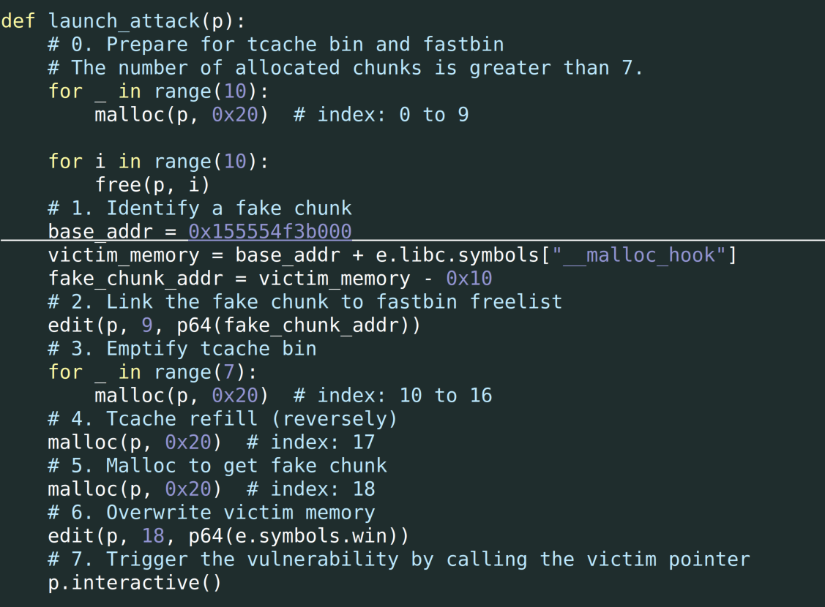

Slide 54
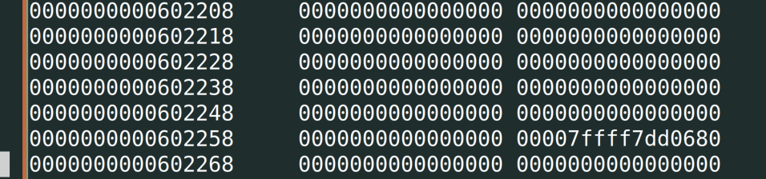
Approach 1: find a fake chunk with libc info
Find a memory location that satisfy the necessary condition for a fake chunk
The libc information is contained in the fake chunk
e.g., 0x602248

Slide 55
Fast Bin
metadata
metadata
metadata
data
data
data
fd pointer
fd pointer
000000
1
2
0x602248
metadata
libc-related
address
Fake Chunk

Slide 56
Tcache Bin
3
malloc() x 7
metadata
metadata
…
…
data
data
00000
fd pointer
fd pointer
Fast Bin
metadata
0x602248
metadata
metadata
victim
data
data
00000000
fd pointer
fd pointer

Slide 57
Tcache Bin
3
malloc() x 7
Fast Bin
0x602248
metadata
metadata
metadata
victim
data
data
00000000
fd pointer
fd pointer

Slide 58
Tcache Bin
4
malloc()
Fast Bin
0x602248
metadata
metadata
metadata
victim
data
data
00000000
fd pointer
fd pointer

Slide 59
Tcache Bin
4
malloc()
0x602248
metadata
metadata
victim
00000000
fd pointer
data
Fast Bin

Slide 60
Disadvantage
Finding a fake chunk like such may not be easy
The address of fake chunk may also change
E.g., PIE and ASLR

Slide 61
Approach 2: unsorted bins
siz0x20
arena -> bins
FD
BK
-> Forward
<- Backward
chunk
chunk
…

Slide 62
Unsorted Bin with one chunk
-> Forward
metadata
metadata
data
fd pointer
bw pointer
fd pointer
bw pointer
main_arena @ glibc

Slide 63
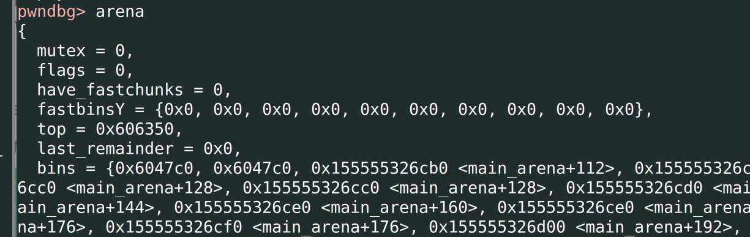

Slide 64
Review

Slide 65
Pwn
miscellaneous
Stack
Heap
Reverse Engineering

Slide 66
Reverse Engineering
Goal: Understand the semantics of a program
Functions may be stripped --- no function name
Tool:
Static: Disassembler and Decompiler
IDA, Ghidra
Dynamic:
gdb (pwndbg, gef)

Slide 67
Pwning --- miscellaneous
Command Line Injection
sprintf(command, “cd %s”, user_input);
system(command);
Directory Traversal
sprintf(directory, “../%s/%s”, user_input);
fopen(user_input, “r”);

Slide 68
pwning --- Memory corruption
Goal: Arbitrary execution
Approach: Take advantage a vulnerability to overwrite an instruction pointer with malicious code pointer

Slide 69
pwning
Instruction pointer:
Overwrite saved return address
Overwrite GOT table
Overwrite hook functions in glibc (e.g., __malloc_hook)

Slide 70
pwning
Malicous code pointer:
the winning function
shellcode
ROP gadget

Slide 71
Vulnerabilities
…
char path[50]
…
int res
saved rbp
saved rip (return address)
…
rsp ->
Stack overflow
Overwrite
rbp ->
rbp + 8 ->
malicious instruction

Slide 72
Vulnerabilities
%0200x%0 200x%020 0x%0200x %0200x%1 1$n\npadd \x08\x47\x55\x55\x55\x55\x00\x00
…
saved rbp
saved rip (return address)
…
Format String
Goal: [0x555555554708] = 1000
char buf[] = “%0200x%0200x%0200x%0200x%0200x%11$n\n” + “padd” + little_end(0x555555554708);
rsp ->
rbp ->
rbp + 8 ->

Slide 73

Vulnerabilities
size
0x20
size
0x30
size
…
size
0x410
Tcache use after free
chunk
chunk
…
victim

Slide 74
Vulnerabilities
size
0x20
size
0x30
size
…
size
0x410
Tcache double free
chunk1
victim
chunk1
In use

Slide 75
Vulnerabilities
size
0x20
size
0x30
size
…
size
0x410
Tcache overflow
chunk1
victim
chunk0
chunk1

Slide 76
Vulnerabilities
Fastbin use after free
Fast Bin
metadata
metadata
metadata
data
data
data
fd pointer
fd pointer
000000
metadata
…
victim
0000
fd pointer
Fake Chunk

Slide 77
Vulnerabilities
Fastbin double free
Fast Bin
metadata
metadata
metadata
data
data
data
fd pointer
fd pointer
fd pointer

Slide 78
Defense
Stack Canary
NX
ASLR
PIE

Slide 79
Stack Canary
Additional bytes in stack
Week 6
Leak stack canary
Overwrite predefined canary
Overwrite function __stack_chk_fail

Slide 80
NX
No stack execution
the winning function: Yes
shellcode: No
ROP gadget: Yes

Slide 81
PIE
Position-independent code
Code will become offset
So does GOT
Winning function: Require the base of the code segment, but it won’t change
Shellcode: Yes
ROP gadget: Require the base of libc, but it won’t change

Slide 82
ASLR
The base of code and data will be randomized
Winning function: Require the base of code segment
Shellcode: Require the base of stack
ROP gadget: Require the base of libc

Slide 83
pwning
Instruction pointer:
Overwrite saved return address
Overwrite GOT table
Overwrite hook functions in glibc (e.g., __malloc_hook)

Slide 84
 |  | NX | PIE | ASLR
Victim function / instruction pointers | Saved return address | ✓ | ✓ | base
 | GOT table | ✓ | constant base | base
 | Hook functions in glibc | ✓ | constant base | base
Malicious Code Location | the winning function | ✓ | constant base | base
 | shellcode | ✕ | ✓ | base
 | ROP Gadget | ✓ | constant base | base

