Slide 1
ERAS Linguistics Statistical Analyses - Race -
UNC ENT Research Group
March 4, 2022
Contact Tiffany Ho (tiffany.d.ho@gmail.com)
for any questions in the following presentation
Notes:
Contact Tiffany Ho (tiffany.d.ho@gmail.com) for any questions

Slide 2
Overview
One-way ANOVA vs Kruskal-wallis
Assumptions check
normality, equal variance, extreme outliers
Variables analyzed
2 objective variables
"step_1" "step_2"
11 subjective variables
"Standout" "Ability" "Grindstone" "Teaching" "Research" "Analytic" "Clout" "Authentic" "Tone" "achieve" "power"

Slide 3

2020-21 LOR Dataset

Slide 4
Checking assumptions of one-way ANOVA
Extreme outliers
See boxplots in ‘ERAS_race_outlier_check_2020-21_LOR.pdf’
See specific extreme outliers in ‘[same name].xlsx’
TO-DO: re-run tests without extreme outliers
Normality
Shapiro test
See QQ plots in ‘ERAS_race_normality_check_2020-21_LOR.pdf’
Homogeneity of variance
Levene’s test

Slide 5
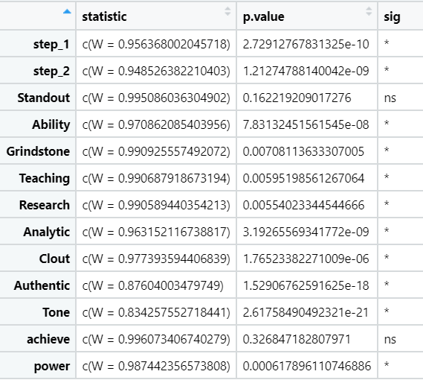
Normality check
Shapiro Test
Assumption met if p > 0.05
Only ‘standout’ and ‘achieve’ meet the normality assumption.
For variables without normal distributions, use Kruskal-Wallis test, the non-parametric equivalent to one-way ANOVA.

Slide 6
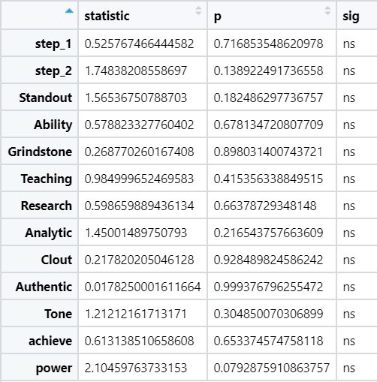
Homogeneity of variance check
Levene’s Test
Assumption met if p > 0.05
All variables met the assumption.

Slide 7
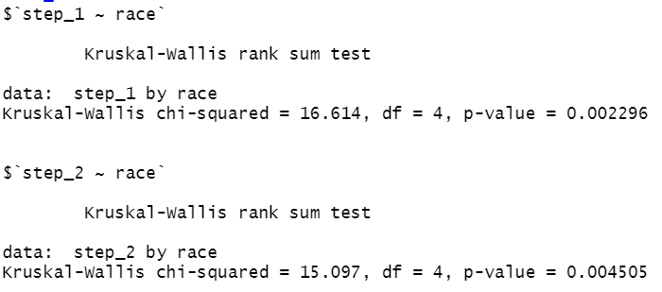
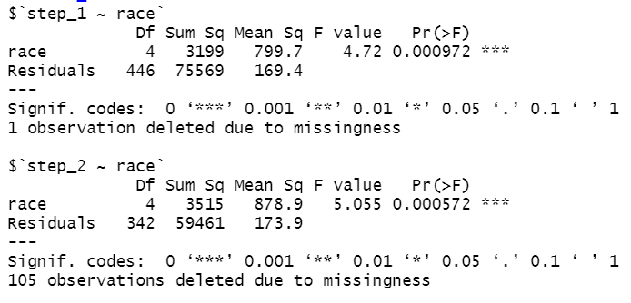
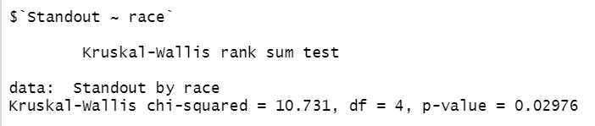
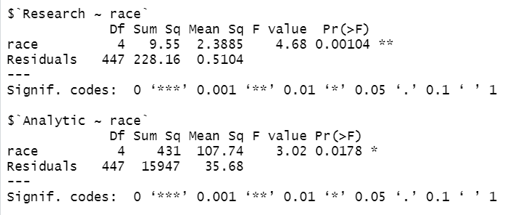
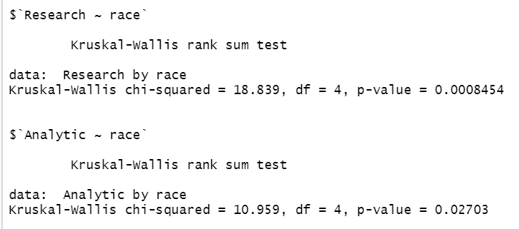
Kruskal-wallis (5):
step_1, step_2, standout, research, analytic
One-way ANOVA (4)
4 variables with statistical significance: step_1, step_2, research, analytic
TO DELETE

Slide 8
Statistical Analyses
One-way ANOVA for “standout” and “achieve”
Neither is significant
Kruskal-wallis test for all others
4 variables are significant: step_1, step_2, research, analytic
Post-hoc analysis: Tukey’s test

Slide 9
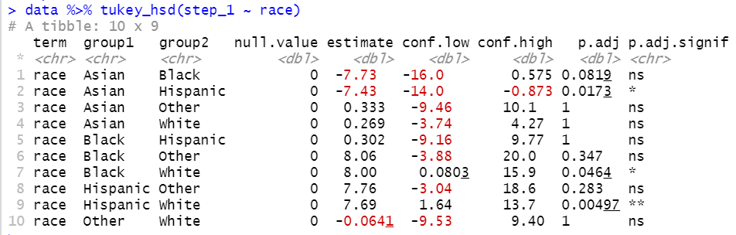
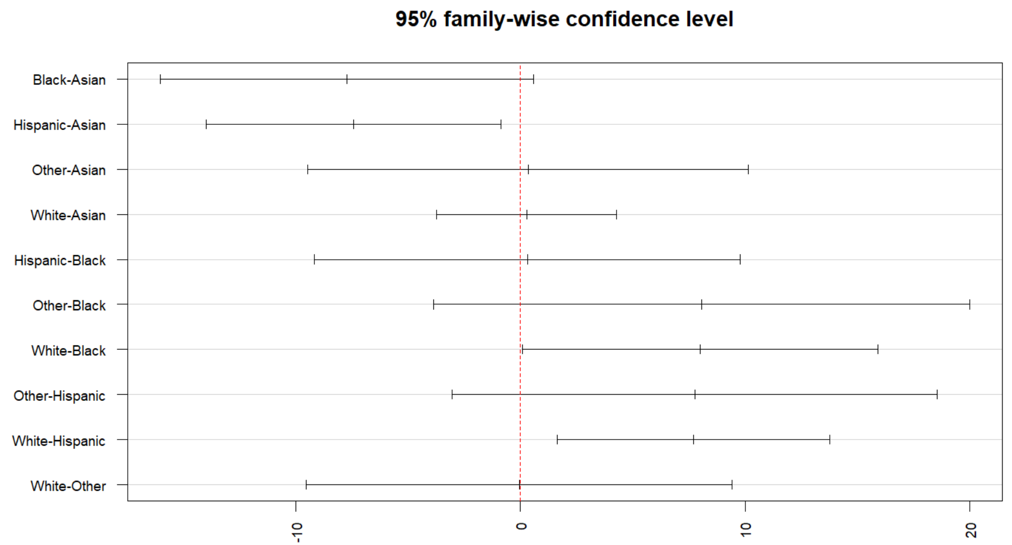
post hoc test:
step_1
3 pairs have sig. difference in mean:
Asian > Hispanic by 7.43 points
White > Black by 8 points
White > Hispanic by 7.69 points

Slide 10
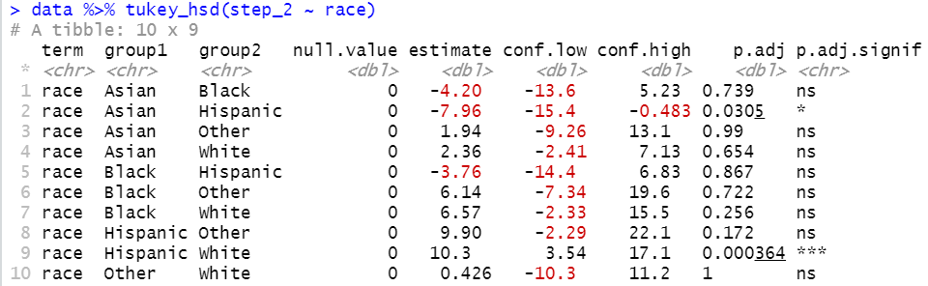
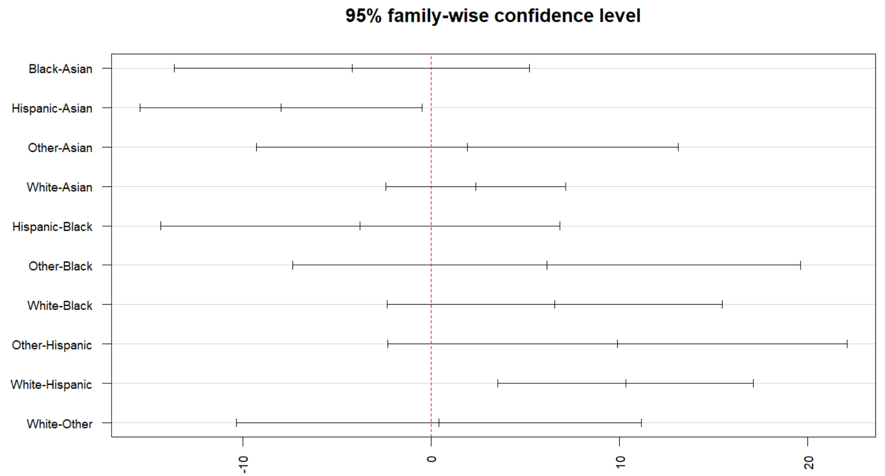
post hoc test:
step_2
2 pairs have sig. difference in mean:
Asian > Hispanic by 7.96 points
White > Hispanic by 10.3 points

Slide 11
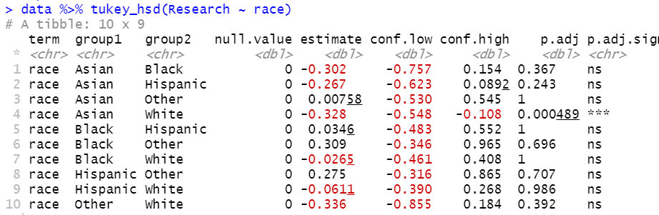
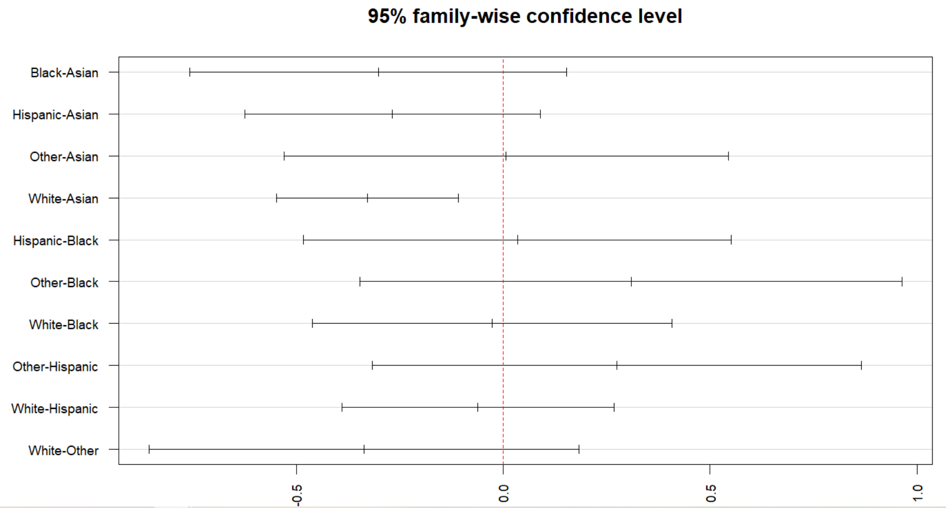
post hoc test:
research
1 pair have sig. difference in mean:
Asian > White by 0.328 points (score calculated by the linguistic algorithm)

Slide 12
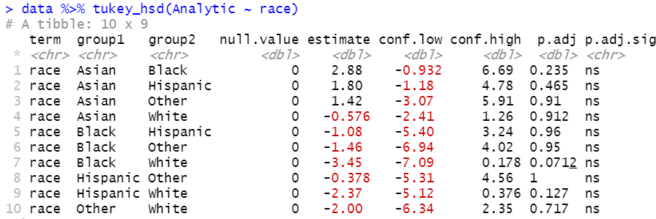
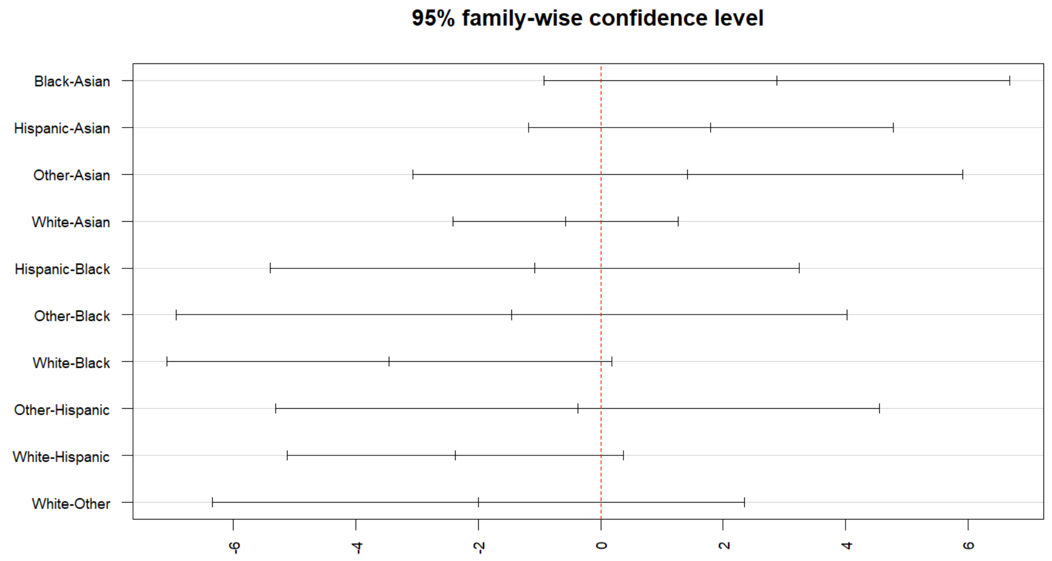
post hoc test:
analytic
No significant pair-wise difference for ‘analytic.’
Non-significant post hoc test given significant ANOVA?
Yes, certainly possible!

Slide 13
Some reasons why post-hoc tests may be not significant while the global effect is:
Weak significant global effect
Conservative post-hoc test
A lack of statistical power
Large number of factor levels
Notes:
Weak significant global effect. Ex: ANOVA p-value close to α level
Conservative post-hoc test. The more conservative the multiple comparison test, the more likely we would reject significant differences between means that might be meaningful.
A lack of statistical power. Ex: small group sizes -> less power -> less likely to detect significant differences
Large number of factor levels. The more pairwise comparisons we do, the more our p-values will get penalized in order to reduce the risk of rejecting true null hypotheses.

Slide 14

2019-20 LOR Dataset

Slide 15
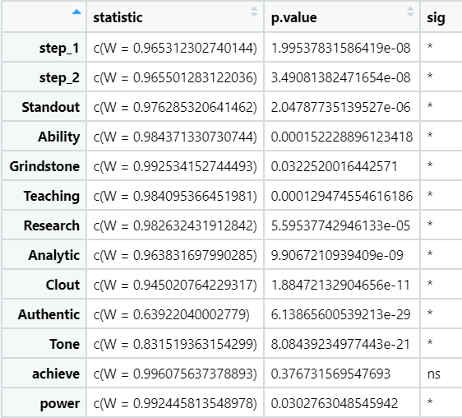
Normality
Shapiro Test
Assumption met if p > 0.05
Only ‘achieve’ meet the normality assumption.
For variables without normal distributions, use Kruskal-Wallis test, the non-parametric equivalent to one-way ANOVA.

Slide 16
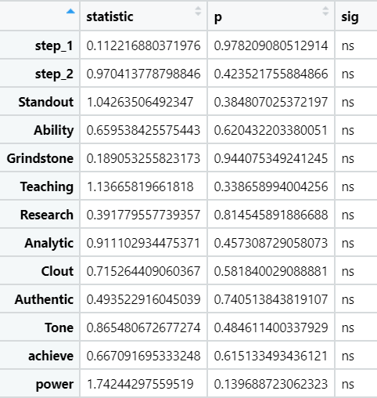
Homogeneity of variance
Levene’s Test
Assumption met if p > 0.05
All variables met the assumption.

Slide 17
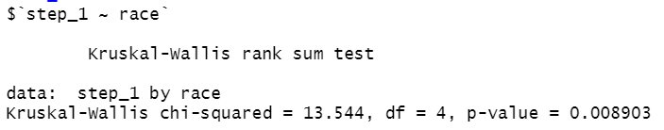

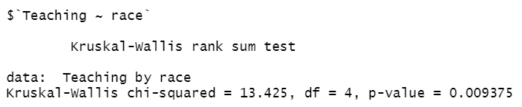
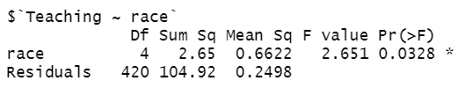
One-way ANOVA:
(2 statistically significant variables)
step_1, teaching
Kruskal-wallis:
(2 statistically significant variables)
step_1, teaching

Slide 18
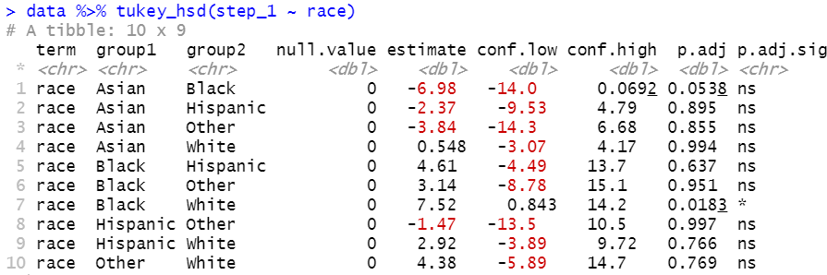
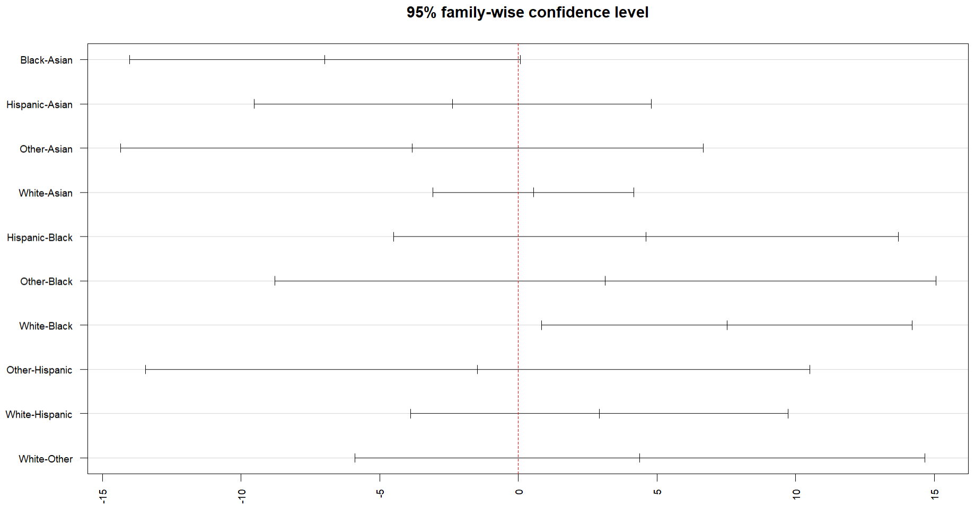
post hoc test:
step_1

Slide 19
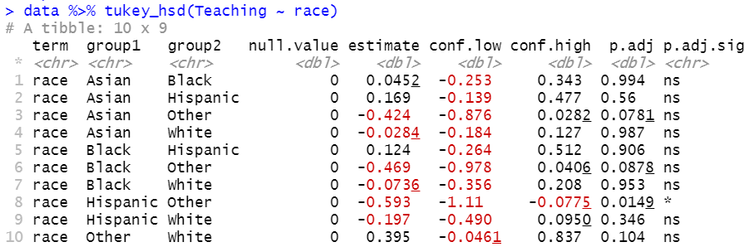
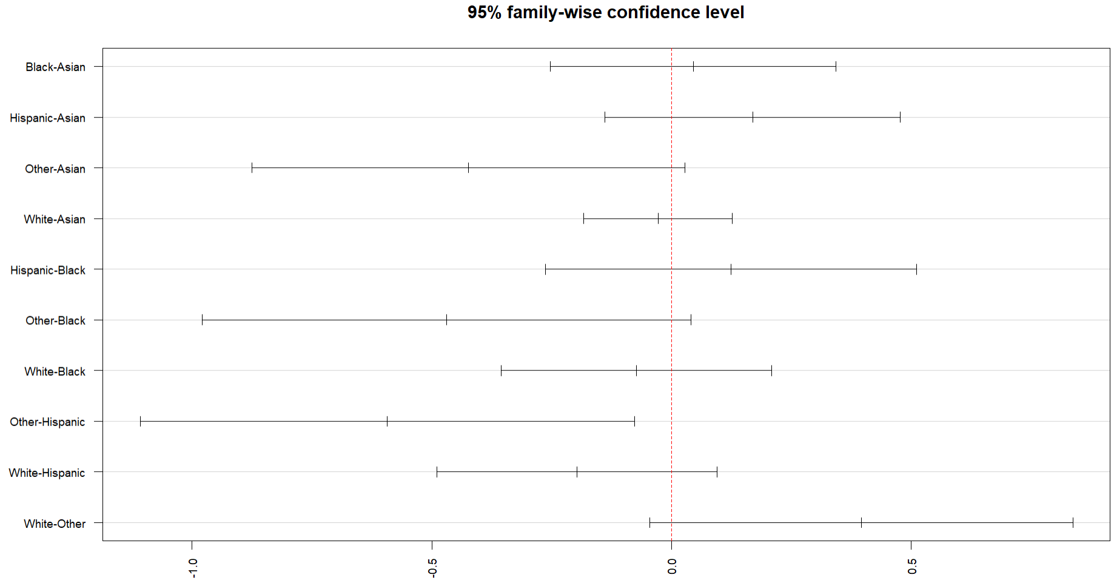
post hoc test:
teaching

