Slide 1
ERAS Linguistics Statistical Analyses
UNC ENT Research Group
Drs. Kimple & Senior
Garrett Berk & Tiffany Ho
tiffany.d.ho@gmail.com
February 2022

Slide 2
Overview
Correct multiple testing using
Bonferroni → FWER
Benjamini-Hochberg → FDR
Statistical tests: t-test vs Mann-Witney U test
Assumptions made by parametric tests (e.g. t-test)
Normality
Equal variances
No outliers
Non-parametric tests (e.g. Mann-Witney U) do not have such assumptions

Slide 3
Objective Variables (10) |  | Subjective Variables (11)
Objective measures from an individual’s application |  | Qualities characterized from PS and LOR using the linguistic algorithm
Step 1 score Step 2 score Peer Reviewed Journal Articles/Abstracts Peer Reviewed Journal Articles/Abstracts Book Chapter (Peer Reviewed) Poster Presentation Oral Presentation Online Publication (Peer Reviewed) Non Peer Reviewed Online Publication Other Articles | “step_1” “step_2” “peer_art_abs” “extra_art_abs” “book_chap” “poster” “oral” “online_pub_peer” “online_pub_non_peer” “other_art” | Standout Ability Grindstone Teaching Research Analytic Clout Authentic Tone Achieve Power
Note: For publication, need to justify why these variables were chosen among the 97 variables available.

Slide 4
Mann-Whitney U / t-tests with FDR correction
 | MWU/t-test: Significance by FDR | Sidedness
Combined Obj | Online_pub_non_peer | F > M
 | Step_1 | F < M
Combined LOR | Achieve | F > M
 | Authentic | F < M
 | Clout | F > M
 | Grindstone | F > M
2020-21 Obj | Online_pub_non_peer | F > M
 | Step_1 | F < M
2020-21 LOR | Authentic | F < M
 | Clout | F > M
2020-21 PS | Ability | F > M
 | Achieve | F > M
 | Tone | F > M
6 vars
7 vars

Slide 5
Two cycles combined
2020-21 & 2019-20

Slide 6
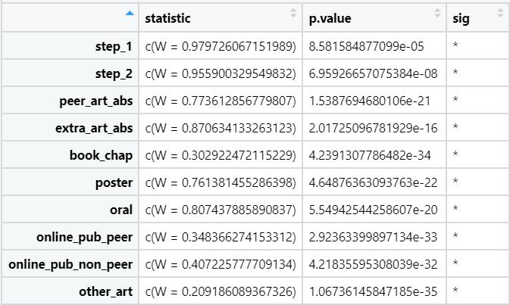
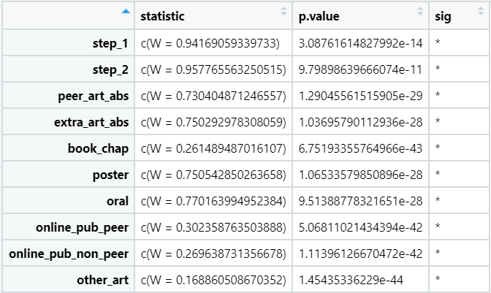
Normalcy Check
Shapiro test: p < 0.05 indicates absence of normality
None of the objective variables have normal distributions. Cannot use t-test.
Use the non-parametric equivalent of t-test: Mann-Whitney U test

Slide 7
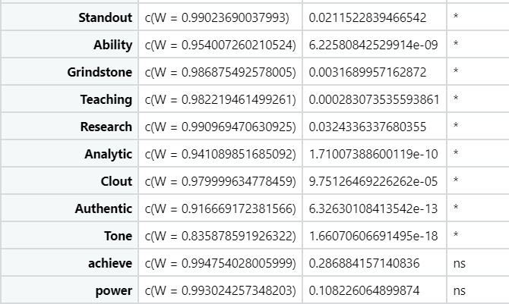
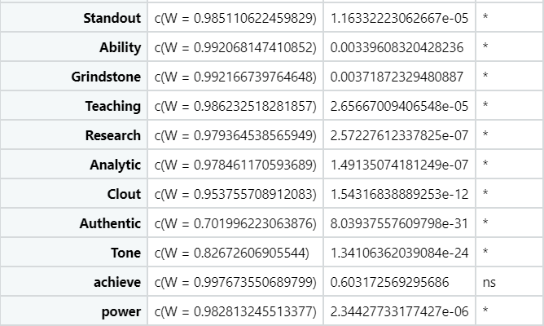
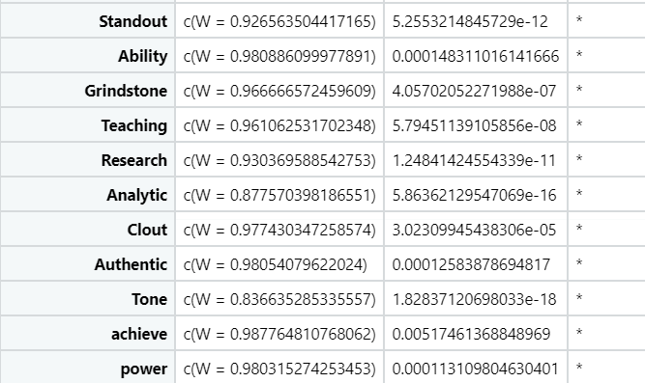
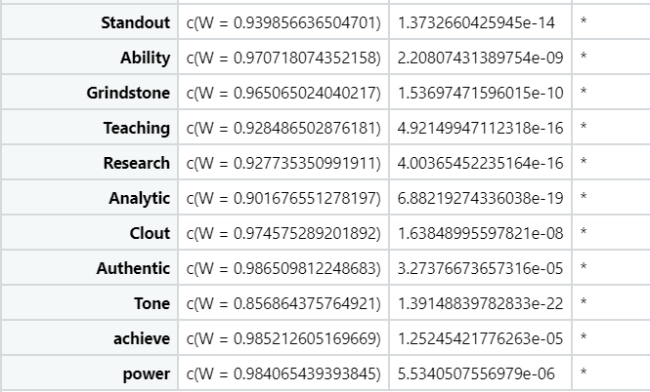
LOR
PS

Slide 8
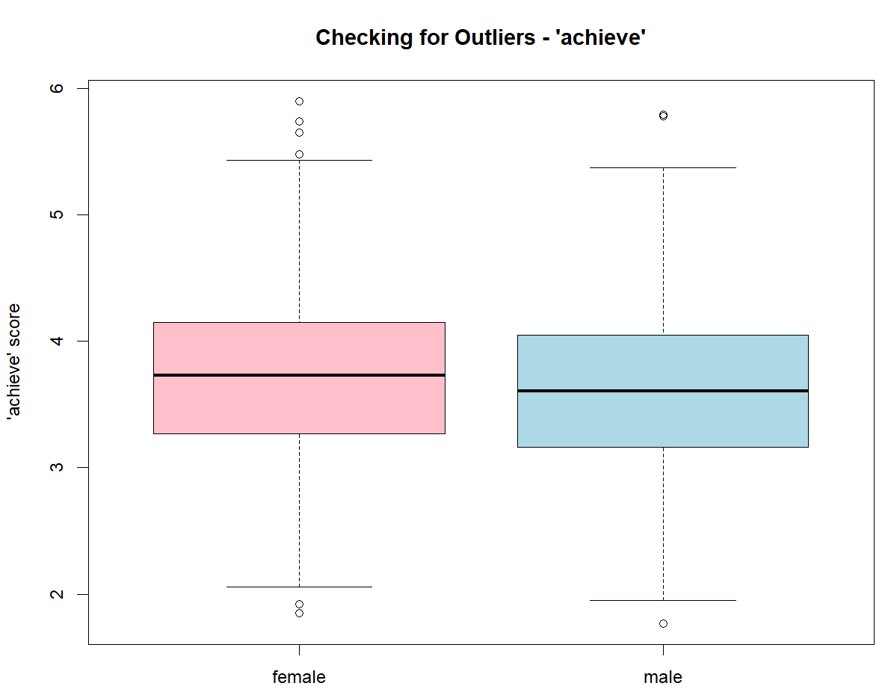
Combined LOR
Examine the reasons for the outliers
Outliers here most likely represent natural variation of the samples
Keep the outliers
Use non-parametric tests as they are robust to outliers
Mann–Whitney U

Slide 9
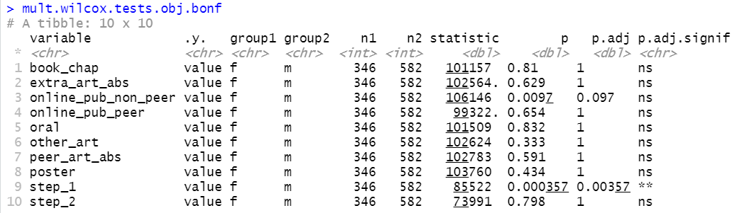
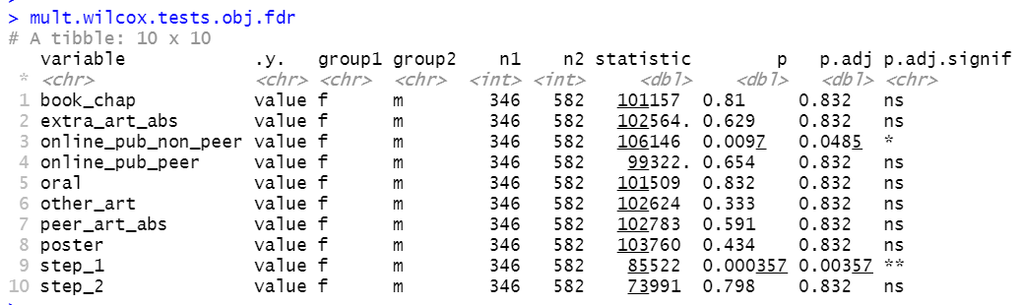
Combined Obj

Slide 10
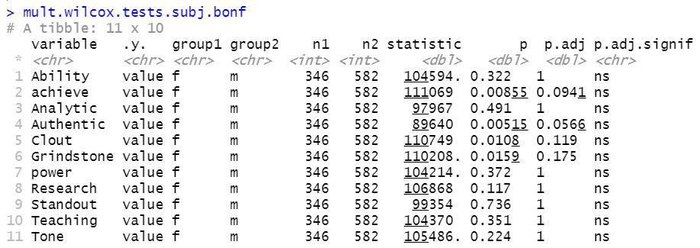
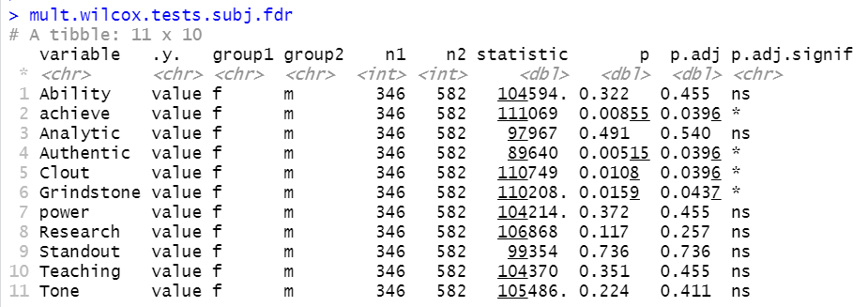
Combined LOR
Additional one-sided tests revealed:
Achieve: F > M
Authentic: F < M
Clout: F > M
Grindstone: F > M

Slide 11
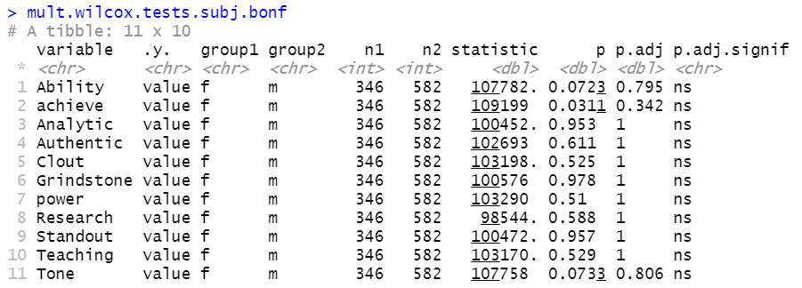
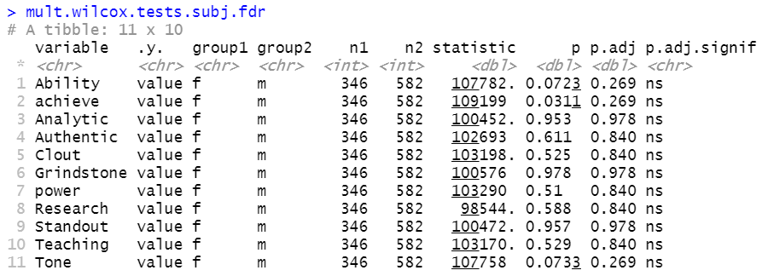
Combined PS

Slide 12
2020-21 Dataset
Subjective variables were characterized by the Linguistics algorithm from both LOR and PS

Slide 13
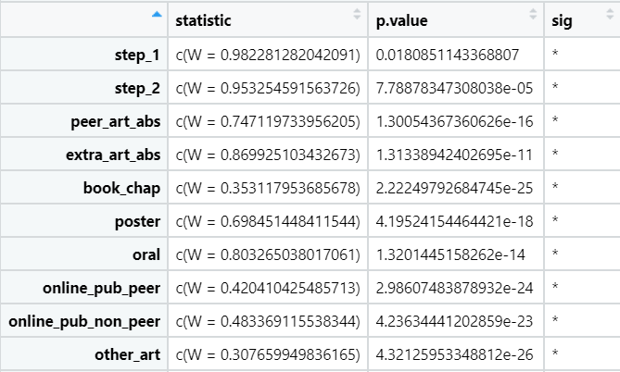
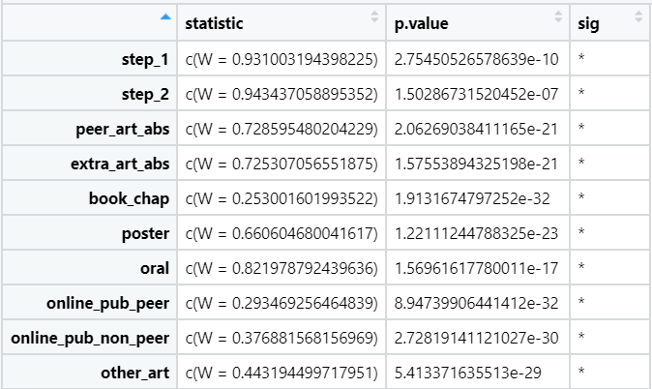
Normalcy Check
Shapiro test: p < 0.05 indicates absence of normality
female
male
None of the objective variables have normal distributions. Cannot use t-test.
Use the non-parametric equivalent of t-test: Mann-Whitney U test

Slide 14
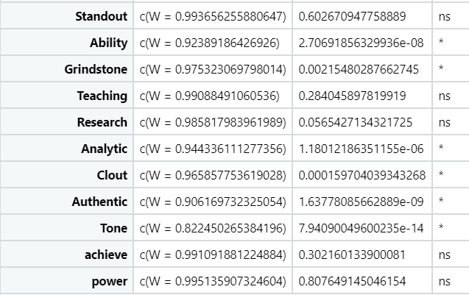
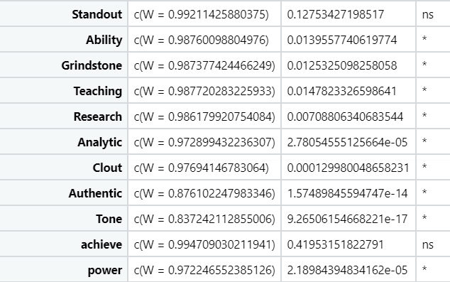
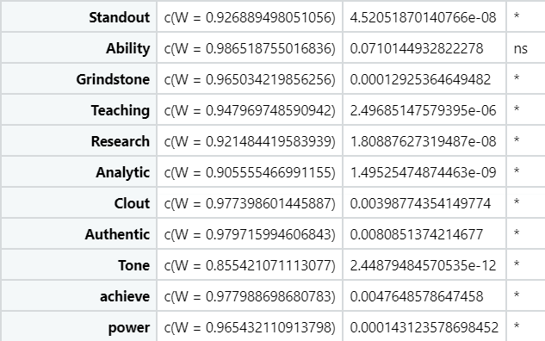
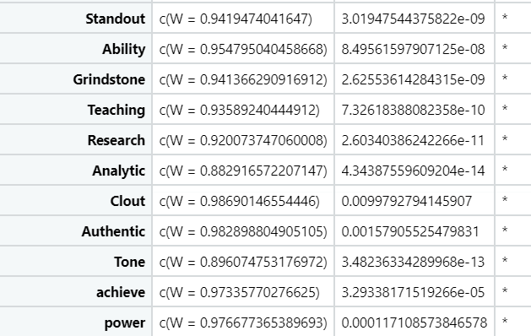
LOR
female
male
PS

Slide 15
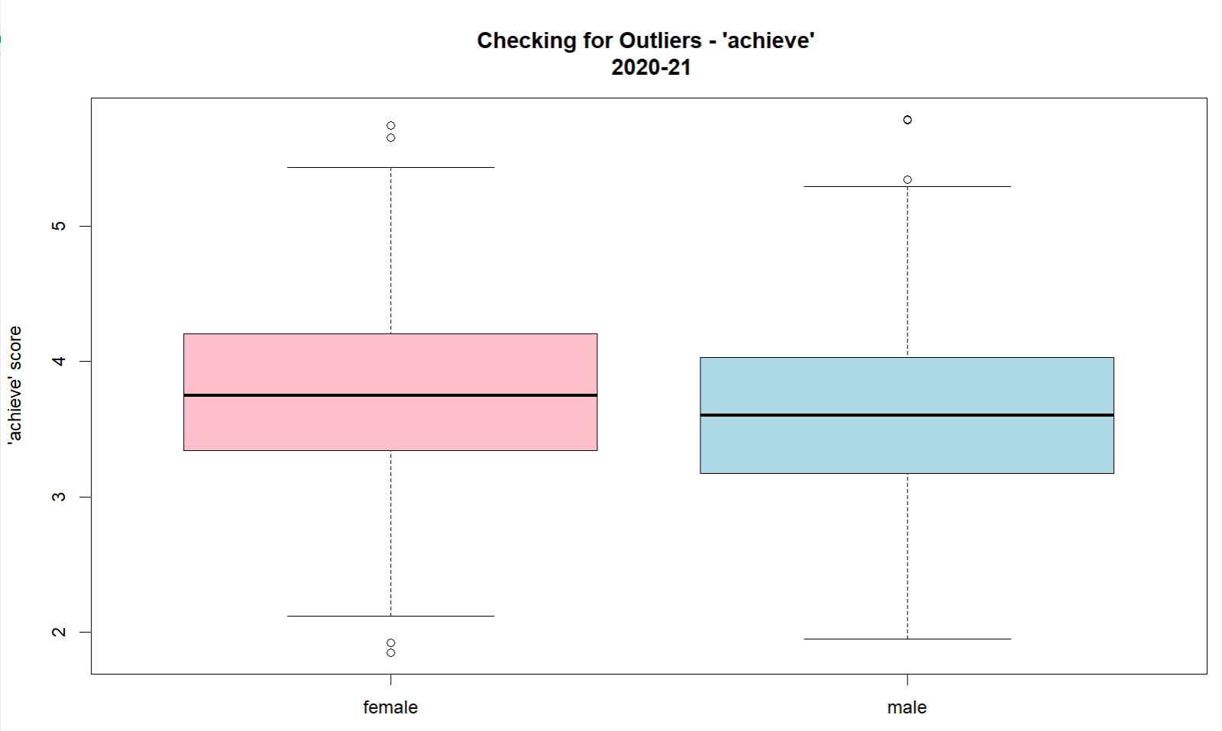
2020-21 LOR

Slide 16
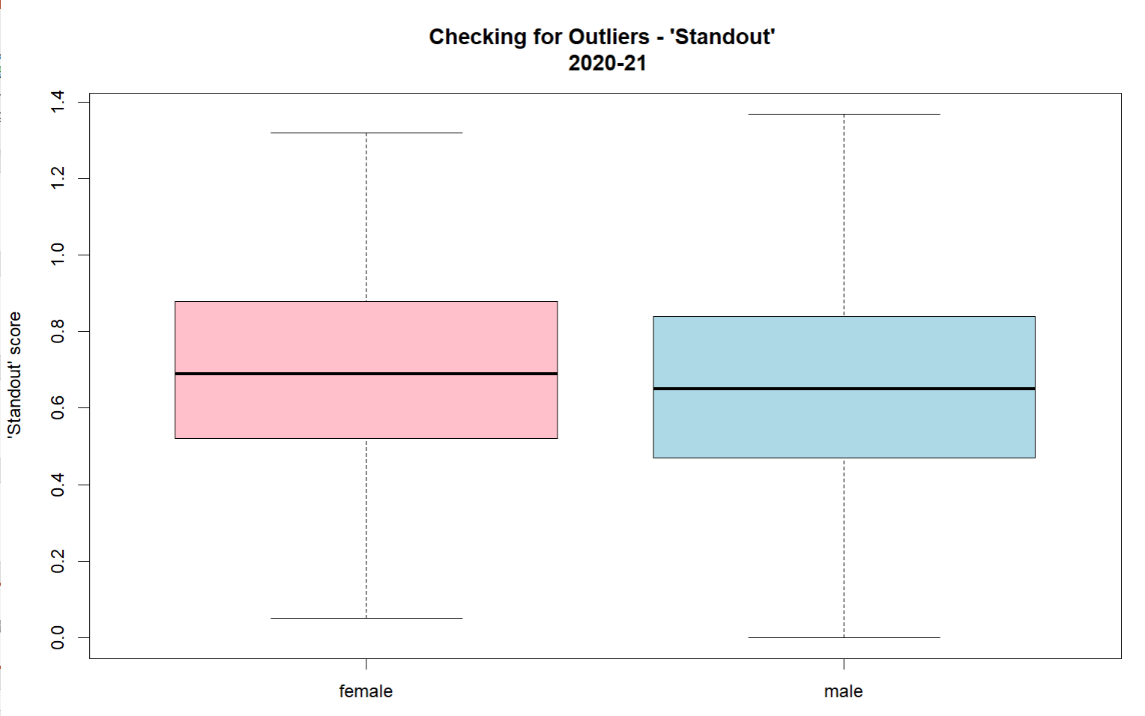
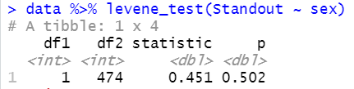
2020-21 LOR
Summary on LOR ‘Standout’
Assess normality
Shapiro test
p > 0.05: pop are normally distributed
No outliers
Assess equality of variances
Levene test
P > 0.05: population variances are equal
Use t-test for ‘Standout’ (Mann-Whitney U test for all others)

Slide 17

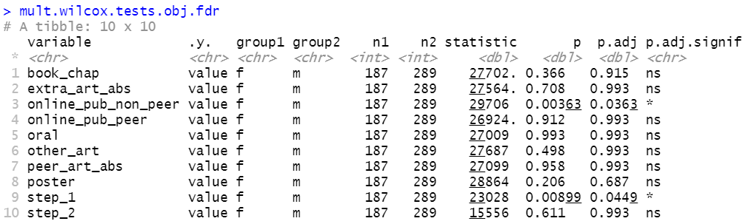
2020-21 Obj

Slide 18
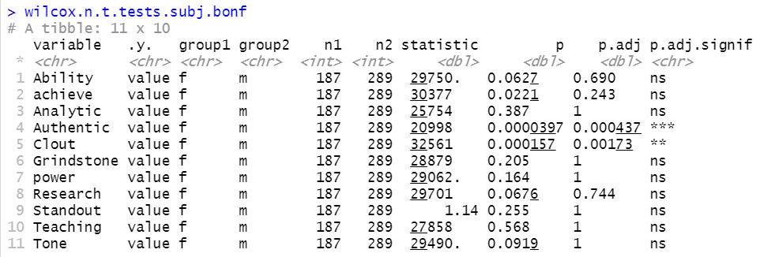
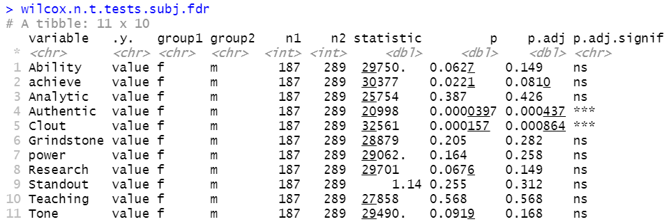
2020-21 LOR
t test for “Standout”

Slide 19
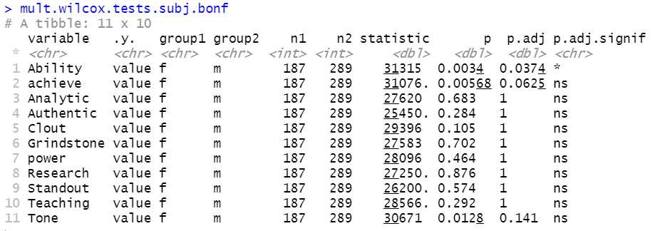
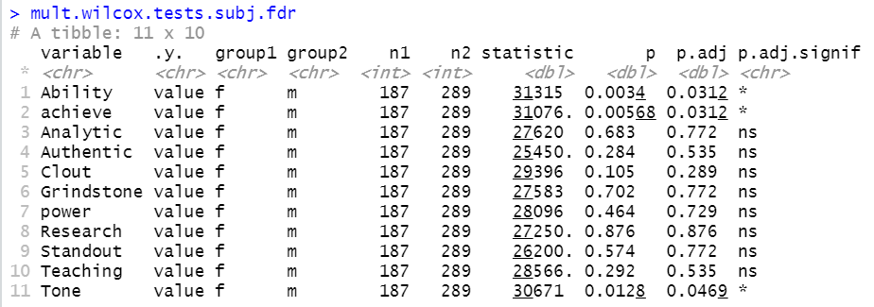
2020-21 PS

Slide 20
2019-2020 Dataset

Slide 21
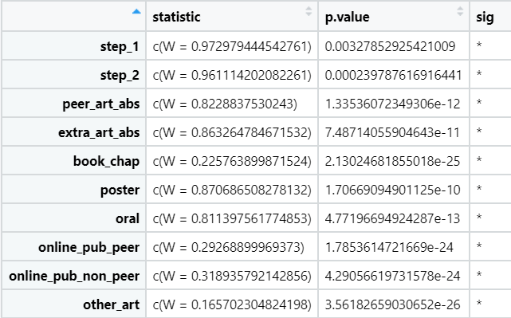
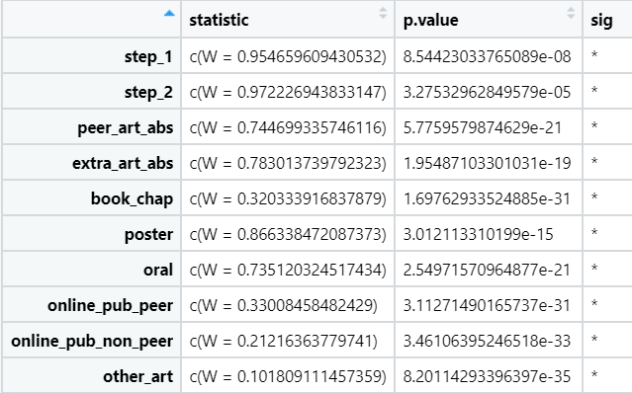
Normalcy Check
Shapiro test: p < 0.05 indicates absence of normality
female
male
None of the objective variables have normal distributions. Cannot use t-test.
Use the non-parametric equivalent of t-test: Mann-Whitney U test

Slide 22
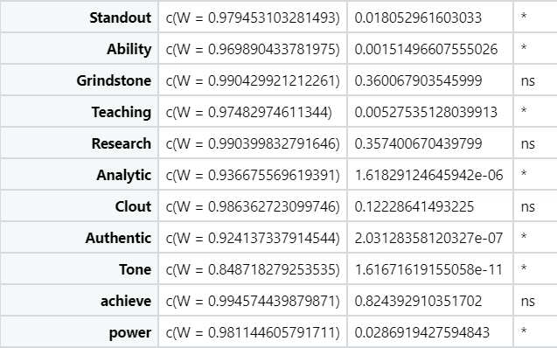
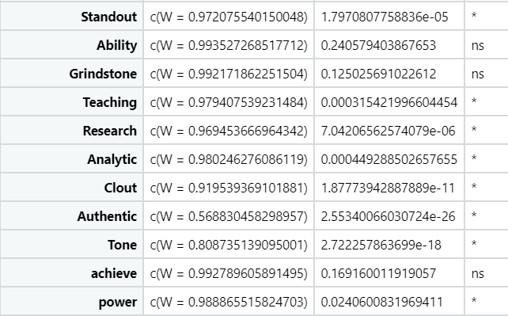
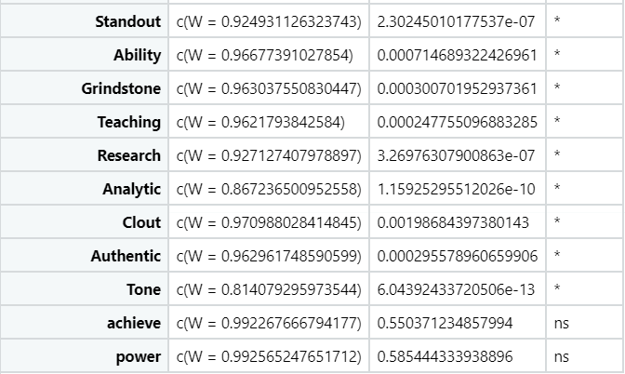
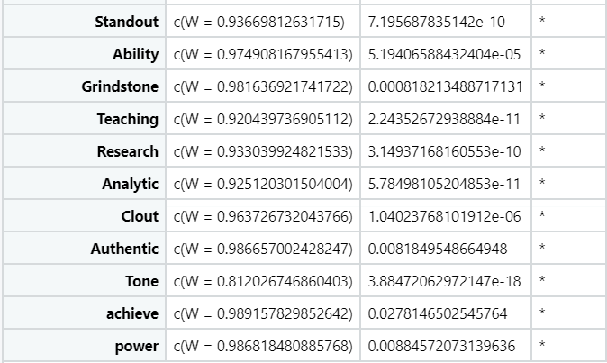
LOR
female
male
PS

Slide 23
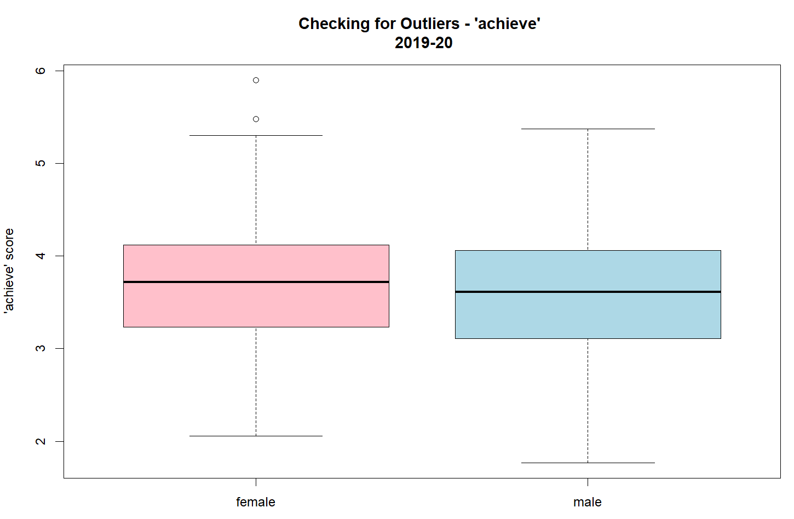
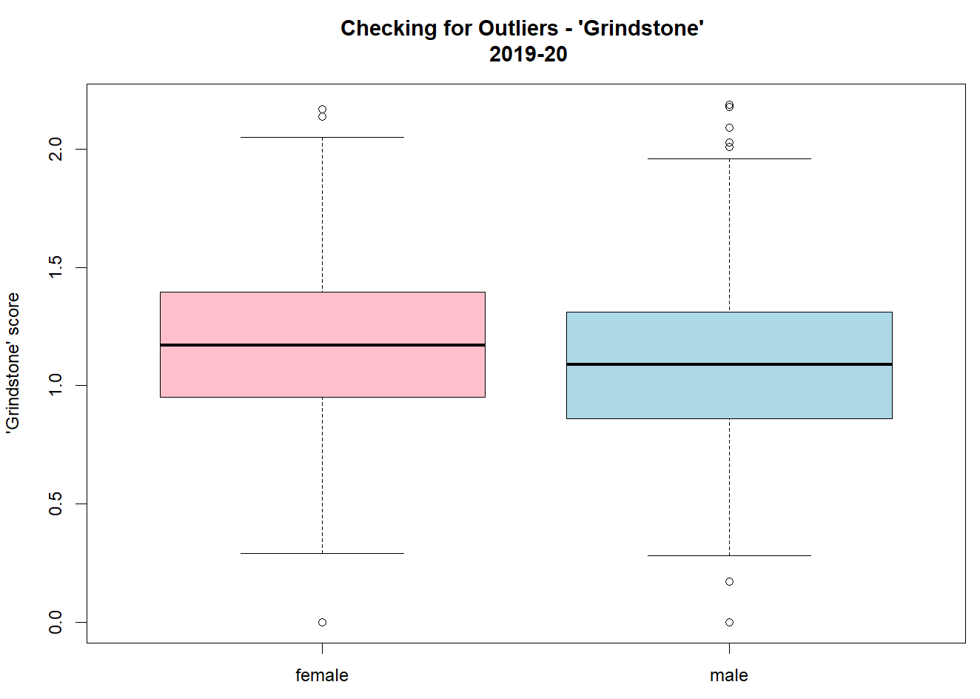
2019-20 LOR
Both ‘achieve’ and ‘Grindstone’ have outliers in both F and M groups.
Perform MWU test.

Slide 24
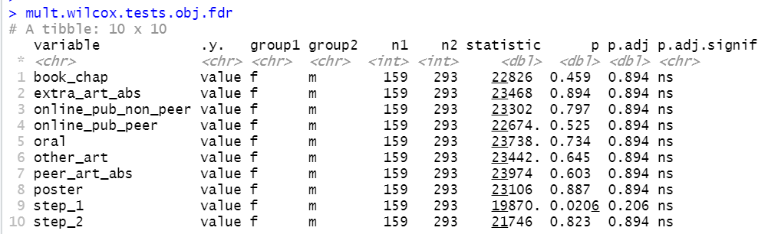
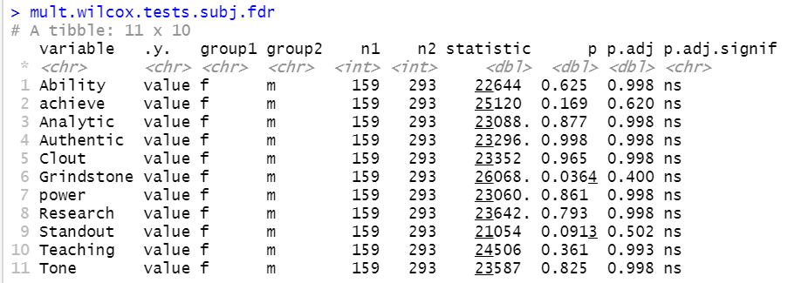
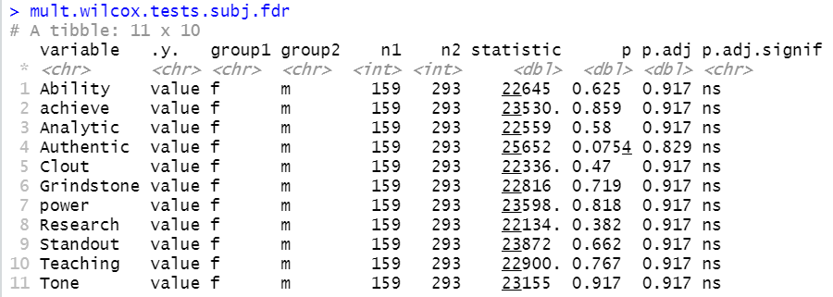
2019-20 data
no sig using FDR correction

Slide 25
 | Significance by FDR | Sidedness
Combined Obj | Online_pub_non_peer | F > M
 | Step_1 | F < M
Combined LOR | Achieve | F > M
 | Authentic | F < M
 | Clout | F > M
 | Grindstone | F > M
2020-21 Obj | Online_pub_non_peer | F > M
 | Step_1 | F < M
2020-21 LOR | Authentic | F < M
 | Clout | F > M
2020-21 PS | Ability | F > M
 | Achieve | F > M
 | Tone | F > M

Slide 26
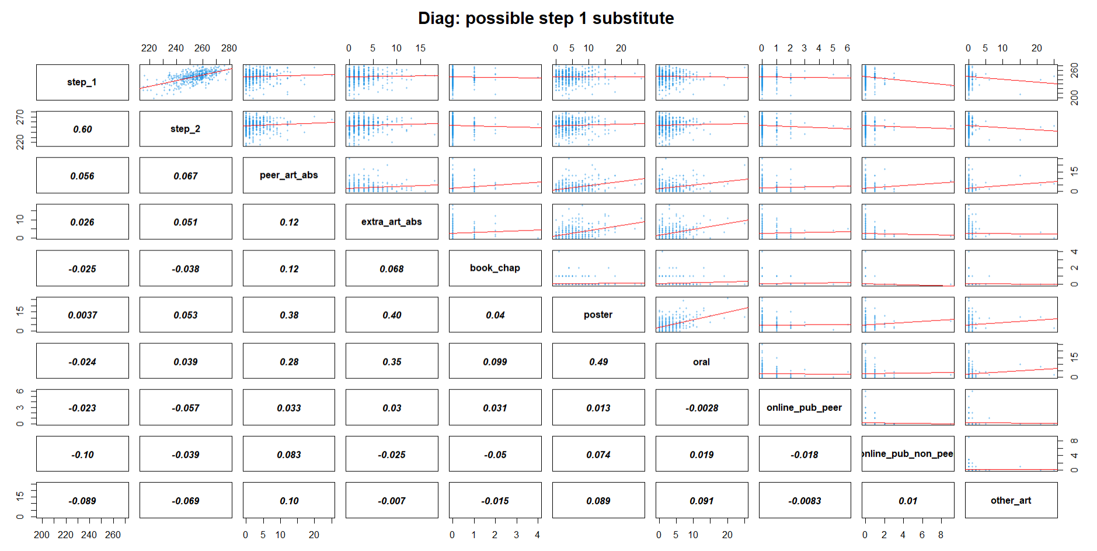
Task 2: substitute metric for Step 1 score?

Slide 27
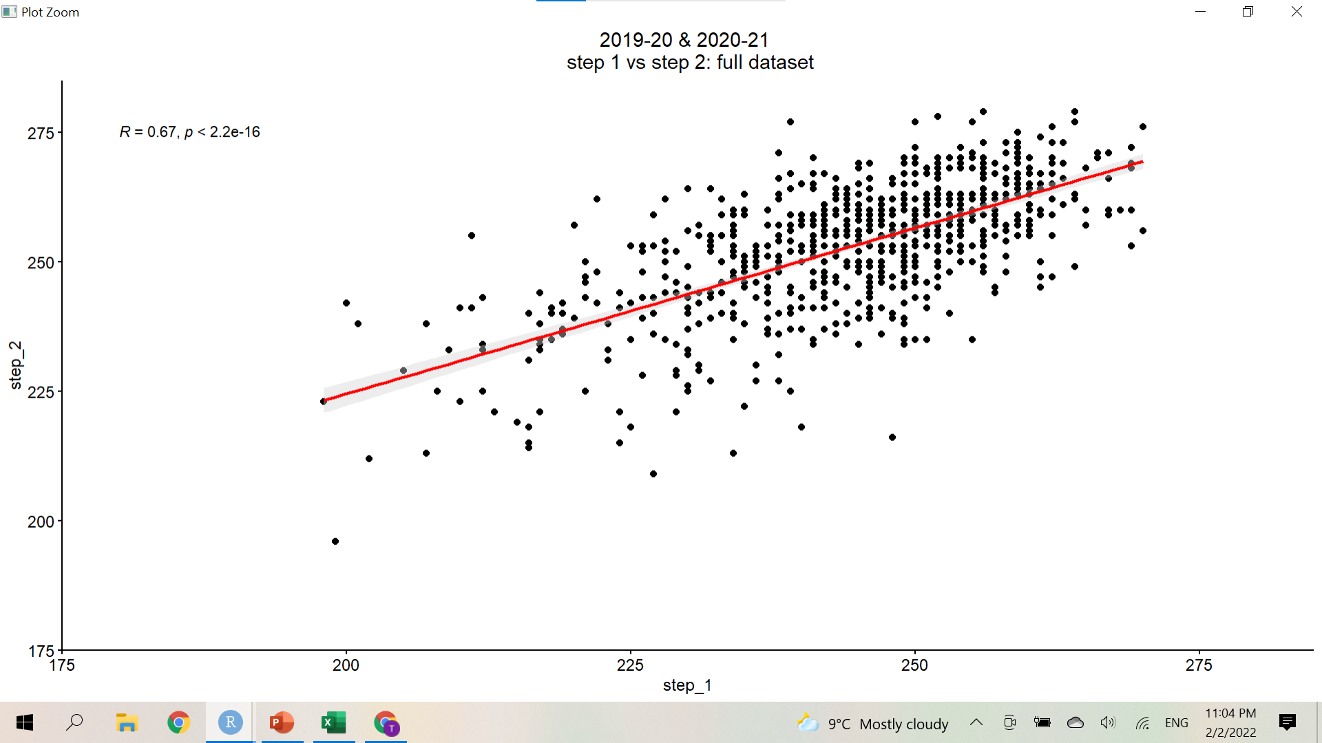

Slide 28
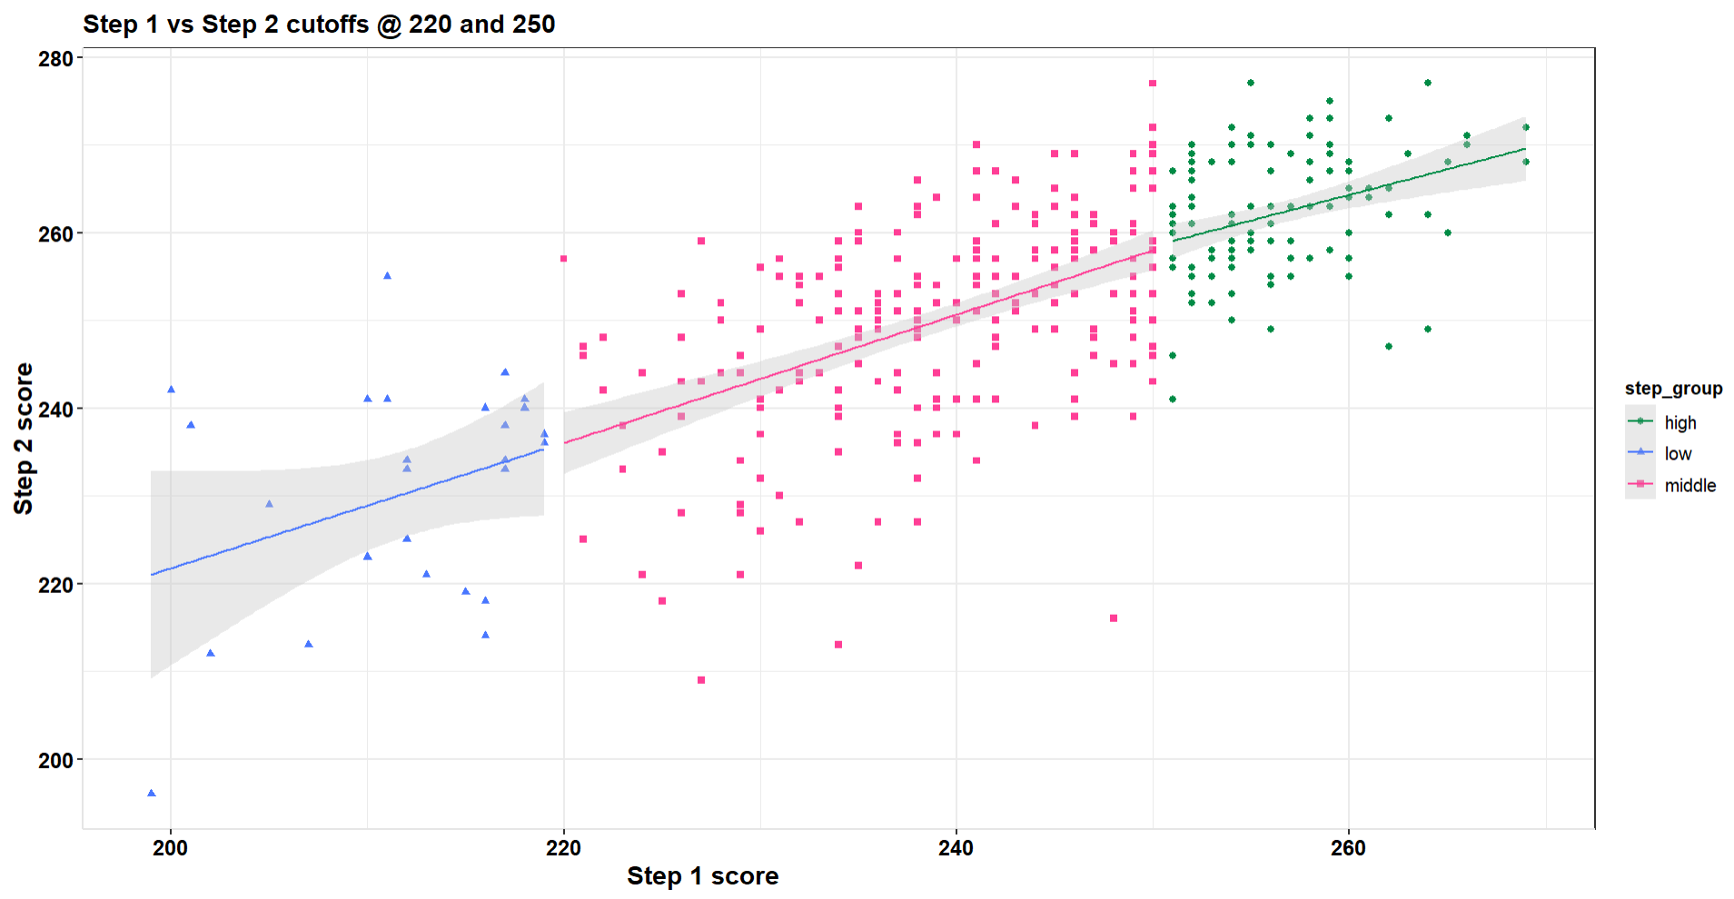

Slide 29
Detailed/Extra slides
On 2019-20 data

Slide 30
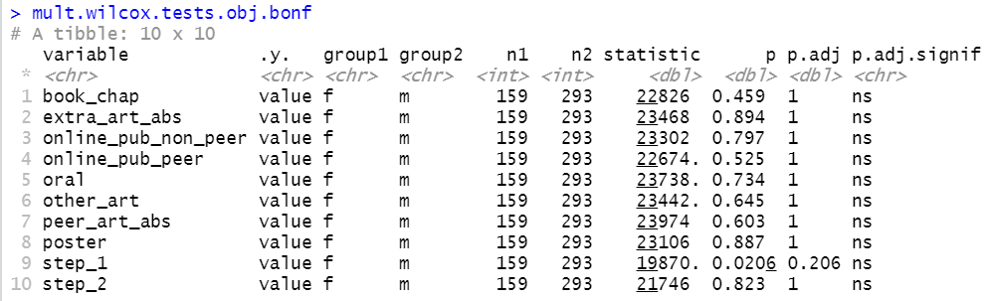
2019-20 Obj

Slide 31
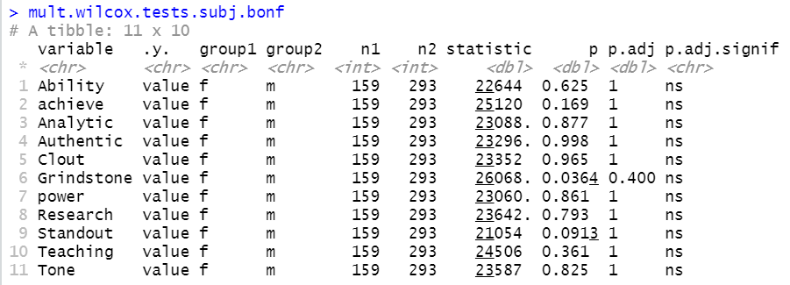
2019-20 LOR

Slide 32
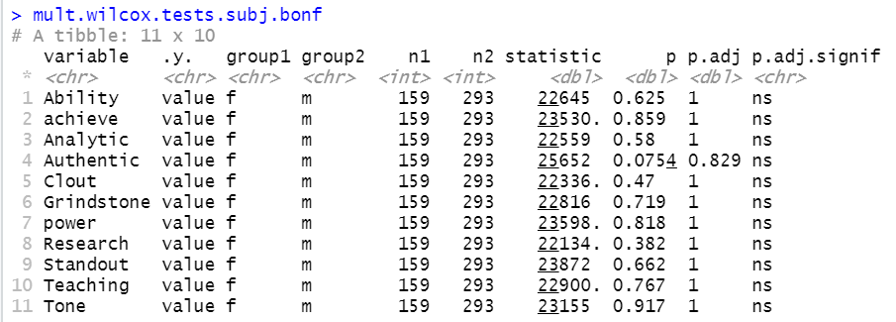
2019-20 PS

