Slide 1
ERAS Linguistics Statistical Analyses
2/2/22

Slide 2
Task 1: Check whether the t tests were done correctly.
Yes, but can be improved in two ways.
Correct for multiple testing
Bonferroni vs Benjamini-Hochberg
Take correlation among predictor variables into account
Regression with FDR

Slide 3
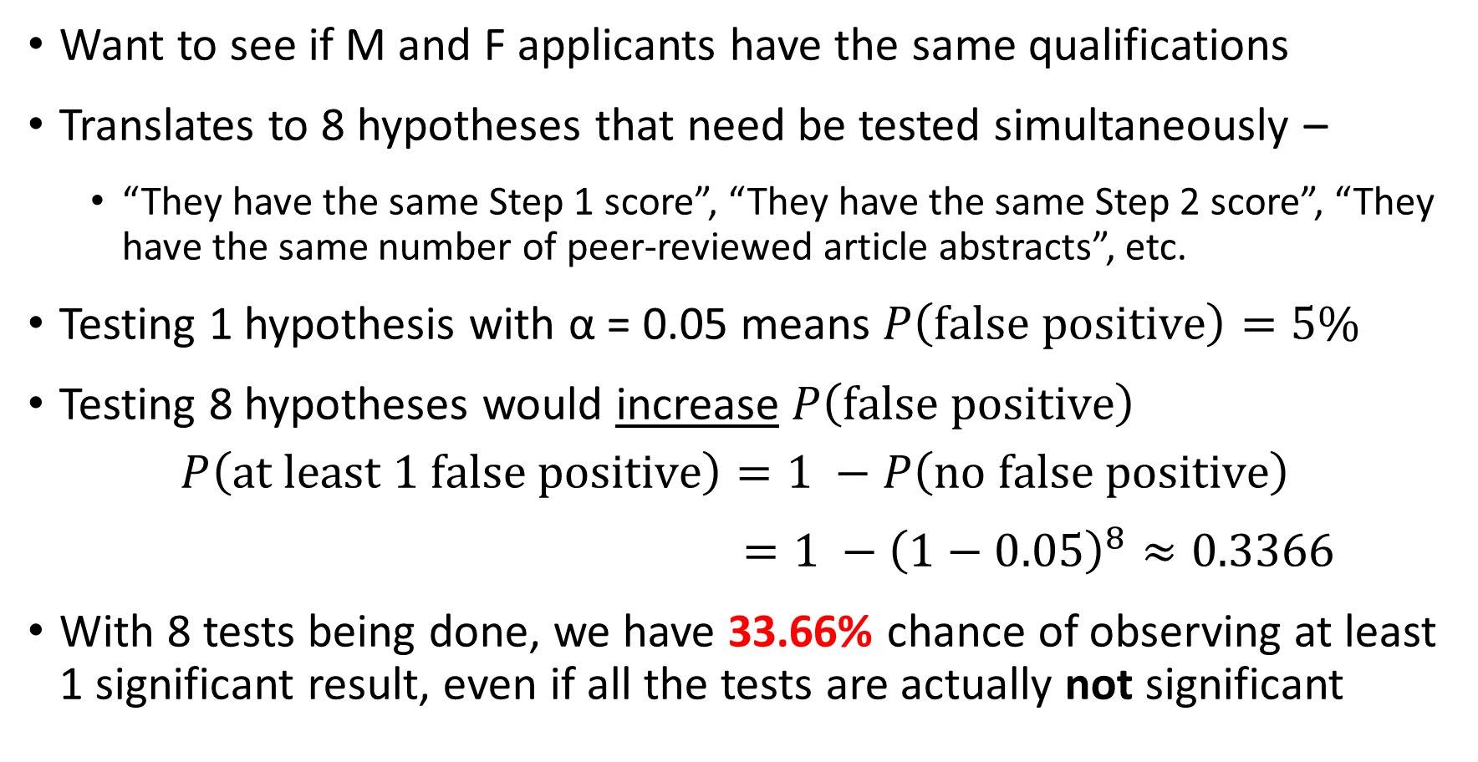
Why correct for multiple testing?
Want to see if M and F applicants have the same qualifications
Translates to 8 hypotheses that need be tested simultaneously –
“They have the same Step 1 score”, “They have the same Step 2 score”, “They have the same number of peer-reviewed article abstracts”, etc.
Testing 1 hypothesis with α = 0.05 means $P\left(false positive\right)=5\%$
Testing 8 hypotheses would increase $P\left(false positive\right)$
$$P\left(at least 1 false positive\right)=1 −P\left(no false positive\right)$$
$=1 −{\left(1−0.05\right)}^{8}≈0.3366$
With 8 tests being done, we have 33.66% chance of observing at least 1 significant result, even if all the tests are actually not significant

Slide 4
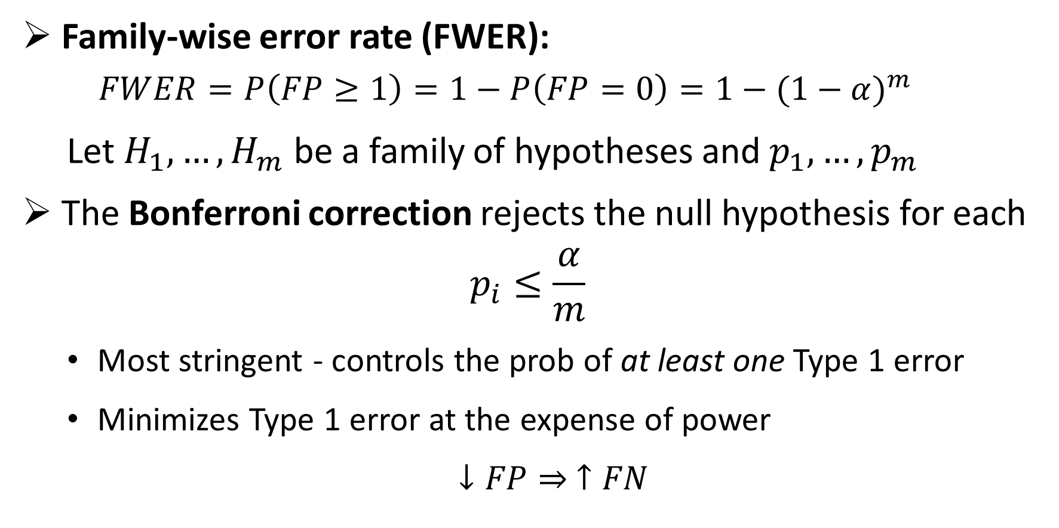

Approach 1: Bonferroni to control for FWER
Family-wise error rate (FWER):
$$FWER=P\left(FP≥1\right)=1−P\left(FP=0\right)=1−{(1−α)}^{m}$$
Let $H_{1}, …,H_{m}$ be a family of hypotheses and $p_{1}, …,p_{m}$
The Bonferroni correction rejects the null hypothesis for each
$$p_{i}≤\frac{α}{m}$$
Most stringent - controls the prob of at least one Type 1 error
Minimizes Type 1 error at the expense of power
$↓FP⇒ ↑FN$
$$\frac{0.05}{8}=0.00625$$
Notes:
The FWER is the probability of making at least one type I error in the family
by assuring FWER <= alpha, the probability of making one or more type I errors in the family is controlled at level alpha
The Bonferroni correction rejects the null hypothesis for each {\displaystyle p_{i}\leq {\frac {\alpha }{m}}}, thereby controlling the FWER at {\displaystyle \leq \alpha }.
FN = Type 2 error; power = 1 – FN = TP
FP = Type 1 error; 1 – FP = TN
0.05 / 8 = 0.00625 = 0.625%

Slide 5
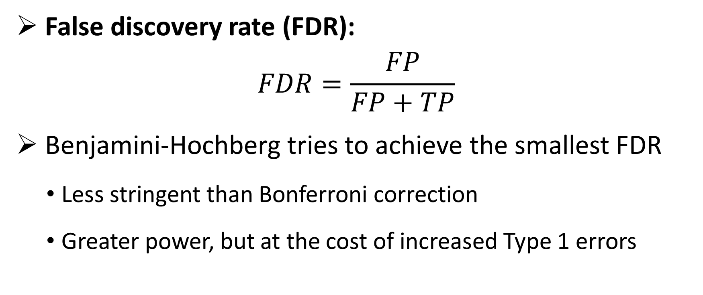
Approach 2: Benjamini-Hochberg to control for FDR
False discovery rate (FDR):
$$FDR=\frac{FP}{FP+TP}$$
Benjamini-Hochberg tries to achieve the smallest FDR
Less stringent than Bonferroni correction
Greater power, but at the cost of increased Type 1 errors
Notes:
BH assumptions: all the null p values are independent from each other AND independent from all the non-null p values.
Bonferroni doesn’t make the same assumptions, more robust/safe
- Our variables are not independent, so we should use Bonferroni
The idea of the FDR is to try to achieve the smallest possible fraction of false signals among all those that appear to be true.
Power is the probability of avoiding a Type II error.

Slide 6
Objective Variables (10) |  | Subjective Variables (11)
Objective measures from an individual’s application |  | Qualities characterized from PS and LOR using the linguistic algorithm
Step 1 score Step 2 score Peer Reviewed Journal Articles/Abstracts Peer Reviewed Journal Articles/Abstracts Book Chapter (Peer Reviewed) Poster Presentation Oral Presentation Online Publication (Peer Reviewed) Non Peer Reviewed Online Publication Other Articles | “step_1” “step_2” “peer_art_abs” “extra_art_abs” “book_chap” “poster” “oral” “online_pub_peer” “online_pub_non_peer” “other_art” | Standout Ability Grindstone Teaching Research Analytic Clout Authentic Tone Achieve Power
Note: For publication, need to justify why these variables were chosen among the 97 variables available.
Notes:
In statistics, it’s usually assumed that there’s a set of variables that we are interested in. Once we determine that, we do multiple hypotheses and control FDR rate. The variables to test should be pre-determined BEFORE statistical analyses and shouldn’t be adjusted based on some pre-liminary tests.

Slide 7
2020-21 Dataset
Subjective variables were characterized by the Linguistics algorithm from both LOR and PS

Slide 8
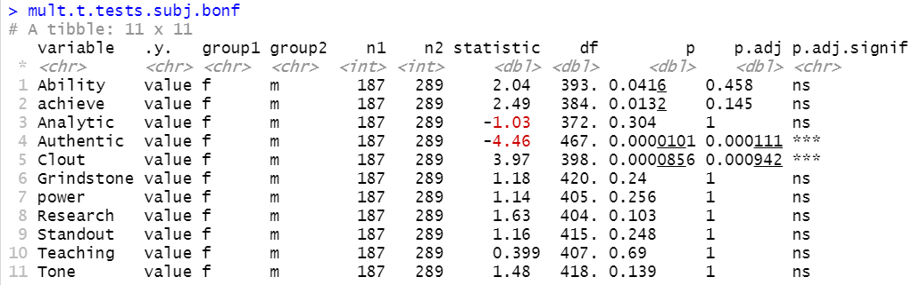
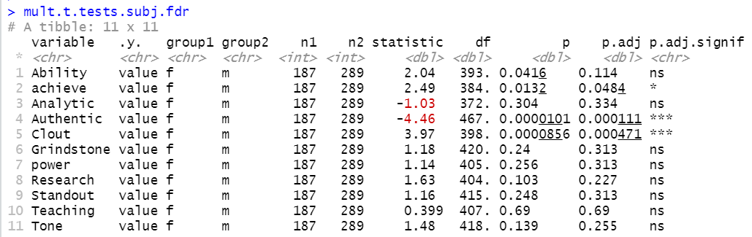
2020-21 Subjective - LOR
Subjective Vars in LOR w/ Multiple Testing Corrections
Group 1 female (n1 = 187)
Group 2 male (n2 = 289)
Notes
Bonferroni and FDR give different results on “achieve.”
I recommend reporting FDR’s result.
Conclusion
With FDR correction, M and F applicants’ LOR differ in -
“achieve”: F > M
“Authentic”: F < M
“Clout”: F > M

Slide 9
Take correlation among predictor variables into account
We can reasonably assume that the predictor variables are correlated to some extent
Important to take correlation into account – regression model
Questions answered by the model
Does any X differ significantly between male and female? If so, which one(s)?
Brief summary of the operations done:
Perform repeated regressions
Calculate the FDR with Benjamini & Hochberg correction
Find which variables should be retained for or excluded from further multivariate analysis according to their corrected p values
Notes:
Why is it important to take correlation into account?
(TO DO)

Slide 10
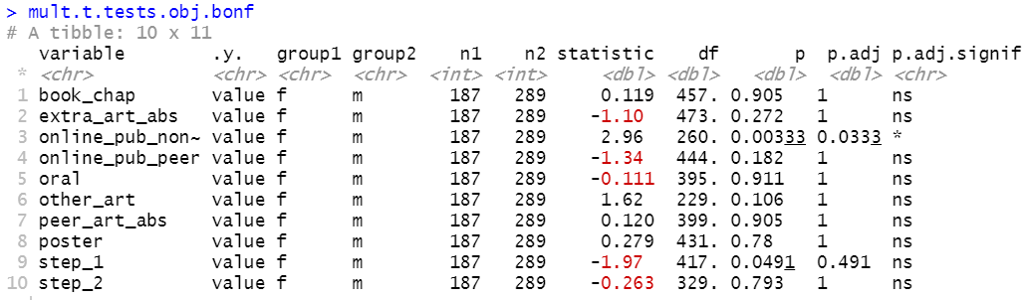
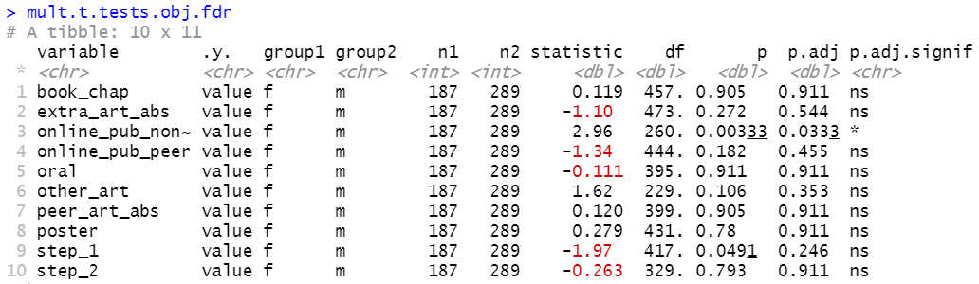
2020-21 Objective
Testing 10 Objective Variables
w/ Multiple Testing Corrections
Group 1 female (n1 = 187)
Group 2 male (n2 = 289)
Non-peer-reviewed online publication remains significantly different between male and female applicants even after multiple testing correction.
Step 1 score is no longer significant once we adjust for multiple testing.
The two methods arrive at the same conclusion:
Male and female applicants differ only in the number of non-peer reviewed online publication (F > M).
Notes:
T test assumes normal distribution →
TO DO: why FDR over Bonferroni
Data visualization: https://www.datanovia.com/en/blog/how-to-perform-t-test-for-multiple-groups-in-r/

Slide 11
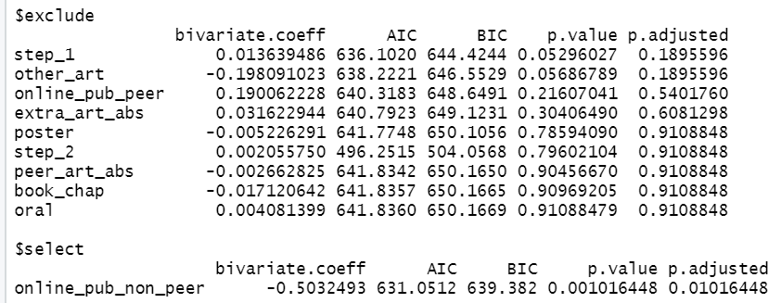
2020-21 Objective
Logistic Regression on 10 Objective Variables Adjusted with FDR Correction
1 variable was selected and 9 were excluded from the model
Conclusion: While holding all other variables constant, M and F applicants differ in non-peer-reviewed online publication. This is the same conclusion as those arrived by the previous multiple testing approaches. The agreement increases our confidence in the conclusion.
Notes:
Logistic regression: compare one variable against all the others (e.g. holding all the other ones constant) → doesn’t make a lot of sense to do this here
The Bayesian information criterion (BIC) is a criterion for model selection among a finite set of models; models with lower BIC are generally preferred. It is based, in part, on the likelihood function and it is closely related to the Akaike information criterion (AIC).
When fitting models, it is possible to increase the likelihood by adding parameters, but doing so may result in overfitting. Both BIC and AIC attempt to resolve this problem by introducing a penalty term for the number of parameters in the model; the penalty term is larger in BIC than in AIC.

Slide 12
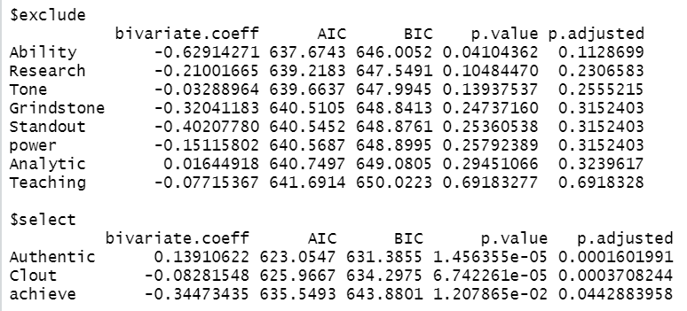
2020-21 Subjective - LOR
Logistic Regression on 11 Subjective Variables
Adjusted with FDR Correction
3 variables were selected and 8 were excluded from the model
The regression model shows male and female applicants’ LORs differ in Authentic, Clout, and achieve.
Notes:
This is the same conclusion as those arrived by FDR multiple testing approach. The agreement increases our confidence in the conclusion.

Slide 13
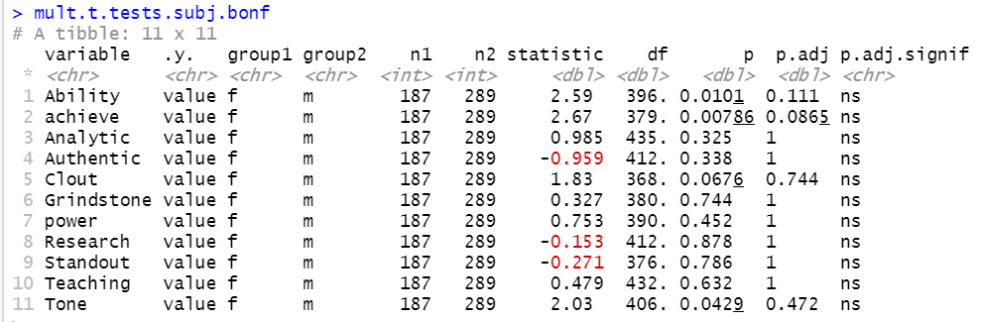
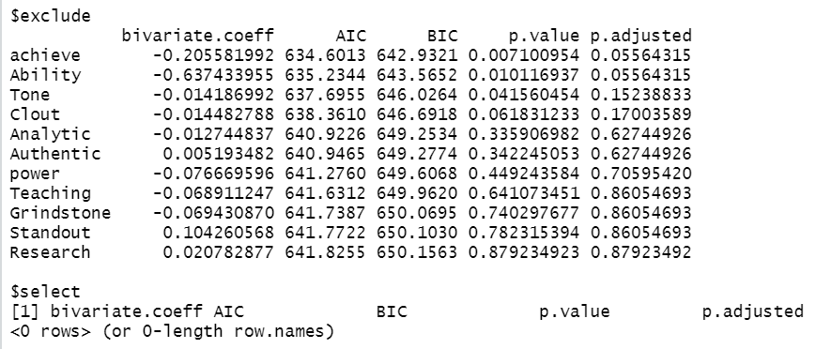
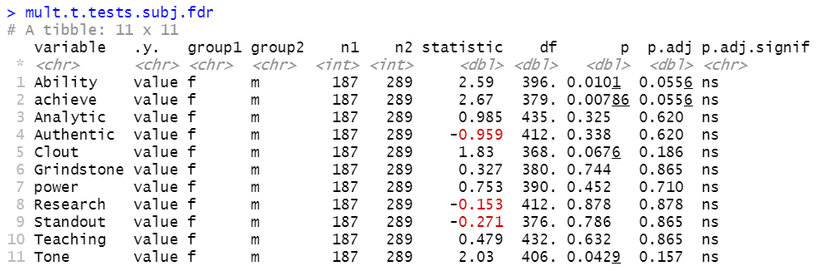
2020-21 Subj - PS

Slide 14
2019-2020 Dataset

Slide 15
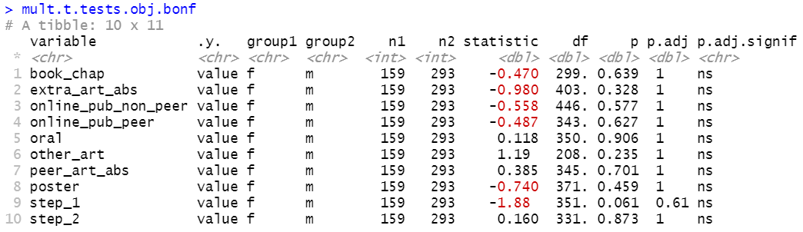
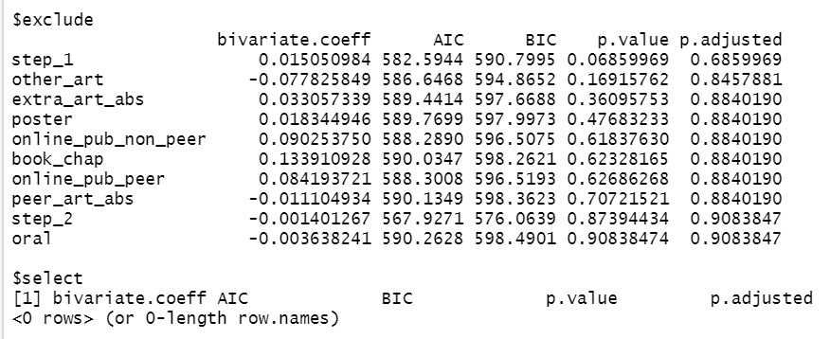
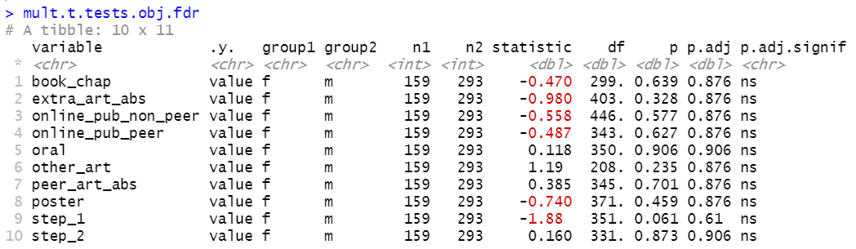
2019-20 Objective
Group 1 female (n1 = 159)
Group 2 male (n2 = 293)

Slide 16
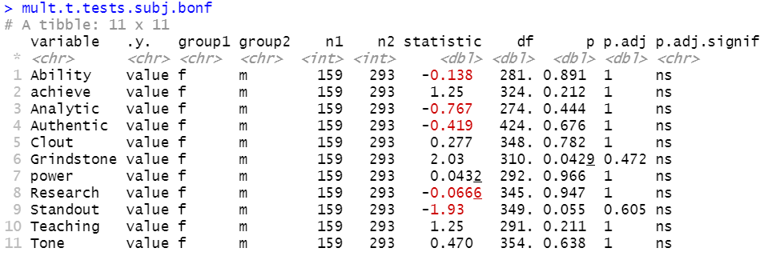
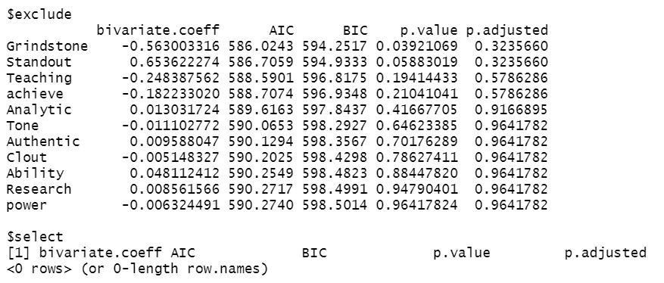
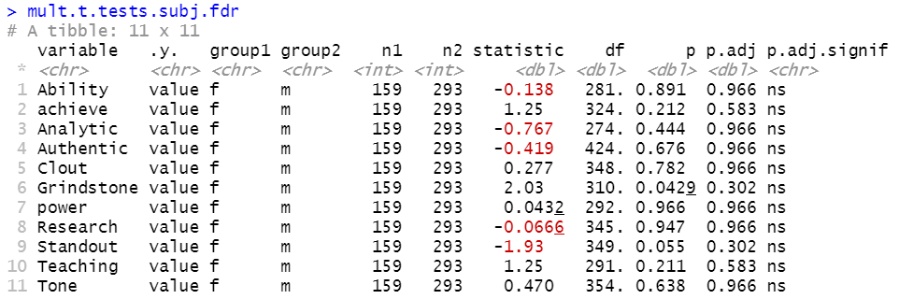
2019-20 Subj - LOR

Slide 17
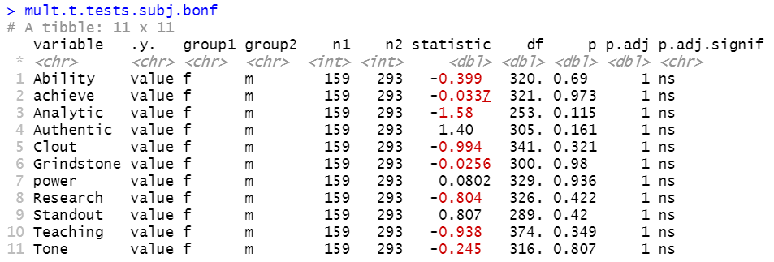
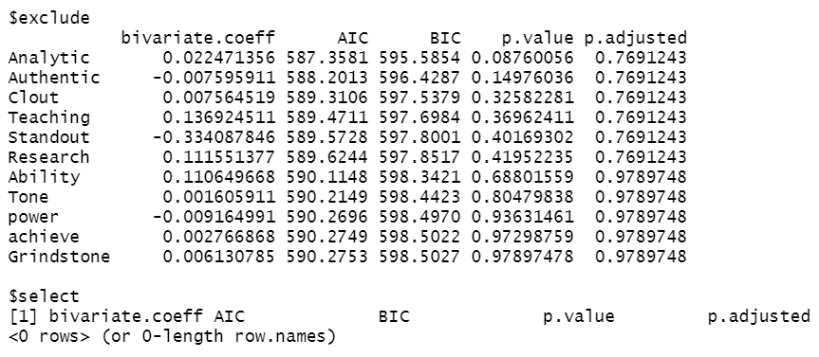
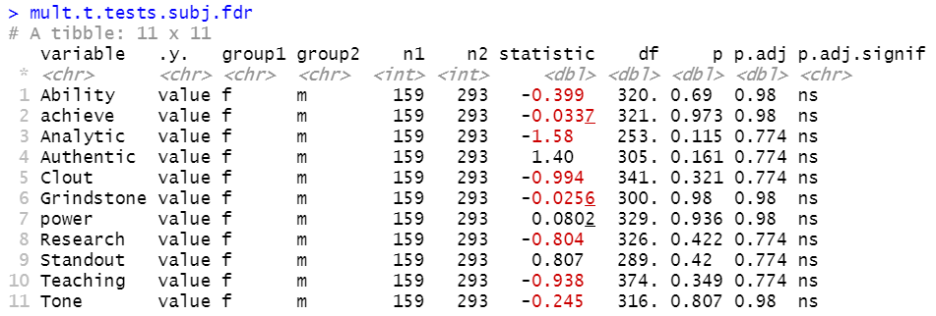
2019-20 Subj - PS

Slide 18
 | Variable found sig different between M and F [not significant] | p | p.adj.bon | p.adj.fdr | p.regress.adj.fdr
2020-21 Obj | Online_pub_non_peer, F > M | 0.00333 | 0.0333 | 0.0333 | 0.01016448
 | [Step_1] | 0.0491 | [0.491] | [0.246] | [0.1895596]
2020-21 Subj - LOR | Authenticity, F < M | 0.0000101 | 0.0000909 | 0.0000909 | 0.0001601991
 | Clout, F > M | 0.0000856 | 0.000770 | 0.000385 | 0.0003708244
 | Achieve, F > M | 0.0132 | [0.145] | 0.0484 | 0.0442883958
 | [Ability] | 0.0416 | [0.458] | [0.114] | [0.1128699]
2020-21 Subj - PS | [Achieve] | 0.00786 | [0.0865] | [0.0556] | [0.05564315]
 | [Ability] | 0.0101 | [0.111] | [0.0556] | [0.05564315]
 | [Tone] | 0.0429 | [0.472] | [0.157] | [0.15238833]
2019-20 Obj | --- | --- | --- | --- | ---
2019-20 Subj - LOR | [Grindstone] | 0.0429 | [0.472] | [0.302] | [0.3235660]
2019-20 Subj - PS | --- | --- | --- | --- | ---
[Bracket]: non-sig.
Notes:
TO DO
Combine the years and do the analyses again

Slide 19
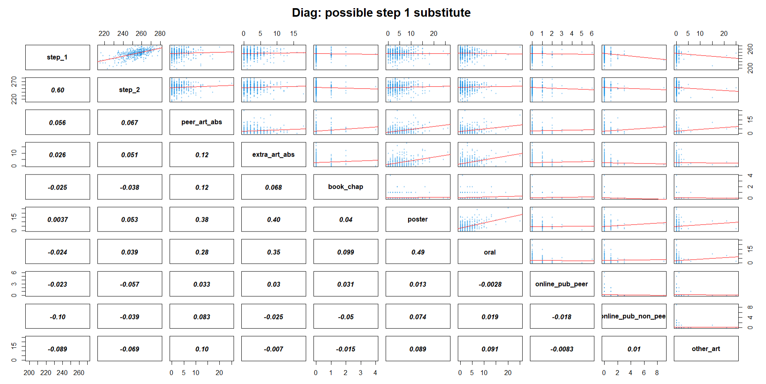
Task 2: substitute metric for Step 1 score?
Notes:
TO DO
Remove outliers in step scores
cutoffs: 190, 200, 210, 220,…, 240
Subset analysis

Slide 20
