Slide 1
ERAS Linguistics Statistical Analyses
2/16/22

Slide 2
Recap / Overview
Last time: Correct multiple testing using
Bonferroni → FWER
Benjamini-Hochberg → FDR
Amendment: instead of t-test, should use Mann-Witney U test
Assumptions typically made by parametric tests (e.g. t-test)
Normality
Equal variances
No outliers
Non-parametric tests (e.g. Mann-Witney U) do not have such assumptions

Slide 3
Objective Variables (10) |  | Subjective Variables (11)
Objective measures from an individual’s application |  | Qualities characterized from PS and LOR using the linguistic algorithm
Step 1 score Step 2 score Peer Reviewed Journal Articles/Abstracts Peer Reviewed Journal Articles/Abstracts Book Chapter (Peer Reviewed) Poster Presentation Oral Presentation Online Publication (Peer Reviewed) Non Peer Reviewed Online Publication Other Articles | “step_1” “step_2” “peer_art_abs” “extra_art_abs” “book_chap” “poster” “oral” “online_pub_peer” “online_pub_non_peer” “other_art” | Standout Ability Grindstone Teaching Research Analytic Clout Authentic Tone Achieve Power
Note: For publication, need to justify why these variables were chosen among the 97 variables available.
Notes:
In statistics, it’s usually assumed that there’s a set of variables that we are interested in. Once we determine that, we do multiple hypotheses and control FDR rate. The variables to test should be pre-determined BEFORE statistical analyses and shouldn’t be adjusted based on some pre-liminary tests.

Slide 4
Previously: t-tests w/ FDR correction
4 variables found to be significant in the 2020-21 cycle
None was significant in the 2019-20 cycle
 | t-test: Sig by FDR | sidedness
2020-21 Obj | Online_pub_non_peer | F > M
2020-21 Subj - LOR | Authenticity | F < M
 | Clout | F > M
 | Achieve | F > M

Slide 5
Mann-Whitney U / t-tests with FDR correction
 | MWU/t-test: Significance by FDR | Sidedness
Combined Obj | Online_pub_non_peer | F > M
 | Step_1 | F < M
Combined LOR | Achieve | F > M
 | Authentic | F < M
 | Clout | F > M
 | Grindstone | F > M
2020-21 Obj | Online_pub_non_peer | F > M
 | Step_1 | F < M
2020-21 LOR | Authentic | F < M
 | Clout | F > M
2020-21 PS | Ability | F > M
 | Achieve | F > M
 | Tone | F > M
6 vars
7 vars

Slide 6
Two cycles combined
2020-21 & 2019-20

Slide 7
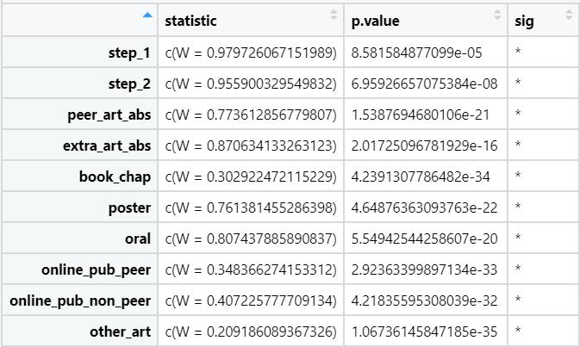
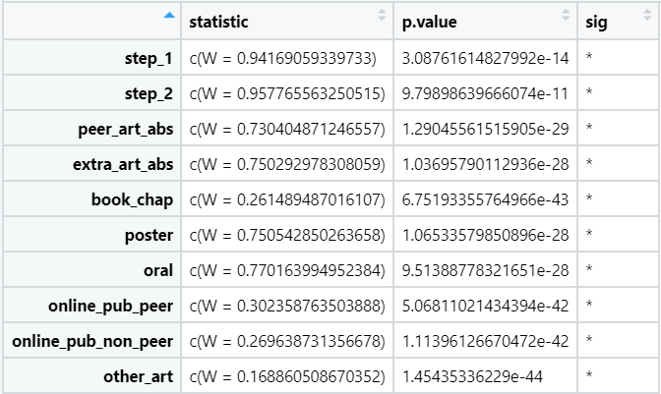
Normalcy Check
Shapiro test: p < 0.05 indicates absence of normality
None of the objective variables have normal distributions. Cannot use t-test.
Use the non-parametric equivalent of t-test: Mann-Whitney U test

Slide 8
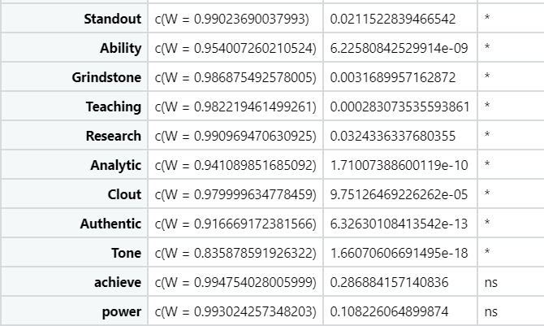
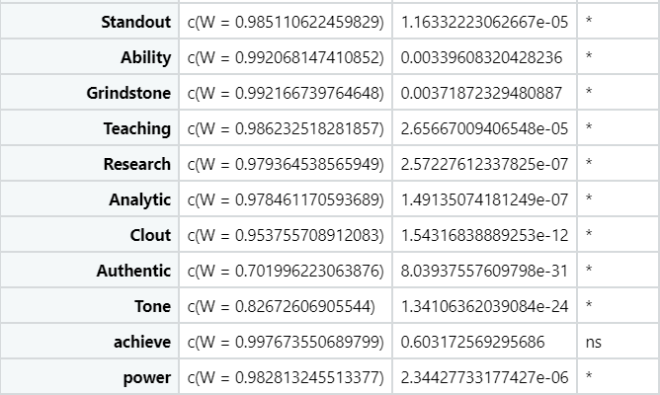
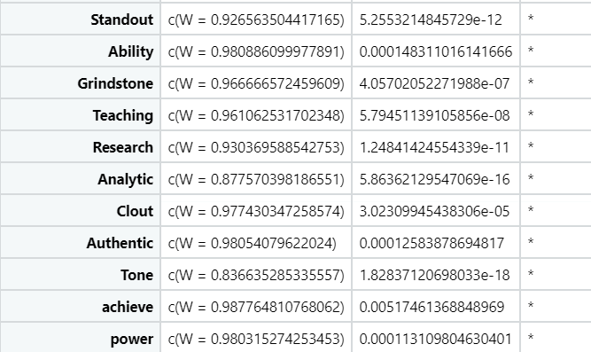
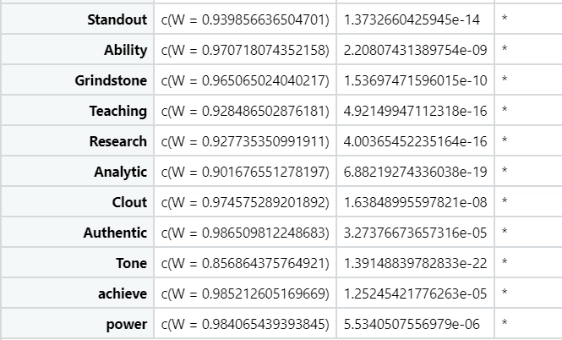
LOR
PS

Slide 9
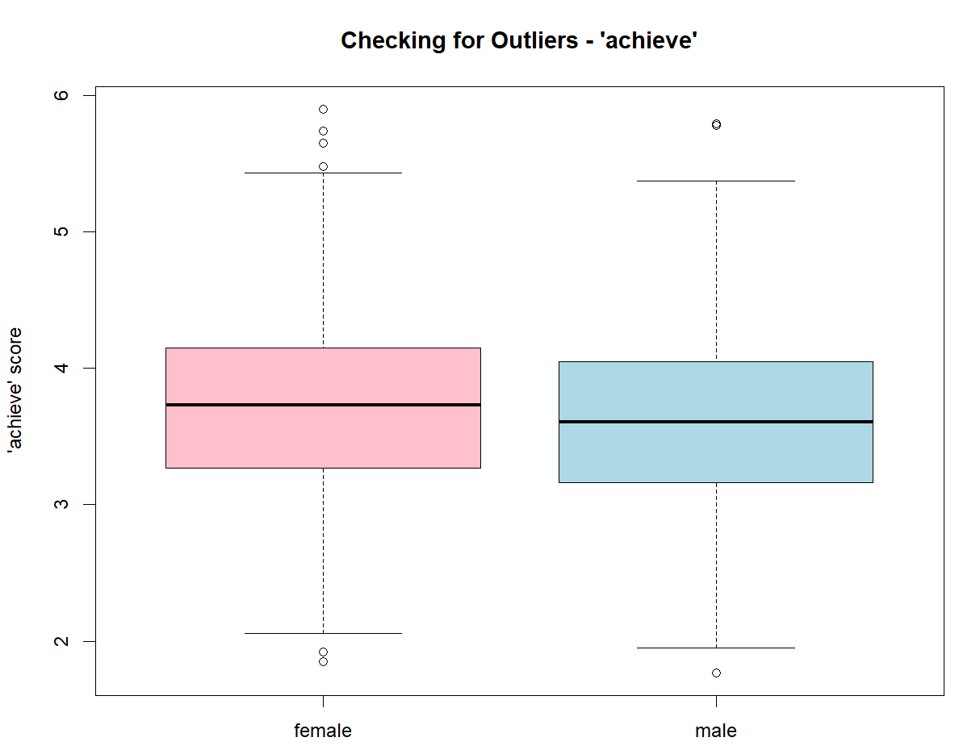
Combined LOR
Examine the reasons for the outliers
Outliers here most likely represent natural variation of the samples
Keep the outliers
Use non-parametric tests as they are robust to outliers
Mann–Whitney U
Notes:
When to remove outliers and how to analyze data when they are present?
Outliers can distort statistical analyses and violate their assumptions. Resisting the temptation to remove outliers inappropriately can be difficult. Outliers increase the variability in your data, which decreases statistical power. Consequently, excluding outliers can cause your results to become statistically significant.
However, removing outliers is legitimate only for specific reasons. If the outlier in question is:
A measurement / data entry error: correct the error if possible. If you can’t fix it, remove that observation because you know it’s incorrect.
Not a part of the population you are studying (i.e., unusual properties or conditions), you can legitimately remove the outlier.
you must be able to attribute a specific cause or reason for why that sample item does not fit your target population.
A natural part of the population you are studying, you should not remove it.
All data distributions have a spread of values. Extreme values can occur, but they have lower probabilities. If your sample size is large enough, you’re bound to obtain unusual values. In a normal distribution, approximately 1 in 340 observations will be at least three standard deviations away from the mean. However, random chance might include extreme values in smaller datasets! In other words, the process or population you’re studying might produce weird values naturally. There’s nothing wrong with these data points. They’re unusual, but they are a normal part of the data distribution.
If there is no justifiable reason to remove that point, we should leave it in even when the data point is influential. It’s bad practice to remove data points simply to produce a better fitting model or statistically significant results.
Nonparametric hypothesis tests are robust to outliers - outliers won’t necessarily violate their assumptions or distort their results.
https://statisticsbyjim.com/basics/remove-outliers/#:~:text=Removing%20outliers%20is%20legitimate%20only,area%20and%20data%20collection%20process.&text=Outliers%20increase%20the%20variability%20in,results%20to%20become%20statistically%20significant.

Slide 10
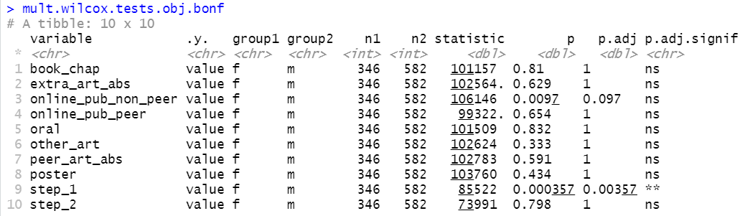
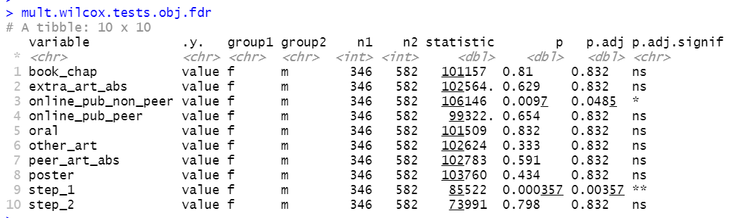
Combined Obj
Notes:
Using non parametric when normal –
https://stats.stackexchange.com/questions/376394/what-will-happen-if-i-use-a-nonparametric-test-with-normally-distributed-data
https://www.analyticsvidhya.com/blog/2017/11/a-guide-to-conduct-analysis-using-non-parametric-tests/

Slide 11
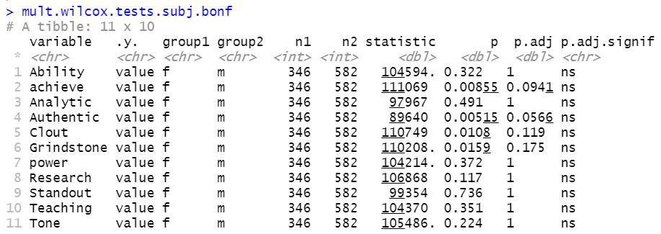
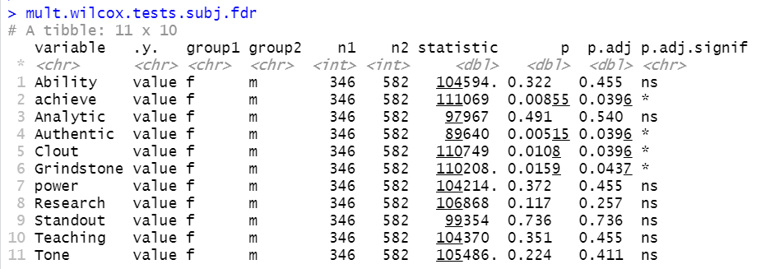
Combined LOR
Additional one-sided tests revealed:
Achieve: F > M
Authentic: F < M
Clout: F > M
Grindstone: F > M

Slide 12
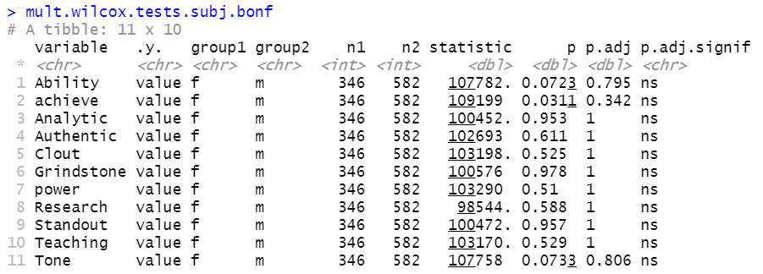
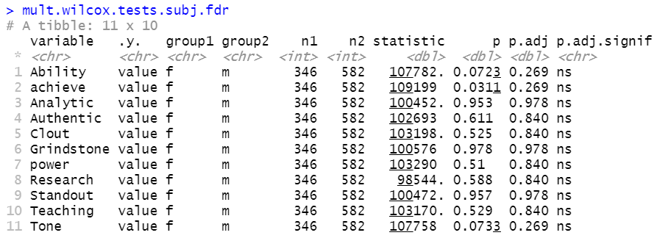
Combined PS

Slide 13
2020-21 Dataset
Subjective variables were characterized by the Linguistics algorithm from both LOR and PS

Slide 14
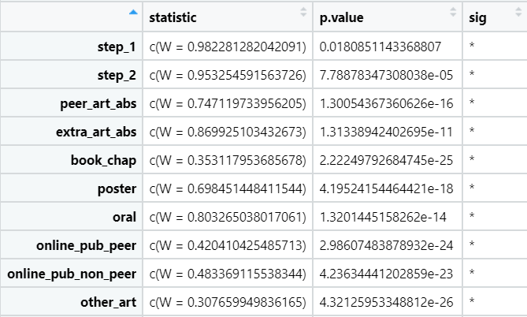
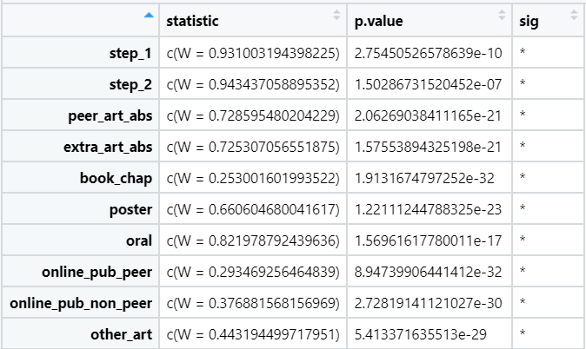
Normalcy Check
Shapiro test: p < 0.05 indicates absence of normality
female
male
None of the objective variables have normal distributions. Cannot use t-test.
Use the non-parametric equivalent of t-test: Mann-Whitney U test

Slide 15
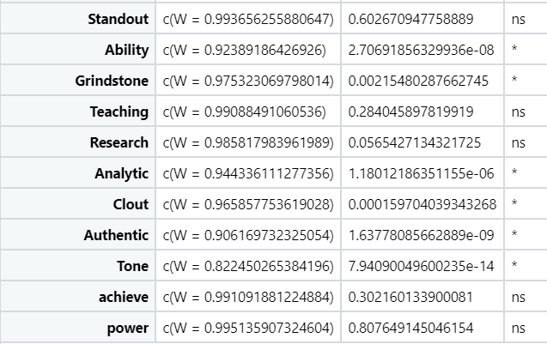
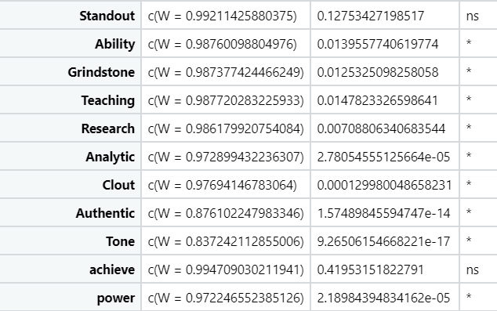
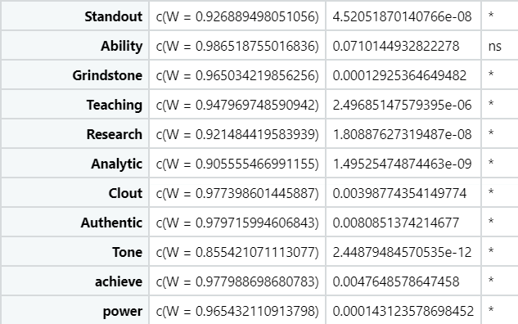
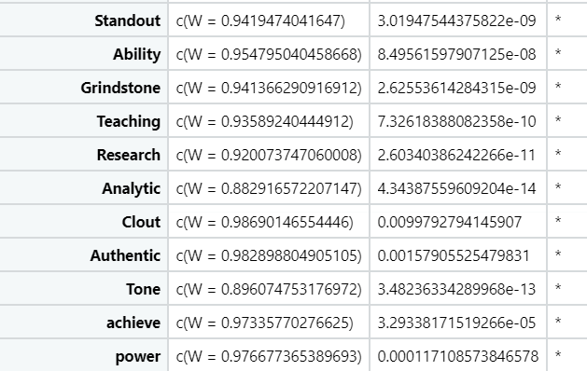
LOR
female
male
PS

Slide 16
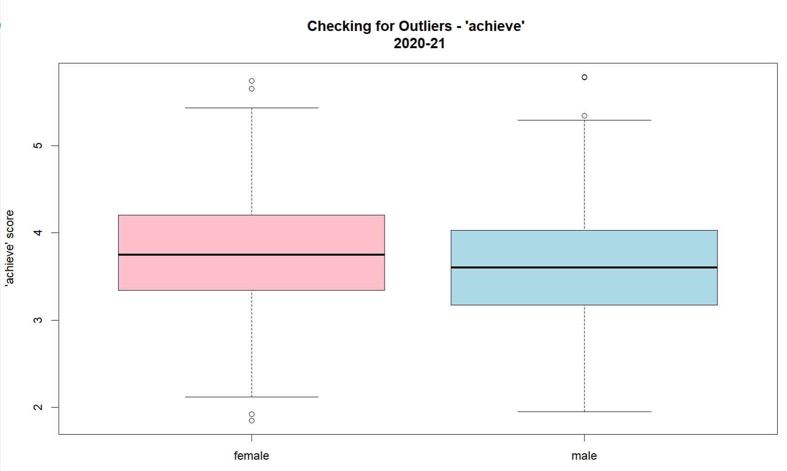
2020-21 LOR

Slide 17
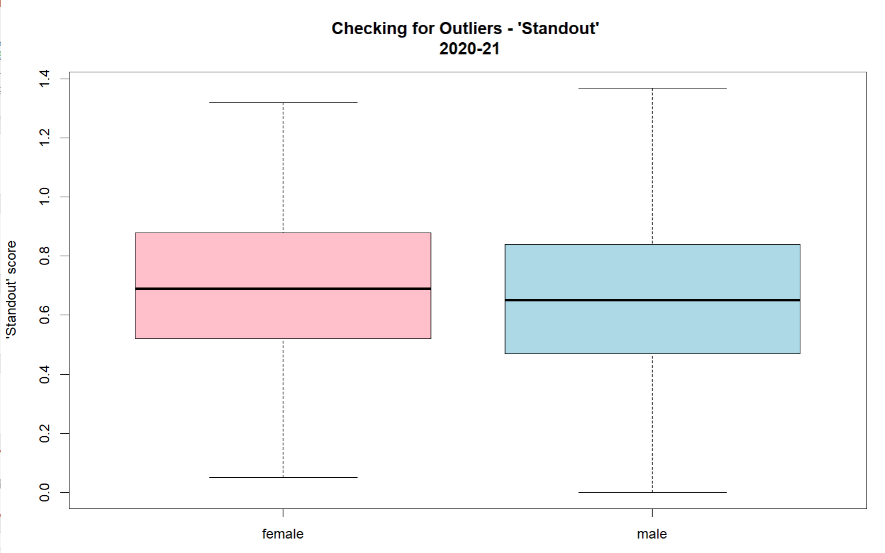
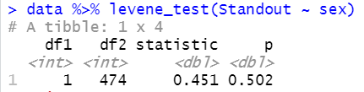
2020-21 LOR
Summary on LOR ‘Standout’
Assess normality
Shapiro test
p > 0.05: pop are normally distributed
No outliers
Assess equality of variances
Levene test
P > 0.05: population variances are equal
Use t-test for ‘Standout’ (Mann-Whitney U test for all others)
Notes:
Levene test: equality of variances
p > 0.05 -> equal variance -> use Student t-test

Slide 18

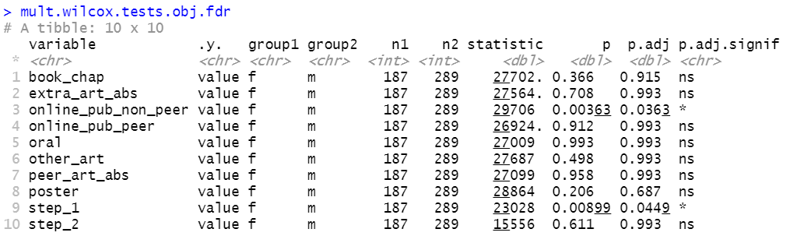
2020-21 Obj

Slide 19
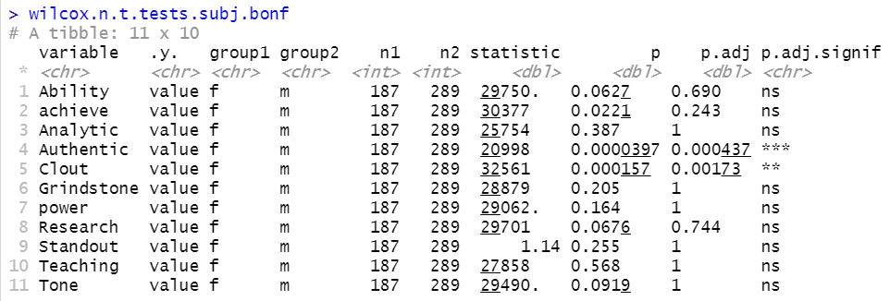
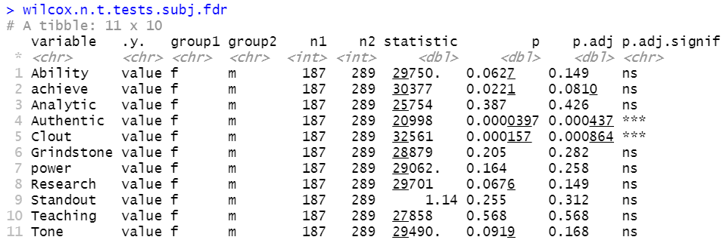
2020-21 LOR
t test for “Standout”

Slide 20
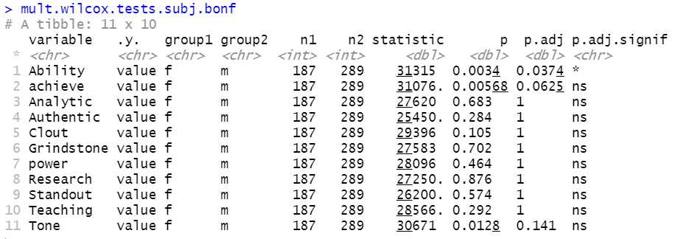
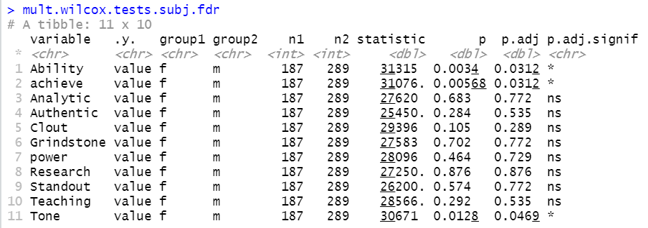
2020-21 PS

Slide 21
2019-2020 Dataset

Slide 22
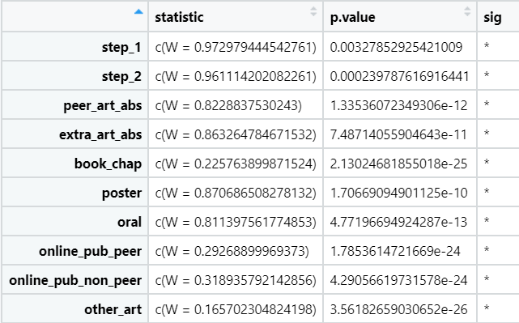
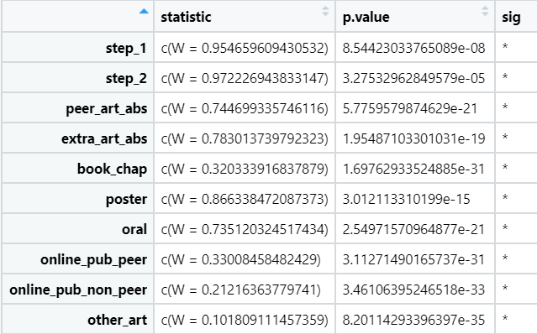
Normalcy Check
Shapiro test: p < 0.05 indicates absence of normality
female
male
None of the objective variables have normal distributions. Cannot use t-test.
Use the non-parametric equivalent of t-test: Mann-Whitney U test

Slide 23
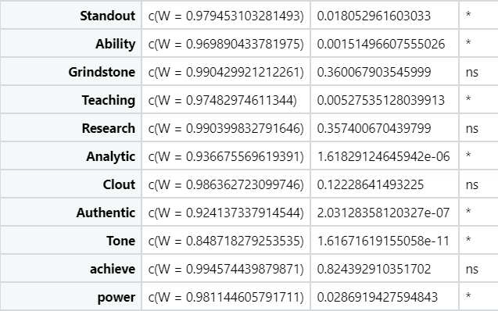
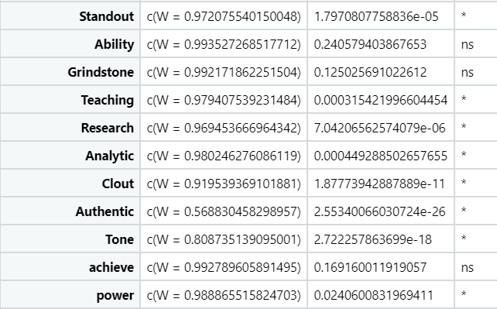
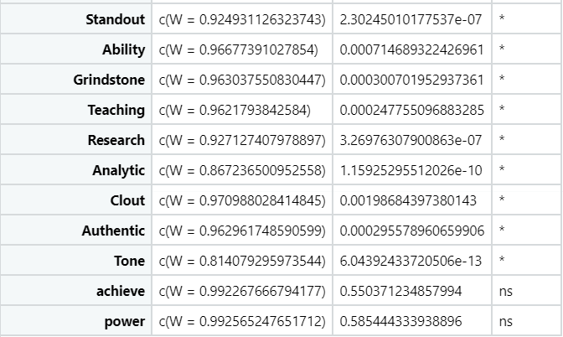
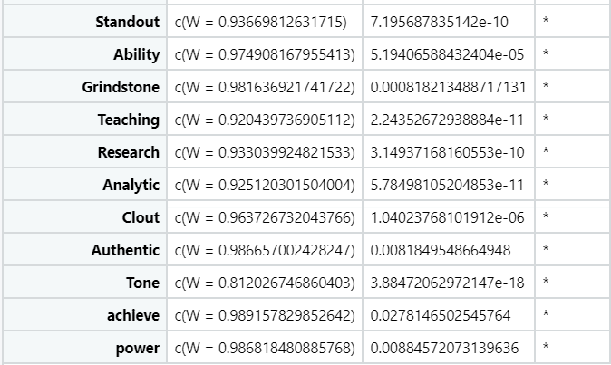
LOR
female
male
PS

Slide 24
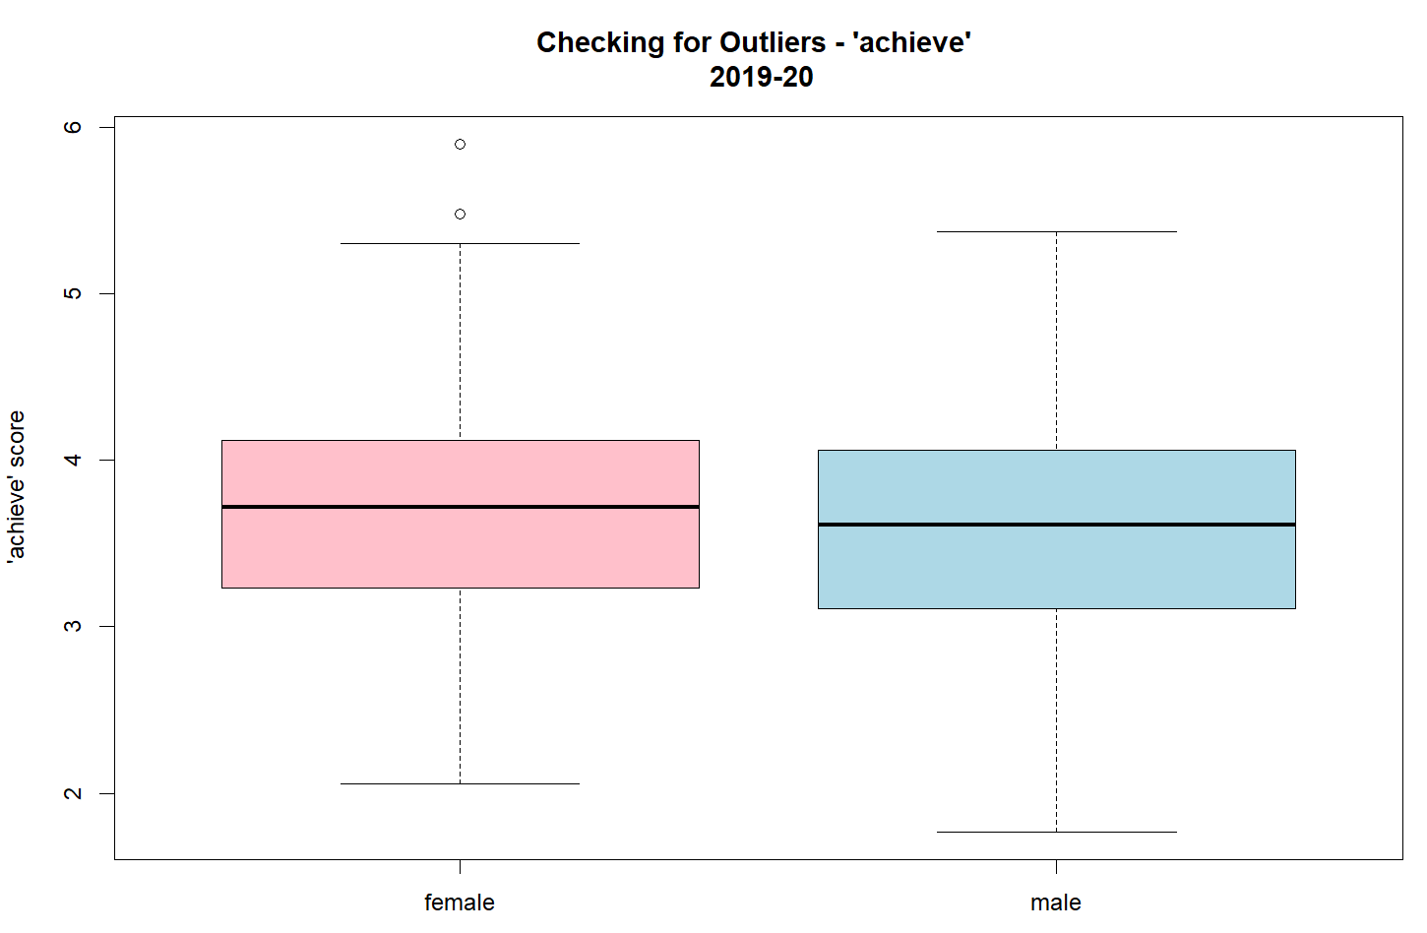
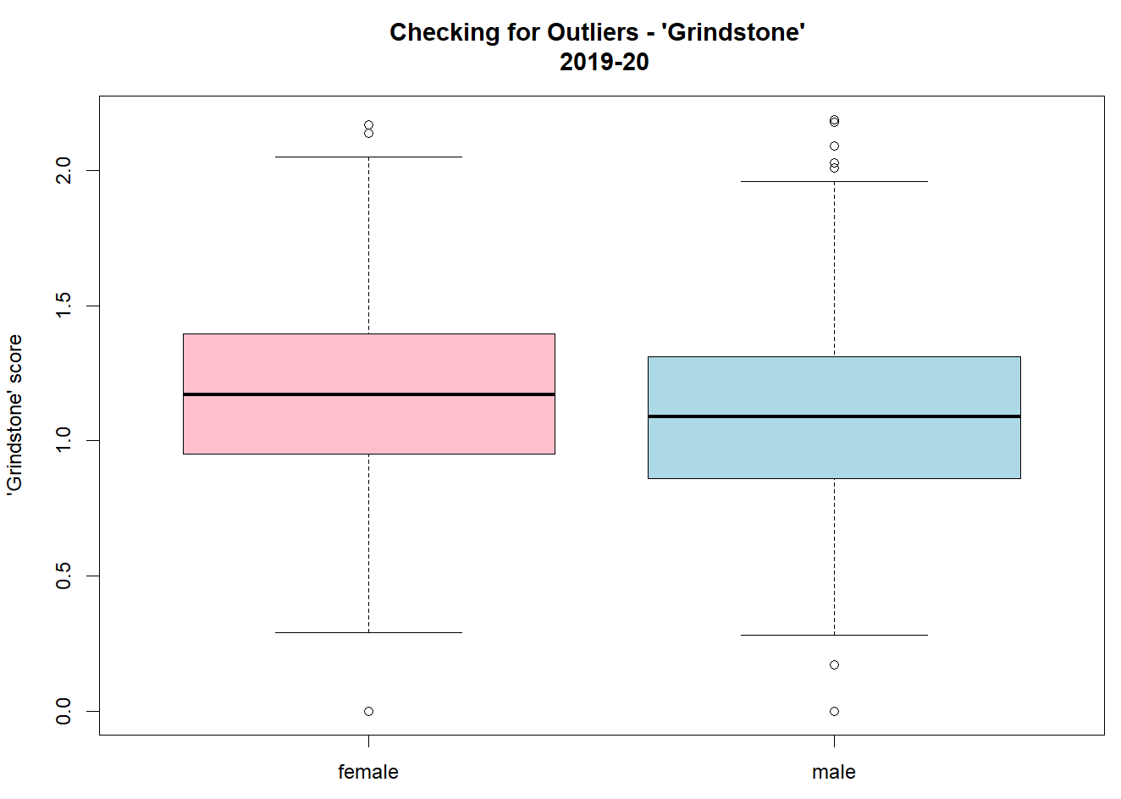
2019-20 LOR
Both ‘achieve’ and ‘Grindstone’ have outliers in both F and M groups.
Perform MWU test.

Slide 25
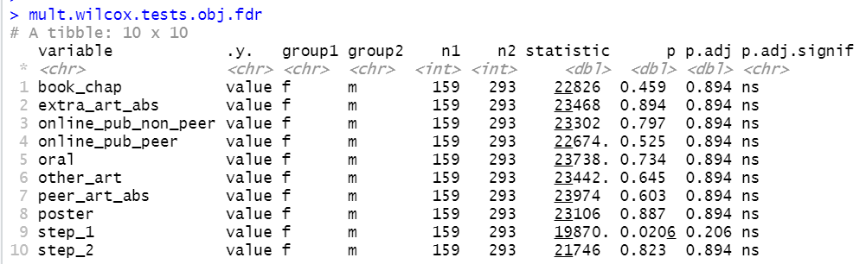
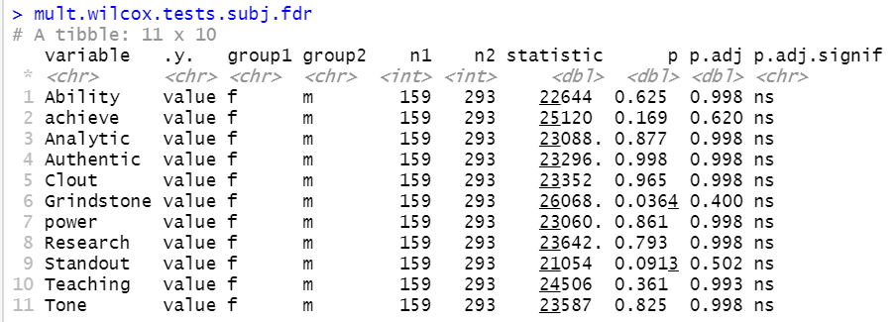
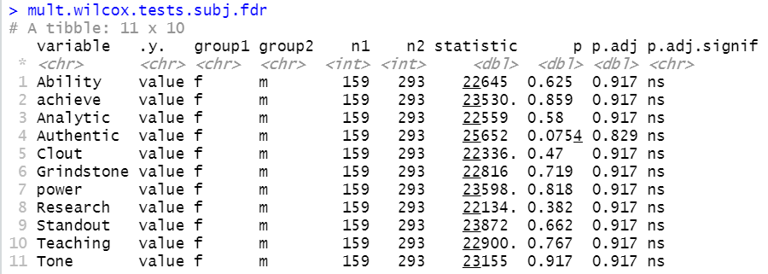
2019-20 data
no sig using FDR correction

Slide 26
 | Significance by FDR | Sidedness
Combined Obj | Online_pub_non_peer | F > M
 | Step_1 | F < M
Combined LOR | Achieve | F > M
 | Authentic | F < M
 | Clout | F > M
 | Grindstone | F > M
2020-21 Obj | Online_pub_non_peer | F > M
 | Step_1 | F < M
2020-21 LOR | Authentic | F < M
 | Clout | F > M
2020-21 PS | Ability | F > M
 | Achieve | F > M
 | Tone | F > M

Slide 27
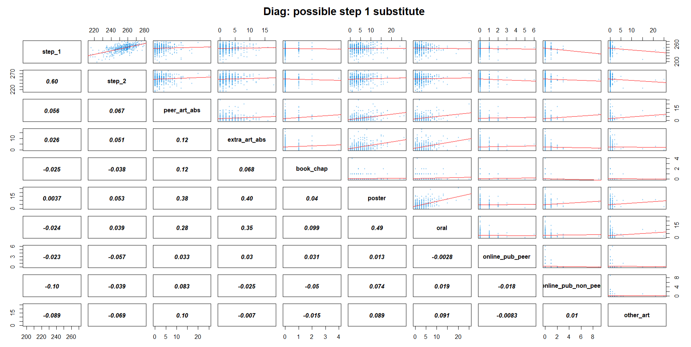
Task 2: substitute metric for Step 1 score?
Notes:
TO DO
Remove outliers in step scores
cutoffs: 190, 200, 210, 220,…, 240
Subset analysis

Slide 28
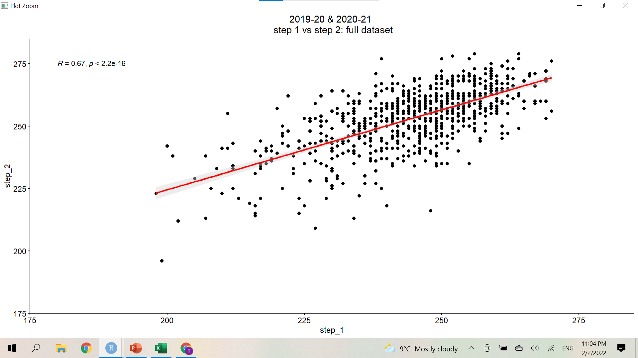

Slide 29
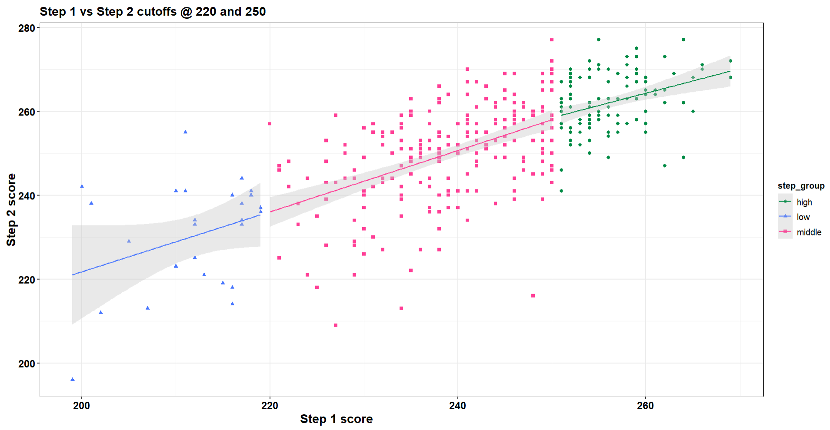

Slide 30
Detailed/Extra slides
On 2019-20 data

Slide 31
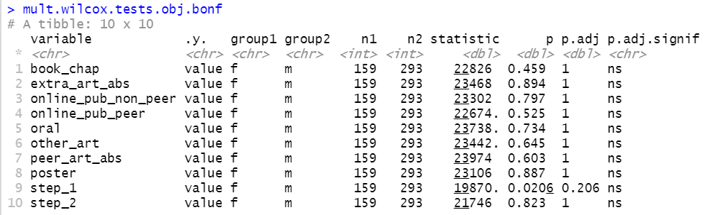
2019-20 Obj

Slide 32
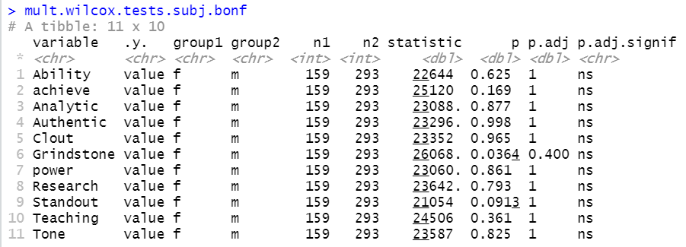
2019-20 LOR

Slide 33
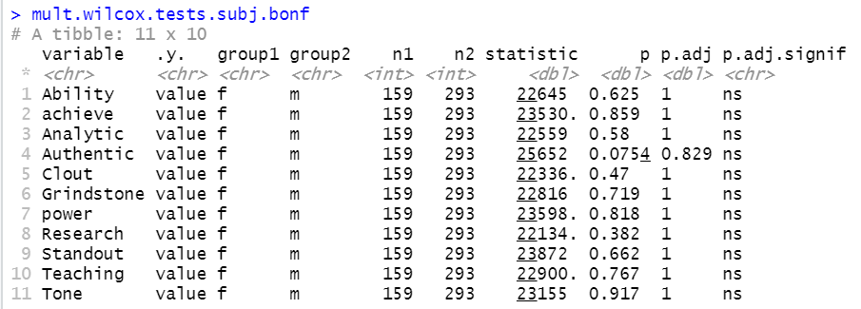
2019-20 PS

