Slide 1
ERAS Linguistics Statistical Analyses - Race -
UNC ENT Research Group
April 6, 2022
Notes:
Contact Tiffany Ho (tiffany.d.ho@gmail.com) for any questions
Started making the presentation on March 4, 2022

Slide 2
Overview
One-way ANOVA vs Kruskal-wallis
Assumptions check
normality, equal variance, extreme outliers
Variables analyzed
2 objective variables
"step_1" "step_2"
11 subjective variables
"Standout" "Ability" "Grindstone" "Teaching" "Research" "Analytic" "Clout" "Authentic" "Tone" "achieve" "power"

Slide 3
Grand Summary
Combined: Post hoc results
2020-21 Post hoc results
Variable | Objective
Step 1 | Asian > Black by 7.27 pts Asian > Hisp by 5.71 pts White > Black by 7.67 pts White > Hisp by 6.11 pts
Step 2 | Asian > Black by 5.69 pts White > Black by 5.92 pts White > Hisp by 7.79 pts
Variable | Objective
Step 1 | Asian > Hispanic by 7.43 pts White > Black by 8 pts White > Hispanic by 7.69 pts
Step 2 | Asian > Hispanic by 7.96 pts White > Hispanic by 10.3 pts
2019-20: Post hoc results
Variable | Objective
Step 1 | White > Black by 7.52 pts
 | Subjective - LOR
Teaching | Hisp > Other by 0.593 pts
 | LOR
Teaching | Asian > Other by 0.327 pts Black > Other by 0.363 pts Hisp > Other by 0.354 pts White > Other by 0.296 pts
Research | Asian > White by 0.222 pts
Analytic | Hisp > White by 2.43 pts
 | Subjective - PS
Authentic | Hisp > Black by 15.6 pts
Clout | Black > Asian by 8.53 pts Black > Hisp by 12.6 pts Black > Other by 13.5 pts Black > White by 8.30 pts
 | Subjective - LOR
Research | Asian > White by 0.328 pts
Analytic | No sig pair-wise difference
 | Subjective - PS
Authentic | White > Asian by 6.70 pts
Tone | White > Black by 9.27 pts
 | PS
Authentic | White > Asian by 4.50 pts
Tone | White > Black by 6.95 pts
Notes:
TO DO:
- Bar graph for each variable w/ pair-wise comparisons
- Similar graph for gender paper
Contextualize the numbers, i.e. significant differences
Two abstracts: LOR & PS (leave out board scores)
Narrative: significant differences in step scores, but not in subjective variables

Slide 4

2020-21 LOR Dataset

Slide 5
Checking assumptions of one-way ANOVA
Extreme outliers
See boxplots in ‘ERAS_race_outlier_check_2020-21_LOR.pdf’
See specific extreme outliers in ‘[same name].xlsx’
TO-DO: re-run tests without extreme outliers
Normality
Shapiro test
See QQ plots in ‘ERAS_race_normality_check_2020-21_LOR.pdf’
Homogeneity of variance
Levene’s test

Slide 6
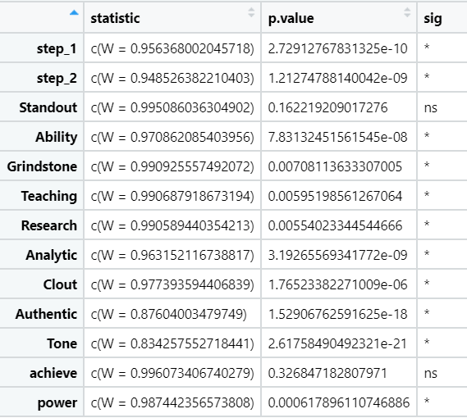
Normality check
Shapiro Test
Assumption met if p > 0.05
Only ‘standout’ and ‘achieve’ meet the normality assumption.
For variables without normal distributions, use Kruskal-Wallis test, the non-parametric equivalent to one-way ANOVA.

Slide 7
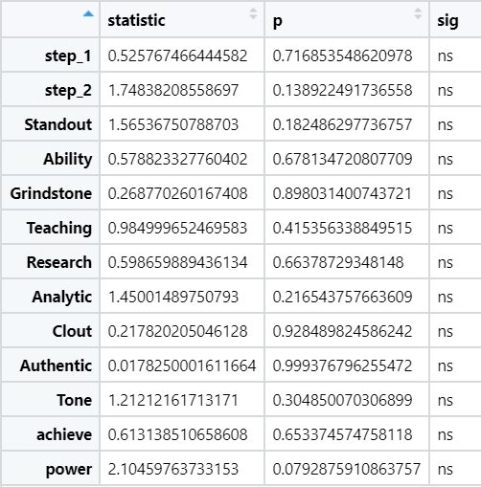
Homogeneity of variance check
Levene’s Test
Assumption met if p > 0.05
All variables met the assumption.

Slide 8
Statistical Analyses
2020-21 LOR
One-way ANOVA for “standout” and “achieve”
Neither is significant
Kruskal-wallis test for all others
4 variables are significant: step_1, step_2, research, analytic
Post-hoc analysis on the 4 variables
Variable | Post hoc test results
Step 1 | Asian > Hispanic by 7.43 pts White > Black by 8 pts White > Hispanic by 7.69 pts
Step 2 | Asian > Hispanic by 7.96 pts White > Hispanic by 10.3 pts
Research | Asian > White by 0.328 pts
Analytic | No significant pair-wise difference

Slide 9
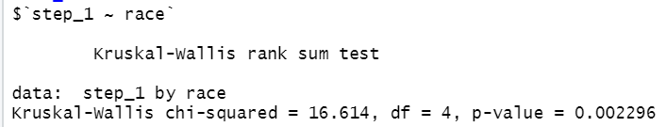
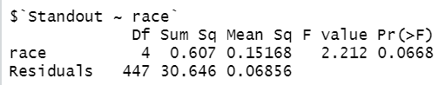
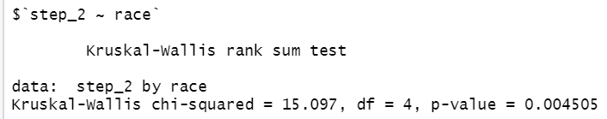

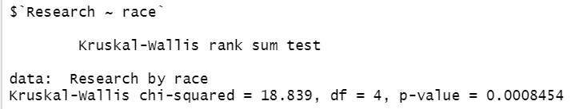
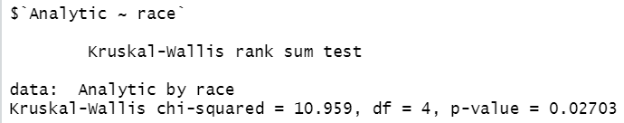
2020-21 LOR
Kruskal-wallis for all others
4 variables with significance
step_1, step_2, research, analytic
One-way ANOVA
for ‘standout’ and ‘achieve’
Neither is significant

Slide 10
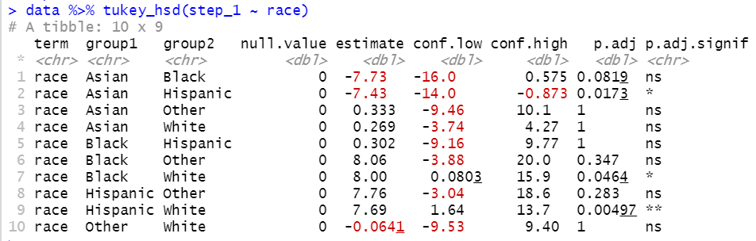
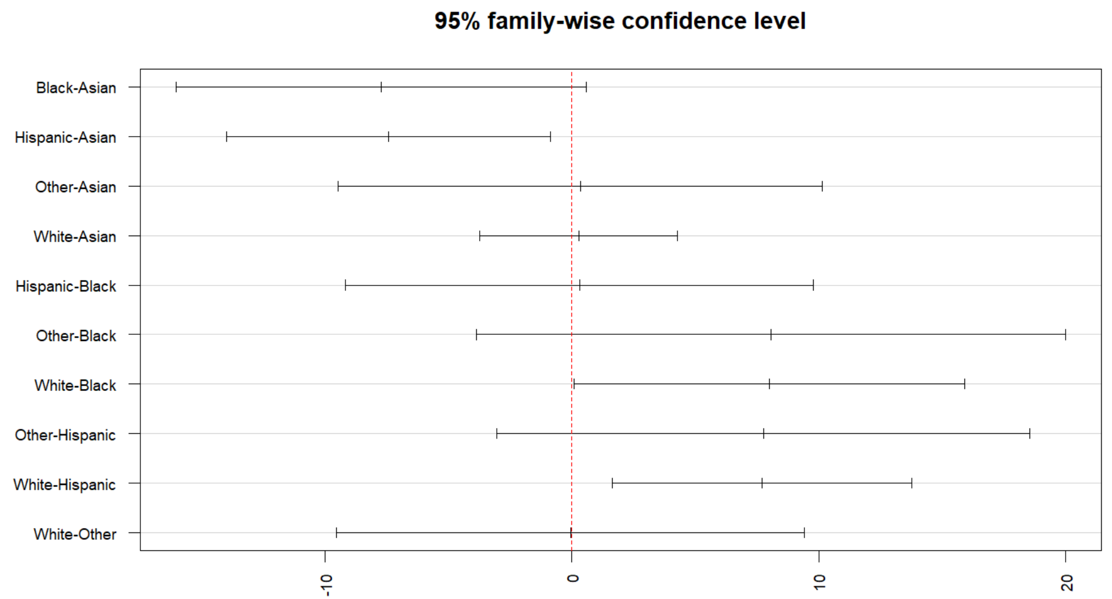
post hoc test:
step_1
3 pairs with sig. difference in
step 1 mean score:
Asian > Hispanic by 7.43 pts
White > Black by 8 pts
White > Hispanic by 7.69 pts

Slide 11
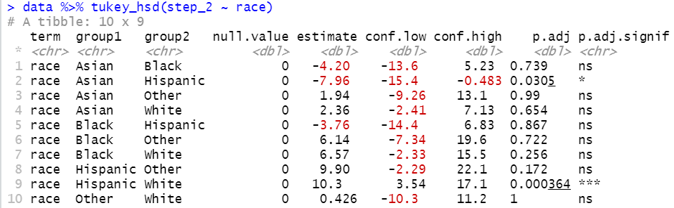
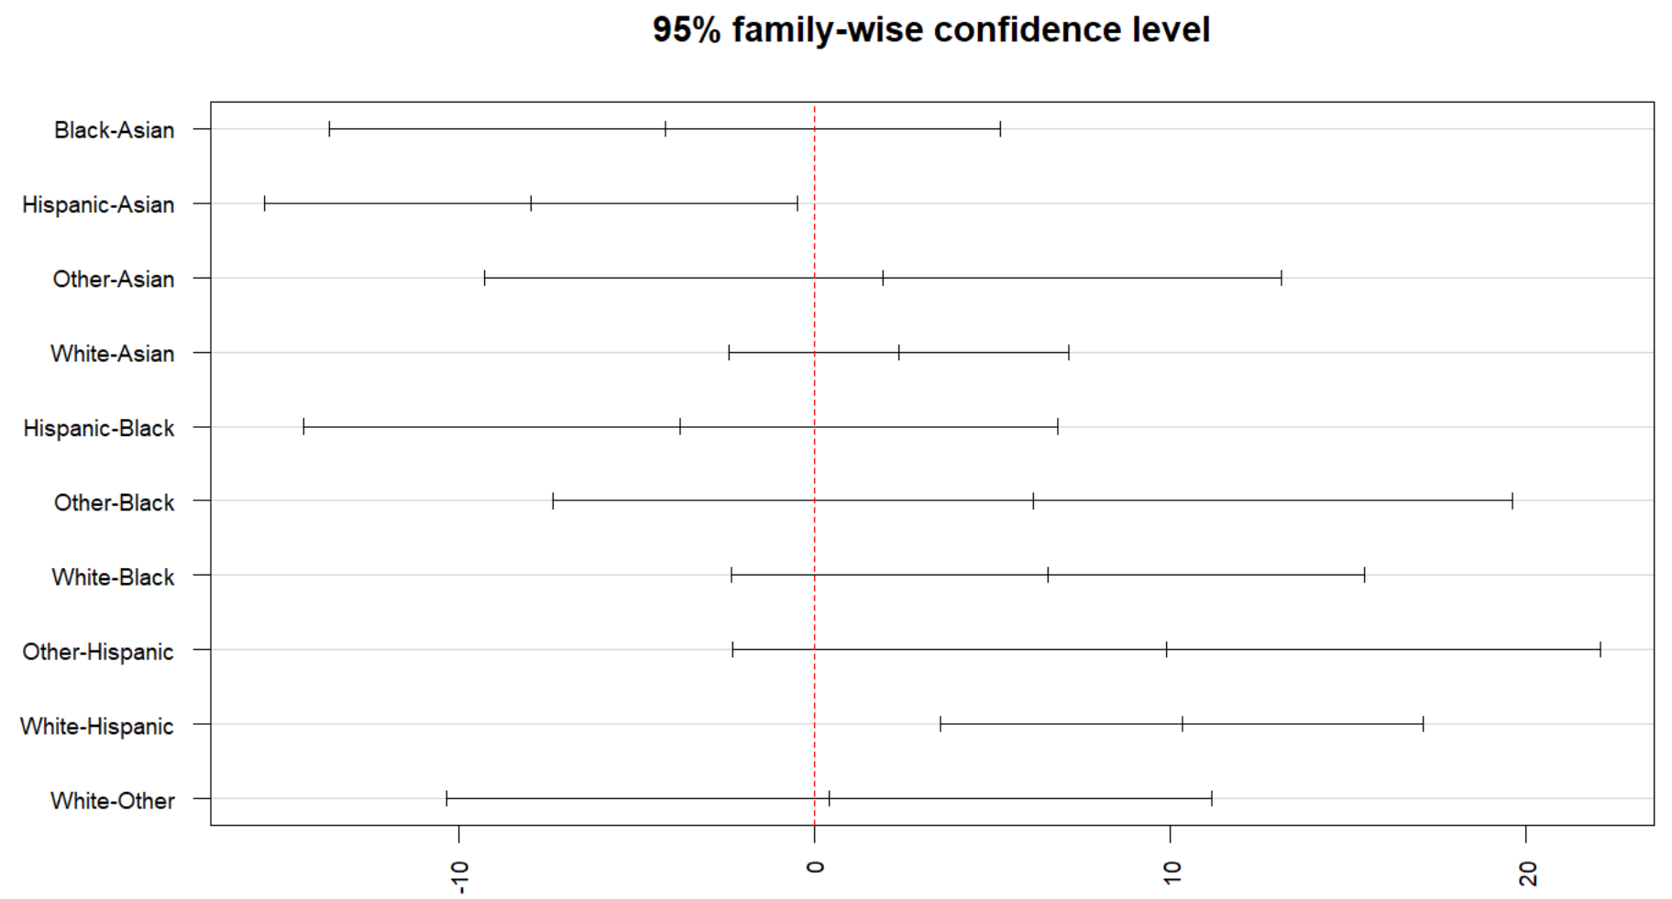
post hoc test:
step_2
2 pairs have sig. difference in
step 2 mean score:
Asian > Hispanic by 7.96 pts
White > Hispanic by 10.3 pts

Slide 12
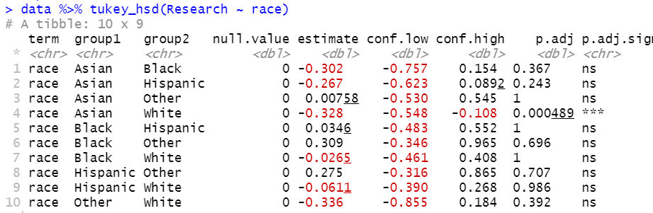
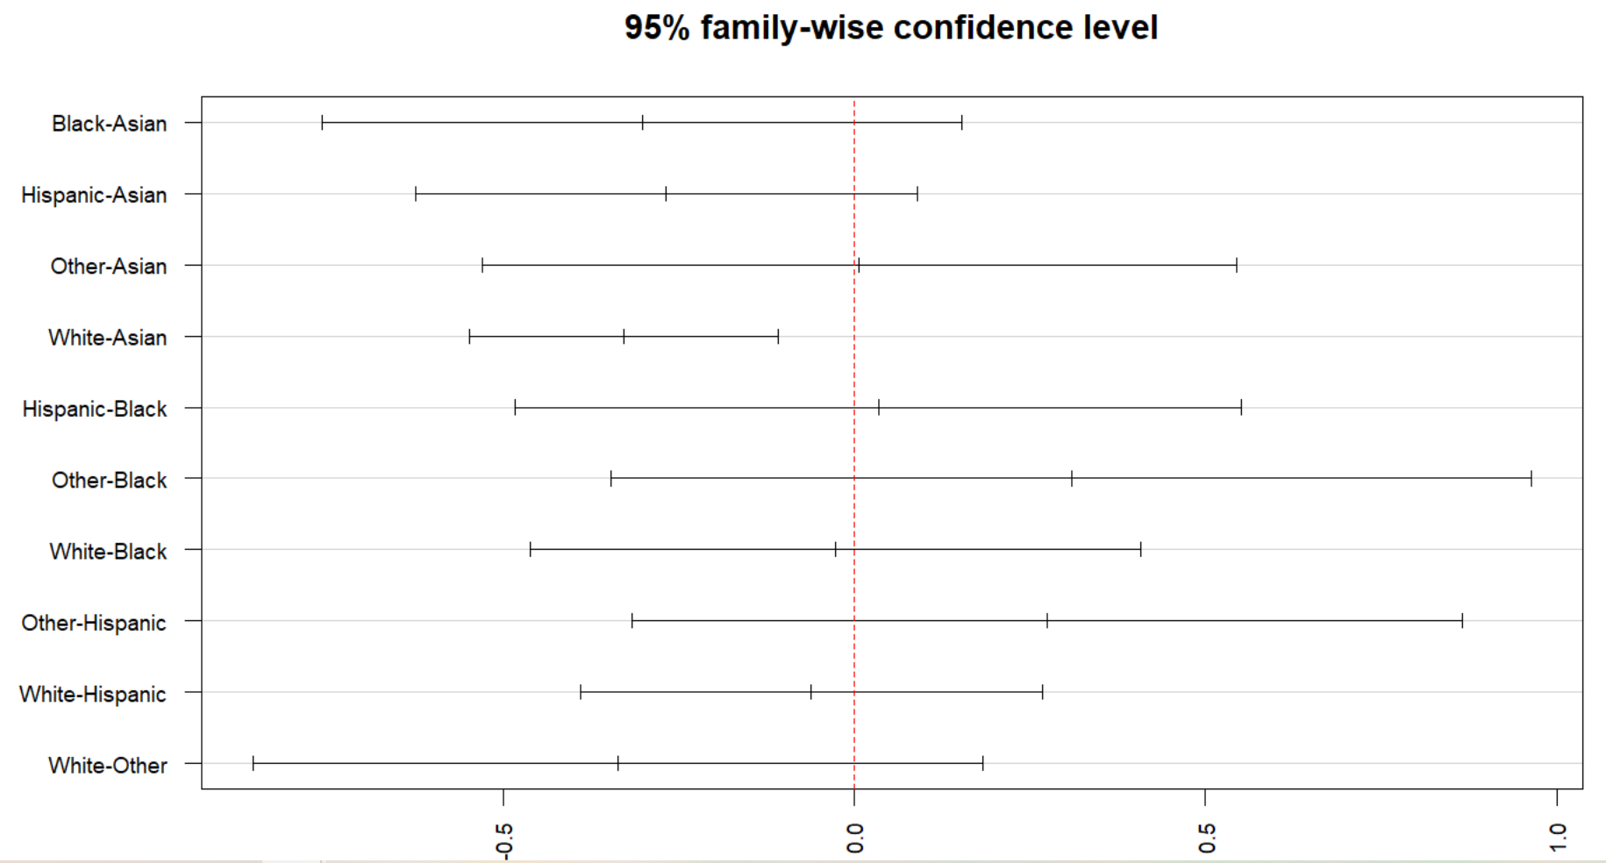
post hoc test:
research
1 pair with sig. difference in
research mean score:
Asian > White by 0.328 pts (score calculated by the linguistic algorithm)

Slide 13
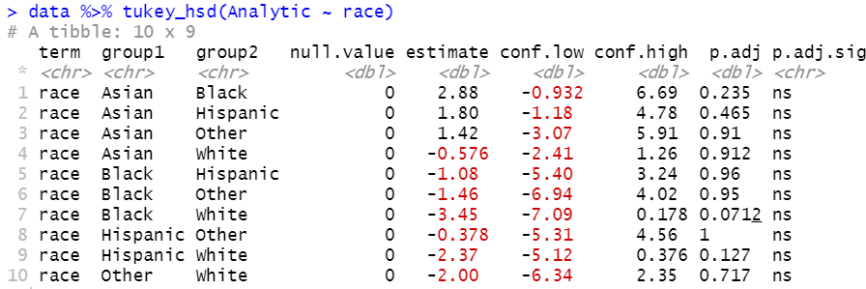
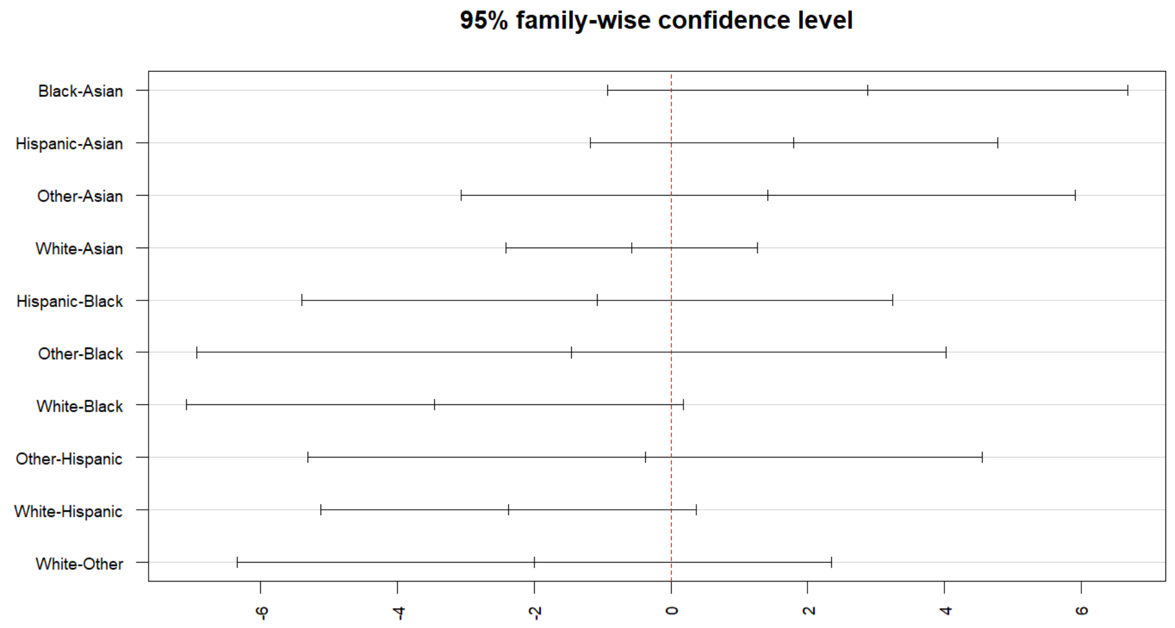
post hoc test:
analytic
No significant pair-wise difference for ‘analytic.’
Non-significant post hoc test given significant ANOVA?
Yes, certainly possible!

Slide 14
Some reasons why post-hoc tests may be not significant while the global effect is:
Weak significant global effect
Conservative post-hoc test
A lack of statistical power
Large number of factor levels
Notes:
Weak significant global effect. Ex: ANOVA p-value close to α level
Conservative post-hoc test. The more conservative the multiple comparison test, the more likely we would reject significant differences between means that might be meaningful.
A lack of statistical power. Ex: small group sizes -> less power -> less likely to detect significant differences
Large number of factor levels. The more pairwise comparisons we do, the more our p-values will get penalized in order to reduce the risk of rejecting true null hypotheses.

Slide 15

2019-20 LOR Dataset

Slide 16
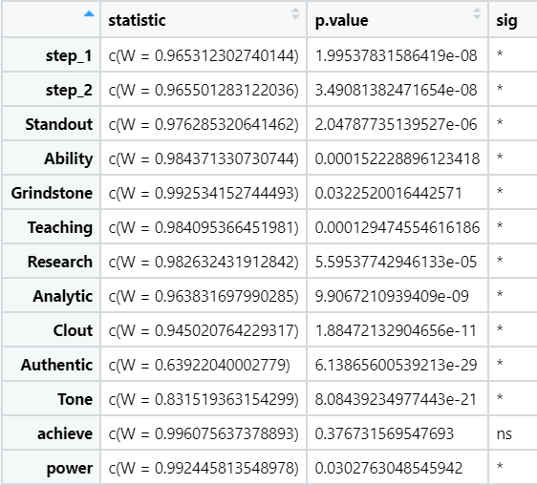
Normality
Shapiro Test
Assumption met if p > 0.05
Only ‘achieve’ meet the normality assumption.
For variables without normal distributions, use Kruskal-Wallis test, the non-parametric equivalent to one-way ANOVA.

Slide 17
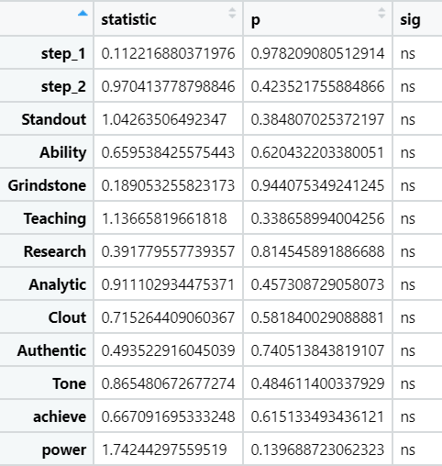
Homogeneity of variance
Levene’s Test
Assumption met if p > 0.05
All variables met the assumption.

Slide 18
Statistical Analyses
2019-20 LOR
One-way ANOVA for “achieve”
Not significant
Kruskal-wallis test for all others
2 variables are significant: step_1, teaching
Post-hoc analysis on the 2 variables
Variable | Post hoc test results
Step 1 | White > Black by 7.52 pts
Teaching | Hispanic > Other by 0.593 pts

Slide 19
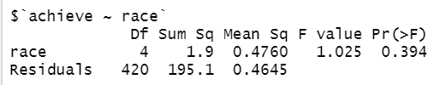

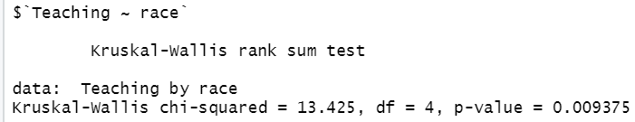
2019-20 LOR
One-way ANOVA
for ‘achieve’
Not significant
Kruskal-wallis for all others
2 variables with significance
step_1 & teaching

Slide 20
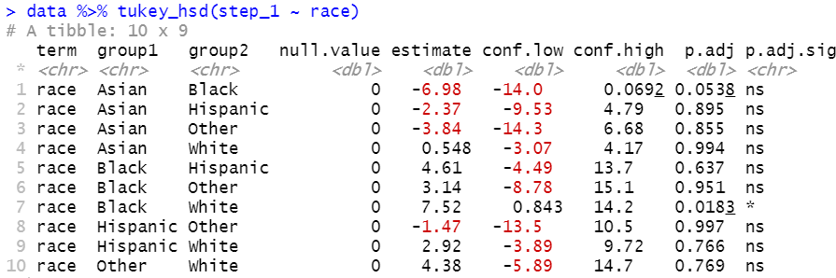
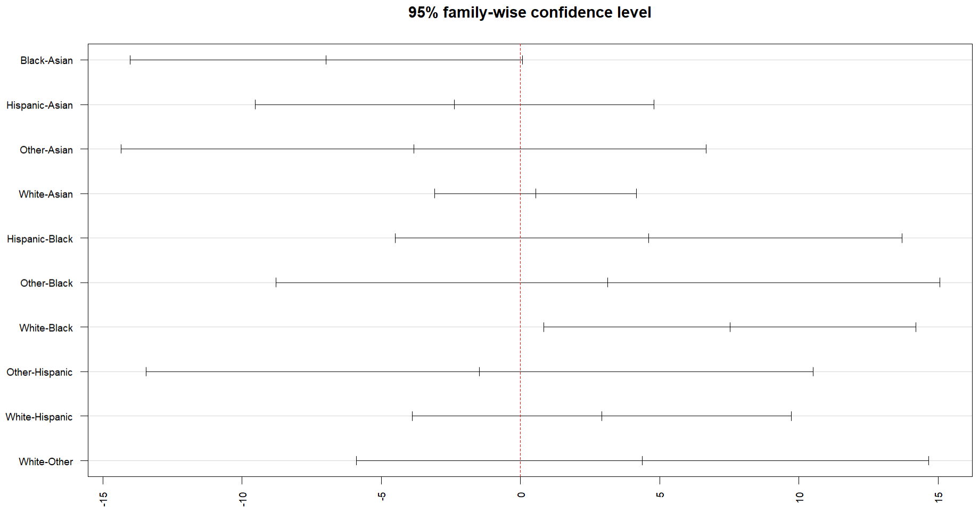
post hoc test:
step_1
1 pair with sig. difference in
step 1 mean score:
White > Black by 7.52 pts

Slide 21
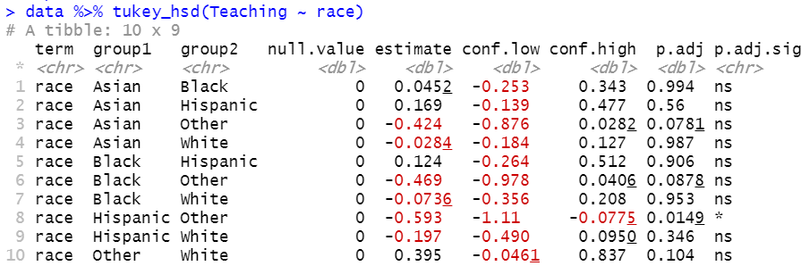
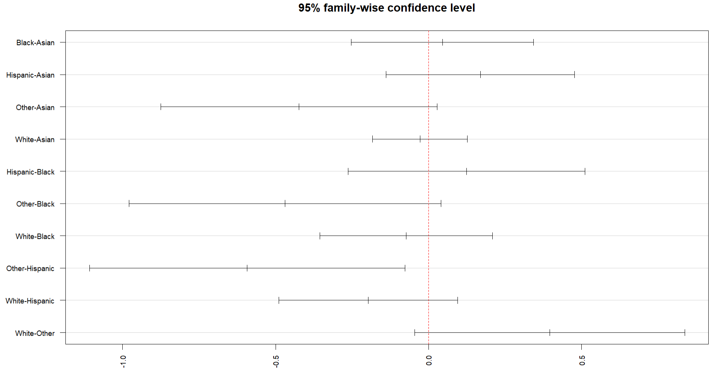
post hoc test:
teaching
1 pair with sig. difference in
teaching mean score:
Hispanic > Other by 0.593 pts

Slide 22
2020-21 PS Dataset

Slide 23
Checking assumptions of one-way ANOVA
Extreme outliers
See boxplots in ‘ERAS_race_outlier_check_2020-21_PS.pdf’
See specific extreme outliers in ‘[same name].xlsx’
TO-DO: re-run tests without extreme outliers
Normality
Shapiro test
See QQ plots in ‘ERAS_race_normality_check_2020-21_PS.pdf’
Homogeneity of variance
Levene’s test

Slide 24
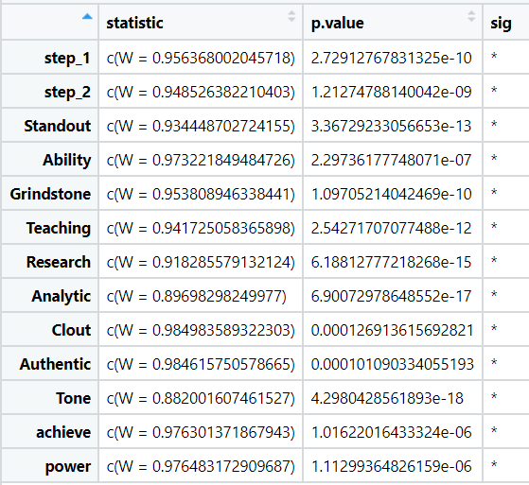
Normality check
Shapiro Test
Assumption met if p > 0.05
None meets the normality assumption.
Use Kruskal-Wallis test for all variables

Slide 25
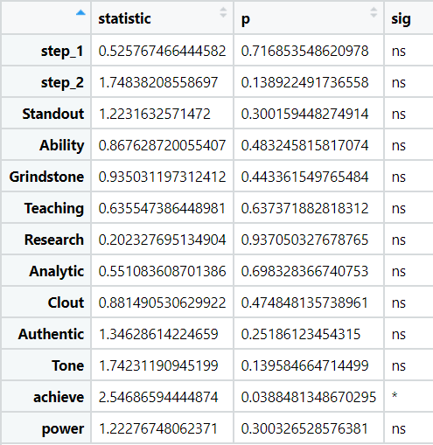
Homogeneity of variance check
Levene’s Test
Assumption met if p > 0.05
All variables meet the assumption except for ‘achieve’
Use Welch one-way ANOVA for ‘achieve’

Slide 26
Statistical Analyses
2020-21 PS
Kruskal-wallis test for all variables except for ‘achieve’
4 variables are significant: step_1, step_2, authentic, tone
Use Welch one-way ANOVA for ‘achieve’ → TO DO
Post-hoc analysis on the 4 variables
Variable | Post hoc test results
Step 1 | Asian > Hispanic by 7.43 pts White > Black by 8 pts White > Hispanic by 7.69 pts
Step 2 | Asian > Hispanic by 7.96 pts White > Hispanic by 10.3 pts
Authentic | White > Asian by 6.70 pts
Tone | White > Black by 9.27 pts
Same data and result as that from the 2020-21 LOR dataset

Slide 27
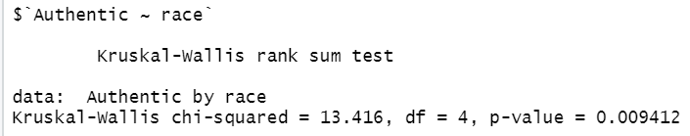
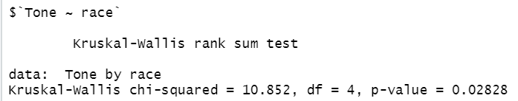
2020-21 LOR
Kruskal-wallis for all variables
4 variables with significance
step_1, step_2, authentic, tone

Slide 28
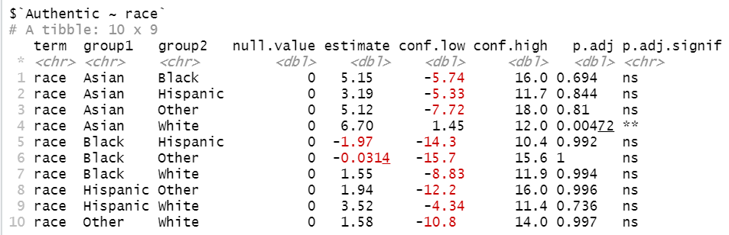
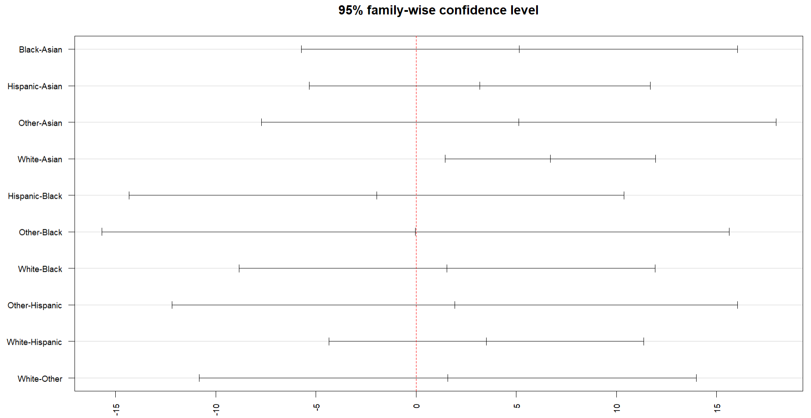
post hoc test:
Authentic
1 pair with sig. difference in ‘authentic’ mean score:
White > Asian by 6.70 pts

Slide 29
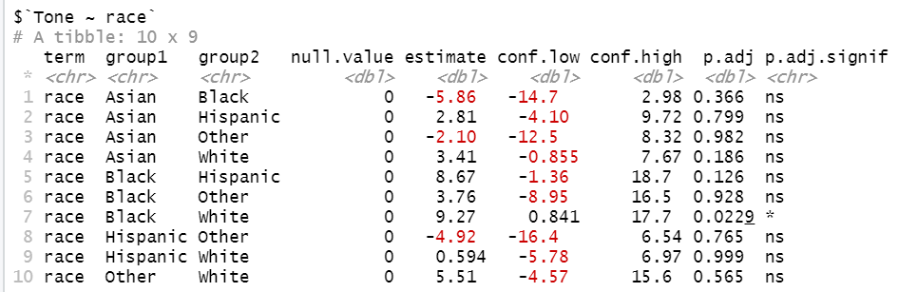
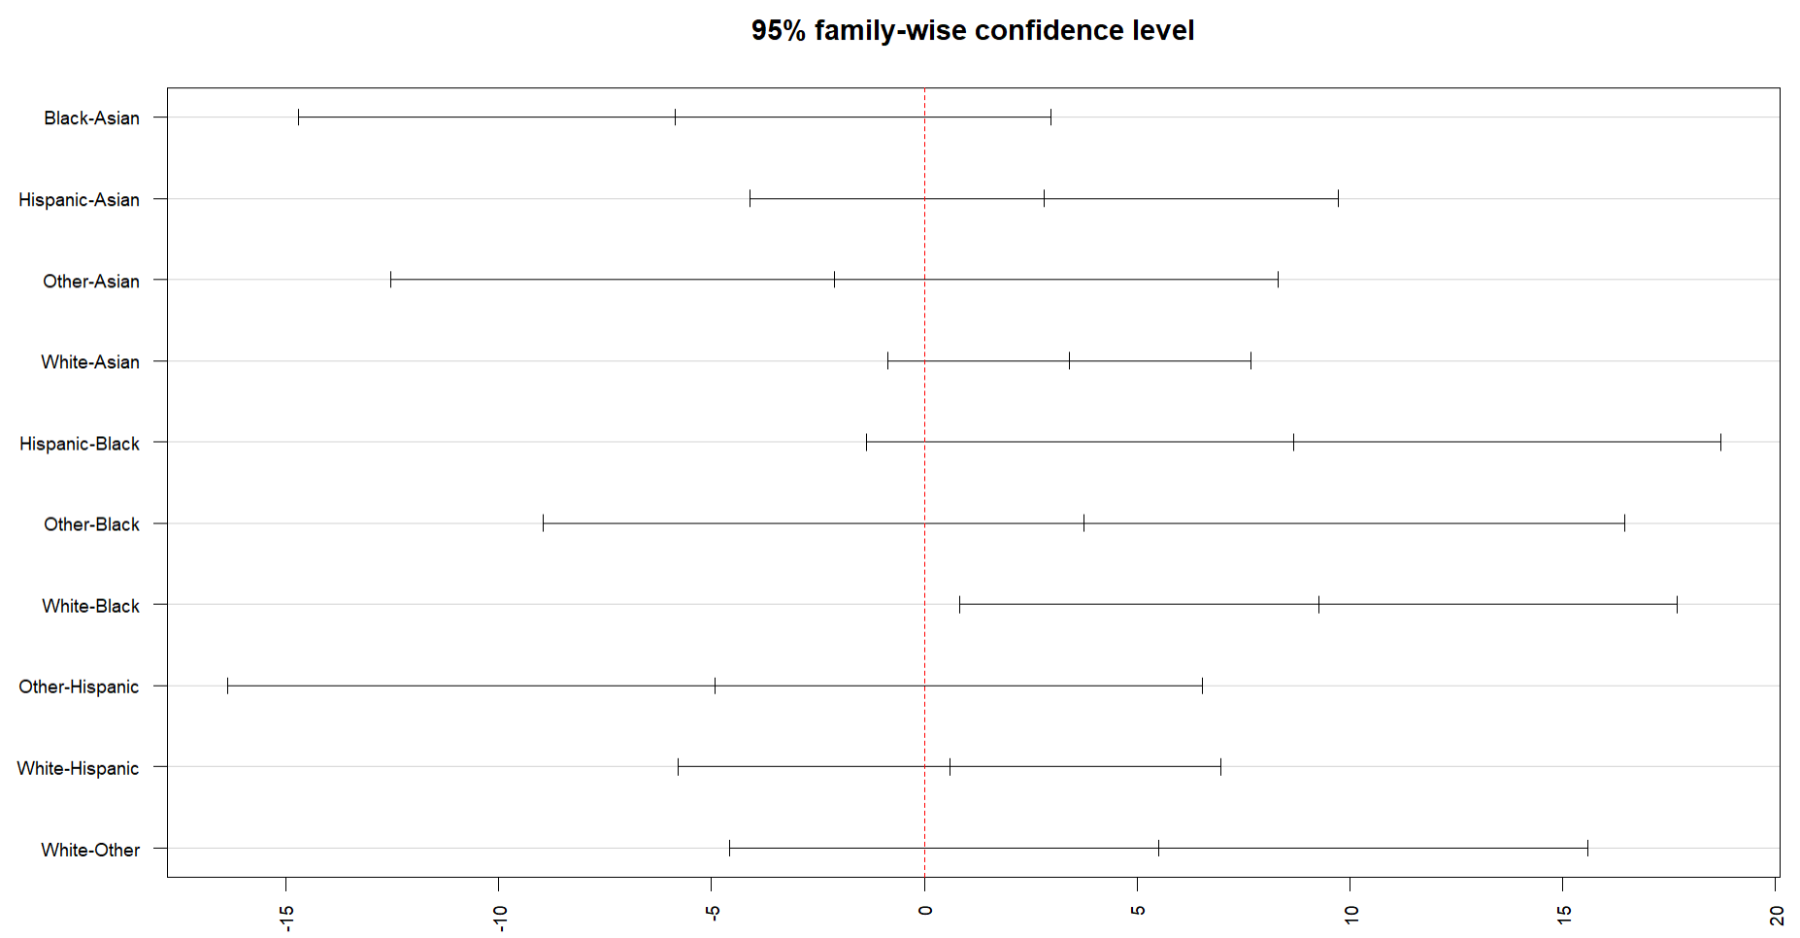
post hoc test:
Tone
1 pair with sig. difference in
‘tone’ mean score:
White > Black by 9.27 pts

Slide 30
2019-20 PS Dataset

Slide 31
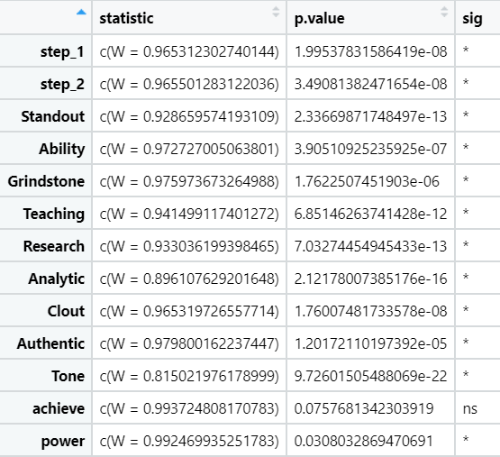
Normality
Shapiro Test
Assumption met if p > 0.05
Only ‘achieve’ meet the normality assumption per the Shapiro test.
Evaluate the QQ plots too

Slide 32
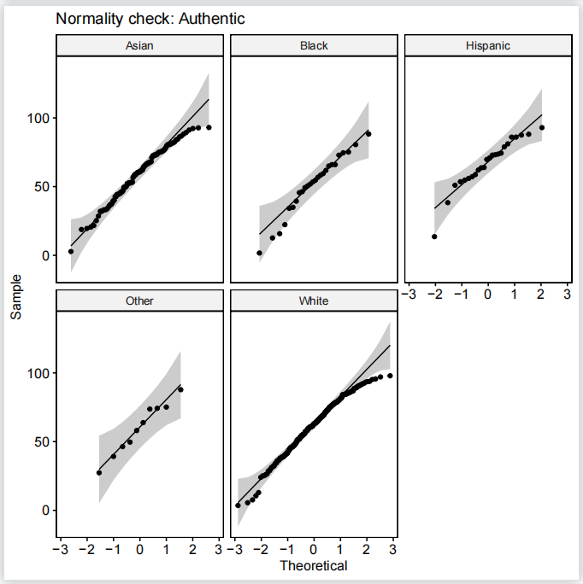
Note that, if your sample size is greater than 50, the normal QQ plot is preferred because at larger sample sizes the Shapiro-Wilk test becomes very sensitive even to a minor deviation from normality.
‘Authentic’ should be considered to be following normal distribution as well
For all the other variables, we will use Kruskal-Wallis test.

Slide 33
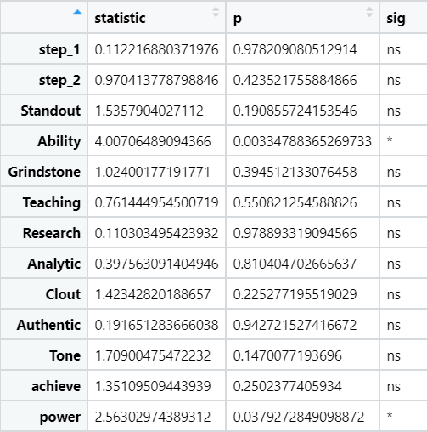
Homogeneity of variance
Levene’s Test
Assumption met if p > 0.05
‘Ability’ and ‘power’ fail to meet the assumption
Use Welch one-way ANOVA for these two variables

Slide 34
Statistical Analyses
2019-20 PS
One-way ANOVA on ‘achieve’ and ‘authentic’
‘achieve’ - not significant
‘authentic’ - significant
Welch one-way ANOVA on ‘ability’ and ‘power’
Neither is significant
Kruskal-wallis test on all others
‘step_1’ and ‘clout’ are significant
Post-hoc analysis on the 3 variables
See table on the right
Variable | Post hoc test results
Step 1 | White > Black by 7.52 pts
Authentic | Hispanic > Black by 15.6 pts
Clout | Black > Asian by 8.53 pts Black > Hispanic by 12.6 pts Black > Other by 13.5 pts Black > White by 8.30 pts

Slide 35

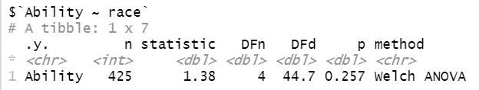
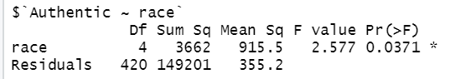
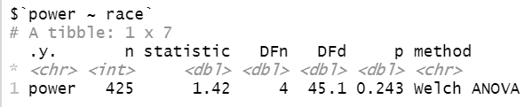
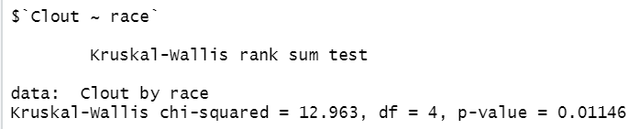
One-way ANOVA
for ‘achieve’ and ‘authentic’
‘authentic’ is significant
2019-20 PS
Welch one-way ANOVA
for ‘ability’ and ‘power’
Neither is significant
Kruskal-wallis for all others
‘step_1’ & ‘clout’ are significant
Notes:
Authentic: significant in one-way ANOVA (p-value = 0.0371) but not in Kruskal-wallis (p-value = 0.06302)

Slide 36
post hoc test:
step_1
1 pair with sig. difference in
step 1 mean score:
White > Black by 7.52 pts

Slide 37
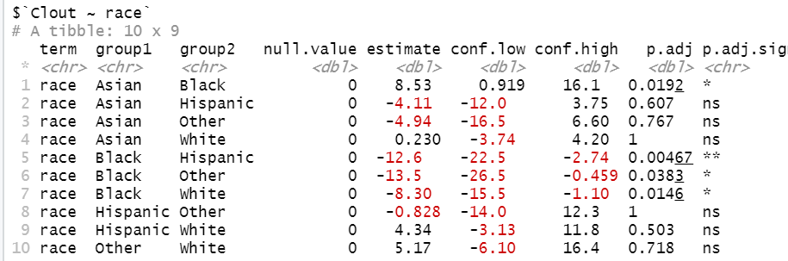
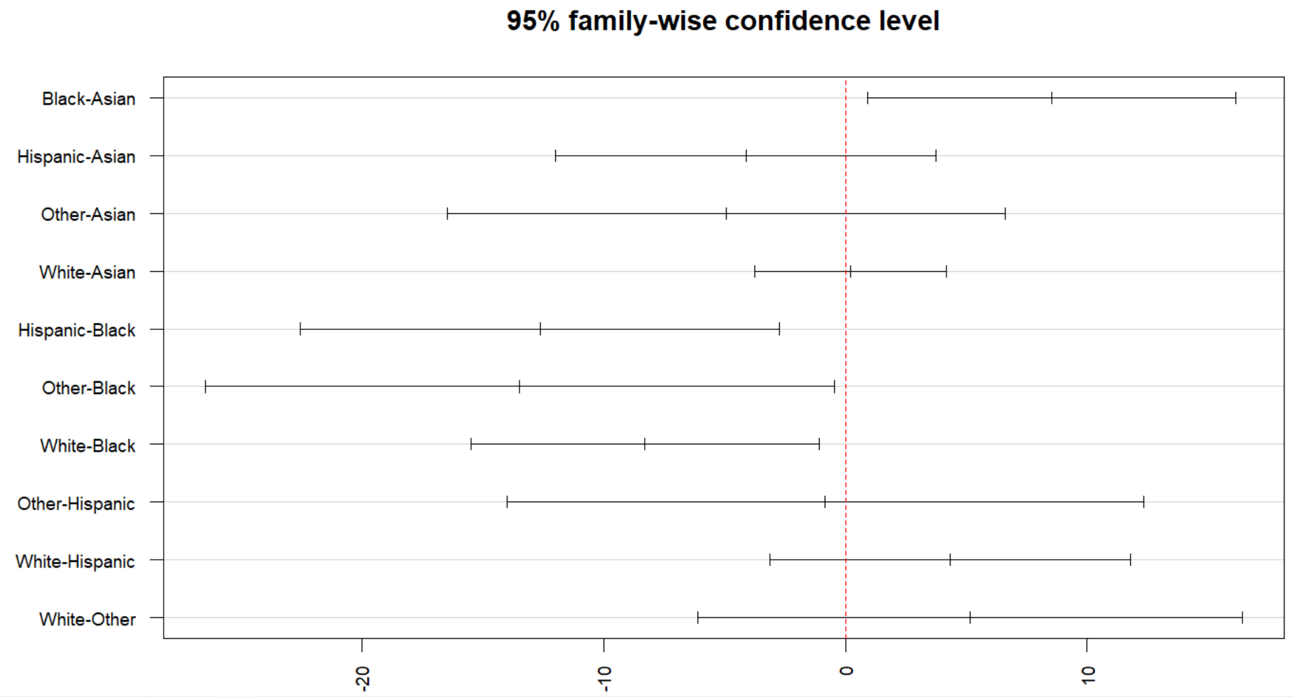
post hoc test:
Clout
4 pairs with sig. difference in
‘clout’ mean score:
Black > Asian by 8.53 pts
Black > Hispanic by 12.6 pts
Black > Other by 13.5 pts
Black > White by 8.30 pts

Slide 38
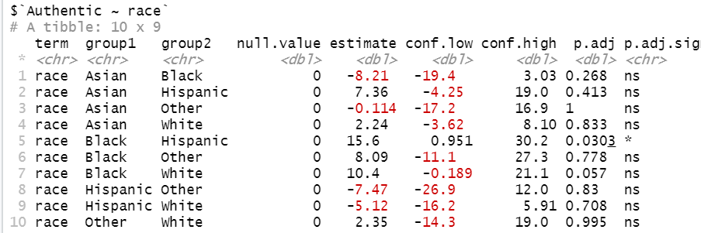
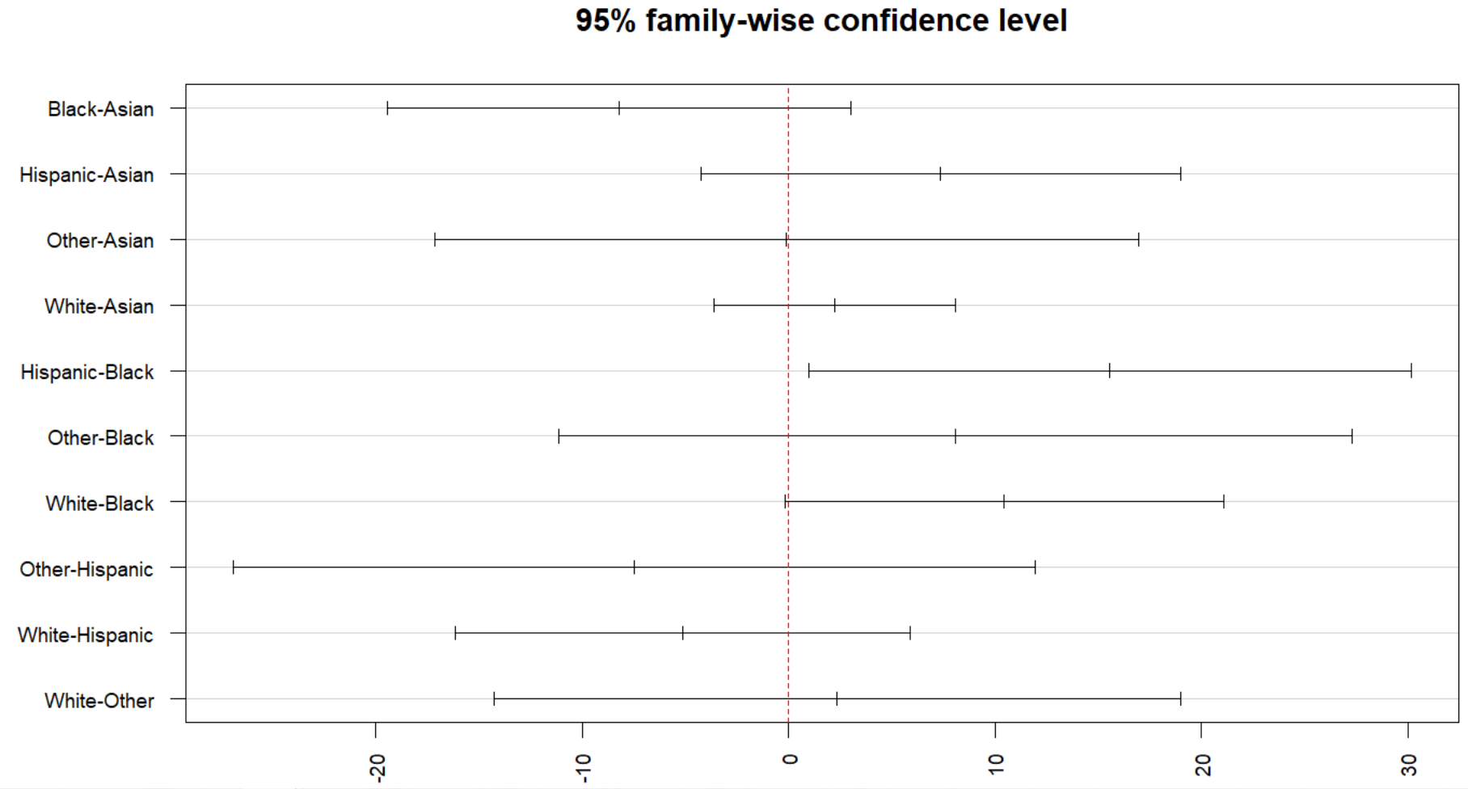
post hoc test:
Authentic
1 pair with sig. difference in
‘authentic’ mean score:
Hispanic > Black by 15.6 pts

Slide 39

Two cycles combined PS Dataset
Notes:
Race with “None” are omitted – there are 51 of them

Slide 40
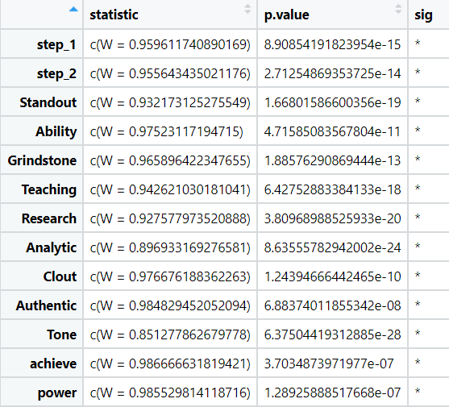
Normality
Shapiro Test
Assumption met if p > 0.05
None meets the normality assumption per the Shapiro test.
Evaluate QQ plots too

Slide 41
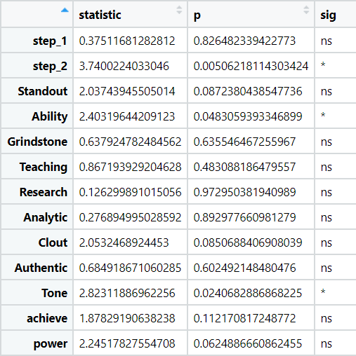
Homogeneity of variance
Levene’s Test
Assumption met if p > 0.05
‘step_2’, ‘Ability’ and ‘tone’ fail to meet the assumption
Use Welch one-way ANOVA for these variables

Slide 42
Statistical Analyses
Combined PS
Vars analyzed with Welch (uneq variance): step 2, ability, tone
Welch sig vars: step2
Vars analyzed with KW (non-norm distribution): all
KW sig vars: step1, step2, clout, authentic
Post hoc significant vars: step1, step2, authentic, tone
Performed post hoc test for all variables, including the ones that KW didn’t find significant
Interestingly, ‘tone’ was found significant using one-way ANOVA
One-way ANOVA sig vars: step1, step2, clout, authentic, tone
Notes:
One-way ANOVA sig variables: step1, step2, clout, authentic, tone
Variables with unequal variance & should use Welch: step 2, ability, tone
Welch sig variables: step1, step2, clout, authentic
Variables with non-normal distribution & should use KW: all
KW sig variables: step1, step2, clout, authentic
Post hoc: step1, step2, authentic, tone
https://stats.stackexchange.com/questions/9751/do-we-need-a-global-test-before-post-hoc-tests

Slide 43
Combined PS
KW sig vars: step1, step2, clout, authentic
Post hoc sig vars: step1, step2, authentic, tone
Variable | Post hoc test results
Step 1 | Asian > Black by 7.27 pts Asian > Hispanic by 5.71 pts White > Black by 7.67 pts White > Hispanic by 6.11 pts
Step 2 | Asian > Black by 5.69 pts White > Black by 5.92 pts White > Hispanic by 7.79 pts
Authentic | White > Asian by 4.50 pts
Tone | White > Black by 6.95 pts
Notes:
‘Clout’ was found significant by KW but not in post hoc test
‘Tone’ was not found significant by KW but was in post hoc test

Slide 44
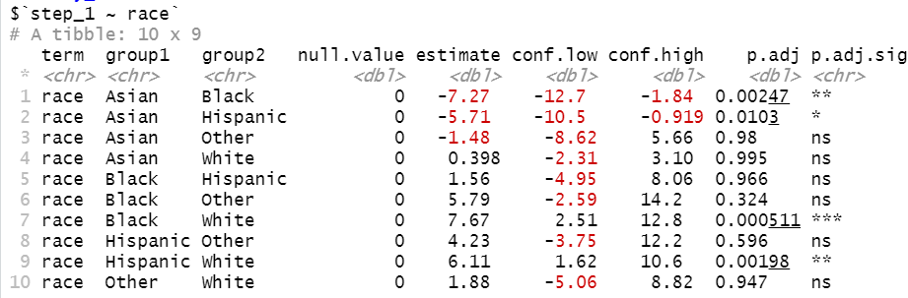
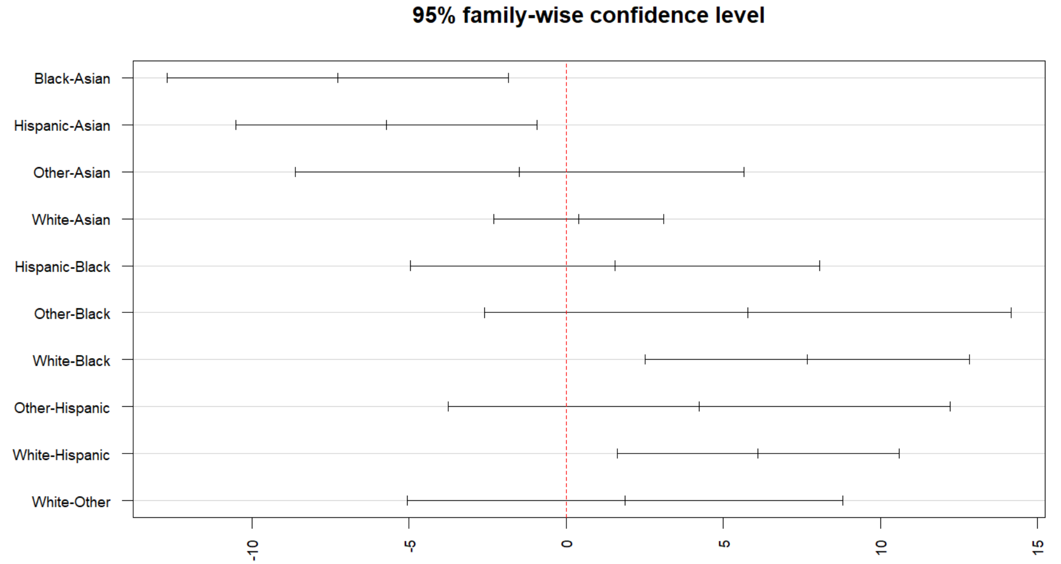
post hoc test:
step_1
4 pairs with sig. difference in
step 1 mean score:
Asian > Black by 7.27 pts
Asian > Hispanic by 5.71 pts
White > Black by 7.67 pts
White > Hispanic by 6.11 pts
Notes:
Post hoc

Slide 45
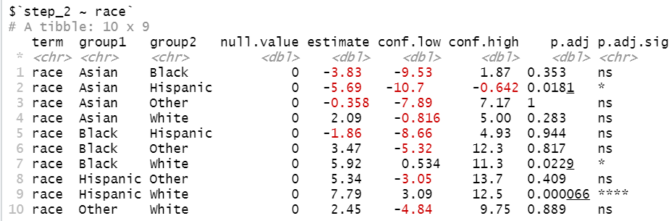
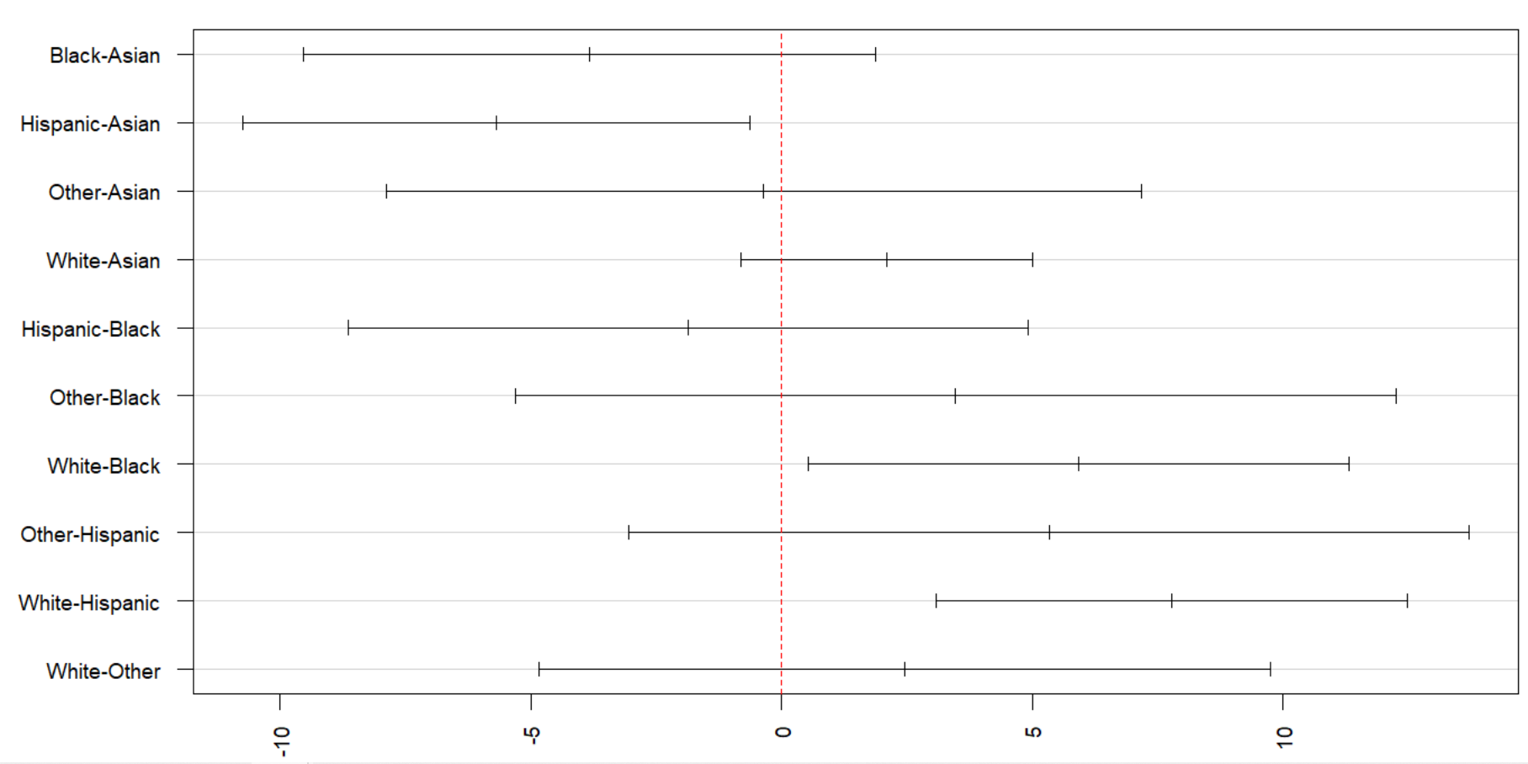
post hoc test:
step_2
3 pairs with sig. difference in
step 2 mean score:
Asian > Black by 5.69 pts
White > Black by 5.92 pts
White > Hispanic by 7.79 pts

Slide 46
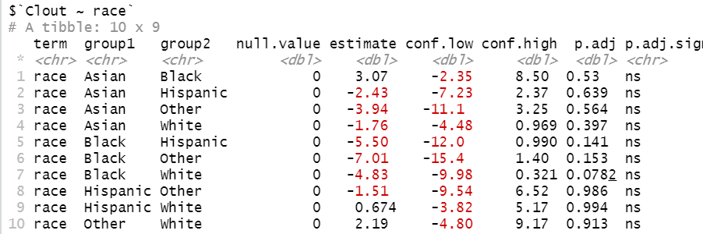
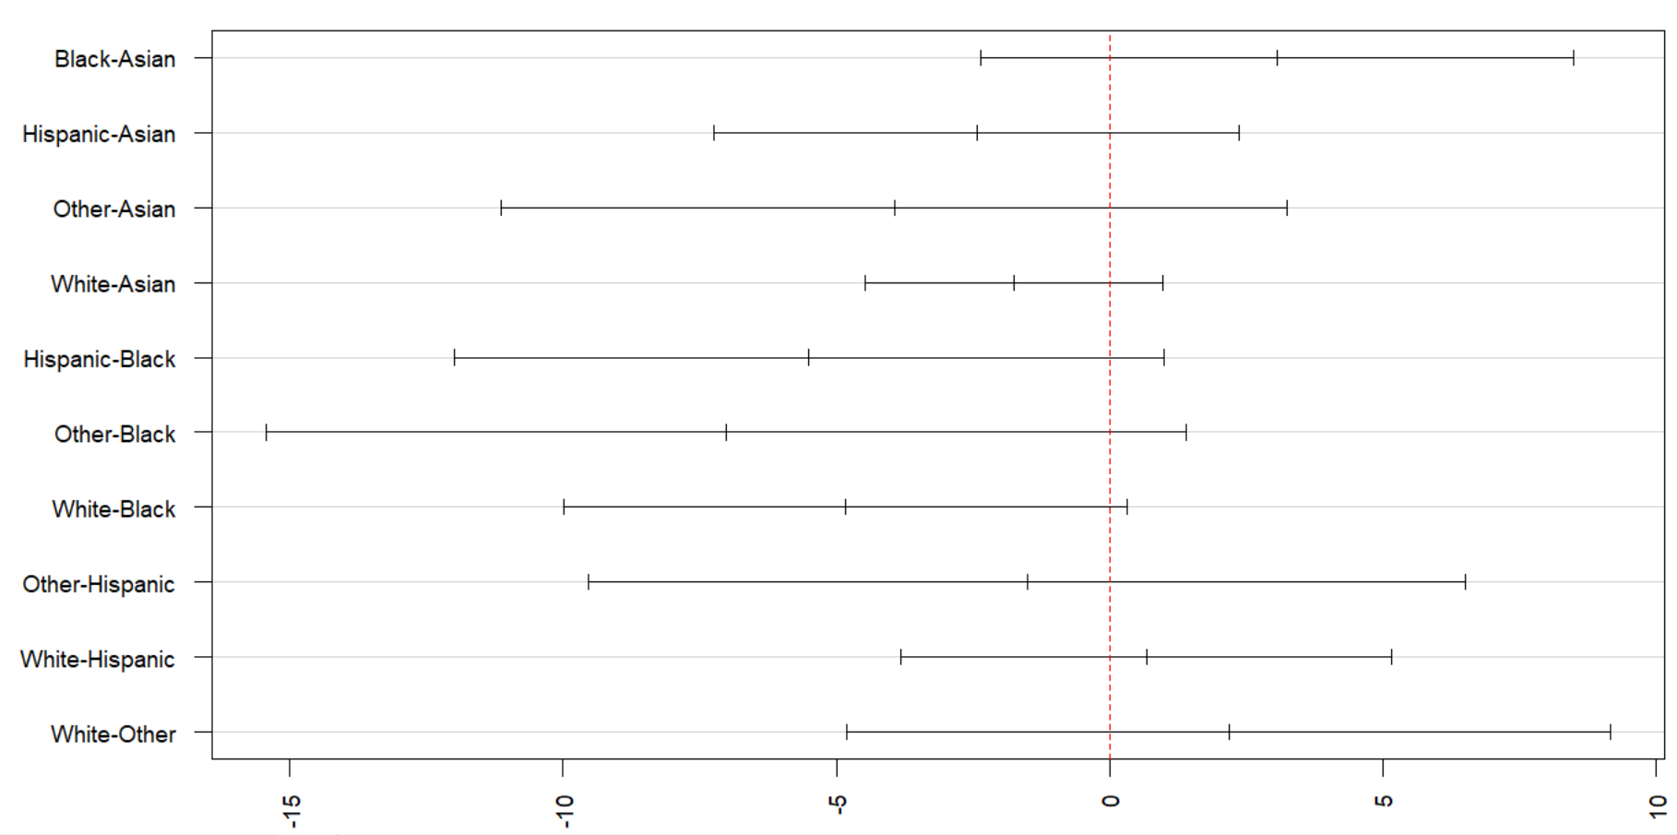
post hoc test:
clout
Although significant KW test, ‘Clout’ does not have any significant mean differences across any pair of racial group per the post hoc test.

Slide 47


post hoc test:
Authentic
1 pair with sig. difference in
‘authentic’ mean score:
White > Asian by 4.50 pts

Slide 48


post hoc test:
Tone
1 pair with sig. difference in
‘tone’ mean score:
White > Black by 6.95 pts

Slide 49
Two cycles combined LOR Dataset
Notes:
Race with “None” are omitted – there are 51 of them

Slide 50

Normality
Shapiro Test
Assumption met if p > 0.05
‘Achieve’ meets the normality assumption per the Shapiro test.
Evaluate QQ plots too

Slide 51

Homogeneity of variance
Levene’s Test
Assumption met if p > 0.05
‘step_2’ and ‘power’ fail to meet the assumption
Use Welch one-way ANOVA for these variables

Slide 52
Statistical Analyses
Combined LOR
Vars analyzed with Welch (uneq variance): step 2, power
Welch sig vars: step2
Vars analyzed with KW (non-norm distribution): all
KW sig vars: step1, step2, clout, authentic
Post hoc significant vars: step1, step2, authentic, tone
Performed post hoc test for all variables, including the ones that KW didn’t find significant
Interestingly, ‘tone’ was found significant using one-way ANOVA
One-way ANOVA sig vars: step1, step2, clout, authentic, tone
Notes:
Slide above has not been updated
One-way ANOVA sig variables: step1, step2, clout, authentic, tone
Variables with unequal variance & should use Welch: step 2, power
Welch sig variables: step1, step2, standout, teaching, research, analytic
Variables with non-normal distribution & should use KW: all except for ‘achieve’
KW sig variables: step1, step2, standout, teaching, research, analytic, achieve
Post hoc: step1, step2, teaching, research, analytic
https://stats.stackexchange.com/questions/9751/do-we-need-a-global-test-before-post-hoc-tests

Slide 53
Combined PS
KW sig vars: step1, step2, clout, authentic
Post hoc sig vars: step1, step2, authentic, tone
Variable | Post hoc test results
Step 1 | Asian > Black by 7.27 pts Asian > Hispanic by 5.71 pts White > Black by 7.67 pts White > Hispanic by 6.11 pts
Step 2 | Asian > Black by 5.69 pts White > Black by 5.92 pts White > Hispanic by 7.79 pts
Authentic | White > Asian by 4.50 pts
Tone | White > Black by 6.95 pts
Notes:
‘Clout’ was found significant by KW but not in post hoc test
‘Tone’ was not found significant by KW but was in post hoc test

Slide 54

post hoc test:
Teaching
4 pairs with sig. difference in
‘teaching’ mean score:
Asian > Other by 0.327 pts
Black > Other by 0.363 pts
Hisp > Other by 0.354 pts
White > Other by 0.296 pts

Slide 55

post hoc test:
Research
1 pair with sig. difference in
‘research’ mean score:
Asian > White by 0.222 pts

Slide 56

post hoc test:
Analytic
1 pair with sig. difference in
‘analytic’ mean score:
Hisp > White by 2.43 pts

