Slide 1
ERAS Linguistics Statistical Analyses
2/2/22

Slide 2
Task 1: Check whether the t tests were done correctly.
Yes, but can be improved in two ways.
Correct for multiple testing
Bonferroni vs Benjamini-Hochberg
Take correlation among predictor variables into account
Regression with FDR

Slide 3
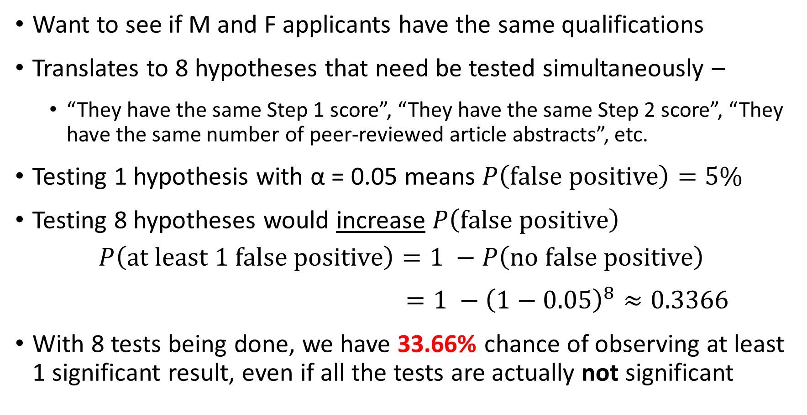
Why correct for multiple testing?
Want to see if M and F applicants have the same qualifications
Translates to 8 hypotheses that need be tested simultaneously –
“They have the same Step 1 score”, “They have the same Step 2 score”, “They have the same number of peer-reviewed article abstracts”, etc.
Testing 1 hypothesis with α = 0.05 means $P\left(false positive\right)=5\%$
Testing 8 hypotheses would increase $P\left(false positive\right)$
$$P\left(at least 1 false positive\right)=1 −P\left(no false positive\right)$$
$=1 −{\left(1−0.05\right)}^{8}≈0.3366$
With 8 tests being done, we have 33.66% chance of observing at least 1 significant result, even if all the tests are actually not significant

Slide 4
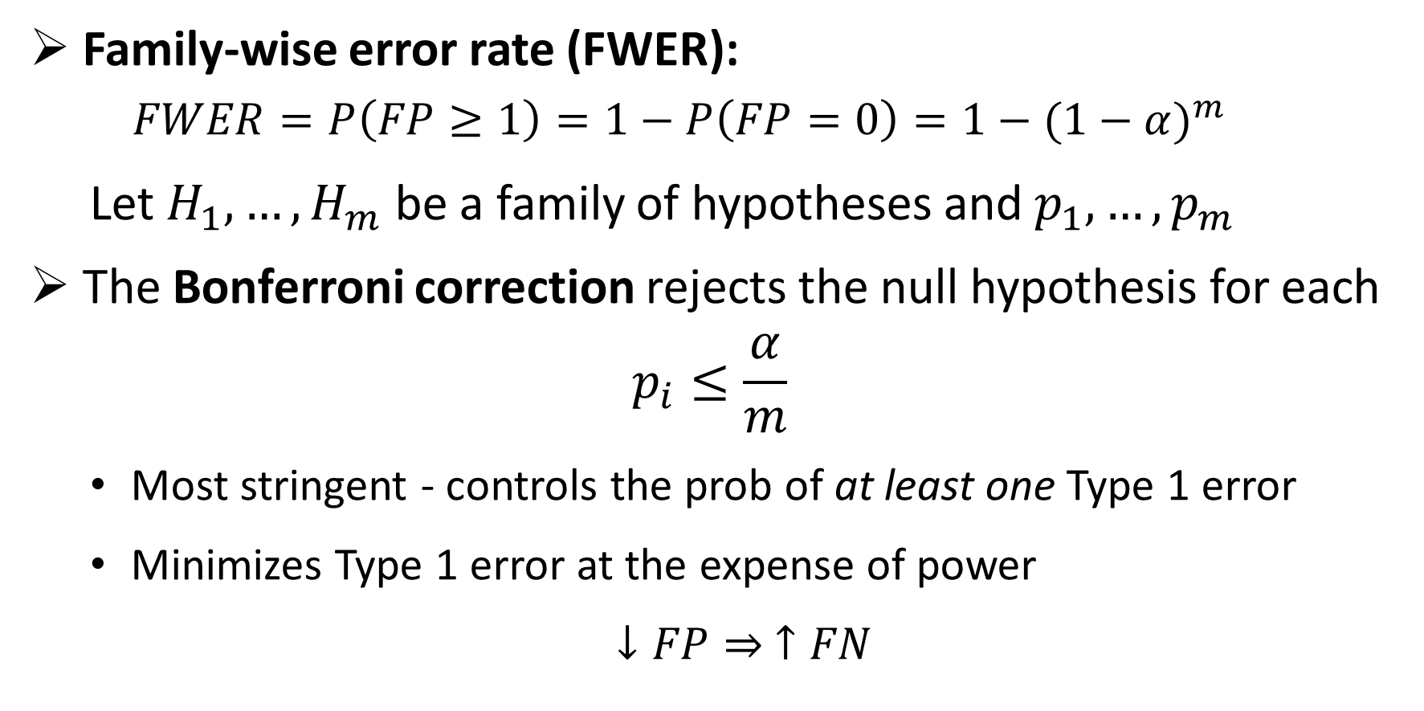

Approach 1: Bonferroni to control for FWER
Family-wise error rate (FWER):
$$FWER=P\left(FP≥1\right)=1−P\left(FP=0\right)=1−{(1−α)}^{m}$$
Let $H_{1}, …,H_{m}$ be a family of hypotheses and $p_{1}, …,p_{m}$
The Bonferroni correction rejects the null hypothesis for each
$$p_{i}≤\frac{α}{m}$$
Most stringent - controls the prob of at least one Type 1 error
Minimizes Type 1 error at the expense of power
$↓FP⇒ ↑FN$
$$\frac{0.05}{8}=0.00625$$
Notes:
The FWER is the probability of making at least one type I error in the family
by assuring FWER <= alpha, the probability of making one or more type I errors in the family is controlled at level alpha
The Bonferroni correction rejects the null hypothesis for each {\displaystyle p_{i}\leq {\frac {\alpha }{m}}}, thereby controlling the FWER at {\displaystyle \leq \alpha }.
FN = Type 2 error; power = 1 – FN = TP
FP = Type 1 error; 1 – FP = TN
0.05 / 8 = 0.00625 = 0.625%

Slide 5
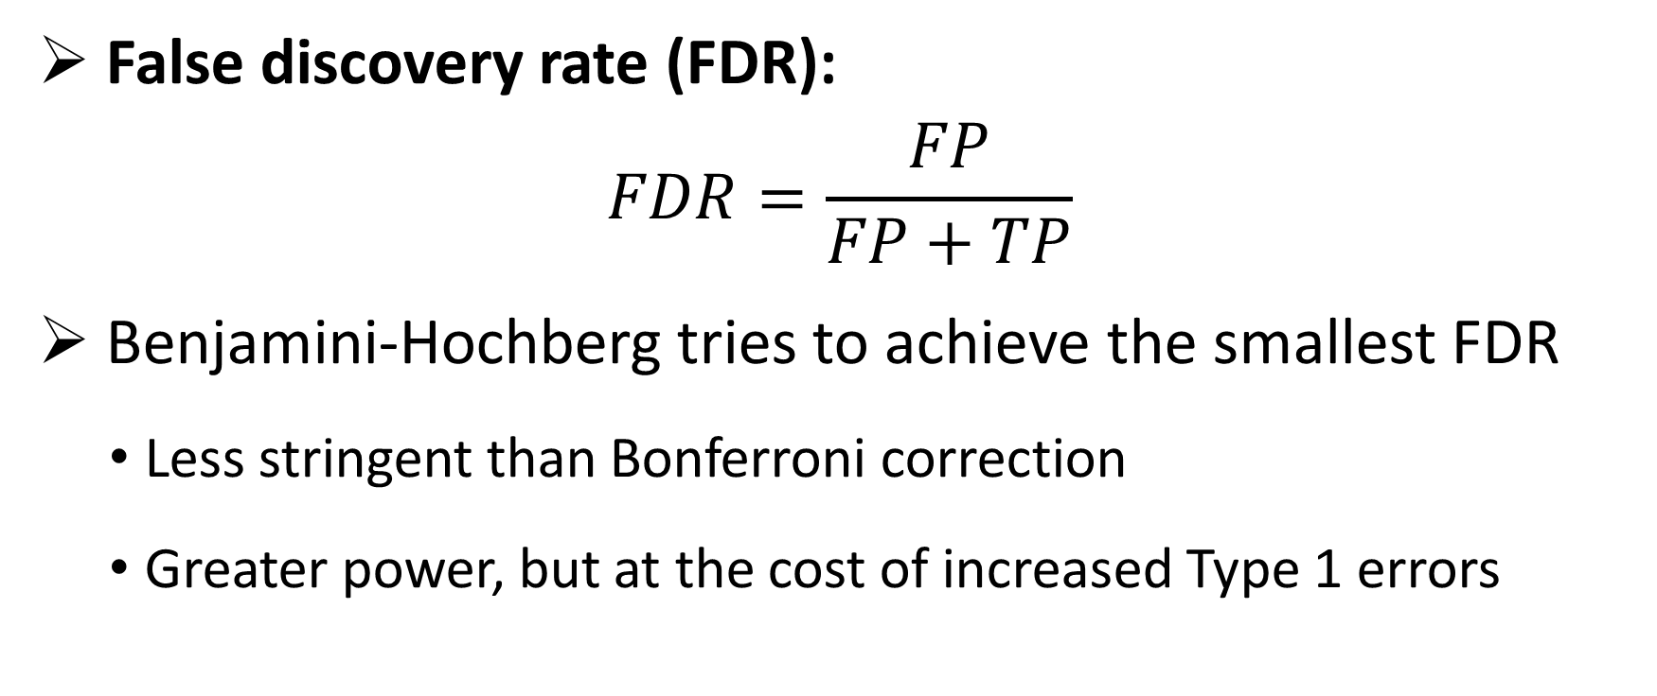
Approach 2: Benjamini-Hochberg to control for FDR
False discovery rate (FDR):
$$FDR=\frac{FP}{FP+TP}$$
Benjamini-Hochberg tries to achieve the smallest FDR
Less stringent than Bonferroni correction
Greater power, but at the cost of increased Type 1 errors
Notes:
The idea of the FDR is to try to achieve the smallest possible fraction of false signals among all those that appear to be true.
Power is the probability of avoiding a Type II error.

Slide 6
Objective Variables (10) |  | Subjective Variables (9)
Objective measures from an individual’s application |  | Qualities characterized from PS and LOR using the linguistic algorithm
Step 1 score Step 2 score Peer Reviewed Journal Articles/Abstracts Peer Reviewed Journal Articles/Abstracts Book Chapter (Peer Reviewed) Poster Presentation Oral Presentation Online Publication (Peer Reviewed) Non Peer Reviewed Online Publication Other Articles | “step_1” “step_2” “peer_art_abs” “extra_art_abs” “book_chap” “poster” “oral” “online_pub_peer” “online_pub_non_peer” “other_art” | Standout Ability Grindstone Teaching Research Analytic Clout Authentic Tone

Slide 7
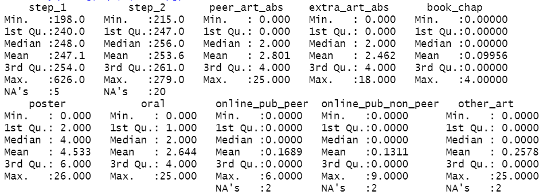
Step 1 score max is 626, which is likely an error. Removed observations with Step 1 score > 300. Turns out that there is only 1 such point.

Slide 8
2020-21 Dataset
Subjective variables were characterized by the Linguistics algorithm from both LOR and PS

Slide 9
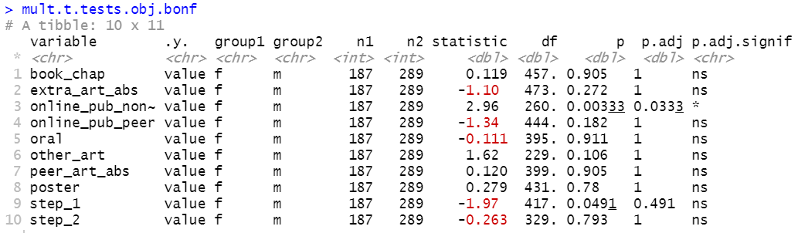
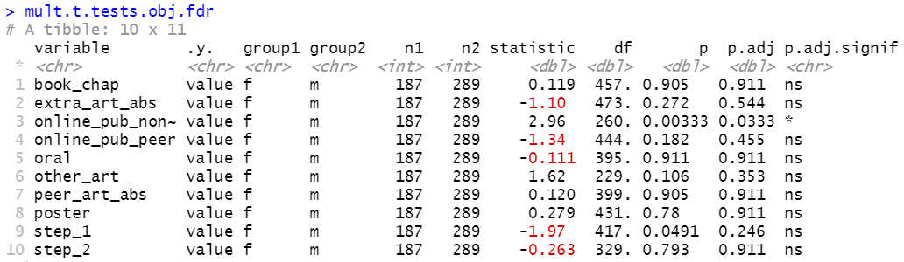
2020-21 Objective
Testing 10 Objective Variables
w/ Multiple Testing Corrections
Group 1 female (n1 = 187)
Group 2 male (n2 = 289)
Non-peer-reviewed online publication remains significantly different between male and female applicants even after multiple testing correction.
Step 1 score is no longer significant once we adjust for multiple testing.
The two methods arrive at the same conclusion:
Male and female applicants differ only in the number of non-peer reviewed online publication (F > M).
Notes:
TO DO: why FDR over Bonferroni
Data visualization: https://www.datanovia.com/en/blog/how-to-perform-t-test-for-multiple-groups-in-r/

Slide 10
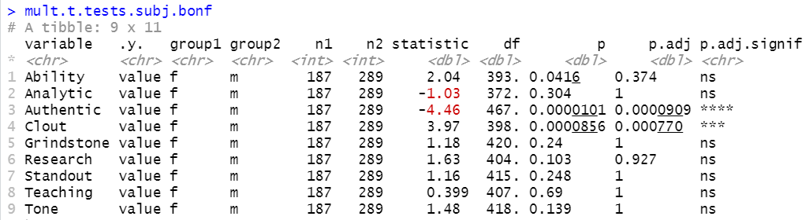
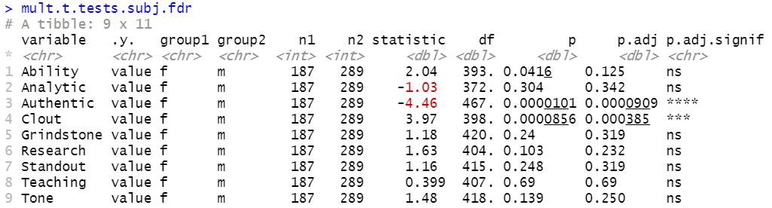
2020-21 Subjective - LOR
Testing 9 Subjective Variables in LOR
w/ Multiple Testing Corrections
TO DELETE
The two methods give the same conclusion:
Male and female applicants’ LOR present different level of “authenticity” (F < M) and “clout” (F > M).
For publication purposes, I recommend reporting results from FDR control.
Notes:
ADD TWO MORE for both LOR and PS: Achieve & Power
Bonferroni minimizes the probability of making at least one false rejection of a null hypothesis.
Benjamini-Hochberg controls the proportion of wrongly rejected null hypotheses amongst those that are rejected (instead of amongst all).
False discovery rate (FDR) is the expected proportion of tests which are incorrectly called significant out of all the tests which are called significant.
The Benjamini-Hochberg (BH) method is a procedure which controls the false discovery rate so that FDR ≤ α.
The difference between the two types of approaches is about the goal and desired error control. E.g. in settings when there is a huge number of signals that need to be screened based on not very much data to determine whether something should be explored further, FDR control may be the most sensible. However, the results should then not be interpreted, as if a strict familywise type I error control had been applied. In contrast, for deciding what claims a drug company can do about a drug based on a clinical registration trial, strict familywise type I error rate is more usual.

Slide 11
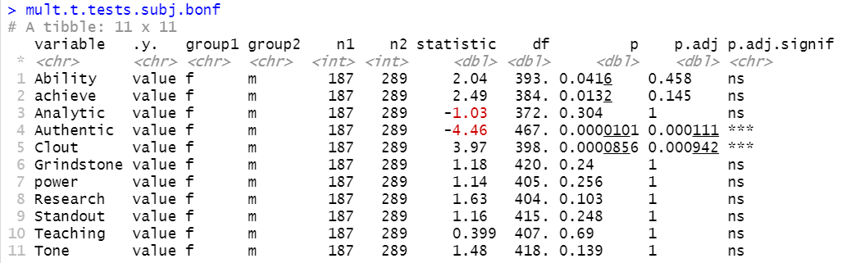
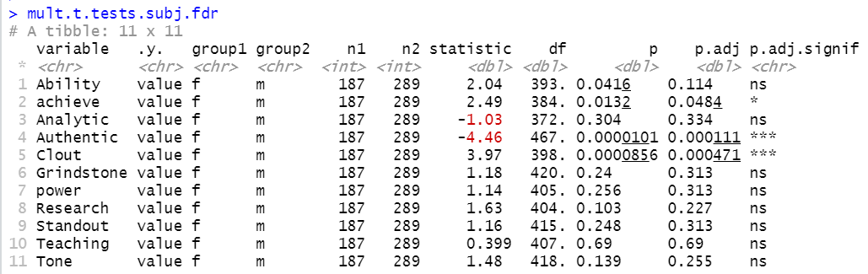
2020-21 Subjective - LOR
Subjective Vars in LOR w/ Multiple Testing Corrections
Group 1 female (n1 = 187)
Group 2 male (n2 = 289)
Notes
Bonferroni and FDR give different results on “achieve.”
I recommend reporting FDR’s result.
Conclusion
With FDR correction, M and F applicants’ LOR differ in -
“achieve”: F > M
“Authentic”: F < M
“Clout”: F > M

Slide 12
Take correlation among predictor variables into account
We can reasonably assume that the predictor variables are correlated to some extent
Important to take correlation into account – regression model
Q’s answered by the model
Does any X differ significantly between male and female? If so, which one(s)?
Brief summary of the operations done:
Perform repeated regressions
Calculate the FDR with Benjamini & Hochberg correction
Find which variables should be retained for or excluded from further multivariate analysis according to their corrected p values
Notes:
Why is it important to take correlation into account?
(TO DO)

Slide 13
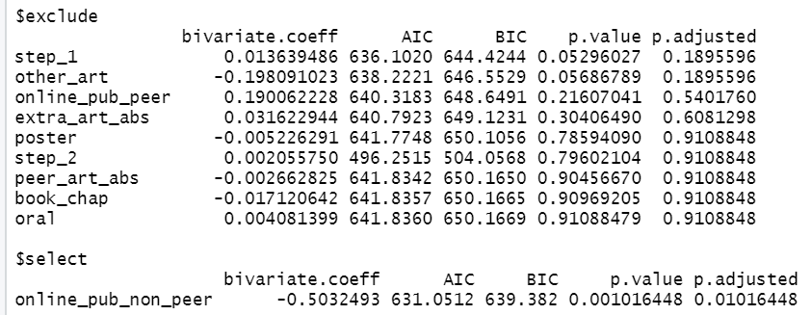
2020-21 Objective
Logistic Regression on 10 Objective Variables Adjusted with FDR Correction
1 variable was selected and 9 were excluded from the model
M and F applicants differ only in non-peer-reviewed online publication. This is the same conclusion as those arrived by the previous multiple testing approaches. The agreement increases our confidence in the conclusion.
Notes:
The Bayesian information criterion (BIC) is a criterion for model selection among a finite set of models; models with lower BIC are generally preferred. It is based, in part, on the likelihood function and it is closely related to the Akaike information criterion (AIC).
When fitting models, it is possible to increase the likelihood by adding parameters, but doing so may result in overfitting. Both BIC and AIC attempt to resolve this problem by introducing a penalty term for the number of parameters in the model; the penalty term is larger in BIC than in AIC.

Slide 14
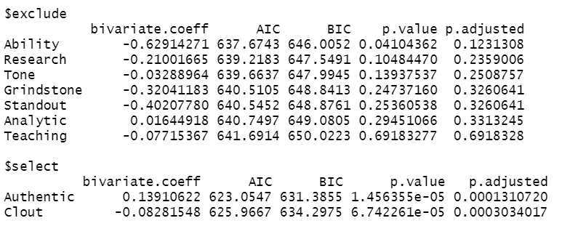
2020-21 Subjective - LOR
TO DELETE
Logistic Regression on 9 Subjective Variables Adjusted with FDR Correction
2 variables were selected and 7 were excluded from the model
The regression model shows male and female LORs differ in Authentic and Clout. This is the same conclusion as those arrived by the previous multiple testing approaches. The agreement increases our confidence in the conclusion.

Slide 15
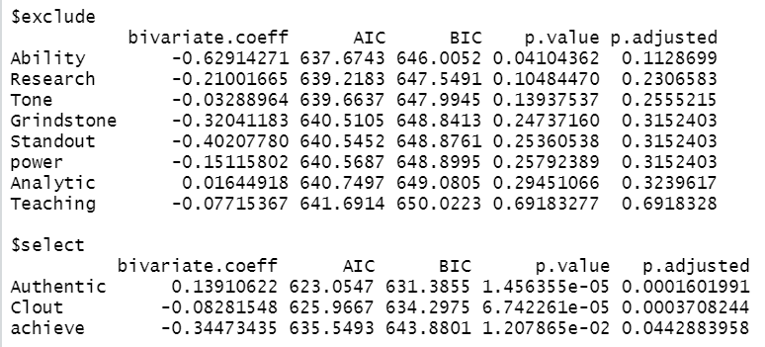
2020-21 Subjective - LOR
Logistic Regression on 11 Subjective Variables
Adjusted with FDR Correction
3 variables were selected and 8 were excluded from the model
The regression model shows male and female LORs differ in Authentic, Clout, and achieve.
Notes:
This is the same conclusion as those arrived by FDR multiple testing approach. The agreement increases our confidence in the conclusion.

Slide 16
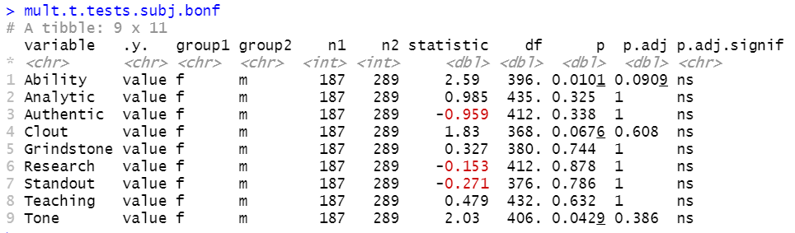
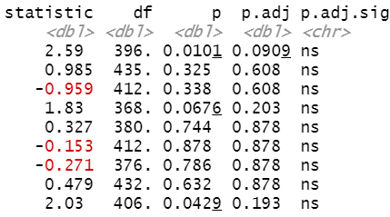
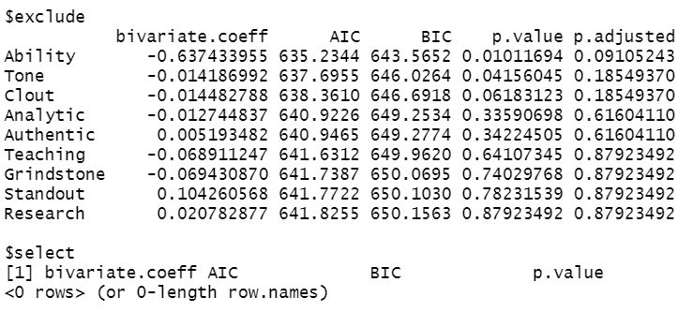
Same analyses on the subjective variables extracted from PS
No significance found using any of the methods
TO DELETE
2020-21 Subj - PS
Bonferroni
FDR
Regression with FDR

Slide 17
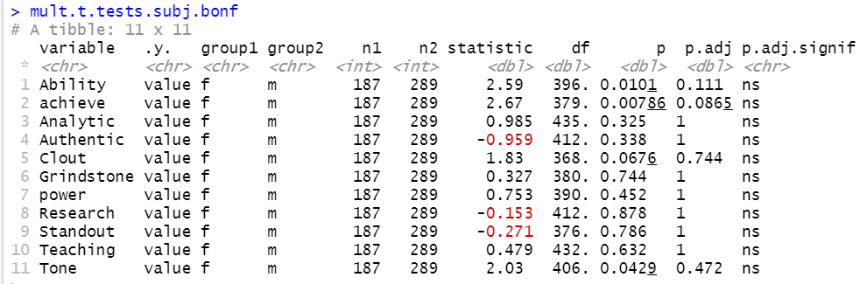
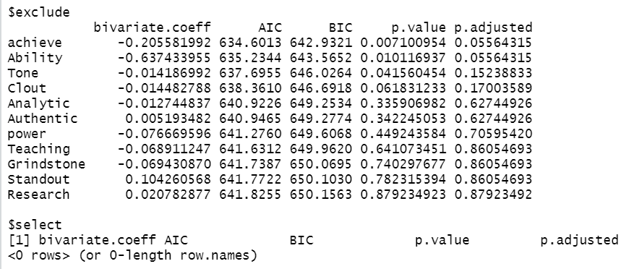
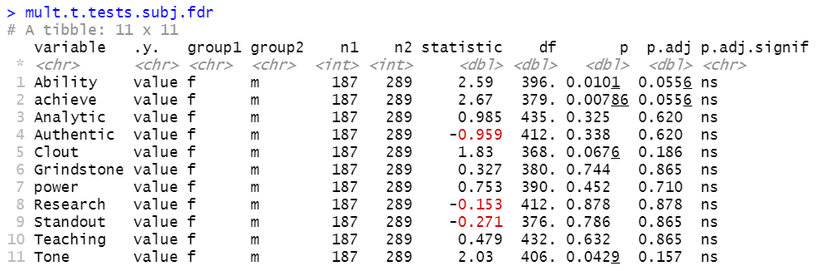
2020-21 Subj - PS

Slide 18
2019-2020 Dataset

Slide 19
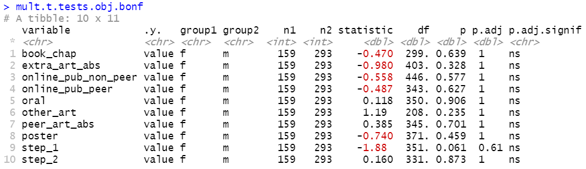
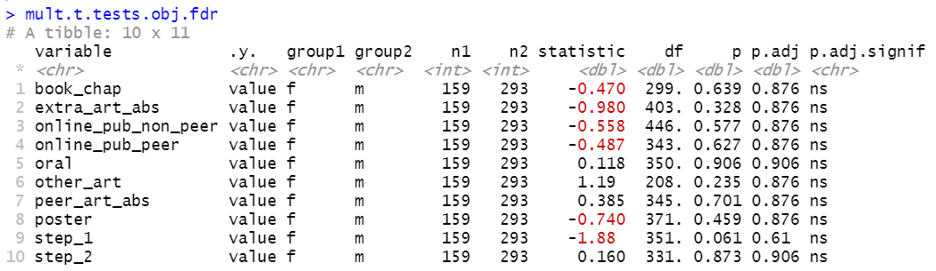
2019-20 Objective
Testing 10 Objective Variables
w/ Multiple Testing Corrections
TO DELETE
Group 1 female (n1 = 159)
Group 2 male (n2 = 293)
The two methods arrive at the same conclusion:
No significant difference between M and F across all variables.

Slide 20
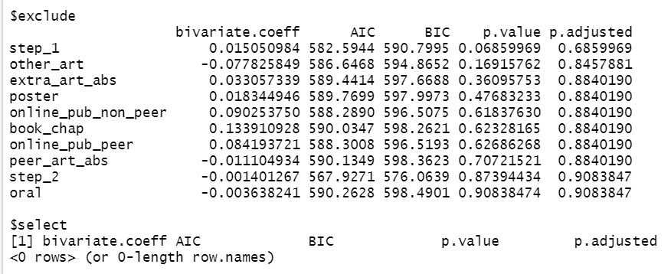
2019-20 Objective
Group 1 female (n1 = 159)
Group 2 male (n2 = 293)

Slide 21
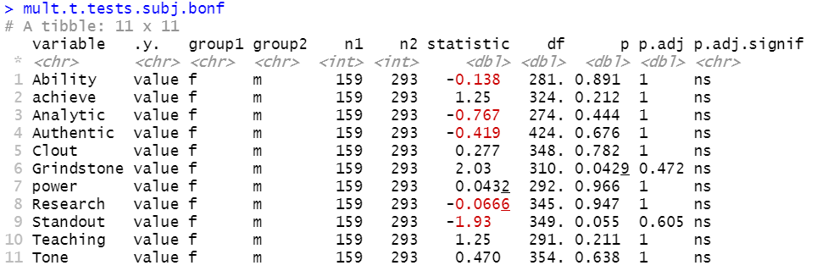
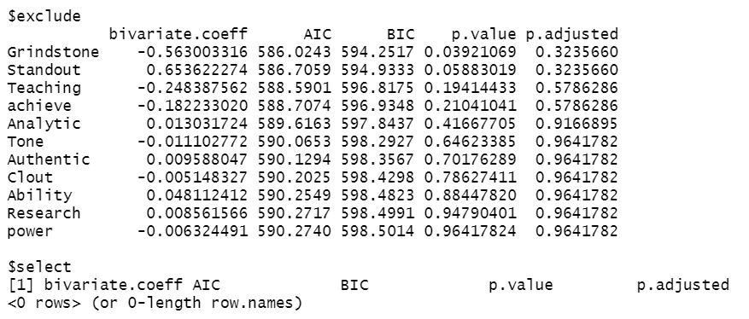
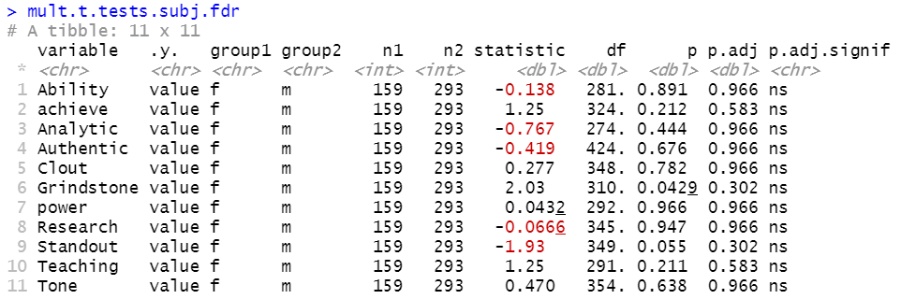
2019-20 Subj - LOR

Slide 22
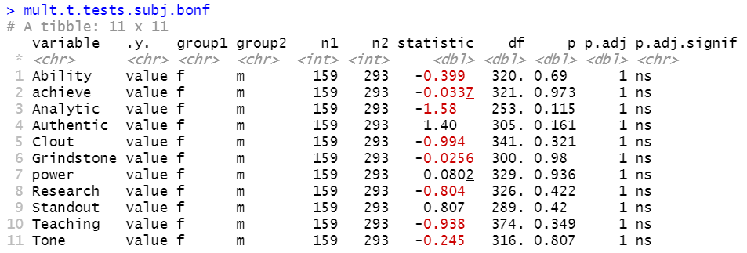
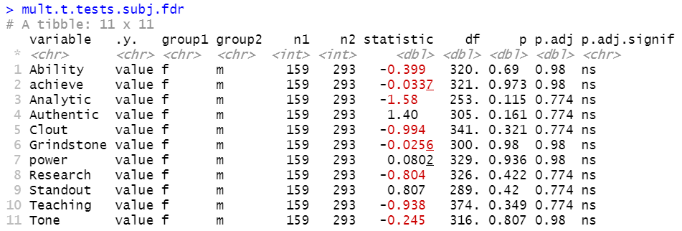
2019-20 Subj - PS

Slide 23
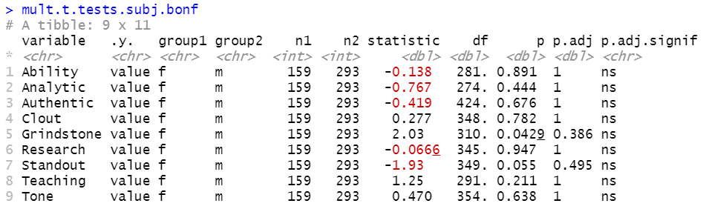
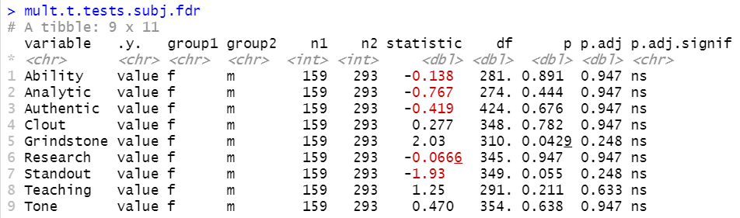
2019-20 Subjective - LOR
Testing 9 Subjective Variables
w/ Multiple Testing Corrections
TO DELETE
Group 1 female (n1 = 159)
Group 2 male (n2 = 293)
The two methods arrive at the same conclusion:
No significant difference between M and F across all variables.

Slide 24
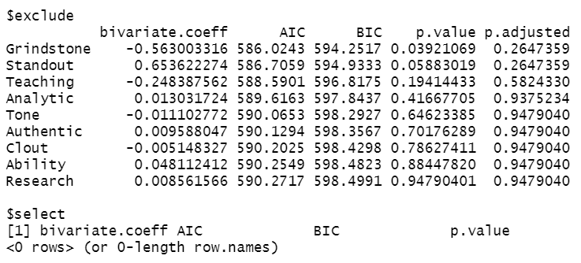
Logistic Regressions Adjusted with FDR Correction
No variable was selected for either the objective or subjective model
2019-20 Obj + Subj (LOR)
TO DELETE

Slide 25
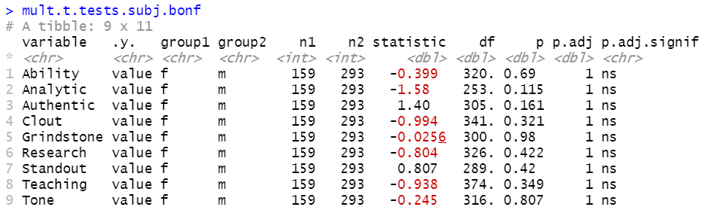
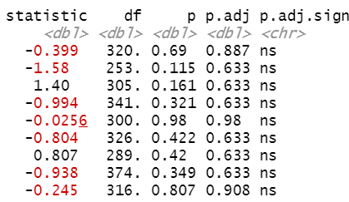
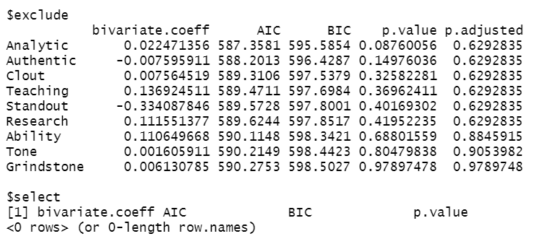
Same analyses on the subjective variables extracted from PS
No significance found using any of the methods
2019-20 Subj - PS
Bonferroni
FDR
Regression with FDR

Slide 26
Summary
 | Variable found sig different between M and F [not significant] | p | p.adj.bon | p.adj.fdr | p.regress.adj.fdr
2020-21 Obj | Online_pub_non_peer | 0.00333 | 0.0333 | 0.0333 | 0.01016448
 | [Step_1] | 0.0491 | [0.491] | [0.246] | [0.1895596]
2020-21 Subj - LOR | Authenticity | 0.0000101 | 0.0000909 | 0.0000909 | 0.000131072
 | Clout | 0.0000856 | 0.000770 | 0.000385 | 0.000303402
2020-21 Subj - PS | [None] | --- | --- | --- | ---
2019-20 Obj | [None] | --- | --- | --- | ---
2019-20 Subj - LOR | [None] | --- | --- | --- | ---
2019-20 Subj - PS | [None] | --- | --- | --- | ---

Slide 27
Two cycles combined
2020-21 & 2019-20
Same analyses

Slide 28
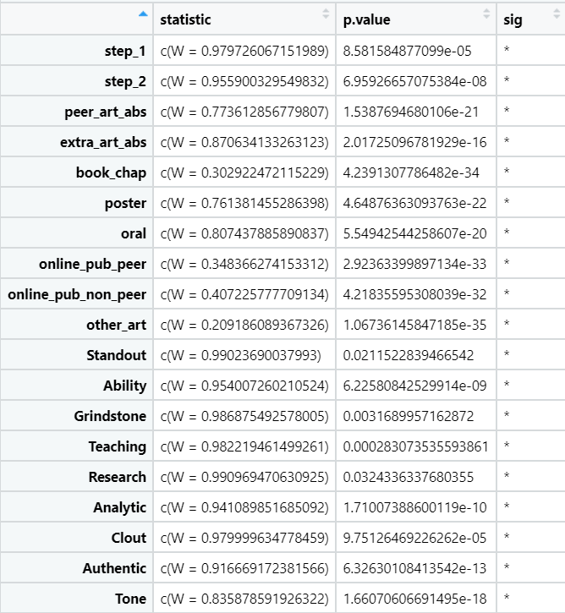
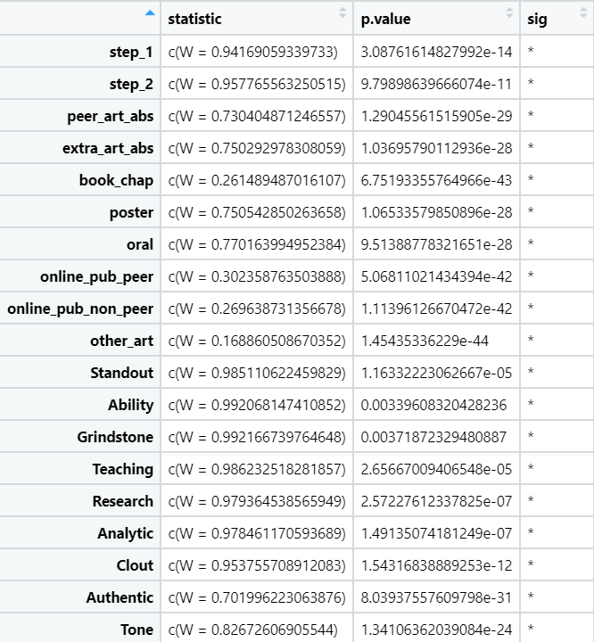


Normality Check – Shapiro test (p < 0.05 indicates absence of normality)
female
male

Slide 29
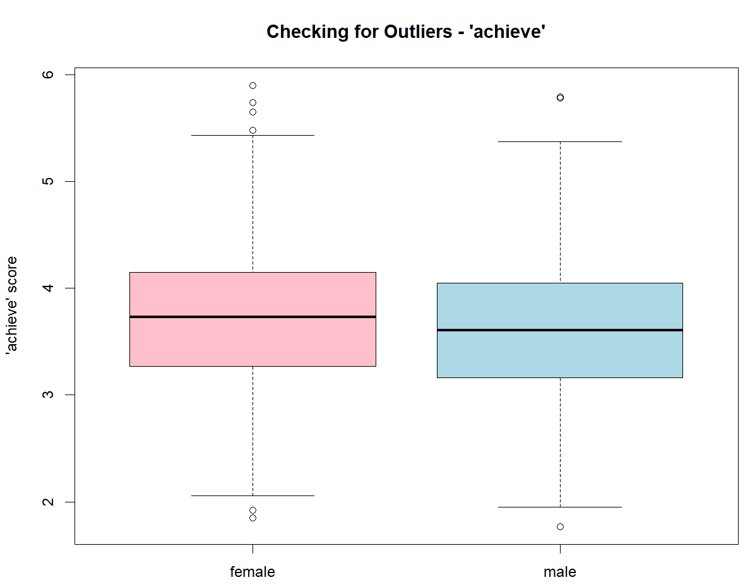
Examine the reasons for the outliers
Outliers here most likely represent natural variation of the samples
Keep the outliers
Use non-parametric tests as they are robust to outliers
Mann–Whitney U
Notes:
When to remove outliers and how to analyze data when they are present?
Outliers can distort statistical analyses and violate their assumptions. Resisting the temptation to remove outliers inappropriately can be difficult. Outliers increase the variability in your data, which decreases statistical power. Consequently, excluding outliers can cause your results to become statistically significant.
However, removing outliers is legitimate only for specific reasons. If the outlier in question is:
A measurement / data entry error: correct the error if possible. If you can’t fix it, remove that observation because you know it’s incorrect.
Not a part of the population you are studying (i.e., unusual properties or conditions), you can legitimately remove the outlier.
you must be able to attribute a specific cause or reason for why that sample item does not fit your target population.
A natural part of the population you are studying, you should not remove it.
All data distributions have a spread of values. Extreme values can occur, but they have lower probabilities. If your sample size is large enough, you’re bound to obtain unusual values. In a normal distribution, approximately 1 in 340 observations will be at least three standard deviations away from the mean. However, random chance might include extreme values in smaller datasets! In other words, the process or population you’re studying might produce weird values naturally. There’s nothing wrong with these data points. They’re unusual, but they are a normal part of the data distribution.
If there is no justifiable reason to remove that point, we should leave it in even when the data point is influential. It’s bad practice to remove data points simply to produce a better fitting model or statistically significant results.
Nonparametric hypothesis tests are robust to outliers - outliers won’t necessarily violate their assumptions or distort their results.
https://statisticsbyjim.com/basics/remove-outliers/#:~:text=Removing%20outliers%20is%20legitimate%20only,area%20and%20data%20collection%20process.&text=Outliers%20increase%20the%20variability%20in,results%20to%20become%20statistically%20significant.

Slide 30
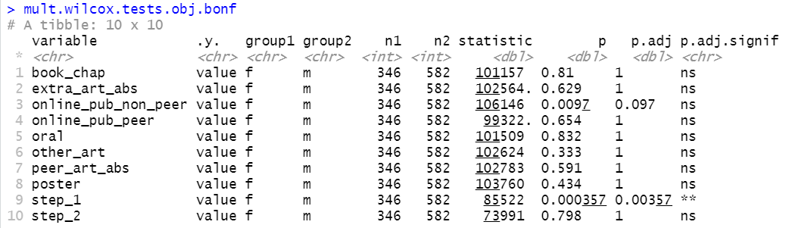
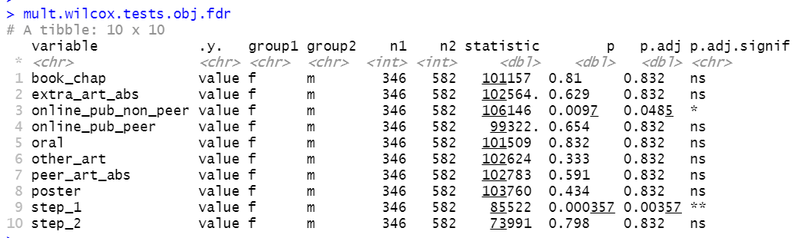
Notes:
Using non parametric when normal –
https://stats.stackexchange.com/questions/376394/what-will-happen-if-i-use-a-nonparametric-test-with-normally-distributed-data
https://www.analyticsvidhya.com/blog/2017/11/a-guide-to-conduct-analysis-using-non-parametric-tests/

Slide 31
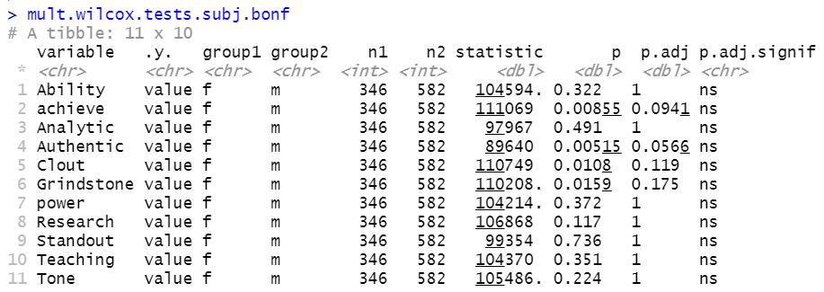
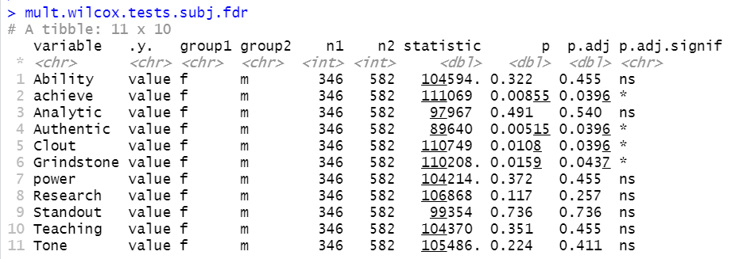

Slide 32
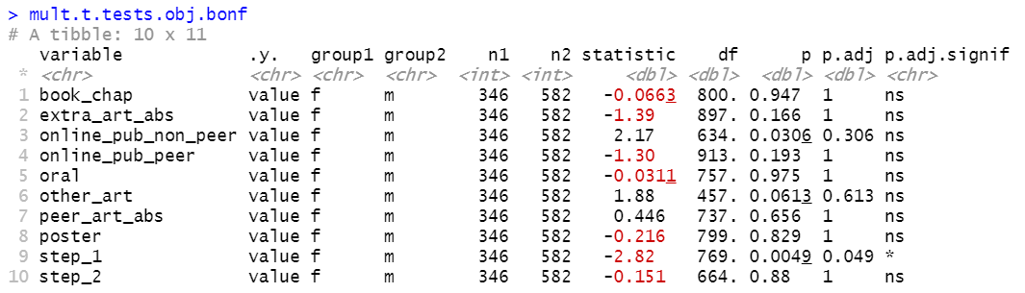
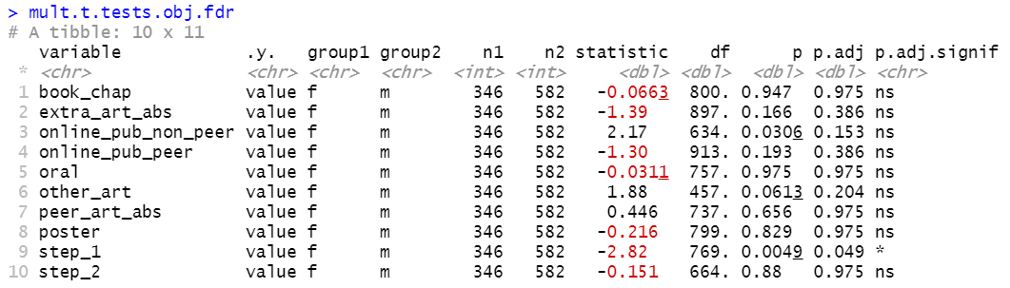
Two cycles combined: Obj
Testing 10 Objective Variables
w/ Multiple Testing Corrections
TO DELETE
Notes:
If we believe there are fundamental differences that contribute to the making of the two applicant pools, then do separate analyses. Otherwise combine them.

Slide 33
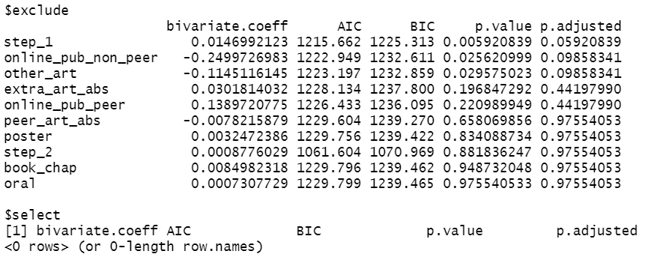
Two cycles combined: Obj
Logistic Regression
TO DELETE

Slide 34
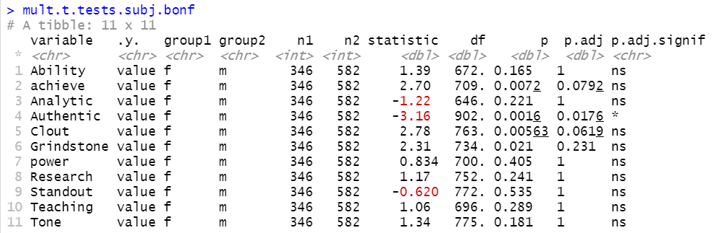
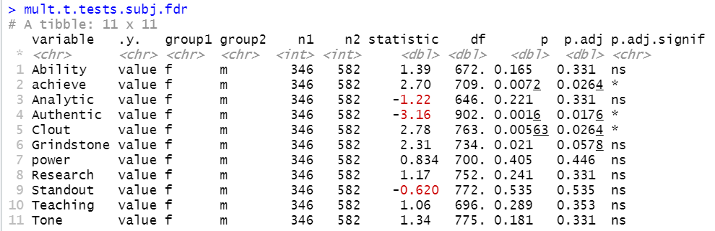
TO DELETE

Slide 35
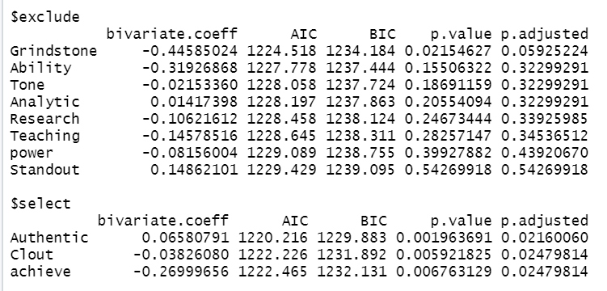
TO DELETE

Slide 36
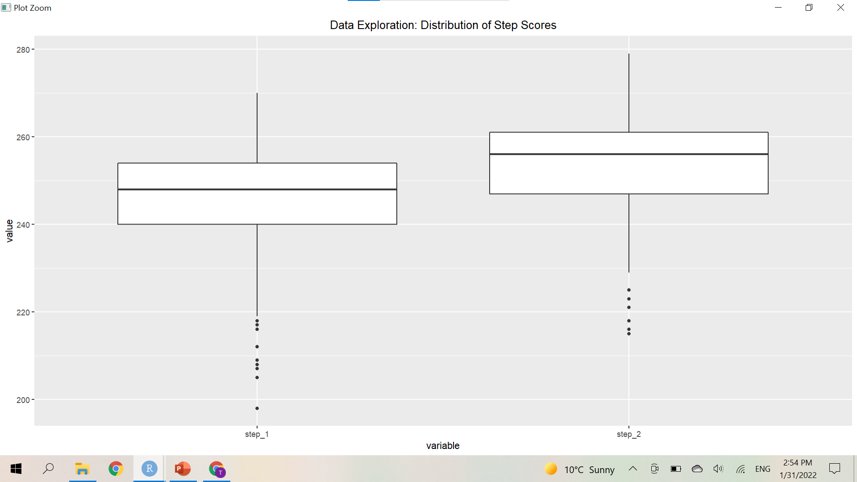
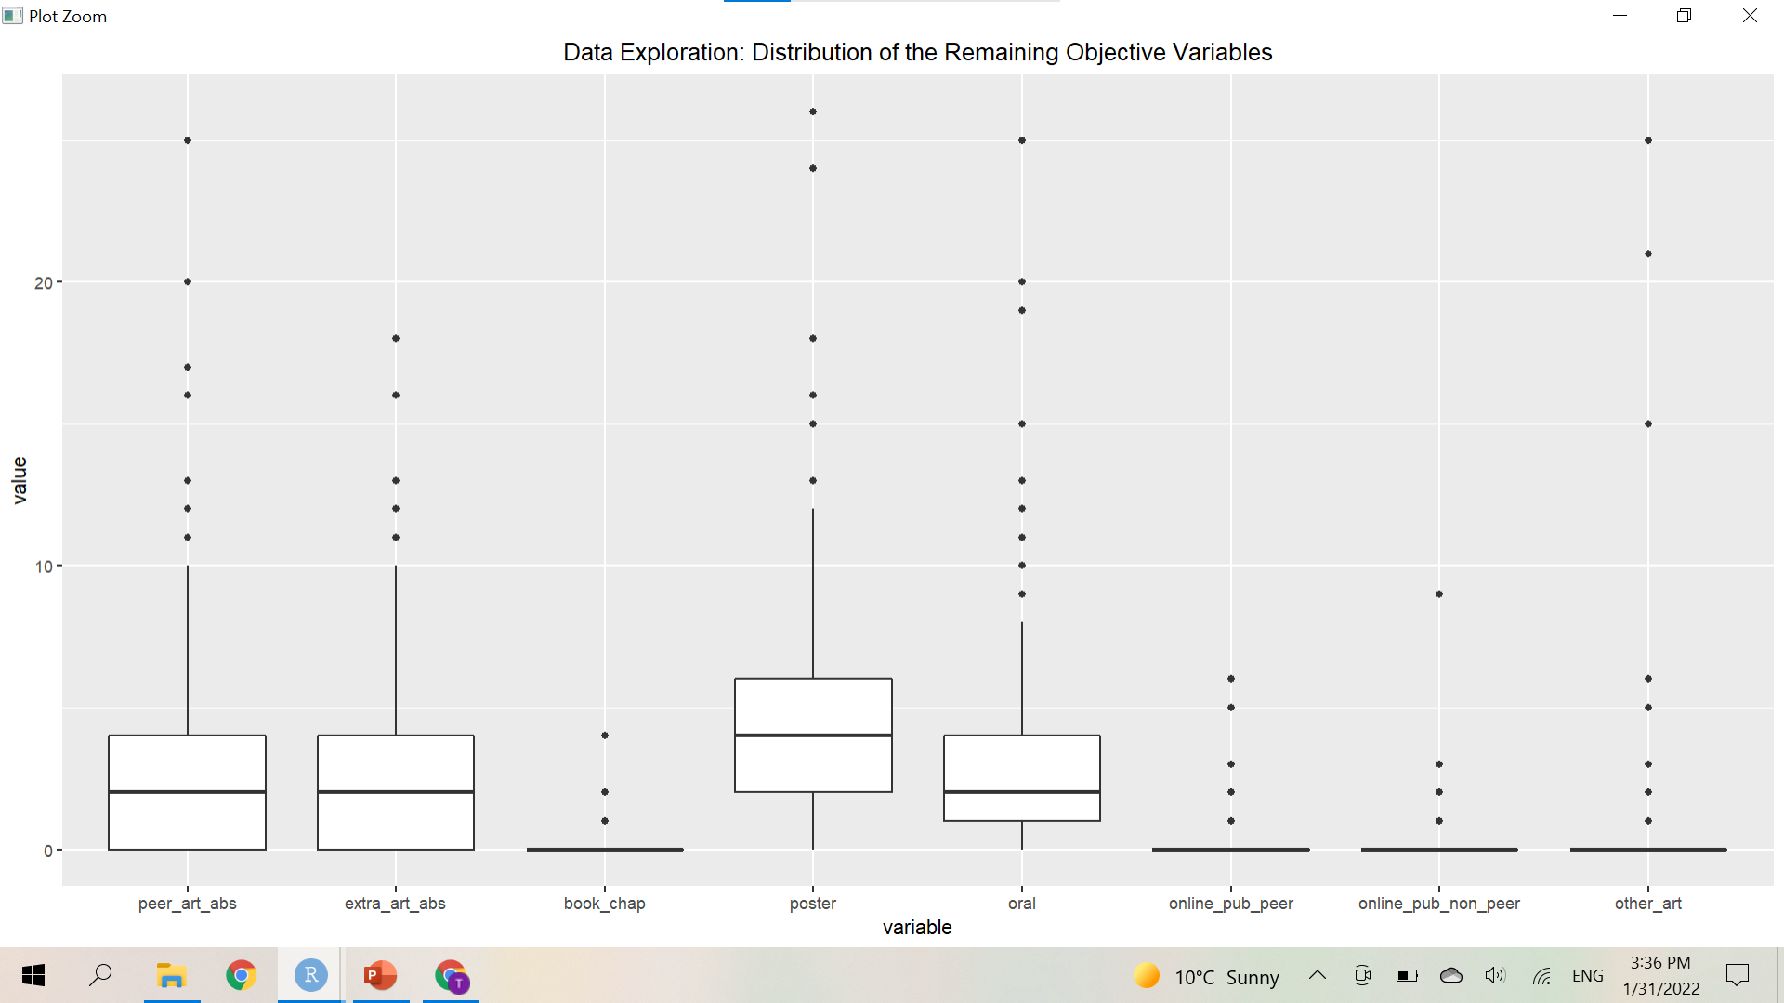

Slide 37
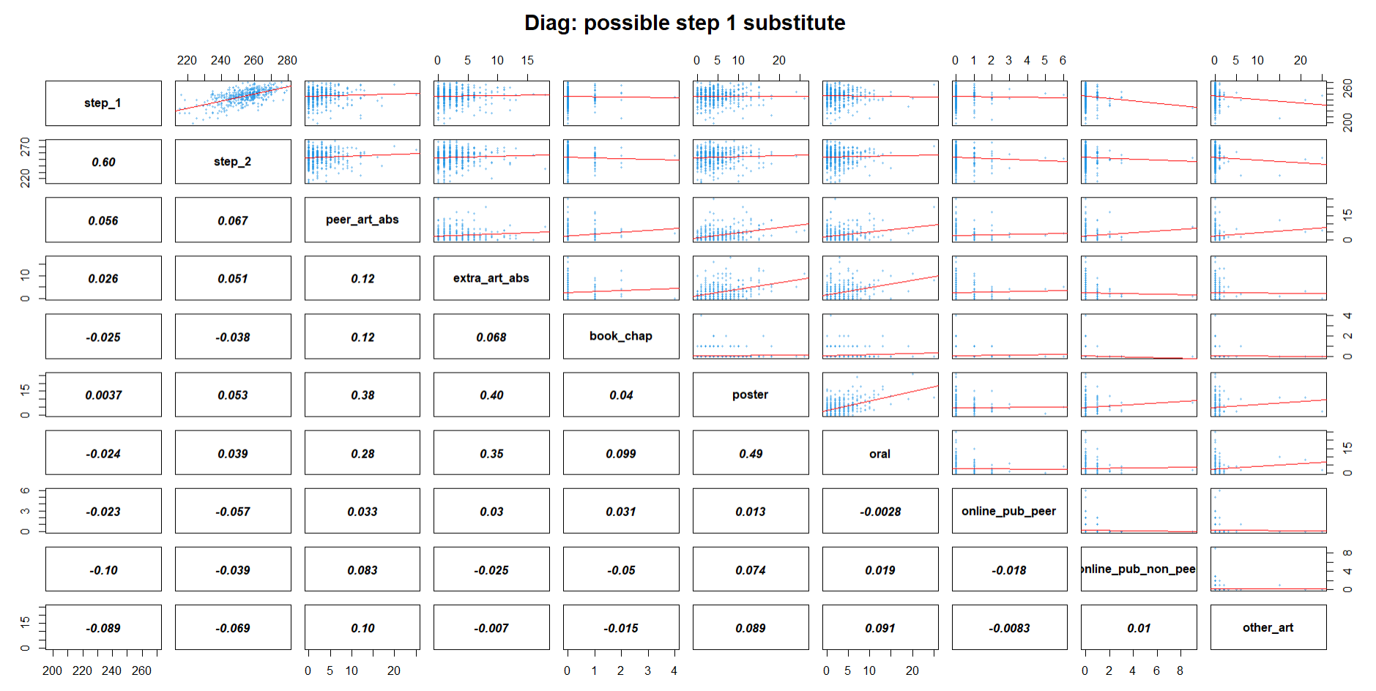

Slide 38
Task 2: substitute metric for Step 1 score?
Linear regression with possible transformation

