Slide 1

Buy / Sell Recommendation
Tiffany Gwyneth Tiono

Slide 2


Sector Thesis & Buy / Sell Thesis
Sector Thesis
The global economy is slowing down
Changing in regulations and taxes
The consumer staples sector in our portfolio is underperforming
Buy / Sell Thesis Recommendation
I recommend to buy Procter & Gamble and to sell Colgate Palmolive.

Slide 3

Why Procter & Gamble?
Buy Thesis:
Mid to high-end brands and innovations in their products
Focus and strengthen its business portfolio to compete in categories and with brands
Having a good projection of earnings and price/share in the next 5 years

Slide 4
Business
Source: SEC 10-K

Slide 5

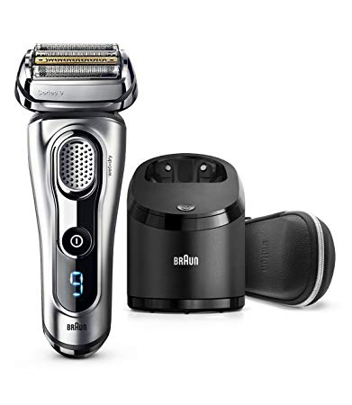
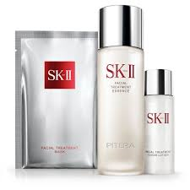
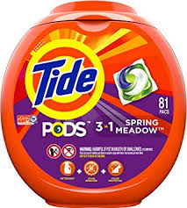
Business
Core Products:

Slide 6
Management
PSP (Performance Stock Program)
STAR (Short-Term Achievement Reward)
- PSP ( Performance Stock Program)
- LTIP ( Long-term Incentive Program)
Source: Proxy Statement

Slide 7
Balance Sheet
Liquidity:
Current Ratio: 0.72
Quick Ratio: 0.54
Operating Cash Flow ratio: 10.84
Dividend Payout: 55.97
Debt Ratios:
Debt to equity ratio: 0.66
Debt to Total Assets ratio: 0.29
Financial Leverage ratio: 1.44
5-Years Projection:
Earning Growths: 8.4%
Price/Share Target: $186.65
Source: Bloomberg ; CSI Market

Slide 8
Valuation
Procter & Gamble
P/E ratio: 81.84
P/B ratio: 6.67
ROA: 3.34
ROE: 7.58
Industry
P/E ratio:21.42
P/B ratio: 6.17
ROA: 6.16
ROE: 21.29
DCF Valuation
BUY
Intrinsic Value: $125.60
Market Value : $122.13
Undervalued
Sources: Bloomberg; CSI Market

Slide 9
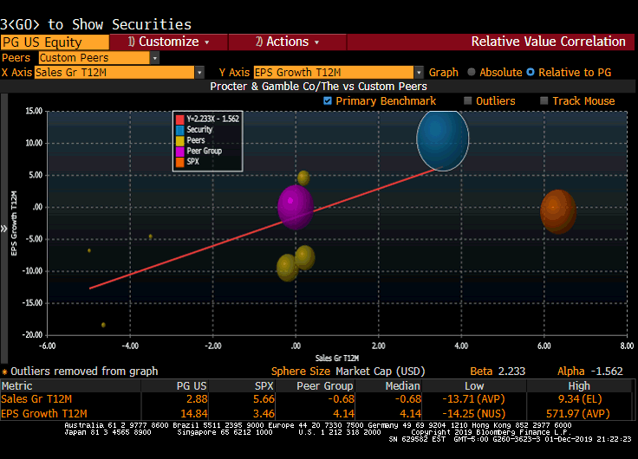

Slide 10

Why Colgate Palmolive?
Sell Thesis:
Concerns about long-term debts and shareholder’s equity
Stagnating in revenue growth & decreasing in the profits
Losing market shares in its key products
Faces the rising of production costs and raw material costs

Slide 11


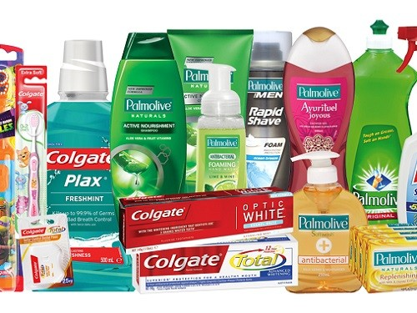

Business
Core Products:

Slide 12
Business
Source: SEC 10-K

Slide 13
Business
Business Risk:
Fluctuation of exchange foreign currencies
Trade War – Imposes taxes for foreign goods
Changing in regulations and taxes have given a negative impact to overall financial condition
Source: SEC 10-K

Slide 14
Management
CEO Compensations:
NEO Compensations:
14.4% Base Salary
Performance Based Salary
- 6.5% Bonus
- 23.5 % Stock Awards
- 52.3 % Option Awards
- 3.3 % other compensations
75-90% of their target direct compensation (salary, target annual and long-term incentives)
Annual and long-term incentive award payments vary from target levels based on the Company’s business performance
The value of equity awards also varies based on the performance of the Company’s common stock
Source: Proxy Statement

Slide 15
Balance Sheet
Liquidity:
Current Ratio: 1.13
Quick Ratio: 0.60
Operating Cash Flow ratio: 22.08
Debt Ratios:
Debt to equity ratio: N/A
Debt to Total Asset ratio: 0.52
Financial Leverage Ratio: 84.84
5-Years Projection:
Earning Growths: 1.2%
Price/Share Target: $58.72
Sources: Bloomberg; CSI Market

Slide 16
Valuation
Colgate Palmolive
P/E ratio: 25.03
P/B ratio: N/A
ROA: 19.3
ROE: N/A
Industry
P/E ratio: 21.42
P/B ratio: 6.17
ROA: 6.16
ROE: 21.29
SELL
DCF Valuation
Overvalued
Intrinsic Value: $45.32
Market Value: $67.87
Sources: Bloomberg ; CSI Market; Yahoo Finance

Slide 17
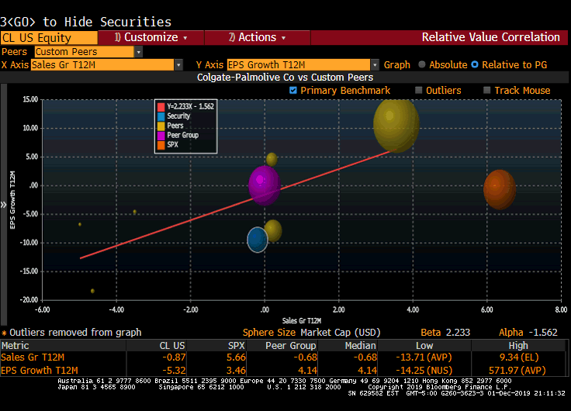

Slide 18

Questions & Answer

