Slide 1
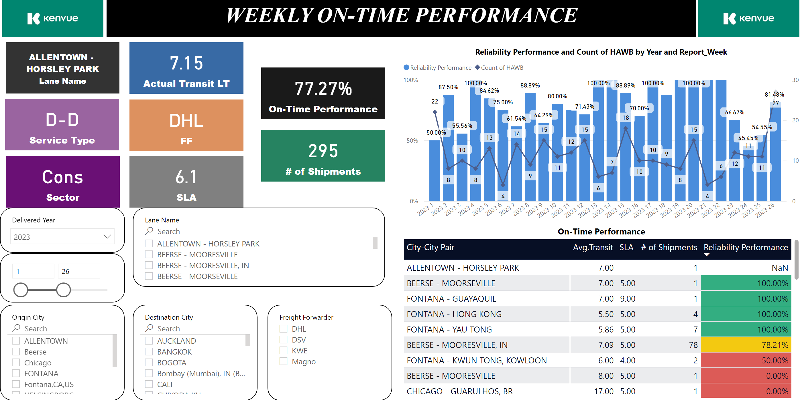
All Lanes
Notes:
slicer
No alt text provided
slicer
No alt text provided
textbox
No alt text provided
image
No alt text provided
image
No alt text provided
slicer
No alt text provided
slicer
No alt text provided
card
No alt text provided
slicer
No alt text provided
slicer
No alt text provided
card
No alt text provided
card
No alt text provided
card
No alt text provided
card
No alt text provided
card
No alt text provided
card
No alt text provided
card
No alt text provided
On-Time Performance
No alt text provided
lineStackedColumnComboChart
No alt text provided

