Slide 1
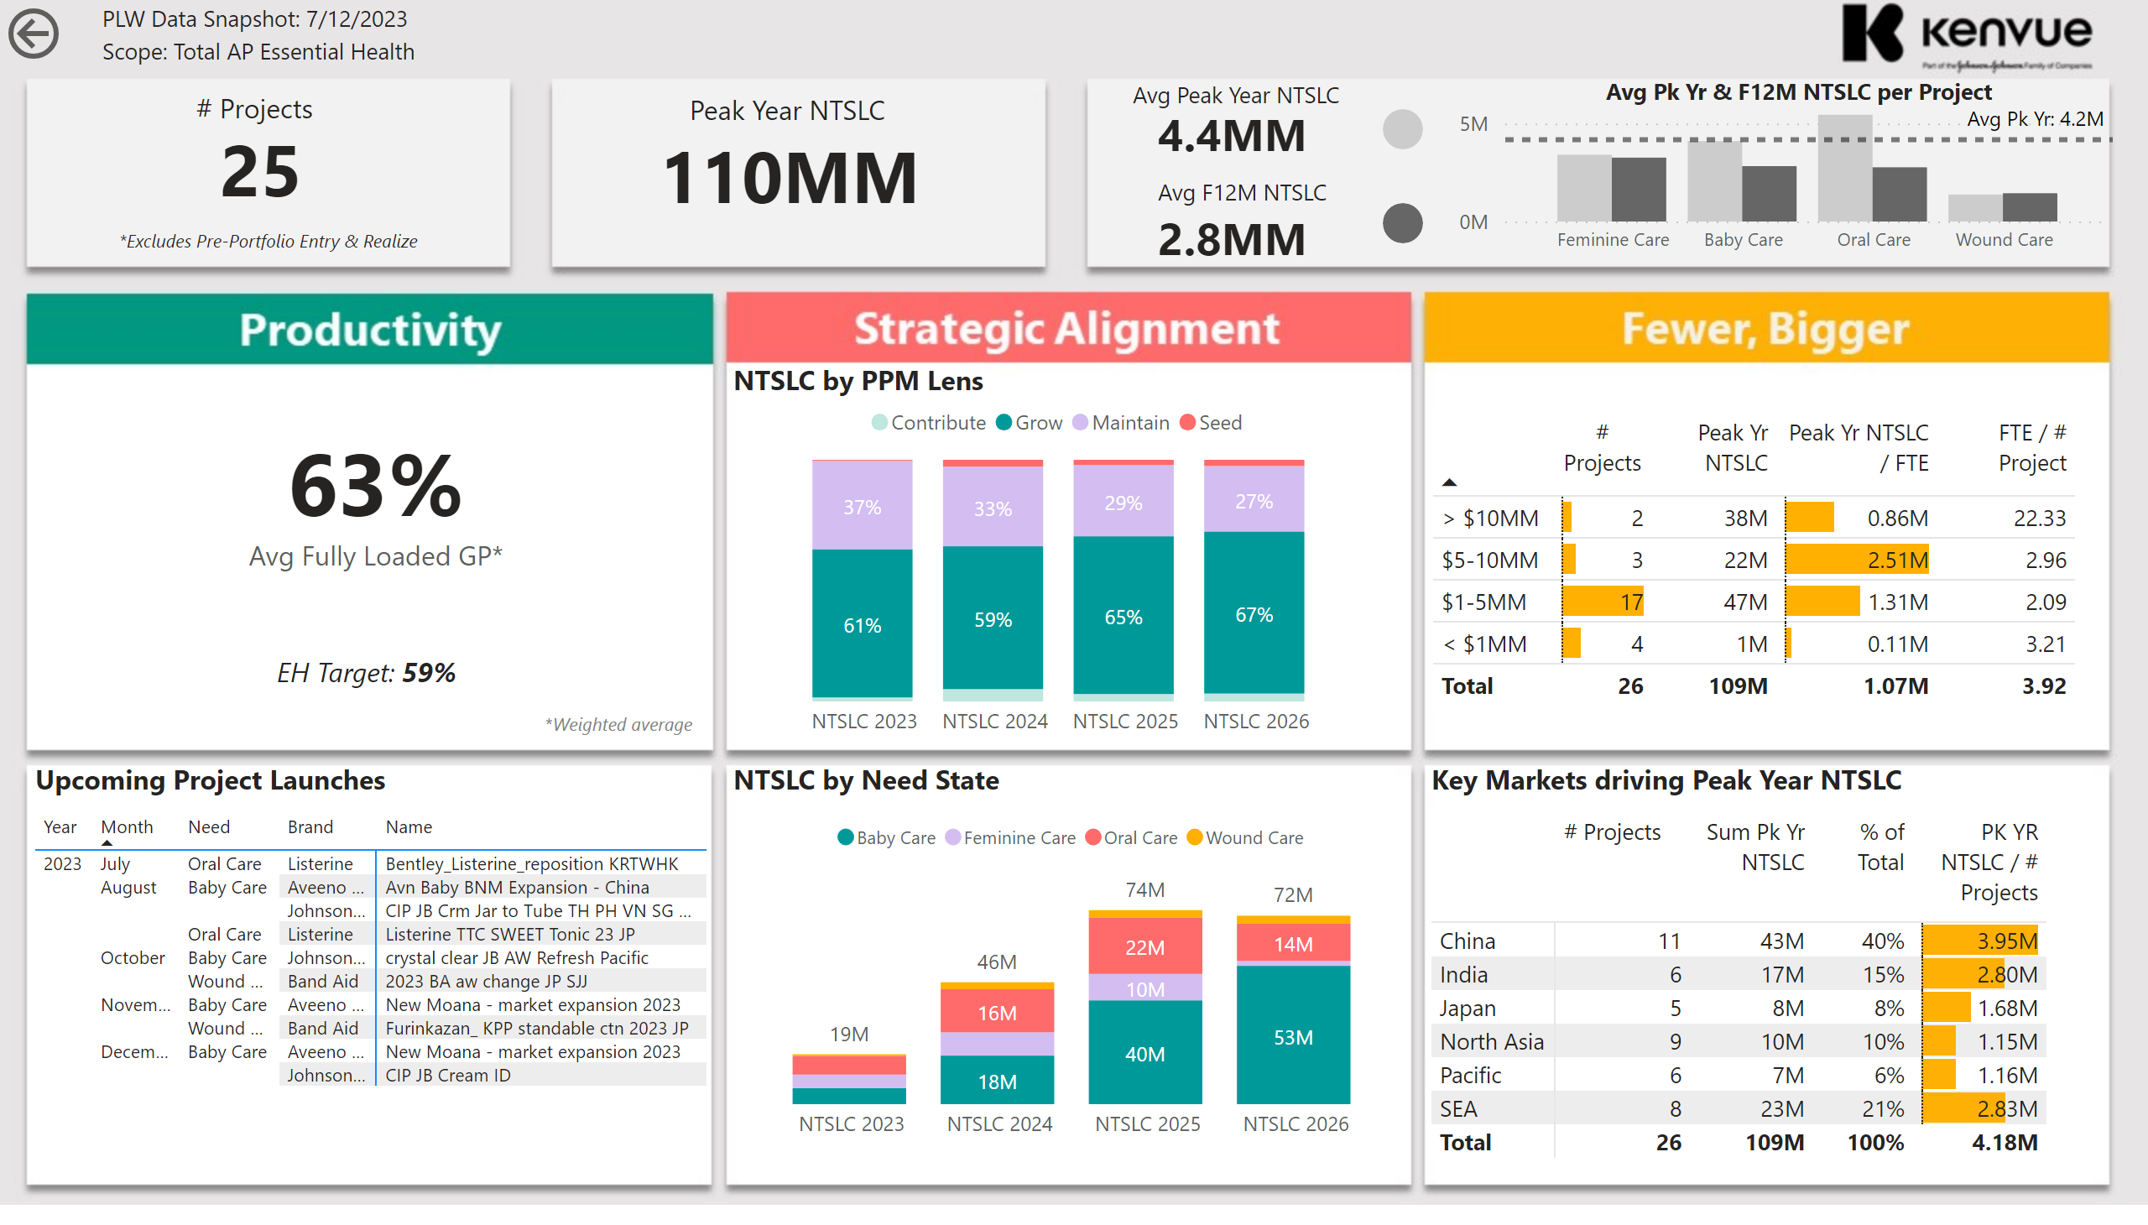
Total EH
Notes:
textbox
No alt text provided
textbox
No alt text provided
textbox
No alt text provided
textbox
No alt text provided
textbox
No alt text provided
textbox
No alt text provided
Standard GP%
No alt text provided
textbox
No alt text provided
textbox
No alt text provided
textbox
No alt text provided
shape
No alt text provided
shape
No alt text provided
textbox
No alt text provided
textbox
No alt text provided
pivotTable
No alt text provided
textbox
No alt text provided
hundredPercentStackedColumnChart
No alt text provided
columnChart
No alt text provided
textbox
No alt text provided
textbox
No alt text provided
textbox
No alt text provided
card
No alt text provided
actionButton
No alt text provided
# of Projects & Value
No alt text provided
Peak Year NTSLC per Project
No alt text provided
% Portfolio Split by Markets
No alt text provided
textbox
No alt text provided
textbox
No alt text provided

