Slide 1
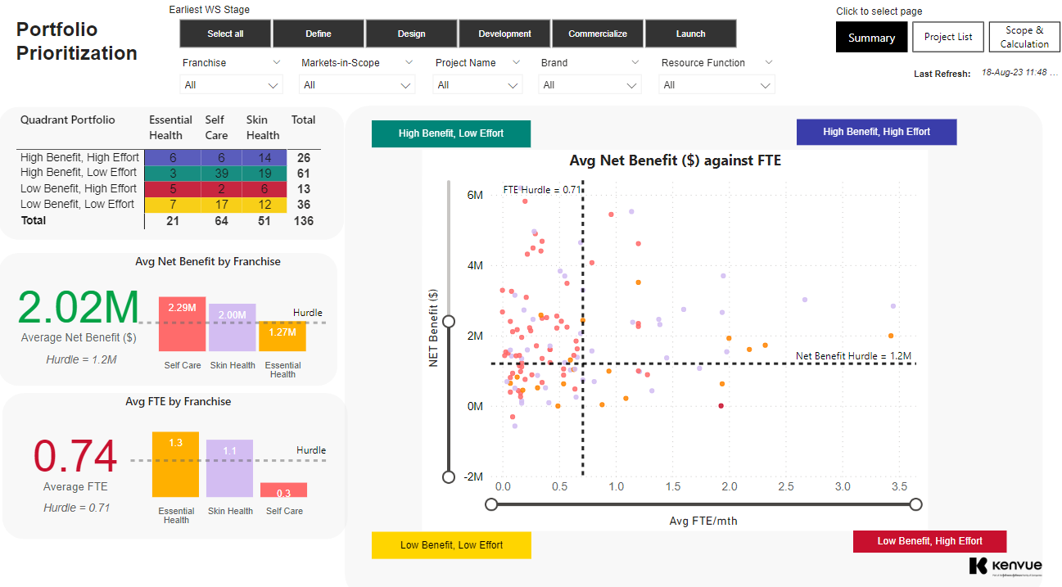
Summary
Notes:
Slicer Launch Yr
No alt text provided
pivotTable
No alt text provided
Top 5 Table
No alt text provided
actionButton
No alt text provided
card
No alt text provided
textbox
No alt text provided
shape
No alt text provided
textbox
No alt text provided
actionButton
No alt text provided
card
No alt text provided
textbox
No alt text provided
actionButton
No alt text provided
actionButton
No alt text provided
actionButton
No alt text provided
shape
No alt text provided
Avg Net Benefit ($) against FTE
No alt text provided
Bottom 5 Table
No alt text provided
textbox
No alt text provided
card
No alt text provided
shape
No alt text provided
Avg FTE by Franchise
No alt text provided
shape
No alt text provided
Click to select page
No alt text provided
Slicer Proj Name
No alt text provided
Slicer Stage
No alt text provided
Slicer Franchise
No alt text provided
Slicer Launch Yr
No alt text provided
Avg Net Benefit by Franchise
No alt text provided
Slicer Launch Yr
No alt text provided
image
No alt text provided

