Slide 1

Optimizing manpower allocation for stb
Tiffany

Slide 2
contents
1. problem statement
2. Data introduction & cleaning
3. EDA
4. CONCLUSION
5. recommendations

Slide 3
INTRODUCTION
INCREASE IN INCOME DEFICIT
Singapore Tourism Board (STB) has been facing a YoY increase in deficit, from $7MM in 2021 to $51MM in 2022
MANPOWER EXPENSES
Of the $51MM, $6.8MM is due to increase in Expenditure on Manpower
SCOPE of project
STB has identified the Zoo and Science Centre to have particularly high manpower expenses
GOAL
Study if there is a correlation between weather data and number of visitors to these attractions to adjust number of staff on shift, while maintaining ratio of visitors to staff for customer service quality
Notes:
Introduction to my project and why we’re looking into it.
So Singapore Tourism Board, or STB Has been facing an increase in YoY deficit from 7MM to 51MM
And out of this 7MM is due to increase in wages & salaries
STB has identified the Zoo and Science Centre to have particularly high manpower expenses
Hence we want to look into see if there’s a correlation between visitor arrivals and rainfall, so that we can adjust the number of staff based on visitors – for eg if there are lesser visitors, we can reduce the number of staff on shift, hence optimizing our manpower allocation and optimize our expenditure on manpwoer

Slide 4
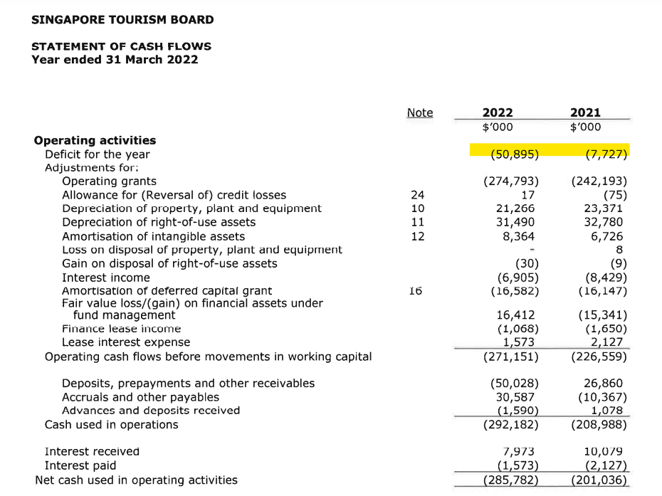
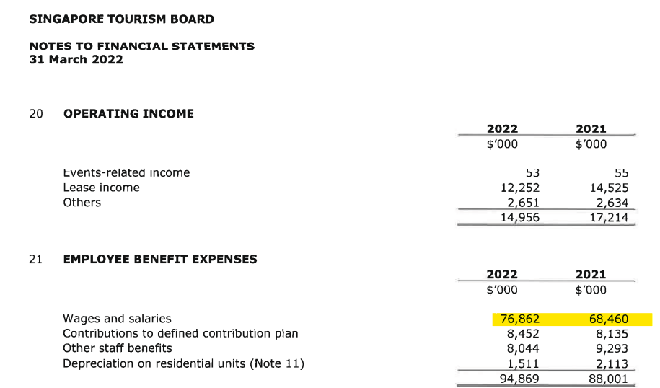

Slide 5
PROBLEM STATEMENT
Correlation: Is there any correlation between total rainfall and the number visitors to the Singapore Zoo and Science Centre?
Difference in Impact: Given that the Singapore Zoo is an outdoor attraction, does the total rainfall have a greater influence on its number of visitors as compared to the Science Centre?
Other Predictors: Are there any other weather features that might be a predictor of number of visitors to both attractions?
Notes:
Is there any correlation between total rainfall and the number visitors to the Singapore Zoo and Science Centre?
Given that the Singapore Zoo is an outdoor attraction, does the total rainfall have a greater impact on its number of visitors as compared to the Science Centre?
Is there any other weather features that might be a predictor of number of visitors?

Slide 6
DATA INTRODUCTION
feature | UNITS | DESCRIPTION
Total Rainfall | mm | Total rainfall
Mean Daily Temperature |  | Mean daily temperature
No. of Rainy Days |  | Number of days that rained (day with rainfall amount of 0.2mm or more)
Mean Relative Humidity | % | Monthly mean relative humidity
Mean Sunshine Hours |  | Monthly mean sunshine hours in a day
Zoo Visitors | ‘000s | Number of visitors to the zoo
Science Centre Visitors | ‘000s | Number of visitors to science centre
Year |  | Year that data was collected
Month |  | Month that data was collected
No Null values hence no dropping of rows
Data Date Range: April 1990 to Feb 2023
Notes:
Data features highlighted in orange are weather data
data features in blue is the data that we are interested in – number of visitors to the attractions
Last 2 are just dates

Slide 7
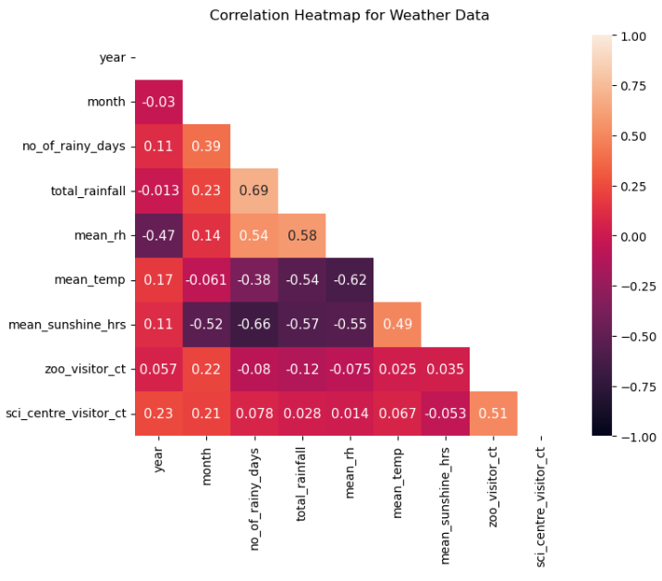
Choosing which weather feature to study:
Out of all the weather features vs visitor counts, total rainfall vs visitors to the zoo has the strongest correlation
Notes:
Now for EDA:
First did a correlation heatmap for my dataset – as I want to select which features to focus on first
Out of all the weather features vs visitor counts, the total rainfall vs zoo visitors has the strongest correlation of -0.12 so I will be looking at rainfall first

Slide 8
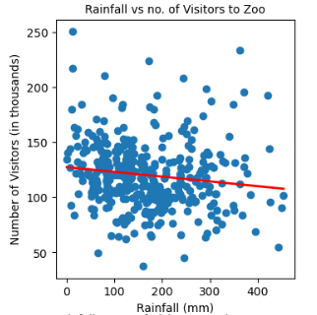
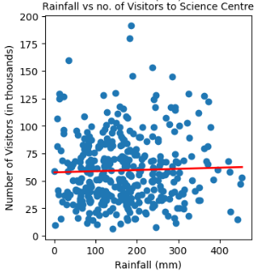
Negative CORRELATION BETWEEN TOTAL RAINFALL AND VISITORS to the zoo, but not for science Centre
Notes:
We can see a negative correlation between rainfall and the zoo (on the left), and science centre on the right.
The correlation negative correlation between rainfall and zoo is expected as the zoo is an outdoor activity

Slide 9
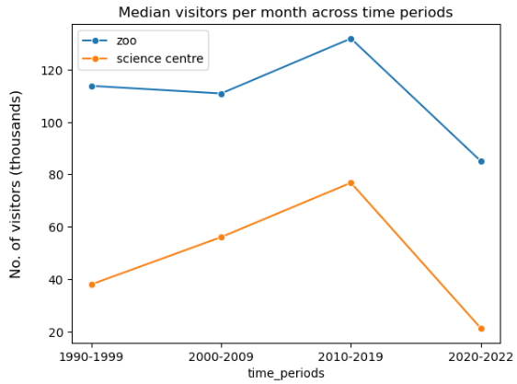
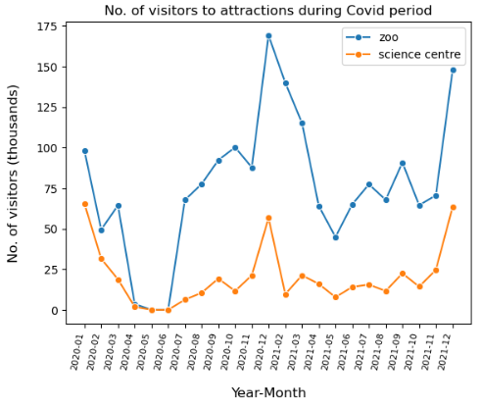
NARROWING THE SCOPE: SELECTING 2010 to 2019 as TIME PERIOD TO STUDY
Overall upward trend in median number of visitors per month
(probably due to improvement in attractions, better economy)
Time period 2020 to 2022 was an exception due to Covid:
During Covid period, median no. of visitors dropped greatly.
Numbers surged slightly in Dec 2020, but was slow to pick up thereafter
Notes:
Now I want to narrow the scope of my project as there is data from 1990. so I start by looking at the years to keep.
On the left, I aggregated time periods in 10 year blocks, except 2020-2022 cos we don’t have enough data for that and due to covid
Overall there’s an upward trend for both visitors to the zoo and science centre due to improvement in economy
On the right is the no. of visitors during covid period, can see that during P2HA, number of visitors were 0

Slide 10
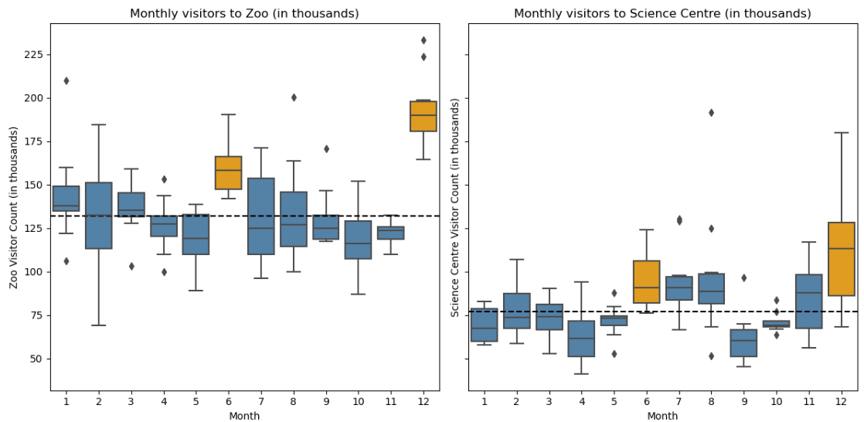
SEEMS LIKE NUMBER OF VISITORS DURING school holidays IS ALWAYS HIGHER THAN THE MEDIAN Monthly VISITORS
Notes:
December is a rainy month – yet the number of visitors is way above the median levels.
Same for June, but not as pronounced.
This is probably because June and Dec are school holiday months.

Slide 11
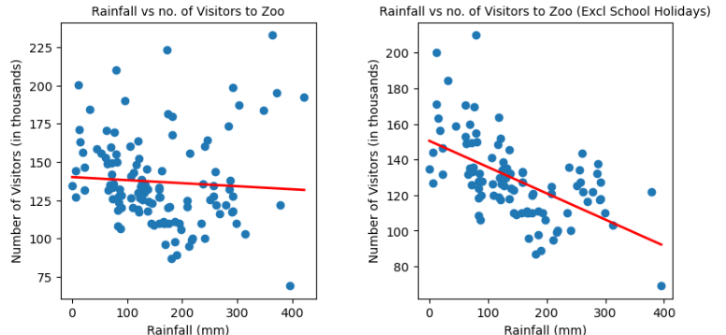
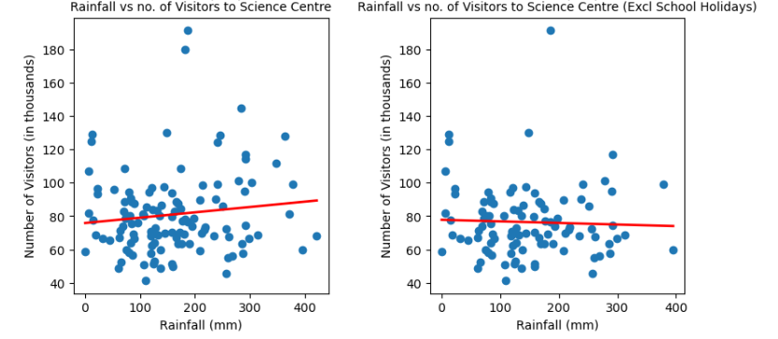
NARROWING THE SCOPE: WHAT happens to the correlation BETWEEN RAINFALL AND VISITORS if we remove school holiday months?
Notes:
Total rainfall vs no. of visitors has a more significant relationship in the zoo than in science centre. So let’s focus our analysis on how we can optimise manpower allocation for the zoo.

Slide 12
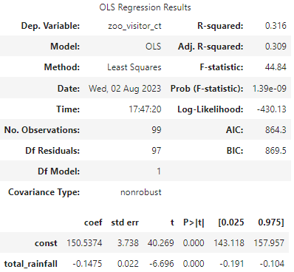
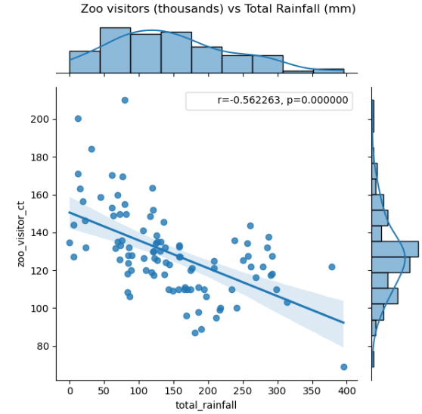
IN GENERAL, FOR EVERY 1MM OF INCREASE IN RAINFALL, THERE IS A DECREASE IN 148 VISITORS
Notes:
OLS ordinary least squares regression
Coefficient is -0.1475

Slide 13
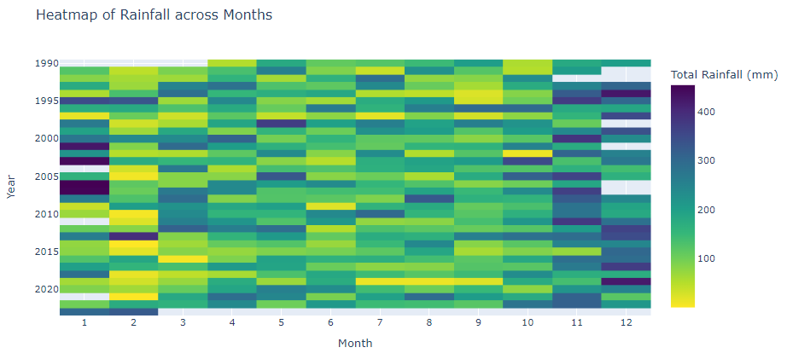
total rainfall is highest IN NOV TO JAN, and lowest in feb to mar
Notes:
This is a heatmap of rainfall across the months
Therefore during these months, we can expect less visitors to the zoo

Slide 14
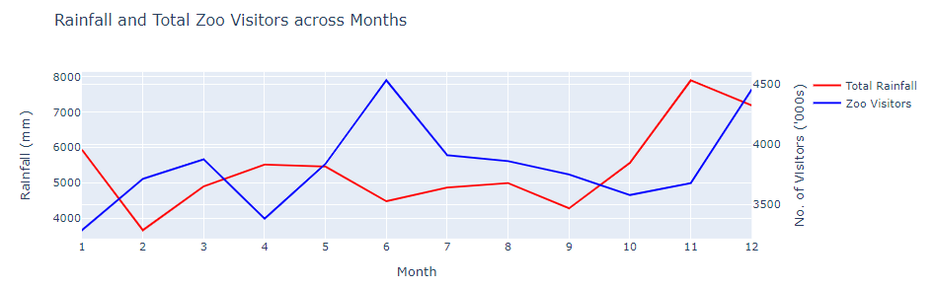
INVERSE RELATIONSHIP between total visitors to the zoo and total rainfall in most months
Notes:
Apart from June and Dec where there are obvious spikes in number of visitors as we have already established them as school holiday months, the trend is that when there is high total amount of rainfall, there was a corresponding decrease in number of visitors to the zoo. This is especially evident in the months with arrows below.

Slide 15
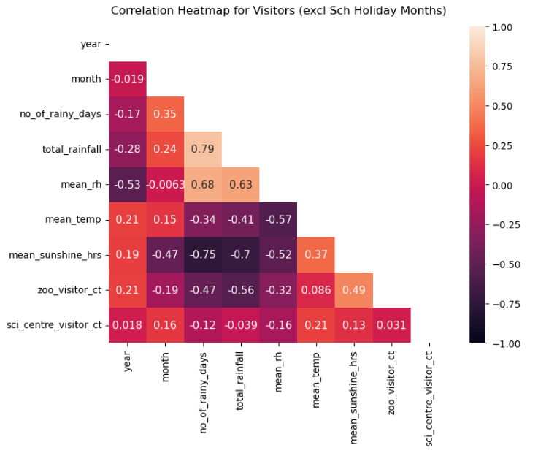
Negative correlation between amount of rainfall and visitors to the zoo has become stronger, from -0.12 to -0.56. next highest correlation is with mean sunshine hours of 0.49
Notes:
After narrowing the scope to exclude holiday months and consider only 2010 to 2019, this is my new correlation heatmap. Correlation between total rainfall and no. of visitors to the zoo has gotten much stronger, meaning rainfall in this scope is a strong predictor for number of visitors.
Not much correlation with any weather features vs visitors to science centre.
For visitors to zoo, next strongest correlation is mean sunshine hours

Slide 16
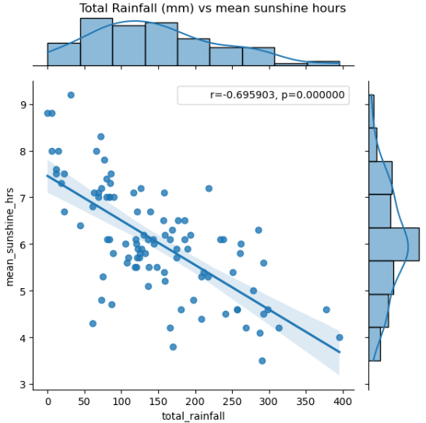
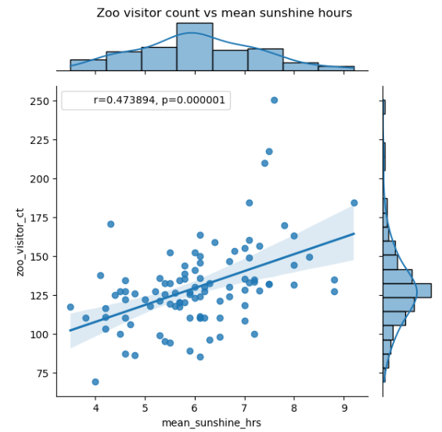
Negative Correlation Exists Between Total Rainfall And Mean Daily Sunshine Hours
WE CAN USE MAIN DAILY SUNSHINE HOURS TO PREDICT NO. OF VISITORS TO THE ZOO TOO
Correspondingly, Positive Correlation Exists Between Total Rainfall And Mean Daily Sunshine Hours
Notes:
Based on the earlier correlation heatmap, we see that mean daily sunshine hours might be a good predictor too – which is logical

Slide 17
limitations
1. BLACK SWAN EVENTS: COVID
Covid-19 resulted in a closure of tourist attractions across Singapore, slow economic recovery and limited global travel. Might have long term effects too.
2. MARKETING EFFORTS & CAMPAIGNS
Successful marketing efforts might have the potential to influence visitors’ arrivals despite bad weather. Not accounted for in data.
Notes:
Covid-19 resulted in a closure of tourist attractions across Singapore, slow economic recovery and limited global travel resulting in lower number of visitors and distorting the data →. Covid period was removed from dataset, but might have long term effects
Marketing Efforts and Campaigns: Successful marketing efforts might have the potential to influence visitors despite bad weather. Not accounted for in data. For example Rediscover SG

Slide 18
CONCLUSION
1. NEGATIVE CORRELATION BETWEEN TOTAL RAINFALL AND VISITORS TO THE ZOO
2. HOLIDAY MONTHS HAS AN IMPACT ON VISITORS TO THE ZOO
3. POSITIVE CORRELATION BETWEEN SUNSHINE HOURS AND VISITORS TO THE ZOO
*Trend of number of tourists across months from STB
Notes:
NEGATIVE CORRELATION BETWEEN TOTAL RAINFALL AND VISITORS TO THE ZOO - Total rainfall exhibits a stronger negative correlation with zoo visitors compared to the science center, likely due to the zoo being an outdoor attraction.
HOLIDAY MONTHS HAS AN IMPACT ON VISITORS TO THE ZOO –
Removing holiday months strengthens the negative rainfall-visitor correlation. This is probably due to:
local school holidays (which increases availability of people)
increase in number of tourists* during these months, hence footfall to the zoo remain high.
3. 3. POSITIVE CORRELATION BETWEEN SUNSHINE HOURS AND VISITORS TO THE ZOO
Mean sunshine hours positively correlate with zoo visitors, as more sunshine increases the likelihood of outdoor attraction availability.

Slide 19
RECOMMENDATIONS
1. Focus on optimising Manpower at Zoo
2. Adjust Staffing during months with higher rainfall
3. Reduce Outdoor Shows during Wet Months
4. Leverage Technology to Supplement Staff
5. Extend the study to other outdoor attractions
Notes:
Focus on optimising Manpower at Zoo: STB should prioritize manpower optimization at Singapore Zoo over the Science Centre, considering 1) the strong correlation between total rainfall and zoo visitors (excluding school holiday months) and 2) the number of visitors to the zoo is much higher (2.5X) of visitors to science centre
Adjust Staffing during months with higher rainfall: Months with higher rainfall generally see less visitors at Singapore Zoo. Therefore, STB could reduce the number of staff on shift in these months to optimise Expenditure on Manpower.
Reduce Outdoor Shows during Wet Months: Reduce the frequency of outdoor shows as they require specialised trainers who are expensive
Leverage Technology to Supplement Staff: For drier months and holiday months with higher number of visitors, STB can leverage technology to empower our staff (such as digitisation of ticket countering, employing robot navigators that can be deployed as per demand). This technology can be deployed on demand, without needing to increase staff on shift.
Next Steps: now that we see there is a trend between rainfall and visitors to outdoor attrations, we can To further optimise manpower expenses using rainfall / weather data, can repeat the same study for other outdoor attractions

Slide 20
THANK YOU
Tiffany Tan
97251564
tiffany@dsif-consult.com
www.dsif-consult.com

