Slide 1
Diabetes Dataset Analysis Prima Indian Diabetes Dataset
CIND820
Name: Yun Shiuan Hwang

Slide 2
Overview
Introduction
Purpose
Dataset
Approach
Conclusion

Slide 3
Introduction
Diabetes is one of the leading causes of death in the world (World Health Organization, 2020).
Chronic metabolic disorder that affect the body’s ability to store and use glucose
Diabetes will affect the heart, blood vessels, kidneys, eyes, and nerves over time.
Three types of Diabetes:
Type 2 is the most common and can be prevented.
Type 1 is genetic
Type 3 is gestational

Slide 4
Dataset
The Pima Indian Diabetes Dataset: National Institute of Diabetes and Digestive and Kidney Diseases (768 women from a population near Phoenix, Arizona, USA)
258 Tested Positive & 500 Tested Negative
One Target variable and 8 attributes
link: https://www.kaggle.com/datasets/akshaydattatraykhare/diabetes-dataset

Slide 5
Dataset
Parameters
Pregnancies.
Glucose: During an oral glucose tolerance test, plasma glucose concentration exceeded 2 hours.
Blood Pressure: Diastolic heart rate (mm Hg).
Skin Thickness: the triceps skinfold thickness (mm).
Insulin: the 2-hour serum insulin (mu U/ml).
BMI: the body mass index .
Diabetes Pedigree Function (DPF): DPF is a function that scores the likelihood of diabetes based on family history.
Age: This parameter represents the age of the person (in years).
Outcome: 0 means nondiabetic, and 1 means diabetic.

Slide 6
Purpose
Use different Method to see the accuracy of the model
Correlation between different variables
Prediction of Diabetic or Non-diabetic

Slide 7
Approach
Pima Indian Dataset
Naïve Bayes
Data Cleaning
Predictive model
Decision Tree
KNN with SVM
Linear Discriminant Analysis
Random Forest
Support Vector Classifier
Evaluation

Slide 8
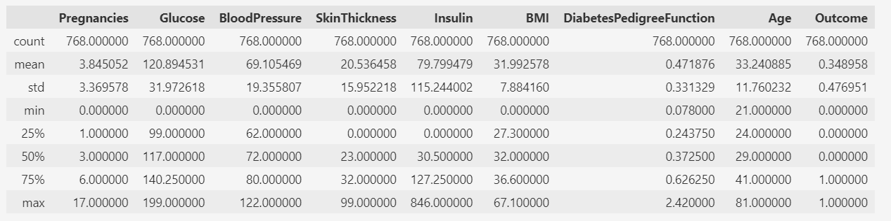
Data Mean-before data processing

Slide 9
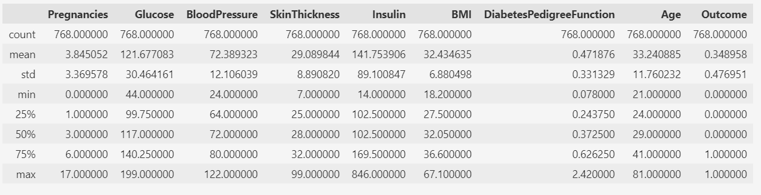
Data Mean-after data processing

Slide 10
Accuracy Comparison
The data was split under test size as 20%(154 data) and train size (614)

Slide 11
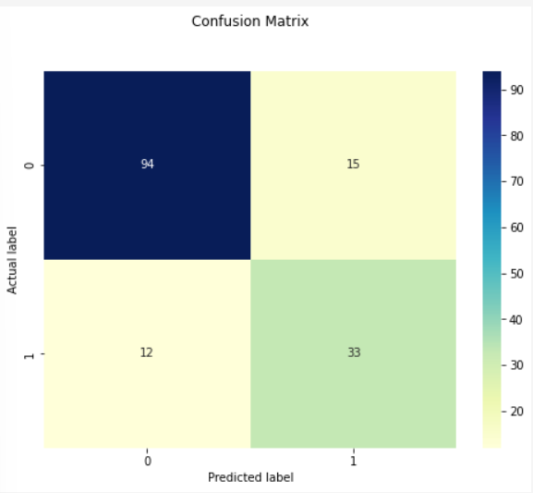
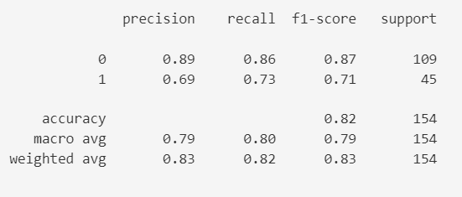
Two Predictive Models
Data Standardization – Use Standard Scaler
From the training data: 0.8941
From the testing data: 0.8247

Slide 12
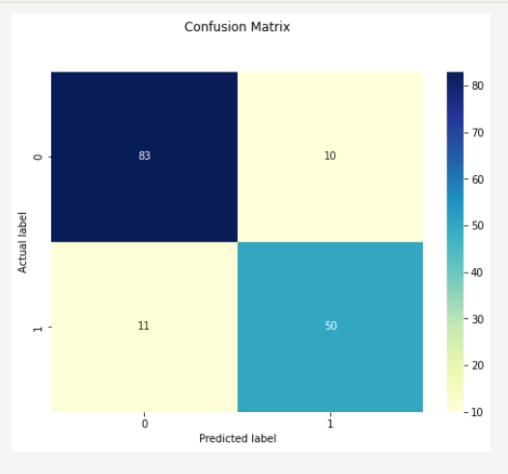
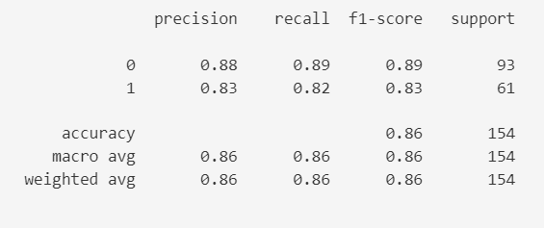
Two Predictive Models
Data Standardization – Use Standard Scaler
From the training data: 0.8486
From the testing data: 0.8636

Slide 13
Two Predictive Models
Input: (3, 140, 74, 24, 170, 26, 0.435, 50)
Result for Model 1: The person is diabetic.
Result for Model 1: The person is not diabetic.

Slide 14
Conclusion
The Pima Indians Diabetes Database has 768 female patients’ data. 80% of these data are used to train machine and 20% to test the machine on the proposed architecture, with a maximum accuracy of 89.61%.
However, in this example, we would like to identify as much diabetes cases so that the patients can have an early treatment, which is the recall value. Support Vector Classifier has a higher score on it for 82%.

Slide 15
Conclusion
Limitation:
The dataset is focused on Prima Indian women.
The dataset is unbalanced.
The dataset is not recent.
The dataset has some missing values.

Slide 17
Thank you.

