Slide 1
Glimpse
Web Platform for 3D Content
Members: Josh Poole, Cam Skubik-Peplaski
Advisor: Joe Moeller
Notes:
josh

Slide 2
Introduction
Background
Kinetic Vision is very used to working with a leveraging 3D data across a variety of mediums
Web-based services have increasingly become a way to deploy and visualize 3D models
Traditionally, KV has used one-off custom solutions for delivering 3D experiences on the web
Goals
Create a standardised web solution for providing such 3D experiences across a variety of different projects
Allow for viewing and storing 3D content of various types
Implement a simple and intuitive client GUI
Develop a Kinetic Vision specific web platform for managing 3D content
Notes:
josh

Slide 3
Merits & Achievements
Cohesive platform for managing and visualizing 3D content on the web
Including mobile AR viewing
Single, lightweight codebase that can be reused and expanded upon in the future
Server application that provides access to server functions, database operations, and file storage within Microsoft Azure, all in one API
Client application utilizing modern web technologies, including ReactJS and three.js, to present users with a stable, modern, easy-to-use interface
Notes:
cam

Slide 4
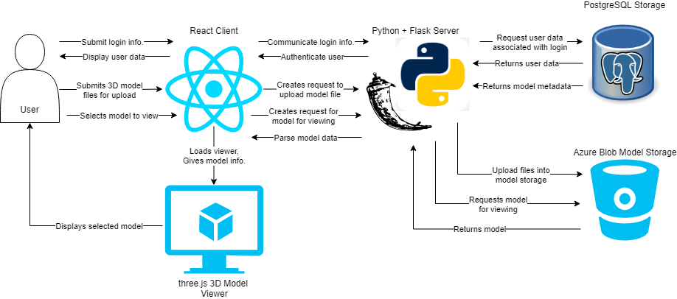
System Architecture
2 main components: the Client and Server
The client allows users to upload, download, view, and interact with models
The server handles the data and model storage as well as the pathways to fetch that data as needed
Data is passed between the client and server through a encrypted SSL tunnel
Notes:
josh

Slide 5
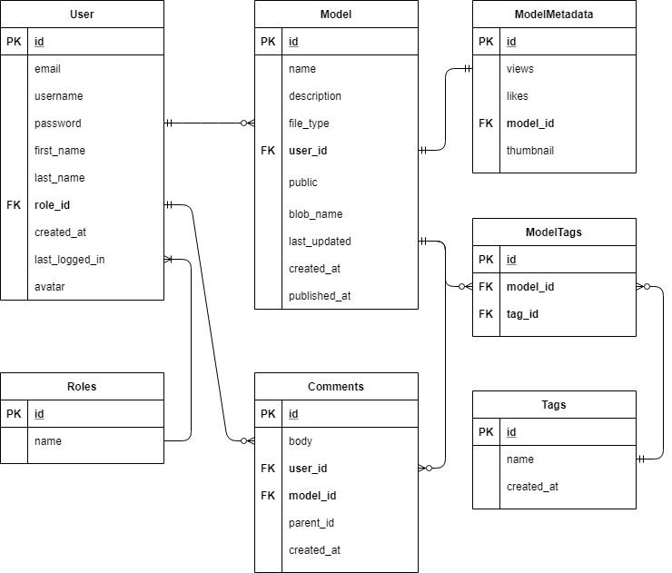
PostgreSQL Database Structure
Notes:
cam

Slide 6
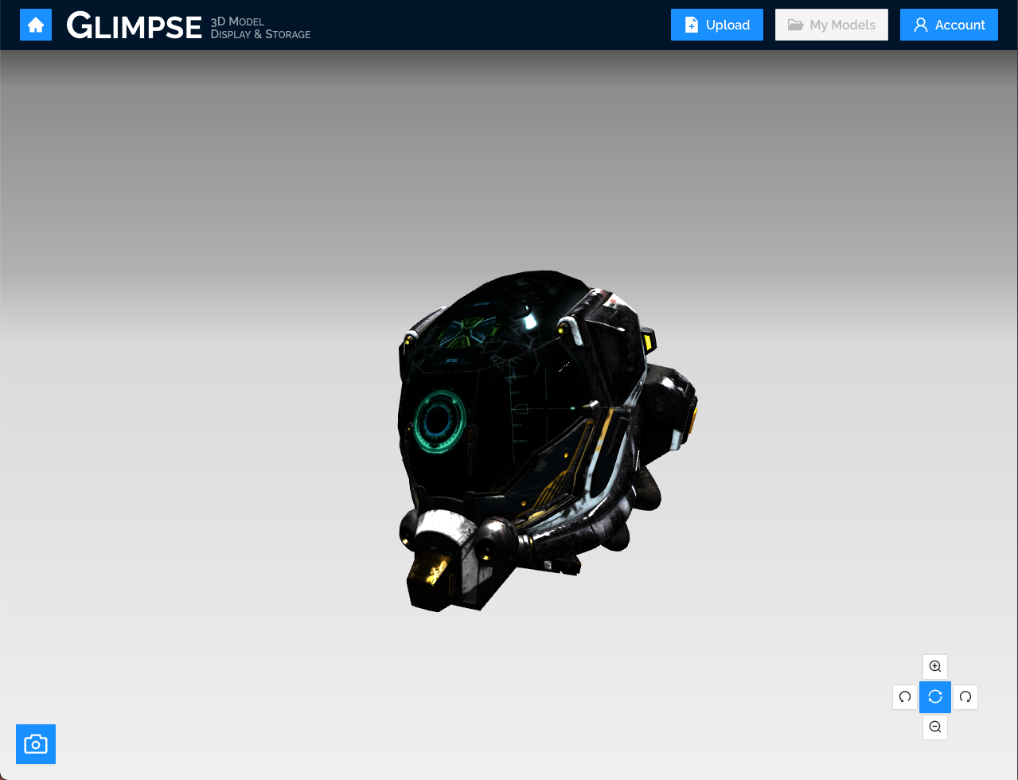
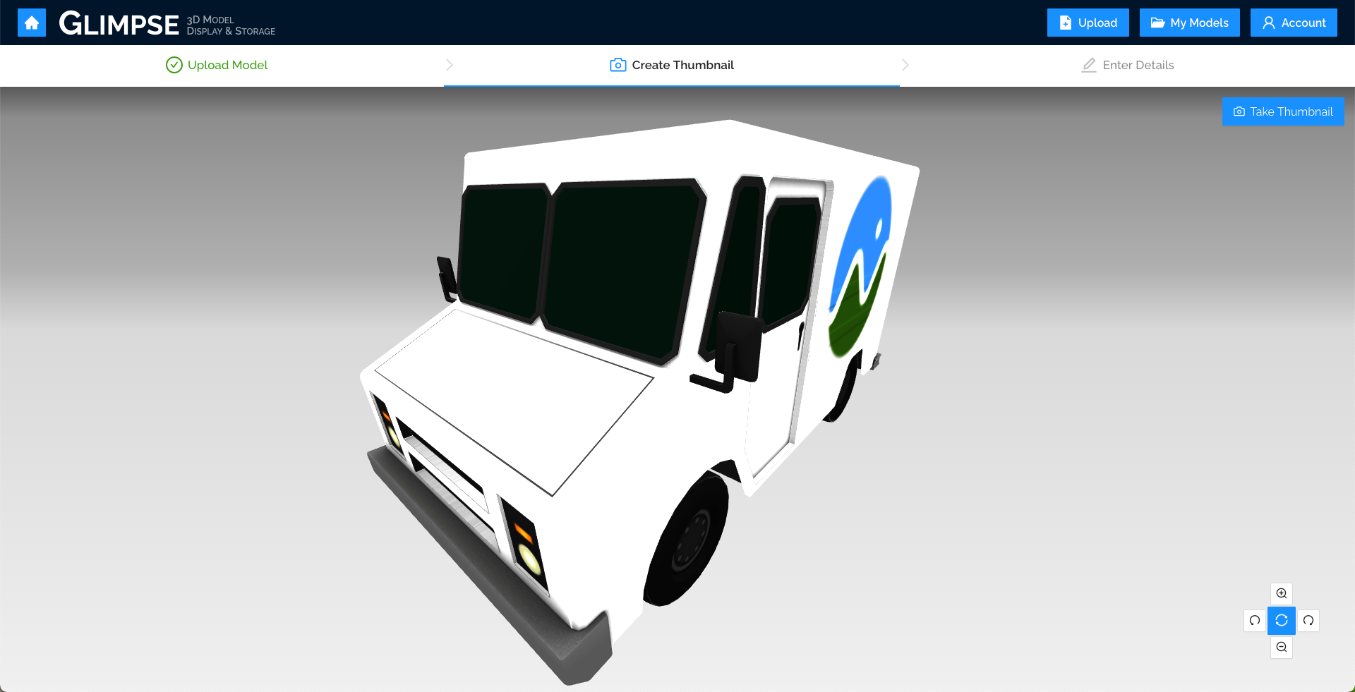
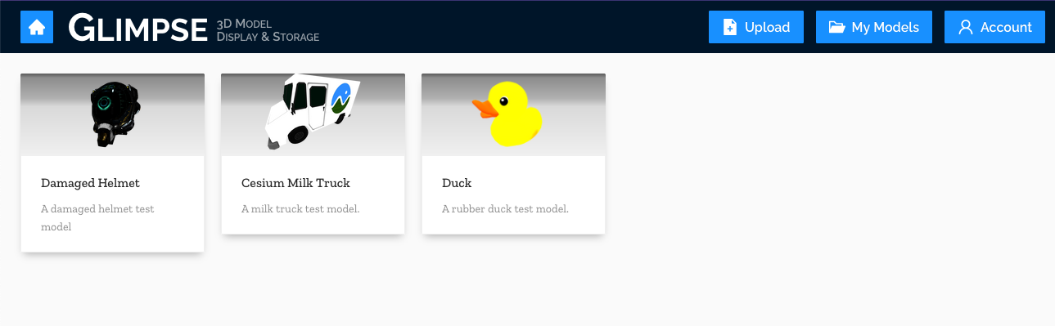
Results
Developed a viewer for 3D content using three.js and react-three-fiber
Built front-end using ReactJS and Typescript
Our Python back-end implements SQLAlchemy to work with the PostgreSQL database
The back-end exposes a Graphene + GraphQL API to allow the client to query and manipulate the database
An Azurite instance emulates Azure Blob Storage, and the Python back-end provides access to it
A staging environment has been deployed via an Azure virtual machine
Notes:
josh

