Slide 1
Glimpse 3D Web Platform
Developed by: Josh Poole & Cam Skubik-Peplaski
Sponsored by: Kinetic Vision

Slide 2
Team
Team Members:
Cam Skubik-Peplaski
Computer Sciences
skubikcj@mail.uc.edu
Joshua Poole
Computer Sciences
poolejd@mail.uc.edu
Advisor:
Joe Moeller
Software + Solutions Group Manager, KineticVision
jmoeller@kinetic-vision.com

Slide 3
Abstract
Glimpse is a content management & storage platform for the visualization of 3D CAD models, simulation results, and VR/AR assets. In leveraging modern web technologies like Azure Cloud, ReactJS, Python Flask, and Docker, the platform will be a flexible and scalable application that enables content-sharing, rapid prototyping, design feedback, and more across an organization.

Slide 4
User Stories
As a mechanical engineer, I want to be able to upload, download, and view 3D content in my, or my team’s, project so I can work efficiently with all my files in one place.
As a project manager, I want to manage the content uploaded to a project, so that I can help designers and engineers collaborate more effectively.
As an organization owner, I want to be able to manage all of the projects associated with my organization so I can make sure all of my employees are using the service appropriately.
As a graphic designer, I want to be able to easily share files as view-only, so that I can show clients my work without worry.
Notes:
We have defined four potential categories for Glimpse users.
A mechanical engineer could use our project to upload, download, and view 3D content for their work.
A project manager can manage content associated with a particular project to assist in collaboration.
An organization owner and manage various projects under their org. to ensure proper and effective use of the product.
A graphic designer can share their creations in a view-only format to their clients.

Slide 5
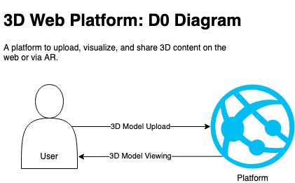
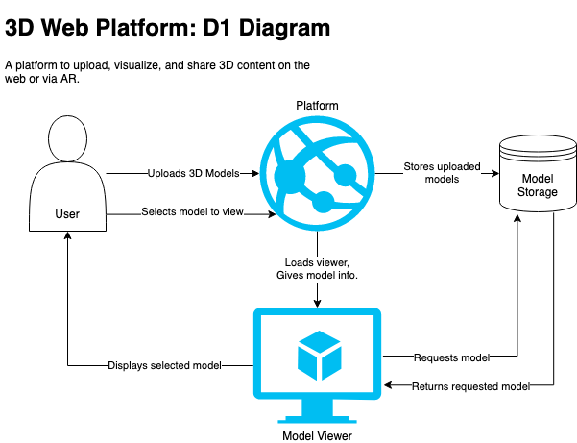
Design Diagrams
Notes:
At the highest level, Glimpse will be a platform that allows users to upload and view 3D models.
As we dig in a little more to the details of the platforms operation, we can define two separate major parts of the platform, the storage system and viewer.
The platform will need to store models uploaded by users and fetch them at a user’s request.
It will then send those details to the model viewer which will allow the user to interact with the model.

Slide 6
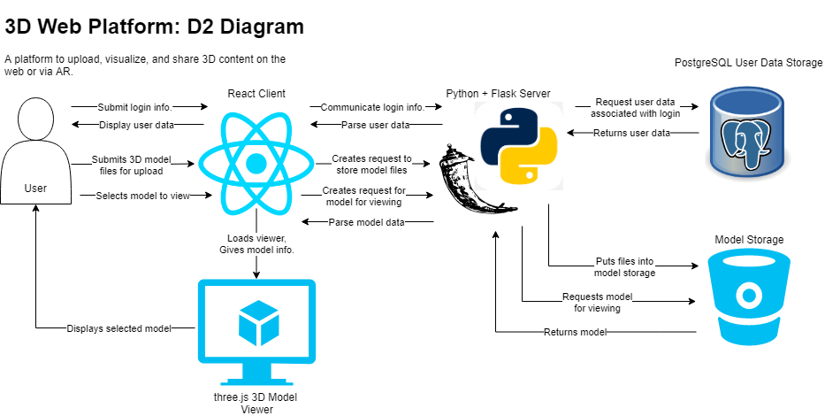
Design Diagrams, cont.
Notes:
This is a most detailed diagram we have for Glimpse’s operation.
The specific products and libraries we have decided to use have been defined here, such as the react client, three.js library for the model viewer, and a python and flask server that interacts with a postgres database in the back-end.
It is also important to note that there will be two separate storage systems.
One standard SQL database for storage of user and model metadata, and a bucket based cloud storage for the actual model files.

Slide 7
Major Constraints
Third Party
Azure Services from Microsoft
Impact: We are reliant on Azure’s services and their uptime consistency.
Solution: We should make sure the project can stand on another service if necessary.
The libraries we plan to use, especially React and three.js
Impact: We are reliant on features that exist in the version we use when starting, if features change, it can break the application.
Solution: We need to make sure we lock down what version we use, and update the libraries and packages only when ready to work with the changes.
Impact: Some package options may not be very popular, so community resources on them would be sparse.
Solution: We should choose commonly known/used packages and libraries.
Time
Project is set to be completed within the year-long period.
Impact: Hard due date for delivery, which limits the project to what can be done in that time frame.
Solution: We should ensure task date estimates are done with the hard delivery date in mind.
Work on the project must be juggled with other schoolwork.
Impact: Limits team members’ time to work on the project.
Solution: We should keep the project simple where possible, so that the project’s workload does not heavily conflict with others.

Slide 8
Major Constraints, cont.
Complexity
The project can be complicated by issues like scope creep, poor-quality code in heavily relied-upon components, or trying to implement too much at the same time.
Impact: Complications will slow down development and push back delivery dates as we try to fix or work around it.
Solution: We need to minimize/disallow scope creep, focus on key features, follow good practices, keep focused on one task at a time, etc.
Team Size
There are only two team members, who have workloads outside of this project.
Impact: Limited dev-power for the majority, if not all, of the project’s timespan. Limits number of features that can be implemented: only 2 things can be worked on at once, etc.
Solution: We have to make sure that project completion stays feasible for a team of 2. This can mean limiting the planned feature set, simplifying existing features, etc.

Slide 9
Progress Review
Defined all tasks to be completed, assigned them, and created an interactive workflow board to implement agile methodologies into the process
Completed research and investigation stage into libraries and resources we plan to use
Decided on official product name for the project
Defined each required page and their purposes
Defined database structure with an entity-relationship diagram in 3rd normal form
Created official project code repository

Slide 10
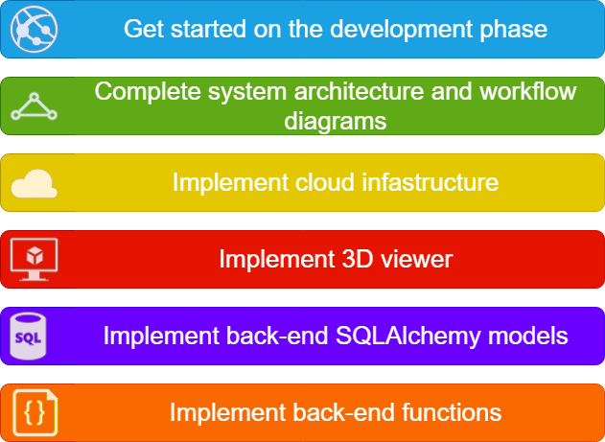
Expectations for this Semester

Slide 11
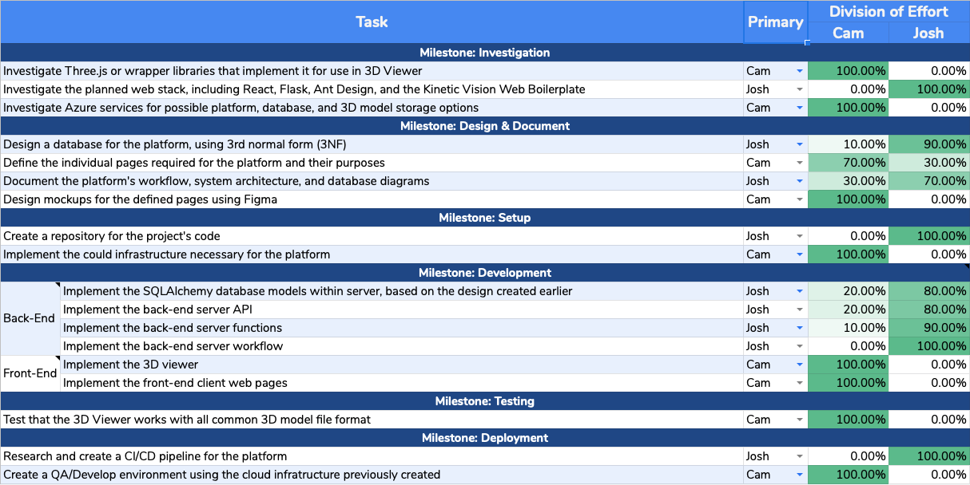
Division of Effort

Slide 12
Expectations for the Expo
Our demo will show how Glimpse will be used by its future customers.
We will show the home page, where public 3D models are displayed, and can be interacted with through likes and comments.
We will demonstrate how a user can upload or download a 3D model file.
Lastly, we will show how a user can interact with the model through the model viewer; specifically, rotating, panning and zooming.

Slide 13
Thank you!

