Slide 1
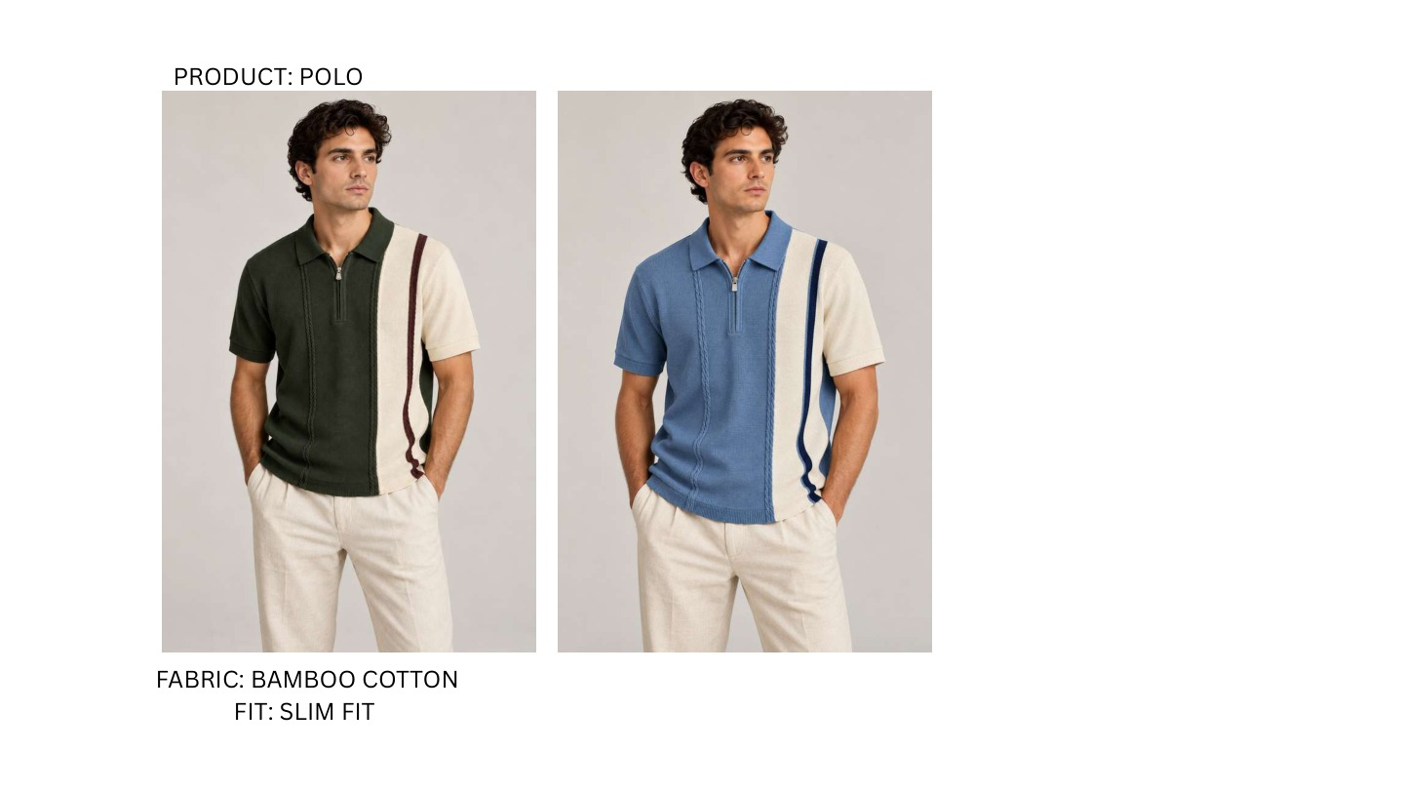
ST-01 | 2 COLOURWAYS
ORDER: LEFT TO RIGHT
CW01
Dark Olive / Off White / Burgundy
CW02
Denim Blue / Off White / Navy
FINAL RANGE | PDF PAGE 01 | ST-01 | COLOUR NAMES MATCH EXCEL
Notes:
ST-01 | Asymmetric cable zip polo | Bamboo Cotton | Slim Fit
Colourways, left to right: Dark Olive / Off White / Burgundy; Denim Blue / Off White / Navy

Slide 2
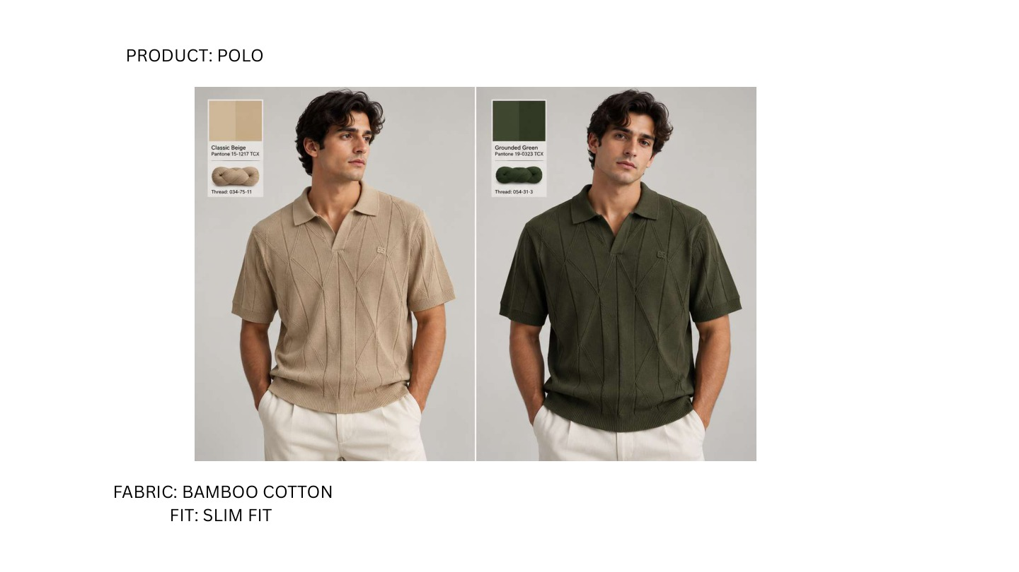
ST-02 | 2 COLOURWAYS
ORDER: LEFT TO RIGHT
CW01
Classic Beige
CW02
Grounded Green
FINAL RANGE | PDF PAGE 02 | ST-02 | COLOUR NAMES MATCH EXCEL
Notes:
ST-02 | Diamond textured open-neck polo | Bamboo Cotton | Slim Fit
Colourways, left to right: Classic Beige; Grounded Green
Colour names transcribed from embedded labels.

Slide 3
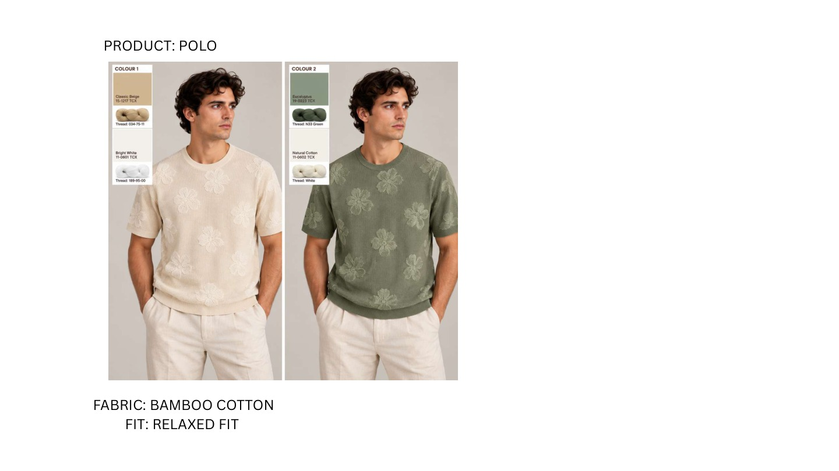
ST-03 | 2 COLOURWAYS
ORDER: LEFT TO RIGHT
CW01
Classic Beige / Bright White
CW02
Eucalyptus / Natural Cotton
FINAL RANGE | PDF PAGE 03 | ST-03 | COLOUR NAMES MATCH EXCEL
Notes:
ST-03 | Floral jacquard crew tee | Bamboo Cotton | Relaxed Fit
Colourways, left to right: Classic Beige / Bright White; Eucalyptus / Natural Cotton
Colour names transcribed from embedded labels; relaxed fit confirmed in PDF.

Slide 4
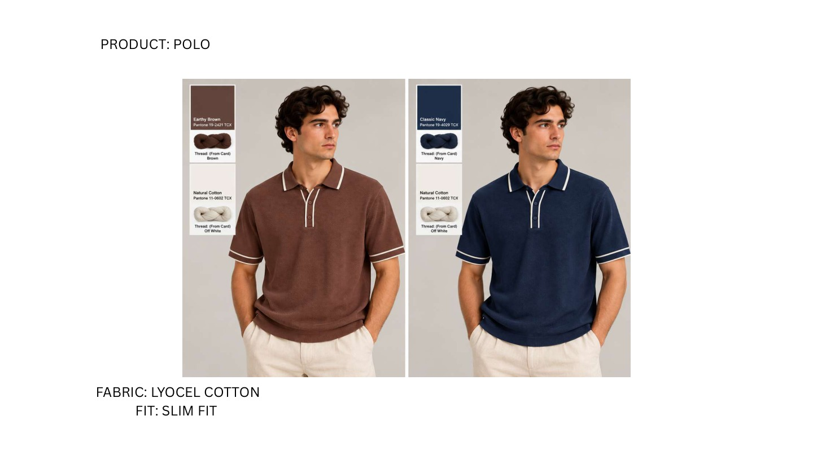
ST-04 | 2 COLOURWAYS
ORDER: LEFT TO RIGHT
CW01
Earthy Brown / Natural Cotton
CW02
Classic Navy / Natural Cotton
FINAL RANGE | PDF PAGE 04 | ST-04 | COLOUR NAMES MATCH EXCEL
Notes:
ST-04 | Contrast piping knit polo | Lyocel Cotton | Slim Fit
Colourways, left to right: Earthy Brown / Natural Cotton; Classic Navy / Natural Cotton
Colour names transcribed from embedded labels.

Slide 5
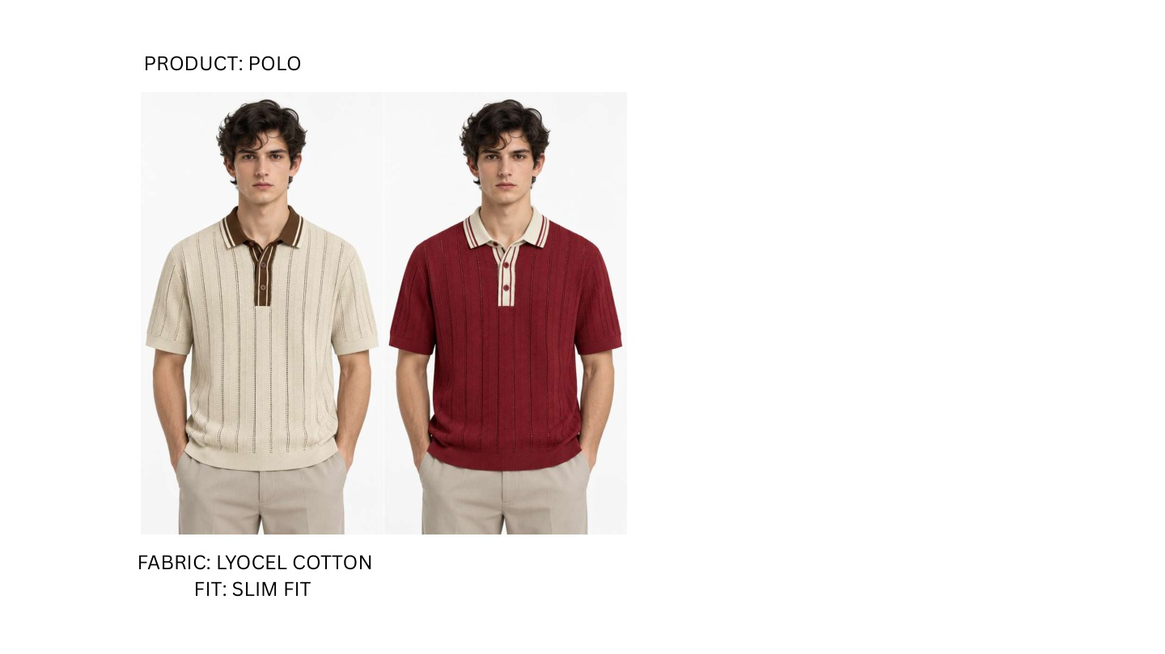
ST-05 | 2 COLOURWAYS
ORDER: LEFT TO RIGHT
CW01
Natural Cotton / Chocolate Brown
CW02
Burgundy / Natural Cotton
FINAL RANGE | PDF PAGE 05 | ST-05 | COLOUR NAMES MATCH EXCEL
Notes:
ST-05 | Striped-placket open-knit polo | Lyocel Cotton | Slim Fit
Colourways, left to right: Natural Cotton / Chocolate Brown; Burgundy / Natural Cotton

Slide 6
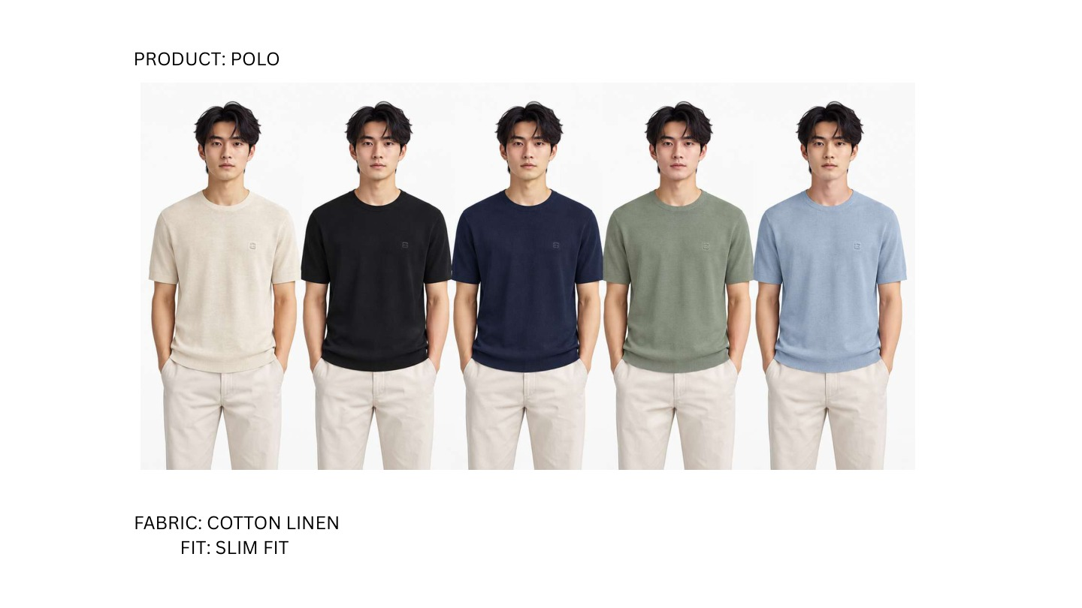
ST-08 | 5 COLOURWAYS
ORDER: LEFT TO RIGHT
CW01
Natural Cotton
CW02
Black
CW03
Navy
CW04
Sage Green
CW05
Powder Blue
FINAL RANGE | PDF PAGE 06 | ST-08 | COLOUR NAMES MATCH EXCEL
Notes:
ST-08 | Essential fine-knit crew tee | Cotton Linen | Slim Fit
Colourways, left to right: Natural Cotton; Black; Navy; Sage Green; Powder Blue
Matches original ST-08 essential crew; expanded from two to five colourways.

Slide 7
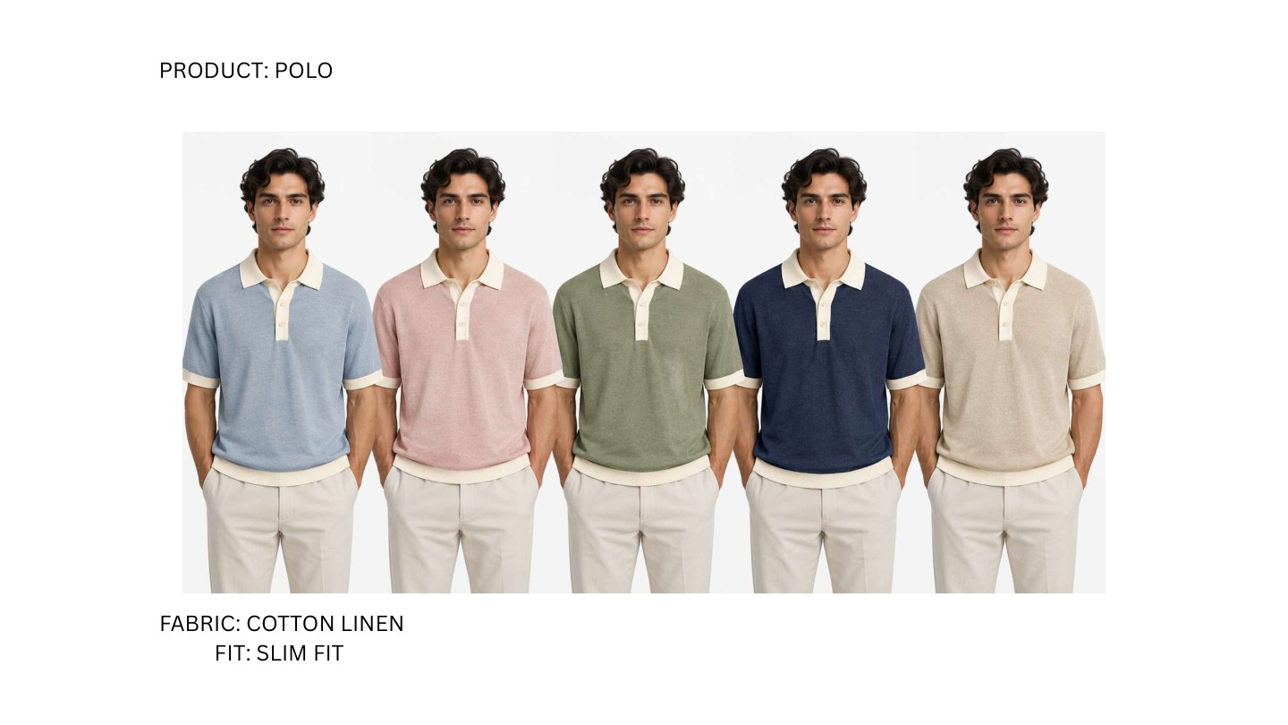
ST-20 | 5 COLOURWAYS
ORDER: LEFT TO RIGHT
CW01
Powder Blue / Off White
CW02
Dusty Rose / Off White
CW03
Sage Green / Off White
CW04
Navy / Off White
CW05
Oatmeal / Off White
FINAL RANGE | PDF PAGE 07 | ST-20 | COLOUR NAMES MATCH EXCEL
Notes:
ST-20 | Contrast-collar essential polo | Cotton Linen | Slim Fit
Colourways, left to right: Powder Blue / Off White; Dusty Rose / Off White; Sage Green / Off White; Navy / Off White; Oatmeal / Off White
New style in final PDF; assigned ST-20 to preserve existing design IDs. Matches additional IMG_8742 silhouette.

Slide 8
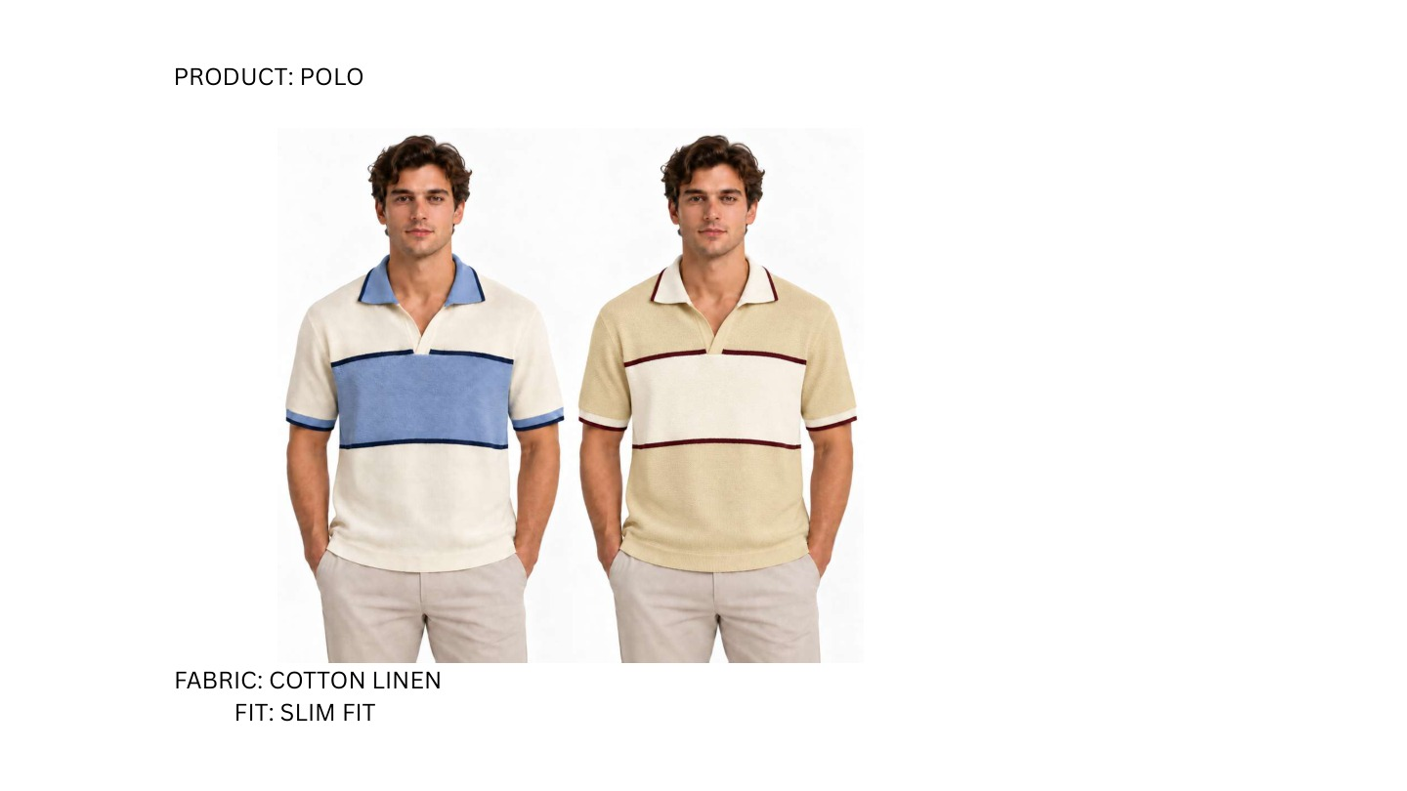
ST-07 | 2 COLOURWAYS
ORDER: LEFT TO RIGHT
CW01
Natural Cotton / Denim Blue / Navy
CW02
Butter Yellow / Natural Cotton / Burgundy
FINAL RANGE | PDF PAGE 08 | ST-07 | COLOUR NAMES MATCH EXCEL
Notes:
ST-07 | Chest-block open-neck polo | Cotton Linen | Slim Fit
Colourways, left to right: Natural Cotton / Denim Blue / Navy; Butter Yellow / Natural Cotton / Burgundy
Original ST-07 silhouette appears on PDF page 8; mapped by design rather than page order.

Slide 9
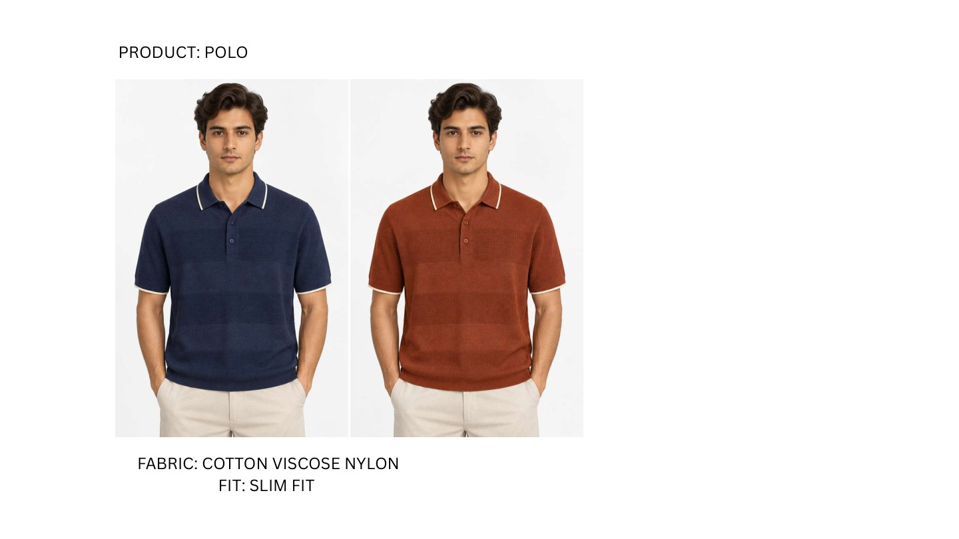
ST-09 | 2 COLOURWAYS
ORDER: LEFT TO RIGHT
CW01
Navy / Off White
CW02
Rust / Off White
FINAL RANGE | PDF PAGE 09 | ST-09 | COLOUR NAMES MATCH EXCEL
Notes:
ST-09 | Tipped fine-knit polo | Cotton Viscose Nylon | Slim Fit
Colourways, left to right: Navy / Off White; Rust / Off White

Slide 10
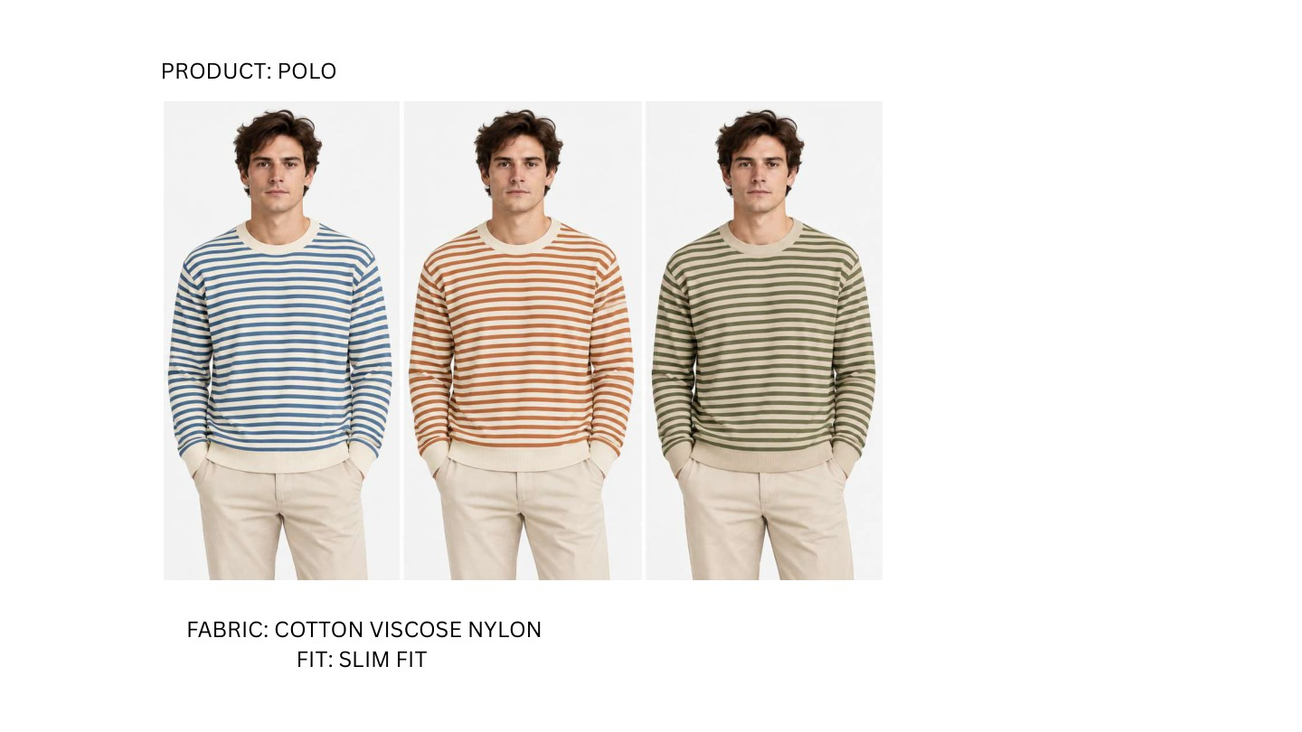
ST-10 | 3 COLOURWAYS
ORDER: LEFT TO RIGHT
CW01
Off White / Denim Blue
CW02
Off White / Rust
CW03
Off White / Olive Green
FINAL RANGE | PDF PAGE 10 | ST-10 | COLOUR NAMES MATCH EXCEL
Notes:
ST-10 | Breton stripe long-sleeve crew | Cotton Viscose Nylon | Slim Fit
Colourways, left to right: Off White / Denim Blue; Off White / Rust; Off White / Olive Green
Expanded to three colourways; long sleeves confirmed in final PDF.

Slide 11
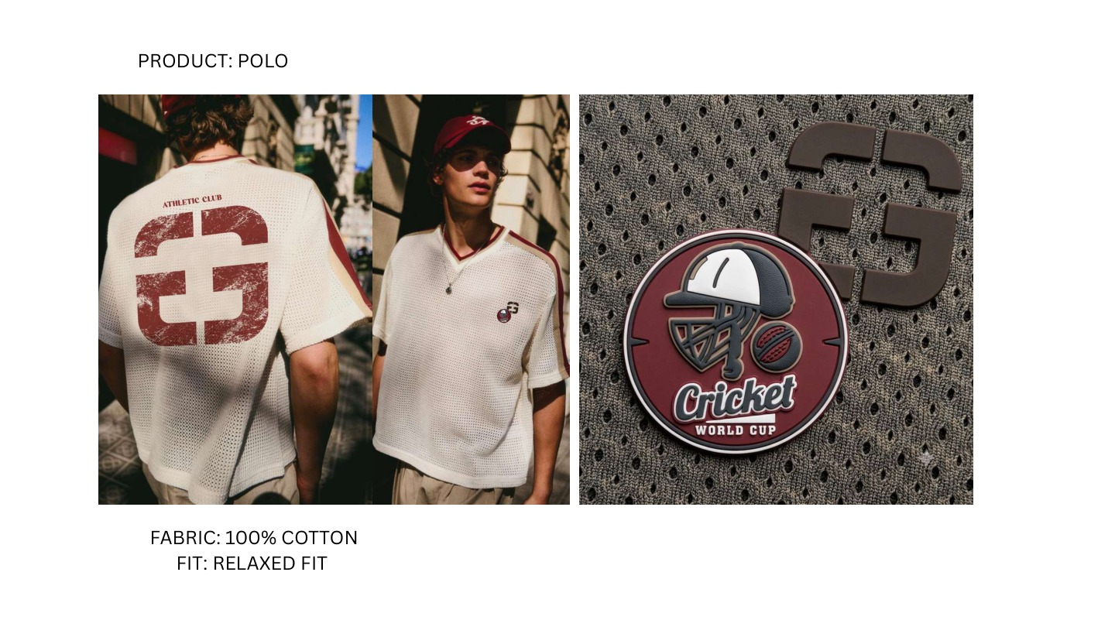
ST-11 | 1 COLOURWAYS
ORDER: LEFT TO RIGHT
CW01
Natural Cotton / Burgundy
One colourway: front, back and badge detail.
FINAL RANGE | PDF PAGE 11 | ST-11 | COLOUR NAMES MATCH EXCEL
Notes:
ST-11 | Athletic Club cricket mesh tee | 100% Cotton | Relaxed Fit
Colourways, left to right: Natural Cotton / Burgundy
ONE colourway shown in front and back views, plus badge detail. Final PDF confirms large graphic on BACK; replaces earlier inferred front placement.

Slide 12
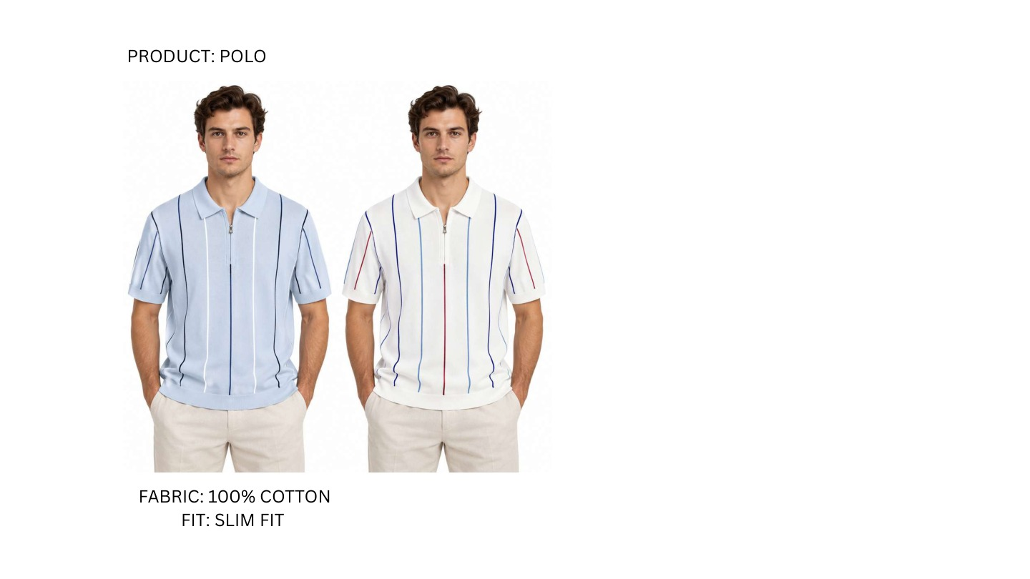
ST-12 | 2 COLOURWAYS
ORDER: LEFT TO RIGHT
CW01
Powder Blue / Navy
CW02
White / Navy / Burgundy
FINAL RANGE | PDF PAGE 12 | ST-12 | COLOUR NAMES MATCH EXCEL
Notes:
ST-12 | Vertical pinstripe zip polo | 100% Cotton | Slim Fit
Colourways, left to right: Powder Blue / Navy; White / Navy / Burgundy

Slide 13
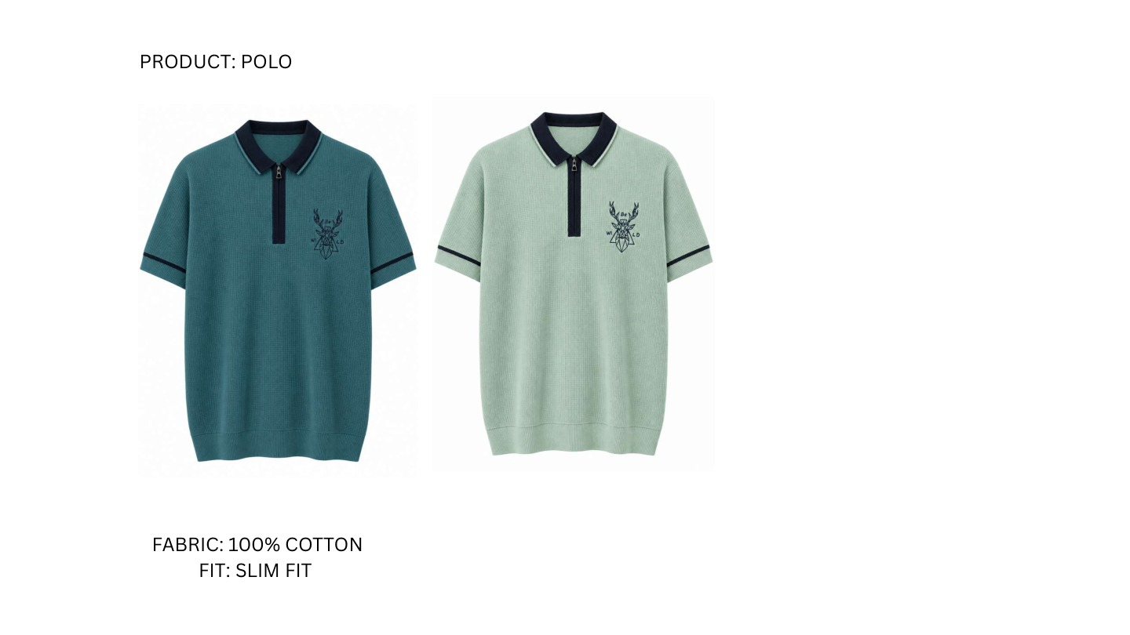
ST-13 | 2 COLOURWAYS
ORDER: LEFT TO RIGHT
CW01
Deep Teal / Navy
CW02
Sage Green / Navy
FINAL RANGE | PDF PAGE 13 | ST-13 | COLOUR NAMES MATCH EXCEL
Notes:
ST-13 | Contrast zip stag polo | 100% Cotton | Slim Fit
Colourways, left to right: Deep Teal / Navy; Sage Green / Navy
Final render is a flat garment image rather than an on-model view; retained exactly as supplied.

Slide 14

ST-14 | 2 COLOURWAYS
ORDER: LEFT TO RIGHT
CW01
White / Navy / Powder Blue
CW02
Navy / Butter Yellow / Dusty Pink
FINAL RANGE | PDF PAGE 14 | ST-14 | COLOUR NAMES MATCH EXCEL
Notes:
ST-14 | Chest-stripe mesh zip polo | 100% Cotton | Slim Fit
Colourways, left to right: White / Navy / Powder Blue; Navy / Butter Yellow / Dusty Pink
Both colourways include red badge / zip-pull accents.

Slide 15

ST-15 | 2 COLOURWAYS
ORDER: LEFT TO RIGHT
CW01
Mustard Yellow / Royal Blue
CW02
Emerald Green / Purple
FINAL RANGE | PDF PAGE 15 | ST-15 | COLOUR NAMES MATCH EXCEL
Notes:
ST-15 | Broad-stripe colour-block polo | 100% Cotton | Slim Fit
Colourways, left to right: Mustard Yellow / Royal Blue; Emerald Green / Purple
Final colourways and band placement follow PDF; replaces earlier off-white/navy/chocolate palette.

Slide 16
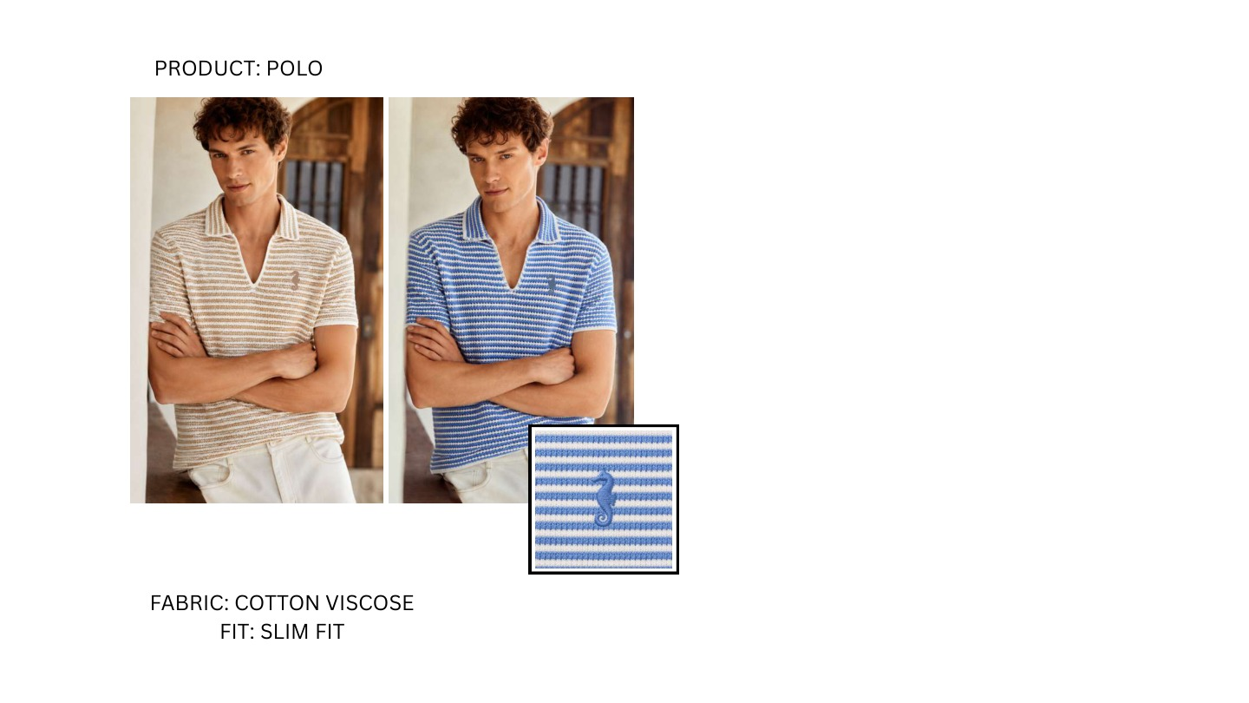
ST-16 | 2 COLOURWAYS
ORDER: LEFT TO RIGHT
CW01
Natural Cotton / Taupe
CW02
Royal Blue / White
Inset is a detail, not an extra colourway.
FINAL RANGE | PDF PAGE 16 | ST-16 | COLOUR NAMES MATCH EXCEL
Notes:
ST-16 | Fine stripe open-neck polo | Cotton Viscose | Slim Fit
Colourways, left to right: Natural Cotton / Taupe; Royal Blue / White
Additional small inset is a trim/logo detail of colourway 2, not a third colourway.

Slide 17
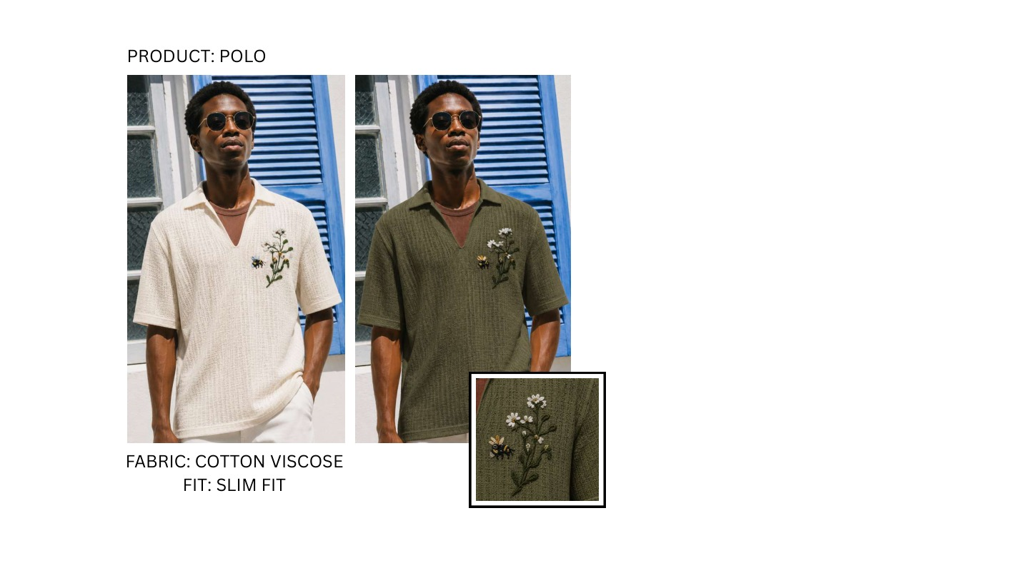
ST-17 | 2 COLOURWAYS
ORDER: LEFT TO RIGHT
CW01
Natural Cotton Botanical
CW02
Dark Olive Botanical
Inset is a detail, not an extra colourway.
FINAL RANGE | PDF PAGE 17 | ST-17 | COLOUR NAMES MATCH EXCEL
Notes:
ST-17 | Botanical rib resort polo | Cotton Viscose | Slim Fit
Colourways, left to right: Natural Cotton Botanical; Dark Olive Botanical
Additional inset is embroidery detail of colourway 2, not a third colourway.

Slide 18
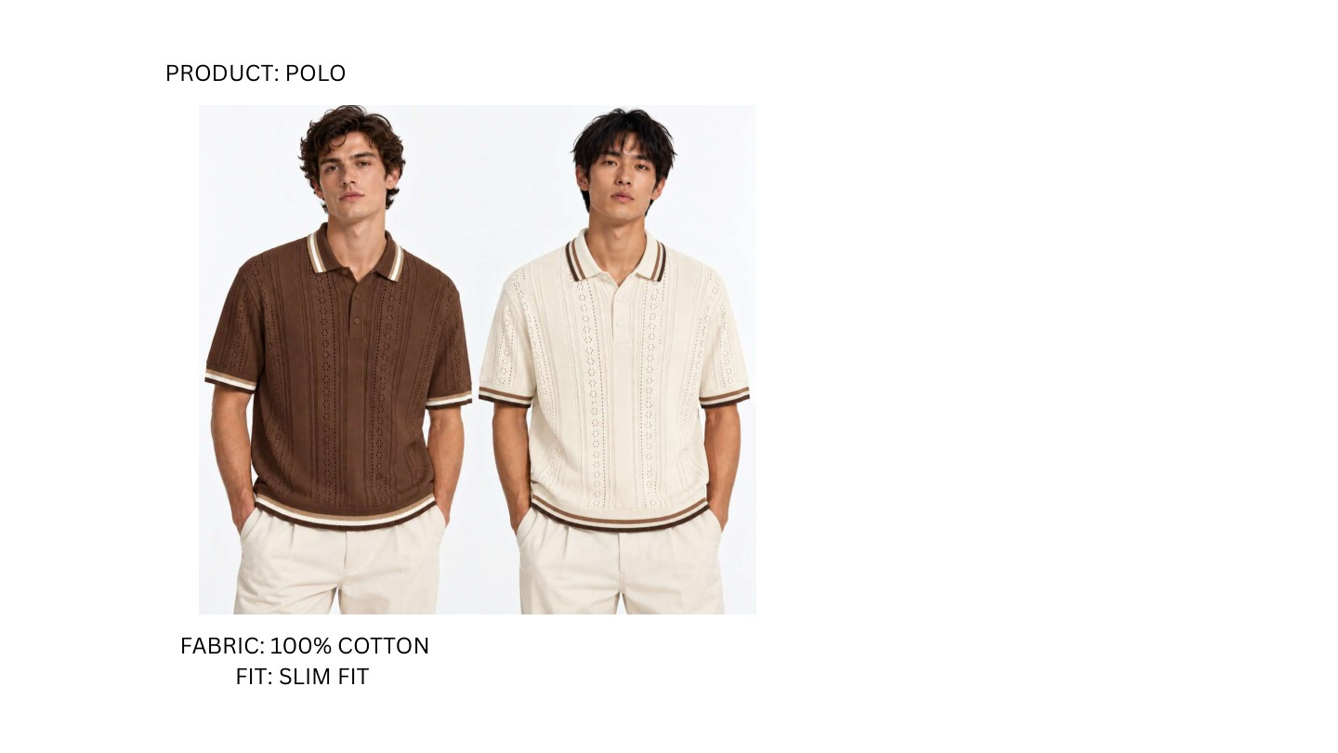
ST-18 | 2 COLOURWAYS
ORDER: LEFT TO RIGHT
CW01
Chocolate Brown / Natural Cotton
CW02
Natural Cotton / Chocolate Brown
FINAL RANGE | PDF PAGE 18 | ST-18 | COLOUR NAMES MATCH EXCEL
Notes:
ST-18 | Pointelle tipped knit polo | 100% Cotton | Slim Fit
Colourways, left to right: Chocolate Brown / Natural Cotton; Natural Cotton / Chocolate Brown
Final PDF specifies 100% cotton; original workbook specified Cotton Viscose. Final PDF value used.

Slide 19
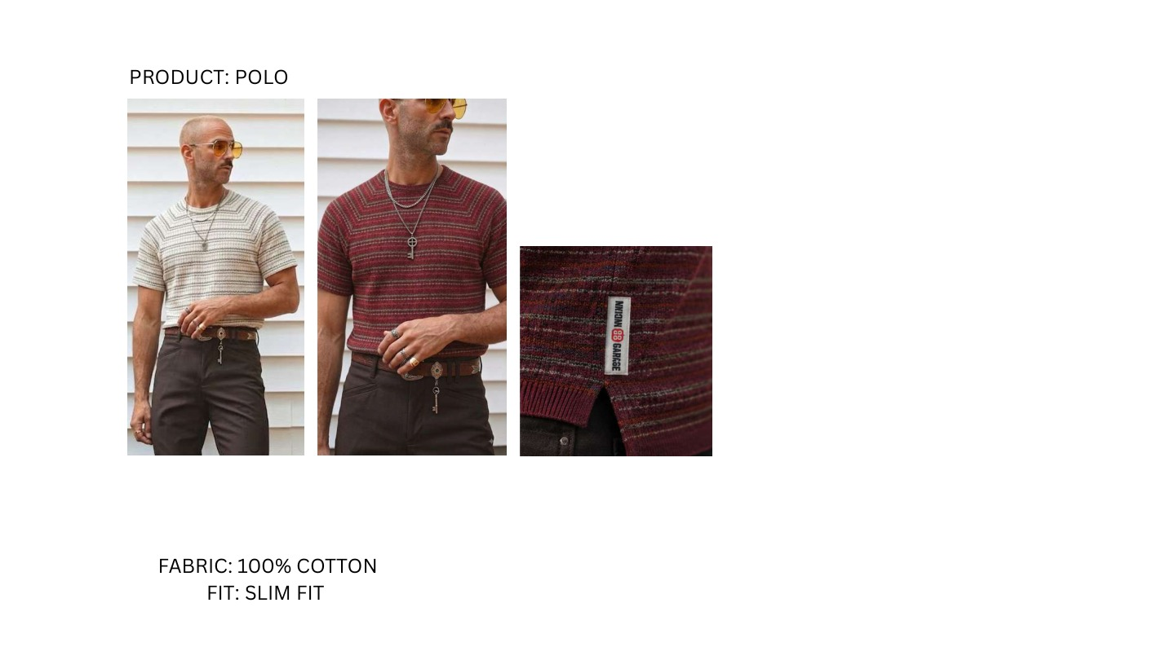
ST-19 | 2 COLOURWAYS
ORDER: LEFT TO RIGHT
CW01
Natural Cotton / Taupe / Grey
CW02
Burgundy / Taupe / Grey
Inset is a detail, not an extra colourway.
FINAL RANGE | PDF PAGE 19 | ST-19 | COLOUR NAMES MATCH EXCEL
Notes:
ST-19 | Raglan micro-stripe crew tee | 100% Cotton | Slim Fit
Colourways, left to right: Natural Cotton / Taupe / Grey; Burgundy / Taupe / Grey
Final PDF specifies 100% cotton; original workbook specified Cotton Viscose. Final PDF value used. Fabric close-up belongs to colourway 2.

