Slide 1
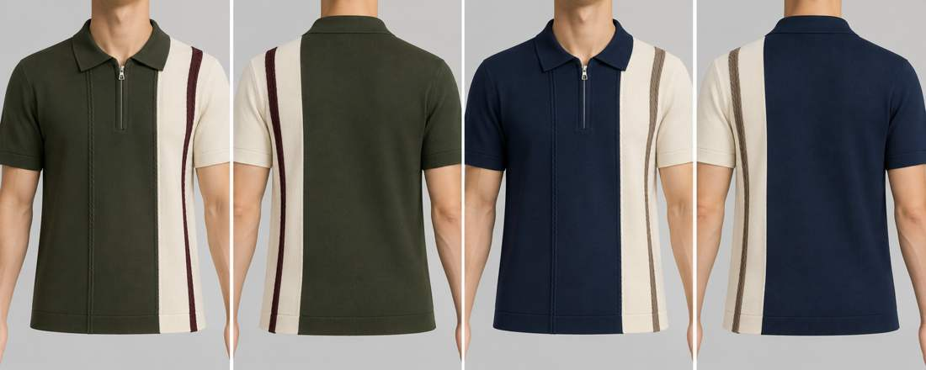
COLLECTION EDIT / 2026
FLAT KNIT / THE COMPLETE RANGE
19 styles · 37 colourways · 74 front/back torso views
Texture, proportion
and a shared
yarn palette.
Polos, crews and henleys.
Original references matched to the catalogue; colourways drawn only from the supplied thread card.
AI concept imagery · Back views inferred · Physical yarn approval required
FLAT KNIT RANGE / THREAD-CARD PALETTE / DESIGN VISUALISATIONS
01

Slide 2
RANGE ARCHITECTURE
37 colourways, one coordinated palette
Fabric grouping retained from the workbook. Two colourways per style, except ST-11: one.
BAMBOO COTTON
LYOCEL COTTON
ST-01 / ST-02 / ST-03
ST-04 / ST-05
6 colourways
4 colourways
COTTON LINEN
COTTON / VISCOSE / NYLON
ST-06 / ST-07 / ST-08
ST-09 / ST-10
6 colourways
4 colourways
COTTON
COTTON VISCOSE
ST-11 / ST-12 / ST-13 / ST-14 / ST-15
ST-16 / ST-17 / ST-18 / ST-19
9 colourways
8 colourways
FLAT KNIT RANGE / THREAD-CARD PALETTE / DESIGN VISUALISATIONS
02

Slide 3
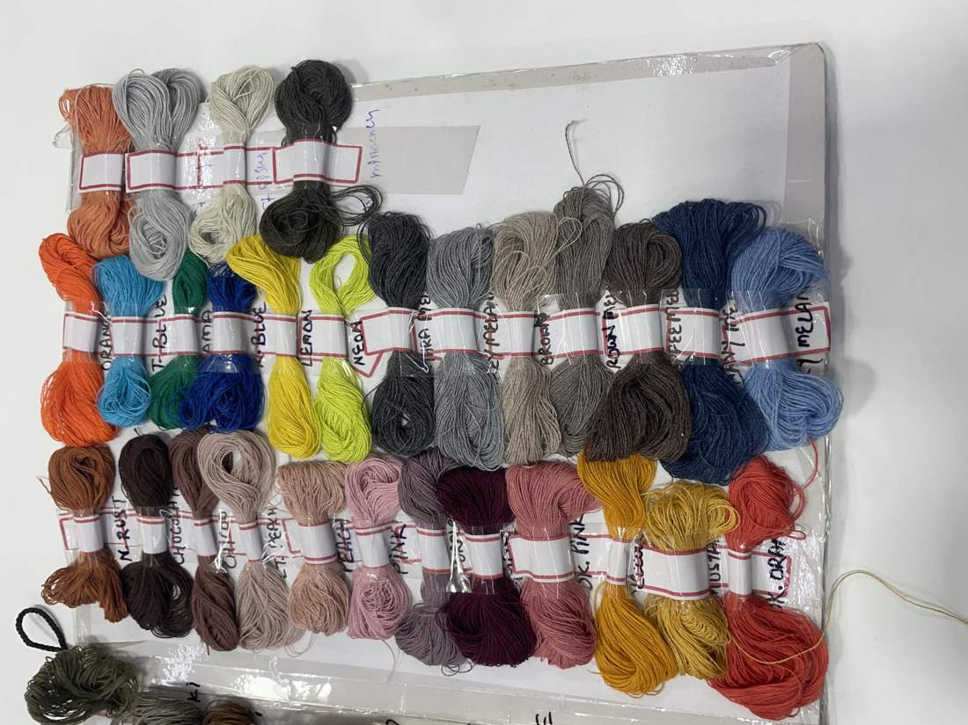
THREAD PALETTE
Available-yarn colour library
Internal TC references identify photographed skeins; descriptive names and screen colours are approximate.
TC01 / Off white
Lower middle row, off-white skein immediately left of white
TC02 / White
Lower middle row, white skein
TC03 / Navy
Main upper row, second skein from right
TC04 / Royal blue
Main upper row, fourth skein from left
TC05 / Denim blue
Main upper row, far-right skein
TC06 / Dark olive
Lower middle row, far-left skein
TC07 / Burgundy
Main lower row, deep wine skein between grey-purple and dusty pink
Source: IMG_8685.HEIC
FLAT KNIT RANGE / THREAD-CARD PALETTE / DESIGN VISUALISATIONS
03

Slide 4
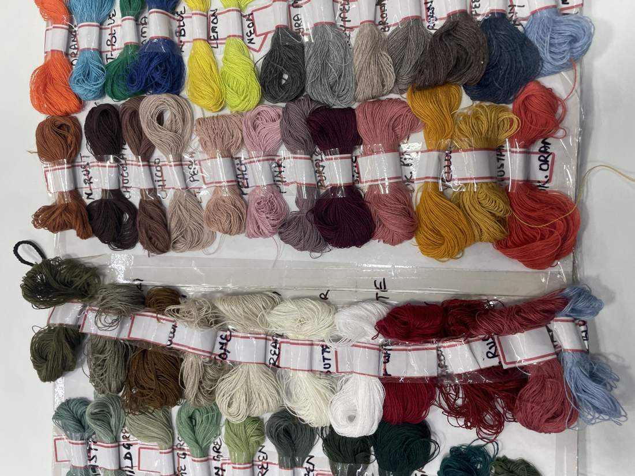
THREAD PALETTE
Available-yarn colour library / continued
Internal TC references identify photographed skeins; descriptive names and screen colours are approximate.
TC08 / Chocolate
Main lower row, second skein from left
TC09 / Taupe
Main upper row, fourth skein from right
TC10 / Mustard
Main lower row, second skein from right
TC11 / Dusty pink
Main lower row, pink skein immediately right of burgundy
TC12 / Rust
Main lower row, far-right skein
TC13 / Medium grey
Main upper row, grey skein between charcoal and taupe
Source: IMG_8684.HEIC
FLAT KNIT RANGE / THREAD-CARD PALETTE / DESIGN VISUALISATIONS
04

Slide 5
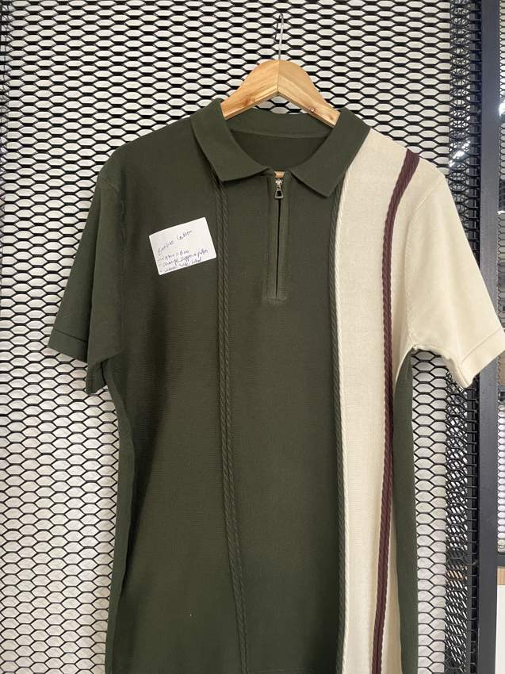
ST-01 / BAMBOO COTTON
Asymmetric cable zip polo
Fine knit with vertical cable accents · Quarter zip
01 / Olive / off white
02 / Navy / off white
FULL REFERENCE
FRONT
BACK*
FRONT
BACK*
IMG_8757.jpg
Match: High
Construction retained from the full garment reference.
body: TC06 · panel: TC01 · stripe: TC07
body: TC03 · panel: TC01 · stripe: TC09
* Back views are inferred design proposals. Yarn shades, stitch details and fit require physical approval.
FLAT KNIT RANGE / THREAD-CARD PALETTE / DESIGN VISUALISATIONS
05

Slide 6
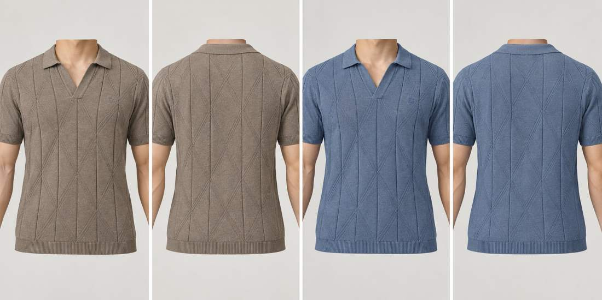
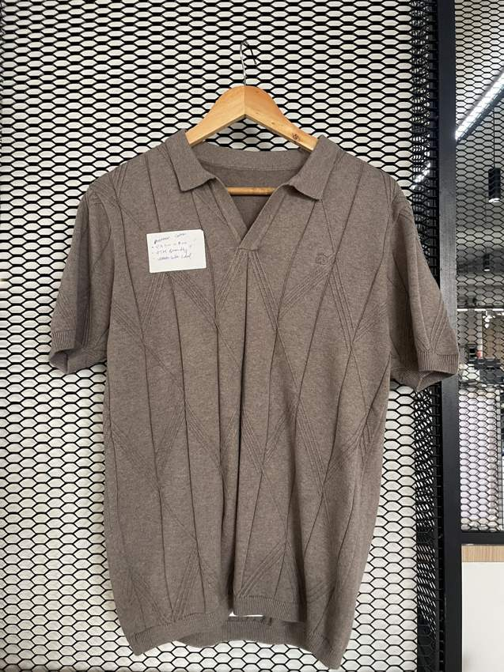
ST-02 / BAMBOO COTTON
Diamond textured open-neck polo
Large elongated diamond knit · Open V placket; no buttons
01 / Taupe
02 / Denim blue
FULL REFERENCE
FRONT
BACK*
FRONT
BACK*
IMG_8759.jpg
Match: High
Full photo confirms open neck rather than button placket.
body: TC09
body: TC05
* Back views are inferred design proposals. Yarn shades, stitch details and fit require physical approval.
FLAT KNIT RANGE / THREAD-CARD PALETTE / DESIGN VISUALISATIONS
06

Slide 7
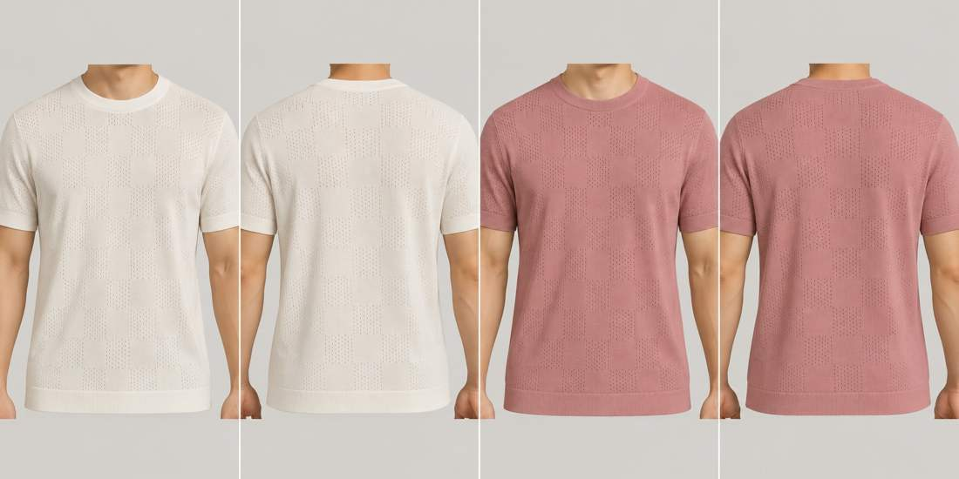
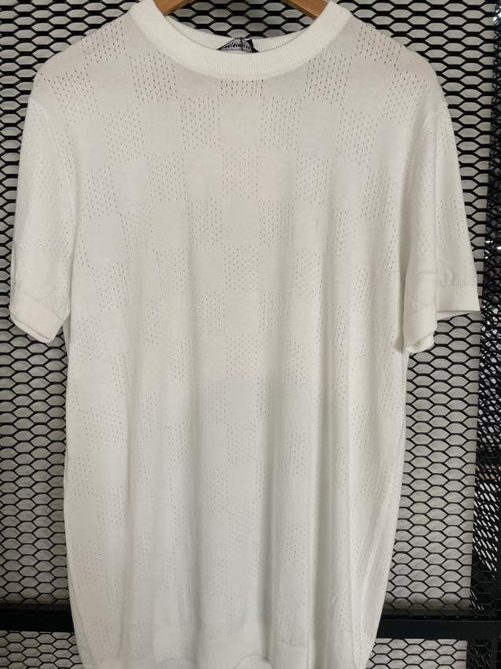
ST-03 / BAMBOO COTTON
Floral pointelle crew tee
Tonal floral pointelle / openwork · Crew neck
01 / Off white
02 / Dusty pink
FULL REFERENCE
FRONT
BACK*
FRONT
BACK*
IMG_8735.jpg
Match: Medium-high
Full ivory pointelle tee is closest match to original ST-03 floral reference; subtle tonal motif is difficult to read in original.
body: TC01
body: TC11
* Back views are inferred design proposals. Yarn shades, stitch details and fit require physical approval.
FLAT KNIT RANGE / THREAD-CARD PALETTE / DESIGN VISUALISATIONS
07

Slide 8
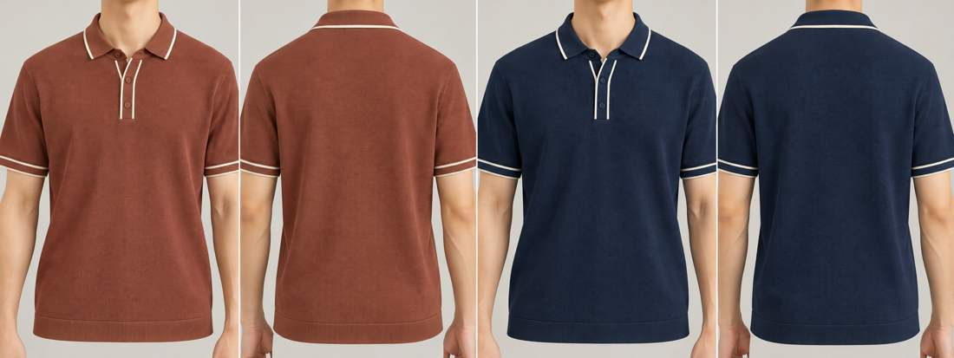
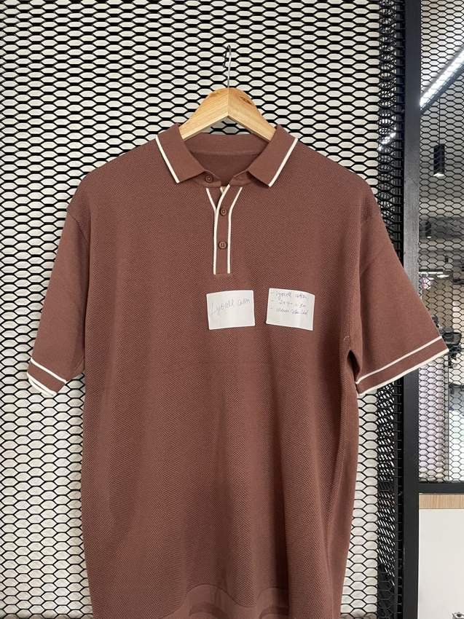
ST-04 / LYOCEL COTTON
Contrast piping knit polo
Fine textured knit · Button placket
01 / Rust / off white
02 / Navy / off white
FULL REFERENCE
FRONT
BACK*
FRONT
BACK*
IMG_8754.jpg
Match: High
Construction retained from the full garment reference.
body: TC12 · piping: TC01
body: TC03 · piping: TC01
* Back views are inferred design proposals. Yarn shades, stitch details and fit require physical approval.
FLAT KNIT RANGE / THREAD-CARD PALETTE / DESIGN VISUALISATIONS
08

Slide 9
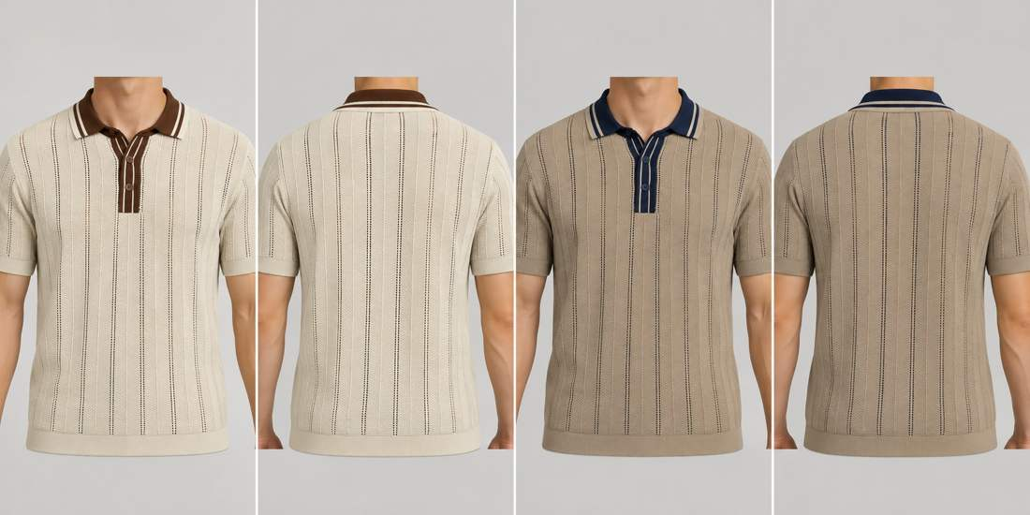
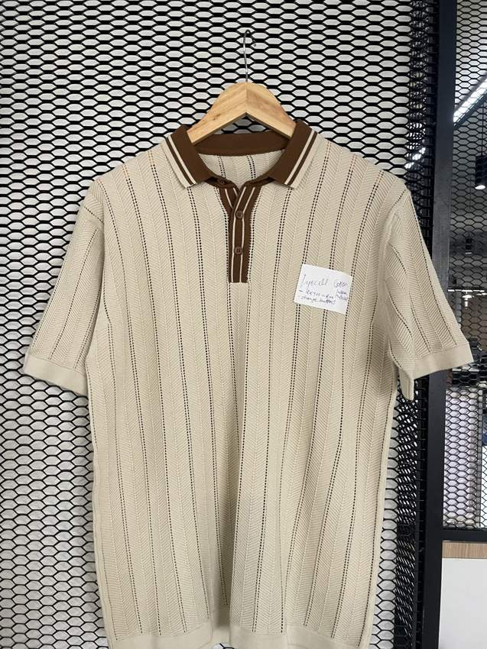
ST-05 / LYOCEL COTTON
Open-knit striped-placket polo
Vertical herringbone / pointelle channels · Button placket
01 / Off white / chocolate
02 / Taupe / navy
FULL REFERENCE
FRONT
BACK*
FRONT
BACK*
IMG_8753.jpg
Match: High
Construction retained from the full garment reference.
body: TC01 · trim: TC08
body: TC09 · trim: TC03
* Back views are inferred design proposals. Yarn shades, stitch details and fit require physical approval.
FLAT KNIT RANGE / THREAD-CARD PALETTE / DESIGN VISUALISATIONS
09

Slide 10
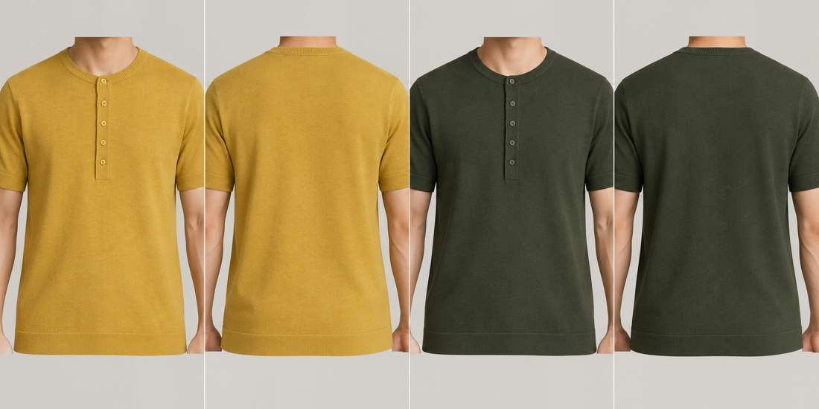
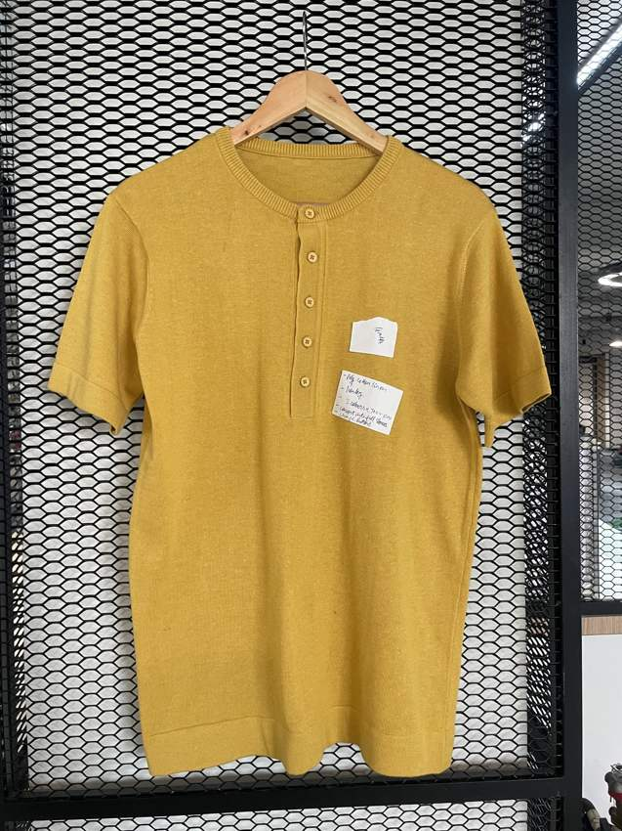
ST-06 / COTTON LINEN
Five-button knit henley
Plain fine knit · Five-button henley
01 / Mustard
02 / Dark olive
FULL REFERENCE
FRONT
BACK*
FRONT
BACK*
IMG_8740.jpg
Match: High
Construction retained from the full garment reference.
body: TC10
body: TC06
* Back views are inferred design proposals. Yarn shades, stitch details and fit require physical approval.
FLAT KNIT RANGE / THREAD-CARD PALETTE / DESIGN VISUALISATIONS
10

Slide 11
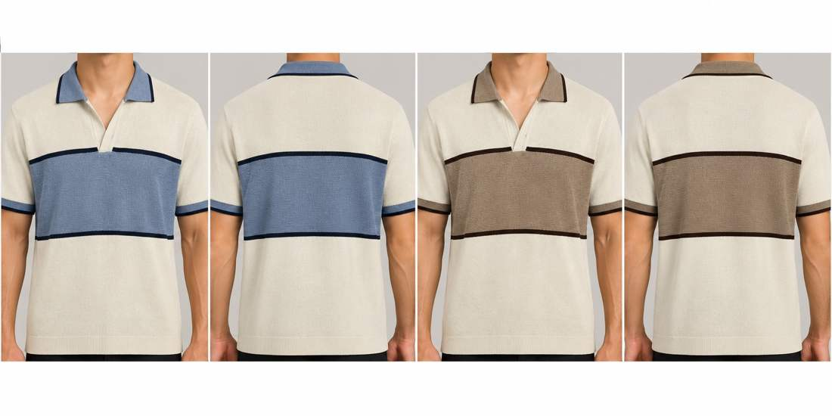
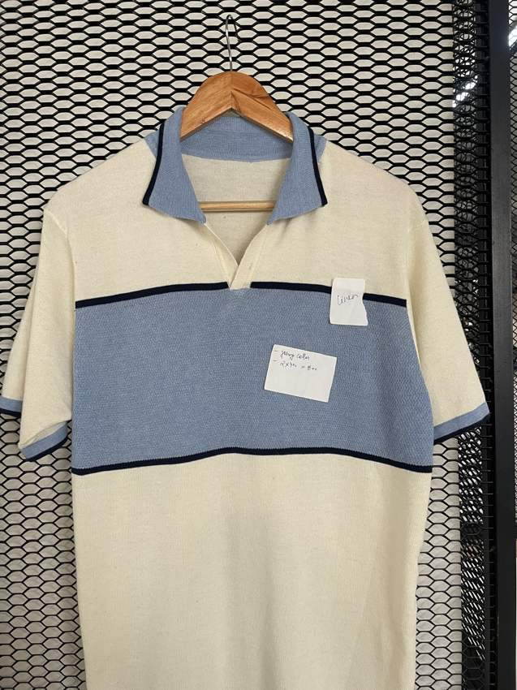
ST-07 / COTTON LINEN
Chest-block open-neck polo
Textured chest block on fine knit · Open V placket
01 / Off white / denim / navy
02 / Off white / taupe / chocolate
FULL REFERENCE
FRONT
BACK*
FRONT
BACK*
IMG_8741.jpg
Match: High
Construction retained from the full garment reference.
body: TC01 · panel: TC05 · piping: TC03
body: TC01 · panel: TC09 · piping: TC08
* Back views are inferred design proposals. Yarn shades, stitch details and fit require physical approval.
FLAT KNIT RANGE / THREAD-CARD PALETTE / DESIGN VISUALISATIONS
11

Slide 12
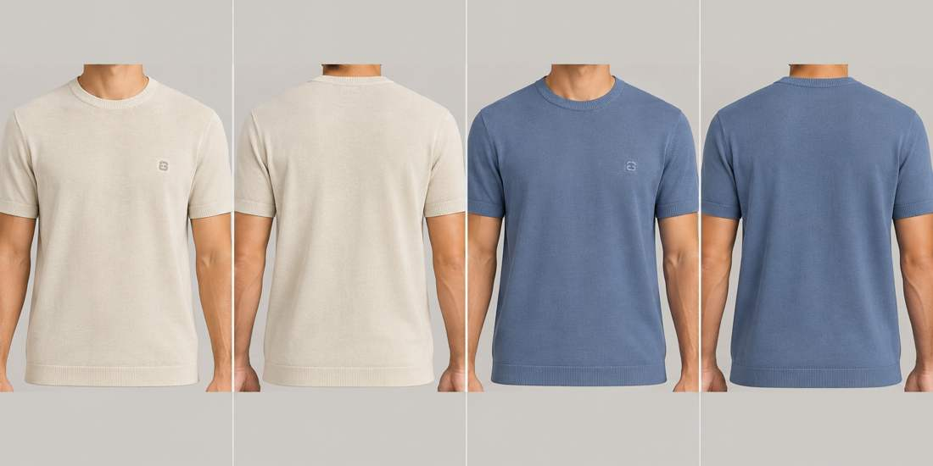
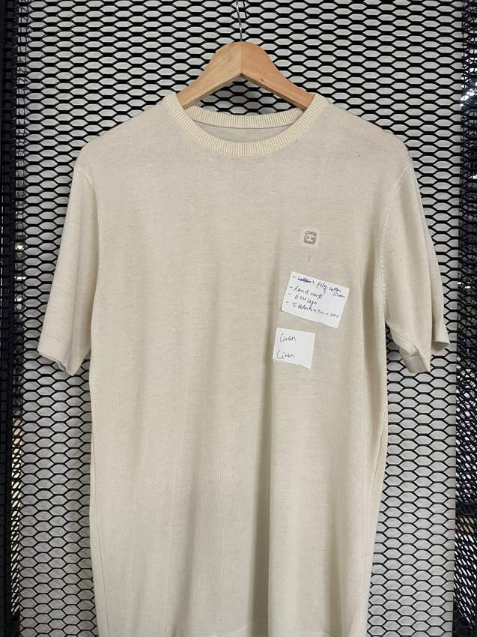
ST-08 / COTTON LINEN
Essential fine-knit crew tee
Plain fine knit · Crew neck
01 / Off white
02 / Denim blue
FULL REFERENCE
FRONT
BACK*
FRONT
BACK*
IMG_8739.jpg
Match: High
Small tonal emblem appears on chest in full photograph; original description said sleeve.
body: TC01
body: TC05
* Back views are inferred design proposals. Yarn shades, stitch details and fit require physical approval.
FLAT KNIT RANGE / THREAD-CARD PALETTE / DESIGN VISUALISATIONS
12

Slide 13
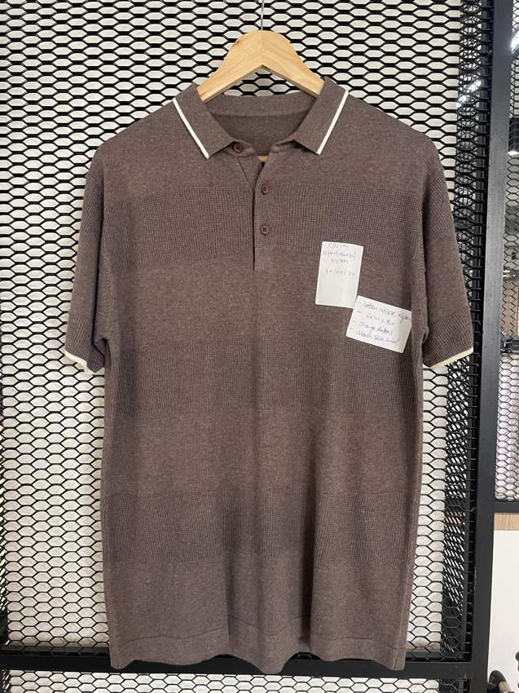
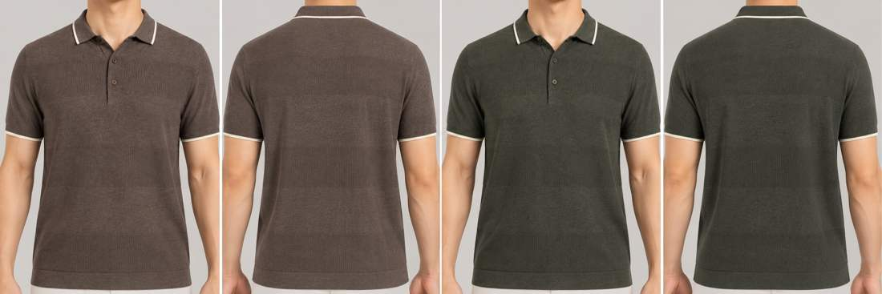
ST-09 / COTTON VISCOSE NYLON (40/40/20)
Tipped fine-knit polo
Plain textured fine knit · Button placket
01 / Chocolate / off white
02 / Dark olive / off white
FULL REFERENCE
FRONT
BACK*
FRONT
BACK*
IMG_8743.jpg
Match: High
Construction retained from the full garment reference.
body: TC08 · tipping: TC01
body: TC06 · tipping: TC01
* Back views are inferred design proposals. Yarn shades, stitch details and fit require physical approval.
FLAT KNIT RANGE / THREAD-CARD PALETTE / DESIGN VISUALISATIONS
13

Slide 14
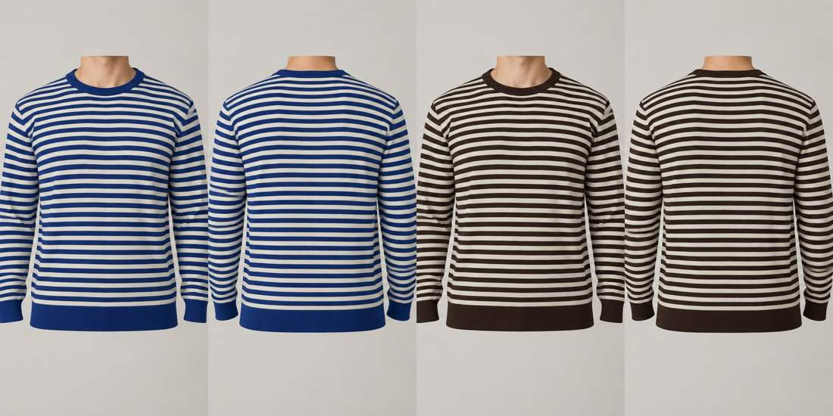
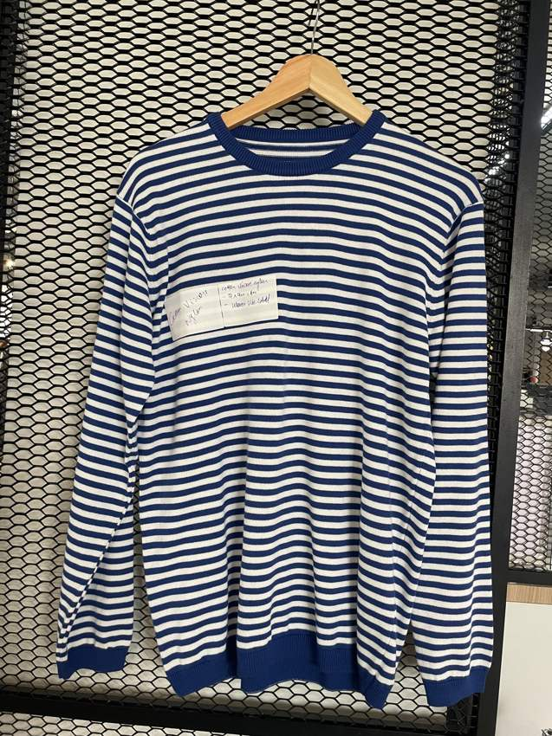
ST-10 / COTTON VISCOSE NYLON (40/40/20)
Breton stripe long-sleeve crew
Even narrow horizontal stripe · Crew neck
01 / Royal blue / off white
02 / Chocolate / off white
FULL REFERENCE
FRONT
BACK*
FRONT
BACK*
IMG_8750.jpg
Match: High
Full IMG_8750 photograph confirms long sleeves; original cropped workbook reference did not show sleeve length clearly.
body: TC04 · stripe: TC01
body: TC08 · stripe: TC01
* Back views are inferred design proposals. Yarn shades, stitch details and fit require physical approval.
FLAT KNIT RANGE / THREAD-CARD PALETTE / DESIGN VISUALISATIONS
14

Slide 15
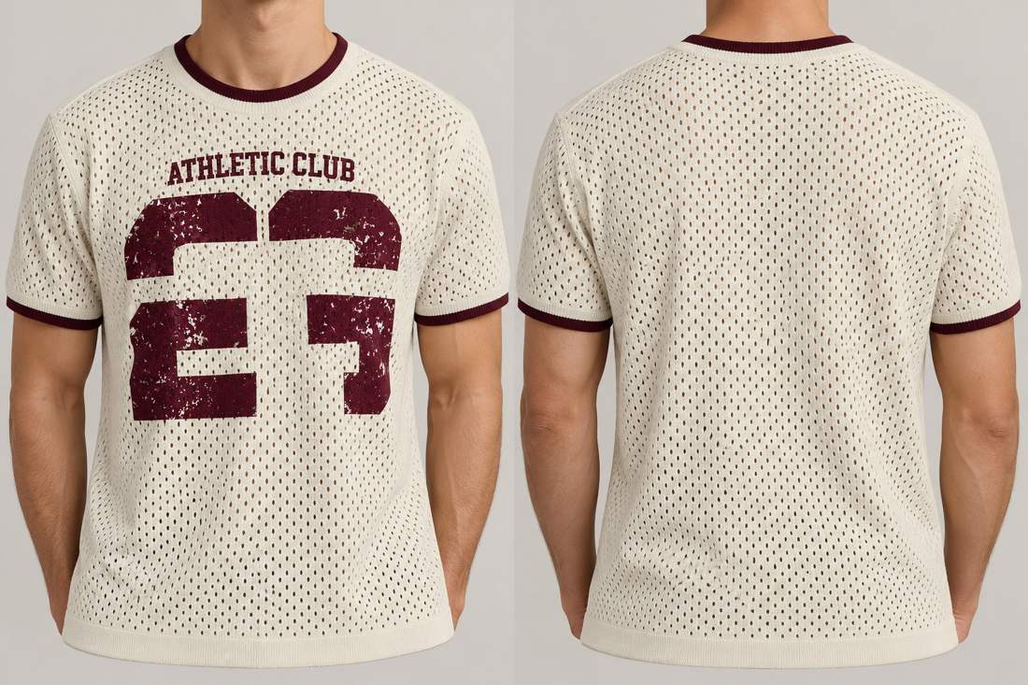
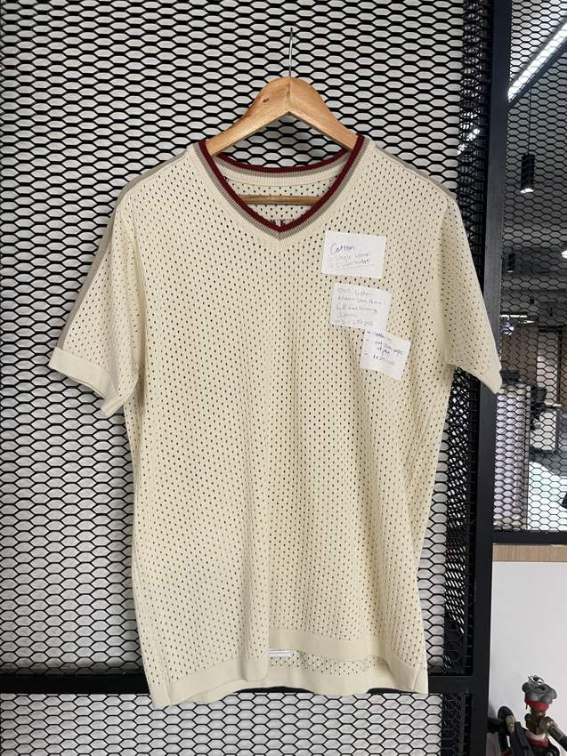
ST-11 / COTTON
Athletic mesh graphic tee
Open mesh with distressed chest graphic · Crew neck
01 / Off white / burgundy
FULL REFERENCE
FRONT
BACK*
IMG_8749.jpg
Match: Provisional
New full photo is a mesh tee without visible Athletic Club graphic and may show reverse or a related sample. Render follows original workbook graphic; match is provisional.
body: TC01 · graphic: TC07
* Back views are inferred design proposals. Yarn shades, stitch details and fit require physical approval.
FLAT KNIT RANGE / THREAD-CARD PALETTE / DESIGN VISUALISATIONS
15

Slide 16
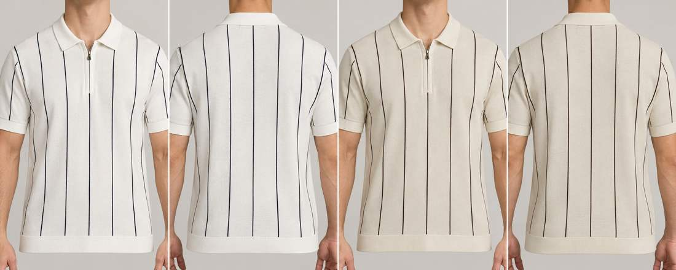
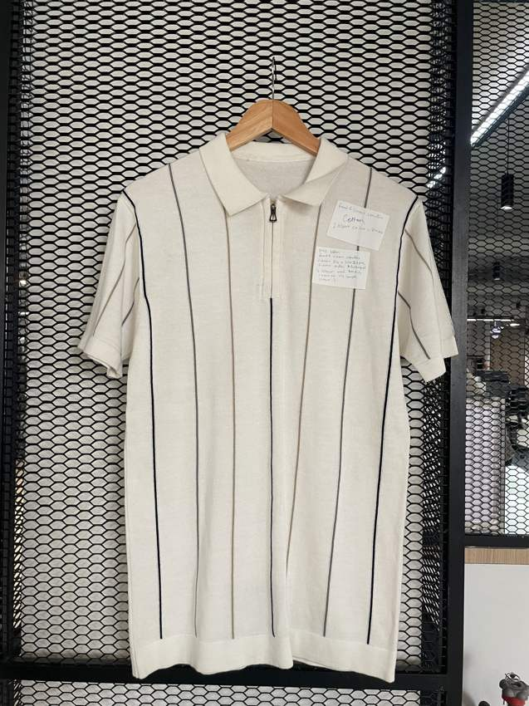
ST-12 / COTTON
Vertical pinstripe zip polo
Fine spaced vertical pinstripes · Quarter zip
01 / White / navy
02 / Off white / chocolate
FULL REFERENCE
FRONT
BACK*
FRONT
BACK*
IMG_8760.jpg
Match: High
Construction retained from the full garment reference.
body: TC02 · stripe: TC03
body: TC01 · stripe: TC08
* Back views are inferred design proposals. Yarn shades, stitch details and fit require physical approval.
FLAT KNIT RANGE / THREAD-CARD PALETTE / DESIGN VISUALISATIONS
16

Slide 17
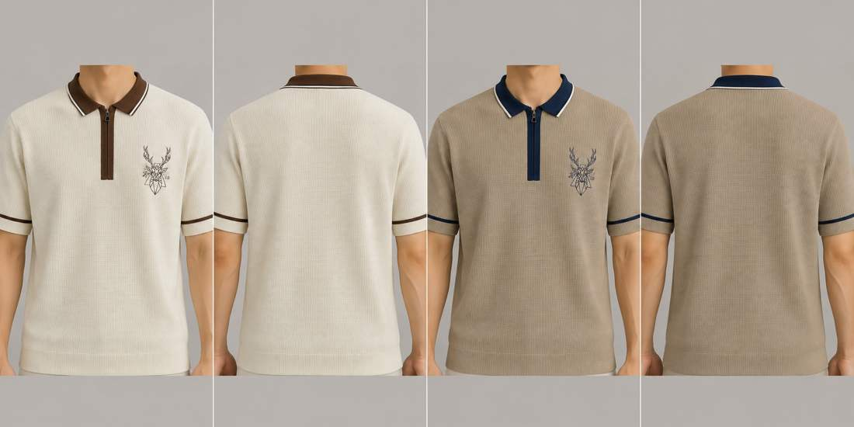
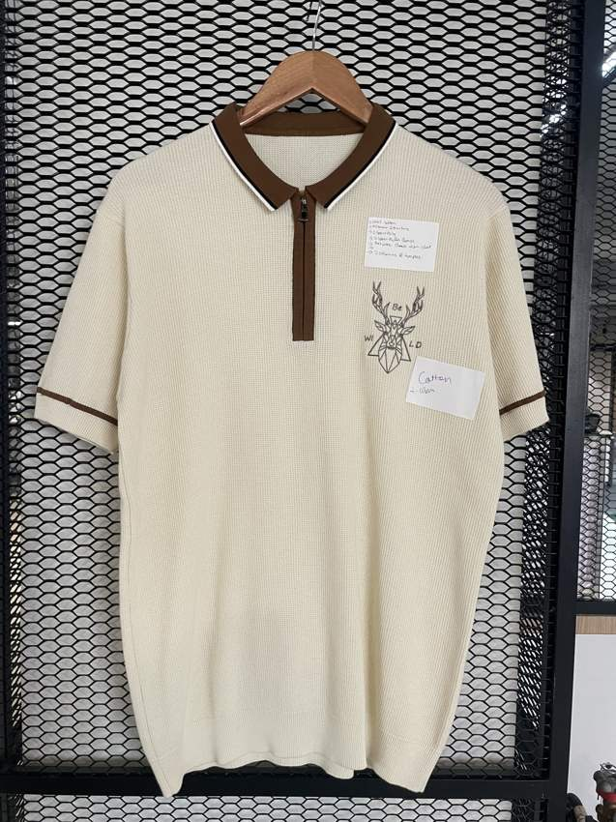
ST-13 / COTTON
Contrast zip stag polo
Plain fine knit · Quarter zip
01 / Off white / chocolate
02 / Taupe / navy
FULL REFERENCE
FRONT
BACK*
FRONT
BACK*
IMG_8745.jpg
Match: High
Full photo confirms geometric stag-head chest embroidery.
body: TC01 · trim: TC08
body: TC09 · trim: TC03
* Back views are inferred design proposals. Yarn shades, stitch details and fit require physical approval.
FLAT KNIT RANGE / THREAD-CARD PALETTE / DESIGN VISUALISATIONS
17

Slide 18
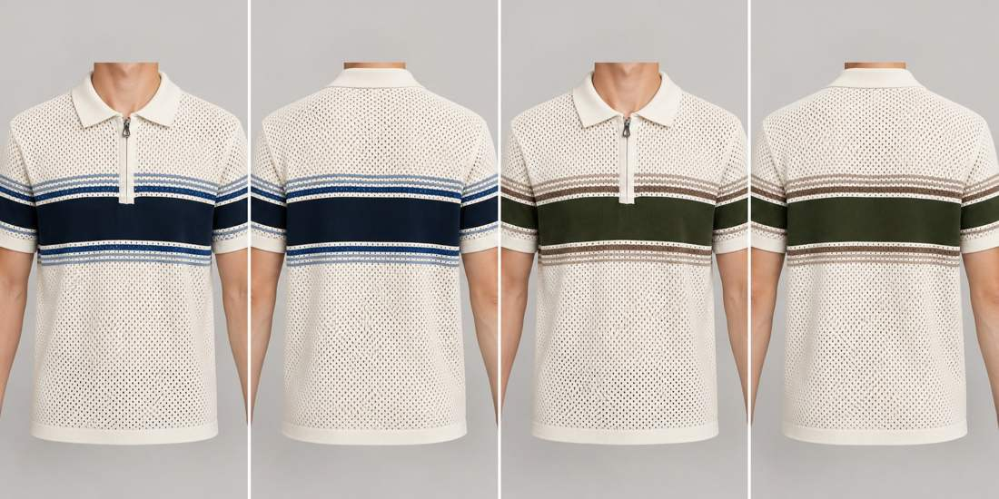
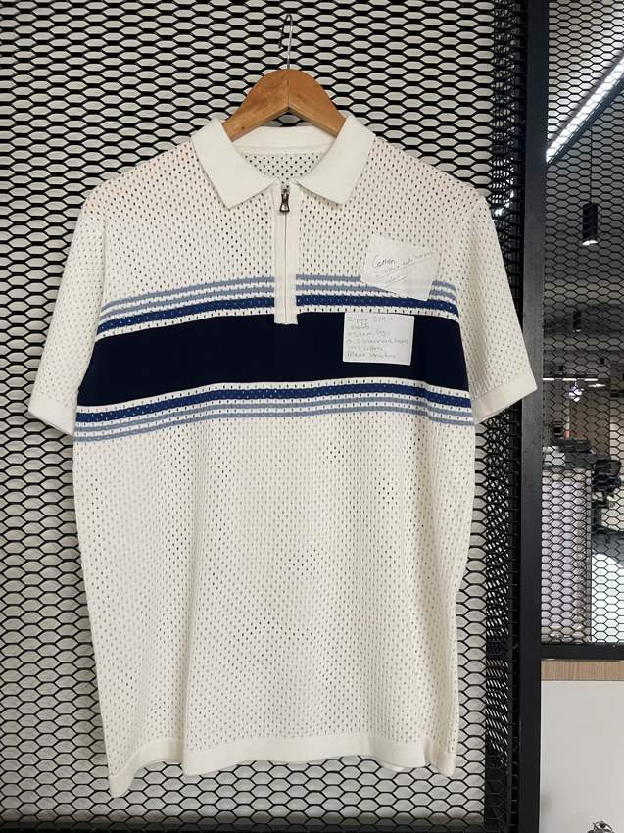
ST-14 / COTTON
Mesh chest-stripe zip polo
Open mesh with horizontal band · Quarter zip
01 / Off white / navy / denim
02 / Off white / olive / taupe
FULL REFERENCE
FRONT
BACK*
FRONT
BACK*
IMG_8755.jpg
Match: High
Construction retained from the full garment reference.
body: TC01 · band: TC03 · stripe: TC05
body: TC01 · band: TC06 · stripe: TC09
* Back views are inferred design proposals. Yarn shades, stitch details and fit require physical approval.
FLAT KNIT RANGE / THREAD-CARD PALETTE / DESIGN VISUALISATIONS
18

Slide 19
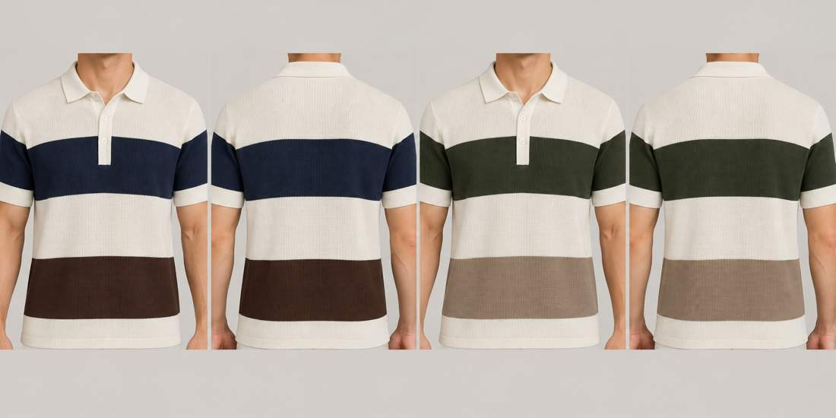
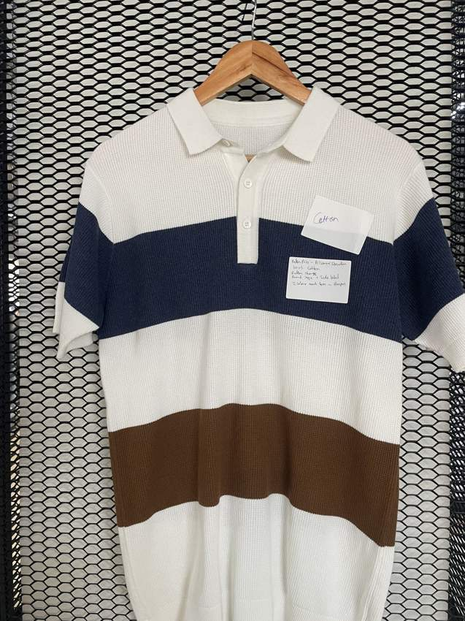
ST-15 / COTTON
Three-band waffle polo
Waffle knit, broad colour blocks · Button placket
01 / Off white / navy / chocolate
02 / Off white / olive / taupe
FULL REFERENCE
FRONT
BACK*
FRONT
BACK*
IMG_8747.jpg
Match: High
Full photo reveals additional chocolate lower band missing from workbook description.
body: TC01 · chest: TC03 · lower band: TC08
body: TC01 · chest: TC06 · lower band: TC09
* Back views are inferred design proposals. Yarn shades, stitch details and fit require physical approval.
FLAT KNIT RANGE / THREAD-CARD PALETTE / DESIGN VISUALISATIONS
19

Slide 20
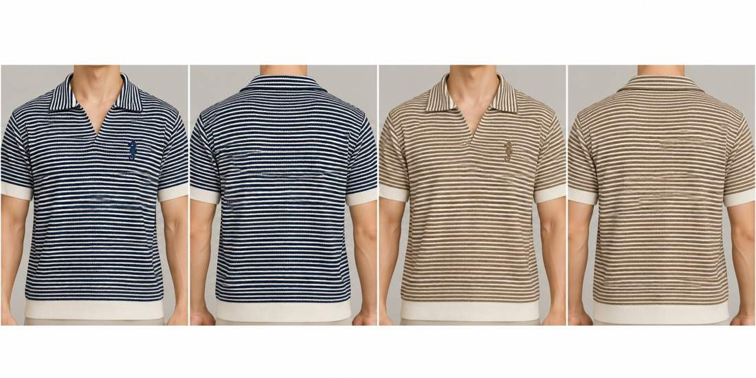
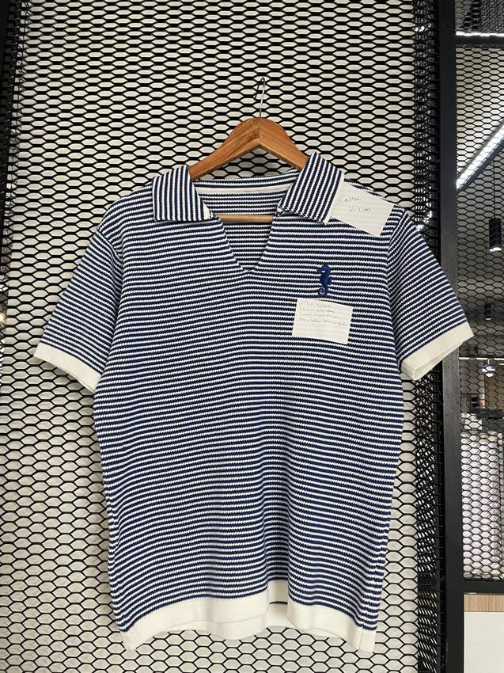
ST-16 / COTTON VISCOSE
Fine stripe open-neck polo
Fine horizontal stripe · Open V placket
01 / Navy / off white
02 / Taupe / off white
FULL REFERENCE
FRONT
BACK*
FRONT
BACK*
IMG_8756.jpg
Match: High
ST-16 second row uses taupe/off white, matching workbook beige/white intent.
body: TC03 · stripe: TC01
body: TC09 · stripe: TC01
* Back views are inferred design proposals. Yarn shades, stitch details and fit require physical approval.
FLAT KNIT RANGE / THREAD-CARD PALETTE / DESIGN VISUALISATIONS
20

Slide 21
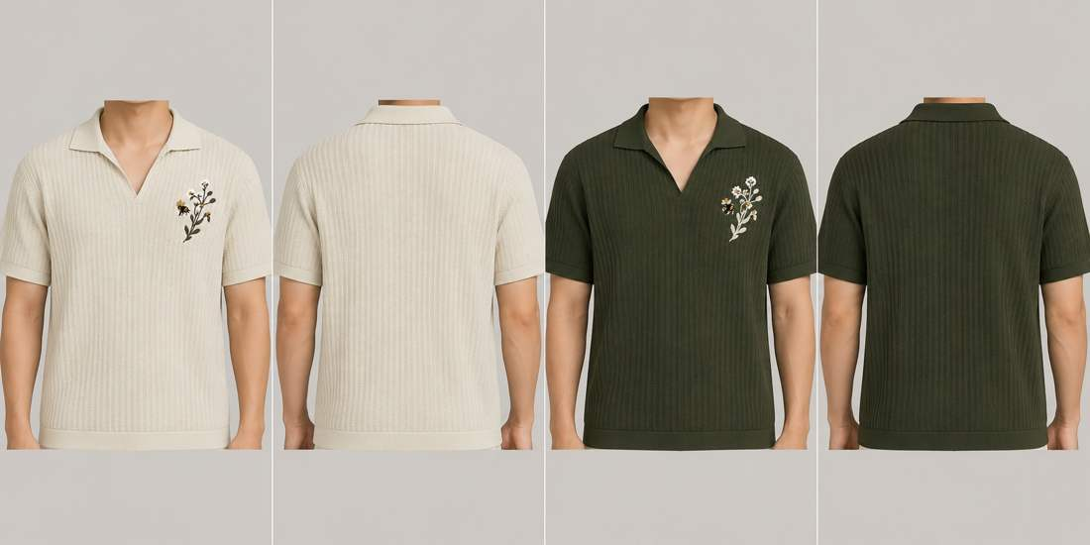
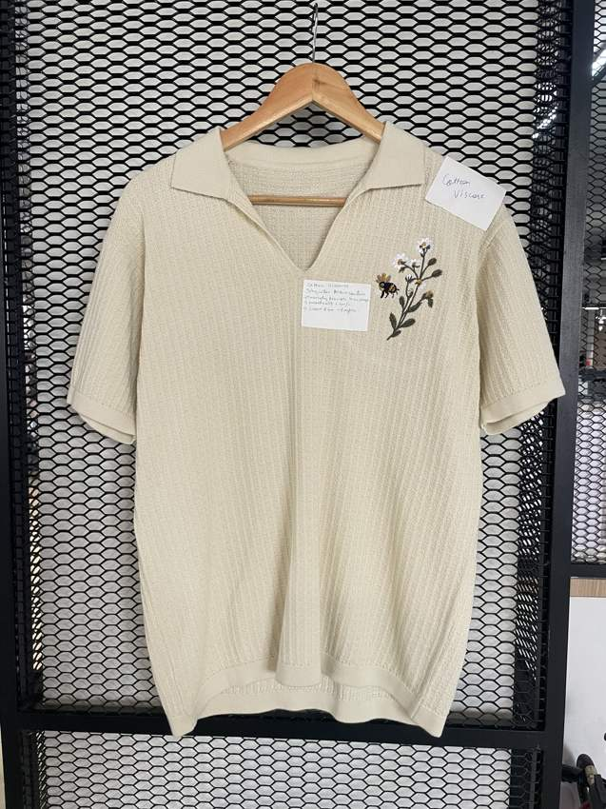
ST-17 / COTTON VISCOSE
Botanical rib resort polo
Textured vertical rib knit · Open V placket
01 / Off white botanical
02 / Dark olive botanical
FULL REFERENCE
FRONT
BACK*
FRONT
BACK*
IMG_8746.jpg
Match: High
Construction retained from the full garment reference.
body: TC01 · stems: TC08 · flowers: TC10 · leaves: TC06
body: TC06 · stems: TC01 · flowers: TC10 · leaves: TC01
* Back views are inferred design proposals. Yarn shades, stitch details and fit require physical approval.
FLAT KNIT RANGE / THREAD-CARD PALETTE / DESIGN VISUALISATIONS
21

Slide 22
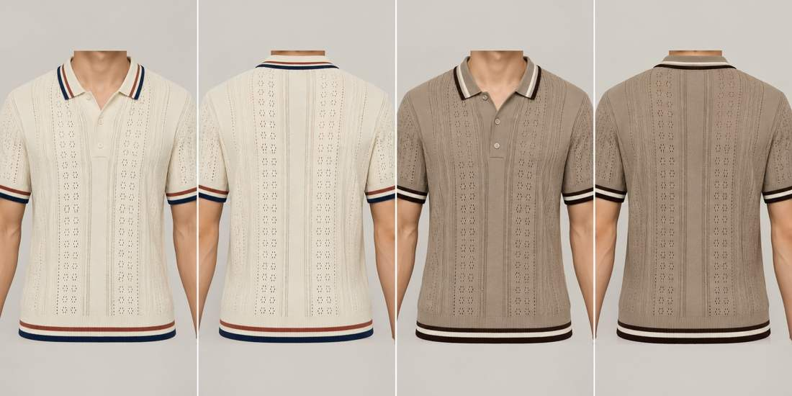
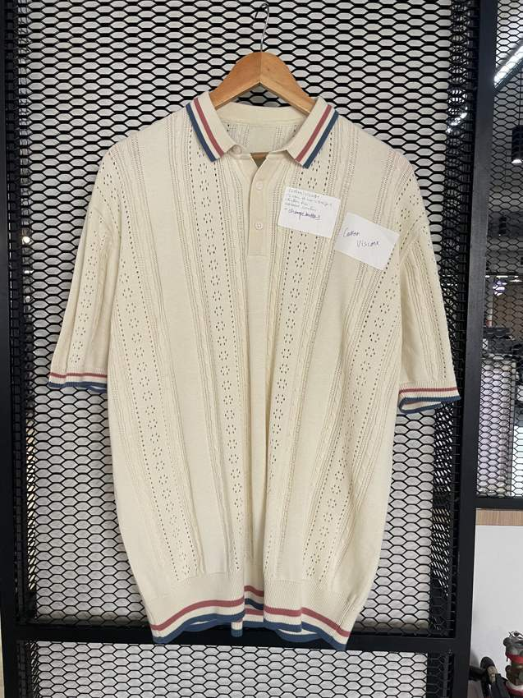
ST-18 / COTTON VISCOSE
Pointelle tipped knit polo
Vertical pointelle / eyelet channels · Button placket
01 / Off white / navy / rust
02 / Taupe / chocolate / off white
FULL REFERENCE
FRONT
BACK*
FRONT
BACK*
IMG_8744.jpg
Match: High
Construction retained from the full garment reference.
body: TC01 · stripe 1: TC03 · stripe 2: TC12
body: TC09 · stripe 1: TC08 · stripe 2: TC01
* Back views are inferred design proposals. Yarn shades, stitch details and fit require physical approval.
FLAT KNIT RANGE / THREAD-CARD PALETTE / DESIGN VISUALISATIONS
22

Slide 23
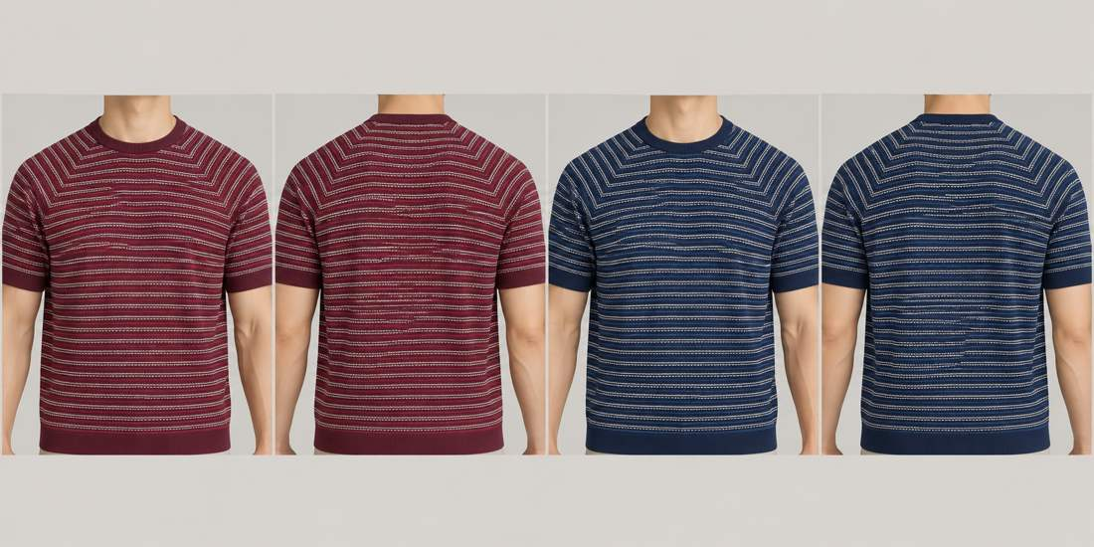
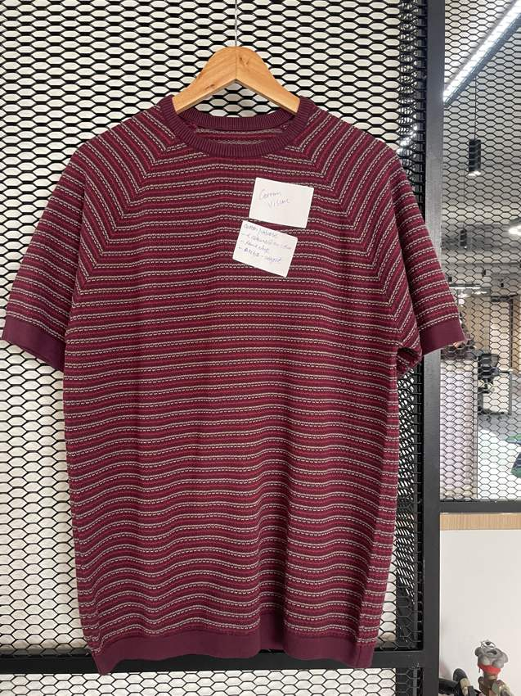
ST-19 / COTTON VISCOSE
Raglan micro-stripe crew tee
Fine broken horizontal stripes, chevron raglan shoulders · Crew neck
01 / Burgundy / off white / dusty pink
02 / Navy / off white / denim
FULL REFERENCE
FRONT
BACK*
FRONT
BACK*
IMG_8752.jpg
Match: High
Corrected from polo/pinstripe in original workbook to crew-neck raglan striped tee, based on full photo.
body: TC07 · stripe 1: TC01 · stripe 2: TC11
body: TC03 · stripe 1: TC01 · stripe 2: TC05
* Back views are inferred design proposals. Yarn shades, stitch details and fit require physical approval.
FLAT KNIT RANGE / THREAD-CARD PALETTE / DESIGN VISUALISATIONS
23

Slide 24
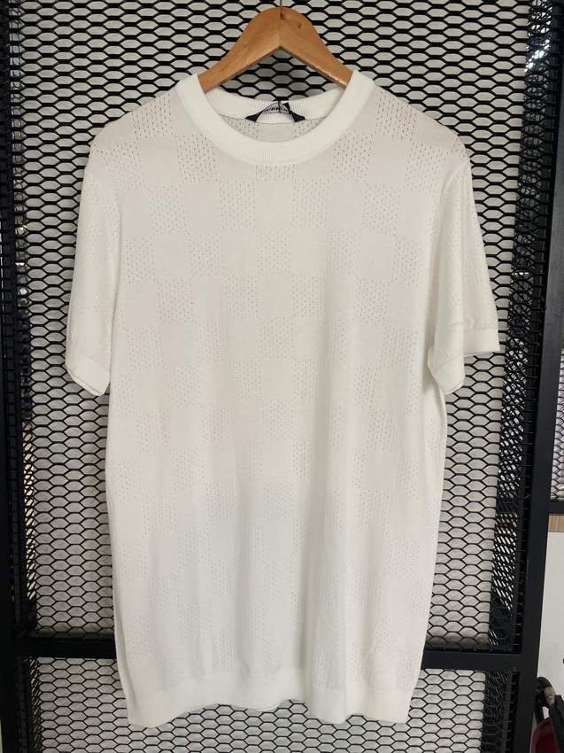
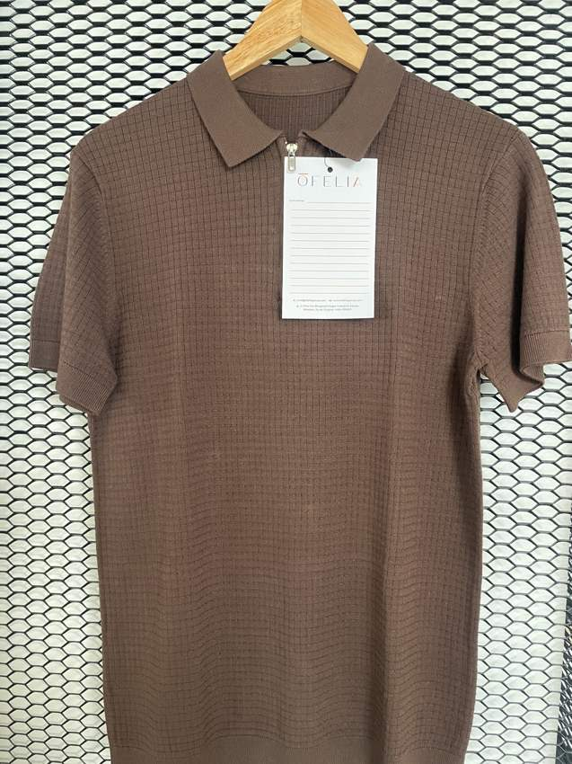
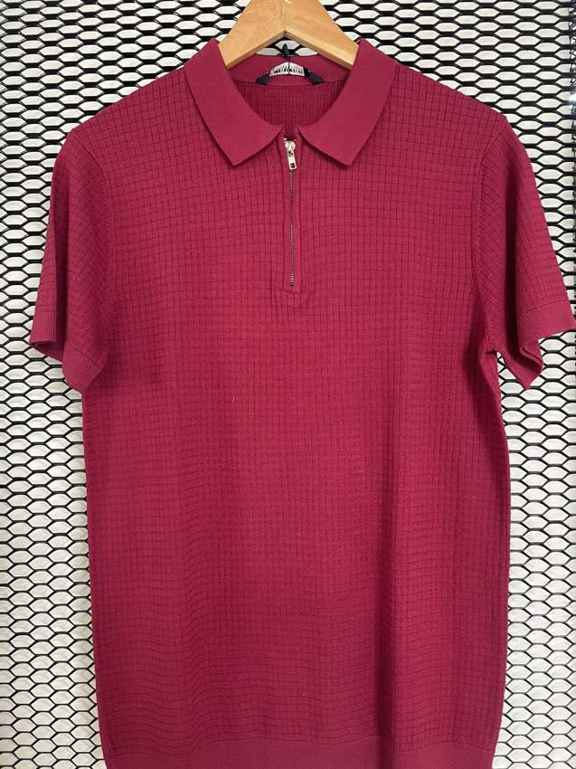
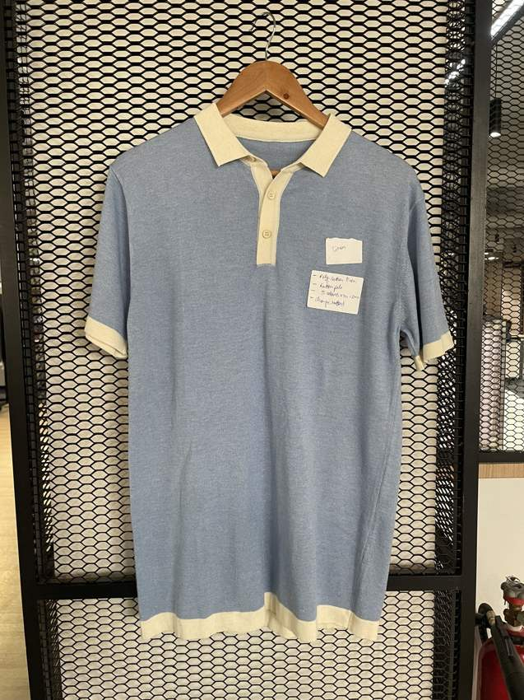
ADDITIONAL REFERENCES
Uploaded samples outside the mapped range
Retained for reference; these seven garments are not added to the confirmed 37 colourways.
IMG_8736.HEIC
IMG_8737.HEIC
IMG_8738.HEIC
IMG_8742.HEIC
Plain white knit crew tee; not assigned to a second style without evidence
Taupe waffle polo; additional silhouette, not ST-09 tipped polo
Red quarter-zip waffle polo; additional silhouette
Denim-blue polo with off-white collar and placket; additional silhouette
FLAT KNIT RANGE / THREAD-CARD PALETTE / DESIGN VISUALISATIONS
24

Slide 25
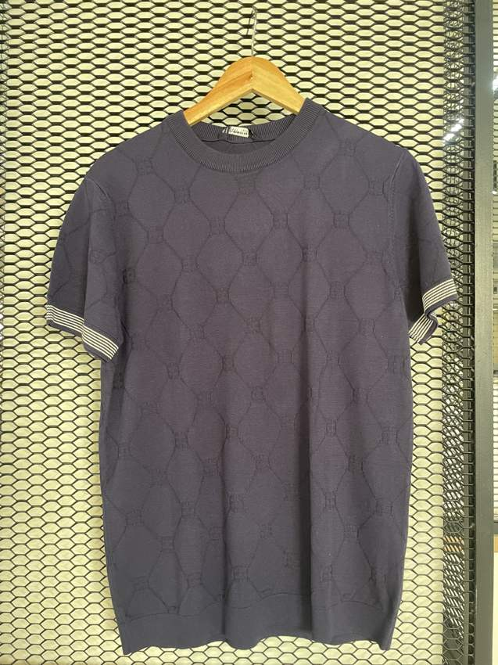
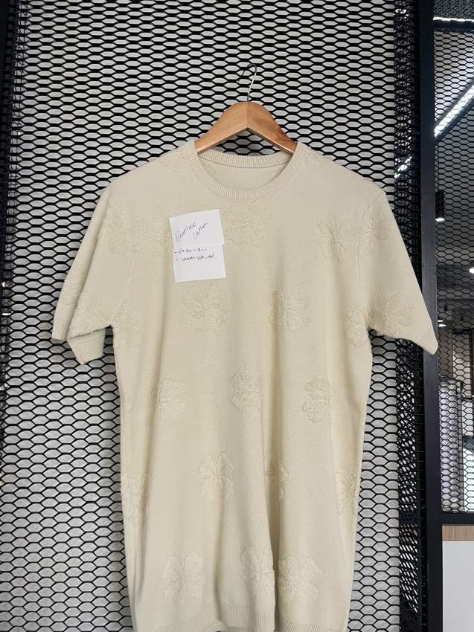
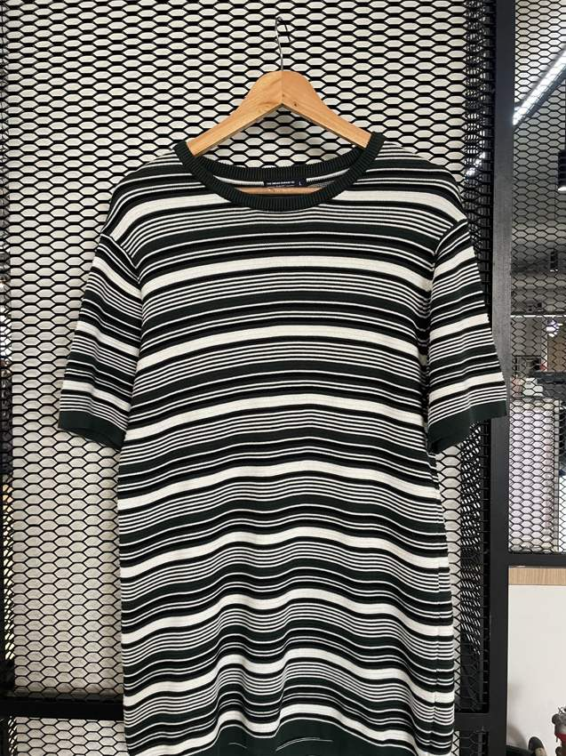
ADDITIONAL REFERENCES
Uploaded samples outside the mapped range
Retained for reference; these seven garments are not added to the confirmed 37 colourways.
IMG_8748.HEIC
IMG_8751.HEIC
IMG_8758.HEIC
Grey large-diamond crew tee; additional silhouette
Plain beige crew tee; possible essential tee alternative, not a unique catalogue style
Black/off-white multi-stripe crew tee; differs from ST-10 even Breton stripe
FLAT KNIT RANGE / THREAD-CARD PALETTE / DESIGN VISUALISATIONS
25

Slide 26
REVIEW NOTES
What needs physical or design confirmation
The range is organised for visual review; generated imagery does not replace a production specification.
01 / BACK CONSTRUCTION
All backs are inferred from front references. Confirm panel, stripe and texture continuation before sampling.
02 / ST-11 GRAPHIC
Full mesh photograph has no visible Athletic Club graphic. Original workbook graphic is the design source; photo mapping remains provisional.
03 / YARN APPROVAL
Use physical skeins for final colour approval. TC01–TC13 are internal references, not supplier shade codes. Photo lighting and screen rendering affect appearance.
04 / CORRECTED DESCRIPTIONS
ST-19 is a raglan stripe crew tee; ST-15 includes a lower chocolate band. Further full-photo corrections are logged in the Excel catalogue.
05 / CANVA HANDOFF
Import this PPTX into Canva. Labels, text and swatches are editable. Garment visuals remain image assets. The supplied PDF is a stable review copy.
FLAT KNIT RANGE / THREAD-CARD PALETTE / DESIGN VISUALISATIONS
26

