Slide 1

A2 Technology & Design Coursework
Candidate Name: Seth O’neill
Candidate Number:2263
Centre Number: 71312

Slide 2
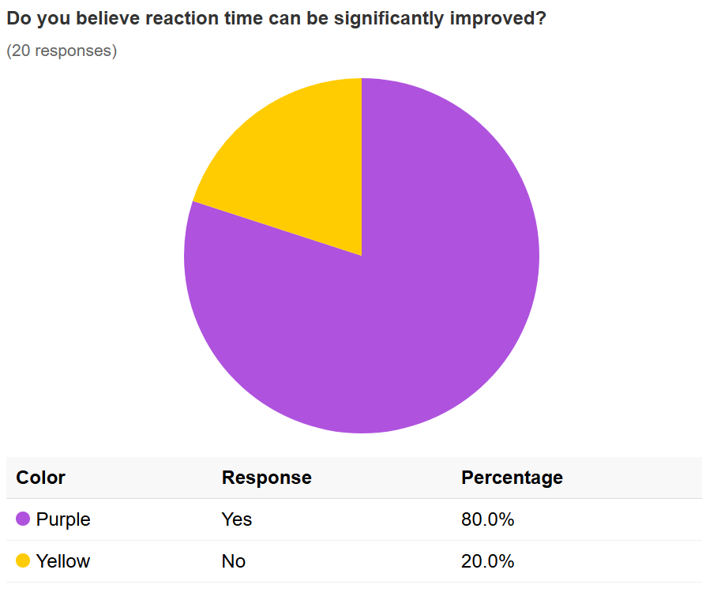
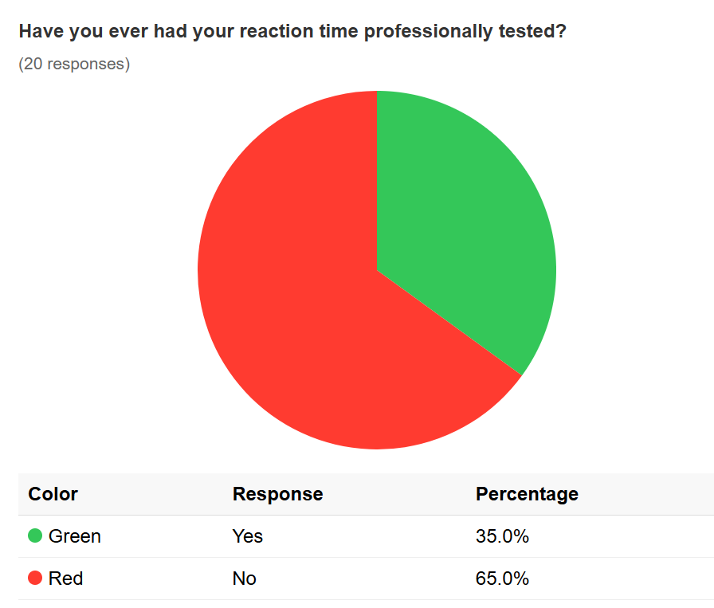
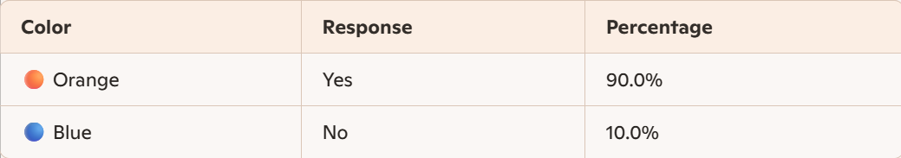
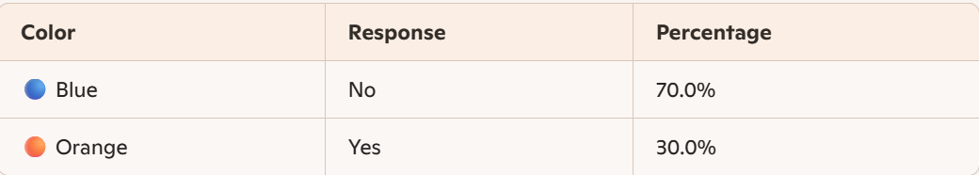
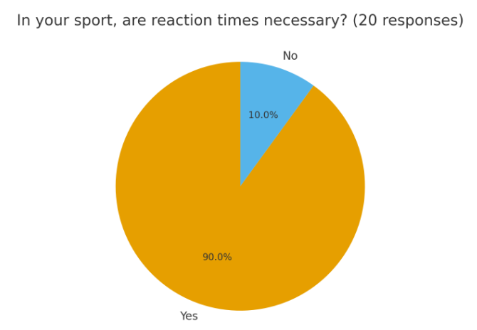
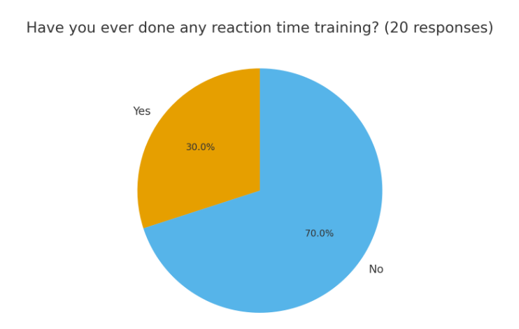
Problem Identification,& Specification
Existing Products, Initial Ideas, Selection of Ideas for Development
Development
Manufacture
Testing and Evaluation
Introduction
Reaction time is a key aspect of being successful in sports. Thesportsedu.com reports on average, simple reaction time is between 0.16s to 0.2s among most people. However, top-tier athletes have shown reaction times as low as 0.15s.. Having a fast reaction time enables athletes to perform better and enhance their abilities in their sport. This is validated by the BBC.com reporting - the quicker someone's body reacts, the better their performance. Demand for a solution that improves reaction time and, therefore, improves sporting performance is significant. Sportsengland.com shows the number of people playing sport and taking part in physical activity is at the highest level on record, with 63.7% of the adult population doing 150 minutes, or more, of moderate intensity physical activity a week. This suggests that the product would have a large target audience that would benefit from improved reaction times.
Problems
Performance improvements through faster reaction times require dedicated training. drgraeme.com highlights that everyone’s reaction time is roughly similar one's brain first needs to recognise the need to react and decide on an action. Identifying effective training techniques that stimulate this change in the brain is a challenge for sportspeople, resulting in reduced performance. As you get older, your reaction times start to slow down. Research indicates that reaction time peaks at 24 years of age and then declines by 4-10 milliseconds per year. Creating a product that improves reaction time would help older people playing sports maintain their performance level; without this, their performance will degrade. blazepod.eu suggests that slow reaction has been linked to several factors, including age, gender, personality type, alcoholism, and physical fitness. I will need to consider how these factors may influence the product design; failure to address these design requirements may minimise the product's effectiveness. Sportpeople with disabilities may be hindered by slower reaction times. cognifit.com suggests visual or auditory problems like blindness or hearing impairments may lead to problems that affect reaction time due to the problems with perception. The solution should adopt universal design concepts to address this problem; failure to do so will limit the solution to sportspeople based on ability.
Needs
It is necessary to introduce a product that enhances the reaction time of athletes, helping them develop and improve their reaction times to boost their performance in their respective sports. This product should have a generic theme to maximise its target audience by attracting all sports users as consumers. Specialising in the product will reduce its appeal and, consequently, the addressable market.
To ensure extensive adoption, the components that the user will use must be arranged in a simplistic layout to minimise confusion while interacting with the product. It should also be durable, as the key components will be repeatedly pressed with force. The materials acoustics must be managed as the solution is a high-impact product; excessive noise will diminish the user experience.
Design brief
I am going to design and make a product that solves the problem of developing and improving reaction times, targeted at the Youth and Young Adult groups. The point of this product is to make a portable and affordable reaction time game that is accessible for all abilities. By appealing to the target audience, they will develop a key skill for their specific sport. My design will allow athletes to customise training sessions based on their specific sport, whether they are developing their hand-eye coordination or their quick decision-making.
Input
Process
Output
Design Implication
Casing
The product casing will be durable and impact-resistant.
The product casing will consider safety by having no sharp edges, so that if the user has poor hand-eye coordination, they will not harm themselves.
The product will be compact, lightweight and have an ergonomic design.
The product casing must be portable to carry from one room to another.
The product casing will consider aesthetics by hiding the electronics from the user.
System
The product system will incorporate visual and sound cues.
The product system will have no flaws with the timing of the input data, therefore giving an accurate reaction time speed
The product system will stop debouncing inputs.
TBD
TBD
TBD
Problem Identification & Client Profile
Client
Youth and Young Adult groups that represent the peak years of performance are typically highly competitive. Statistia.com conducted face-to-face interviews and gathered data from 28,031 respondents across Europe. A majority of 15-24-year-olds exercise or play sports regularly. This suggests a large market for solutions that would address competitive advantages by improving reaction times. To maximise the use of the product, it will equally address males and females. topendsports.com has ranked the top 10 sports by reaction times. In order of reaction times: softball, fencing, boxing, badminton, martial arts, motorsports, equestrian, table tennis, netball, and ultimate. This is an important consideration when I am making my product, so that I can ensure these specific groups are addressed. Conversely, sportskeeda.com reports, gymnastics is a sport that requires little to no reaction time. Artistic gymnastic events like floor, high bar, vault, pommel horse, still rings, and parallel bars – all require shorter reaction times. For this classification of sports, the product's appeal will primarily focus on its coordination functions. Another point to consider when designing this product is whether I should consider accessibility as a requirement. One in five people in the United Kingdom has a long-standing limiting disability or illness. Our Active Lives Adult Survey data shows disabled people are almost twice as likely to be physically active. The adoption rate in this group could be significant, so considering Inclusive Design in the solution could be beneficial.
Based on this research, I believe there is justification to develop a product that improves the reaction times of sports players in the Youth and Young Adult segment. These studies demonstrate a sizeable market for a portable device that addresses this group.
survey
This pie chart shows that 80% believe that reaction time can be significantly improved. This suggests that improving reaction changes is fundamental for athletes who play sports, and it means there is a high demand for a product that improves reaction times
This pie chart shows that only 35% have ever had their reaction times professionally tested. This suggests that while reaction time training is not common, this could be attributed to a lack of testing infrastructure.
This pie chart shows that 18 of 20 participants said that fast reaction times are necessary in their particular sport. This indicates the importance of reaction times to a large percentage of the target market.
This pie chart shows that 14 of 20 people had never participated in reaction time training. This demonstrates a need in the market for cheap and effective reaction time training infrastructure.
Notes:
https://thesportsedu.com/reaction-time-definition/
https://www.bbc.co.uk/bitesize/guides/zf9bf4j/revision/2
https://www.sportengland.org/research-and-data/data/active-lives/active-lives-data-tables
https://www.drgraeme.com/articles/2024/08/overlooked-cause-of-poor-reaction-times
https://blazepod.eu/en-uk/blogs/all/how-to-improve-reaction-time-a-comprehensive-guide?srsltid=AfmBOopcEL3VORQlEmdlsJq60CZ9HpkcamsH3Aj6-KvzCQhrISyoU8oO&utm_medium=redirect&utm_source=organic
https://www.cognifit.com/science/response-time?srsltid=AfmBOoprBYbjBfJGhg-C5gwNB9R3RknFPraF4gK4kxOIi0V4HmdI2hTj
https://www.statista.com/statistics/592929/distribution-of-exercise-and-sport-frequencies-by-age-group-and-gender-eu/#:~:text=The%20survey%20was%20conducted%20via,those%20aged%2055%20or%20over.&text=The%20most%20frequently%20offered%20reason,a%20lack%20motivation%20or%20interest.&text=The%20positive%20correlation%20shown%20between,Dossier:%20Fitness%20industry%20in%20Europe.
https://www.topendsports.com/fitness/sports/reaction-time-tes.htm
https://www.sportskeeda.com/table-tennis/top-5-sports-requiring-lesser-reaction-time-with-more-precision
Top 5 sports requiring lesser reaction time with more precision
Disabled people | Sport England

Slide 3
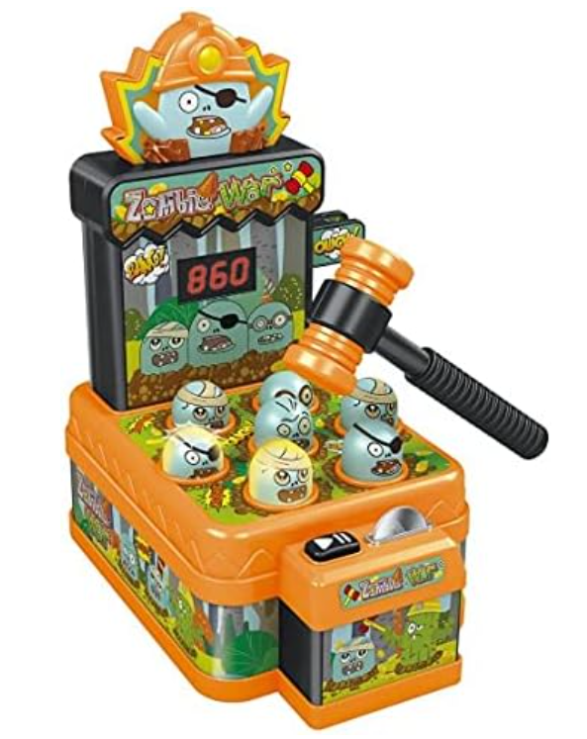
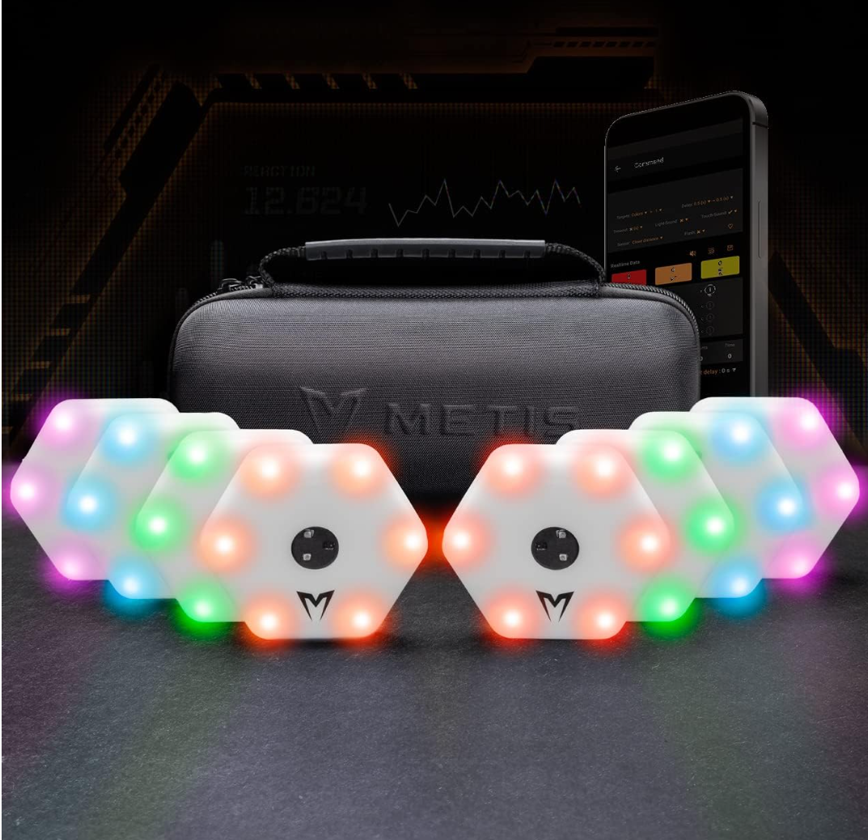
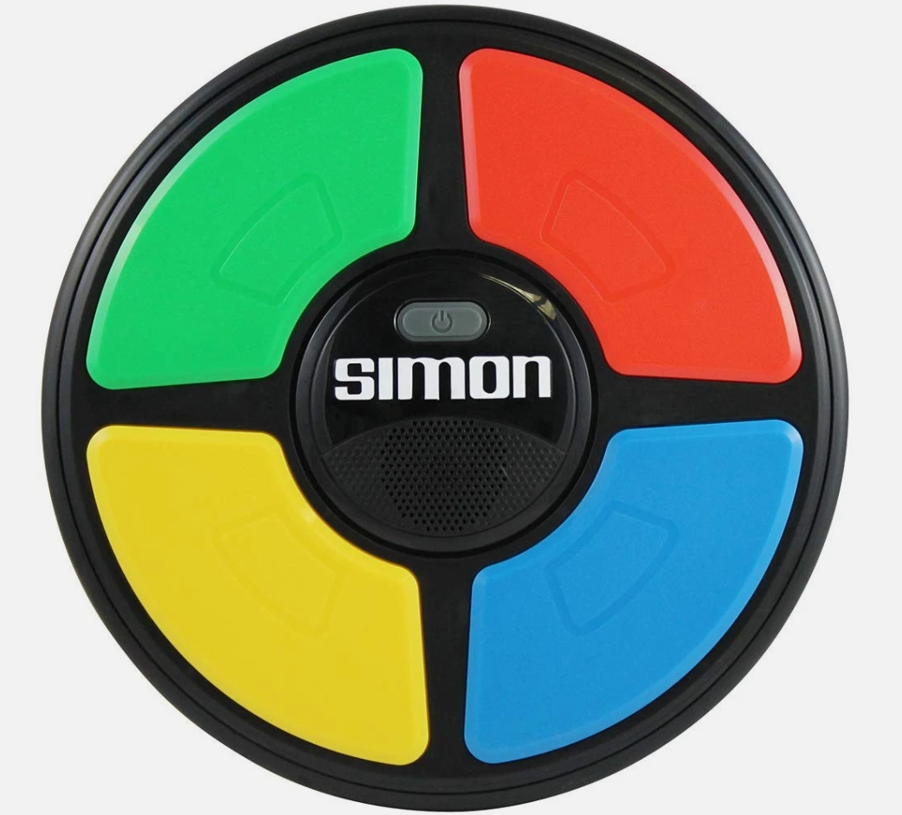
Problem Identification,& Specification
Existing Products, Initial Ideas, Selection of Ideas for Development
Development
Manufacture
Testing and Evaluation
AJ-Whack-Electronic-arcade-Hammers
Purpose
This product is designed for Children. It includes reaction times and timing awareness. This game is designed to replicate the gameplay of an arcade whack-a-mole game. It aims to teach kids about reaction times and speed by showing them how much time they have left. It also teaches them about spatial awareness.
Aesthetics
The product features imagery of zombies wearing eye patches, along with head straps(1), designed to capture the user's attention. The product's shape features actual zombies and has a simple design, making it easy to use while being engaging for the player.
Features
The key features are the coin access to start the machine. They also include the zombies (1) that you hit with a hammer (2) as the primary objective of the game. The manufacturer also includes a timing system (3) to track the time as they hit the zombies. An interesting feature of this game is making the zombies move up and down, which helps maintain the child’s interest in the game.
System
The circuit for this product features three 7-segment displays to visualise the game’s countdown. (3) Additionally, it includes a rocker switch that, once triggered, shows the score on the three 7-segment displays. Lastly, the product features a coin that passes by an infrared laser switch, which counts the coins as they are inserted into the game slot.
(3)
(2)
Safety
This product is relatively safe, featuring smooth corners and edges with no sharp parts to harm anyone using the product. No components are small enough to swallow except the coin, and all are in some way connected to the product. The hammer is also lightweight, therefore causing no harm other than to the zombies (2)
Materials
The materials used are purely thermoplastics, such as acrylic and ABS. They are used for their strong and misshapen strength, and acrylic is also a lot more shock-resistant than glass, preventing easy smashing, shattering, or snapping. They are also used due to their coming in a wide variety of colours and shapes to allow a good selection of materials for the design of the product.
Manufacturing
The manufacturing process for this product involves blow moulding and vacuum forming the main body, as well as using soldering irons to create the circuit board that controls the product. The processes used for this are suitable for the mass production of the product because a single mould can be repeatedly used to produce the product in large quantities.
Portability
This product weighs 810g, making it reasonably light, and features a simple shape with dimensions of 28 x 22 x 21 cm, allowing an adult to easily lift it. However, it would be harder for a younger person to access and transport due to the small coins and the product's shape. It also has no handle for easy carrying.
Cost
£16.99 is the price for this product. This is very well-priced for the material used and the purpose of the product.
(1)
METIS Reaction Training Lights |
Purpose
This product is designed to enhance reaction times and agility. It is suitable for sportspeople who want to train their reflexes and coordination. The lights provide (2) an interactive way to test timing and decision-making skills. It also enables users to improve their reaction time to visual stimuli, a crucial skill in sports, which is beneficial for both overall fitness training and games.
Aesthetics
The lights feature a modern, futuristic layout with glowing LED colours. The hexagonal shape and glowing edges make them visually attractive and engaging, especially in dark or indoor environments. The phone app(3) interface uses bright graphics to enhance the training experience. The app layout is aesthetically pleasing, featuring a motivational colour scheme that is particularly important for a sports-based training app.
Features
Features of this product include multiple hexagonal light pods (1) that light up in different colours(2). The pods can be programmed with over 20 game modes. The lights connect wirelessly and are controlled by a smartphone app (3), allowing users to choose their own training sessions. The user can set specific speeds to tailor the product’s performance to their individual skill level.
System
The system uses LED lights (2)to provide visual cues. Each pod contains sensors to detect when they are touched. These devices are linked through a wireless system connected to the app, which records data such as reaction times and accuracy. The app functions as a control system, displaying results and enabling mode changes.
(3)
(2)
(2)
Research of Existing Products
Safety
This product is safe; it has a hexagonal shape (1) with edges that have rounded corners. The electronics are enclosed within the product, minimising the risk of electric shock.
Materials
The materials used are a thermoplastic, and a bright colour has been selected to engage the player. ABS is used because it is very durable and offers good impact resistance, which is essential in a contact trainer. The electronic components are housed inside an energy-efficient casing, which is essential for maximising battery life.
Manufacturing
The pods are manufactured using moulded plastic. The circuit boards, LEDs, and sensors are put together using solder. The casing is designed to resist light impacts and regular use.
Portability
According to Amazon, this product (9.5×8.5×2.5cm) weighs 21kg, which is extremely heavy compared to its competitors. This is a significant drawback for this product; the manufacturer addresses this by including a travel case to enhance its portability.
Cost
The cost varies based on the bundle size (2, 4, or 8 lights). Smaller bundles are targeted at personal use, while larger bundles are targeted for teams or professional training. Prices on Amazon range between £59.99 and £249.99, which reflects the
technology, features, and market purpose.
(1)
Purpose
This product is designed for children and young adults. It improves reaction times and helps improve concentration. The user watches the sequence of LED lights (1) turn on and off and repeats the sequence as quickly as possible. As the game continues, the LED pattern continues. The game progressively gets harder with larger patterns and shorter reaction times to input the pattern. The purpose of this game is to improve your memory skills and increase your reaction times while ensuring the user is engaged.
Aesthetics
The design of this product is bright and colourful, with each pad having a distinct colour that lights up. The flashing lights make the product visually engaging. The circular shape is intentionally simplistic in design, a key design goal in attracting its target audience.
Features
The main feature of this product is the colour LED (1) that lights up in varying sequences. The user must press the correct pads (2) to continue playing the game. If the pads are pushed in the wrong order, the game is over. The game gradually increases in difficulty by making the sequences longer and the speed at which they are played shorter. The product features a scoring system (3), allowing users to track their performance and target a new high score. These features are designed to keep the player engaged.
System
The product is a handheld, portable electronic game featuring internal circuits that control both the light and timing systems. The logic of the game is stored inside the electronics. The product is powered by batteries, making it portable without any leads attached. The LED lights up in a specific sequence, which provides the user with visual cues, helping them complete the game.
Hasbro Gaming Simon Electronic
(3)
(2)
Materials
The primary material used is plastic. Plastic is used for the outer casing as well as the pads (2). The manufacturer uses a rubber switch for the power function.
Portability
This product is highly portable, being both handheld and lightweight. This product weighs 500g and measures 26.7 x 4.1 x 26.7 cm. It is also battery-powered, eliminating the need for a power supply. Because of its size and shape, it can be easily stored in a travel bag.
Cost
This product costs around £20. Compared with other reaction-based games, this is competitive. This makes it affordable for sportspeople, allowing them to improve their reaction time without significant investment.
Safety
This product is very safe, featuring a smooth outer casing and a secure inner casing that can only be accessed through screws at the rear. Another key feature is the enclosed battery casing; without mains power, the risk of electric shock is minimised.
Manufacturing
The manufacturing for this product involves moulding the plastic into the casing and then assembling the colour pads (2) to the electronics. This process can be mass-produced, enabling the manufacturer to produce many products at a low cost.
(1)
Notes:
AJ Whack a Mole Game Electronic arcade game with coin & 2 Hammers : Amazon.co.uk: Toys & Games.
METIS Reaction Training Lights | Improve Speed, Agility & Reaction Times - Pack of 2, 4 or 8 Reaction Lights with 20 Game Modes (Pack of 2) : Amazon.co.uk: Sports & Outdoors
Hasbro Gaming Simon Electronic Memory Game, Handheld Light and Sound Game, Ages 8 and Up : Amazon.co.uk: Toys & Games

Slide 4
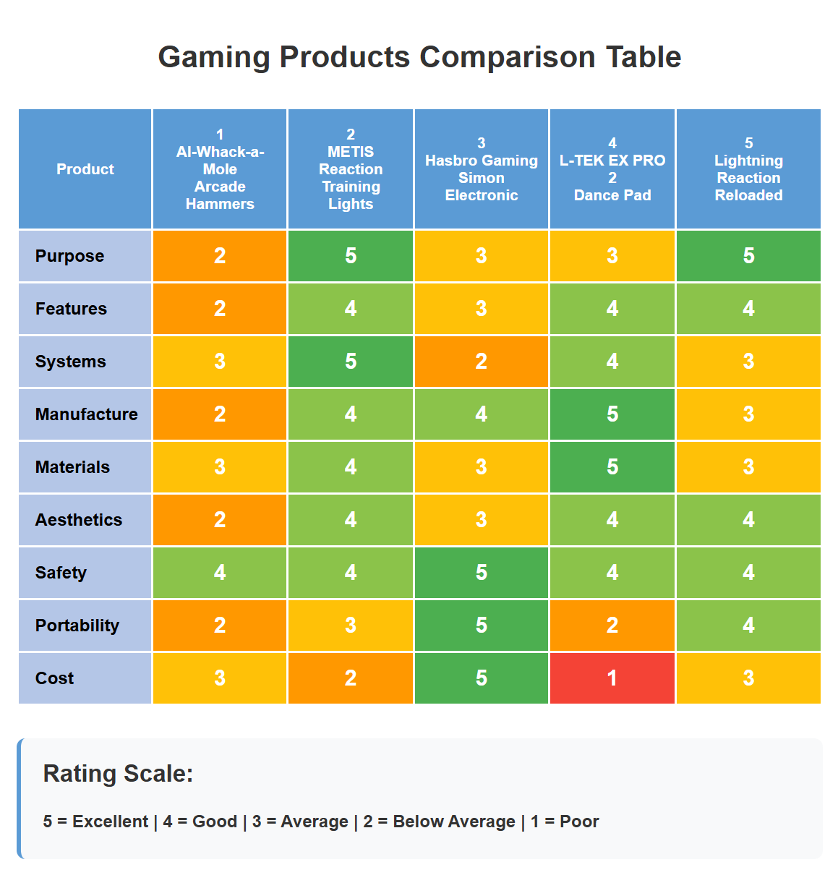
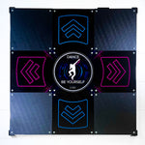
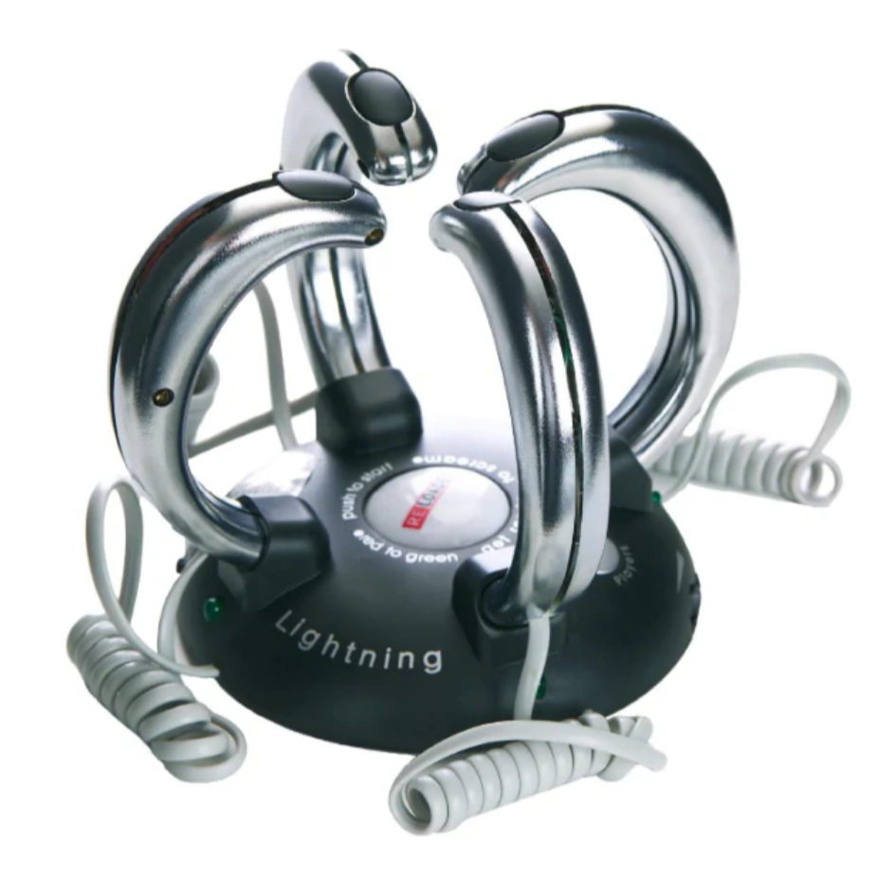
Problem Identification,& Specification
Existing Products, Initial Ideas, Selection of Ideas for Development
Development
Manufacture
Testing and Evaluation
L-TEK EX PRO 2 - Dance Pad – DDRPad.com
Purpose
This product is suitable for its intended purpose. It allows players to play rhythm games such as Dance Dance Revolution and StepMania from the comfort of their own home. It is designed to replicate the experience of an arcade pad by improving fast reactions and accurate timing. It also allows players to practise and improve their rhythm, coordination and footwork. This is essential for sportspeople as most sports require this skill.
Aesthetics
The product has been designed to look professional and luxurious. It features a graphical design on the panels, which gives it a sharp finish. The aluminium borders and reinforced corners add to its visual appeal, while also making it look firm and sturdy. The overall look is similar to arcade dance pads, which makes it attractive to users who recognise the game.
(3)
(2)
Safety
This product has been designed with many safety features. Anti-slip stands are used to prevent the device from sliding during gameplay. Rounded and reinforced corners reduce the risk of injury, for example, slipping hazards, while the hidden USB port prevents cables from being pulled or broken. The pad is heavy, which makes it stable, but this also means care must be taken when lifting or moving it from one place to another.
Materials
The main materials used are polycarbonate, aluminium, and silicone. Polycarbonate provides a rigid surface for the panels, while aluminium strengthens the edges and frame. Silicone is used to protect and reinforce the corners. These materials have been chosen for their durability and ability to handle repeated pressure from the user's feet during gameplay.
Portability
The product measures 90cm by 90cm and weighs 18 kg. This makes it durable during gameplay, as it doesn't move easily, but also makes it heavy to carry. The panels are slightly smaller and closer together than an arcade pad, which may affect the performance for some users. However, it is large enough to be comfortable for most users, and can be used with shoes or barefoot if size really becomes an issue.
(1)
Manufacturing
The frame fabrication involves CNC cutting and shaping of the aluminium. Similarly, a CNC will be used for the panel fabrication (polycarbonate). The final stage will mount the step dampener pada and the electronic into the frame. A wiring harness will be used to route to the control board.
Features
The key features include a 32-bit ARM controller with a 1000Hz polling rate for accurate inputs, which stops missed input reads(1). It also has polycarbonate panels that are strong and durable,(2) as well as aluminium borders.(3) Anti-slip stands are included to prevent the pad from moving while the user is using the product. It also prevents users from damaging the electronics inside the product. It features a detachable USB cable and a hidden USB port to protect the connection from damage. These features make the pad more reliable and long-lasting compared to cheaper mats.
Cost
The product is priced as a premium dance pad. The base model costs about £344, while the version with a PlayStation 2 adapter costs about £386. A version with a bar add-on costs around £656. This is expensive compared to other reaction time-based games, but the high price reflects the stronger materials, better performance, and long-lasting design.
System
This product can be used with a wide range of systems. It connects to PC and Mac for games such as StepMania. It can also be used with PlayStation 1 and PlayStation 2 through an adapter, allowing it to work with older consoles as well. This means it can be enjoyed by both modern players and those who want a nostalgic DDR experience.
Research of Existing Products
Purpose
The Lightning Reaction Reloaded is designed to improve reaction time and develop hand-eye coordination by giving a low-voltage electric shock. This electronic gaming device serves as a beneficial training tool for athletes to enhance their reaction time. The product makes sportspeople respond quickly to randomised light and sound cues. Its applications are customisable. This product is designed for individuals involved in serious athletic training programs and those engaging in casual reaction time training exercises.
Gaming Products Individual Reviews
Product 1: AI-Whack-a-Mole Arcade Hammers
The Whack-a-Mole Arcade Hammers attempt to update the classic carnival game. While it captures nostalgic appeal and provides safe entertainment for children, the build quality appears flimsy, and the gameplay differs significantly from the original. The product leans heavily toward being a children's toy rather than a serious reaction device.
Client Reviews:
"My 8year old loves it, but it feels cheap, and one hammer broke after two weeks."
Product 2: METIS Reaction Training Lights
The METIS Reaction Training Lights is a premium training tool for serious athletes, with instant-response hexagonal pods, wireless connectivity, and wide mobile app integration. The build quality is excellent, and the detailed analytics help track the improvement in reaction times over a specific period. While expensive, it's invaluable for enhancing reaction times and coordination across multiple sports that involve reactions.
Client Reviews:
"As a tennis coach, these lights have dramatically improved my players' reaction times. The data tracking is incredible"
Product 3: Hasbro Gaming Simon Electronic
The Hasbro Gaming Simon Electronic proves that classic gameplay remains excellent as a reaction time game. This modern version retains the addictive, reaction-based gameplay while enhancing portability. With LED lights, clear sounds, and outstanding safety features, it appeals to all ages. The compact design makes it ideal for travel, and its simple yet engaging gameplay provides a great reaction game for sports enthusiasts.
Client Reviews:
"I use this with my football team for reaction-based exercises. It's perfect - not intimidating but still works as its intended use"
Product 4: L-TEK EX PRO 2 Dance Pad
The L-TEK EX PRO 2 Dance Pad is a premium pad offers instantaneous response times and stays perfectly in place during intense sessions. Compatible with multiple platforms and built to last, it's the ultimate choice for serious rhythm game enthusiasts, though the high price point limits its accessibility.
Client Reviews:
"Been using this to improve my reaction times for two years. Still works like new and gives me the precision I need for tournament play."
Product 5: Lightning Reaction Reloaded
The Lightning Reaction Reloaded from CM School Supply combines entertainment with reaction time skill development through fast-paced reaction training. It also features multiple game modes and supports up to 8 players, challenging users with random light and sound cues. Designed for improving reactions, it provides excellent value for enhancing hand-eye coordination and reaction times across all age groups.
Client Reviews:
"Perfect for our PE classes! Kids love the competition and their reaction times have noticeably improved over the semester."
Lightning Reaction Reloaded – CM School Supply
Cost
This product costs between £45 and £65. The cost is good value for a reaction time game, considering the features provided.
(2)
(3)
Portability
Weighing approximately 550g and 17.5 × 15.5 × 16 cm, the Lightning Reaction Reloaded is highly portable for both classroom-to-classroom transport and home use. The unit requires no permanent installation and can be easily stored in cabinets. Battery operation eliminates the need for charging leads, making it suitable for outdoor events and field trips.
Safety
The device has multiple safety features, including rounded edges and secure battery compartments with child-resistant locks. All electrical components are adequately insulated, and the product operates on safe, low-voltage power. The design has no sharp edges, making it suitable for users of all ages, whether in supervised or unsupervised play.
Aesthetics
The Lightning Reaction Reloaded features a modern design with a unique dome-shaped central hub and has challenge pods. The black and silver colour scheme gives it a high-tech appearance that appeals to sportspeople. LED lights provide visual feedback.
(1)
Manufacturing
Manufactured by CM School Supply, the main base is made using injection moulding, with handles featuring chrome plating. A conductive base layer is applied using electroless plating to give a safe physical shock. A small step-up transformer is inserted to convert a low-voltage battery into a low-current pulse. Each product undergoes strict testing for electronic functionality and durability before packaging. This type of manufacturing is cheap and reliable.
Materials
The product is primarily made from high-impact ABS plastic that withstands repeated use and accidental drops. The hand grips feature a non-slip rubber for secure handling during gameplay. Internal components utilise high-quality electronic parts designed for extended operation, while the LED indicators are capable of thousands of hours of continuous use without breaking.
Features
The product features various game modes, including single-player challenges, head-to-head competitions, and group tournaments that accommodate up to 8 players. This allows for healthy competition. Key features include different difficulty levels, customisable time limits, and scoring systems that monitor improvement over time. The product features LED lights(1), audio alerts(2), and ergonomic hand grips (3), all designed for comfortable extended play. Additional features include automatic shutdown to save battery life, score memory for tracking personal bests, and various challenge modes that test different aspects of reaction speed and hand-eye coordination.
System
Lightning Reaction Reloaded uses state-of-the-art microprocessor technology to generate random response patterns, ensuring unpredictable gameplay. The electronic system features timing mechanisms with an accuracy of milliseconds, providing reliable performance measurement. The product operates on a system requiring no complex setup. Internal circuits are designed for consistent performance across multiple environmental conditions, while the digital display gives clear feedback on reaction times and scoring.
Notes:
Lightning Reaction Reloaded – CM School Supply add scoring to both pages do scoring at side of each product so they don’t have to flick back and forward-teacher

Slide 5
Problem Identification,& Specification
Existing Products, Initial Ideas, Selection of Ideas for Development
Development
Manufacture
Testing and Evaluation
1.0 Purpose
To improve athletes’ reaction times.
To measure and track reaction performance over time.
To provide competitive training feedback.
Test: Check if the device records measurable improvements during training sessions.
Features 2.0-
2.1-
2.2-
2.3-
2.4-
Materials 3.0-
3.1-
3.2-
3.3-
3.4-
3.5-
3.6-
Manufacturing 5.0-
5.1-
5.2-
5.3-
Sustainability 4.0-
4.1-
4.2-
PCB 10.0-
10.1-
10.2-
10.3-
Specification
System 7.0-
7.1-
7.2-
7.3-
Aesthetics 11.0-
11.1-
11.2-
11.3-
Function 6.0-
6.1-
6.2-
6.3-
Ergonomics and Arthrometric 8.0-
8.1-
8.2-
8.3-
Cost+ Timescale 12.0-
12.1-
12.2-
12.3-
Safty9.0-
9.1-
9.2-
9.3-
portability13.0-
13.1-
13.2-
13.3-
Notes:
tec spec
Critia-CEEA marking critical end key differences testing after each section makes it stand out. The design plan has to match system function, aesthetics, ergonomics, anthropometrics, manufacturing materials, safety, sustainability, cost, maintenance,, portability, purpose, function, and features time scale.
Give a numbering system with a minimum of 15 quantifiable or measurable specific points test will be done based on this test at the end of each paragraph should have numbers red
Specification – Reaction Time Game for Sportspeople
1. Match System Function
Must record reaction times accurately to the millisecond.
Must store and display results clearly.
Must allow comparison between multiple users. Test: Run repeated trials with a stopwatch to check accuracy and consistency.
2. Aesthetics
Should have a modern, sporty look (bold colours, minimal design).
Display should be bright and clear in both indoor and outdoor settings.
Buttons and lights should be visually appealing and motivating to athletes. Test: Gather user feedback on appearance and clarity.
3. Ergonomics
Buttons should be easy to press without excessive force.
Display/interface must be easy to read at a glance.
Comfortable to interact with for long training sessions. Test: Ask athletes to use it for 15 minutes and record comfort ratings.
4. Anthropometrics
Buttons sized appropriately for average adult finger dimensions.
Device height/position adjustable for seated or standing athletes.
Reachable controls for a range of body sizes (5th–95th percentile). Test: Trial with users of different sizes to ensure usability.
5. Manufacturing Materials
Durable plastic for casing to resist impact.
Non-slip rubber for grips or base.
Recyclable materials where possible. Test: Check prototype for impact resistance and stability.
6. Safety
No sharp edges or small detachable parts.
Electrical components insulated to prevent shocks.
Lights not overly bright to avoid eye strain. Test: Safety inspection against relevant standards.
7. Sustainability
Low energy consumption.
Use of recyclable or biodegradable materials where possible.
Designed for long lifespan to reduce waste. Test: Audit material sources and energy usage.
8. Cost
Affordable for schools, clubs, and individual athletes.
Manufacturing cost must remain under set budget.
Replacement parts should be low-cost. Test: Compare projected cost against target budget.
9. Maintenance
Easy to clean (wipeable surfaces).
Replaceable batteries or rechargeable unit.
Clear troubleshooting guide provided. Test: Trial disassembly/replacement of battery within 2 minutes.
10. Portability
Lightweight (<2kg).
Compact design, easy to carry in a sports bag.
Robust enough for frequent transport. Test: Weigh, measure, and transport in a standard sports bag.
11. Purpose
To improve athletes’ reaction times.
To measure and track reaction performance over time.
To provide competitive training feedback. Test: Check if the device records measurable improvements during training sessions.
12. Function and Features
Random light or sound stimuli to test reactions.
Timer function with digital display.
Data storage for multiple players. Test: Use each feature and verify it works under different conditions.
13. Time Scale
Prototype development within 3 months.
User testing phase of 4 weeks.
Market-ready within 6–12 months. Test: Compare actual project timeline against planned milestones.

Slide 6
Problem Identification,& Specification
Existing Products, Initial Ideas, Selection of Ideas for Development
Development
Manufacture
Testing and Evaluation
Brainstorming Concepts

Slide 7
Problem Identification,& Specification
Existing Products, Initial Ideas, Selection of Ideas for Development
Development
Manufacture
Testing and Evaluation
Innovative Idea 1:Casing

Slide 8
Problem Identification,& Specification
Existing Products, Initial Ideas, Selection of Ideas for Development
Development
Manufacture
Testing and Evaluation
Innovative Idea 1:System

Slide 9
Problem Identification,& Specification
Existing Products, Initial Ideas, Selection of Ideas for Development
Development
Manufacture
Testing and Evaluation
Innovative Idea 2: Casing

Slide 10
Problem Identification,& Specification
Existing Products, Initial Ideas, Selection of Ideas for Development
Development
Manufacture
Testing and Evaluation
Innovative Idea 2: System

Slide 11
Problem Identification,& Specification
Existing Products, Initial Ideas, Selection of Ideas for Development
Development
Manufacture
Testing and Evaluation
Innovative Idea 3: Casing

Slide 12
Problem Identification,& Specification
Existing Products, Initial Ideas, Selection of Ideas for Development
Development
Manufacture
Testing and Evaluation
Innovative Idea 3: System

Slide 13
Problem Identification,& Specification
Existing Products, Initial Ideas, Selection of Ideas for Development
Development
Manufacture
Testing and Evaluation
Development of Casing
Include modelling

Slide 14
Problem Identification,& Specification
Existing Products, Initial Ideas, Selection of Ideas for Development
Development
Manufacture
Testing and Evaluation
Development of System

Slide 15
Problem Identification,& Specification
Existing Products, Initial Ideas, Selection of Ideas for Development
Development
Manufacture
Testing and Evaluation
Programme Development

Slide 16
Problem Identification,& Specification
Existing Products, Initial Ideas, Selection of Ideas for Development
Development
Manufacture
Testing and Evaluation
PCB Development

Slide 17
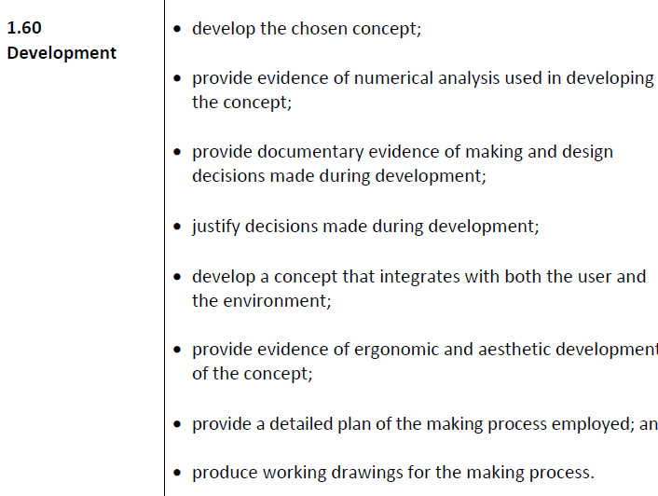
Problem Identification,& Specification
Existing Products, Initial Ideas, Selection of Ideas for Development
Development
Manufacture
Testing and Evaluation
Plan of Manufacture

Slide 18
Problem Identification,& Specification
Existing Products, Initial Ideas, Selection of Ideas for Development
Development
Manufacture
Testing and Evaluation
Working Drawing

Slide 19
Problem Identification,& Specification
Existing Products, Initial Ideas, Selection of Ideas for Development
Development
Manufacture
Testing and Evaluation
Testing & Evaluation

Slide 20
Problem Identification,& Specification
Existing Products, Initial Ideas, Selection of Ideas for Development
Development
Manufacture
Testing and Evaluation
Testing & Evaluation

Slide 21
Problem Identification,& Specification
Existing Products, Initial Ideas, Selection of Ideas for Development
Development
Manufacture
Testing and Evaluation
Testing & Evaluation

