Slide 1

Rosemount 5300 Guided Wave Radar for Raptor

Slide 2
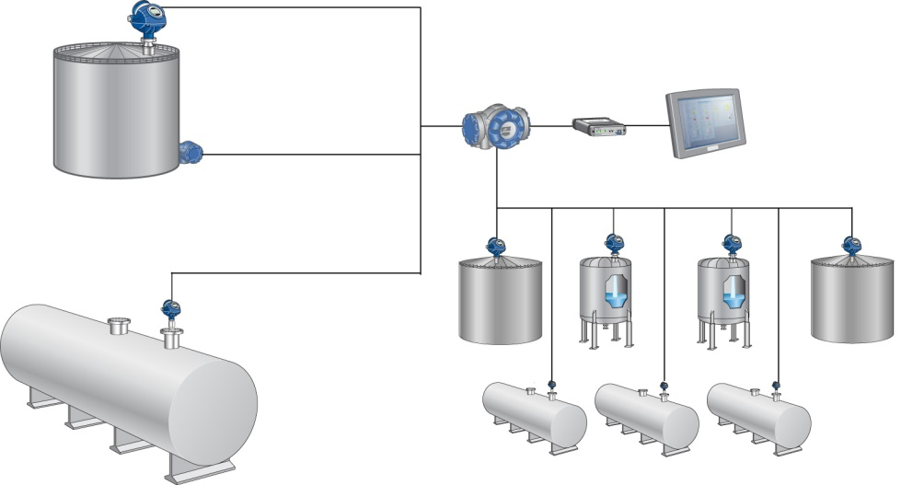

Operational Control
5300- or 5400 system configuration
5400 Level Transmitter
644 Transmitter / Rosemount 65 Single Point Temperature Sensor
2410 Tank Hub
TankMaster WinView
2180 FBM
5300 Level Transmitter

Slide 3
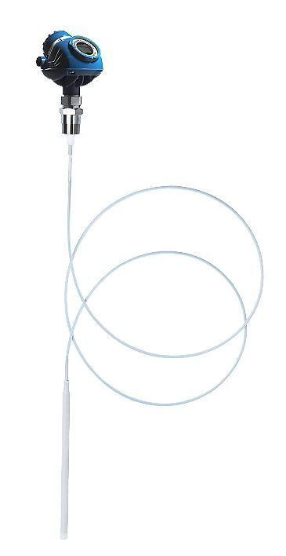
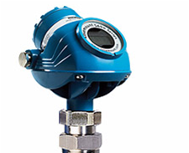
5300 Radar Level Transmitter
2-wire pulsed guided wave radar (GWR)
Direct level and interface measurement of liquids and slurries
5301T for liquid level or submerged interface
5302T for liquid level and interface
Wide range of tank connections to fit existing openings
Wide range of probes
Optional Integral Display Unit
Accuracy: ±3 mm or 0.03% of measured distance

Slide 4
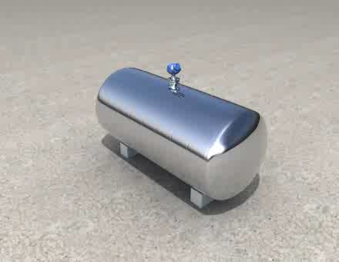
Measurement Principle
Time Domain Reflectometry (TDR) technology
Microwave pulses guided down a probe
Pulses reach media with different dielectric constant (DK) where part of the microwaves are reflected back
Click picture to run movie
Distance = Speed x Time of Flight / 2
Notes:
The Rosemount Guided Wave Radars (sometimes also called Contacting Radars or Radars on a Rope) are based on the TDR (Time Domain Reflectometry) technology.
The level is measured by low-power nano-second microwave pulses that are guided down a probe suspended in the process media. When a radar pulse reaches a media of a different dielectric constant, part of the energy is reflected back to the transmitter. The time difference between the transmitted reference pulse and the reflected pulse is converted into a distance value from which the level is calculated. Distance = (Speed X Time of Flight) /2

Slide 5
Interface Measurement Principle
Part of pulse continues through the surface and is reflected back at the lower product surface – the interface
DK determines the propagation speed of microwaves
Accurate calculation of interface measurement is dependent on correct DK configuration
Click picture to run movie
Distance = Speed x Time of Travel / 2
Notes:
For measuring the interface level, the transmitter uses the residual pulse of the first reflection. Part of the pulse, which was not reflected at the upper product surface, continues until it is reflected at the lower product surface.
The dielectric constant, determines the speed of the microwave propagation in a product (ΔΚ = 1 means that the wave propagates with the same speed as in air). As the propagation speed changes with the dielectric constant, it is important to configure the transmitter with the exact dielectric constant of the upper product. The accurate calculation of the interface level is dependent on the correct dielectric constant value.

Slide 6
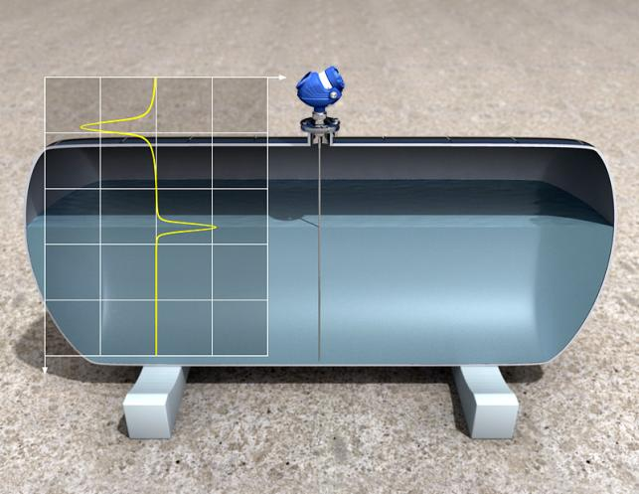
Signal Strength
Dielectric constant of the media (ε_{r} or DK)
Probe type
Distance
Surface characteristics
Disturbing objects
Reference
pulse
Surface
reflection
Notes:
A reliable measurement is always more simple to achieve with a strong signal from the surface. When comparing different applications, the signal strength can vary significantly, and knowing possible causes for signal strenght differences is a great help in understanding installation success. This will be covered in more detail, but here is first a short overview.
The dielectric constant of the media has great impact. The higher the DK, the more microwaves are reflected providing a stronger signal.
Different probes is differently capable of guiding microwaves without loosing energy along the way.
Regardless what probe is being used, some losses will always be present. Therefore, long distance measurements gives weaker signals than short ones.
Surface characteristics is one of the most important factors. A flat, calm surface will give a strong signal but excessive turbulence or foam will scatter the microwave reflection or absorb the microwaves giving weaker signal returns.
Finally, it is helpful to remember that disturbing objects that generate echoes steal microwaves that otherwise would have been reflected on the surface. Thereby, the more echoes from disturbing echoes inside a tank the weaker will the signal be.

Slide 7
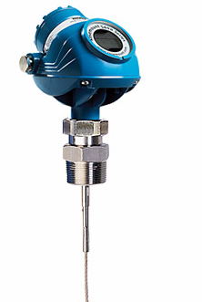
5300 Components
Terminal side
Integral digital display
Dual Compartment transmitter housing
One of two cable entries
Radar Electronics
Tank Connection
Probe
Notes:
The dual compartment transmitter housing can be removed is fast and easy without opening the tank. No matching between housing and probes also minimize spares needed on the shelves. No moving parts minimize need for maintenance of probe.It has electronics and cabling separated.
The housing has two entries for conduit/cable connections. A ½-14 NPT cable entry is standard, but adapters to other connection types are available, see “Ordering Information” on page 121.
The tank connection consists of a tank seal, a flange or a threaded tank connection. Flange mating face dimensions follow ANSI B 16.5, JIS B2220, and EN 1092-1 (DIN 2527) standards for blind flanges. Fisher and Masoneilan flanges are also available.
Several versions of probes are available:
coaxial (perforated and non-perforated versions), Flexible single lead, flexible twin lead.

Slide 8
Hardware
Rosemount 5300 consists of:
Transmitter housing
Removed without opening the tank
Remote mounting
Tank Connection
Tank Seal
Flange
Threaded tank connection
Probe
Various choices
Notes:
The dual compartment transmitter housing can be removed is fast and easy without opening the tank. No matching between housing and probes also minimize spares needed on the shelves. No moving parts minimize need for maintenance of probe.It has electronics and cabling separated.
The housing has two entries for conduit/cable connections. A ½-14 NPT cable entry is standard, but adapters to other connection types are available, see “Ordering Information” on page 121.
The tank connection consists of a tank seal, a flange or a threaded tank connection. Flange mating face dimensions follow ANSI B 16.5, JIS B2220, and EN 1092-1 (DIN 2527) standards for blind flanges. Fisher and Masoneilan flanges are also available.
Several versions of probes are available:
coaxial (perforated and non-perforated versions), Flexible single lead, flexible twin lead.

Slide 9
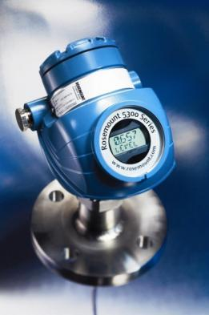
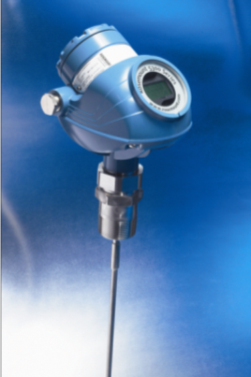
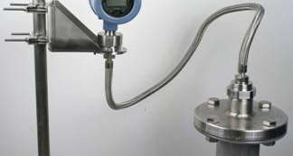
Process Connection
Flanged Connection
Welded
Wide range of ANSI-, DIN- & JIS-flanges
2”, 3”, 4”, 6” as standard
Proprietary flanges, Fisher & Masonelian
Threaded Connection
1”, 1.5” NPT or BSP/G
Bracket Mounting
Remote Housing
1m, 2m, 3m (40”, 80”, 120”)
High amb. temp, excessive vibration, tight installation space etc.
Notes:
The Rosemount GWR comes with a wide varity of process connections; flanged, threaded, bracket mountings and remote connections.
The remote housing connection are typically used in applications with high ambient temperatures, excessive vibrations, tight installation space or just to have the ability to place the transmitter display more conviniently than at the process connection.

Slide 10
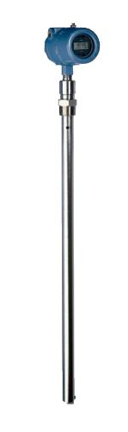
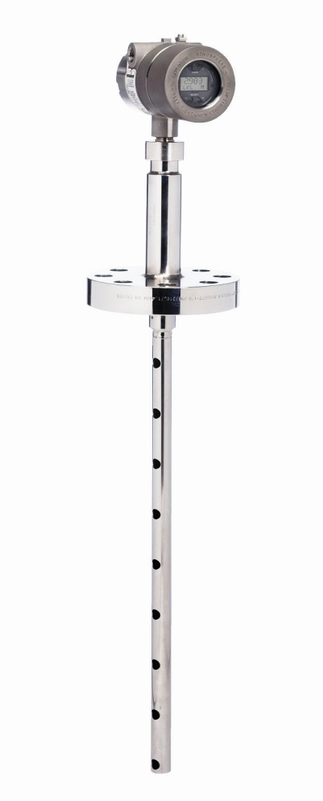
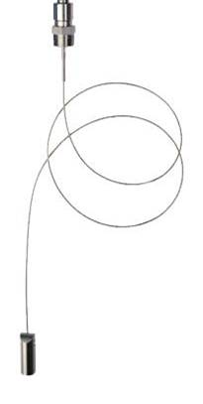
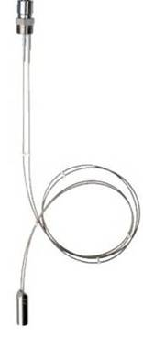
Probes
Coaxial
Not affected by disturbing objects, turbulence, low dielectrics
Clean applications only
Flexible Single
Best choice for solids, highly viscous, thick or dirty media
Avoid nearby objects
Flexible Twin Lead
Better than coaxial for viscous media
Better than single for nearby objects
Avoid product bridging between probes
Notes:
The microwave propagation is guided along the probes down through the process media. Rosemount 5300 series uses mainly three different designs of probes.
The coaxial type with wave propagation between an inner rod and an outer pipe. This means all signal stays in the pipe and no signal is lost. Thus it is the optimum solution for applications with disturbing objects, turbulence, low dielectrics but is for clean liquid applications only. Avoid dirty, thick or viscous media.
The twin-lead probes uses two parallel rods where the wave propagation goes between the two rods. The highest concentration of the signal is close to the rods, in the middle meaning the wave propagation is less dispersed than for a single lead probe. This probe is something in between the coaxial and the single lead probe. It is not as optimal as the Coaxial for disturbances but is better for viscous media. Avoid sticky media where there is risk for product bridging between probes.
The single-lead probe only uses one rod. Here the signal propagates freely around the rod but the concentration is highest close to the rod. Thus it is more affected by disturbing objects than Coaxial and Twin probes but a better choice for high viscous, thick or dirty media. Avoid mounting too close to non-smooth metallic tank walls or disturbing objects and in longer, small diameter nozzles.
Furthermore, the twin- and single-lead probe can be obtained in both a rigid and in a flexible design. Flexible design manage longer measuring range and requires less head-room above tank for installation.
If we compare 5300 with 3300 because of the higher signal strength we can now manage most applications using the single lead probe including low dielectric dirty or sticky product as some crude oils where the coaxial or twin is not a good choice. With 5300 you can also measure interface with the single probe. However as said single probe is more affected by nearby objects and installation constraints compared with coaxial and twin so take this into consideration when selecting probe.

Slide 11

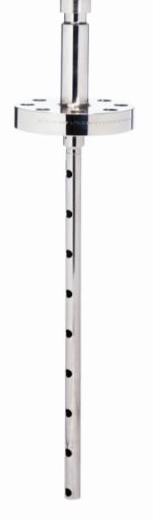
Probe Types and Their Wave Shapes
Single Flex
Twin Flex
Coaxial
Notes:
The microwave propagation is guided along the probes down through the process media. Rosemount GWR Series uses three different basic designs of probes to best match different applications.
First, the coaxial type has a wave propagation between an inner rod and an outer pipe. This means that all microwaves is contained inside the pipe without losses. Thus it is the optimum solution for applications with disturbing objects, turbulence, low dielectrics, but it is for clean liquid applications only. Avoid dirty, thick or viscous media.
The twin-lead probes uses two parallel rods where the wave propagation is concentrated between the rods. This means that the wave propagation is less dispersed than for a single lead probe. This probe is something in between the coaxial and the single lead probe in performance. It is not as optimal as the Coaxial for disturbances but is better for viscous media. Avoid sticky media where there is risk for product bridging between probes.
The single-lead probe only uses one rod. Here, the signal propagates freely around the rod but the concentration is highest close to the rod. Thus, among the different probes, the single is most affected by disturbing objects but is the best choice for high viscous, thick or dirty media. Avoid mounting to close to non-smooth metallic tank walls or disturbing objects and in longer, small diameter nozzles.
Furthermore, the twin- and single-lead probe can be obtained in both a rigid and in a flexible design. The flexible design is for long distance measurements and requires less head-room above tank during installation.
Because of the higher signal strength of the 5300, it can manage more applications using the single lead probe including low dielectric dirty or sticky product as some crude oils where the coaxial or twin is not a good choice. With 5300 you can also measure interface with the single probe.

Slide 12
5300 Installation Considerations
Intrinsically Safe
Powered over the tankbus from 2410
Requires 21 mA
Housing should be grounded according to national and local electrical regulations
Daisy-chain possible
Built-in termination jumper
To be connected if required
Basic configurations in TankMaster and 375 Field communicator

Slide 13
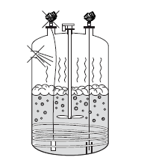
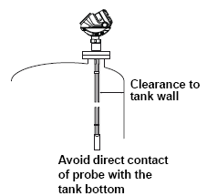
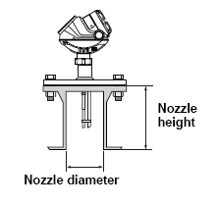
Installation Considerations
Maximum recommended nozzle height for single lead: 10cm (4 in.) + nozzle diameter
Keep inlets at distance
Avoid physical contact between probes and agitators/applications with strong fluid movement unless probe is anchored
If contact with wall, nozzle or other tank obstruction, coaxial probe is the only recommended choice
Select probe length according to required measuring range
Notes:
To get best possible performance, the following must be considered before installing the transmitter:
• Maximum recommended nozzle height is 10 cm (4 in.) + the nozzle diameter for single lead probes. For the coaxial probe there are no such restric
• Inlets should be kept at a distance in order to avoid product filling on the probetions
• Avoid physical contact between probes and agitators as well as applications with strong fluid movement unless the probe is anchored. If the probe can move to within 30 cm (1 ft) of any object during operation then probe tie-down is recommended
• In order to stabilize the probe for side forces, it is possible to fix or guide the probe to the tank bottom
• If there is a chance the probe comes into contact with a wall, nozzle or other tank obstruction, the coaxial probe is the only recommended choice
• Select probe length according to the required measuring range. Probes can be cut in field, but there are some restrictions for the coaxial probe: It can be cut up to 0.6 m (2 ft). Probes shorter than 1.25 m (4.1 ft) can be cut to the minimum length of 0.4 m (1.3 ft).

Slide 14
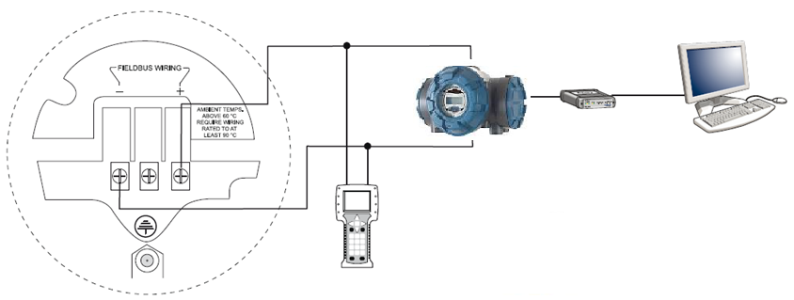
Cable Connections
Foundation Fieldbus, IS power supply
2410 Tank Hub, power supply with barrier
2180 FBM
TankMaster PC
375 Field Communicator
Internal ground screw
FISCO IS Parameters: U_{i}=17.5 V, I_{i}=380 mA, P_{i}=5.32 W L_{i}=0 H, C_{i}=0 nF

Slide 15
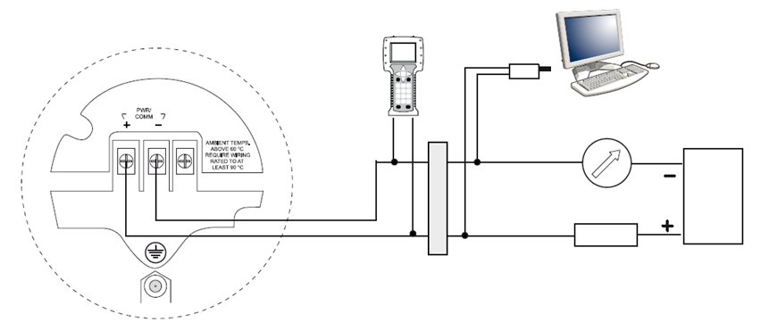
Cable Connections
Intrinsically Safe Installations (HART)
375 Field Communicator
Modem
PC
Approved IS barrier
R_{L}=250 Ω
IS Parameters: U_{i}=30 V, I_{i}=130 mA, P_{i}=1 W, L_{i}=0 H , C_{i}=7.26 nF
Notes:
NOTE!
Make sure the instruments in the loop are installed in accordance with
intrinsically safe field wiring practices and System Control Drawings when
applicable.
For HART communication, a minimum load resistance of 250  within the
loop is required.

Slide 16
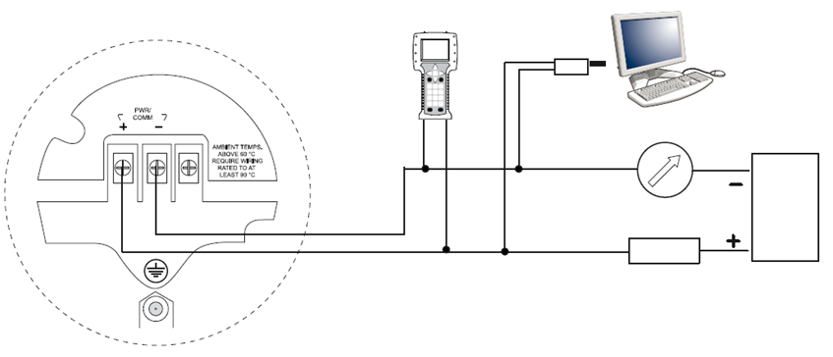
Cable Connections
Non-intrinsically Safe installations, HART Explosionproof/Flameproof power supply
375 Field Communicator
Modem
PC
R_{L}=250 Ω
Notes:
For HART communication a minimum load resistance of 250 ohm within the loop
is required. For maximum load resistance. For Explosion-proof/Flameproof applications the resistance between the
negative terminal on the transmitter and the power supply must not exceed
435 Ohm.
NOTE!
For Explosion-proof/Flameproof installations, make sure the transmitter is
grounded to the internal ground terminal inside the terminal compartment in
accordance with national and local electrical codes.

Slide 17

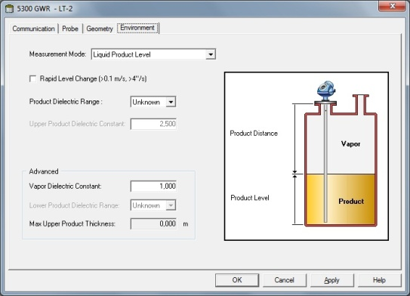
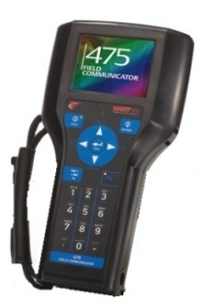

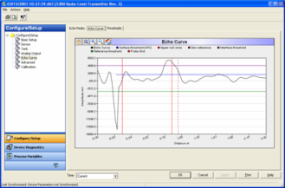

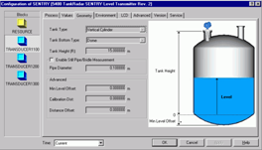
Configuration
Basic configurations
TankMaster
RadarMaster
Field communicator
AMS Suite
Delta V
Any other DD compatible host system
Advanced configurations
RadarMaster

Slide 18
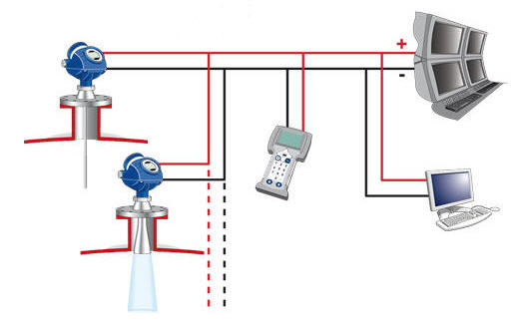
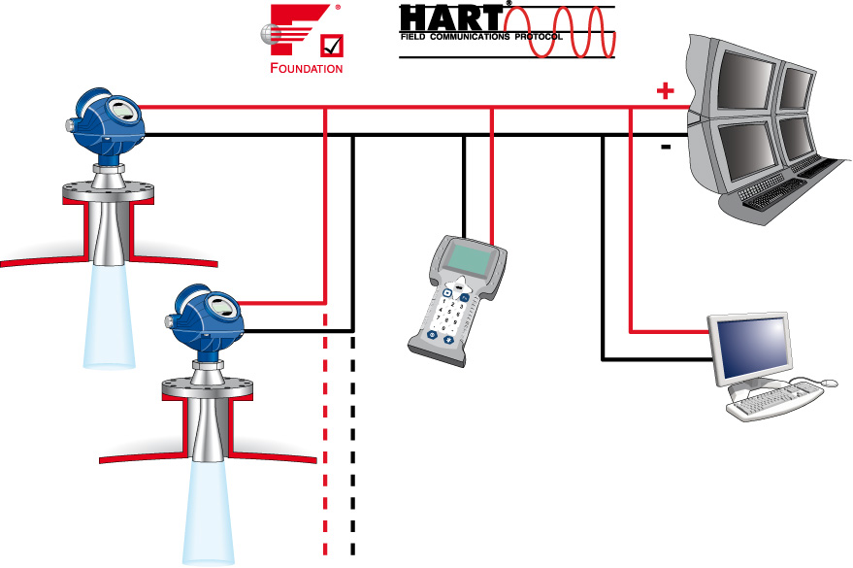




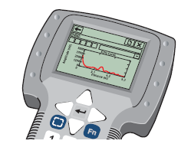

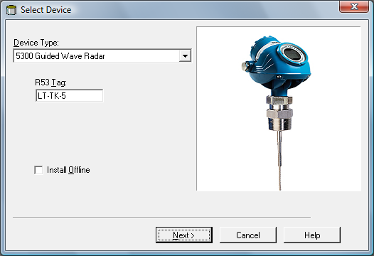
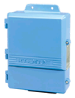
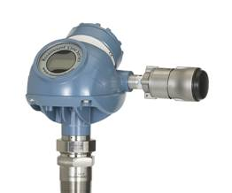
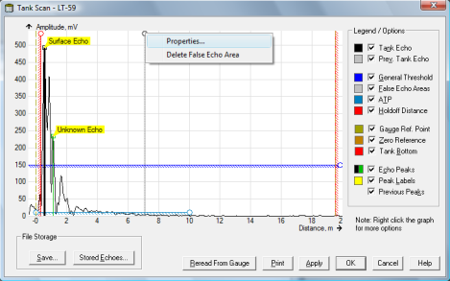
System Integration & Configuration
Interoperability
Advanced Diagnostics
375 w/ EDDL
Rosemount Tank Master
3420
Wireless w/ THUM
Notes:
The 5300 has virtually unlimited connectivity. It supports all common industry-standards such as Hart & Foundation Fieldbus which ensures that it will integrate easily into almost any plant. Although the emphasis in this slide are Emerson’s tools (AMS, DeltaV, 375) it is also possible
to use other host-systems thanks to the 5300’s extensive support of Device Descriptors
(DD) and Enhanced EDDL (HART units).
Simple configuration via: AMS, 375 Field communicator or the configuration and diagnostics PC based RRM software. Rosemount Tank Master is the software package enclosed free-of-charge with every transmitter. TankMaster can also be used with the 5400.
Burst mode functionality allows integration of multi variable measurement with any control system or monitoring system
Wireless with the THUM wireless adapter.

Slide 19
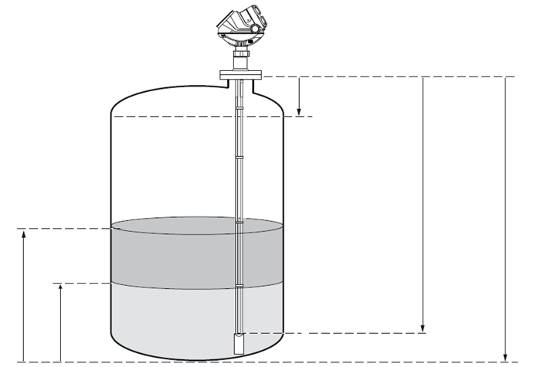
Basic Configuration Parameters
Upper Reference Point
Hold Off/ Upper Null Zone
Probe length
Product Level
Tank Height
Interface Level
Lower Reference Point
Notes:
Tank Height
The Tank Height is defined as the distance from the Upper Reference Point to
the Lower Reference Point. The transmitter measures the distance to the
product surface and subtracts this value from the Tank Height to determine
the product level. The Lower Reference Point can be set to any position in the
tank simply by adjusting the Tank Height.
Mounting Type
Enter the type of mounting for the device. This configuration optimizes the
device for the respective mounting type.
• Unknown – default factory setting for mounting type, and can also be
used if the mounting type is unknown
• Pipe/Chamber – select this option if the device is mounted on a
chamber/bridle or in a pipe. When selecting this alternative enter the
corresponding Inner Diameter as well
• Nozzle – select this if the device is installed on a nozzle. When
selecting this alternative, configure the Inner Diameter and the Nozzle
Height as well
• Direct/Bracket – when the device is mounted directly on the tank roof
with no traditional nozzle, this is the alternative to use. With this
selection no inner diameter or height is required, thus those selections
are disabled
Inner Diameter
Using with pipe, chamber - and nozzle installations.
Nozzle Height
For nozzle installations.
Probe Length
The probe length is the distance between the Upper Reference Point and the
end of the probe. If a weight is used at the end of the probe, it should not be
included.
For Flexible Single Lead probes anchored with clamps, the probe length
should be configured as the distance between the underside of the flange and
the upper clamp (see “Anchoring” on page 3-22).
This parameter is pre-configured at the factory. It must be changed if the
probe is shortened.
Probe Type
The transmitter is designed to optimize measurement performance for each
probe type.
This parameter is pre-configured at the factory. This value needs to be
changed if the probe type is changed. Hold Off/Upper Null Zone
This parameter should only be changed if there are measurement problems in
the upper part of the tank. Such problems may occur if there are disturbing
objects, such as a narrow nozzle with rough walls, close to the probe. By
adjusting the Hold Off/Upper Null Zone, the measuring range is reduced. See
“Handling of Disturbances from Nozzle” on page C-4 for further information.

Slide 20
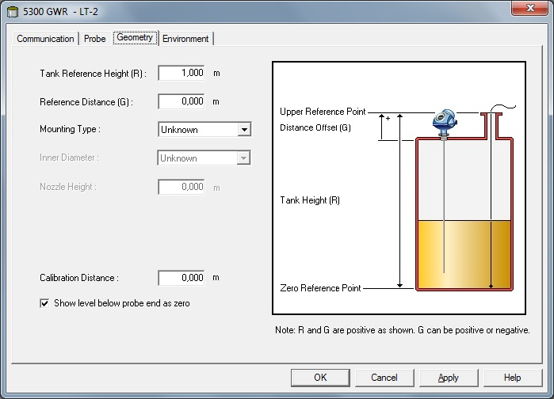
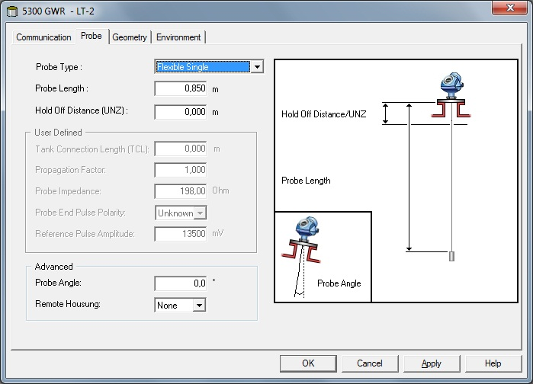
Configuration Reminders
Tank Height equals the distance from flange face to tank bottom
Level = Tank Height – Distance
Probe Length equals the distance from flange face to probe end OR top of weight if flexible probe
HTHP probes are seperate Probe Type entries
Hold Off/UNZ excludes echoes close to flange
Notes:
During basic configurations, you will be asked to enter the Reference Gauge Height or Tank Height. This is defined as the distance from the flange face to the tank bottom and is important since it is used to calculate the level measurement. The GWR actually reads the distance to the surface and then calculates Level = Tank Height – Distance
Probe Length is defined as the distance from the flange face to the end of the probe, or the top of the weight for flexible probes. Also remember that HTHP probes are seperate Probe Type entries.
Hold-Off/Upper Null Zone (UMZ) is a selectable distance below the flange that will be excluded from the measurement range. This is typically used to eliminate possible disturbances from a nozzle end. If level raises above the UNZ, device will go into Full Tank state.

Slide 21
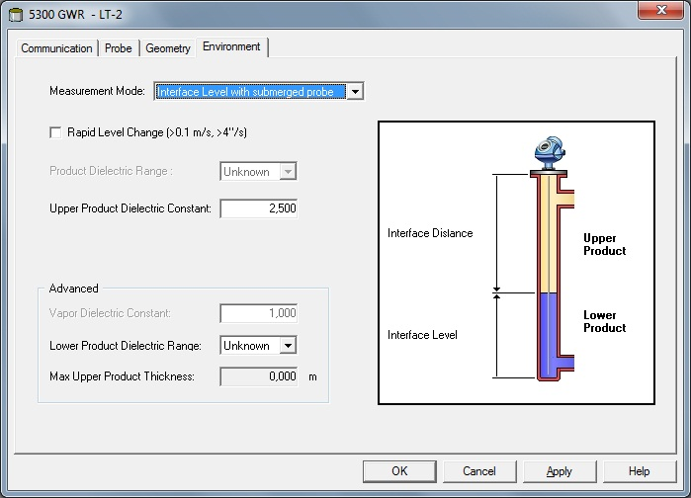
Configuration Interface – Upper Product Dielectric
Upper Product DC is critical to have accurate compensation of microwave speed

Slide 22

View Measurement Data
Optional display
2 rows
Measurement value
Parameter / Unit
Configured with TankMaster or Field Communicator
Notes:
The Rosemount 5300 transmitter uses an optional Display Panel for
presentation of measurement data. When the transmitter is switched on, the
Display Panel presents information such as transmitter model, measurement
frequency, software version, communication type (HART, FF), serial number,
HART identification tag, setting of write protection switch, and Analog Output
settings.
When the transmitter is up and running, the Display Panel presents Level,
Signal Amplitude, Volume, and other measurement data depending on the
Display Panel configuration (see “Specifying Display Panel Variables” on
page 6-3). The available LCD parameters are listed in Table 6-1 on page 6-6.
The display has two rows, the upper row shows the measurement value and
the lower row shows the parameter name and measurement unit. It toggles
between the different measurement values every 2 seconds. The lower row
toggles between parameter name and measurement unit each second.
Variables to be presented are configurable by using a 375 Handheld
Communicator, AMS, DeltaV or the Rosemount Radar Master software.

Slide 23

LCD Error Messages
Error Message | Description
RAM FAIL | Error in gauge data memory (RAM)
FPROM FAIL | Error in gauge program memory (FPROM)
HREG FAIL | Error in transmitters config memory (EEPROM)
MWM FAIL | Error in microwave module
DPLY FAIL | Error in LCD
MODEM FAIL | Modem hardware failure
AOUT FAIL | Error in Analog Out Module
OHW FAIL | Unspecific hardware error
ITEMP FAIL | Error in internal temp measurement
MEAS FAIL | Serious measurement error
CONFIG FAIL | Config parameter out of range
SW FAIL | Error in transmitter software
Notes:
Error Message Description
RAM FAIL
An error in the gauge data memory (RAM) has been
detected during the startup tests. Note: this resets the
gauge automatically.
FPROM FAIL
An error in the gauge program memory (FPROM) has
been detected during the startup tests. Note: this
resets the gauge automatically.
HREG FAIL
An error in the transmitter configuration memory
(EEPROM) has been detected. The error is either a
checksum error that can be solved by loading the
default database, or a hardware error.
NOTE: the default values are used until the problem is
solved.
OMEM FAIL
MWM FAIL An error in the microwave module.
DPLY FAIL An error in the LCD.
MODEM FAIL Modem hardware failure.
AOUT FAIL An error in the Analog Out Module.
OHW FAIL An unspecified hardware error has been detected.
ITEMP FAIL An error in the internal temperature measurement.
MEAS FAIL A serious measurement error has been detected.
CONFIG FAIL
At least one configuration parameter is outside the
allowed range.
NOTE: the default values are used until the problem is
solved.
SW FAIL An error has been detected in the transmitter software.

Slide 24

LED Error Messages
For 5300 without display
Normal operation
LED flashes once every second
Error
LED flashes a sequence corresponding to an error code followed by a five second pause
Flashing LED

