Slide 1

Rosemount 5400 Radar Level Transmitter for Raptor

Slide 2
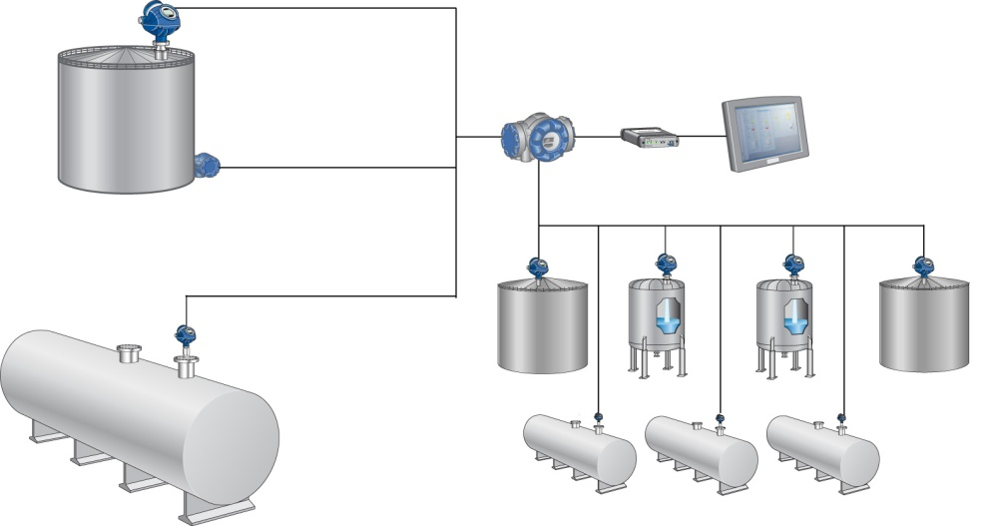

Operational Control
5300- or 5400 system configuration
5400 Level Transmitter
644 Transmitter / Rosemount 65 Single Point Temperature Sensor
2410 Tank Hub
TankMaster WinView
2180 FBM
5300 Level Transmitter

Slide 3
5400 Radar Level Transmitter
Non-contacting 26 GHz pulse radar
9° beam angle
Wide range of antennas and flanges
Optional LCD-display
Instrument accuracy: 5402: ± 3mm

Slide 4
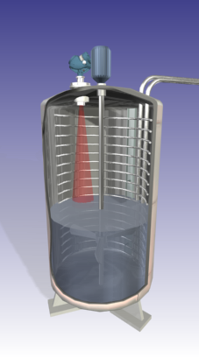
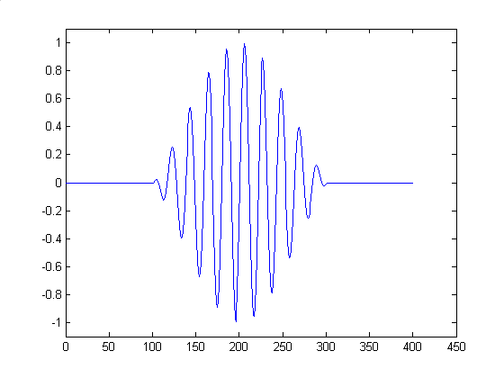
Measurement Principle
Pulse radar
Short radar pulses are emitted from the antenna each microsecond
Pulses reach media with different dielectric constant (DK) where part of the microwaves are reflected back
~ 1 ns
~ 1 μs
Distance = Speed x Time of Travel / 2
Notes:
The 5400 is using the pulse radar technology. This means that the level measurement is accomplished by short radar pulses that are emitted from the antenna every microsecond. When a radar pulse reaches media with a different dielectric constant, part of the microwaves are reflected back. The transmitter reads the time of travel and uses the propagation speed (speed of light) to calculare the surface distance.
Level is given by subract
Mention that the 5400 sends out 2 million pulses per second. The pulse itself has the low or high microwave frequency.
5400 measures the distance to the surface of the product in the tank. Using tank distances stored locally in the memory of the gauge, it calculates the level of the liquid´s surface.
ing the measured distanced from the Tank Height.

Slide 5
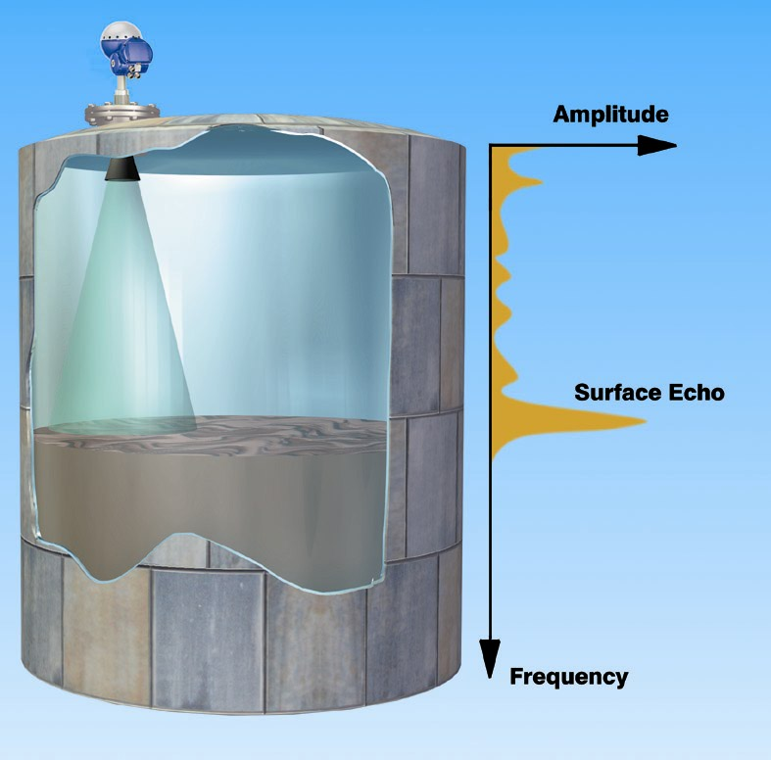
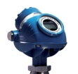
Signal Strength
Dielectric constant of the media (ε_{r} or DK)
Antenna type
Measurement range
Surface characteristics
Disturbing objects
Notes:
The signal strength of a radar echo is important for a reliable measurement. How strong the signal is depends on a couple of different factors.
First, the dielectric constant (DK) of the media is important. The higher the DK, the more microwaves will be refledted and give the echo a stronger signal strength. Moreover, the signal strength is improved by using the optimal antenna type and as large antennnas as possible. Finally, the signal strength is stronger for short measuring ranges, calm surface conditions and when there are few disturbing objects.

Slide 6
Circular Polarization
Notes:
Smart use of microwave technology automatically reduces the disturbance effect close to tankwalls, simplifying commissioning and maximizing reliability.

Slide 7
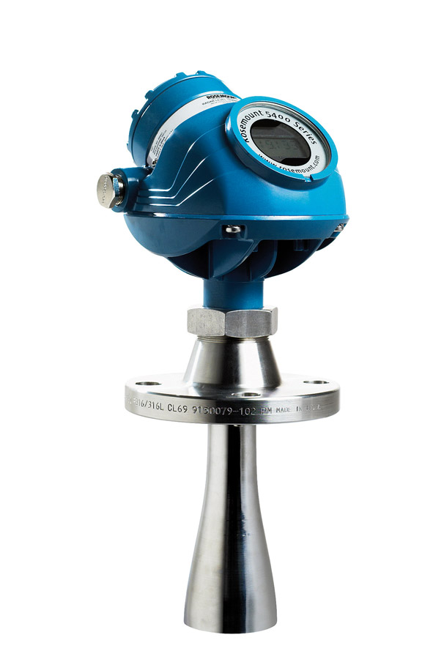
5400 Components
Terminal side
Integral digital display
Dual Compartment transmitter housing
One of two cable entries
Radar Electronics
Tank Seal
Flange
Antenna
Notes:
The dual compartment transmitter housing can be removed is fast and easy without opening the tank. No matching between housing and probes also minimize spares needed on the shelves. No moving parts minimize need for maintenance of probe.It has electronics and cabling separated.
The housing has two entries for conduit/cable connections. A ½-14 NPT cable entry is standard, but adapters to other connection types are available, see “Ordering Information” on page 121.
The tank connection consists of a tank seal, a flange or a threaded tank connection. Flange mating face dimensions follow ANSI B 16.5, JIS B2220, and EN 1092-1 (DIN 2527) standards for blind flanges. Fisher and Masoneilan flanges are also available.
Several versions of probes are available:
coaxial (perforated and non-perforated versions), Flexible single lead, flexible twin lead.

Slide 8
Hardware
Rosemount 5400 consists of:
Transmitter housing
Separates cabling from the electronics
Can be rotated and removed from antenna without opening tank
2 integral ½-in. NPT cable entries
Adapters to other types are available
Antenna assembly
Only part in contact with tank atmosphere
Focuses the radar beam towards the product
Notes:
Rosemount 5400 consists of the transmitter housing and an antenna assembly. The transmitter housing contains all electronics.
The dual-compartment housing separates cabling from the electronics for increased moisture resistance.
The transmitter housing can be rotated and removed from the antenna assembly for service or replacement, without opening the tank.
The transmitter housing has two integral ½-in. NPT cable entries for conduit / cable connections.
Adapters to other connection types are available, see “Ordering Information” .
The antenna assembly is the only part in contact with the tank atmosphere. It seals off the tank atmosphere from the transmitter housing and its surroundings.

Slide 9
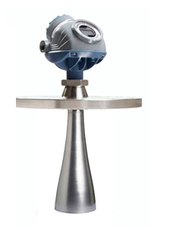
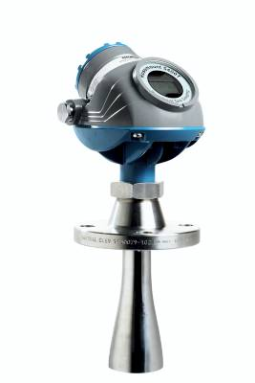
5400 Antennas
Antenna assembly consists of
Antenna
O-ring
Tank Seal or Flange
Cone antenna 2-4 in.
4 in. Standard
2 and 3 in. suitable for still-pipe installations
Notes:
The antenna assembly consists of an antenna, an O-ring, a tank seal, or a flange. The antenna focuses the radar beam.
Rosemount 5400 level transmitters are equipped with high performance cone antennas in various sizes. The recommendation is to always use the largest possible antenna to achieve the highest gain.
Rosemount 5400 level transmitters are equipped with high performance cone antennas in various sizes. The recommendation is to always use the largest possible antenna to achieve the highest gain.

Slide 10
5400 Installation Considerations
Intrinsically Safe
Powered over the tankbus from 2410
Requires 21 mA
Housing should be grounded according to national and local electrical regulations
Daisy-chain possible
To be connected if required
Basic configurations in TankMaster and Field communicator

Slide 11
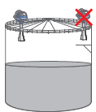
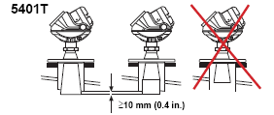
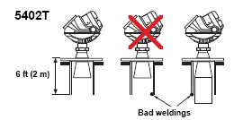
Installation Considerations
Install off-center, away from disturbing inlets or metallic objects within radar beam.
Circular polarization, no clearance distance requirements from the tank wall
5401T with cone antenna should extend 10 mm (0.4 in.) below the nozzle
5402T with cone antenna can be recessed in smooth nozzles up to 2 m (6 ft), but if inside of nozzle contains disturbing objects, extended cone should be used
Notes:
To get best possible performance, the following must be considered before installing the transmitter:
The transmitter should be installed off-center, and at a location away from disturbing inlets or metallic objects within the radar beam. Because of circular polarization, there is no clearance distance requirement from the tank wall if it is flat and free from obstructions.
5402T with cone antenna: The antenna can be recessed in smooth nozzles up to 2 m (6 ft), but if the inside of the nozzle contains disturbing objects, use the extended cone. 5401T with cone antenna: The antenna should extend 10 mm (0.4 in.) below the nozzle. If required, use the extended cone solution.

Slide 12
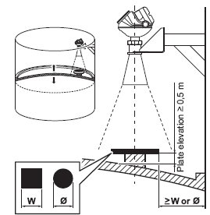
Installation Considerations
Possible to measure towards a reflector on floating roofs
The size of reflector same as distance between the reflector and the tank wall
Notes:
The 5400 transmitter can be installed to measure on floating roof tanks. If no still-pipe is available, it is possible to install the transmitter on a bracket, and measure towards a reflector on the floating roof. The size of the horizontal metallic reflector should be according to the illustration. The distance from the reflector to the tank wall should be approximately the same as the reflector size.

Slide 13
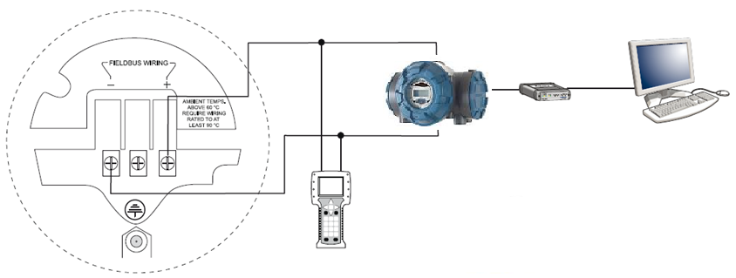
Cable Connections
Foundation Fieldbus, IS power supply
2410 Tank Hub, power supply with barrier
2180 FBM
TankMaster PC
375 Field Communicator
Internal ground screw
FISCO IS Parameters: U_{i}=17.5 V, I_{i}=380 mA, P_{i}=5.32 W L_{i}=0 H, C_{i}=0 nF

Slide 14
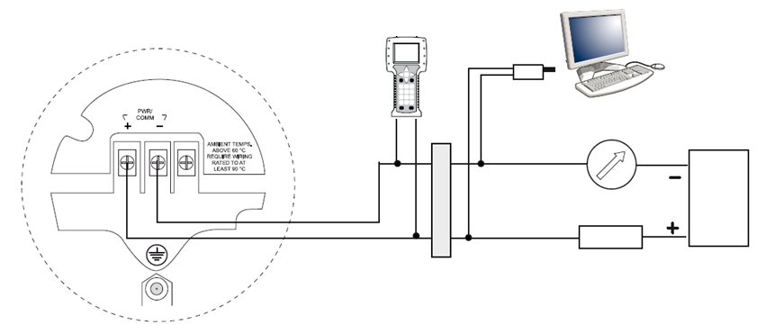
Cable Connections
Intrinsically Safe Installations (HART)
375 Field Communicator
Modem
PC
Approved IS barrier
R_{L}=250 Ω
IS Parameters: U_{i}=30 V, I_{i}=130 mA, P_{i}=1 W, L_{i}=0 H , C_{i}=7.26 nF
Notes:
NOTE!
Make sure the instruments in the loop are installed in accordance with
intrinsically safe field wiring practices and System Control Drawings when
applicable.
For HART communication, a minimum load resistance of 250  within the
loop is required.

Slide 15
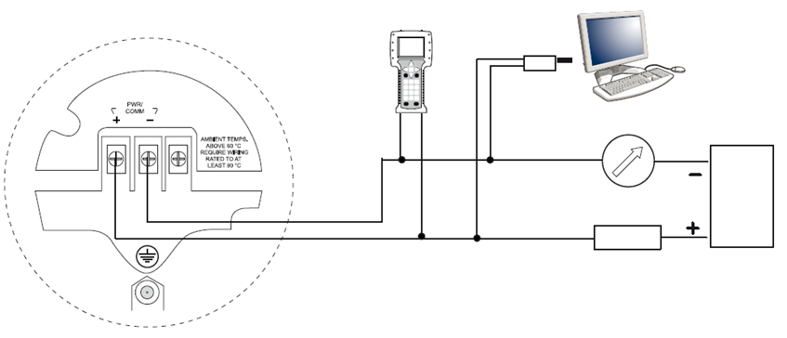
Cable Connections
Non-intrinsically Safe installations, HART Explosionproof/Flameproof power supply
375 Field Communicator
Modem
PC
R_{L}=250 Ω
Notes:
For HART communication a minimum load resistance of 250 ohm within the loop
is required. For maximum load resistance. For Explosion-proof/Flameproof applications the resistance between the
negative terminal on the transmitter and the power supply must not exceed
435 Ohm.
NOTE!
For Explosion-proof/Flameproof installations, make sure the transmitter is
grounded to the internal ground terminal inside the terminal compartment in
accordance with national and local electrical codes.

Slide 16

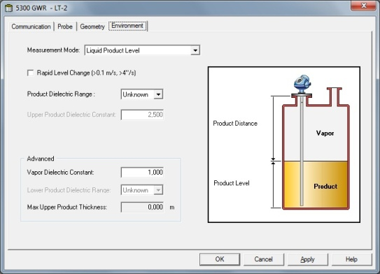
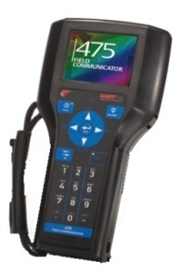

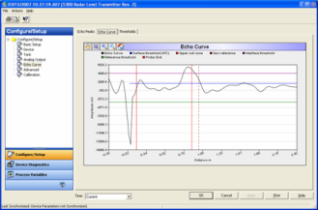

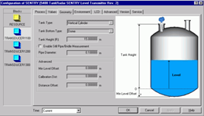
Configuration
Basic configurations
TankMaster
RadarMaster
Field communicator
AMS Suite
Delta V
Any other DD compatible host system
Advanced configurations
RadarMaster

Slide 17
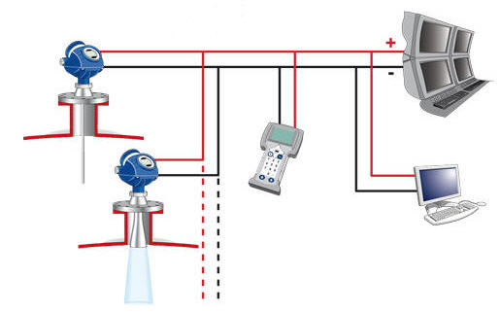
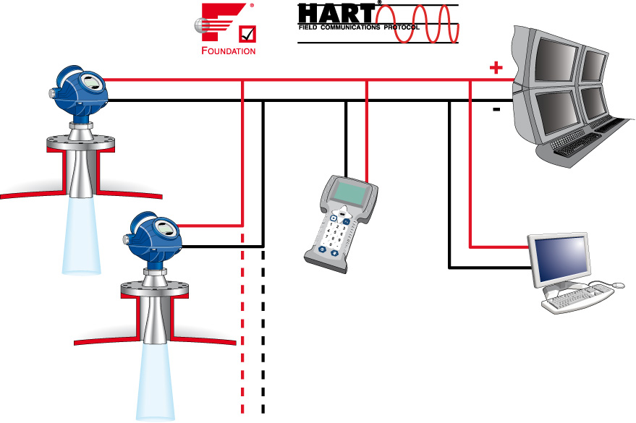




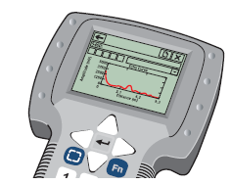

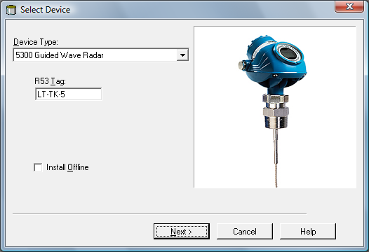
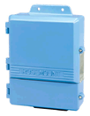
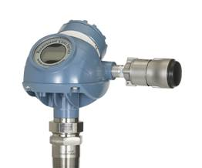
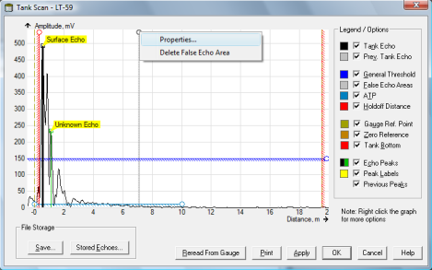
System Integration & Configuration
Interoperability
Advanced Diagnostics
375 w/ EDDL
Rosemount Tank Master
3420
Wireless w/ THUM
Notes:
The 5300 has virtually unlimited connectivity. It supports all common industry-standards such as Hart & Foundation Fieldbus which ensures that it will integrate easily into almost any plant. Although the emphasis in this slide are Emerson’s tools (AMS, DeltaV, 375) it is also possible
to use other host-systems thanks to the 5300’s extensive support of Device Descriptors
(DD) and Enhanced EDDL (HART units).
Simple configuration via: AMS, 375 Field communicator or the configuration and diagnostics PC based RRM software. Rosemount Tank Master is the software package enclosed free-of-charge with every transmitter. TankMaster can also be used with the 5400.
Burst mode functionality allows integration of multi variable measurement with any control system or monitoring system
Wireless with the THUM wireless adapter.

Slide 18
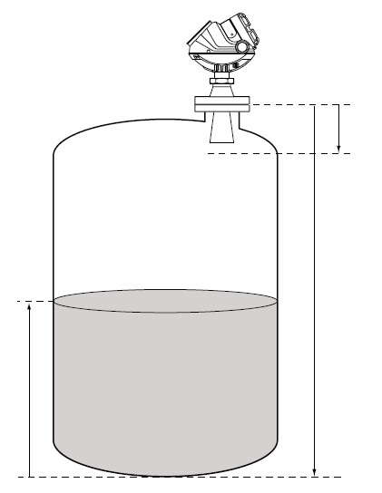
Basic Configuration Parameters
Upper Reference Point
Dead Zone
Tank Height
Product Level
Lower Reference Point (Level =0)
Notes:
Tank Height
The Tank Height is defined as the distance from the Upper Reference Point to
the Lower Reference Point. The transmitter measures the distance to the
product surface and subtracts this value from the Tank Height to determine
the product level. The Lower Reference Point can be set to any position in the
tank simply by adjusting the Tank Height.
Tank Type and Tank Bottom Type
The 5400 transmitter is optimized according to the Tank Type and Tank
Bottom Type configuration by automatically setting some parameters to
pre-defined default values.
Select Tank Bottom Type Flat Inclined if the bottom inclination is between 10
and 30 degrees. If the inclination is less than 10 degrees but there are
disturbing objects on the tank floor (like heating coils) within the radar beam,
this selection should also be used. If inclination is greater than 30 degrees
use Tank Bottom Type Cone.
Pipe Diameter
When the transmitter is mounted in a still pipe the inner diameter of the pipe
must be specified. The Pipe Diameter is used to compensate for the lower
microwave propagation speed inside the pipe. An incorrect value will give a
scale factor error. If locally supplied still-pipes are used, make sure the inner
diameter is noted before the pipe is installed.
Dead Zone
The measurement accuracy is reduced within the Dead Zone region close to
the antenna. See Specifications on page A-1 for more information.

Slide 19
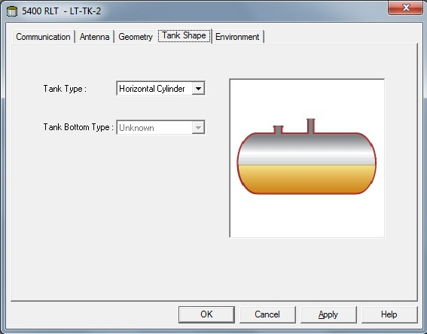
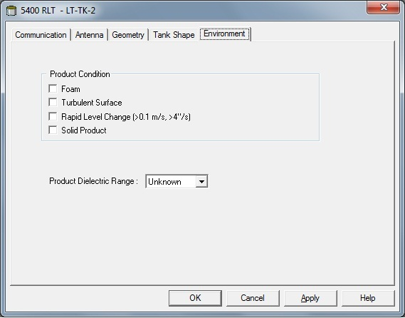
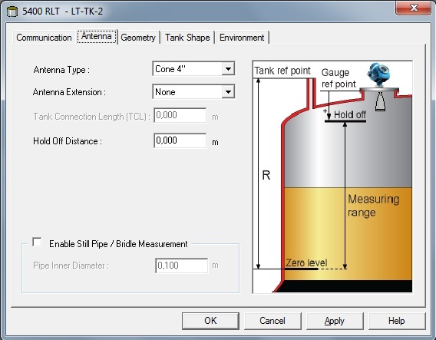
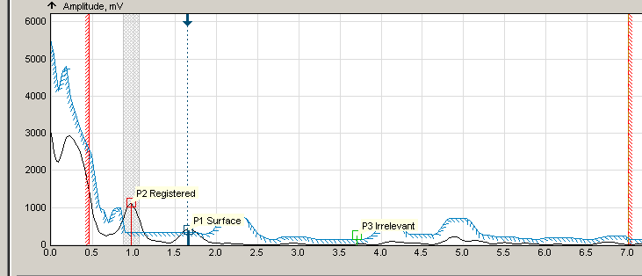
5. Configuration Advices
Correct Tank Shape and Tank Bottom configuration sets optimal performance
Only select one or two most appearant Process Conditions
Read echoes and customizes threshold and false echo areas accordingly
Is best to perform in empty tank
Hold-Off is an excellent way to exclude echoes from antenna area
Hold-Off
Notes:
During basic configurations, Tank Shape and Tank Bottom. This is important settings that the 5400 uses to optimize the processing of echoes from the tank.
Also, you will be asked to select process conditions that reflects the application. You can prepare the gauge to optimize for Foam, Turbulent Surface or Rapid Level Changes. Recommendation is to only select the 1, or maybe 2, that best decribes the process conditions
First time you enter the Echo Curve, RRM will recommend Measure & Learn. This function scans the tank customizes threshold and false echo areas accordingly. This function can manually be reached by a button in the Echo Curve screen. Best practice is to perform the Measure & Learn function with an empty tank since that is the condition that will reveal any obstructions giving false echoes to the 5400.
Hold-Off/Upper Null Zone (UMZ) is a selectable distance below the flange that will be excluded from the measurement range. This is typically used to eliminate possible disturbances from a nozzle end. If level raises above the UNZ, device will go into Full Tank state.

Slide 20

View Measurement Data
Optional display
2 rows
Measurement value
Parameter / Unit
Configured with TM or Field Communicator
Notes:
The Rosemount 5300 transmitter uses an optional Display Panel for
presentation of measurement data. When the transmitter is switched on, the
Display Panel presents information such as transmitter model, measurement
frequency, software version, communication type (HART, FF), serial number,
HART identification tag, setting of write protection switch, and Analog Output
settings.
When the transmitter is up and running, the Display Panel presents Level,
Signal Amplitude, Volume, and other measurement data depending on the
Display Panel configuration (see “Specifying Display Panel Variables” on
page 6-3). The available LCD parameters are listed in Table 6-1 on page 6-6.
The display has two rows, the upper row shows the measurement value and
the lower row shows the parameter name and measurement unit. It toggles
between the different measurement values every 2 seconds. The lower row
toggles between parameter name and measurement unit each second.
Variables to be presented are configurable by using a 375 Handheld
Communicator, AMS, DeltaV or the Rosemount Radar Master software.

Slide 21

View Measurement Data
Optional display
2 rows
Measurement value
Parameter / Unit
Configured with TankMaster or Field Communicator
Notes:
The Rosemount 5300 transmitter uses an optional Display Panel for
presentation of measurement data. When the transmitter is switched on, the
Display Panel presents information such as transmitter model, measurement
frequency, software version, communication type (HART, FF), serial number,
HART identification tag, setting of write protection switch, and Analog Output
settings.
When the transmitter is up and running, the Display Panel presents Level,
Signal Amplitude, Volume, and other measurement data depending on the
Display Panel configuration (see “Specifying Display Panel Variables” on
page 6-3). The available LCD parameters are listed in Table 6-1 on page 6-6.
The display has two rows, the upper row shows the measurement value and
the lower row shows the parameter name and measurement unit. It toggles
between the different measurement values every 2 seconds. The lower row
toggles between parameter name and measurement unit each second.
Variables to be presented are configurable by using a 375 Handheld
Communicator, AMS, DeltaV or the Rosemount Radar Master software.

Slide 22

LCD Error Messages
Error Message | Description
RAM FAIL | Error in gauge data memory (RAM)
FPROM FAIL | Error in gauge program memory (FPROM)
HREG FAIL | Error in transmitters config memory (EEPROM)
MWM FAIL | Error in microwave module
DPLY FAIL | Error in LCD
MODEM FAIL | Modem hardware failure
AOUT FAIL | Error in Analog Out Module
OHW FAIL | Unspecific hardware error
ITEMP FAIL | Error in internal temp measurement
MEAS FAIL | Serious measurement error
CONFIG FAIL | Config parameter out of range
SW FAIL | Error in transmitter software
Notes:
Error Message Description
RAM FAIL
An error in the gauge data memory (RAM) has been
detected during the startup tests. Note: this resets the
gauge automatically.
FPROM FAIL
An error in the gauge program memory (FPROM) has
been detected during the startup tests. Note: this
resets the gauge automatically.
HREG FAIL
An error in the transmitter configuration memory
(EEPROM) has been detected. The error is either a
checksum error that can be solved by loading the
default database, or a hardware error.
NOTE: the default values are used until the problem is
solved.
OMEM FAIL
MWM FAIL An error in the microwave module.
DPLY FAIL An error in the LCD.
MODEM FAIL Modem hardware failure.
AOUT FAIL An error in the Analog Out Module.
OHW FAIL An unspecified hardware error has been detected.
ITEMP FAIL An error in the internal temperature measurement.
MEAS FAIL A serious measurement error has been detected.
CONFIG FAIL
At least one configuration parameter is outside the
allowed range.
NOTE: the default values are used until the problem is
solved.
SW FAIL An error has been detected in the transmitter software.

Slide 23

LED Error Messages
For 5400 without display
Normal operation
LED flashes once every second
Error
LED flashes a sequence corresponding to an error code followed by a five second pause
Flashing LED

