Slide 1

Inventory Management - TankMaster WinOpi

Slide 2
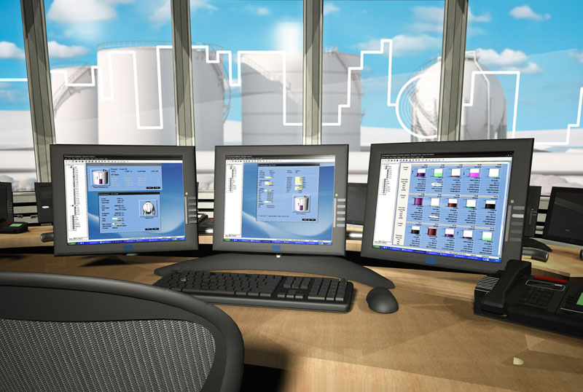
Lesson’s Goal
Get basic knowledge about the WinOpi Software
Product Table
TCT tables
Alarm limits
Tank groups
Alarm groups
Reports
Historical tables
Hands on, workshop with WinOpi

Slide 3
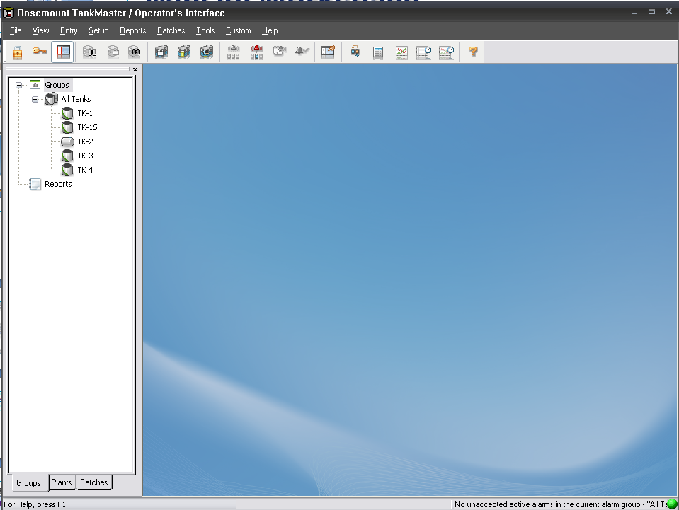
WinOpi Workspace
Minimize
Maximize
Close
Menu bar
Tool bar
Workspace
Status bar
Notes:
Main window in WinOpi. Menu bar for accessing different functions.
Tool bar for quick access of most important functions.
Workspace showing all installed tanks, allows also group setup and report handling.
Status bar is showing current user, current alarm status and green ball on the right is indicating current status of tankserver.
Green= Good. Red=Bad

Slide 4







Toolbar
- Let’s you log off
- Alarm Summary
- Let’s you log on as user
- Group Alarm View
- Toggle Workspace On/Off
- Alarm Log
- Tank View
- Accept Alarm
- Tank Inventory
- Program Options
- Tank View Extended
- Group View
- Bargraph View
- Tank Movement View
Notes:
Toolbar allows for quick access of most important functions for day to day usage of WinOpi.

Slide 5
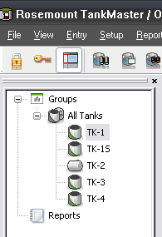
Workspace
Installed tanks
Reports
Groups
Alarm groups
Notes:
The Workspace window shows the installed tanks and devices and available communication protocols. It also provides information about the configuration
of installed devices.
-Logical View: all installed tanks and devices, as well asavailable communication protocols, are organized in separate folders to provide a clear overview of the system. The Tanks folder contains an overview of the installed tanks.
For each tank the associated devices are displayed.

Slide 6
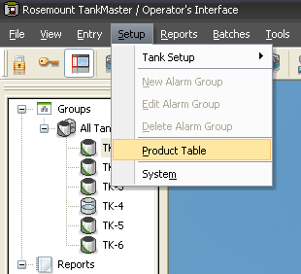
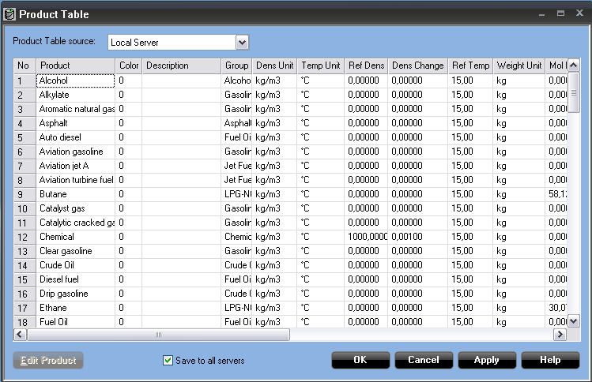
Product table
Pre-configured products
Possible to add new products
Max 100 products
Product specific data stored
When changing in product table all tanks associated with the product will be affected
Possible to update product tables on remote connected servers
Notes:
TankMaster allows definition of up to 100 different products for volume calculation. Each product can be assigned to one or several tanks. Product definition can be changed when desired allowing for easy modification of volume calculations. All product are located on the server which allows for easy distribution of strapping tables across the whole TankMaster network.

Slide 7
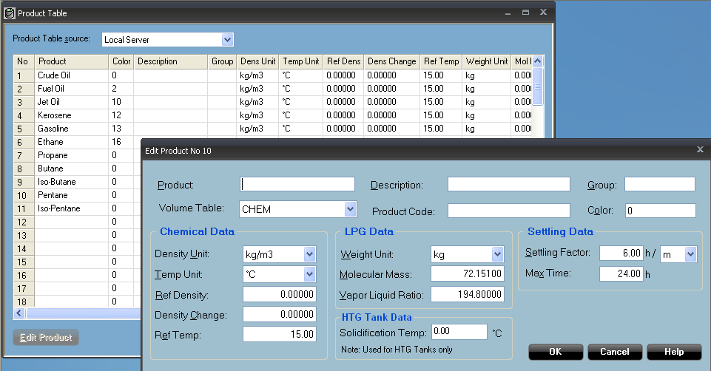
Product Table
Specifies when to define that the product is settled
When Volume table CHEM is used only
For LNG/LPG tanks
Notes:
Product table supports standard API tables, Chemical products, LPG and LNG data.
Volume Table
The Volume Table pop-up list lets you choose the API Table to be used for
calculating the Volume Correction Factor (VCF).
By choosing one of the RT tables you can use another reference temperature
value than the standard 15 °C/60 °F. The reference temperature is specified in
the System Setup window (Setup>System).
When using volume table CHEM, WinOpi calculates the Observed Density by
using the Reference Density from the Product Table.
For Volume Tables Linear and Custom, see paragraph Extended Volume
Correction Table Setup on page 4-24.
Volume table ALCOHOL is valid for strengths between 50 and 100%, and
temperature range 10 to 40 °C (50 to 104 °F).
Volume Tables USER1-10 are for users who want to order special volume
tables from Rosemount Tank Radar AB.

Slide 8
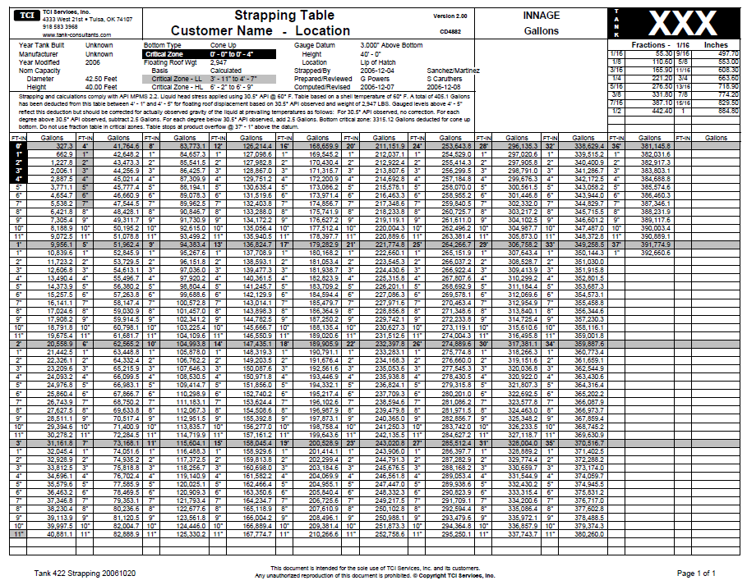
Tank Capacity Table (TCT)
Describes the geometry of the tank
Converts level into volume
Three methods available
Northern
International
Raw
1000 points possible by default (max 5000)
Possible to copy strapping data from Excel sheets
Notes:
For each tank a tank capactiy table can be set up which defines the gemotry of the tank allowing for conversion between leven and volume.
The methods are availiable. Northern which is used mostly in scandinavian countries is based on the linear relationship between level and volume. It includes a coefficient which describes how volume varies with the level within the interval based on the base volume.
International method is similar to northern but they also include level at the start of the interval. The raw method uses only linear relation between level and volume. A certain level corresponds to a certain volume. Each TCT table can support up to 5000 points.

Slide 9
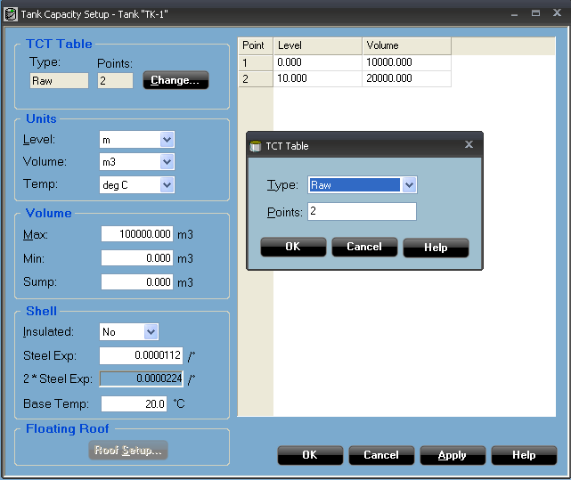
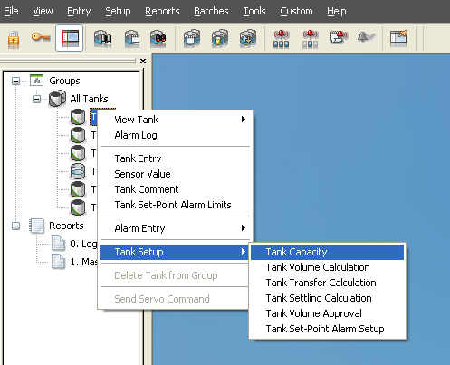
Enter TCT into TankMaster

Slide 10
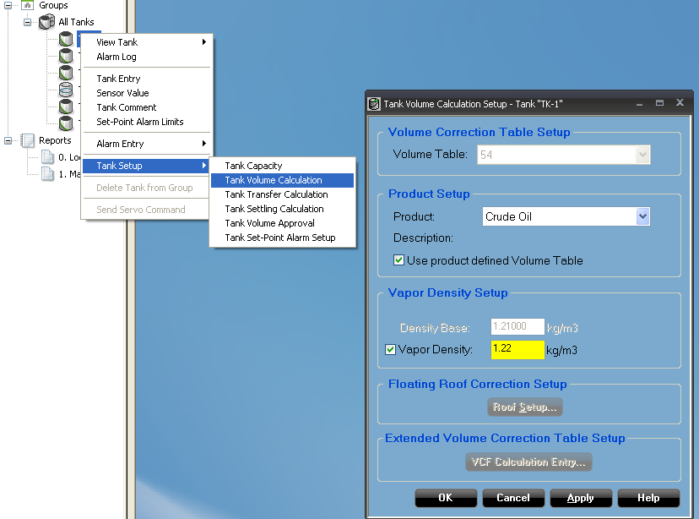
Assign product to tank
Select product table
Volume Correction Table
Select if defined or not
If not defined, select desired API table
Vapor Density Setup
For pressurized tanks
Constant or Calculated
Floating Roof Correction Setup
For floating roof tanks
Included in TCT or not
Weight, Roof Critical Zone
Extended Volume Correction Table
Only for Linear & Custom

Slide 11
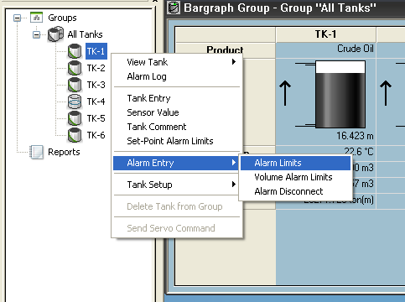
Tank Alarm Limits
Settings of all alarm concerning the specific tank
Hysteresis and delay possible on each alarm
Prevent turbulent surface and temporary changes of measurements from activating the alarm
Alarms are given in following priority
Disconnected (Discon)
Communication failure (Cfail)
Error
Blocked
HiHi, LoLo
Leak Alarm Hi, Leak Alarm Lo
High, Low
Leakage alarm (net volume of level)
Increased safety
Environmental protection
Set-Point alarm

Slide 12
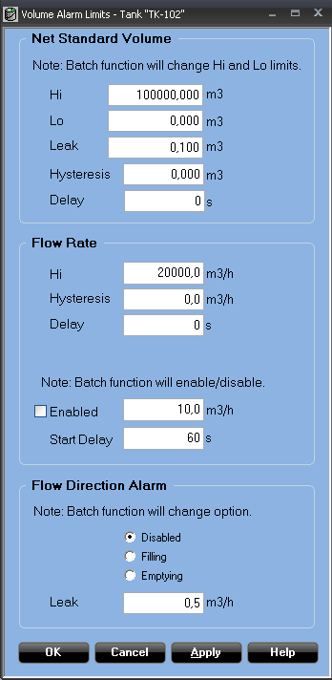
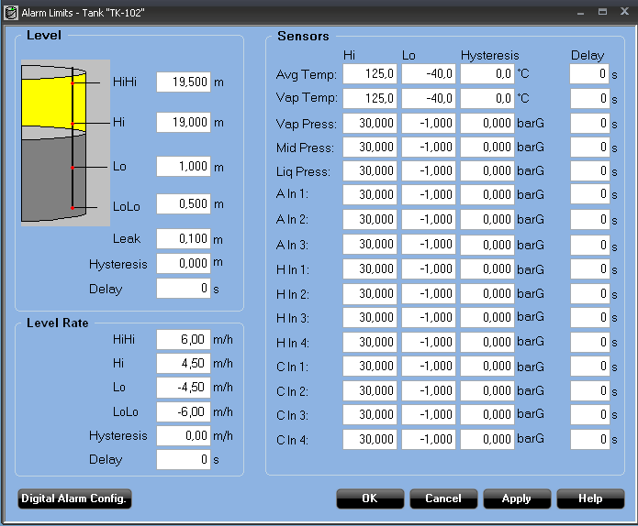
Tank Alarm Limits
Volume Alarms
Level ans sensor alarms

Slide 13
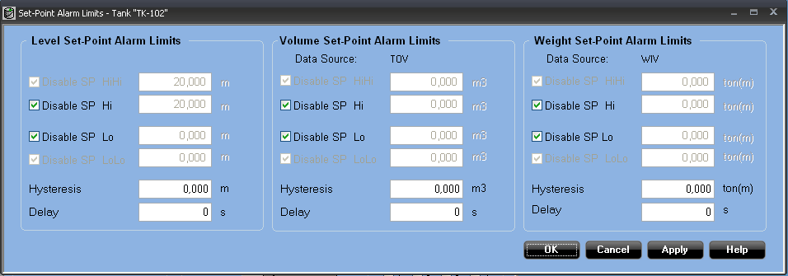
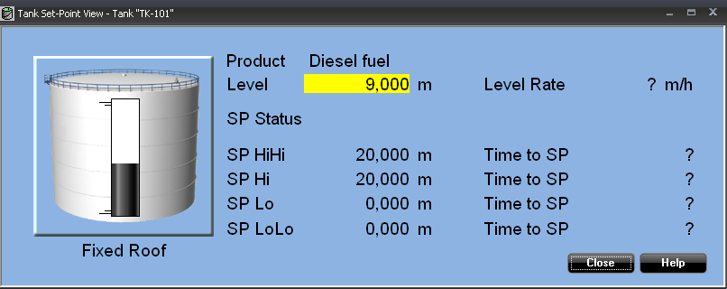
Set-Point Alarm

Slide 14
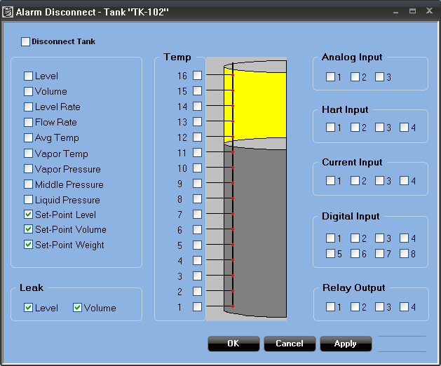
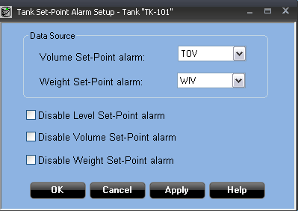
Enable/Disable Alarms
Entry > Alarm Entry > Alarm Disconnect
Tank Setup > Tank Set-Point Alarm Setup

Slide 15
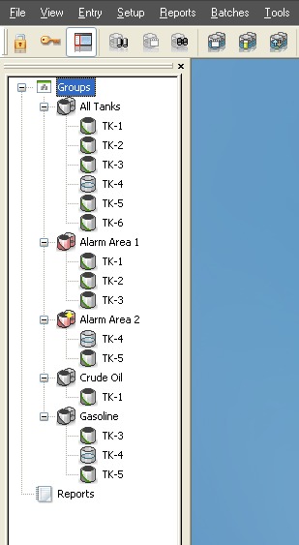
Tank Groups
Example of groups
Product groups
Geographical groups
Alarm Groups
Active Alarm Group
current workstation is authorized to accept alarms from tanks within the active alarm group

Slide 16
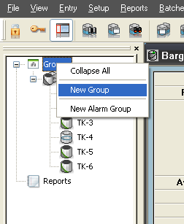
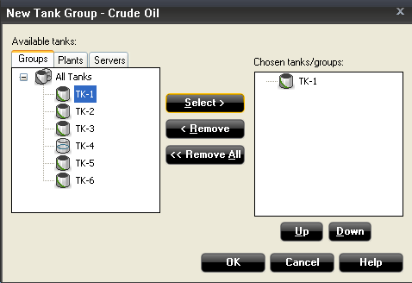
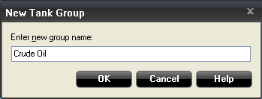
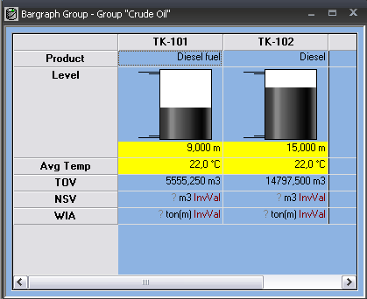
Tank Groups

Slide 17
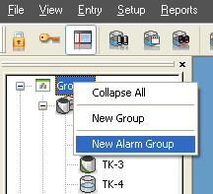
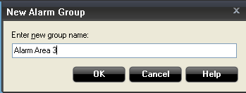
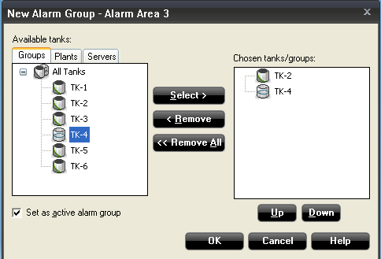
Alarm groups

Slide 18
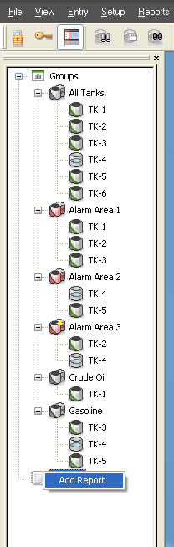
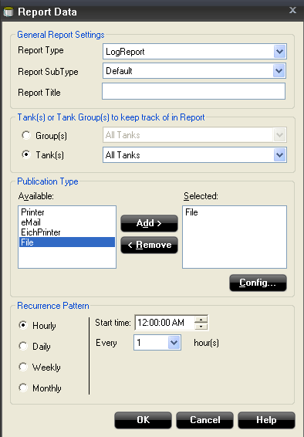
Reports
Logreport or massbalance report
Tanks or Groups
Outputs
Printer
Email (based on time of day or shift)
Eichprinter
File
Configure recurrency pattern
Possible to format report and add/remove items by editing rgm.ini-file
C:\Rosemount\TankMaster\Opi\Shared

Slide 19
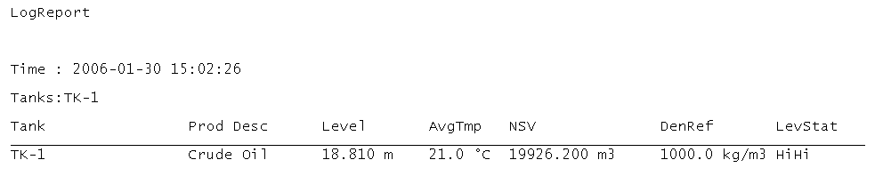
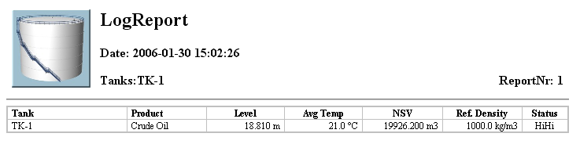
Log Reports

Slide 20
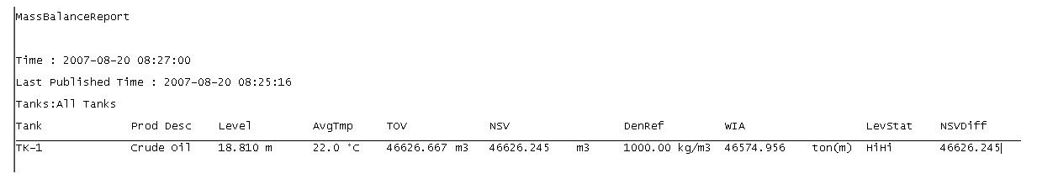
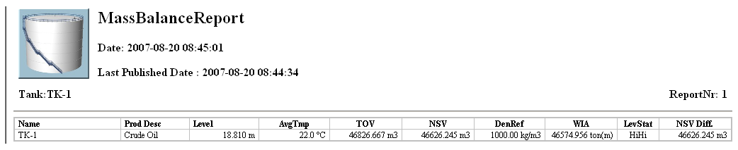
Mass Balance Reports

Slide 21
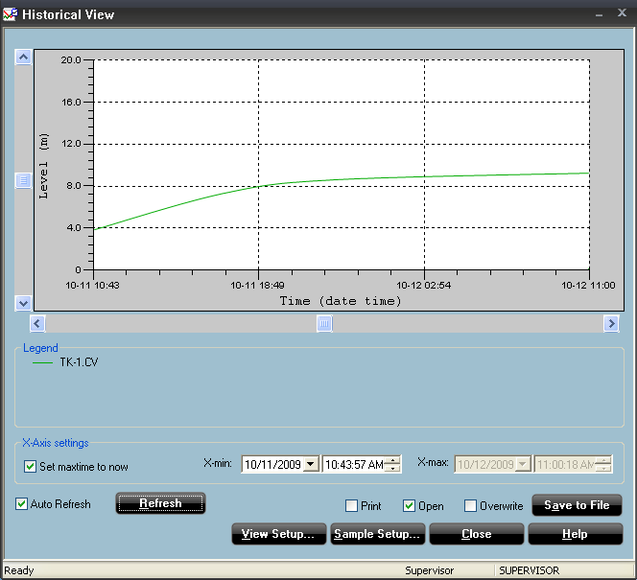
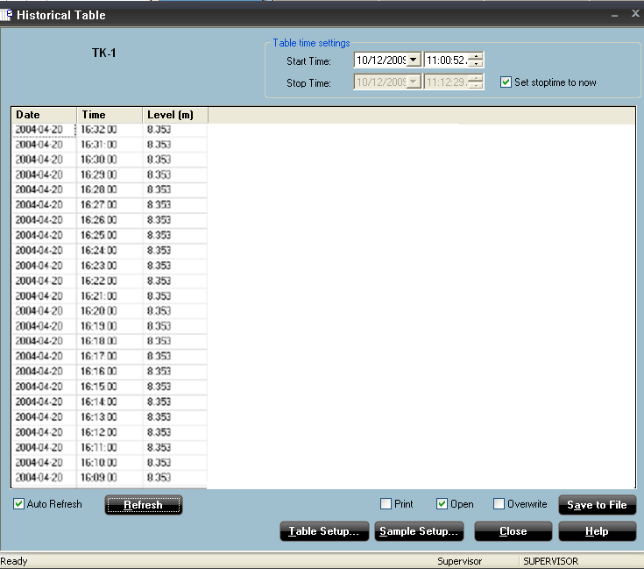
Historical Data
Collect historical data for reliable follow up
Graph
Table
More than 100 000 samples
Store to text file
Print
Real time view
Remember to save to file or print before closing the window!!!

Slide 22
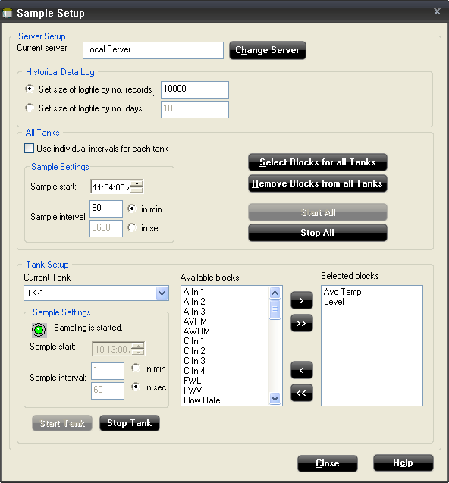
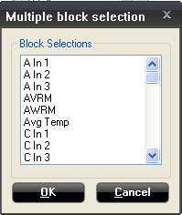
Configure/View historical data

Slide 23
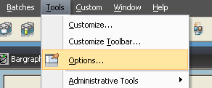
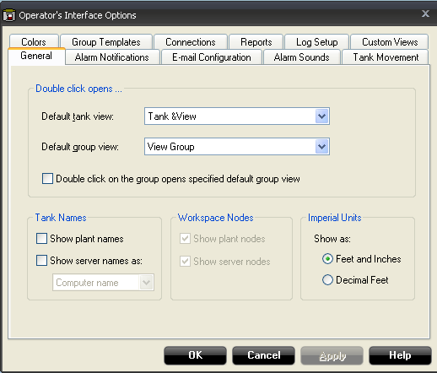
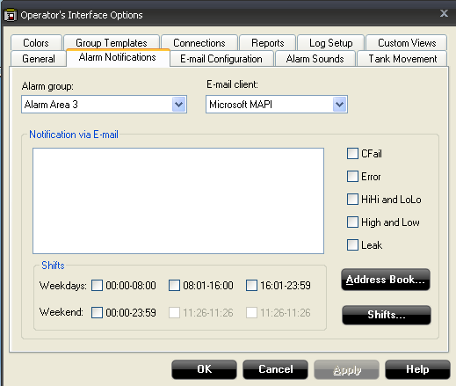
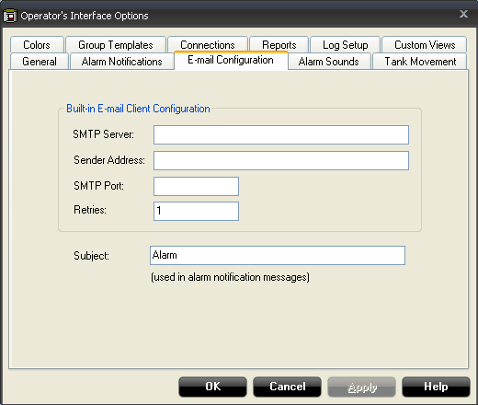
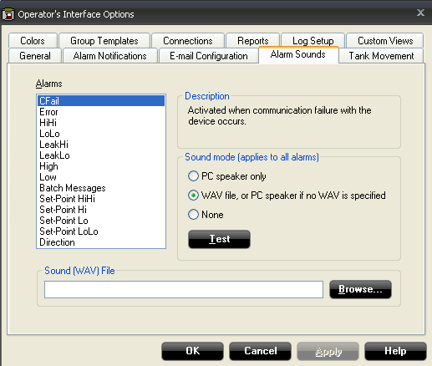
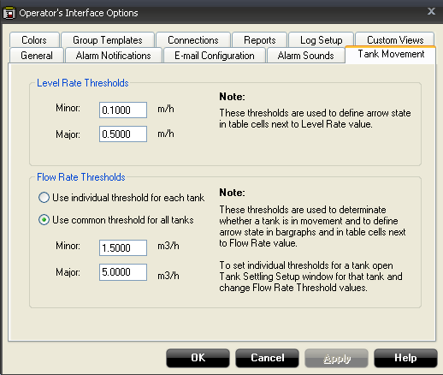
WinOpi Options
Possible to customize WinOpi according to customer requirements
General
Default view
Alarm notifications
Alarms to be sent as email
Email configuration
Email sending config
Requires mailserver in network
Alarm sounds
Configure alarmsounds
Tank Movement
Level Rate Threshold
Flow Rate Threshold
Notes:
The Tank Movement window shows level rates and flow rates and the direction of the current product surface movement. A limit can be set in order to exclude tanks with Flow Rates below a certain "Minor" value. Thus only tanks with flow rates exceeding the specified "Minor" limit appear in the Tank Movement window. A second "Major" limit can also be defined to separate between high and low flow rates.
In the Tank Movement window an arrow points in the direction of surface movement.
A thin arrow indicates a low flow rate/level rate that exceeds the Minor threshold.
A thick arrow indicates a high flow rate/level rate that exceeds the Major threshold.

Slide 24
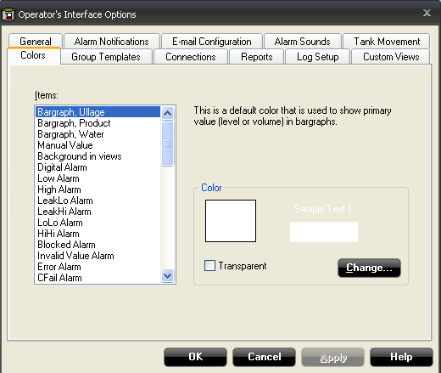
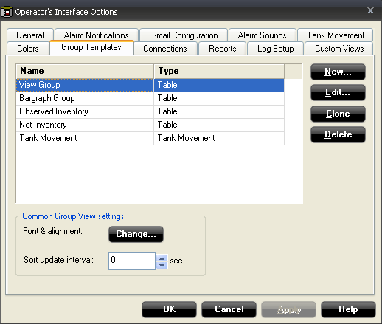
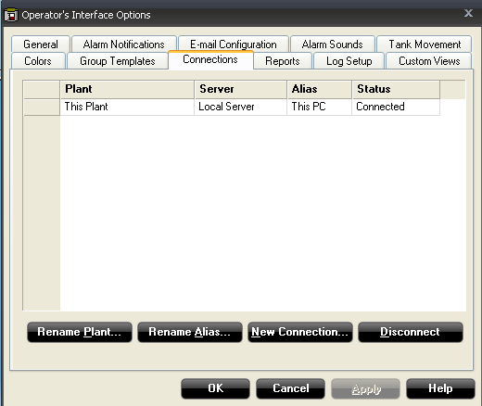
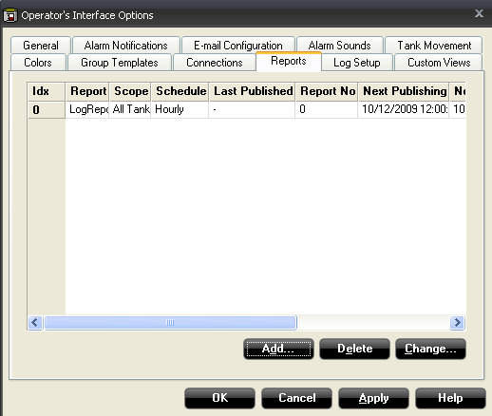
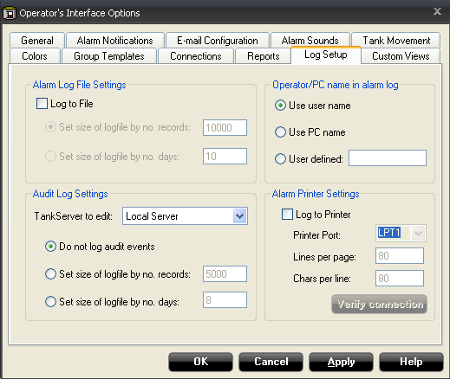
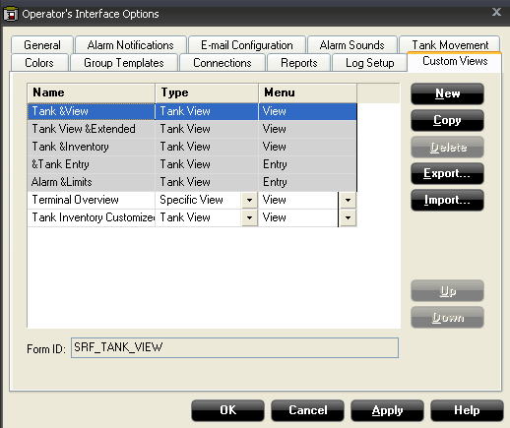
WinOpi Options
Colors
Group templates
Edit group views
Connections
Handle network connections
Reports
Config Reports
Log Setup
Alarm Log
Audig Log
Custom Views
Modify existing windows
Create new windows
Visual Basic

Slide 25
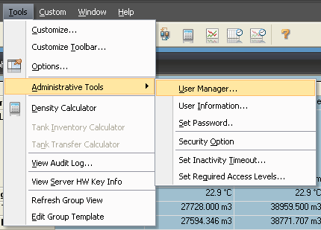
Administrative tools
User Manager
Manage user accounts
User Information
See info about logged in user
Set Password
Change password for current user
Sequrity Options
Run WinOpi maximized
Not possible to change between programs
Set inactivity timeout
Auto logout of user
Set required access level
Alarm handling
Group handling
Exit WinOpi etc

Slide 26
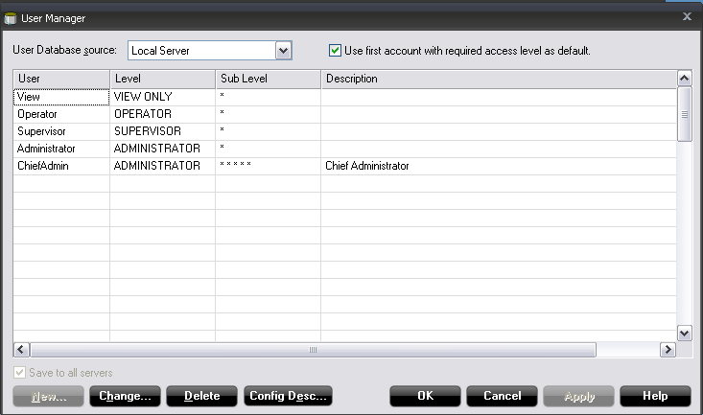
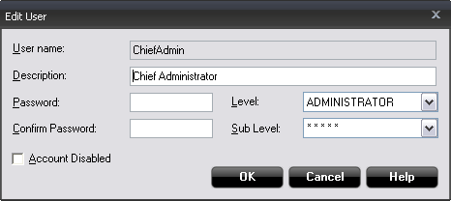
User manager
Handles user accounts
Different access rights per user
5 access levels
5 access sublevels
Different access levels for each window
Account automatically disabled if failed to log in 6 times
Administrator account cannot be disabled
Notes:
TankMaster provides several protection levels allowing you to prevent
unauthorized changes. These protection levels are categorized as User
Access Levels and User Sub Access Levels.
The User Access Levels are Chief Administrator, Administrator, Supervisor,
Operator, and View Only. Each user access level has five User Sub Access
Levels providing a total of 25 unique access levels.
In order to change tank and device configuration, install new tanks and
devices, calibrate a level gauge, change holding register values etc. you have
to be logged on to the appropriate TankMaster user access level.
You can be logged on in Chief Administrator, Administrator, Supervisor,
Operator, or View Only mode.

Slide 27

Hardware Key Info

Slide 28

TankMaster backup – When?
Backup of TankMaster is done from administrator program
Important to do after finished installation of TankMaster
Should be done when changes has been done in the system
Note! Configuration in gauges will not be included in backup. This has to be done by saving holding registers to a file

Slide 29
TankMaster backup – on what?
Tank Server
Installed devices
Tanks
Strapping tables etc
Historical data
Sampled data
WinOpi
Custom views
Product table
WinSetup
Protocol and port settings
Register key for TankMaster
Windows register for TM installation

Slide 30


TankMaster backup – How?
Make sure TankMaster is running
Specify a folder to save backup in
A Pop-up message will let you know when backup is done

Slide 31


Tank Master – Restore Backup

Slide 32


Tank Master – Restore Backup

Slide 33


Tank Master – Restore Backup

Slide 34

Tank Master – Restore Backup

Slide 35
TankMaster – Backup/Restore
To do a backup, copy the following folders
..\server\data
..\opi\data
..\setup\data
To restore a backup
Make sure TankMaster is NOT running
Copy data in backup folder into correct folder in TankMaster installation directory
..\backup\server\data → ..\rosemount\server\data
..\backup\opi\data → ..\rosemount\opi\data
..\backup\setup\data → ..\rosemount\setup\data
Start TankMaster

