Slide 1


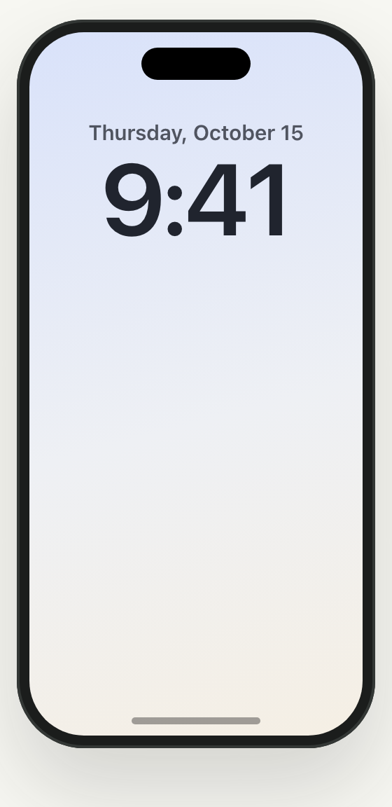



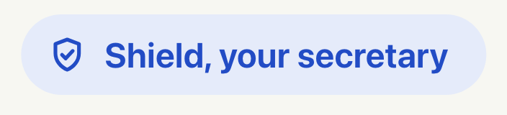
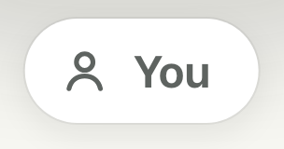
Notes:
Meet your secretary. Advance with → or a clicker.
then: Title
then: The secretary at her desk
then: Caller and your phone
then: Phone lines and labels

Slide 2
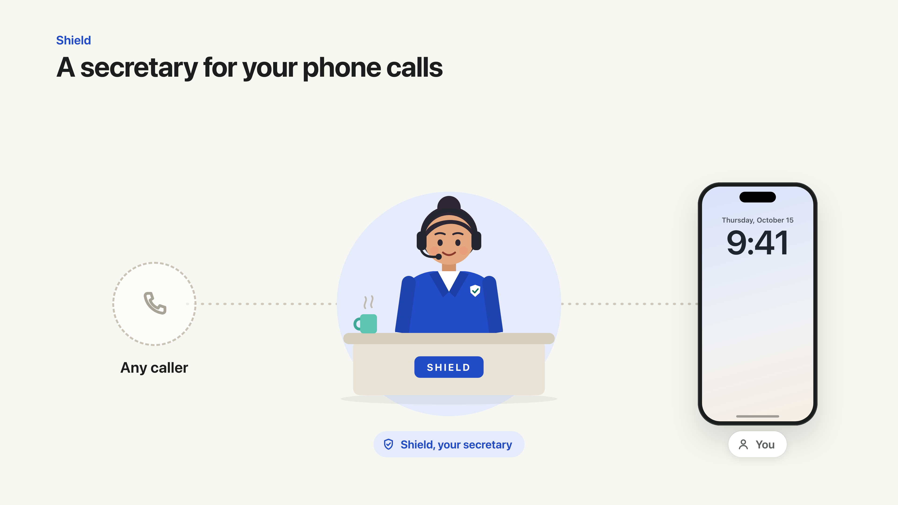
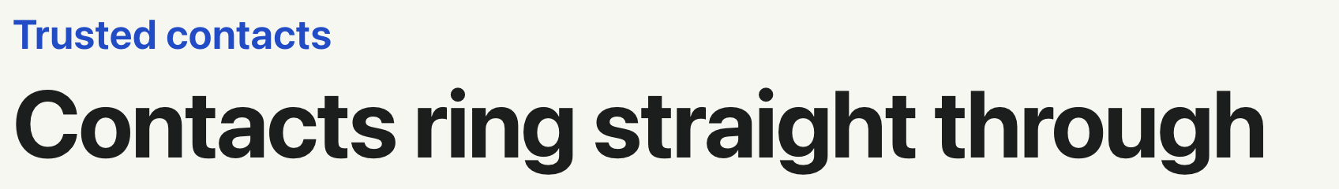


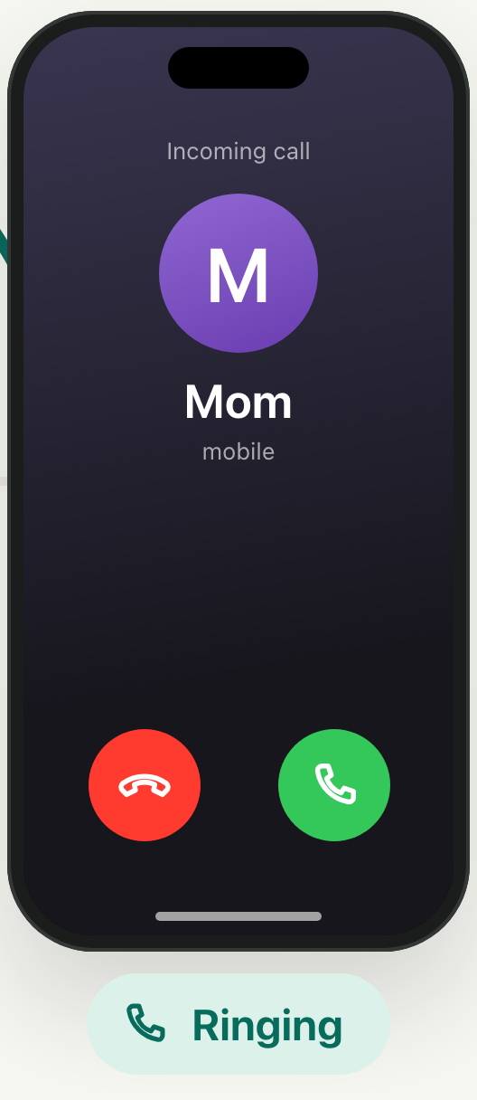
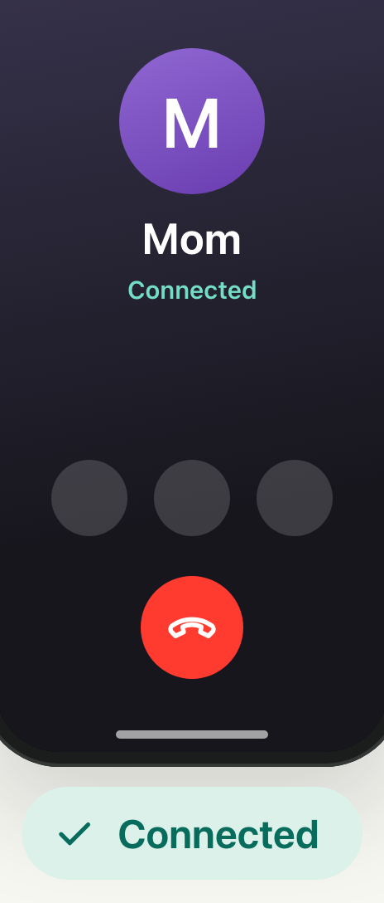



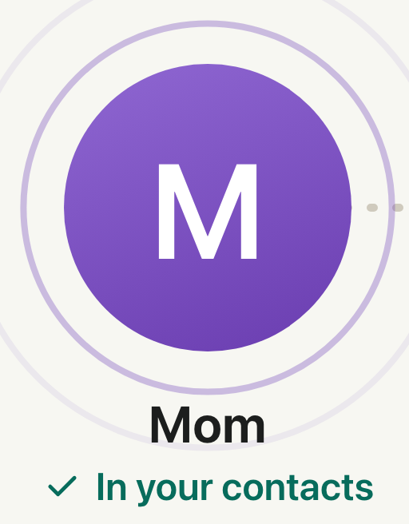

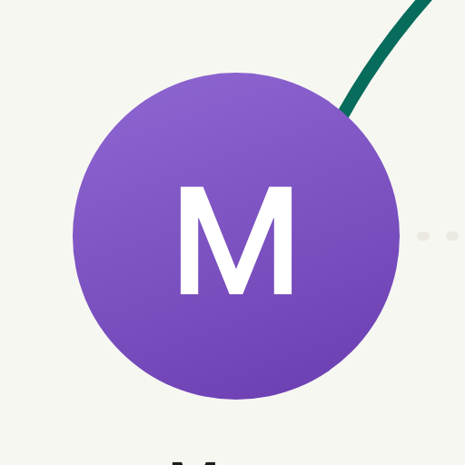



Notes:
Contacts ring straight through. Advance with → or a clicker.
Click 1: Mom calls
then: Secretary takes her headset off: not listening
then: Call skips the secretary
then: Call skips the secretary
then: Your phone rings
Click 2: You answer

Slide 3
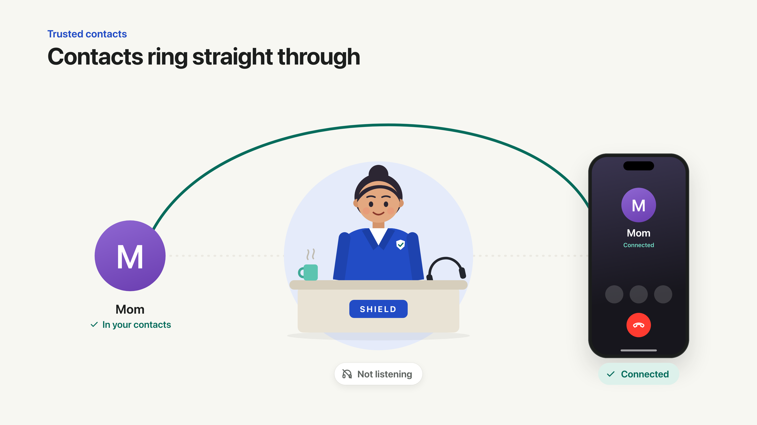


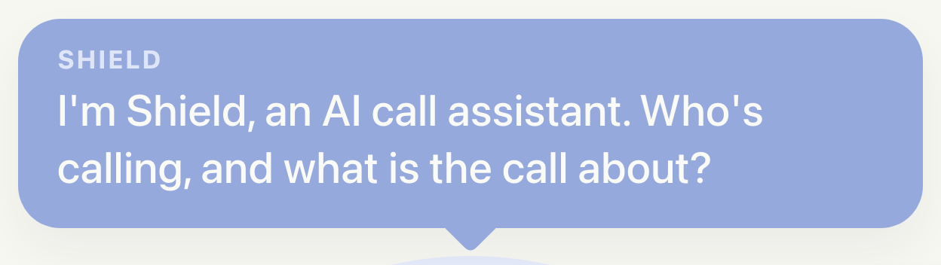
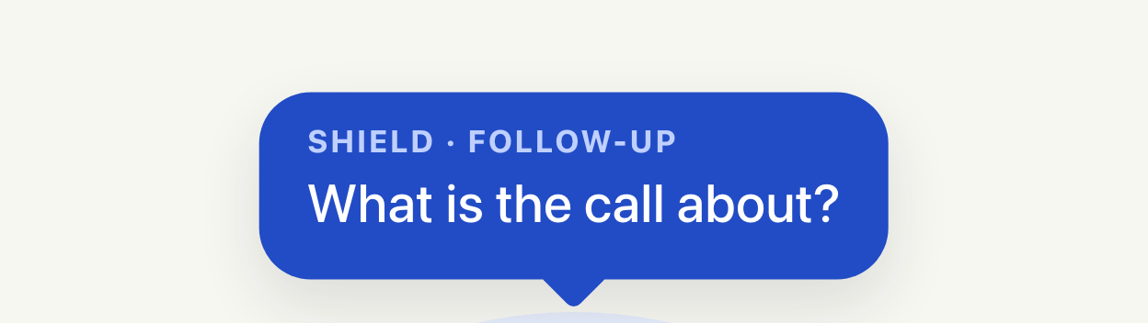
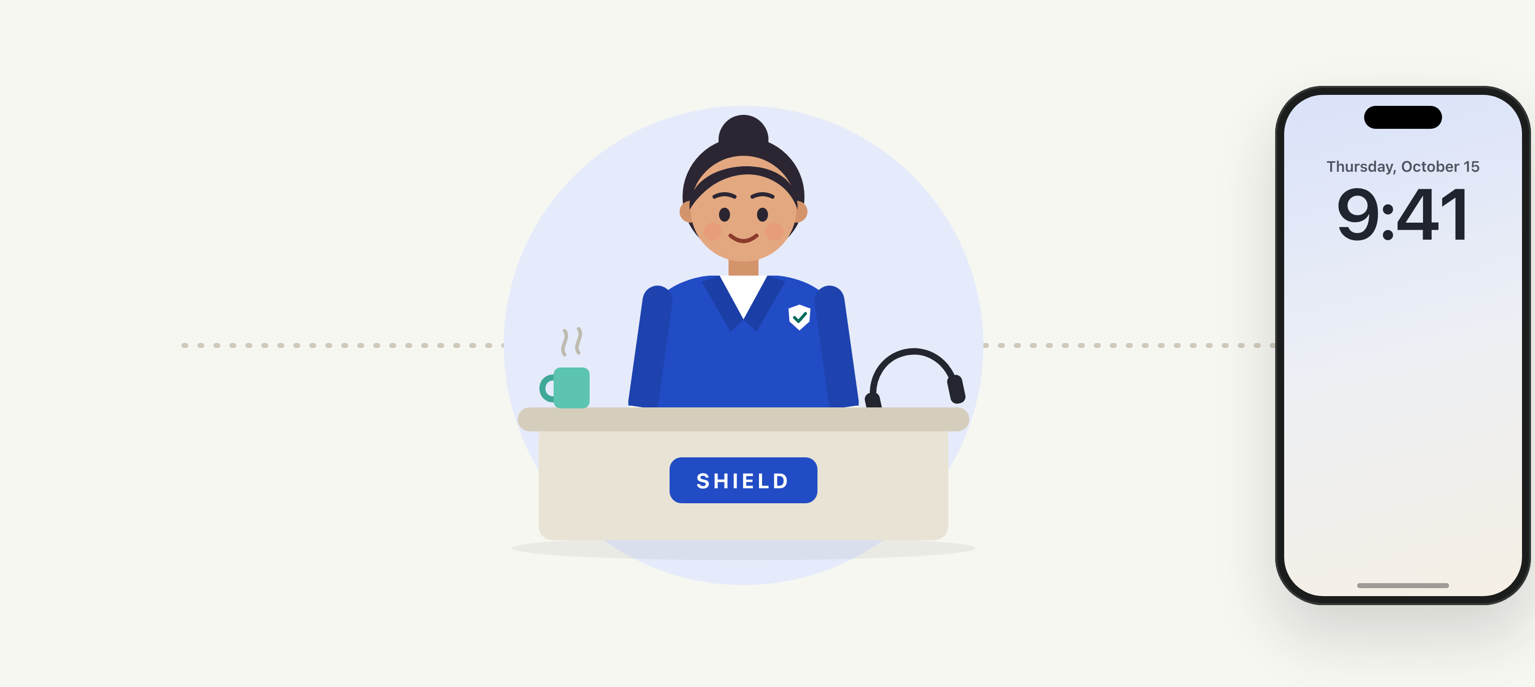
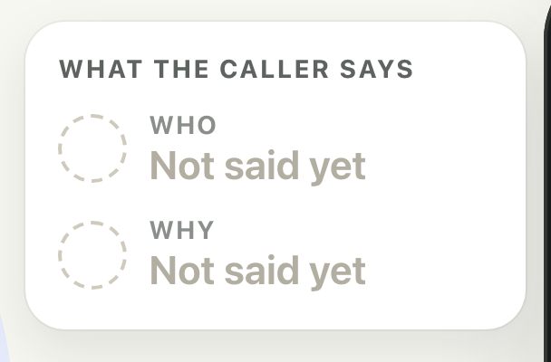
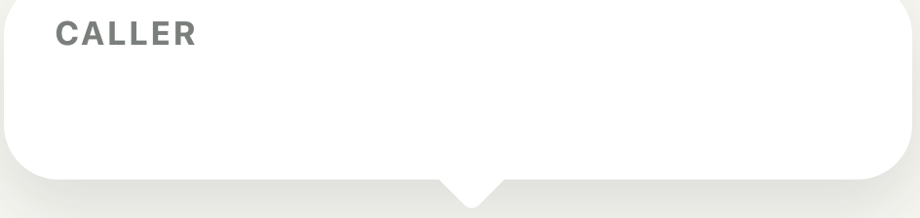
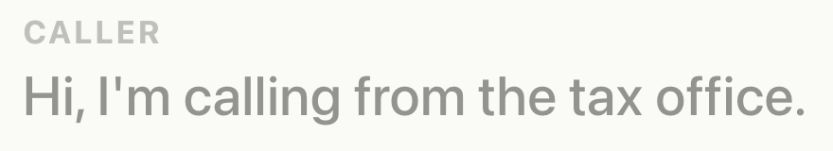


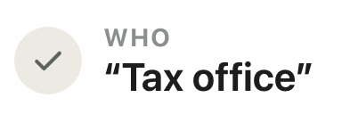
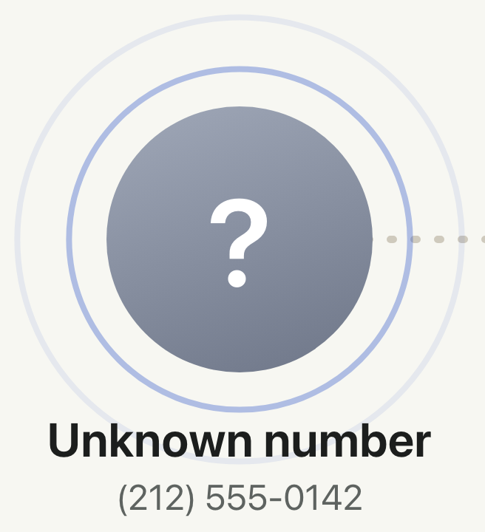
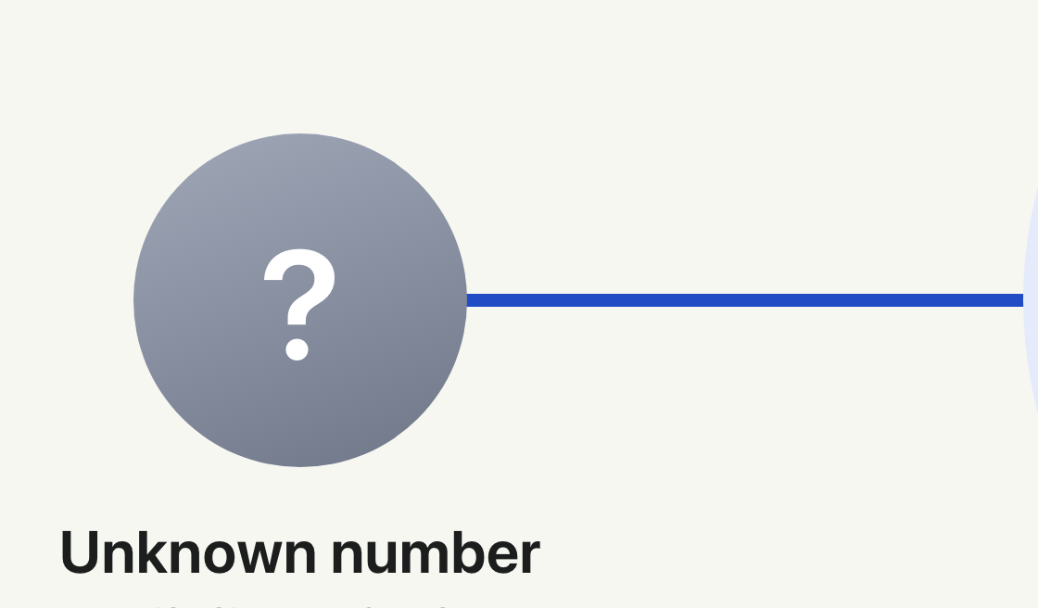

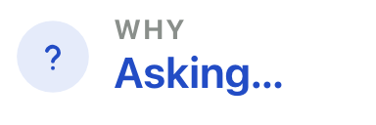

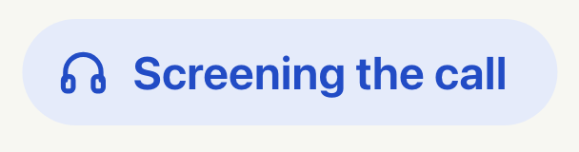
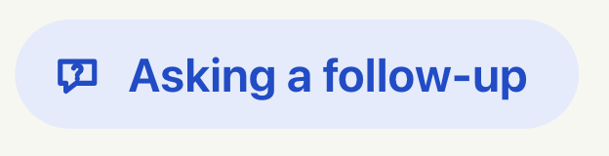
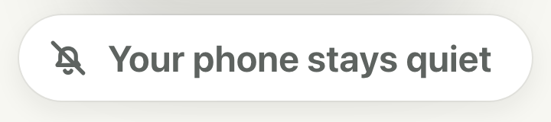
Notes:
Shield questions unknown callers first. Advance with → or a clicker.
Click 1: Unknown number calls; secretary puts her headset on
then: Call reaches the secretary
then: Screening starts; your phone stays quiet
then: Shield asks who is calling and why
Click 2: Caller: "the tax office"
then: Who: noted
Click 3: Why is missing, so Shield asks a follow-up

Slide 4
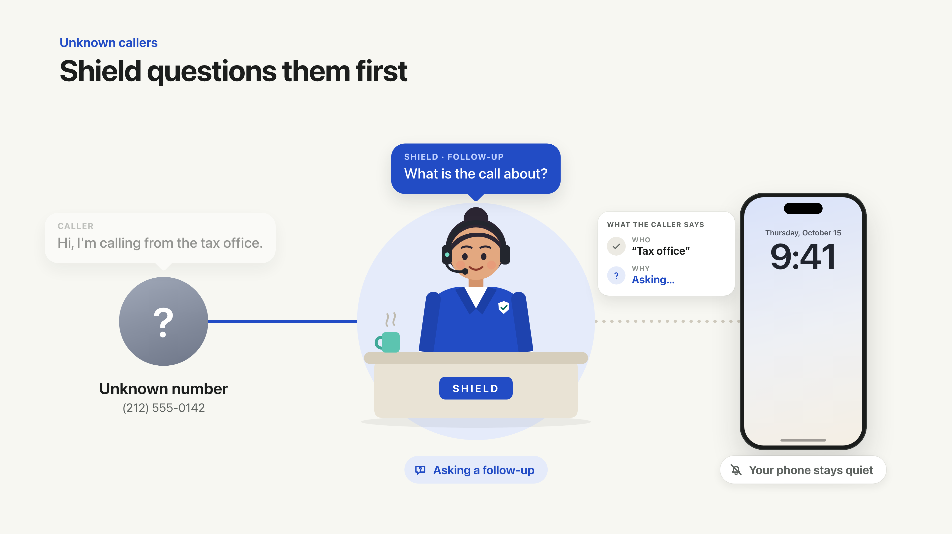
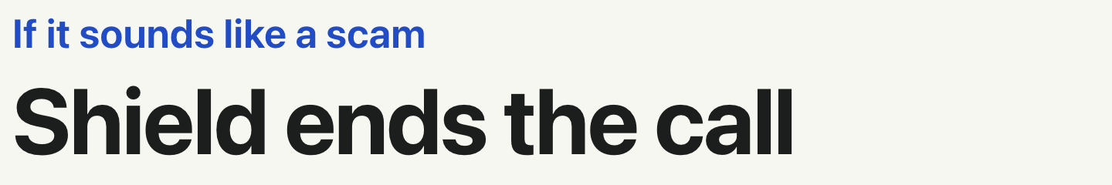
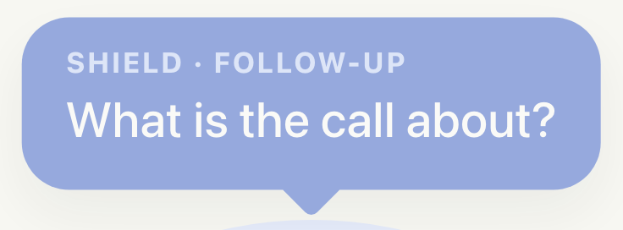

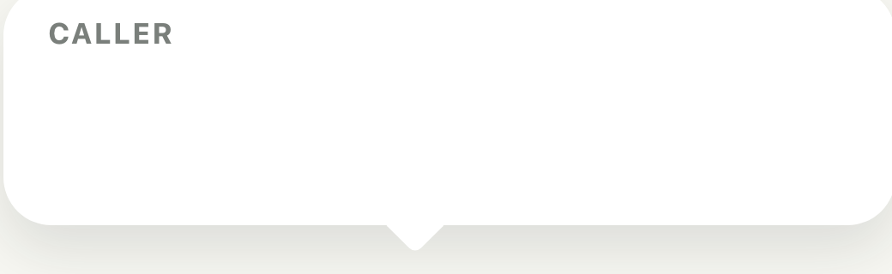

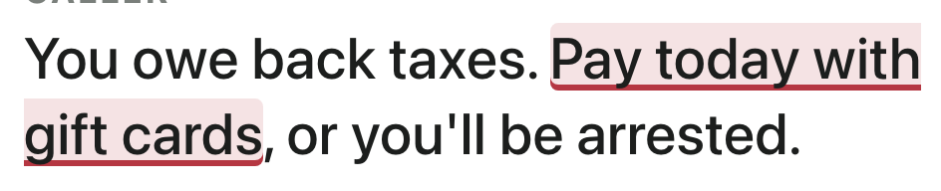


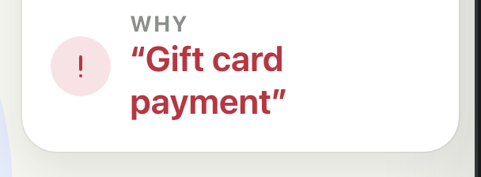
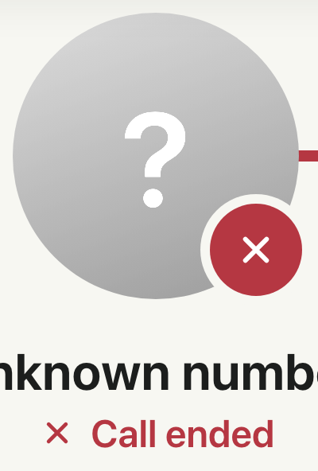
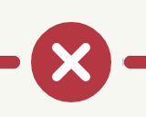


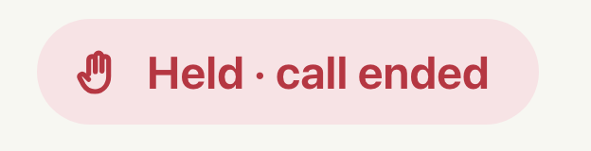
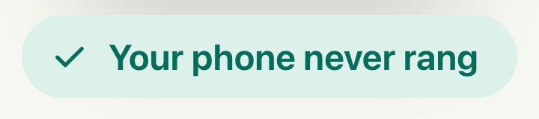
Notes:
Scam calls end with Shield. Advance with → or a clicker.
Click 1: Caller demands gift cards
then: The reason is flagged
then: Secretary raises a hand
then: Line is cut
then: Line is cut
then: Call ended
then: Held; your phone never rang
then: Secretary lowers her hand

Slide 5
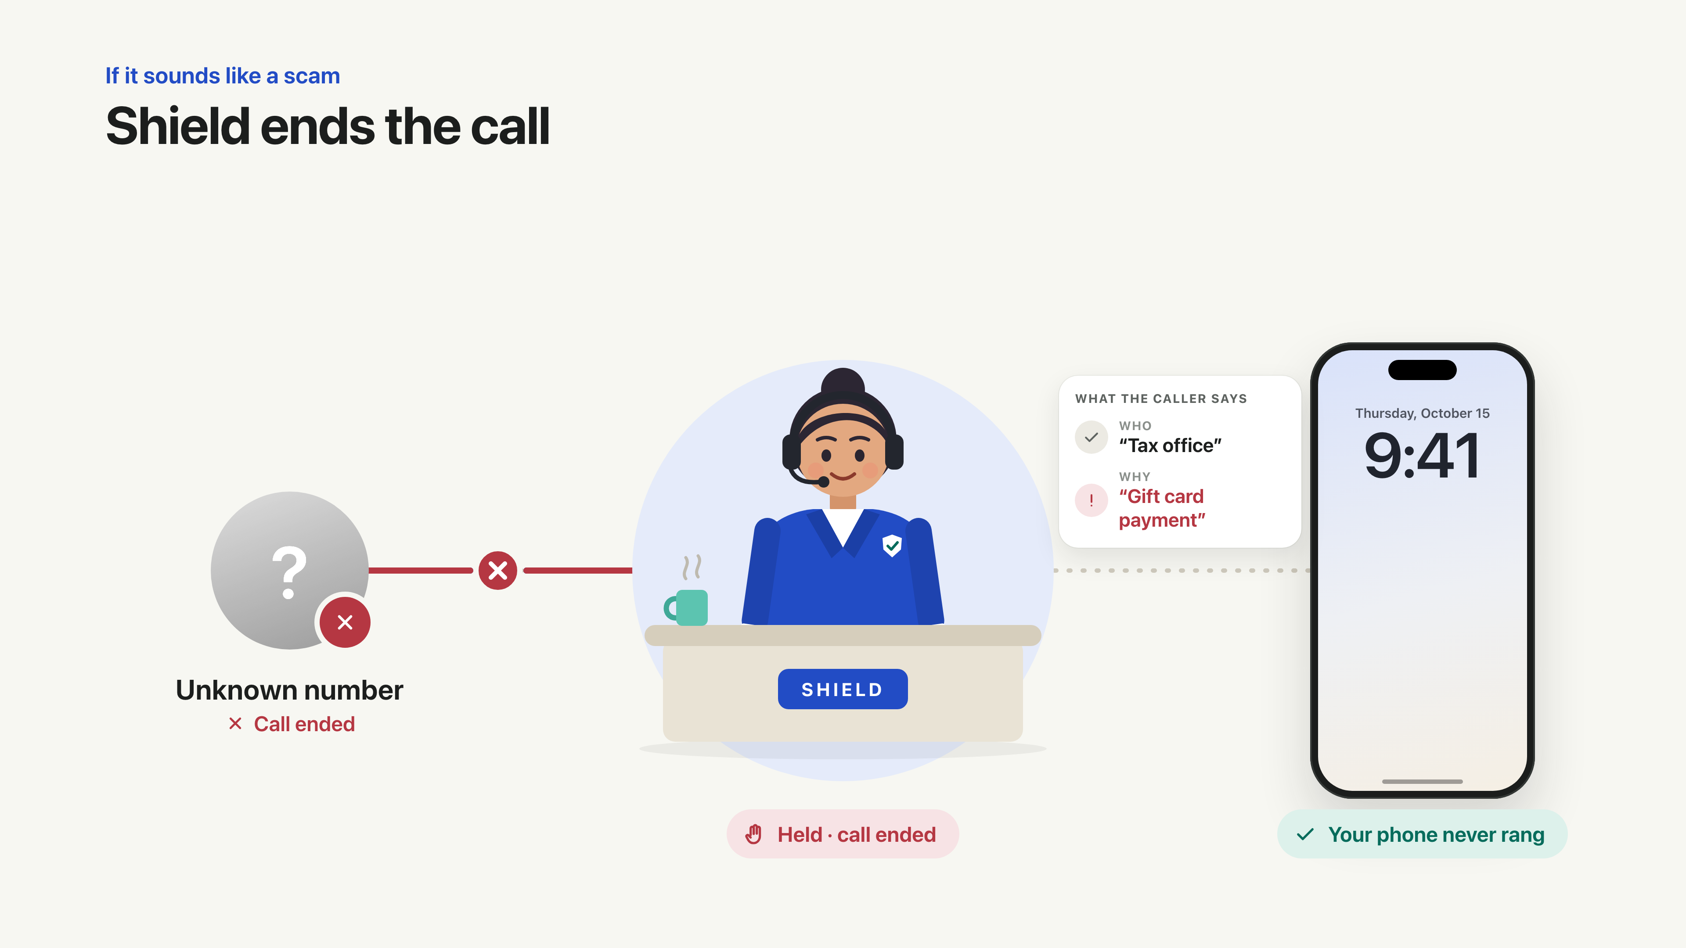
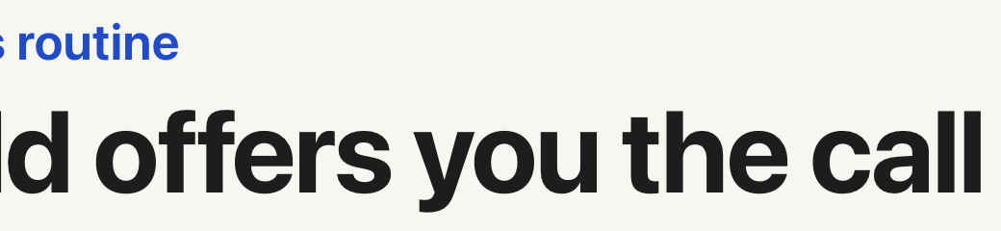
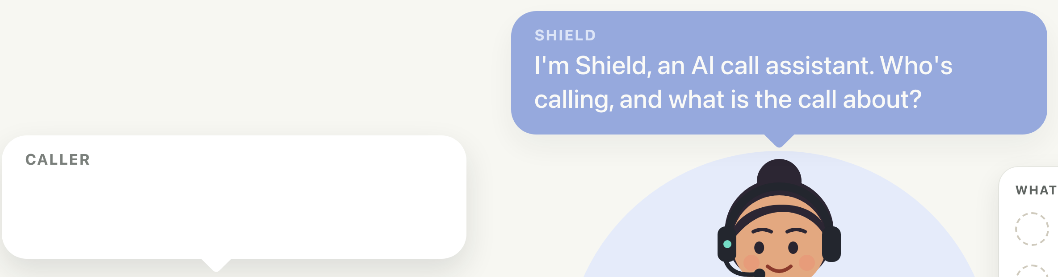
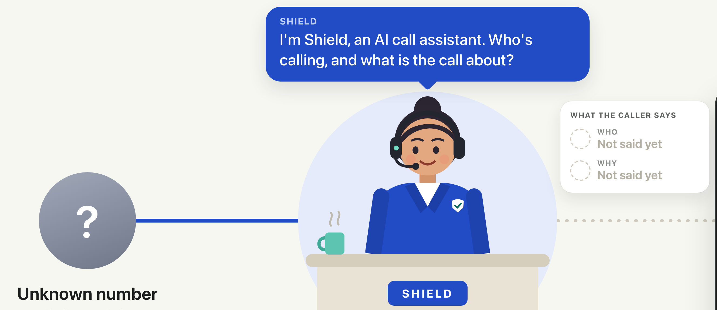
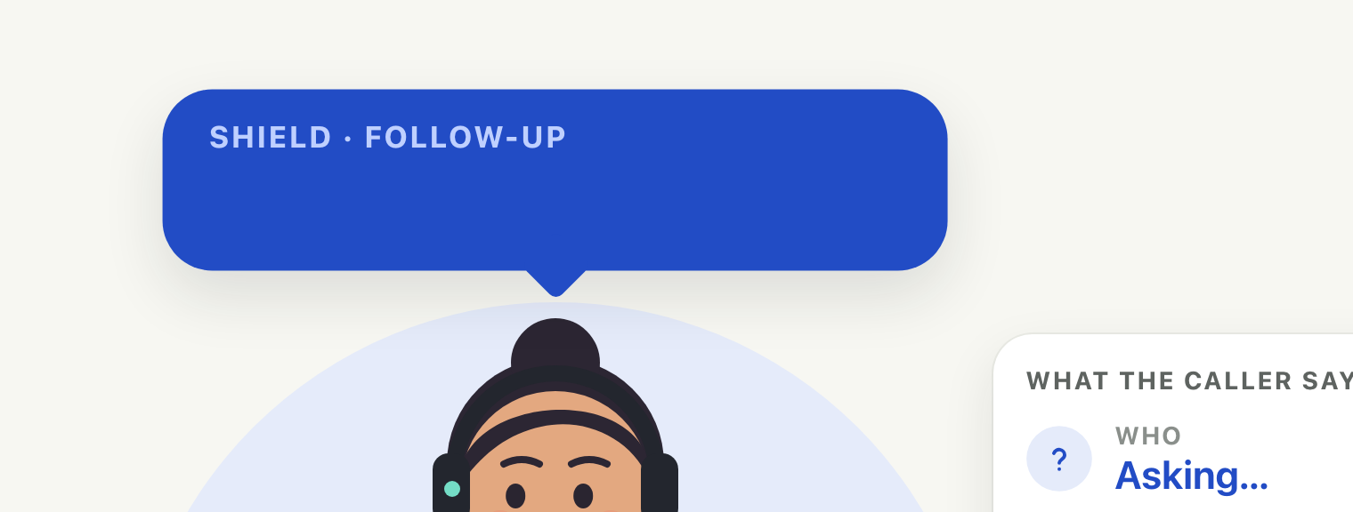
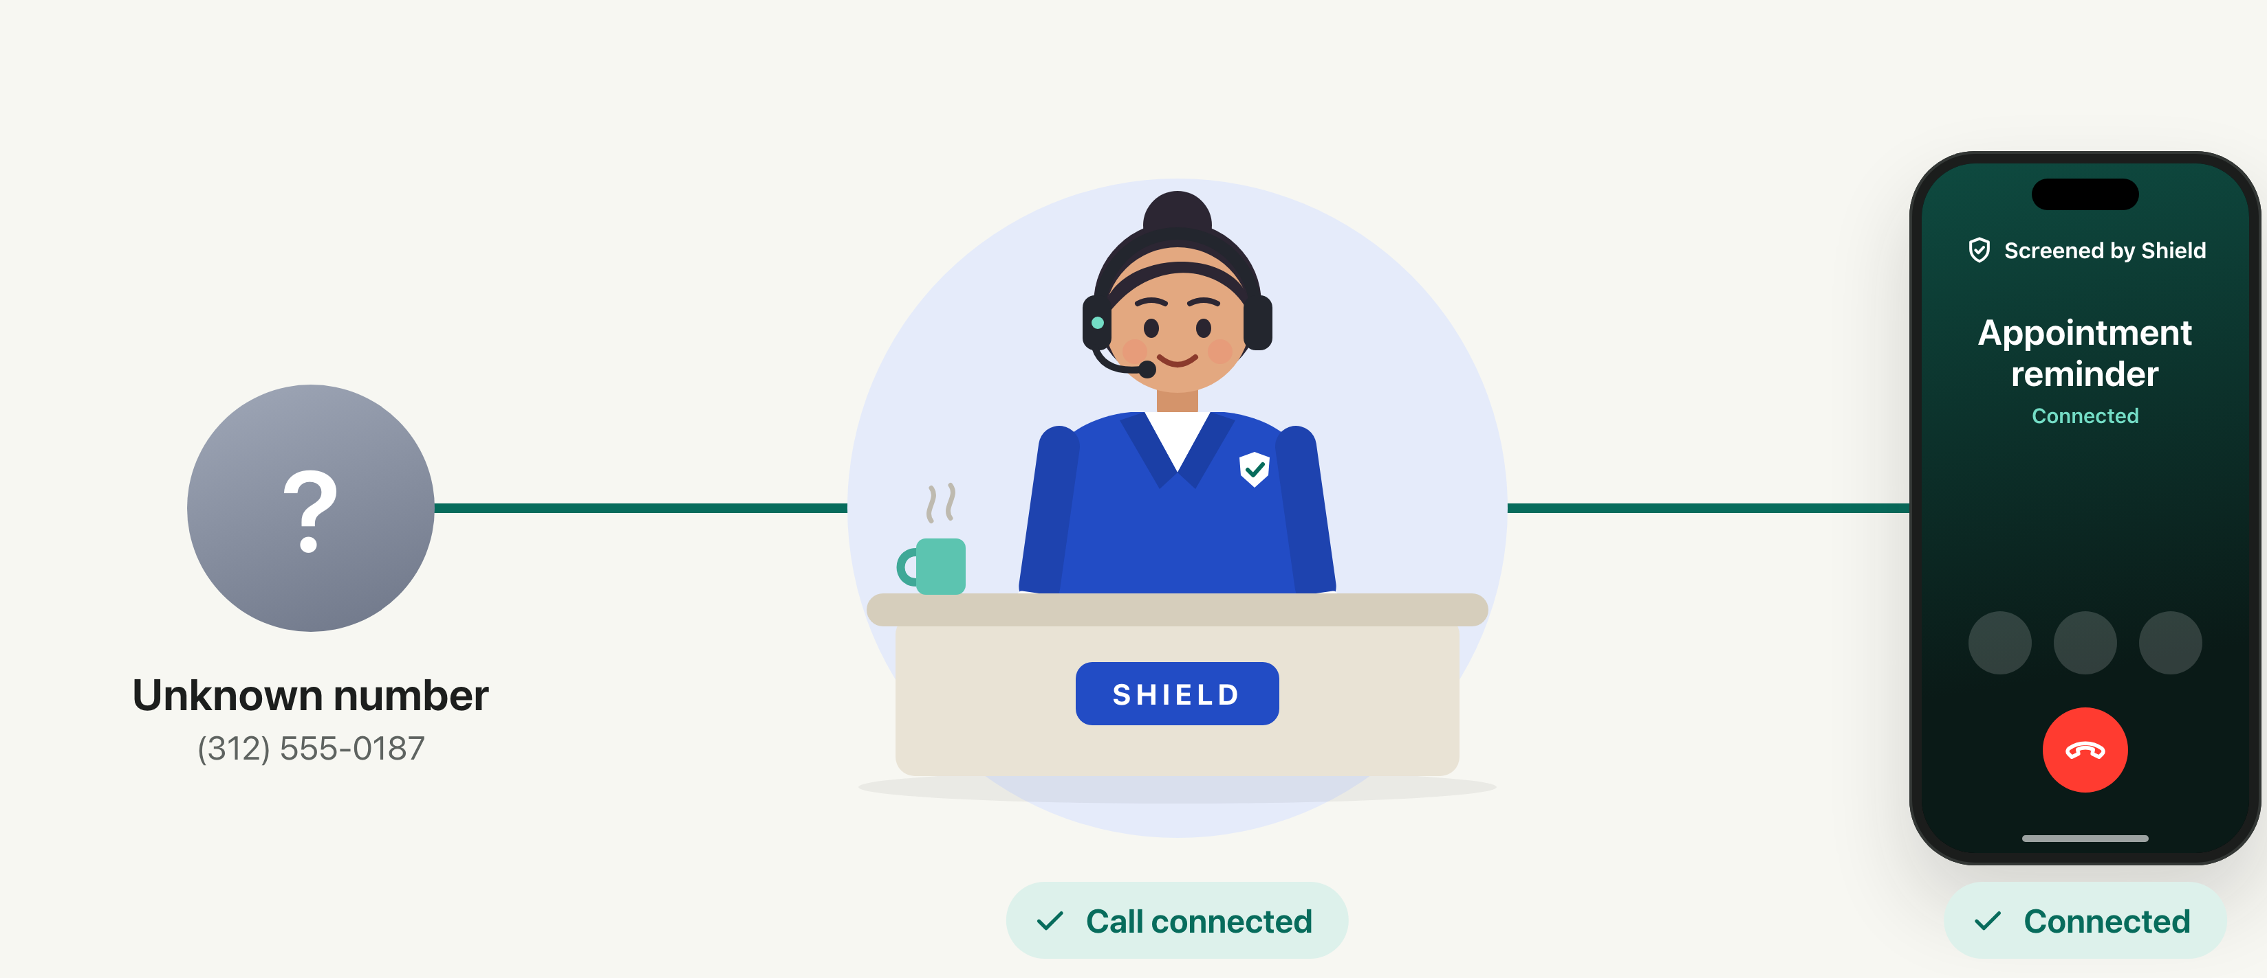

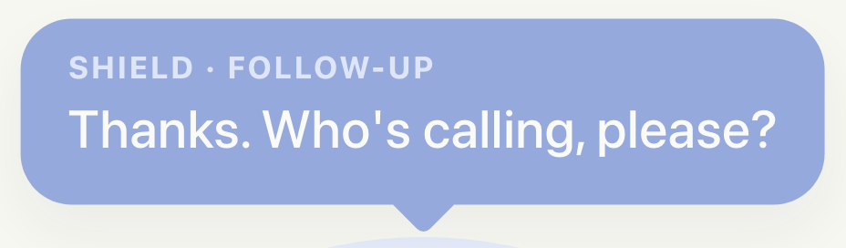
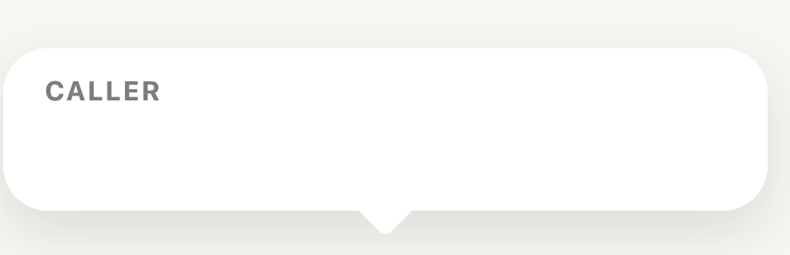
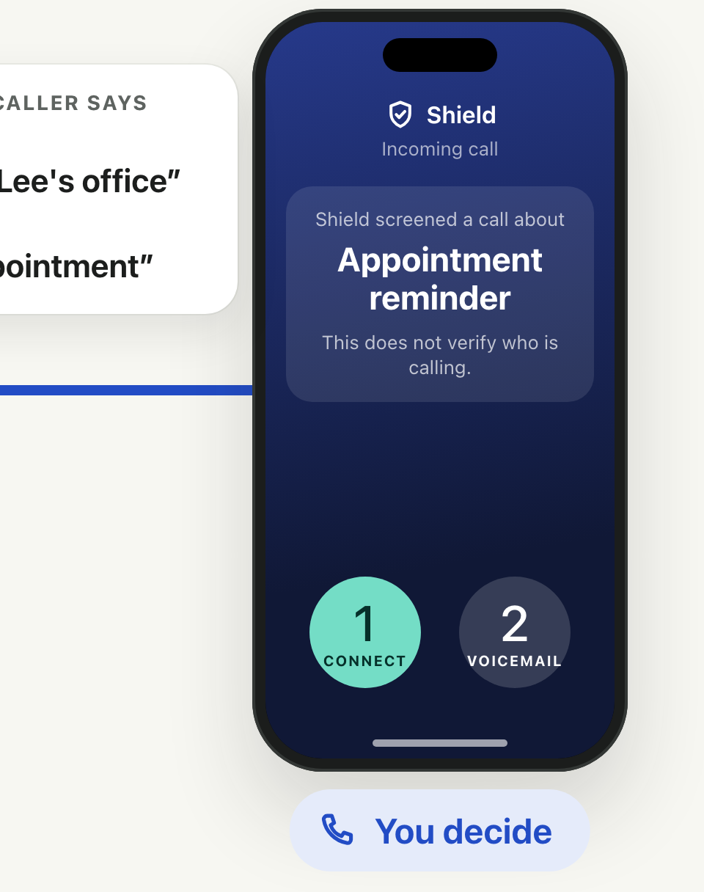
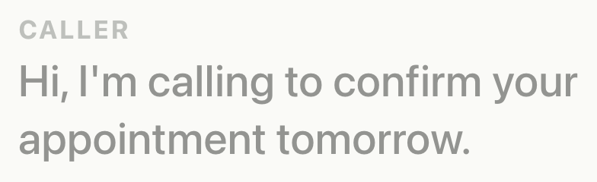

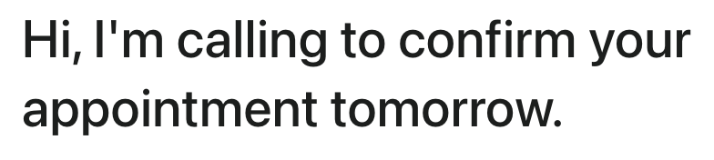
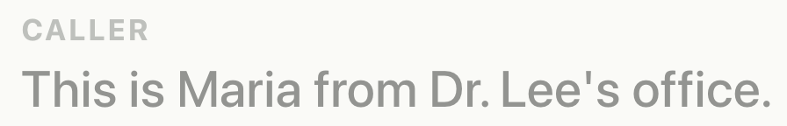
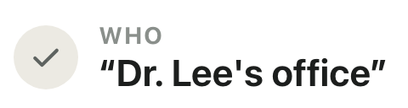
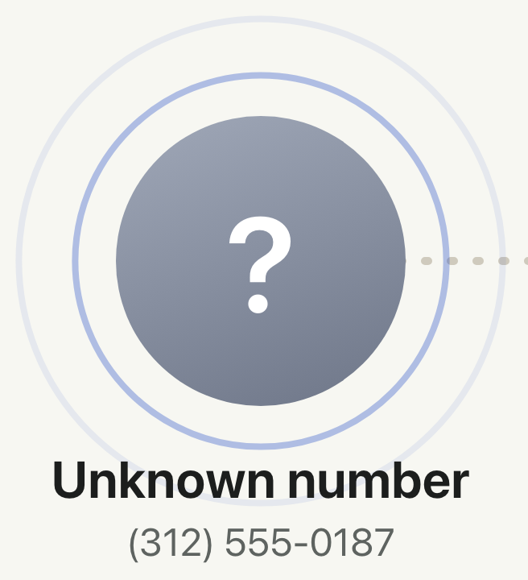

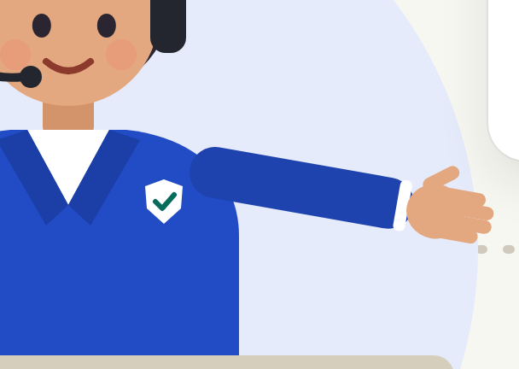
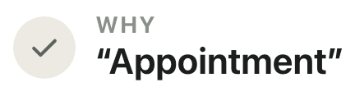




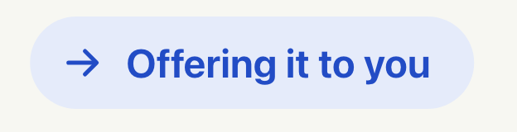


Notes:
Routine calls are offered to you. Advance with → or a clicker.
Click 1: Another unknown number calls
then: Call reaches the secretary
then: Shield asks who is calling and why
Click 2: Caller gives a reason but no name
then: Why: noted
Click 3: Shield asks a follow-up: who is calling?
Click 4: Caller: "Maria from Dr. Lee's office"
then: Who: noted
Click 5: Shield: "Please hold while Shield offers your call."
then: Secretary passes it to you
then: Call goes to your phone
then: Your phone shows the summary: you decide
then: Secretary lowers her arm
Click 6: You press 1
then: Connected

Slide 6




















Notes:
Shield stays on the line. Advance with → or a clicker.
then: Shield keeps listening (optional feature note)
Click 1: Caller: "You're all set for 10 a.m."
then: You: "Perfect, thank you!"
Click 2: Caller asks for the texted code
then: The request is flagged
then: Secretary steps in
then: Line is cut
then: Call ended; Shield warns you
then: Your phone shows why
then: Code kept private

