Slide 1
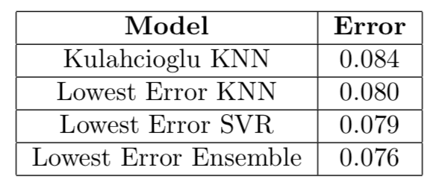
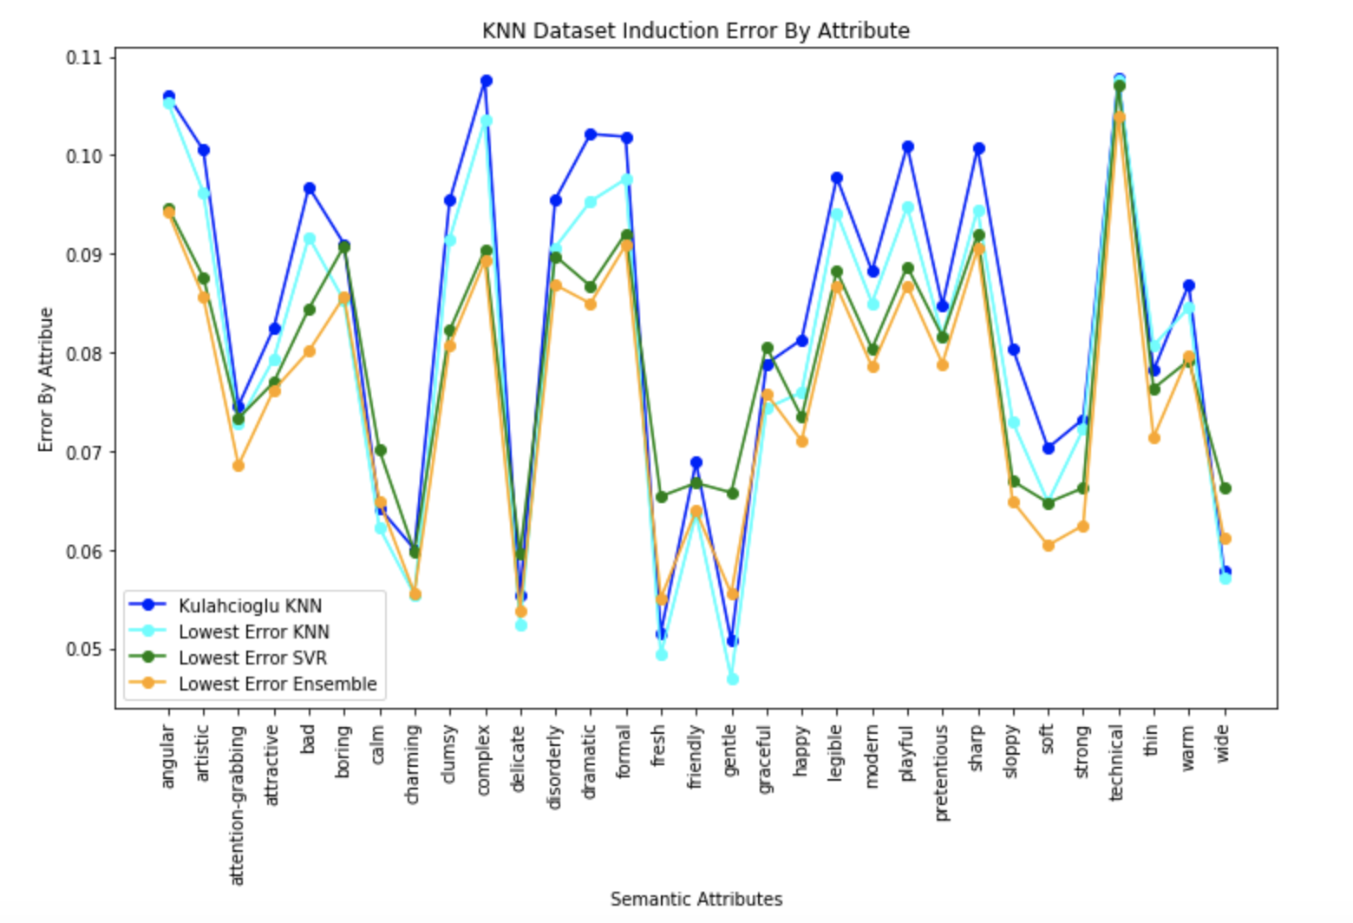
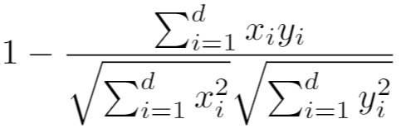
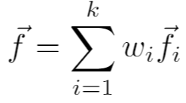
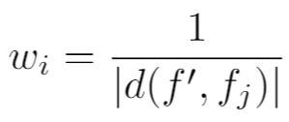
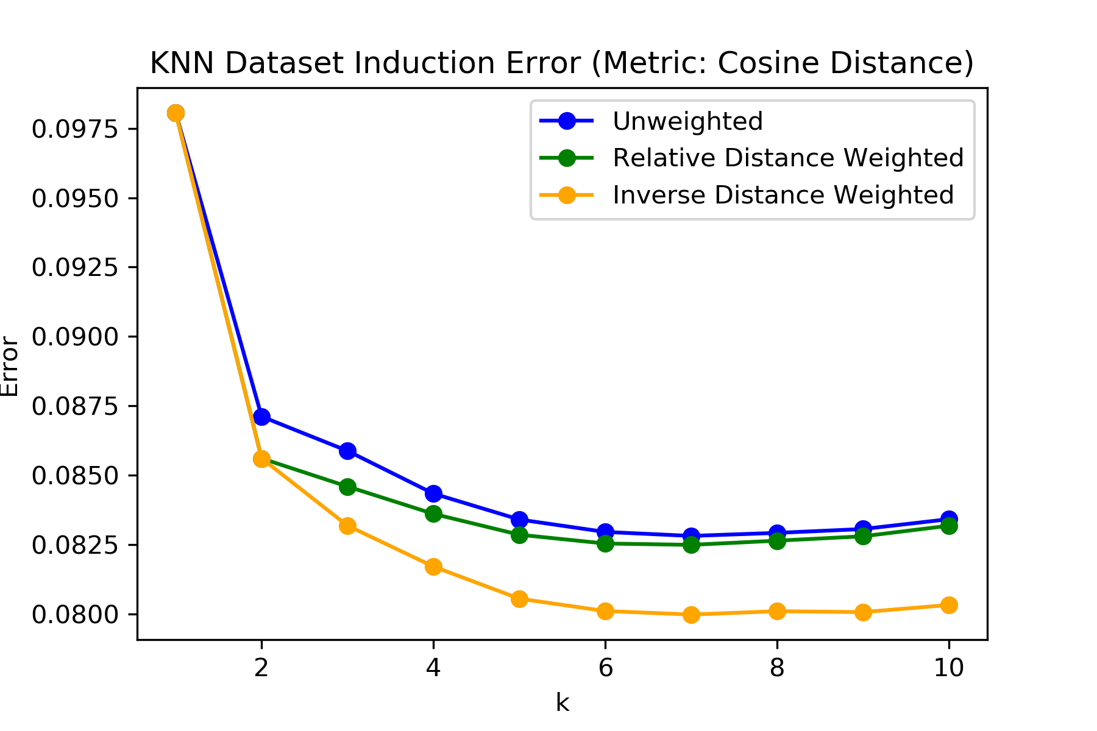
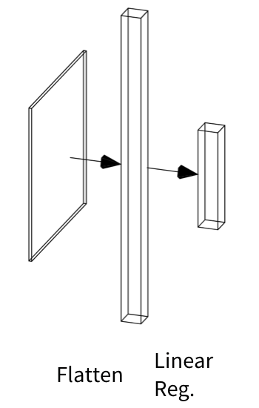
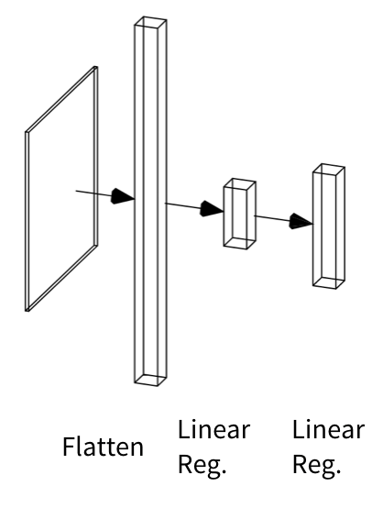
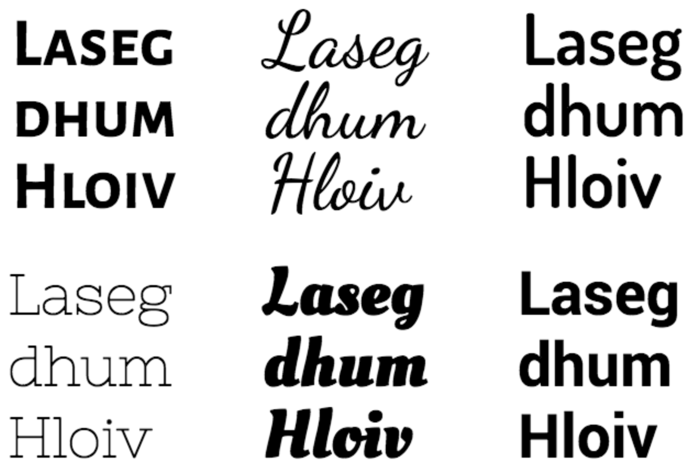
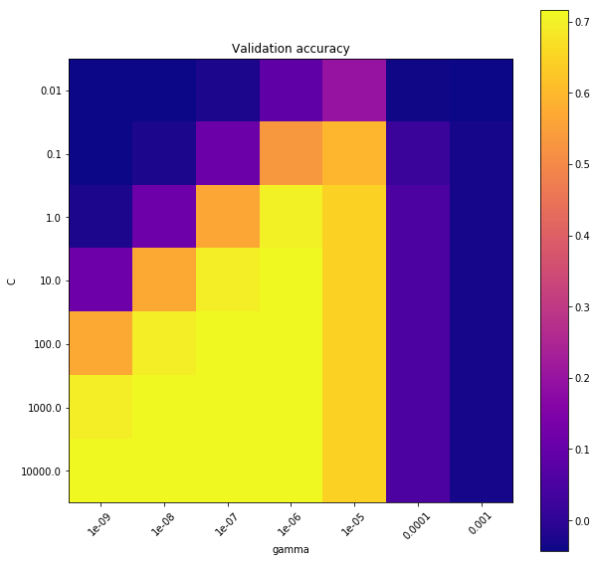
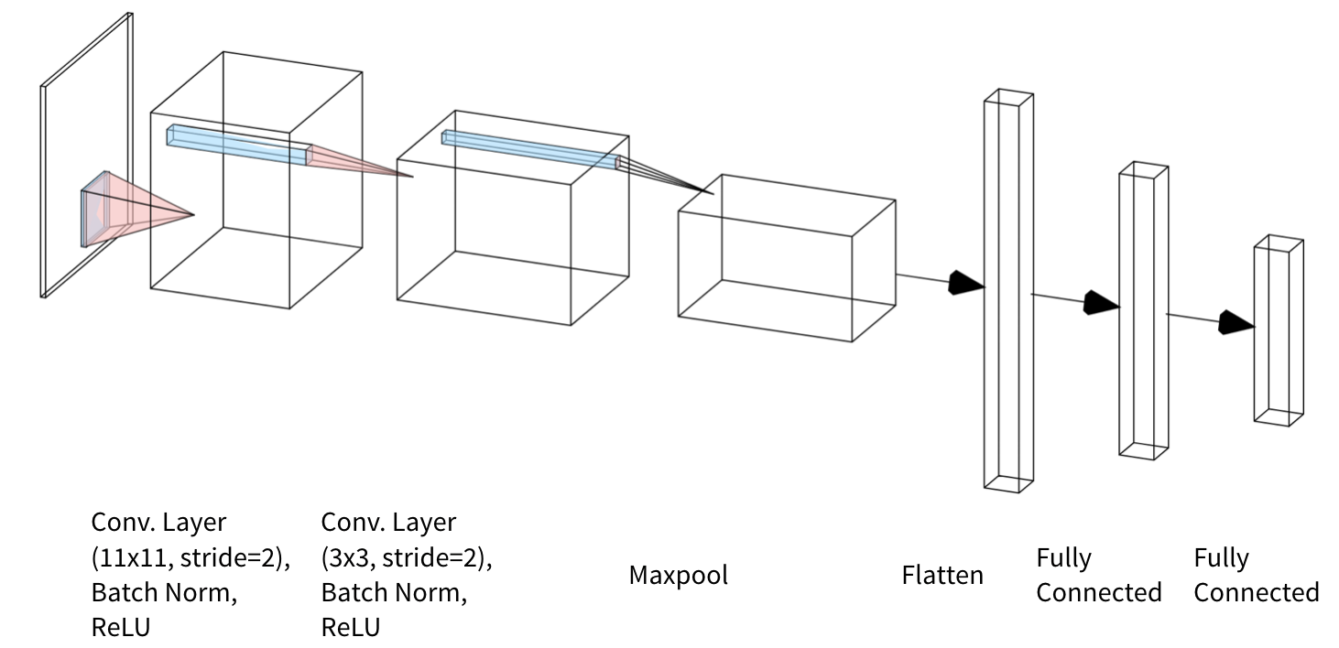
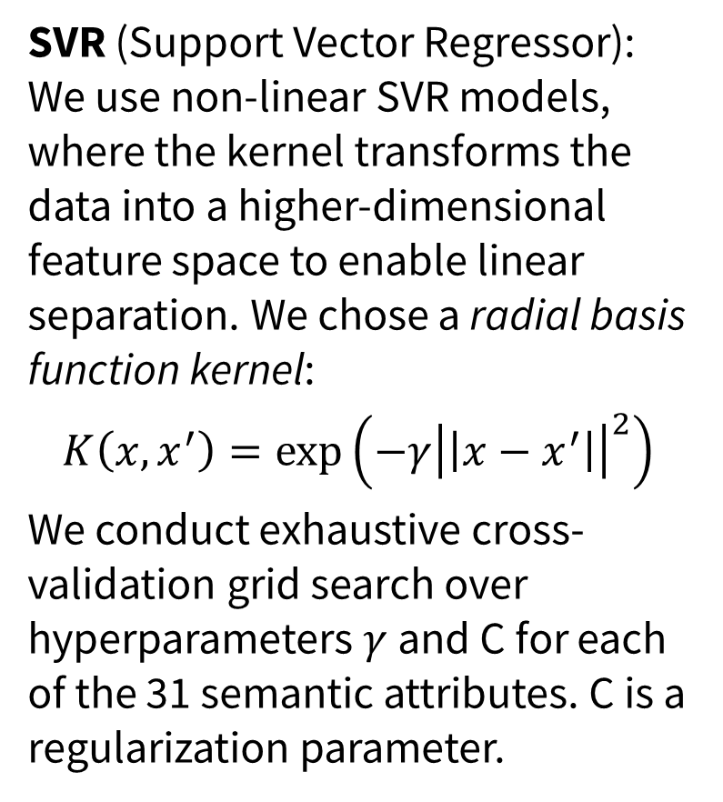
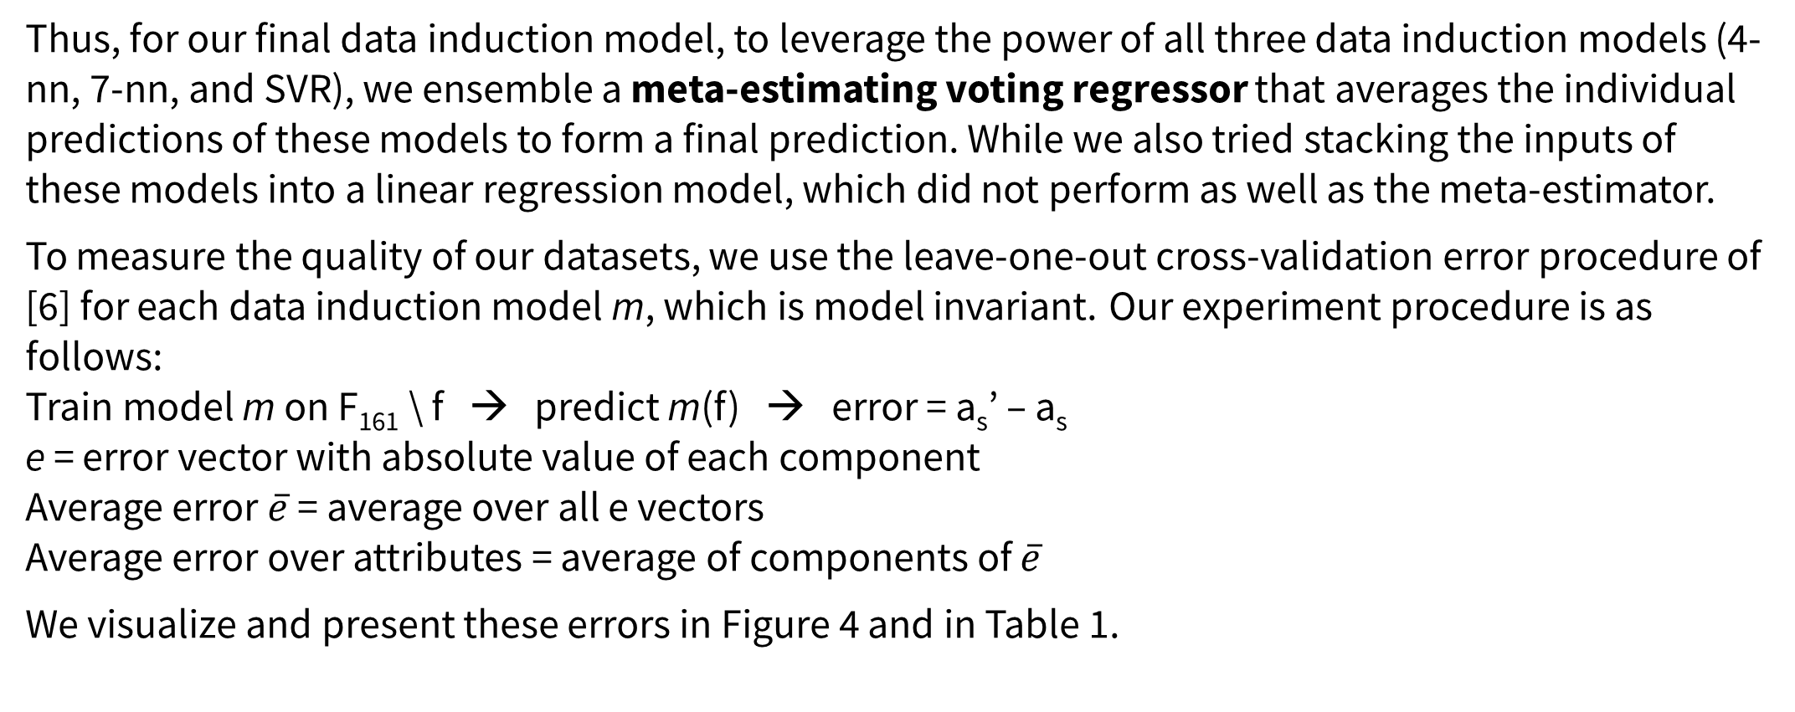
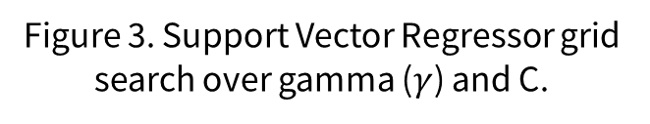
Typeface Semantic Attribute Prediction from Rasterized and Vectorized Font Representations Suvir Mirchandani Lucia Zheng Julia Gong {smirchan, zlucia, jxgong}@stanford.edu
Motivation and Problem
Method: Semantic Attribute Induction
Ensemble Inducted Dataset and Results
Characterizing attributes of typefaces is of interest for font search, selection, and pairing.
Related work has used deep networks for typeface generation or grouped typefaces using font styles (e.g. ‘bold’, ‘italic’) or typographic attributes (e.g. ‘serif’, ‘all-capitals’) [1, 2, 4, 5, 7], which is less interpretable and meaningful.
Recent work [6] has introduced human-labeled semantic attributes for 200 typefaces, such as ‘artistic’, ‘playful’, and ‘boring’.
Machine learning can be applied to semantic attribute regression to generalize these human annotations to unseen typefaces.
We improve on [3] in inducing a semantic attribute dataset for 1861 typefaces from the dataset of 200 in [6] and introduce a novel downstream task: semantic attribute prediction.
NOTATION
F = set of all 1883 FontJoy embedding vectors
F₁₆₁ = embedding vectors from FontJoy with known semantic attribute labels from O’Donovan (intersection of [3, 6] dataset)
f = font embedding vector from FontJoy CNN
a_{s} = predicted 31-dimensional semantic attribute vector
a_{s}’ = ground truth 31-dimensional semantic attribute vector
We experiment with different data induction methods by using F₁₆₁ to predict a_{s}’ for each typeface in F.
4-NN: As a baseline, we reproduce the optimal result in [3]. We cluster the F₁₆₁ font embedding vectors and predict a_{s}’ using k = 4, a cosine distance metric, and relative distance weighting.
7-NN: We perform grid search over multiple values of k, three distance metrics (cosine, Manhattan, Euclidean), and weightings (unweighted, inverse distance, relative weighting). We out-perform the model in [6] with k =7, a cosine distance metric, and inverse distance weighting.
Thus, for our final data induction model, to leverage the power of all three data induction models (4-nn, 7-nn, and SVR), we ensemble a meta-estimating voting regressor that averages the individual predictions of these models to form a final prediction. While we also tried stacking the inputs of these models into a linear regression model, which did not perform as well as the meta-estimator.
To measure the quality of our datasets, we use the leave-one-out cross-validation error procedure of [6] for each data induction model m, which is model invariant. Our experiment procedure is as follows:
Train model m on F₁₆₁ \ f → predict m(f) → error = a_{s}’ – a_{s}
e = error vector with absolute value of each component
Average error $\overline{e}$ = average over all e vectors
Average error over attributes = average of components of $\overline{e}$
We visualize and present these errors in Figure 4 and in Table 1.
Semantic Attribute Prediction
Table 1. Data Induction Error for highest-performing models of each category. Kulahcioglu is [3].
Using the induced dataset, we investigated how well models could predict semantic attributes given a typeface. We tested two baseline models:
1-step LR (*): Linear regression model with rasterized image input of a collection of visually distinct glyphs
2-step LR (**): Sequentially predict typographic attribute vector from rasterized image input with linear regression, and then predict semantic attributes using linear regression
We also created and tested a Convolutional Neural Network model (***) with two convolutional layers, which outperformed these baselines.
Dataset and Task Formulation
Cosine distance metric, k-NN weighting of nearest neighbors f_{i}, and inverse distance weighting
Input: human-labeled 31-dimensional real-valued semantic attribute vectors with entries in [0, 1] for 200 typefaces (e.g. ‘Source Sans Pro Semibold’) as part of the semantic attribute dataset in [6]; FontJoy¹ embeddings for 1861 typefaces to be utilized for dataset induction.
Task: induce corresponding 31-D semantic attribute vectors for all 1861 FontJoy typefaces.
Figure 2. Dataset induction error for all k-NN experiments using the cosine distance for each of the three nearest neighbor weighting schemes across values of k.
The inverse distance metric performs the best across the board and performs best at k = 7.
^{(*)}
^{(**)}
Figure 4. Dataset Induction Error of each model for each of the 31 semantic attributes. The ensemble performs best overall.
References
SVR (Support Vector Regressor): We use non-linear SVR models, where the kernel transforms the data into a higher-dimensional feature space to enable linear separation. We chose a radial basis function kernel:
$$K\left(x,x^{′}\right)=\exp\left(−γ{\left|\left|x−x^{′}\right|\right|}^{2}\right)$$
We conduct exhaustive cross-validation grid search over hyperparameters $γ$ and C for each of the 31 semantic attributes. C is a regularization parameter.
^{(***)}
[1] Avilés-Cruz, C., Villegas, J., Arechiga-Martínez, R., and Escarela-Perez, R. Unsupervised font clustering using stochastic version of the em algorithm and global texture analysis. In Sanfeliu, A., Martínez Trinidad, J. F., and Carrasco Ochoa, J. A. (eds.), Progress in Pattern Recognition, Image Analysis and Applications, pp. 275–286, Berlin, Heidelberg, 2004. Springer Berlin Heidelberg. ISBN 978-3-540-30463-0.
[2] Azadi, S., Fisher, M., Kim, V. G., Wang, Z., Shechtman, E., and Darrell, T. Multi-content GAN for few-shot fontstyle transfer. CoRR, abs/1712.00516, 2017. URL http://arxiv.org/abs/1712.00516.
[3] Kulahcioglu, T. and de Melo, G. Predicting semantic signa-tures of fonts. pp. 115–122, 01 2018. doi: 10.1109/ICSC.2018.00025.
[4] Lin, X., Li, J., Zeng, H., and Ji, R. Font generation based on least squares conditional generative adversarial nets. Multimedia Tools Appl., 78(1):783–797, January 2019. ISSN 1380-7501. doi: 10.1007/s11042-017-5457-4. URL https://doi.org/10.1007/s11042-017-5457-4.
[5] Lopes, R. G., Ha, D., Eck, D., and Shlens, J. A learned representation for scalable vector graphics. CoRR, abs/1904.02632, 2019. URL http://arxiv.org/abs/1904.02632.
[6] O’Donovan, P., Libeks, J., Agarwala, A., and Hertzmann, A. Exploratory Font Selection Using Crowdsourced Attributes. ACM Transactions on Graphics (Proc. SIGGRAPH), 33(4), 2014.
[7] Oztürk, S., Sankur, B., and Abak, A. Font clustering and classification in document images. European Signal Processing Conference, 2015, 01 2000.
Future Work
Figure 3. Support Vector Regressor grid search over gamma ($γ$) and C.
We hope to further investigate clustering algorithms, such as spectral clustering, to induce lower-error datasets, as well as create higher-performing models for rasterized and SVG image input for our downstream task.
Figure 1. Examples of the diverse typefaces in the FontJoy dataset.
¹See fontjoy, https://github.com/Jack000/fontjoy

