Slide 1
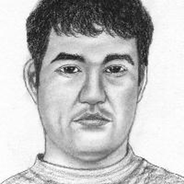
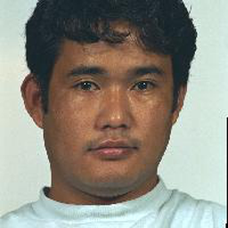
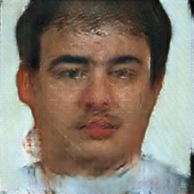
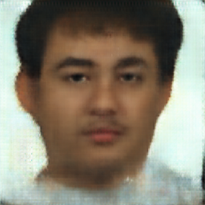
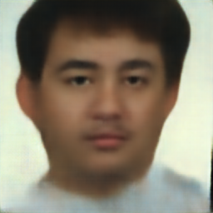
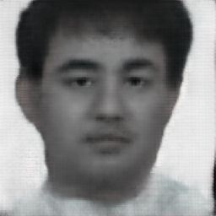
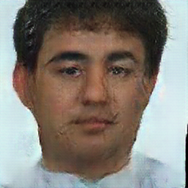
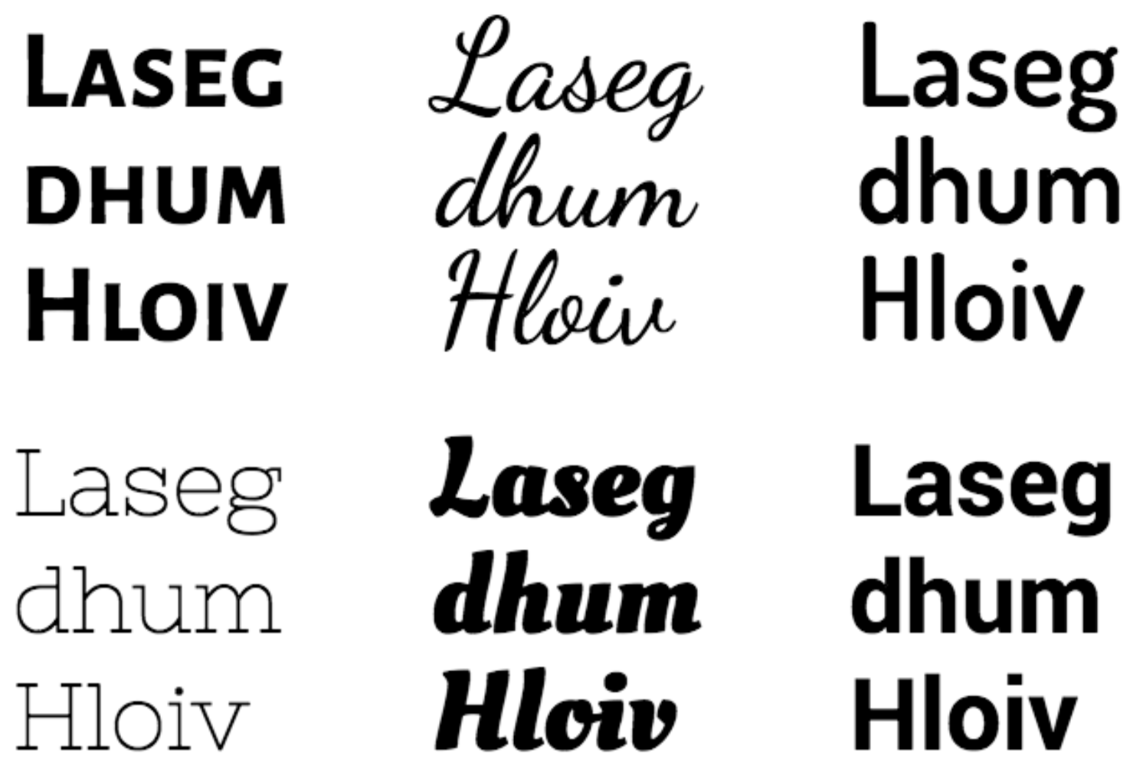
Typeface Semantic Attribute Prediction from Rasterized and Vectorized Font Representations Suvir Mirchandani Lucia Zheng Julia Gong {smirchan, zlucia, jxgong}@stanford.edu
Motivation and Problem
Method: Semantic Attribute Induction
Results and Discussion
Characterizing attributes of typefaces is of interest for font search, selection, and pairing.
Related work has used deep networks for typeface generation or grouped typefaces using font styles (e.g. ‘bold’, ‘italic’) or typographic attributes (e.g. ‘serif’, ‘all-capitals’) [1, 2, 4, 5, 7], which is less interpretable and meaningful.
Recent work [6] has introduced human-labeled semantic attributes for 200 typefaces, such as ‘artistic’, ‘playful’, and ‘boring’.
Machine learning can be applied to semantic attribute regression to generalize these human annotations to unseen typefaces.
We improve on [3] in inducing a semantic attribute dataset for 1861 typefaces from the dataset of 200 in [6] and introduce a novel downstream task: semantic attribute regression.
Kulahcioglu and de Melo [3] use k-nearest neighbors (k-NN) regression for dataset induction. They calculate the cosine similarity distance between FontJoy embeddings for each typeface and obtain best results in regressing the 31-D attributes by taking an unweighted average over the four nearest neighbors (k = 4). They measure error as the average leave-one-out cross-validation error for the 161 typefaces present in both the O’Donovan [6] and FontJoy datasets.
We experiment with ways to improve this dataset induction error using five different learning models: k-NN with relative-distance-weighted average, k-NN with inverse-distance-weight average, SVM with a radial basis function kernel, Gaussian Mixture Models, and Mean-Shift clustering.
We need equations.
We finetuned each model for 200 epochs and evaluated them using 5 metrics: L1 and L2 distance from the true image, structural similarity (SSIM), and L1 and L2 distance between the FaceNet embeddings [5] of the generated pics and those of the true photos.
All of the iterative refinement models outperform the baseline by a large margin on the L1 and L2 distance metrics as well as SSIM. The cGAN-Initial Loss model’s 2nd generator produced the most realistic images, qualitatively and in terms of L1 distance and SSIM. It appears the cGAN and L1 loss helped generator 1 create semi-natural images with crisp boundaries to fool the discriminator; generator 2 and its L1 loss smooth them out.
Many of the realistic generated images were visually distinct from the real photos; more fidelity to the likeness of the subject remains to be desired for forensic applications.
Sketch
True Face
Baseline (pix2pix)
IR w with cGAN-Initial Loss
Grayscale IR cGAN
Dataset and Task Formulation
Model | L1 dist | L2 dist | SSIM | FaceNet L1 | FaceNet L2
Baseline (pix2pix) | 35.245 | 56.928 | 0.487 | 43.147 | 1.999082
IR with cGAN-Final Loss, generator 1 | 32.579 | 53.332 | 0.579 | 43.157 | 1.999086
IR with cGAN-Final Loss, generator 2 | 33.647 | 55.367 | 0.524 | 43.098 | 1.999075
Grayscale IR w/cGAN-Final Loss, generator 2 | 33.409 | 55.135 | 0.526 | 43.088 | 1.999072
IR with cGAN-Initial Loss, generator 2 | 32.273 | 53.794 | 0.608 | 43.220 | 1.999104
IR with cGAN-Both Loss, generator 1 | 32.705 | 53.490 | 0.564 | 43.137 | 1.999084
IR with cGAN-Final Loss, spectral norm, self-attn, gen. 2 | 34.811 | 57.038 | 0.530 | 43.090 | 1.999072
Input: human-labeled 31-dimensional real-valued semantic attribute vectors with entries in [0, 1] for 200 typefaces (e.g. ‘Source Sans Pro Semibold’) as part of the semantic attribute dataset in [6]; FontJoy¹ embeddings for 1861 typefaces to be utilized for dataset induction.
Task: induce corresponding 31-D semantic attribute vectors for all 1861 FontJoy typefaces.
$ℒcGANFinal=λℒ_{L_{1}}\left(G_{1}\right)+λℒ_{L_{1}}\left(G_{2}\right)$+ $ℒ_{cGAN}\left(G_{2}, D\right)$
Spectral Normalization, Self-Attention
Future Work
References
Our last model uses spectral normalization [3]: we divide each weight matrix by its largest singular value to make that largest singular value equal 1, bounding the gradients. Like SAGAN [8], it also has self-attention layers after the third layer of each generators and the discriminator.
Removing backgrounds could prevent learning correlations between facial features and background color.
A sharpening model could be employed to turn smooth output images into crisper, more realistic ones. A pretrained colorization network could also boost the grayscale network performance.
Channeled autoencoders [4] could allow manipulation of latent space of the cGAN to control skin tone, eye color, hair color, and other variables to correct model inferences.
[1] Avilés-Cruz, C., Villegas, J., Arechiga-Martínez, R., and Escarela-Perez, R. Unsupervised font clustering using stochastic version of the em algorithm and global texture analysis. In Sanfeliu, A., Martínez Trinidad, J. F., and Carrasco Ochoa, J. A. (eds.), Progress in Pattern Recognition, Image Analysis and Applications, pp. 275–286, Berlin, Heidelberg, 2004. Springer Berlin Heidelberg. ISBN 978-3-540-30463-0.
[2] Azadi, S., Fisher, M., Kim, V. G., Wang, Z., Shechtman, E., and Darrell, T. Multi-content GAN for few-shot fontstyle transfer. CoRR, abs/1712.00516, 2017. URL http://arxiv.org/abs/1712.00516.
[3] Kulahcioglu, T. and de Melo, G. Predicting semantic signa-tures of fonts. pp. 115–122, 01 2018. doi: 10.1109/ICSC.2018.00025.
[4] Lin, X., Li, J., Zeng, H., and Ji, R. Font generation based on least squares conditional generative adversarial nets. Multimedia Tools Appl., 78(1):783–797, January 2019. ISSN 1380-7501. doi: 10.1007/s11042-017-5457-4. URL https://doi.org/10.1007/s11042-017-5457-4.
[5] Lopes, R. G., Ha, D., Eck, D., and Shlens, J. A learned representation for scalable vector graphics. CoRR, abs/1904.02632, 2019. URL http://arxiv.org/abs/1904.02632.
[6] O’Donovan, P., Libeks, J., Agarwala, A., and Hertzmann, A. Exploratory Font Selection Using Crowdsourced Attributes. ACM Transactions on Graphics (Proc. SIGGRAPH), 33(4), 2014.
[7] Oztürk, S., Sankur, B., and Abak, A. Font clustering and classification in document images. European Signal Processing Conference, 2015, 01 2000.
Figure 1. Examples of the diverse typefaces in the FontJoy dataset.
¹See fontjoy, https://github.com/Jack000/fontjoy

