Slide 1
Nikhil Jain
Senior Software Engineer

Slide 2
About me
I’m passionate about building great products that make people’s lives easier. I have over 8 years of experience in building large scale and high concurrents systems.

Slide 3
Career highlights
Senior Software Developer
Moonfrog Labs, Bangalore
August 2022 - Present
Senior Software Developer
Walmart Labs, Bangalore
June 2019 - August 2022
Software Developer
SAP Labs, Bangalore
March 2016 - June 2019

Slide 4
Craft Demo
Rate Limiter

Slide 5
Requirement
Web Services like AWS and Intuit impose Rate Limits on how many Requests per Second a Client can make. For example, you can only poll the AWS CloudFormation Status Service less than 30 times/second.
Design a solution for a Rate-Limiting Scheme under these conditions:
A single DataCenter/region
We have different Web Services and want to impose different rate-limits on them
Each Client has a Client Id
Each Client has a different Rate-Limit per Web Service
Be sure to explain any issues you can think of! For example, what if 1000 Clients all make simultaneous calls to the same Web Service?

Slide 6
There can be these types of Rate Limiting Algorithm
The Token bucket
Leaky bucket
Sliding window logs
Sliding window counters
I have Used Sliding window counters for this Demo

Slide 7
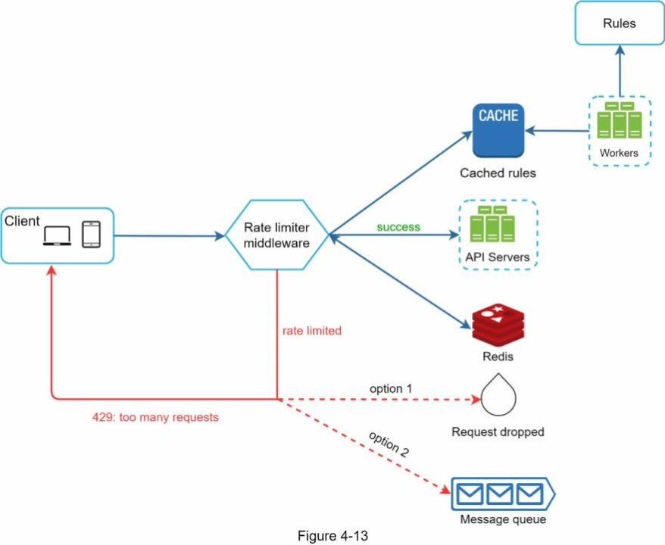
System Design
Rules can be stored in some NoSQL DB.
Workers will update the cache in an specific time interval.
Cache is in-memory cache where we can access rules faster.
Redis will store the counters of the request by client and web-service.
We can extend our solution in request drop when throttling happens or we can use message queues also in cane we don’t want request to drop.
Message queues help when system is overloaded with the requests.

Slide 8
Working
We can Create small time frames window buckets and add counters instead of timestamp which is more memory optimised.
I have created RateLimitterWrapper which is used to extend the rate limiting with multiple strategy.
I have used RateLimitConfigConfiguration which in current case used for reading config file which can come from NoSQL like (MongoDB).
RateLimitException this is to handle custom exceptions.
globalRateLimit will take care of system’s total rate limit.

Slide 9
Improvements / Next Steps
Rate Limiter can be extended with multiple type of algorithm depends on usecase.
We can use Mongo DB for storing the config and an poller worker node which will update the cache every 20 seconds or so.
We will use redis for storing the counter and can use redis inbuilt feature to invalidate cache after certain time so that we dont have to delete the cache.

Slide 10

Contact
Nikhil Jain
nikhiljn20@gmail.com
www.linkedin.com/in/nikhilnareshjain

