Slide 1
Single Cell Perturbation
scPerturb
DS542 DL4DS
Sicheng Yi (Tiger Yi)
tigeryi@bu.edu

Slide 2
Table of Contents
1
Background
NeurIPS 2023 Kaggle competition
2
Data
3
Augmentation
4
Model
5
Result

Slide 3
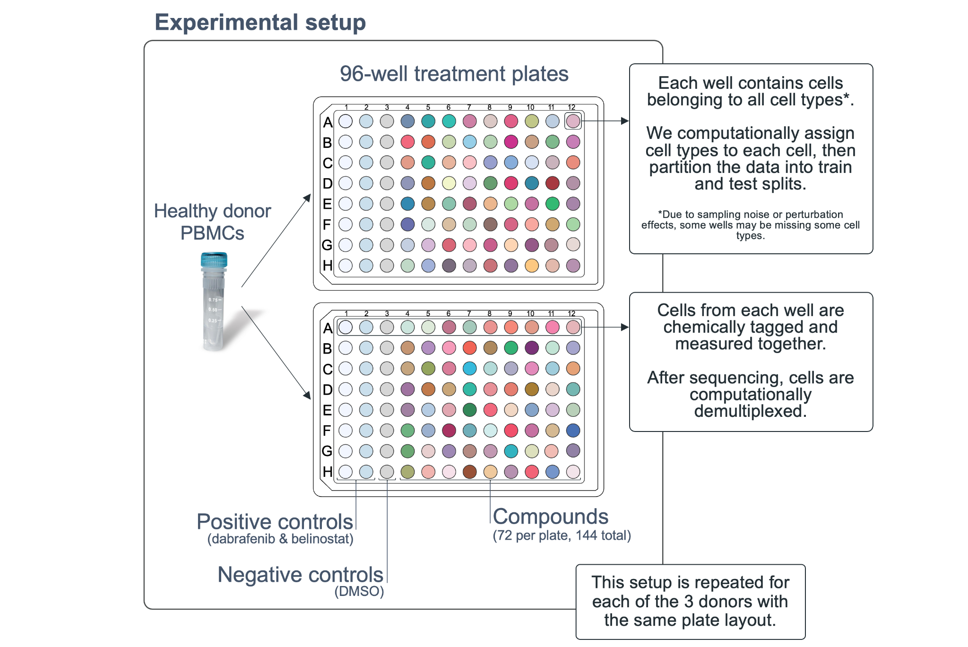
Background
scPerturb
PBMC: peripheral blood molecular cell
- T cells, NK cells, B cells, myeloid cells
144 compounds (drug, sm_names)
16 positive control: dabrafenib, belinostat
8 negative control: DMSO
scRNA-seq: raw RNA counts
scATAC-seq: chromatin peaks
DE differential expression

Slide 4
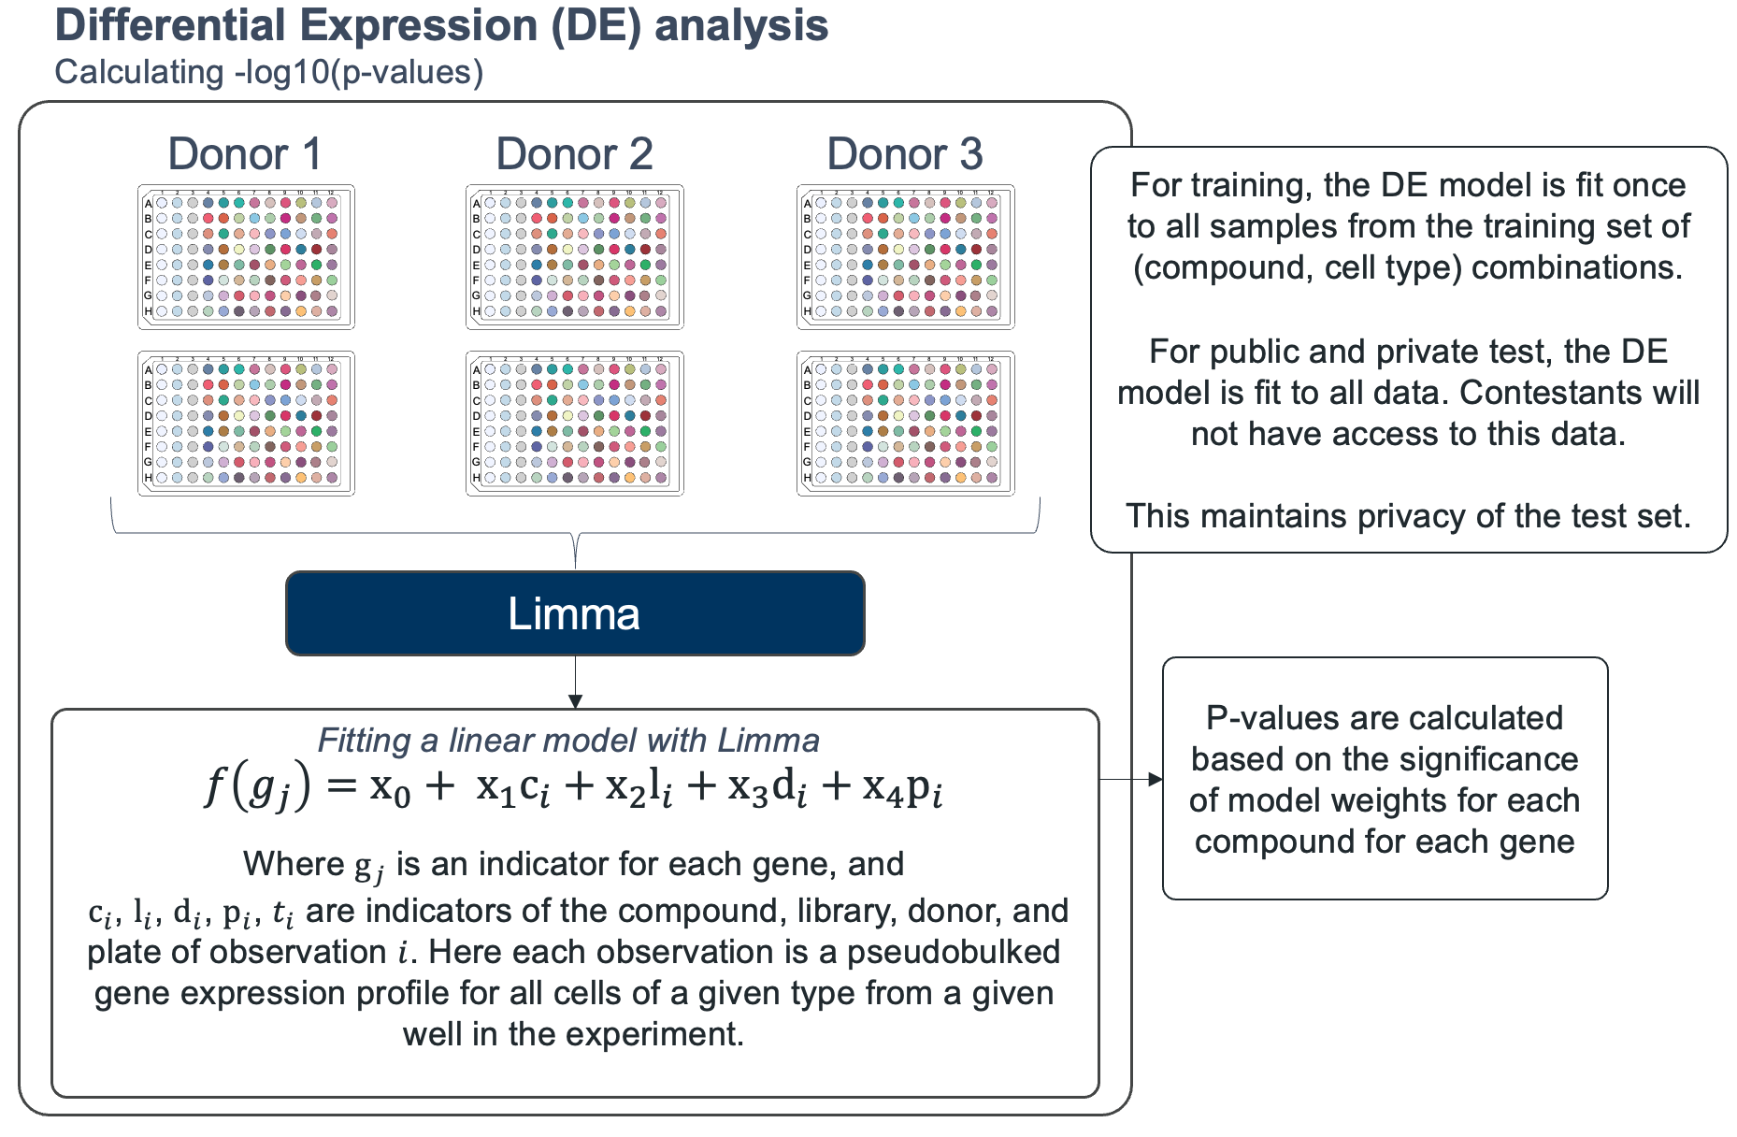
Background
scPerturb
DE differential expression:
Identify change in gene expression level
Between control and perturbed cells
LIMMA: linear model
Calculate DE value
-log10(p-value) * sign(Log Fold Change)
144 drug compounds, 18000+ genes

Slide 5
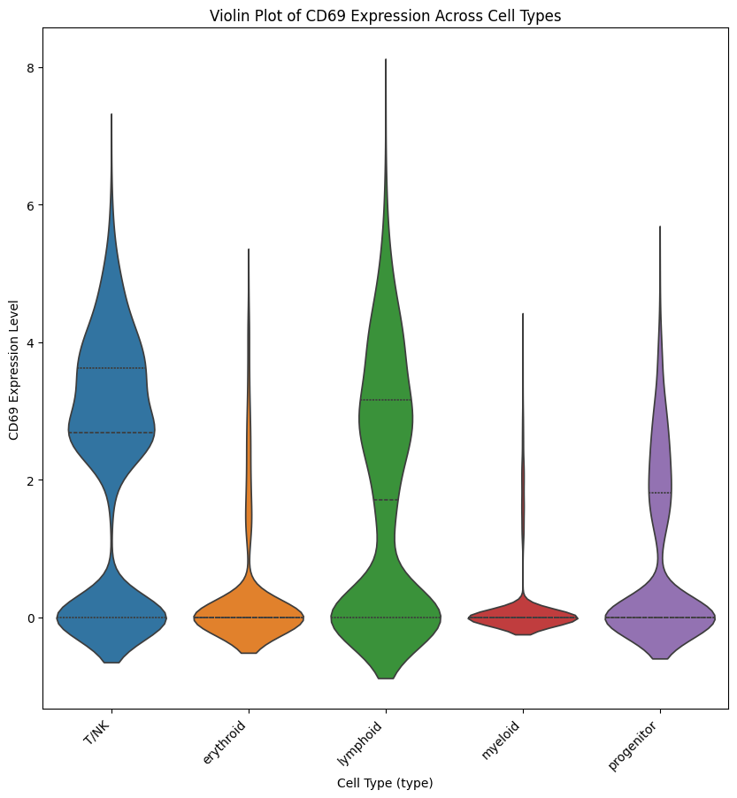
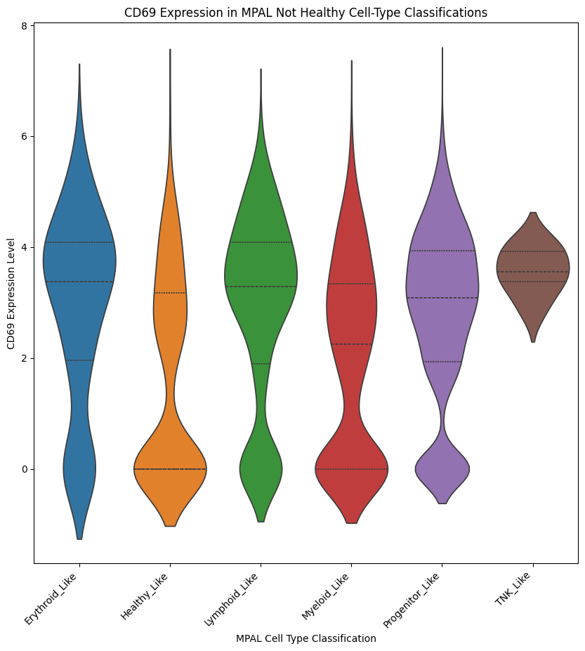
EDA
scPerturb

Slide 6
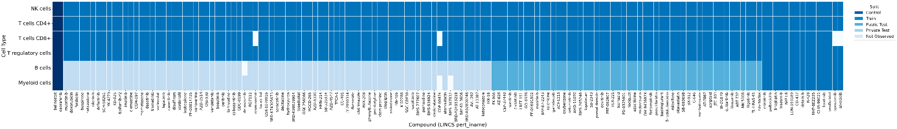
Data
scPerturb
Test: Predict differential expression for majority of Myeloid cells and B cells
Train: 144 compounds in T, NK cells. 15 compounds + controls in Myeloid, B cells.
T cells: CD4+ , CD8+, regulatory

Slide 7
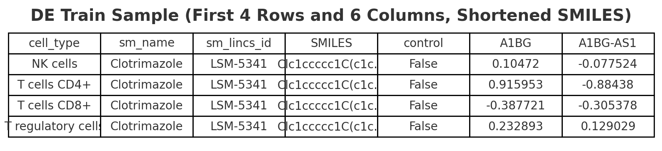
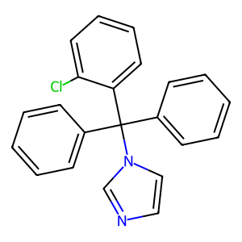
Data - de_train
scPerturb
Row (614): cell type, sm compound pairs
Column (18216):
18211 genes of DE value: -log10(p-value)
control: true or false
SMILES: single line 1D molecular structure
+ up regulated
- down regulated
number: -log10(p)
Higher, more significant

Slide 8
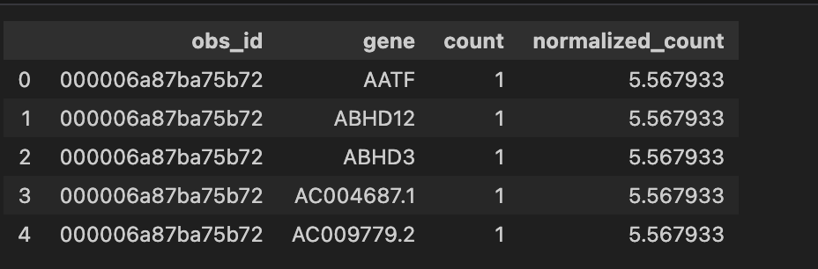
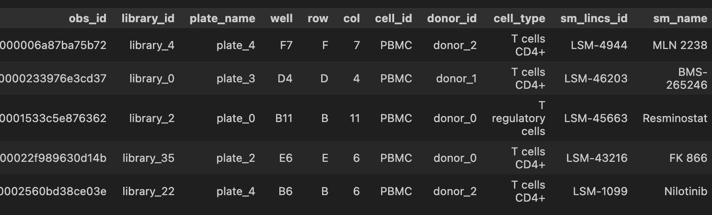
Data - adata
scPerturb
scRNA-seq
obs: individual cell
gene: column detrain
count: raw molecular counts of gene in cell
Norm: log(X+1)

Slide 9
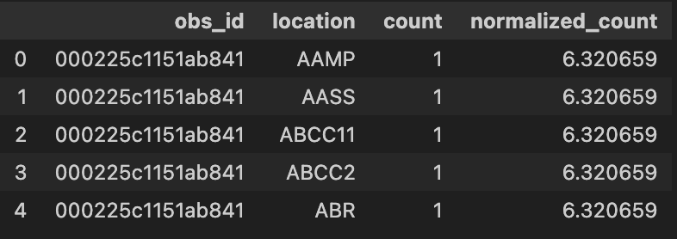
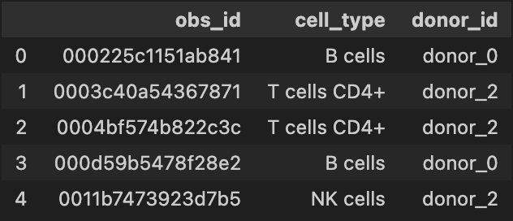
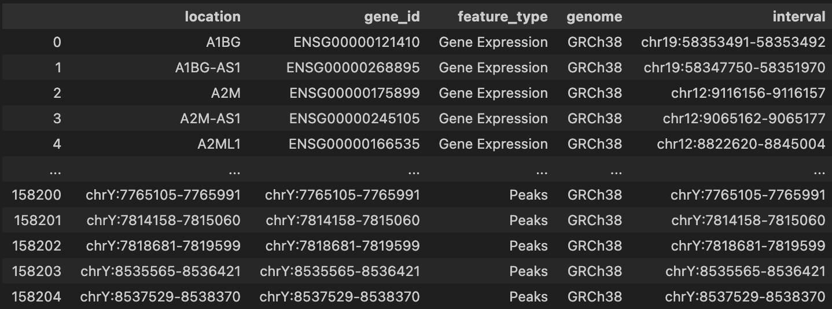
Data - multiome
scPerturb
scRNA-seq:
gene expression
scATAC-seq:
chormation peaks

Slide 10
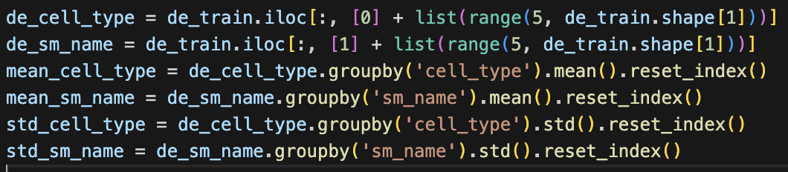
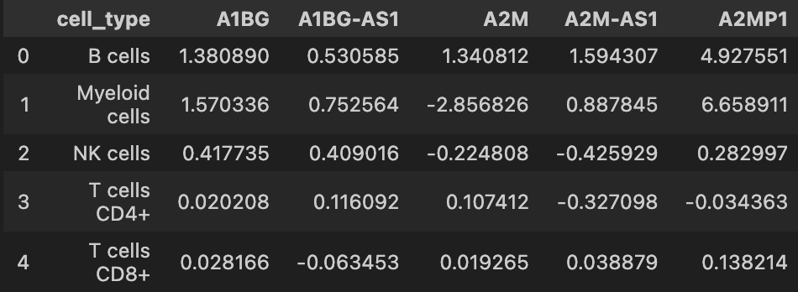
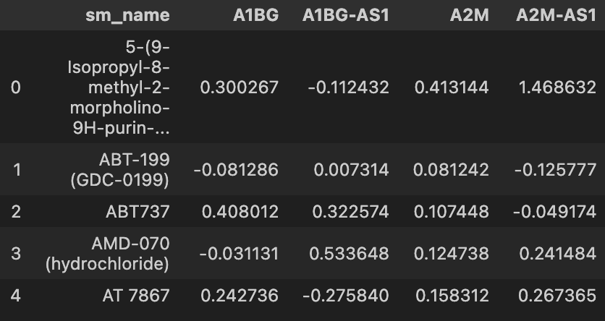
Augmentation - mean, std of cell types, sm_name
scPerturb

Slide 11
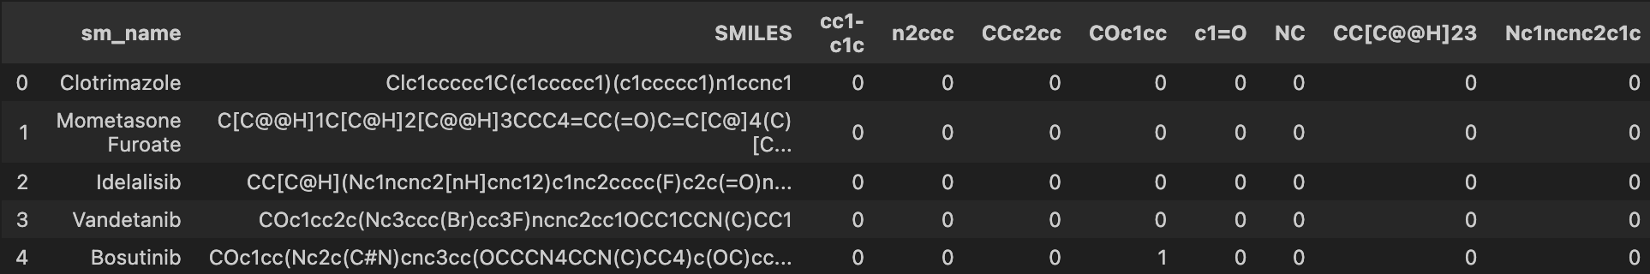
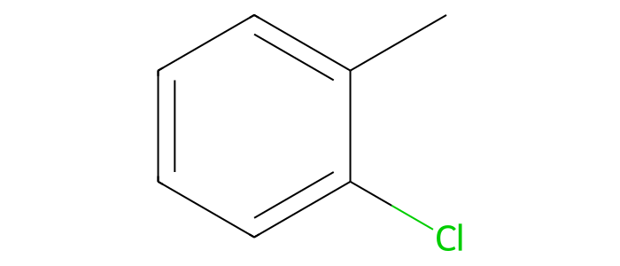
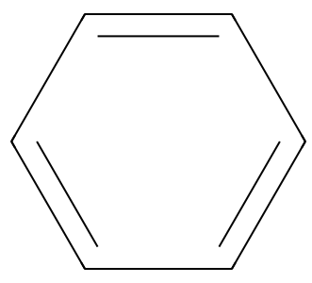
Augmentation - SMILES
scPerturb
Clc1ccccc1C(c1ccccc1)(c1ccccc1)n1ccnc1
Element_Count: {'Cl': 1, 'C': 22, 'N': 2}

Slide 12
Model
scPerturb
Differential Expression
Differential Expression
MLP
MLP
Cell Type
Representation
Compound
Representation
Transformer encoder
MLP
MLP
Cell Type
Representation
Compound
Representation
Gene (1,2…,N)
Representation
Cell Type
Feature
Compound
Feature
RNA-seq ATAC-seq
sm: SMILES
controls

Slide 13
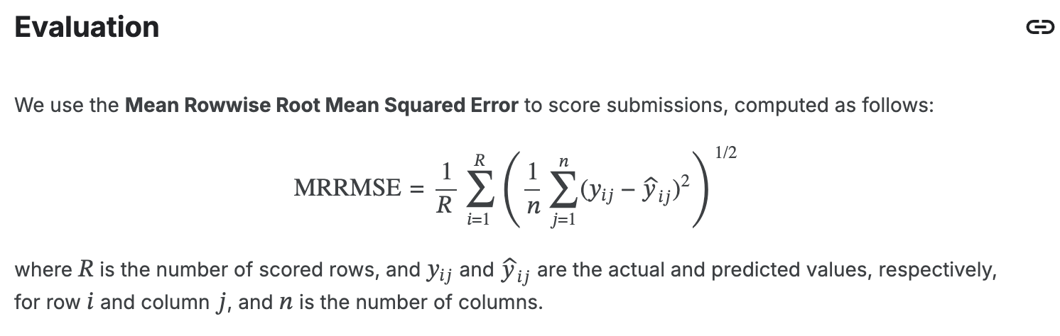
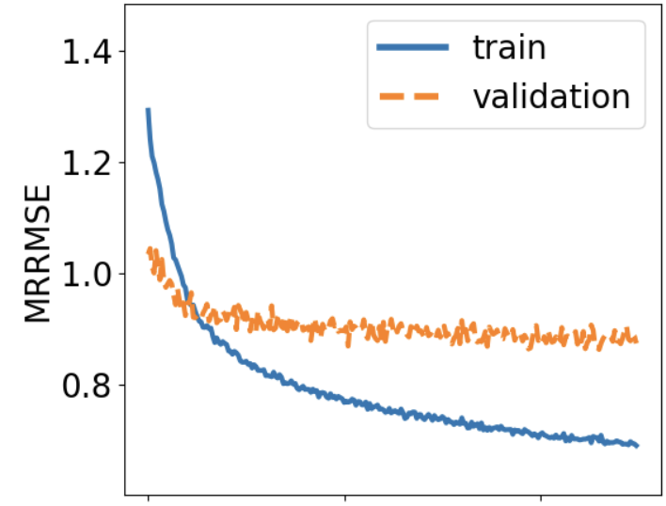
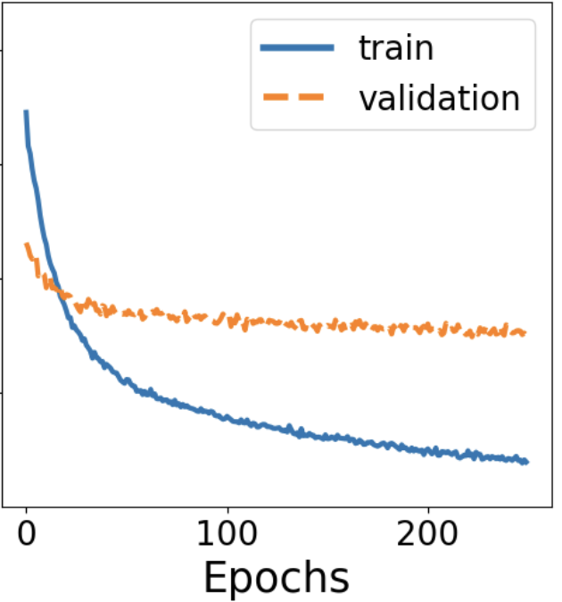
Results
scPerturb
 | MLP | Transformer
validation | 0.86 | 0.90
test | 0.93 | 0.87
Transformer seems to generalize better on the unseen test set.

Slide 14
Questions?
scPerturb

