Slide 1

AwesomePlayer
edda_jin@realsil.com.cn
Ext: 5358

Slide 2
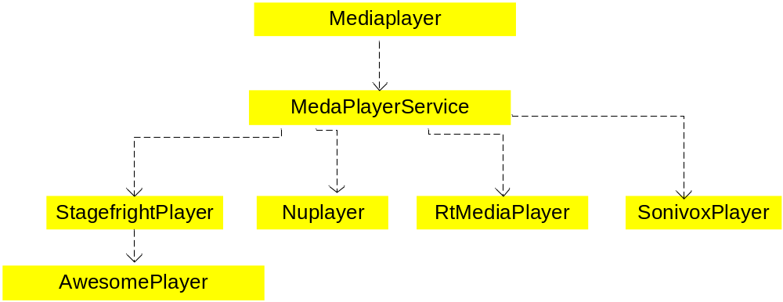
Android native playback architecture

Slide 3
Constructor
StagefrightPlayer::StagefrightPlayer()
: mPlayer(new AwesomePlayer) {
ALOGV("StagefrightPlayer");
mPlayer->setListener(this);
}

Slide 4
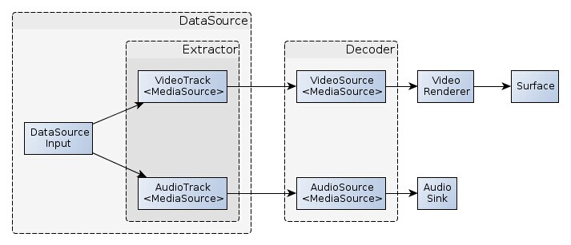
Awesomeplayer architecture
MediaPlayer 的 Native 层定义了各种负责实际播放的player, 分别对应不同的媒体类型. 其中比较重要的一个player就是 stagefright. StagefrightPlayer其实只是个壳, 里面具体调用的是AwesomePlayer.
Awesomeplayer框图

Slide 5
AwesomePlayer
control center
Video - AwesomePlayer
Audio - AudioPlayer
Text - TextPlayer

Slide 6
Playback flow
setDataSource
prepare
play

Slide 7
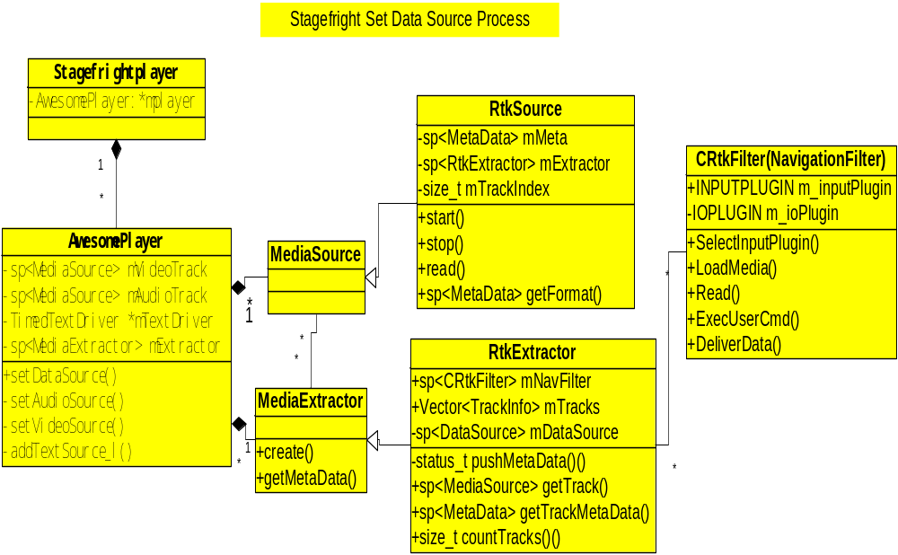
Set data source

Slide 8
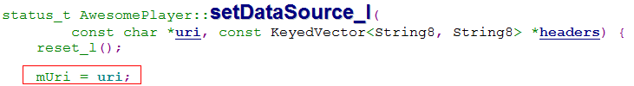
Set data source
setDataSource - url

Slide 9
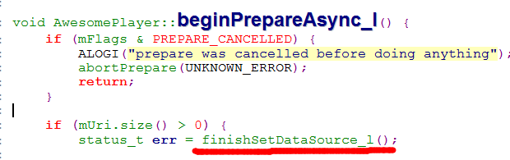

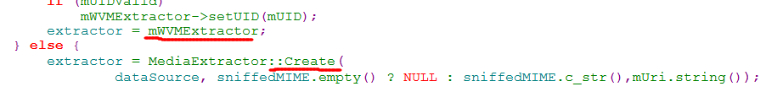
Set data source
setDataSource – url

Slide 10
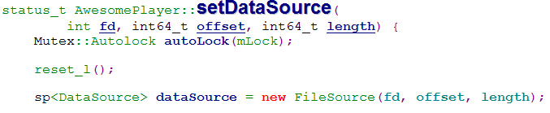
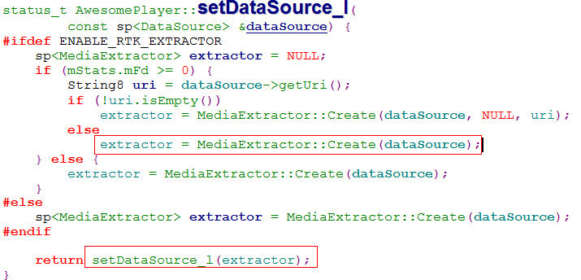
Set data source
setDataSource - fd

Slide 11
Set data source
setDataSource - fd

Slide 12
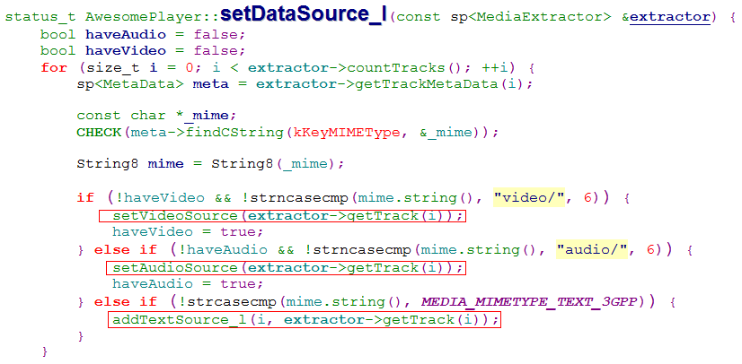
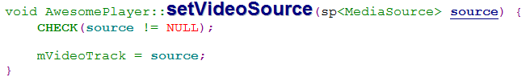
Set data source
setDataSource – fd

Slide 13
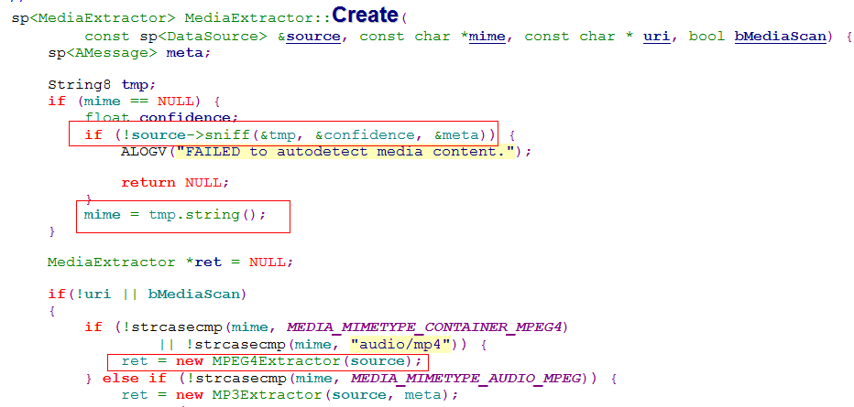
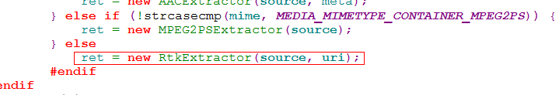
MediaExtractor::Create

Slide 14
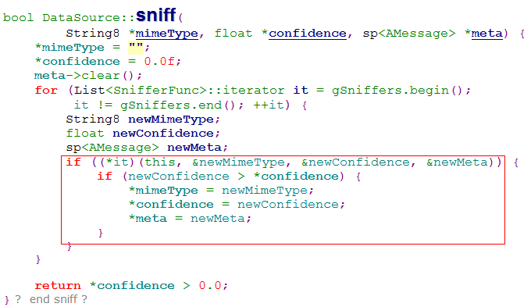
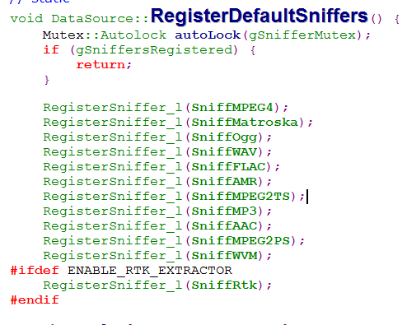
DataSource::sniff

Slide 15
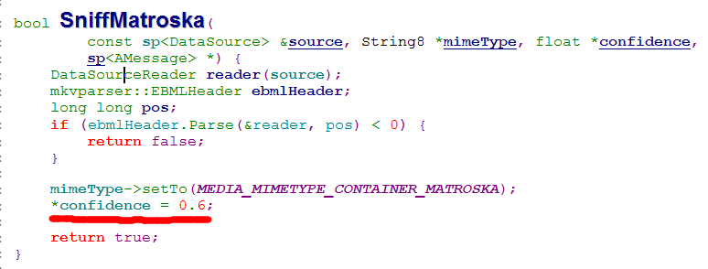
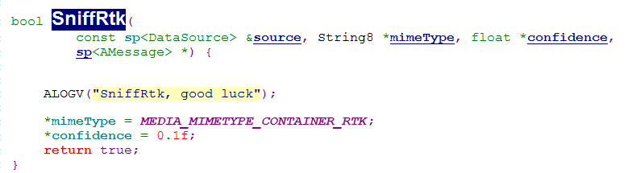
DataSource::sniff

Slide 16
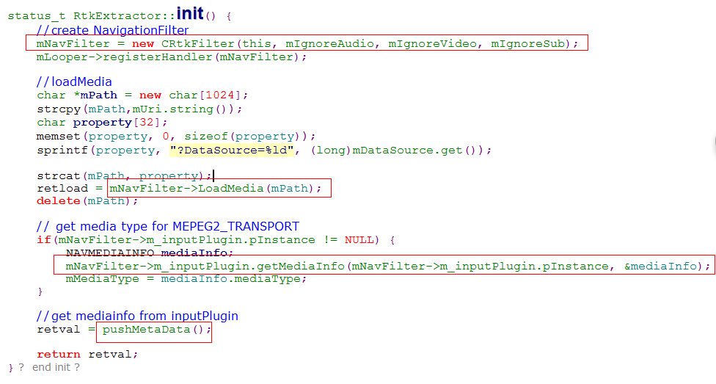
RtkExtractor

Slide 17

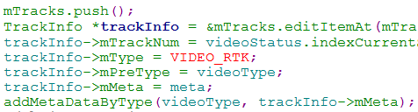

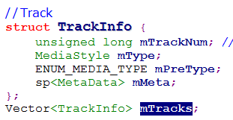


RtkExtractor
pushMetaData

Slide 18
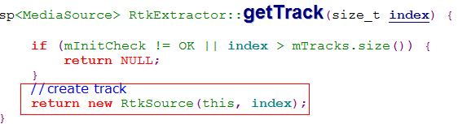
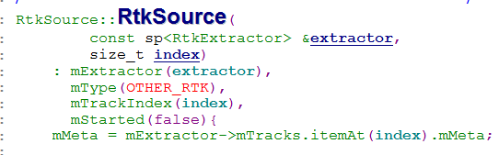
RtkExtractor::getTrack()

Slide 19
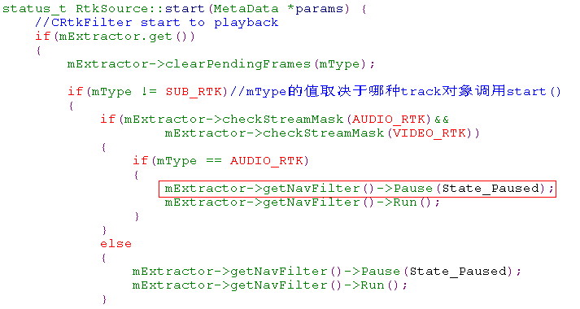
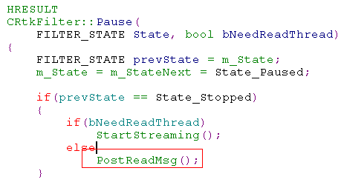
RtkExtractor::Start()

Slide 20
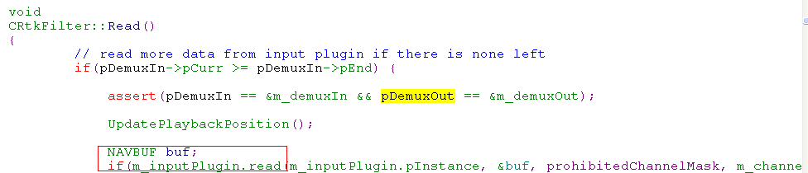

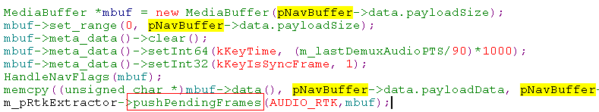
RtkExtractor::Start()

Slide 21
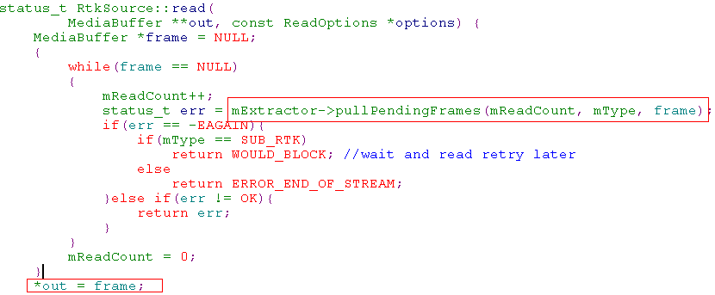
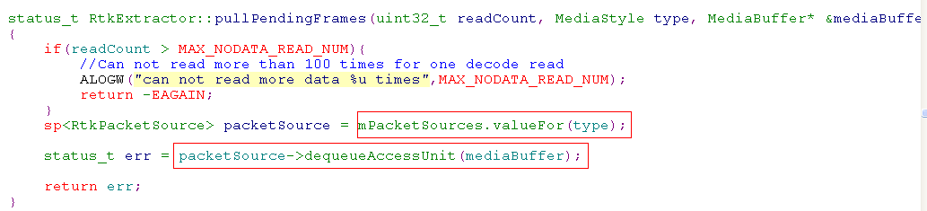
RtkExtractor::Read()

Slide 22
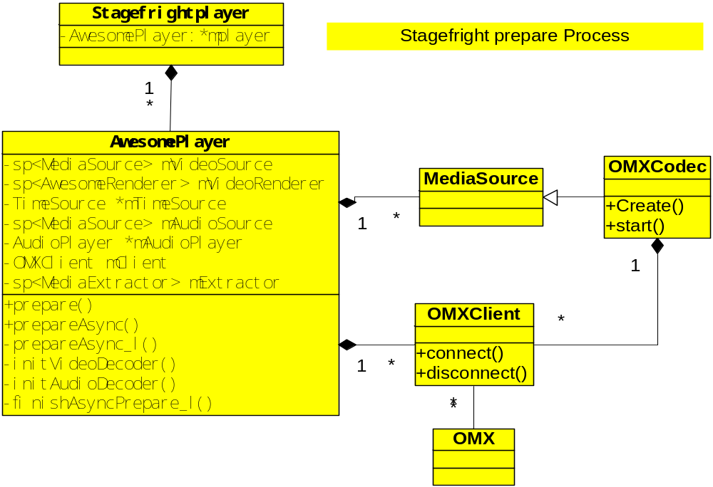
Prepare

Slide 23
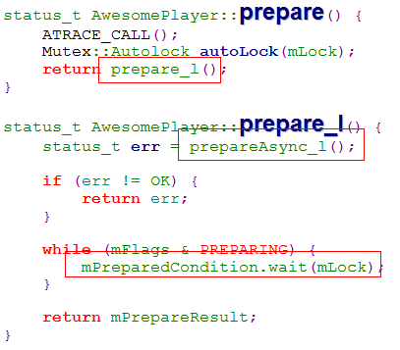
Prepare

Slide 24

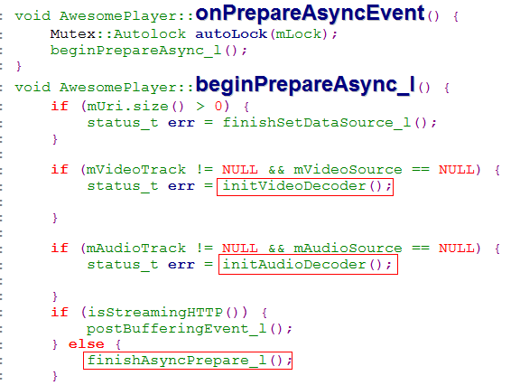
Prepare

Slide 25
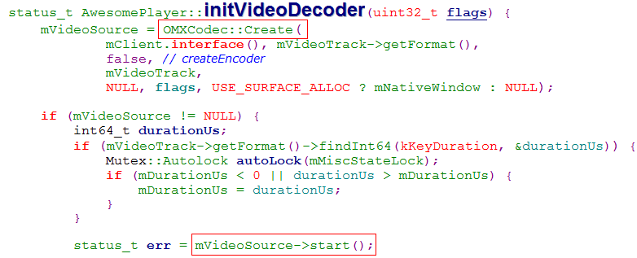
Prepare

Slide 26
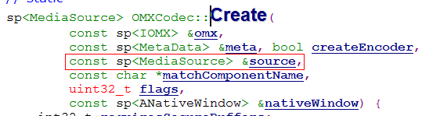
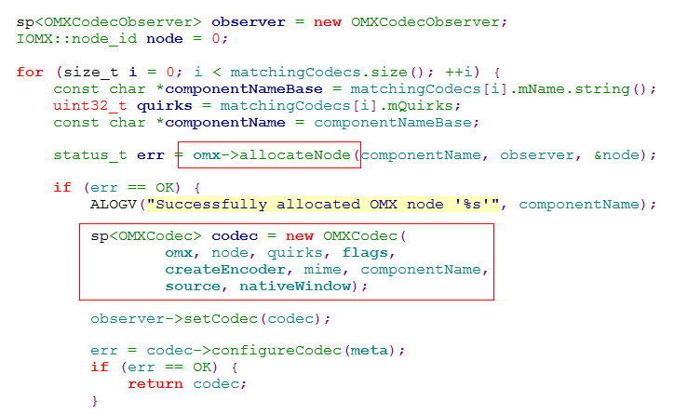
Prepare
Open /etc/media_codecs.xml 找到所有匹配的
matchcodecs 信息.

Slide 27
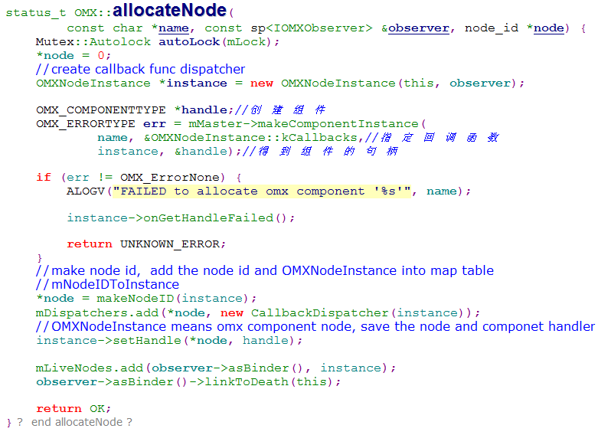

Prepare

Slide 28
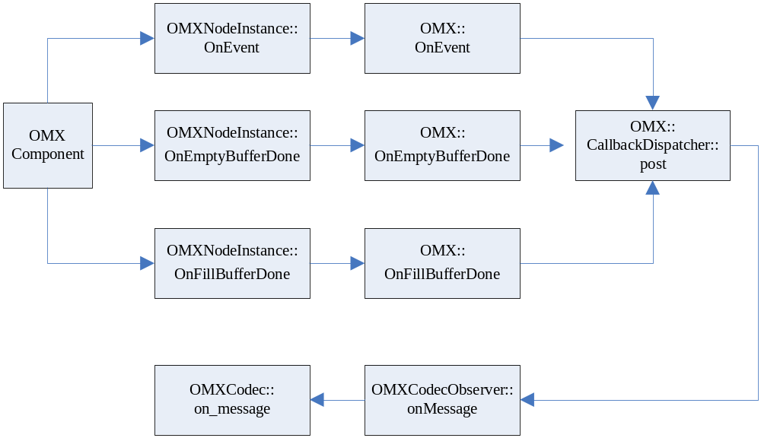
Prepare
OMXCodec
组件的消息上报过程 onMessage()

Slide 29
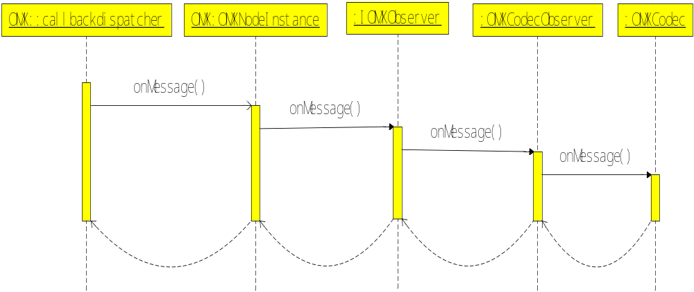
OMXCodec
组件的消息上报过程 onMessage()

Slide 30
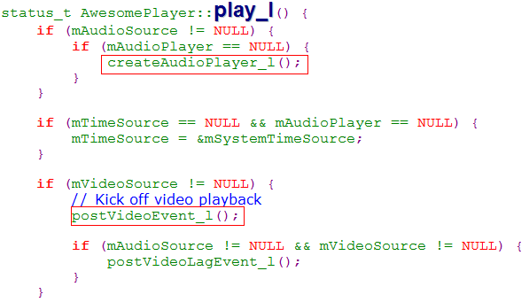
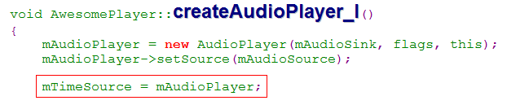
Play

Slide 31


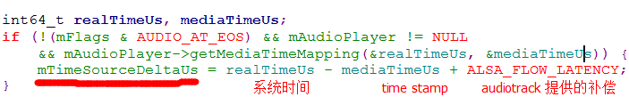
Video Play

Slide 32
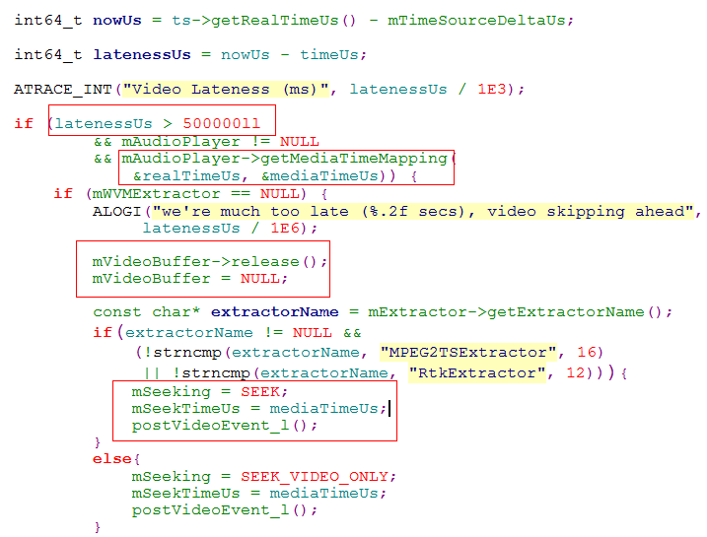
Video Play
AV sync check

Slide 33
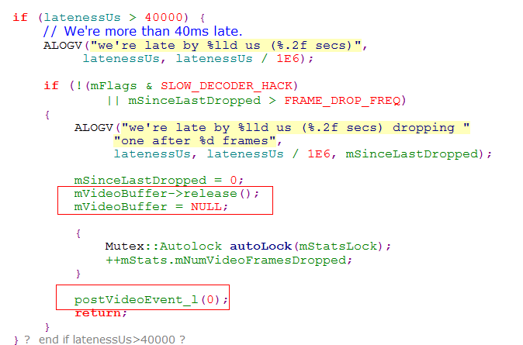
Video Play
AV sync check

Slide 34
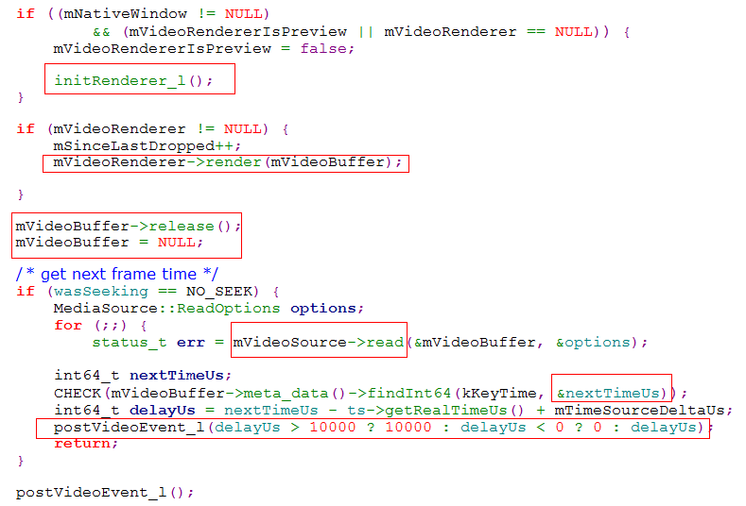
Video Play

Slide 35
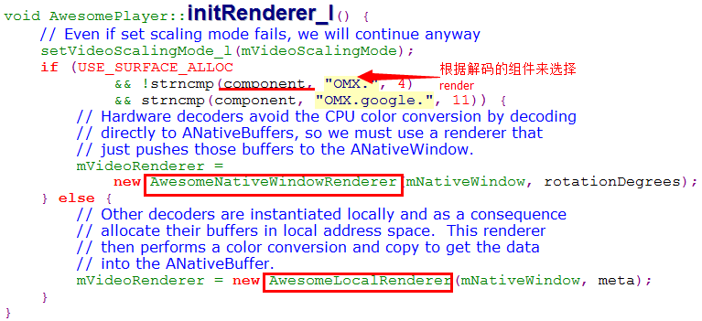
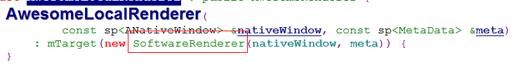
Video render

Slide 36
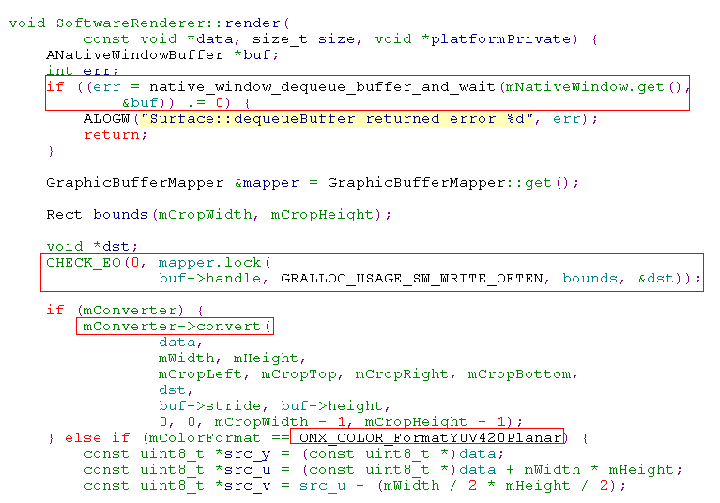
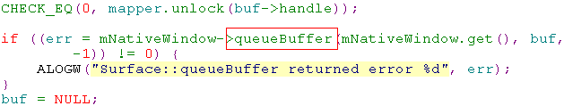
Video render

Slide 37
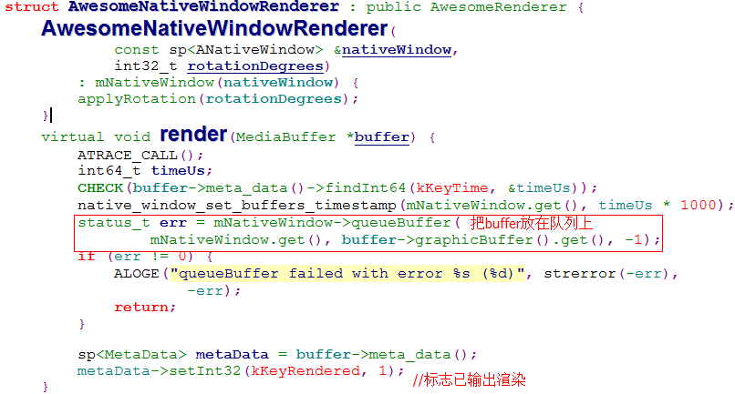
Video render

Slide 38
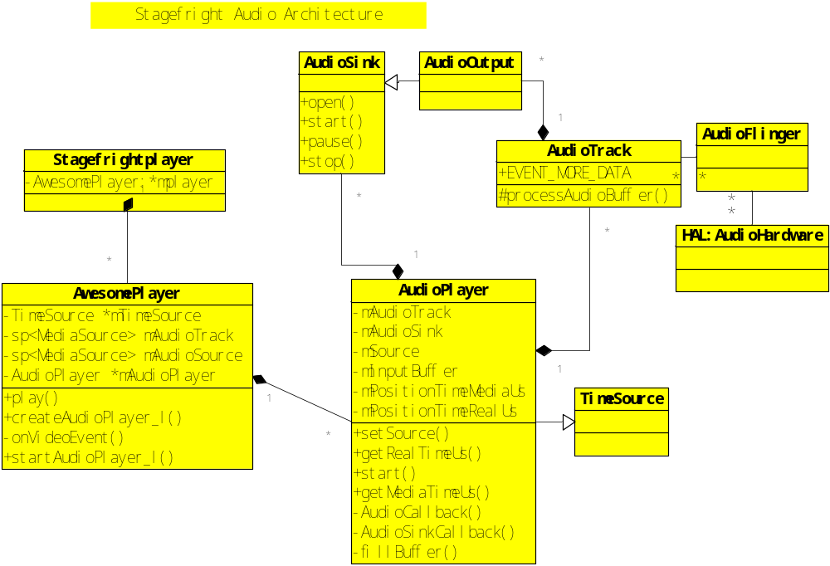

Audio Play

Slide 39

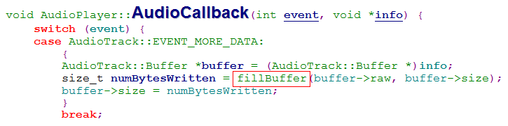
Audio Play

Slide 40
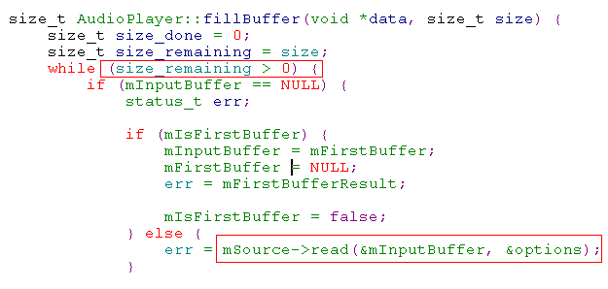


Audio Play
*data是Audiotrack指定的共享buffer指针，
Size是audiotrack规定的可以写入buffer的大小
size_done是实际写入buffer的大小

Slide 41
Thanks !

