Slide 1

Stagefright Player
jk_wang@realsil.com.cn
Ext: 5305

Slide 2
Create Stagefright Player
MediaPlayerService::Client::setDataSource
MediaPlayerFactory::getPlayerType
(url , fd or StreamSource)
STAGEFRIGHT_PLAYER, NU_PLAYER, SONIVOX_PLAYER, REALTEK_PLAYER

Slide 3
Constructor
StagefrightPlayer::StagefrightPlayer()
: mPlayer(new AwesomePlayer) {
ALOGV("StagefrightPlayer");
mPlayer->setListener(this);
}

Slide 4
AwesomePlayer
control center
Video - AwesomePlayer
Audio - AudioPlayer
Text - TextPlayer

Slide 5
Demux and Decode
Demux:
DataSource MediaExtractor MediaSource
Decode:
OMX DecodeComponent

Slide 6
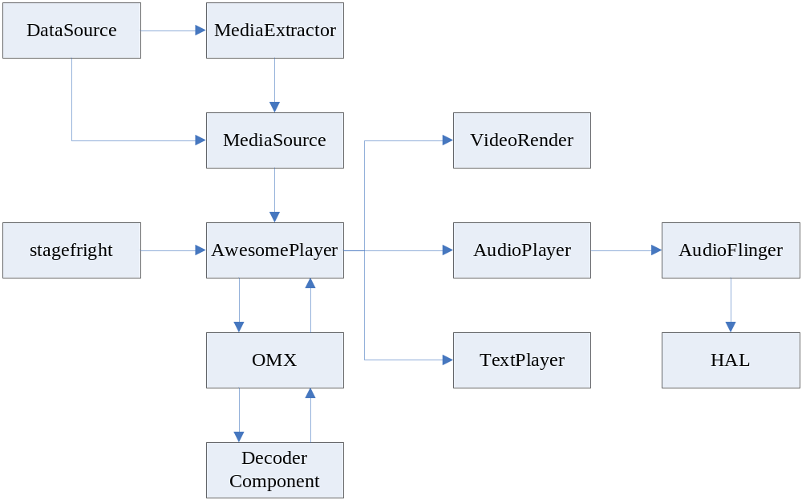

Slide 7
Playback flow
setDataSource
prepare
play

Slide 8
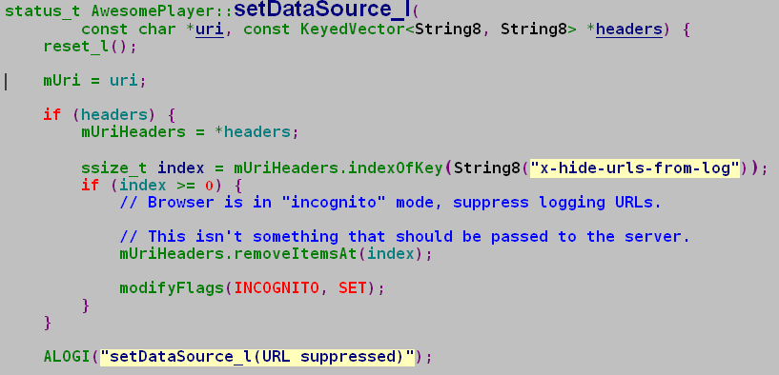
Playback flow
setDataSource - url

Slide 9
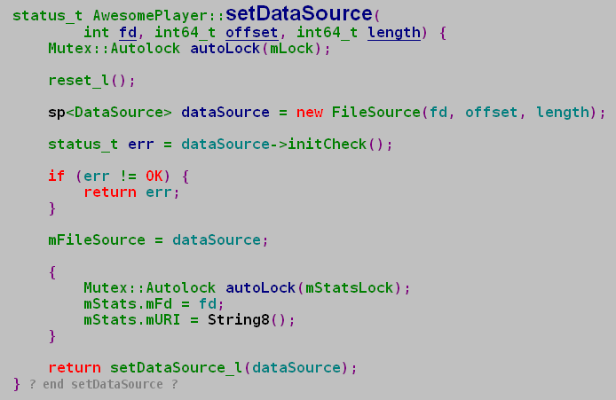
Playback flow
setDataSource - fd

Slide 10
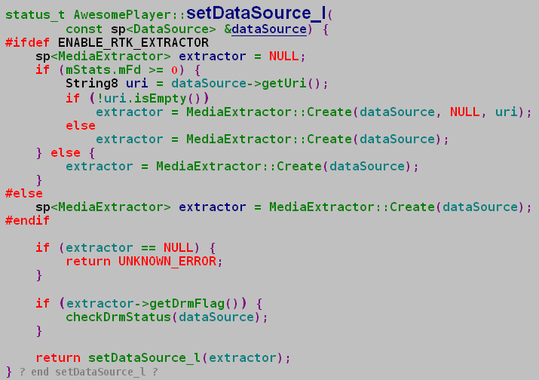
Playback flow
setDataSource - fd

Slide 11
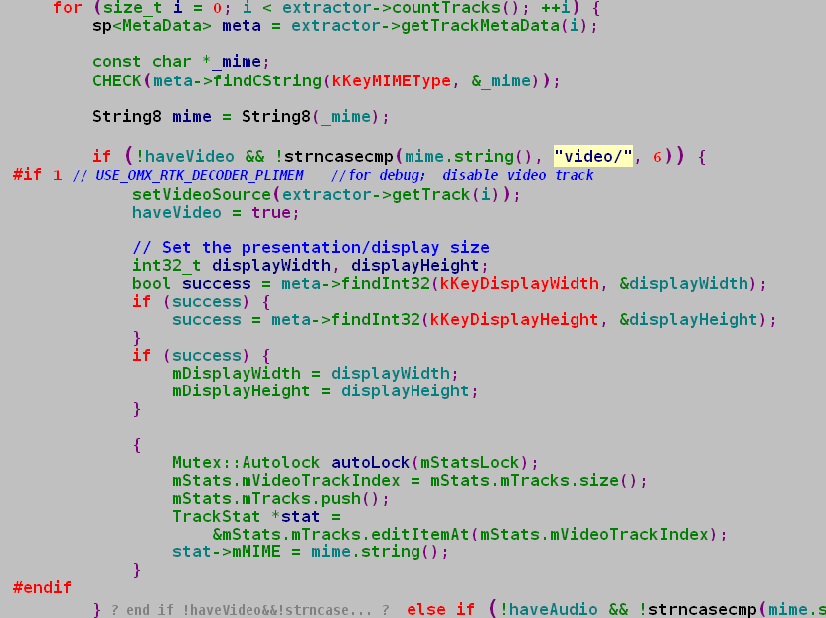

Slide 12
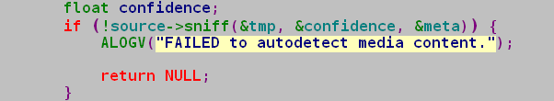
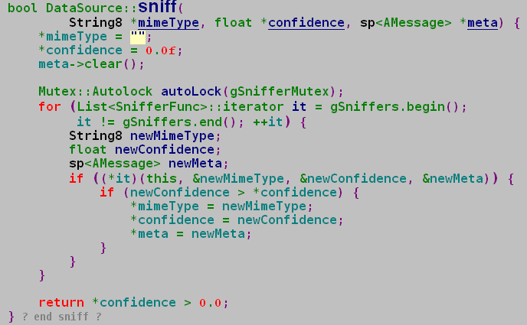
Extractor
MediaExtractor::Create

Slide 13
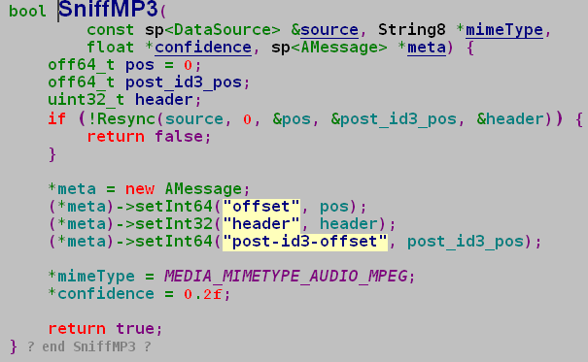
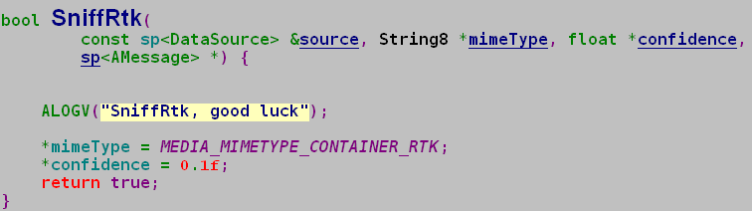

Slide 14
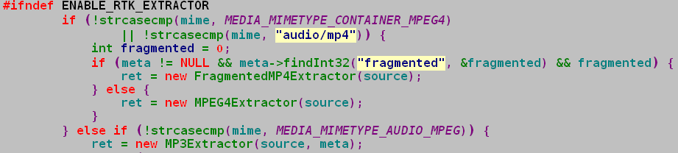
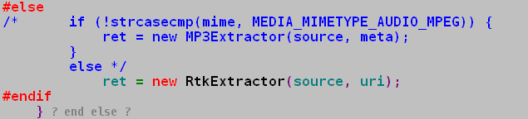
Extractor
MediaExtractor::Create

Slide 15
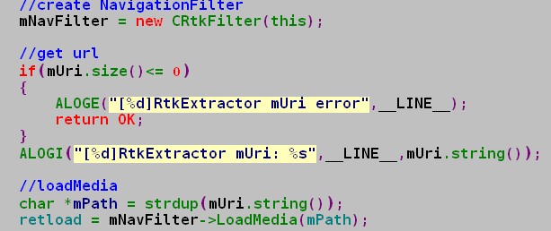

Extractor
LoadMedia

Slide 16

Extractor
pushMetaData

Slide 17

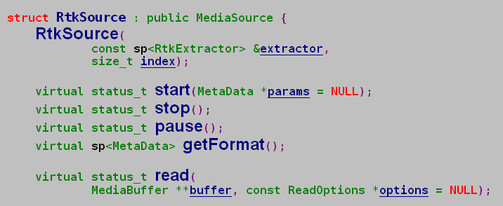
Extractor
Important Interface

Slide 18
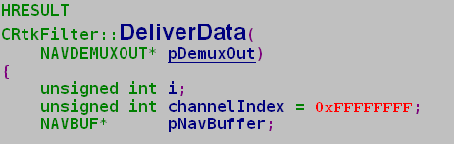
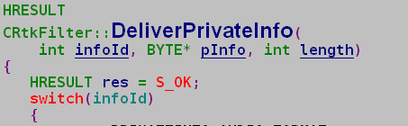
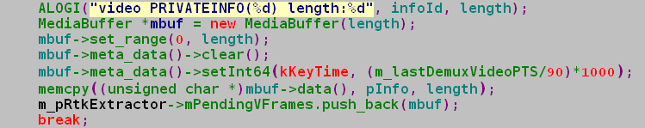
Extractor
CRtkFilter

Slide 19
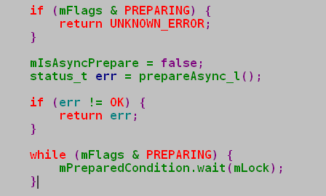
Playback flow
prepare (prepareAsync )

Slide 20

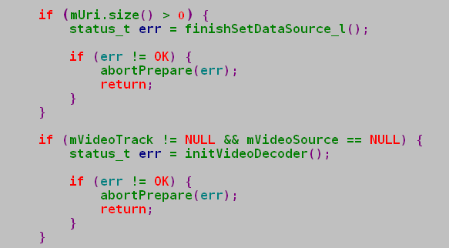
Playback flow
prepare

Slide 21
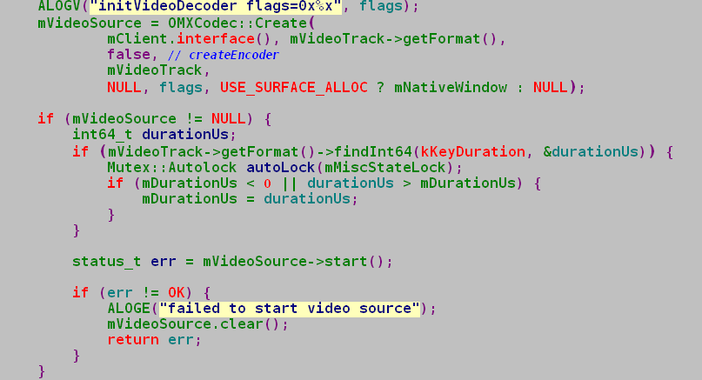
Playback flow
prepare

Slide 22
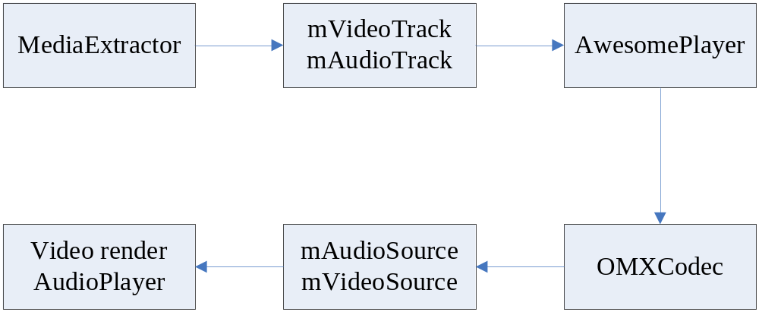
Playback flow
prepare

Slide 23
Playback flow
play
status_t AwesomePlayer::play_l()
void AwesomePlayer::onVideoEvent()

Slide 24


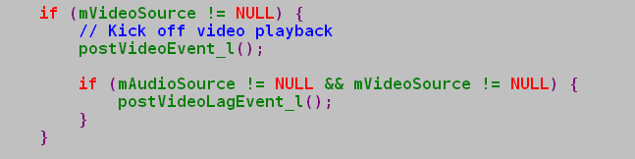
Playback flow
play – play_l()

Slide 25

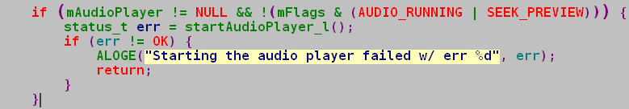
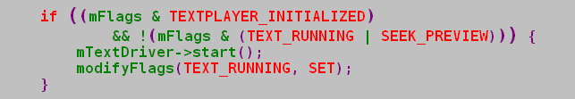
Playback flow
play - onVideoEvent()

Slide 26

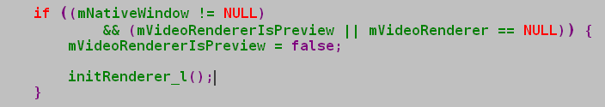


Slide 27
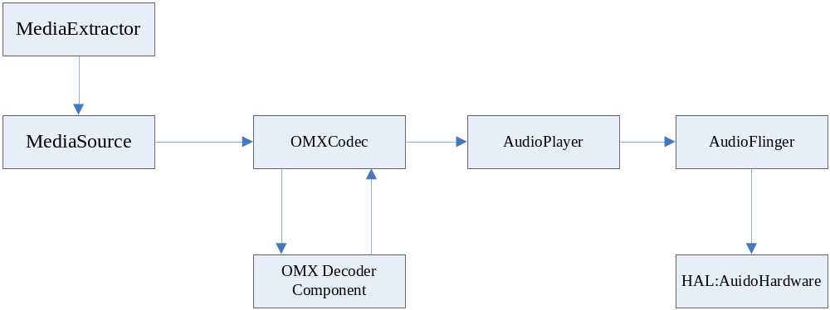
AudioPlayer

Slide 28

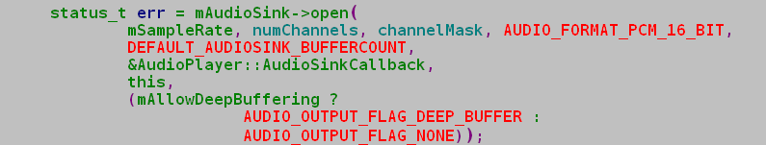
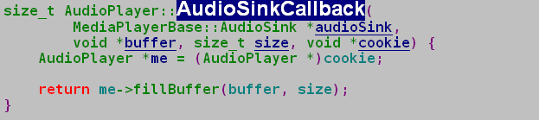
AudioPlayer

Slide 29
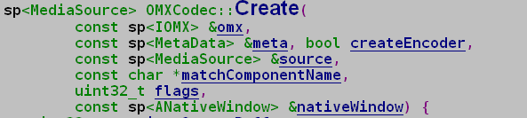
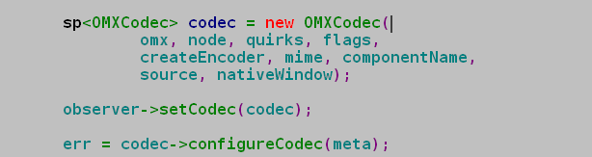
OMXCodec (OpenMAX Integrateion Layer)
Create

Slide 30
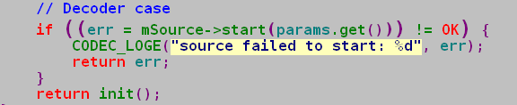

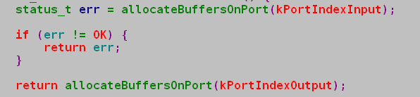
OMXCodec
Start

Slide 31
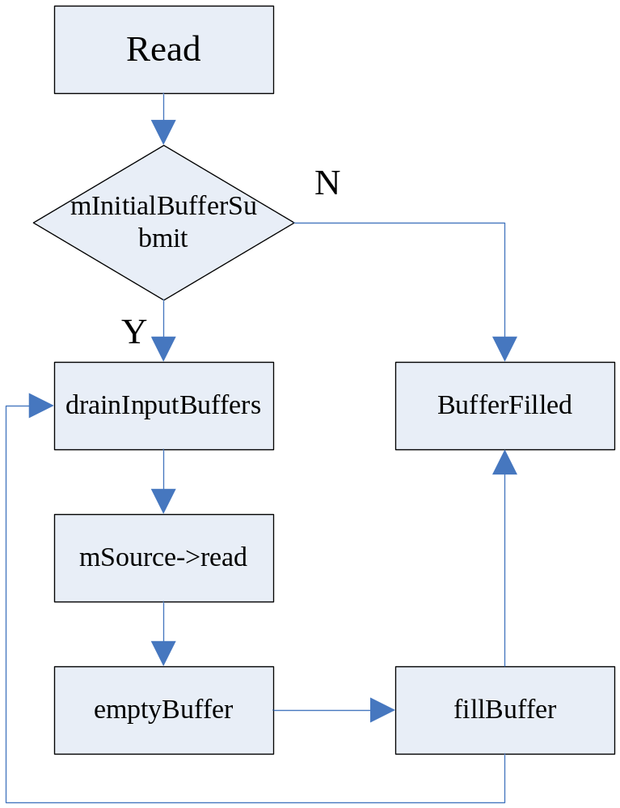
OMXCodec
read

Slide 32
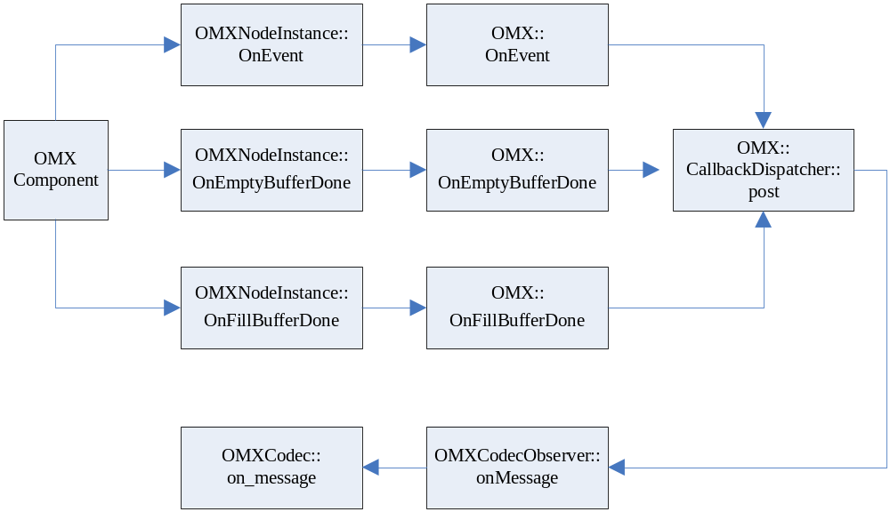
OMXCodec
on_message

Slide 33
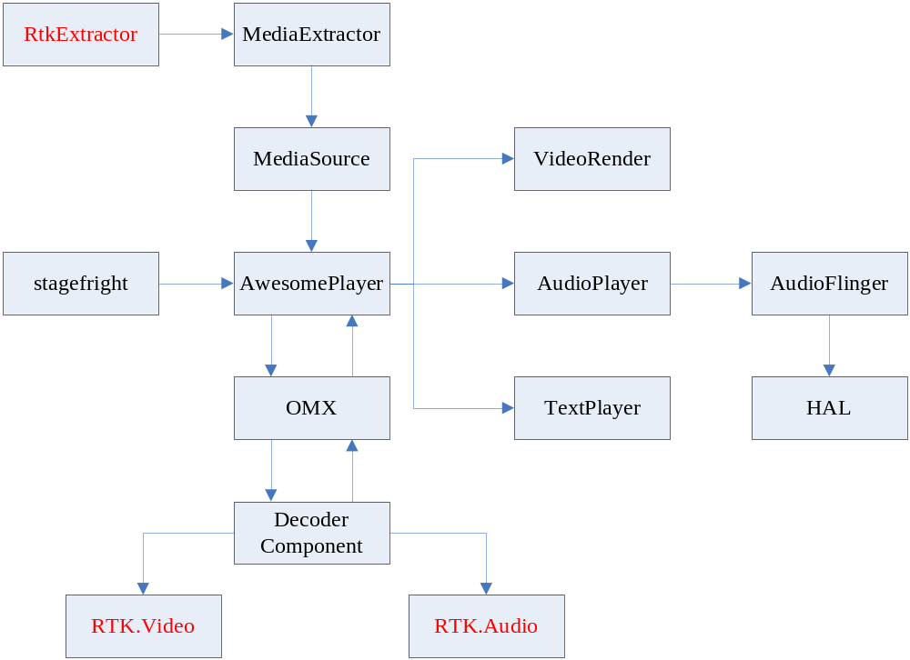
Summary

Slide 34
Thanks !

