Slide 1

Playback Subtitle Inside
jacob_shen
2010.8.9
jacob_shen@realsil.com.cn
Tel:5307

Slide 2
Table
Subtitle Format
Subtitle Framework
Internal Subtitle Manager
Vobsub and XSub
Q&A

Slide 3
Subtitles Format
Subtitle format
1.Text Subtitle（文字字幕）
比较流行的文本字幕有srt、smi、ssa，因为是文本格式，所以就比较小了，一般大不过百来k。其中srt文本字幕最为流行，因为其制作规范简单，一句时间代码+一句字幕，使得制作修改就相当简单。配合上.style文件还能让srt自带一些字体上的特效等。
2.Image Subtitle（图形字幕）
常见的图形字幕有vobsub、xsub等，这种字幕以压缩的图片形式储存，相对文字字幕所占空间要大一些。

Slide 4
Subtitles-Text Subtitle
Text Subtitle
1. SRT
2. SSA
3. SMI
4. Others

Slide 5
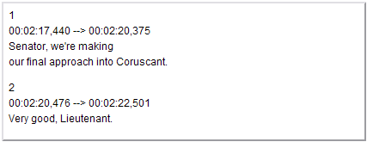
Subtitles-SRT
SRT
SRT is perhaps the most basic of all subtitle formats.
It consists of 4 parts:
1. A number indicating the which subtitle it is in the sequence.
2. The time that the subtitle should appear on the screen, and then disappear.
3. The subtitle itself.
4. A blank line indicating the start of a new subtitle.

Slide 6
Subtitles-SSA/ASS
SSA/ASS
SubStation Alpha (SSA) is an external subtitle fileformat that supports Text Formatting and Styling. It has an enormous amount of options including Karaoke, audio effects, graphic drawing etc. It is the only subtitle format that really supports text formatting and styling at all. It is popular in the Anime scene and among Karaoke fans.
There were several versions. 1, 2, 3, 4 and 4+. The latter is better known Advanced SubStation (ASS). Only 4 and 4+ are still being used.

Slide 7
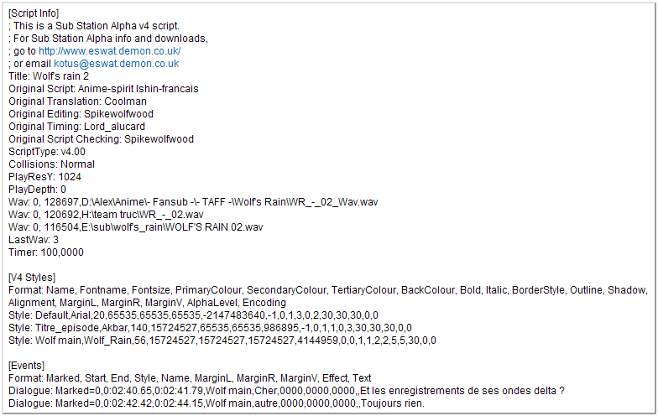
Subtitles-SSA/ASS
A file consists of 4 or 5 parts:

Slide 8
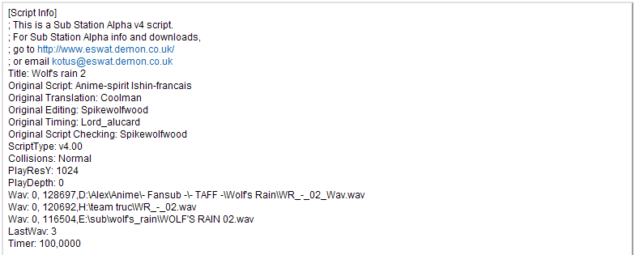
Subtitles-SSA/ASS
1. [Script Info]
information about the subtitle file, such as it's title, who created it, type of script and a very important one : "PlayResY".

Slide 9

Subtitles-SSA/ASS
2. [V4 Styles]
A list of style definitions. A style describe how will look a text on the screen. It defines font, font size, primary/.../outile colour, position, aligment etc ...

Slide 10

Subtitles-SSA/ASS
3. [Events]
The list of text you want to display at the right timing. You can specify some attribute here. Like the style to use for this event (must be defined in the list), the position of the text (Left, Right, Vertical Margin), an effect. Name is mostly used by translator to know who said this sentence. Timing is in h:mm:ss.cc (centisec).
4.[Pictures] or [Fonts]
May be found in some SSA file.

Slide 11
Subtitles-Image Subtitle
Image Subtitle
1. Vobsub(DVD Subtitle)
2. XSub(Divx Subtitle)
3. Others

Slide 12
Subtitles-Vobsub
Vobsub(DVD Subtitle)
DirectVobSub(VSFilter) is a software add-on for Microsoft Windows (a DirectShow filter) that is able to read external subtitle files and render their subtitles along with digital video playback.
DirectVobSub/VSFilter were formerly part of a whole application known as VobSub which was also able to extract subtitles from DVD Video and create text-based subtitles. The last version of VobSub was version 2.23, after which the development of VobSub ceased. VSFilter was a part of the guliverkli project on SourceForge web site.

Slide 13
Subtitles-Vobsub
Vobsub(DVD Subtitle)
Vobsub extracts the DVD subtitles raw PES from a DVD and dumps this to a .sub file. It also creates a .idx Index file with the times and byteoffsets for each and every single subtitle. The format has support for multiple tracks and can also be embedded in MP4 (by Nero) and Matroska files.
DVD subtitles use a system called SPU (SubPicture Units) and they are Run Length Encoded. The format was reverse engineered by Sam Hocevar.
Vobsub Subtitle has Extensions: .idx AND .sub

Slide 14
Subtitles-Vobsub
Vobsub .idx file
An index file for vob, it contains:
1.parameter setting
2.timestamp for subtitles
3.index for subtitles pictures in .vob file
Vosub .vob file
Store subtitle pictures

Slide 15
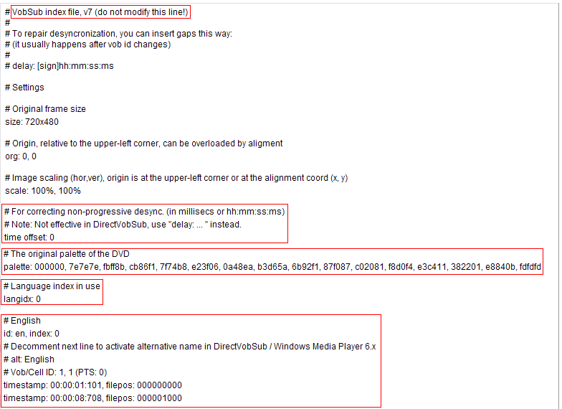
Subtitles-Vobsub

Slide 16
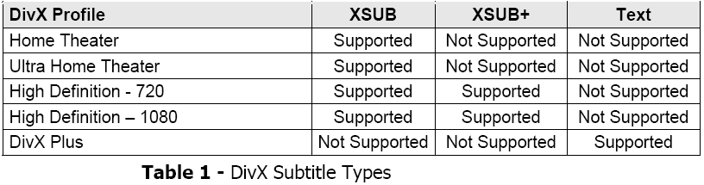
Subtitles-XSub
XSub(Divx Subtitles)
Subtitles are supported by a variety of DivX’s Certification Profiles and in all versions of the DivX Media Format specification.

Slide 17
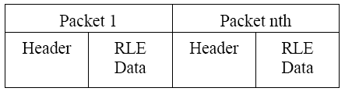
Subtitles-XSub
XSub
Consists of a sequence of packets, each with their own configuration information and data block. Each packet contains information to decode one frame. Each of the packets can be separately decoded .In the subtitle packet, the byte order of multi-byte words is least significant byte first (little endian).

Slide 18
Subtitle Framework
Subtitle In Playback
In our Playback Framework,subtitles are treated as:
1.External Subtitle
Subtitle is packed in some files,putted in the same directory with the video file.It is outside of Input Plugin.
2.Internal Subtitle
Some video file’s track may contain the subtitles.Such as MKV,MP4,AVI may contain some kinds of subtitles.These subtitles is delivered from Input Plugin.

Slide 19
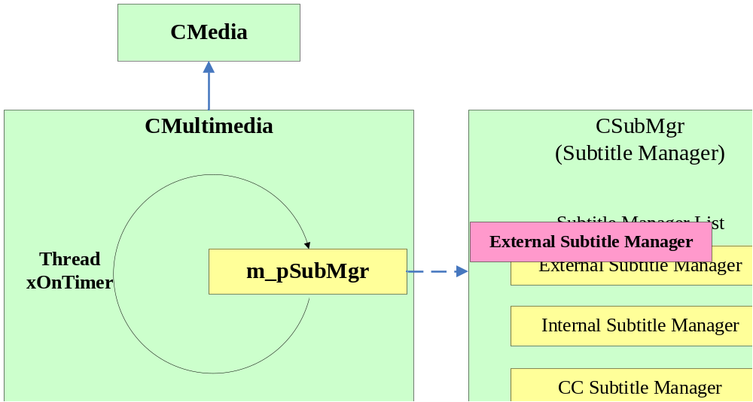
Subtitle Framework-External
External Subtitle Deliver Path
Setp1. Delivered direct to Subtitle Manager.

Slide 20
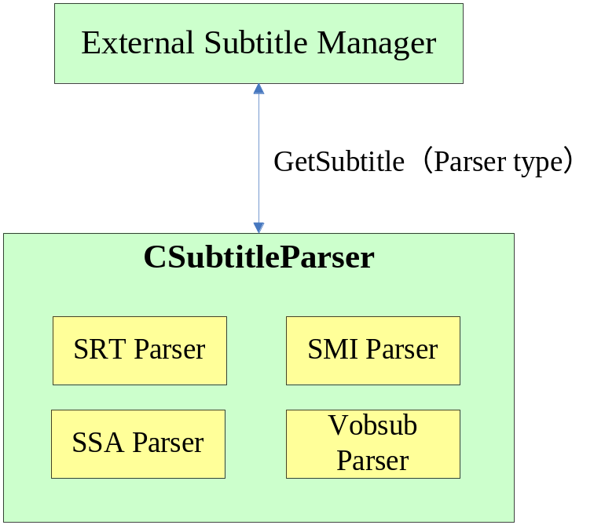
Subtitle Framework-External
External Subtitle Deliver Path
Setp2. External Subtitle Manager will call CSubtitleParser to get subtitles.

Slide 21
Subtitle Framework-Internal
Internal Subtitle Deliver Path
Internal Subtitle is delivered through 2 ways:
1.Text Subtitle is delivered through flow event FE_Playback_SpicFrame.
2.Image Subtitle is delivered direct to ring buffer, rmpSPUFilter parse it.

Slide 22
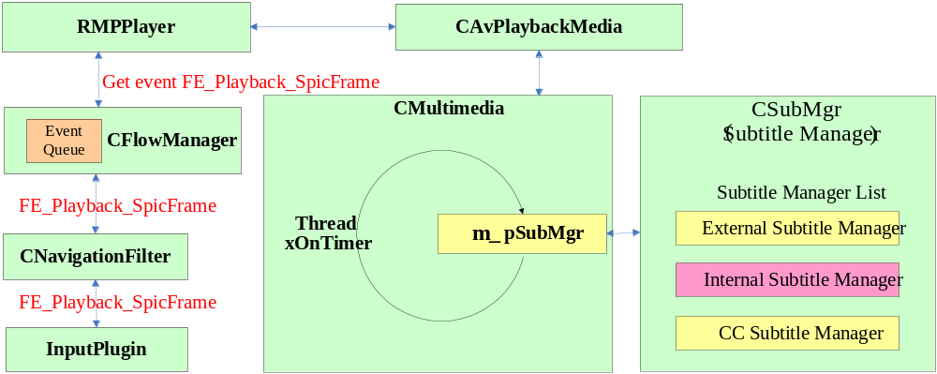
Subtitle Framework-Internal
Text Subtitle Deliverer through FE_Playback_SpicFrame

Slide 23
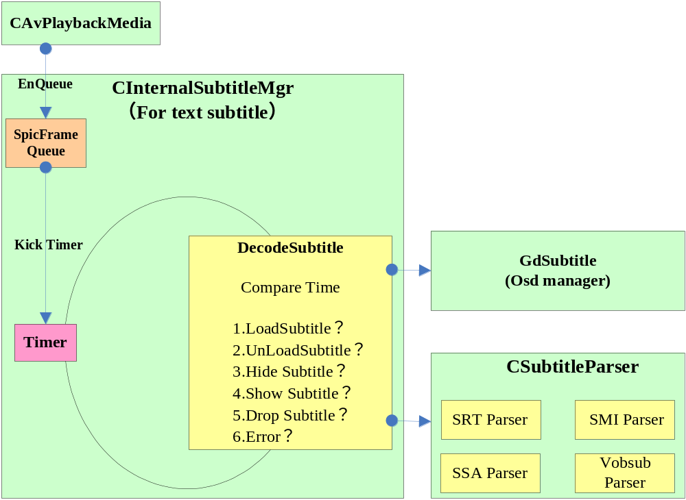
Subtitle Framework-Internal
Text Subtitle Deliverer through FE_Playback_SpicFrame
InternalSubtitleManager code flow

Slide 24
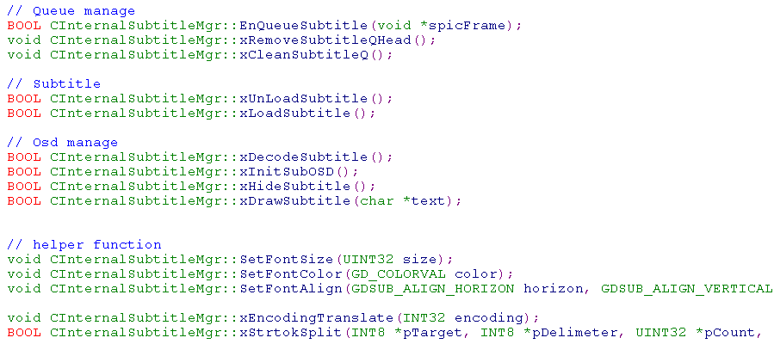
Subtitle Framework-Internal
Internal Subtitle Manager API

Slide 25
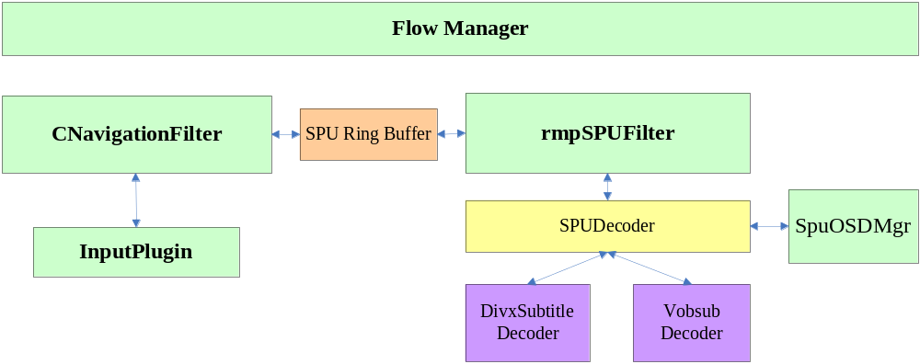
Subtitle Framework-Internal
Image Subtitle Deliverer to rmpSPUFilter

Slide 26
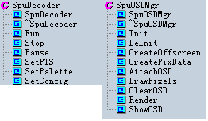
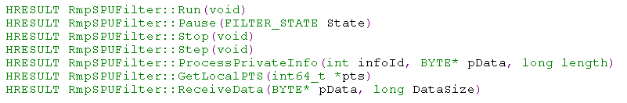
rmpSPUFilter
SpuDeoceder
Abstract class for Vobsubdecoer and DivxsubDecoder
SpuOsdMgr
Osd manager
rmpSPUFilter

Slide 27
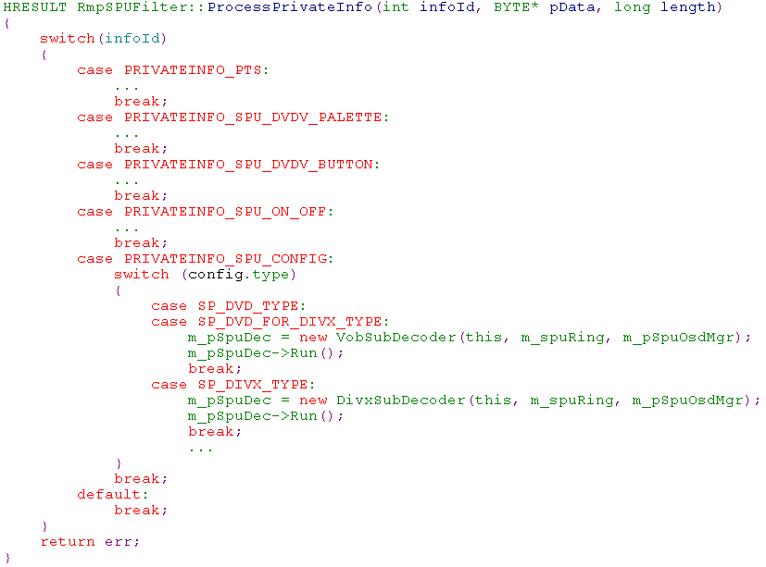
rmpSPUFilter

Slide 28

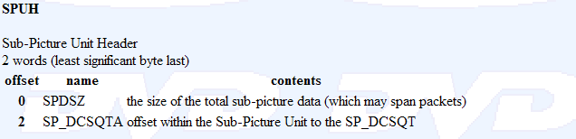

Vobsub
Struct of Vobsub packet
1.Header
2.Data

Slide 29
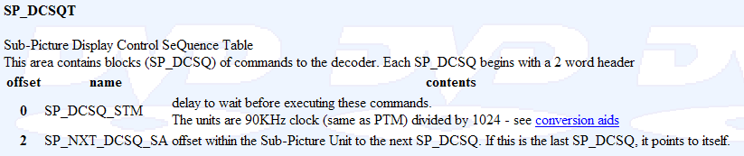
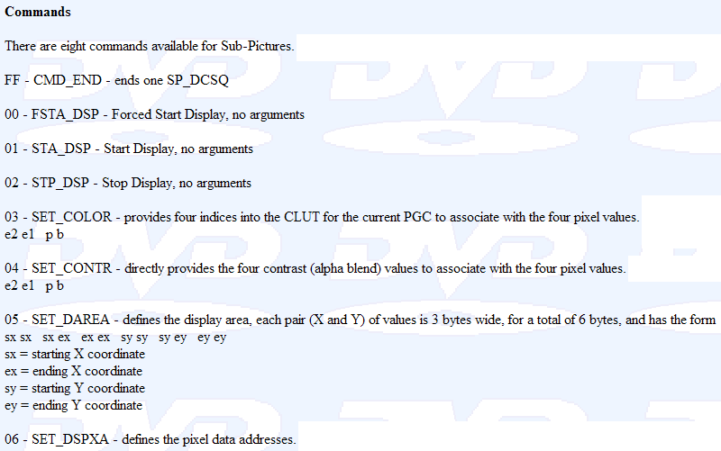
Vobsub
3.Command

Slide 30
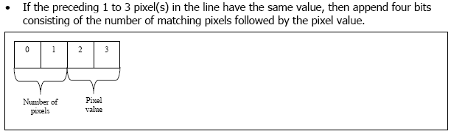
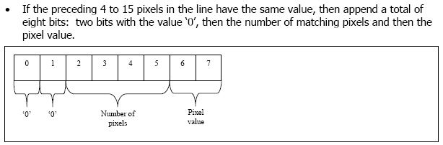
Subtitle Framework-Vobsub
4.RLE

Slide 31
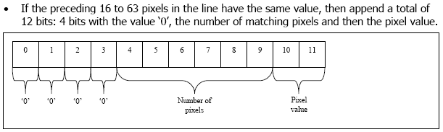
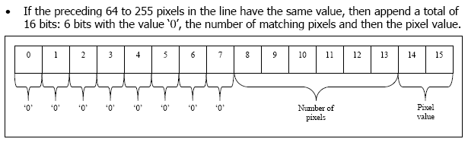
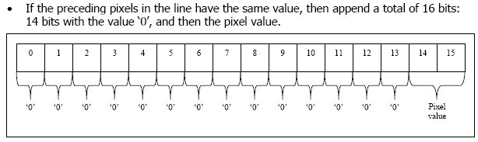
Vobsub

Slide 32
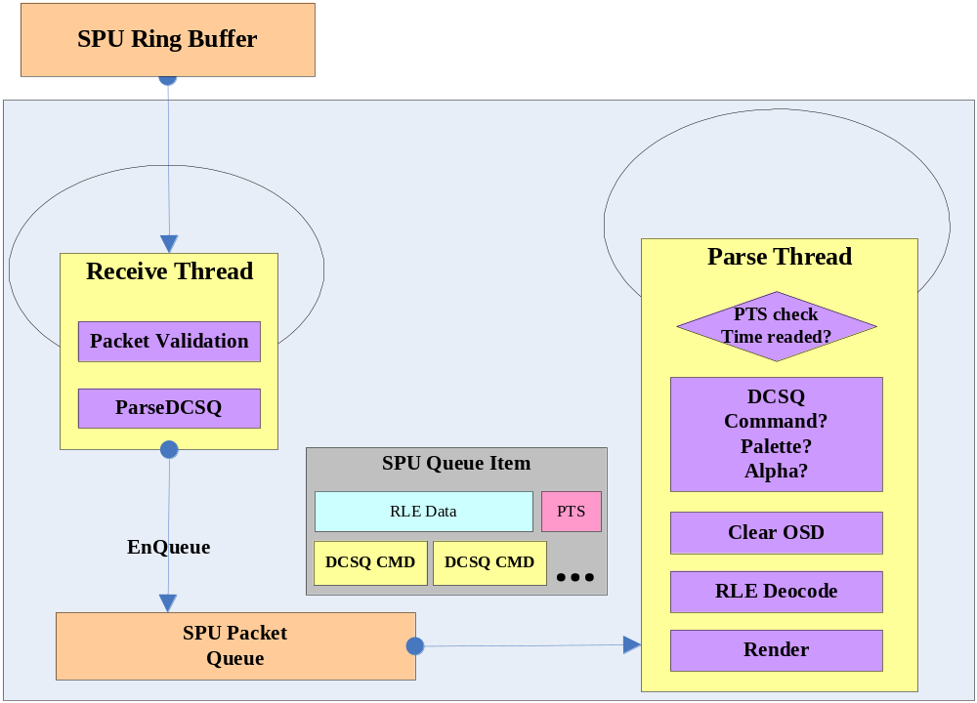
Vobsub
VobsubDecoder

Slide 33
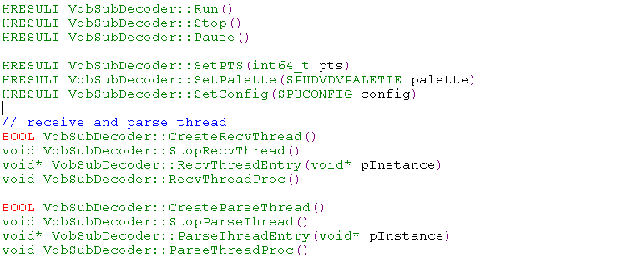
Vobsub
VobsubDecoder API

Slide 34
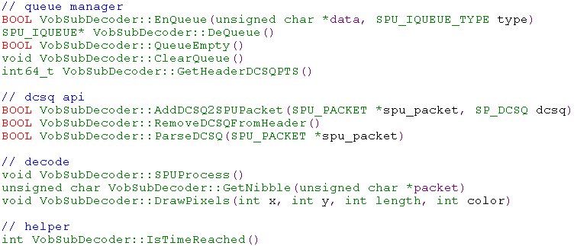
Vobsub
VobsubDecoder API

Slide 35
XSub
DivxSubtitleDecoder(XSub)
Reference VobsubDeocder.

Slide 36
Q&A
Question?

