Slide 1

Project Management – Commercial Management

Slide 2


Home
Recent
Projects
Contact
Home
Create-iF – Building Three – 36 Tenby Street – Birmingham – B1 3EE

Slide 3
Home
Recent
Projects
Contact
Recent Projects & Services
Commercial and Project Management Services to the Construction Industry.
Services Include:
Bills of Quantities
Cost Planning
Design / Value Engineering
Procurement
Contractors Commercial Management
Financial Report (Cost/Value) Auditing
Subcontract Final Accounts
Shannons Mill Walsall | ‘FUSION’ Wolverhampton | Baskerville House Birmingham | Floorplanning & Marketing Photography
Create-iF – Building Three – 36 Tenby Street – Birmingham – B1 3EE

Slide 4
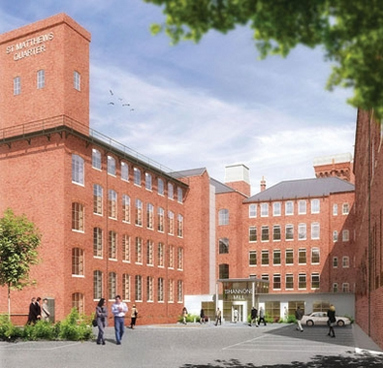
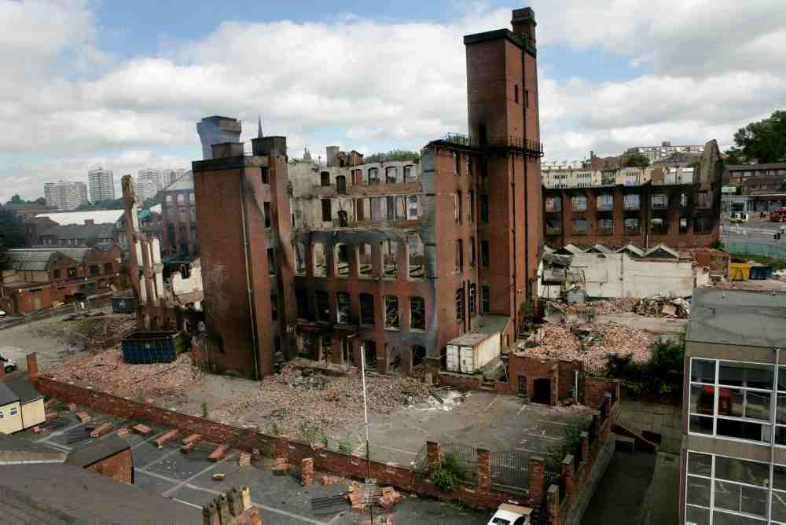
Shannon’s Mill Walsall
Home
Recent
Projects
Contact
Mixed Use Refurbishment of Historic Listed Mill Building
Phase II of St Matthews Quarter
refurbishment to create retail,
residential and commercial space
within a historic listed mill building.
The mill was unfortunately burnt
down and the project became an
emergency demolition and site
clearance project.
 | St Modwen Logo | DBK Back Logo
Shannons Mill Walsall | ‘FUSION’ Wolverhampton | Baskerville House Birmingham | Floorplanning & Marketing Photography

Slide 5

‘FUSION’
Wolverhampton
Home
Recent
Projects
Contact
New Residential Development of Old Rail Station
A new residential development at
the site of the old rail station.
The development will encompass
elements of the existing site such
as ‘Brunel’s Blue Brick Wall’ and
former routes of the rail track
 | Barratt Logo | DBK Back Logo
Shannons Mill Walsall | ‘FUSION’ Wolverhampton | Baskerville House Birmingham | Floorplanning & Marketing Photography

Slide 6
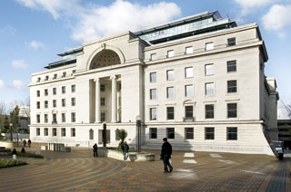
Baskerville House
Birmingham
Home
Recent
Projects
Contact
Refurbishment of Historic Listed City Centre Building
Xxxxxxxxxxxxxxxxxxxxxxxxxx
Xxxxxxxxxxxxxxxxxxxxxxxxxx
Xxxxxxxxxxxxxxxxxxxxxxxxxx
Xxxxxxxxxxxxxxxxxxxxxxxxxx
Xxxxxxxxxxxxxxxxxxxxxxxxxx
Xxxxxxxxxxxxxxxxxxxxxxxxxx
xxxxxxxxxxxxxxxxxxxxxxxxxx
 | Targetfollow Logo | AMCP Logo
Shannons Mill Walsall | ‘FUSION’ Wolverhampton | Baskerville House Birmingham | Floorplanning & Marketing Photography

Slide 7
Floorplanning & Marketing Photography
Home
Recent
Projects
Contact
Xxxxxxxxxxxxxxxxxxxxxxxxxx
Xxxxxxxxxxxxxxxxxxxxxxxxxx
Xxxxxxxxxxxxxxxxxxxxxxxxxx
Xxxxxxxxxxxxxxxxxxxxxxxxxx
Xxxxxxxxxxxxxxxxxxxxxxxxxx
Xxxxxxxxxxxxxxxxxxxxxxxxxx
xxxxxxxxxxxxxxxxxxxxxxxxxx
Shannons Mill Walsall | ‘FUSION’ Wolverhampton | Baskerville House Birmingham | Floorplanning & Marketing Photography

Slide 8

Home
Recent
Projects
Contact
Contact Us
Create-iF
Building Three
36 Tenby Street
Birmingham
B1 3EE
Tel: 0121 233 9313
Fax: 0121 233 9314
Matt Butler
0777 560 7867
matt.butler@create-if.com

