Slide 1
Asynchronous Messaging

Slide 2
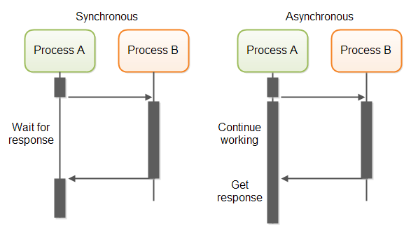
Asynchronous vs Synchronous Communication

Slide 3
Asynchronous Messaging Technologies
JMS(Java Messaging Service) - Java API for Messaging
AMQP(Advanced Message Queueing Protocol) - A Language-independent Protocol for Messaging
MQTT(Message Queueing Telemetry Transport)- A Simplified Messaging Technology for Devices with Less Computing Power(IoT).

Slide 4
JMS
Standard messaging API for JAVA platform
Interoperability is only within Java and JVM languages like Scala, Groovy
Does not worry about the wire level protocol(description of the format of the data that is sent across the network)
Supports 2 messaging models with queues and topics
Supports transactions
Defines the message format (headers, properties and body)
Most widely used implementation: ActiveMQ

Slide 5
AMQP
Platform independent wire level messaging protocol
Consumer driven messaging
Interoperable across multiple languages and platforms
Have 5 exchange types direct, fanout, topic, headers, system
Buffer oriented
Supports long lived messaging
Supports classic message queues, round-robin, store and forward
Metadata allows to control the message flow
Most widely used implementation: RabbitMQ

Slide 6
RabbitMQ
The most widely deployed open source message broker
Lightweight and easy to deploy
Development tools for wide range of programming languages: Java, .Net, Ruby, Python, PHP, Objective-C, Javascript, C, C++, Go, Erlang, Haskell, OCaml, Perl,...

Slide 7
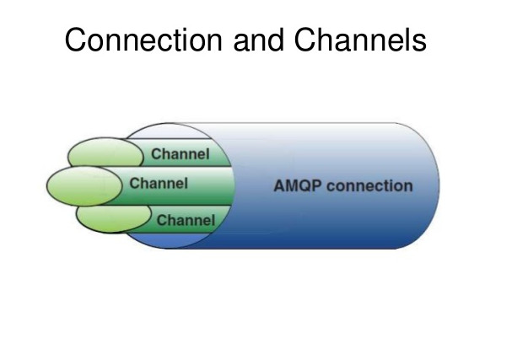
AMQP Connection and Channels
AMQP allows creating multiple channels in a single TCP Connection. Channels are usually getting opened in multiple threads but use the same TCP connection for efficiency.

Slide 8
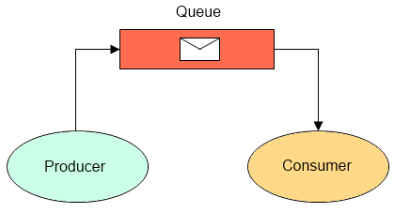
Producers and Consumers

Slide 9
AMQP Messaging Model
Messages are published to exchanges, which are often compared to post offices or mailboxes.
Exchanges then distribute message copies to queues using rules called bindings.
Then AMQP brokers either deliver messages to consumers subscribed to queues, or consumers fetch/pull messages from queues on demand.

Slide 10
Queues
A queue is the name for a post box which lives inside RabbitMQ. Although messages flow through RabbitMQ and your applications, they can only be stored inside a queue.
A queue is only bound by the host's memory & disk limits, it's essentially a large message buffer.
Many producers can send messages that go to one queue, and many consumers can try to receive data from one queue.

Slide 11
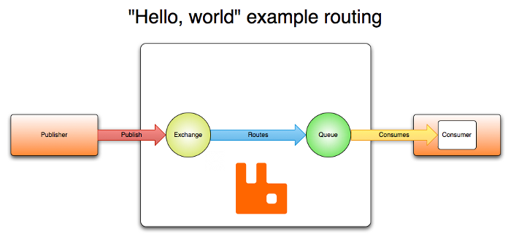
Routing Example

Slide 12
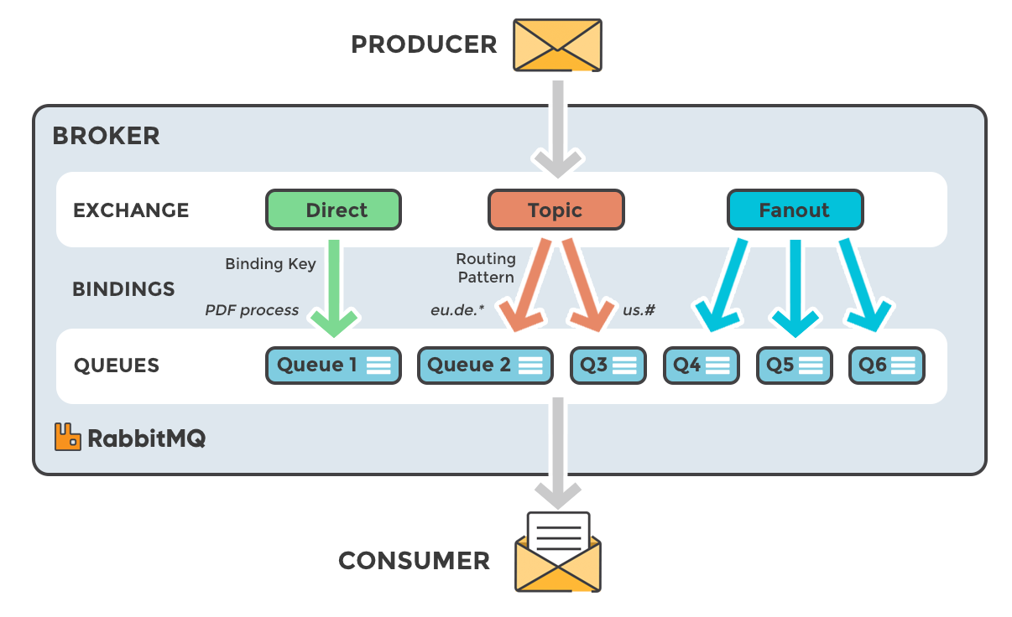
Exchange Types

Slide 13
Direct Exchange
A direct exchange delivers messages to queues based on the message routing key. A direct exchange is ideal for the unicast routing of messages (although they can be used for multicast routing as well).
Here is how it works:
1. A queue binds to the exchange with a routing key K
2. When a new message with routing key R arrives at the direct exchange, the exchange routes it to the queue if K = R

Slide 14
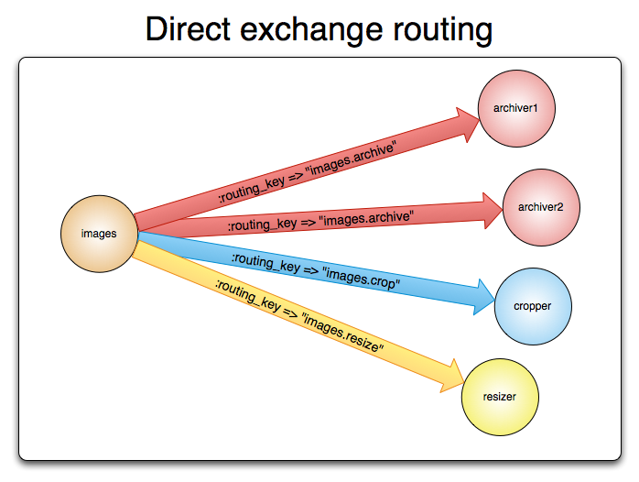
Direct Exchange Illustration

Slide 15
Fanout Exchange
A fanout exchange routes messages to all of the queues that are bound to it and the routing key is ignored. If N queues are bound to a fanout exchange, when a new message is published to that exchange a copy of the message is delivered to all N queues. Fanout exchanges are ideal for the broadcast routing of messages.
Use cases:
Massively multi-player online (MMO) games can use it for leaderboard updates or other global events
Sport news sites can use fanout exchanges for distributing score updates to mobile clients in near real-time
Distributed systems can broadcast various state and configuration updates

Slide 16
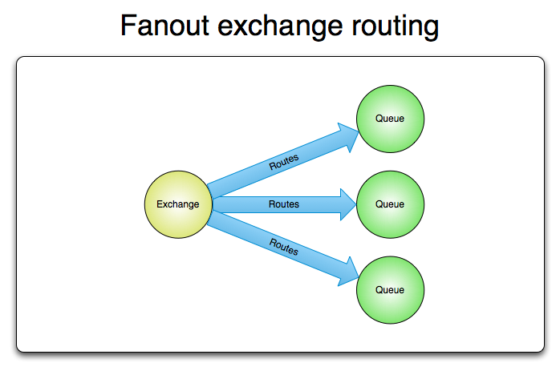
Fanout Exchange Illustration

Slide 17
Topic Exchange
Topic exchanges route messages to one or many queues based on matching between a message routing key and the pattern that was used to bind a queue to an exchange. The topic exchange type is often used to implement various publish/subscribe pattern variations. Topic exchanges are commonly used for the multicast routing of messages.
Use Cases:
Distributing data relevant to specific geographic location, for example, points of sale
Background task processing done by multiple workers, each capable of handling specific set of tasks
Stocks price updates (and updates on other kinds of financial data)
News updates that involve categorization or tagging (for example, only for a particular sport or team)
Orchestration of services of different kinds in the cloud

Slide 18
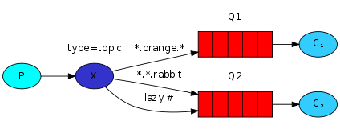
Topic Exchange Illustration

Slide 19
Headers Exchange
A headers exchange is designed for routing on multiple attributes that are more easily expressed as message headers than a routing key.
Headers exchanges ignore the routing key attribute. Instead, the attributes used for routing are taken from the headers attribute.
A message is considered matching if the value of the header equals the value specified upon binding.

Slide 20
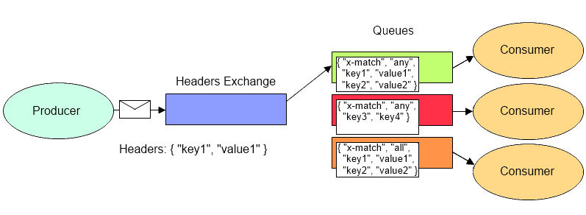
Headers Exchange Illustration

Slide 21
Creating a Channel
ConnectionFactory factory = new ConnectionFactory();
factory.setHost(“host”);
factory.setUsername("guest");
factory.setPassword("pass");
Connection connection = factory.newConnection();
Channel channel = connection.createChannel();

Slide 22
Sending a Message(Producing)
channel.queueDeclare(QUEUE_NAME, false, false, false, null);//queue name, //passive(false- for already existing exchange), durable,autoDelete, Map of arguments.
String message = "Message Body";
channel.basicPublish("", QUEUE_NAME, null, message.getBytes());//”” - default exchange, routing key - same as queue name, null - other properties for the message - routing headers etc,the message body
channel.close();
connection.close();

Slide 23
Receiving a Message(Consuming)
//create channel the same way as in Producer
channel.queueDeclare(QUEUE_NAME, false, false, false, null);
//Create a Consumer Handler
Consumer consumer = new DefaultConsumer(channel) {
public void handleDelivery(String consumerTag, Envelope envelope,AMQP.BasicProperties properties, byte[] body)
throws IOException {
String message = new String(body, "UTF-8"); }};
//Consume
channel.basicConsume(QUEUE_NAME, true, consumer);

Slide 24
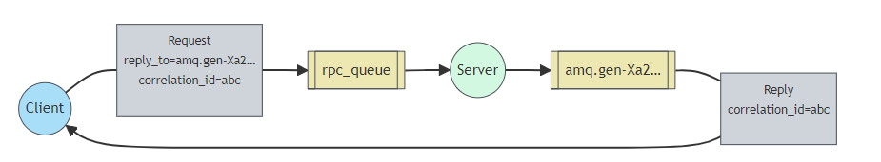
RPC over AMQP(a design pattern)
The Client sends a message with two properties: replyTo, which is set to an anonymous exclusive queue created just for the request, and correlationId, which is set to a unique value for every request.
The request is sent to an rpc_queue queue.
The RPC Server is waiting for requests on that queue. When a request appears, it does the job and sends a message with the result back to the Client, using the queue from the replyTo field.
The client waits for data on the reply queue. When a message appears, it checks the correlationId property. If it matches the value from the request it returns the response to the application.

Slide 25
Direct Exchange Example(Producer)
public class Producer {
private static final String EXCHANGE_NAME = "directExchange";
public static void main(String[] argv) throws Exception {
ConnectionFactory factory = new ConnectionFactory();
factory.setUri("amqps://serveraddress");
try (Connection connection = factory.newConnection(); Channel channel = connection.createChannel()) {
channel.exchangeDeclare(EXCHANGE_NAME, BuiltinExchangeType.DIRECT);
String severity = "error"; String message = "Hello!";
channel.basicPublish(EXCHANGE_NAME, severity, null, message.getBytes("UTF-8"));
System.out.println(" [x] Sent '" + severity + "':'" + message + "'"); }}}

Slide 26
Direct Exchange Example(Consumer) 1
private static final String EXCHANGE_NAME = "directExchange";
public static void main(String[] argv) throws Exception {
ConnectionFactory factory = new ConnectionFactory();
factory.setUri("amqps://serveraddress");
Connection connection = factory.newConnection();
Channel channel = connection.createChannel();
channel.exchangeDeclare(EXCHANGE_NAME, BuiltinExchangeType.DIRECT);
String queueName = channel.queueDeclare().getQueue();
String severity = "error"; // The routing key this consumer listens to
channel.queueBind(queueName, EXCHANGE_NAME, severity);

Slide 27
Direct Exchange Example(Consumer) 2
System.out.println(" [*] Waiting for " + severity + " messages. To exit press CTRL+C");
DeliverCallback deliverCallback = (consumerTag, delivery) -> {
String message = new String(delivery.getBody(), "UTF-8");
System.out.println(" [x] Received '" + delivery.getEnvelope().getRoutingKey() + "':'" + message + "'");
};
channel.basicConsume(queueName, true, deliverCallback, consumerTag -> {});
}

Slide 28
Topic Exchange Example(Producer) 1
public class Producer {
private static final String EXCHANGE_NAME = "topic_logs";
public static void main(String[] argv) throws Exception {
ConnectionFactory factory = new ConnectionFactory();
factory.setUri("amqps://serveraddress");
try (Connection connection = factory.newConnection();
Channel channel = connection.createChannel()) {
channel.exchangeDeclare(EXCHANGE_NAME, BuiltinExchangeType.TOPIC);
String[] routingKeys = {"quick.orange.rabbit", "lazy.orange.elephant", "quick.orange.fox",
"quick.fox"};

Slide 29
Topic Exchange Example(Producer) 2
for (String routingKey : routingKeys) {
String message = "Message for " + routingKey;
channel.basicPublish(EXCHANGE_NAME, routingKey, null, message.getBytes("UTF-8"));
System.out.println(" [x] Sent '" + routingKey + "':'" + message + "'");
}
}
}
}

Slide 30
Topic Exchange Example(Consumer) 1
public class Consumer {
private static final String EXCHANGE_NAME = "topic_logs";
public static void main(String[] argv) throws Exception {
ConnectionFactory factory = new ConnectionFactory();
factory.setUri("amqps://serveraddress");
Connection connection = factory.newConnection();
Channel channel = connection.createChannel();
channel.exchangeDeclare(EXCHANGE_NAME, BuiltinExchangeType.TOPIC);
String queue1Name = channel.queueDeclare().getQueue();
String queue2Name = channel.queueDeclare().getQueue();
// Bind with a pattern to receive all messages about orange animals
String bindingKey1 = "*.orange.*";
channel.queueBind(queue1Name, EXCHANGE_NAME, bindingKey1);
String bindingKey2 = "*.fox";
channel.queueBind(queue2Name, EXCHANGE_NAME, bindingKey2);
// System.out.println(" [*] Waiting for messages for pattern (" + bindingKey + "). To exit press CTRL+C");
System.out.println(" [*] Waiting for messages.");
DeliverCallback deliverCallback1 = (consumerTag, delivery) -> {
String message = new String(delivery.getBody(), "UTF-8");
String routingKey = delivery.getEnvelope().getRoutingKey();
System.out.println(" [x] Received '" + routingKey + "':'" + message + "'");
};
DeliverCallback deliverCallback2 = (consumerTag, delivery) -> {
String message = new String(delivery.getBody(), "UTF-8");
String routingKey = delivery.getEnvelope().getRoutingKey();
System.out.println(" [xx] Received '" + routingKey + "':'" + message + "'");
};
channel.basicConsume(queue2Name, true, deliverCallback2, consumerTag -> {});
channel.basicConsume(queue1Name, true, deliverCallback1, consumerTag -> {});
}
}

Slide 31
Topic Exchange Example(Consumer) 2
// Bind with a pattern to receive all messages about orange animals
String bindingKey1 = "*.orange.*";
channel.queueBind(queue1Name, EXCHANGE_NAME, bindingKey1);
String bindingKey2 = "*.fox";
channel.queueBind(queue2Name, EXCHANGE_NAME, bindingKey2);
System.out.println(" [*] Waiting for messages.");
DeliverCallback deliverCallback1 = (consumerTag, delivery) -> {
String message = new String(delivery.getBody(), "UTF-8");
String routingKey = delivery.getEnvelope().getRoutingKey();
System.out.println(" [x] Received '" + routingKey + "':'" + message + "'"); };
DeliverCallback deliverCallback2 = (consumerTag, delivery) -> {
String message = new String(delivery.getBody(), "UTF-8");
String routingKey = delivery.getEnvelope().getRoutingKey();
System.out.println(" [xx] Received '" + routingKey + "':'" + message + "'");
};
channel.basicConsume(queue2Name, true, deliverCallback2, consumerTag -> {});
channel.basicConsume(queue1Name, true, deliverCallback1, consumerTag -> {});
}
}

Slide 32
Topic Exchange Example(Consumer) 3
DeliverCallback deliverCallback2 = (consumerTag, delivery) -> {
String message = new String(delivery.getBody(), "UTF-8");
String routingKey = delivery.getEnvelope().getRoutingKey();
System.out.println(" [xx] Received '" + routingKey + "':'" + message + "'");
};
channel.basicConsume(queue2Name, true, deliverCallback2, consumerTag -> {});
channel.basicConsume(queue1Name, true, deliverCallback1, consumerTag -> {});
}
}

Slide 33
Fanout Exchange Example(Producer)
public class Producer {
private static final String EXCHANGE_NAME = "fanoutExchange";
public static void main(String[] argv) throws Exception {
ConnectionFactory factory = new ConnectionFactory();
factory.setUri("amqps://serveraddress");
try (Connection connection = factory.newConnection();
Channel channel = connection.createChannel()) {
channel.exchangeDeclare(EXCHANGE_NAME, BuiltinExchangeType.FANOUT);
String message = "Hello World!";
channel.basicPublish(EXCHANGE_NAME, "", null, message.getBytes("UTF-8")); }}}
System.out.println(" [x] Sent '" + message + "'");
}}}

Slide 34
Fanout Exchange Example(Consumer) 1
public class Consumer {
private static final String EXCHANGE_NAME = "fanoutExchange";
public static void main(String[] argv) throws Exception {
ConnectionFactory factory = new ConnectionFactory();
factory.setUri("amqps://serveraddress");
Connection connection = factory.newConnection();
Channel channel = connection.createChannel();
channel.exchangeDeclare(EXCHANGE_NAME, BuiltinExchangeType.FANOUT);
String queueName1 = channel.queueDeclare().getQueue();
channel.queueBind(queueName1, EXCHANGE_NAME, "");

Slide 35
Fanout Exchange Example(Consumer) 2
String queueName2 = channel.queueDeclare().getQueue();
channel.queueBind(queueName2, EXCHANGE_NAME, "");
System.out.println(" [*] Waiting for messages. To exit press CTRL+C");
DeliverCallback deliverCallback1 = (consumerTag, delivery) -> {
String message = new String(delivery.getBody(), "UTF-8");
System.out.println(" [x] Received '" + message + "'");
};
DeliverCallback deliverCallback2 = (consumerTag, delivery) -> {
String message = new String(delivery.getBody(), "UTF-8");
System.out.println(" [xx] Received '" + message + "'"); };

Slide 36
Fanout Exchange Example(Consumer) 3
channel.basicConsume(queueName1, true, deliverCallback1, consumerTag -> {});
channel.basicConsume(queueName2, true, deliverCallback2, consumerTag -> {});
}
}

Slide 37
Header Exchange Example(Producer) 1
public class Producer {
private static final String EXCHANGE_NAME = "my-header-exchange";
public static void main(String[] argv) throws Exception {
ConnectionFactory factory = new ConnectionFactory();
factory.setUri("amqps://serveraddress");
try (Connection connection = factory.newConnection();
Channel channel = connection.createChannel()) {
channel.exchangeDeclare(EXCHANGE_NAME, BuiltinExchangeType.HEADERS);
String message = "Header Exchange example 1";
Map<String, Object> headerMap = new HashMap<>();

Slide 38
Header Exchange Example(Producer) 2
headerMap.put("h1", "Header1");
headerMap.put("h3", "Header3");
AMQP.BasicProperties properties = new AMQP.BasicProperties()
.builder().headers(headerMap).build();
channel.basicPublish("my-header-exchange", "", properties, message.getBytes());
message = "Header Exchange example 2";
headerMap.put("h2", "Header2");
properties = new AMQP.BasicProperties()
.builder().headers(headerMap).build();
channel.basicPublish("my-header-exchange", "", properties, message.getBytes()); } } }

Slide 39
Header Exchange Example(Consumer) 1
public class Consumer {
private static final String EXCHANGE_NAME = "my-header-exchange";
public static void main(String[] argv) throws Exception {
ConnectionFactory factory = new ConnectionFactory();
factory.setUri("amqps://serveraddress");
Connection connection = factory.newConnection();
Channel channel = connection.createChannel();
channel.exchangeDeclare(EXCHANGE_NAME, BuiltinExchangeType.HEADERS);

Slide 40
Header Exchange Example(Consumer) 2
//Create the Queues
channel.queueDeclare("HealthQ", true, false, false, null);
channel.queueDeclare("SportsQ", true, false, false, null);
channel.queueDeclare("EducationQ", true, false, false, null);
Map<String, Object> healthArgs = new HashMap<>();
healthArgs.put("x-match", "any"); //Match any of the header
healthArgs.put("h1", "Header1");
healthArgs.put("h2", "Header2");
channel.queueBind("HealthQ", "my-header-exchange", "", healthArgs);
Map<String, Object> sportsArgs = new HashMap<>();
sportsArgs.put("x-match", "all"); //Match all of the header
sportsArgs.put("h1", "Header1");
sportsArgs.put("h2", "Header2");
channel.queueBind("SportsQ", "my-header-exchange", "", sportsArgs);
Map<String, Object> educationArgs = new HashMap<>();
educationArgs.put("x-match", "any"); //Match any of the header
educationArgs.put("h1", "Header1");
educationArgs.put("h2", "Header2");
channel.queueBind("EducationQ", "my-header-exchange", "", educationArgs);
channel.basicConsume("HealthQ", true, ((consumerTag, message) -> {
System.out.println("\n\n=========== Health Queue ==========");
System.out.println(consumerTag);
System.out.println("HealthQ: " + new String(message.getBody()));
System.out.println(message.getEnvelope());
}), consumerTag -> {
System.out.println(consumerTag);
});
channel.basicConsume("SportsQ", true, ((consumerTag, message) -> {
System.out.println("\n\n ============ Sports Queue ==========");
System.out.println(consumerTag);
System.out.println("SportsQ: " + new String(message.getBody()));
System.out.println(message.getEnvelope());
}), consumerTag -> {
System.out.println(consumerTag);
});
channel.basicConsume("EducationQ", true, ((consumerTag, message) -> {
System.out.println("\n\n ============ Education Queue ==========");
System.out.println(consumerTag);
System.out.println("EducationQ: " + new String(message.getBody()));
System.out.println(message.getEnvelope());
}), consumerTag -> {
System.out.println(consumerTag);
});
System.out.println(" [*] Waiting for messages.");
}
}

Slide 41
Header Exchange Example(Consumer) 3
Map<String, Object> sportsArgs = new HashMap<>();
sportsArgs.put("x-match", "all"); //Match all of the header
sportsArgs.put("h1", "Header1");
sportsArgs.put("h2", "Header2");
channel.queueBind("SportsQ", "my-header-exchange", "", sportsArgs);
Map<String, Object> educationArgs = new HashMap<>();
educationArgs.put("x-match", "any"); //Match any of the header
educationArgs.put("h1", "Header1");
educationArgs.put("h2", "Header2");
channel.queueBind("EducationQ", "my-header-exchange", "", educationArgs);
channel.basicConsume("HealthQ", true, ((consumerTag, message) -> {
System.out.println("\n\n=========== Health Queue ==========");
System.out.println(consumerTag);
System.out.println("HealthQ: " + new String(message.getBody()));
System.out.println(message.getEnvelope());
}), consumerTag -> {
System.out.println(consumerTag);
});
channel.basicConsume("SportsQ", true, ((consumerTag, message) -> {
System.out.println("\n\n ============ Sports Queue ==========");
System.out.println(consumerTag);
System.out.println("SportsQ: " + new String(message.getBody()));
System.out.println(message.getEnvelope());
}), consumerTag -> {
System.out.println(consumerTag);
});
channel.basicConsume("EducationQ", true, ((consumerTag, message) -> {
System.out.println("\n\n ============ Education Queue ==========");
System.out.println(consumerTag);
System.out.println("EducationQ: " + new String(message.getBody()));
System.out.println(message.getEnvelope());
}), consumerTag -> {
System.out.println(consumerTag);
});
System.out.println(" [*] Waiting for messages.");
}
}

Slide 42
Header Exchange Example(Consumer) 4
channel.basicConsume("HealthQ", true, ((consumerTag, message) -> {
System.out.println("\n\n=========== Health Queue ==========");
System.out.println(consumerTag);
System.out.println("HealthQ: " + new String(message.getBody()));
System.out.println(message.getEnvelope());
}), consumerTag -> {
System.out.println(consumerTag);
});

Slide 43
Header Exchange Example(Consumer) 5
channel.basicConsume("SportsQ", true, ((consumerTag, message) -> {
System.out.println("\n\n ============ Sports Queue ==========");
System.out.println(consumerTag);
System.out.println("SportsQ: " + new String(message.getBody()));
System.out.println(message.getEnvelope());
}), consumerTag -> {
System.out.println(consumerTag);
});
channel.basicConsume("EducationQ", true, ((consumerTag, message) -> {
System.out.println("\n\n ============ Education Queue ==========");
System.out.println(consumerTag);
System.out.println("EducationQ: " + new String(message.getBody()));
System.out.println(message.getEnvelope());
}), consumerTag -> {
System.out.println(consumerTag);
});
System.out.println(" [*] Waiting for messages.");
}
}

Slide 44
Header Exchange Example(Consumer) 6
channel.basicConsume("EducationQ", true, ((consumerTag, message) -> {
System.out.println("\n\n ============ Education Queue ==========");
System.out.println(consumerTag);
System.out.println("EducationQ: " + new String(message.getBody()));
System.out.println(message.getEnvelope());
}), consumerTag -> {
System.out.println(consumerTag);
});
System.out.println(" [*] Waiting for messages."); }}

