Slide 1
Distributed Systems
Tigran Shahinyan, PhD in Computer Science
Researcher at IIAP, NAS, Yerevan.
Senior Developer, Epam Systems, Yerevan.
tigran.shahinyan@gmail.com
+37455 314159

Slide 2
Scope
Introduction to Distributed Computing
Network Programming in Java
Java Concurrent Programming
RPC Technologies in Java
MapReduce Paradigm
Hadoop Ecosystem
Hadoop Distributed File System(HDFS)
Hadoop MapReduce Engine
Introduction to Apache Pig
Introduction to Apache Hive
Integration with other Systems(NoSQL and RDBMS)
Distributed Computing Beyond Hadoop

Slide 3
Prerequisites
Willingness to study New Things.
Knowledge of Basic Algorithms.
Basic knowledge of Computer Networks.
Basic knowledge of Java. Python is a plus.
Elementary knowledge of Relational Databases.

Slide 4
Organization
Lessons consist of theoretical and practical parts.
Each lecture presentation will be sent by email if not uploaded in the portal.
On examine you will have 3 tasks all covered in the slides.
Further learning materials:
https://tools.ietf.org/html/rfc1180
https://www.coursera.org/learn/distributed-programming-in-java
https://www.coursera.org/learn/hadoop
Hadoop: The Definitive Guide, 4th Edition, 2015, Tom White

Slide 5
What you will learn during the course
Basic networking. TCP/IP protocol.
Java socket programming.
Asynchronous and Synchronous communication.
RPC technologies. RMI.
Messaging. RabbitMQ.
Basic knowledge of Hadoop ecosystem.
MapReduce paradigm. Writing programs using Hadoop MapReduce.
Higher level languages for Hadoop: Hive and Pig.
Distributed computing advanced algorithms and concepts

Slide 6
Introduction to Distributed Computing

Slide 7
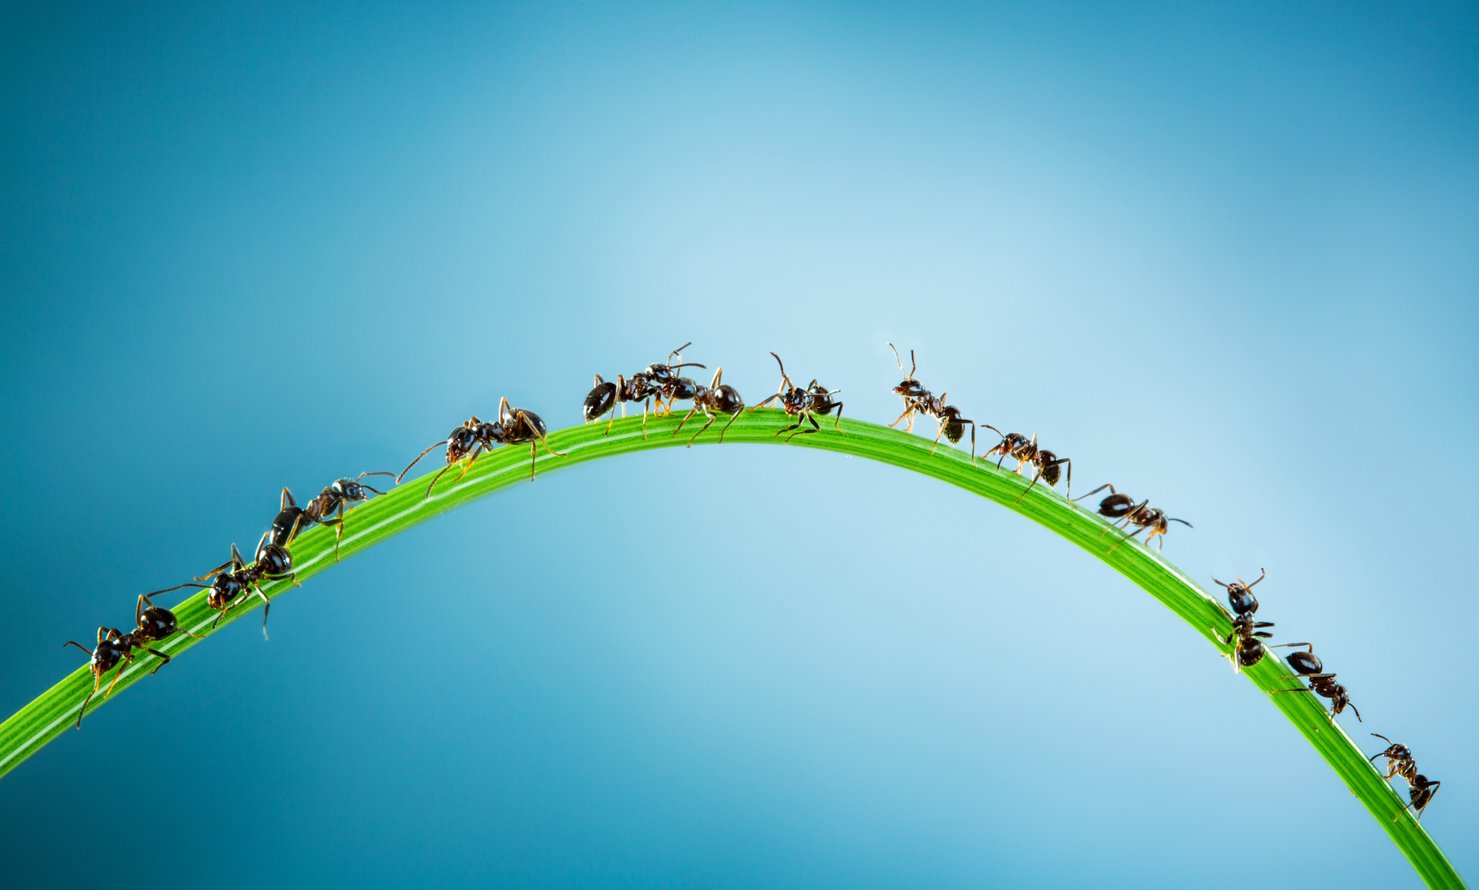
Examples of Distributed Systems
The Internet
Wireless Communication
Cloud Computing
Multi-core Systems
Brain
Ant Colony
Human Society

Slide 8
Why Distributed Computing?
Performance
Fault Tolerance
Security

Slide 9
Common Features
Many entities(nodes) of the system are active at any moment of time.
Nodes have certain degree of freedom(hardware and/or software)
Nodes operate concurrently.
Nodes fail independently. The fail of a node doesn’t necessarily mean fail of the whole system.
Nodes do not share a global clock. Nodes are not strongly synchronized.
There is a necessity of coordination.

Slide 10
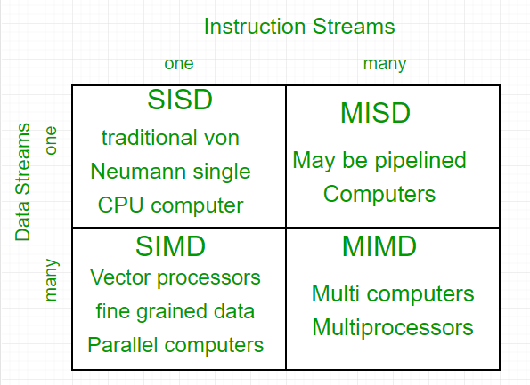
Computer Architecture Types(Flynn’s classification)

Slide 11
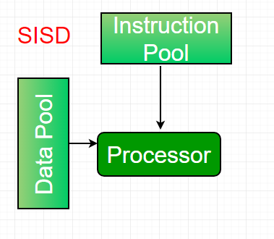
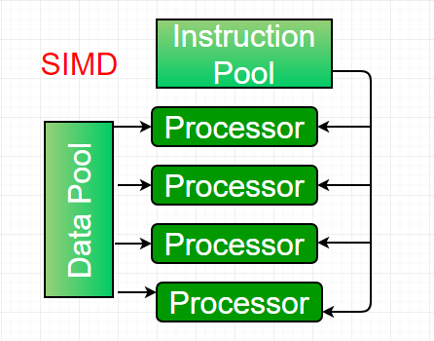
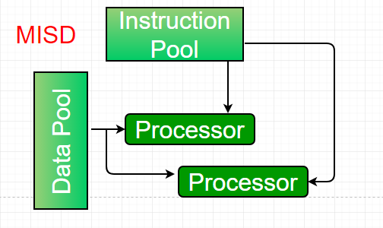
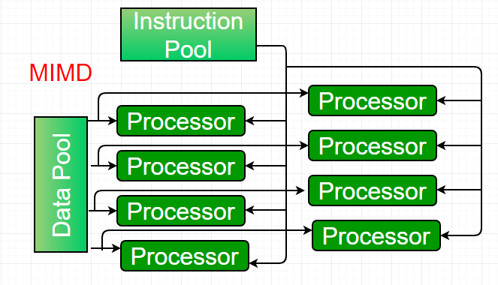

Slide 12
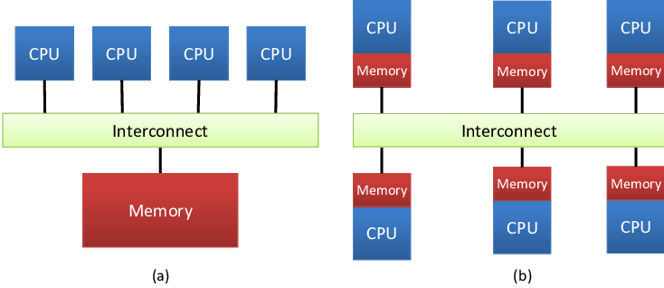
MIMD subtypes
aa
Shared Memory, b) Shared Nothing

Slide 13
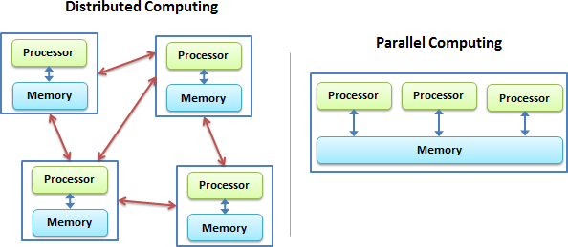
Distributed vs. Parallel Systems

Slide 14
Differences
Cooperation of nodes : synchronous vs. asynchronous
Types of nodes: homogeneous vs. heterogeneous
Communication techniques, e.g., message exchange, shared memory

Slide 15
Main Artefacts
Storage(local and distributed file systems, relational and non-relational databases, etc,.)
Computation(computational resources and models of computation)
Communication(networks, synchronous and asynchronous communication)

Slide 16
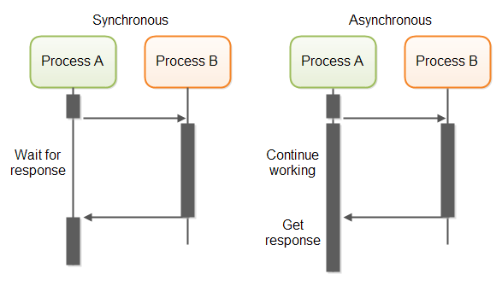
Messaging
Means of loosely coupled subsystems.

Slide 17
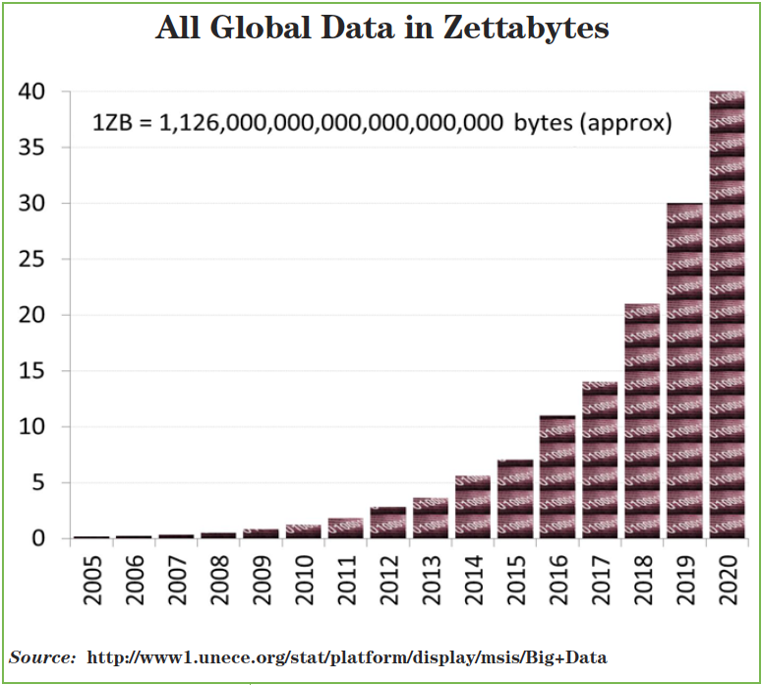
Global Data Growth(one of the main reasons for distributed computing)

Slide 18
Scalability
Capability of a system, network, or process to handle a growing amount of work, or its potential to be enlarged to accommodate that growth.

Slide 19
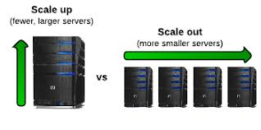
Scaling
Horizontal(Scale out) - add more nodes
Vertical(Scale up) - add more resources on a single node

Slide 20
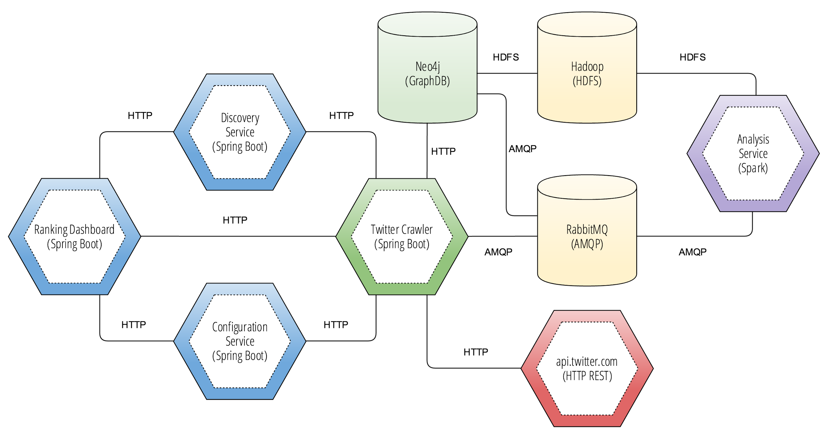
An Example of Distributed Architecture

