Slide 1
2. Network Programming in Java

Slide 2
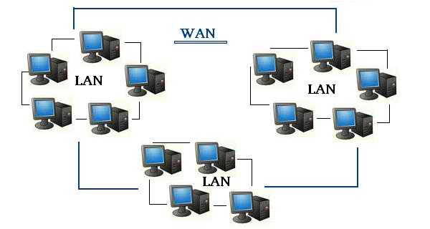
LAN and WAN
LAN ( Local Area Network) is a network covering a small geographic area and connecting various end devices like computers and printers. LAN may be limited to a home, office, schools or building.
WAN( Wide Area Network) is a network that covers a broad area and used to connect end devices like computers and printers which are distributed across long distance. WAN is used to connect different LANs.

Slide 3
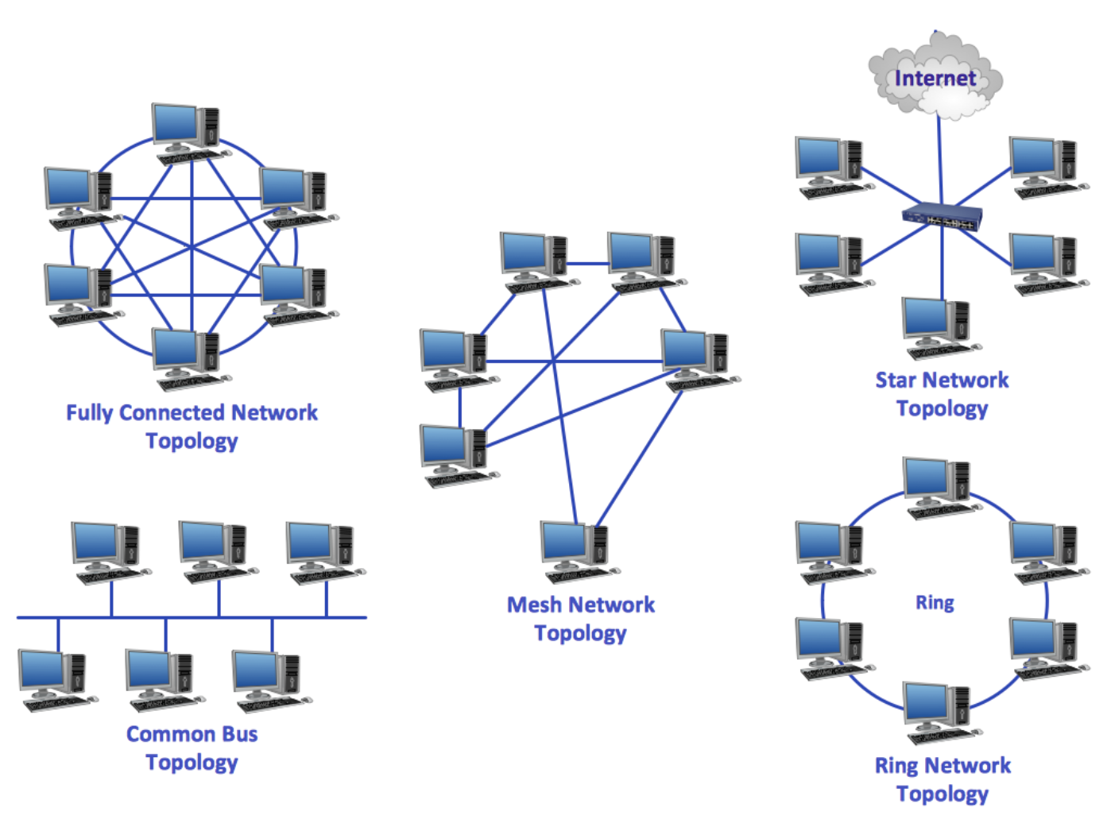
Different Network Topologies
Fully Connected Network Topology - each node is connected to every other node on the network through a dedicated point-to-point link.
Star Topology - each node in the network is connected to a central device called hub.
Ring Topology - each node is connected with the two nodes on both sides of it.
Common Bus Topology - all the nodes are connected to the main cable(bus) through drop lines.
Mesh Topology - each node is connected directly, dynamically and non-hierarchically to as many other nodes as possible.

Slide 4
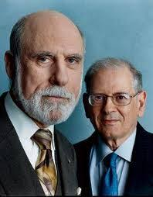
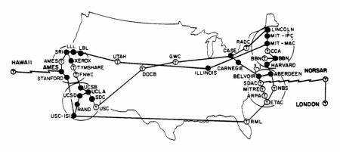
Emerging of Arpanet 1973
Networking research in the early 1970s by Bob Kahn and Vint Cerf led to the formulation of the Transmission Control Program (TCP) in 1974.
As the network development progressed, a protocol for internetworking was developed by which multiple separate networks could be joined into a network of networks. Originally referred to as IP/TCP, version 4 of TCP/IP was installed in the ARPANET for production use in January 1983 after the Department of Defense made it standard for all military computer networking.

Slide 5
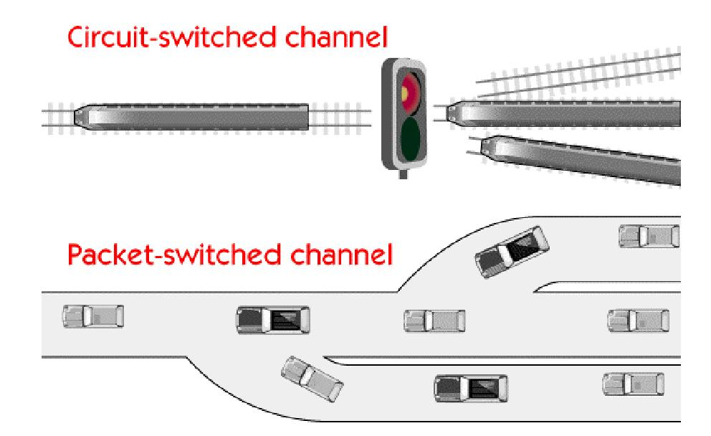
Circuit Switching vs. Packet Switching
 | Pros | Cons
Circuit switching | Offers a dedicated transmission channel that is reserved until it is disconnected. | Dedicated channels can cause delays because a channel is unavailable until one side disconnects. Uses a dedicated physical link between the sending and receiving devices.
Packet switching | Packets can be routed around network congestion. Packet switching makes efficient use of network bandwidth. | Packets can become lost while taking alternative routes to the destination. Messages are divided into packets that contain source and destination information.

Slide 6
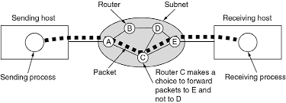
Packet Switching Subnet
Typically, within an individual network, there exists a protocol for communication between any source and destination process. Only the source and destination processes require knowledge of this convention for communication to take place. Processes in two distinct networks would ordinarily use different protocols for this purpose. The ensemble of packet switches and communication media is called the packet switching subnet.

Slide 7
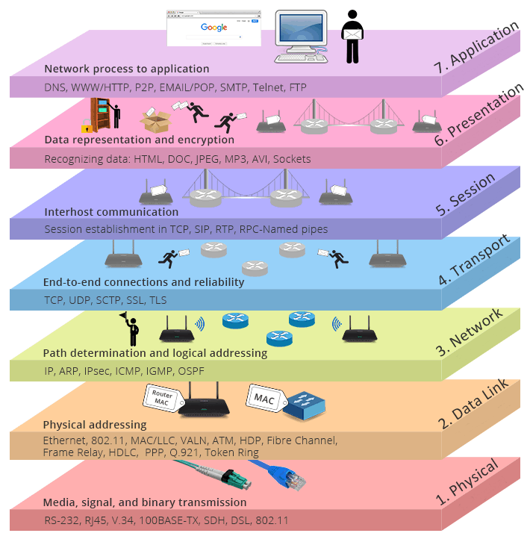
OSI Reference Model Layers
OSI model is a conceptual model that characterizes and standardizes how different software and hardware components involved in a network communication should divide labor and interact with one another.

Slide 8
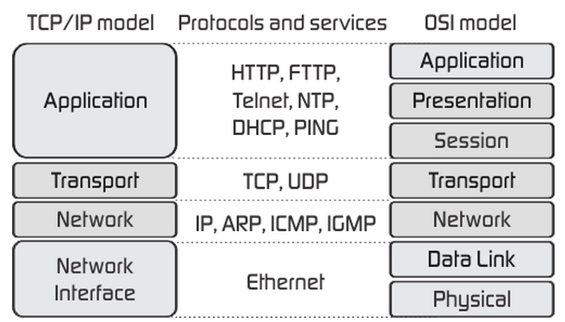
TCP/IP Stack
TCP/IP model is also a layered reference model, but it is a four-layer model. Another name for it is Internet protocol suite. It is commonly known as TCP/IP because the foundational protocols are TCP and IP, but not only these two protocols are used in this model.

Slide 9
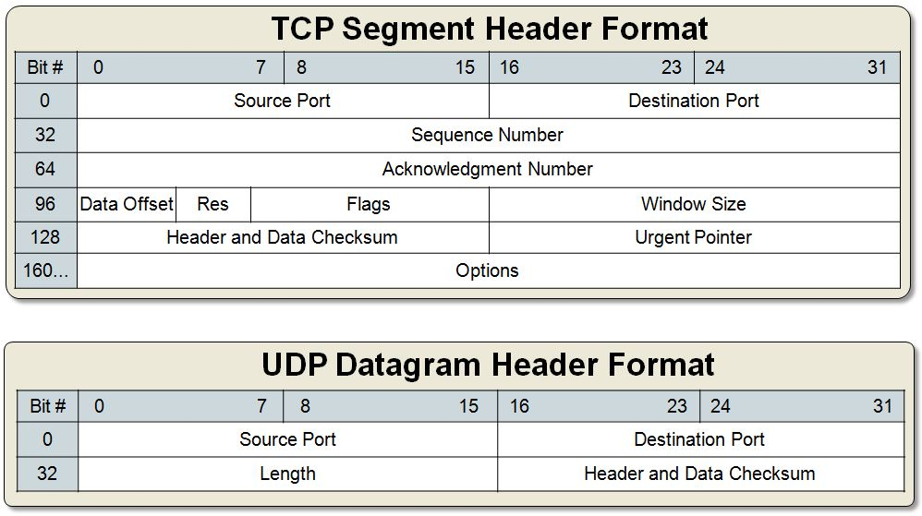
TCP vs. UDP Header

Slide 10
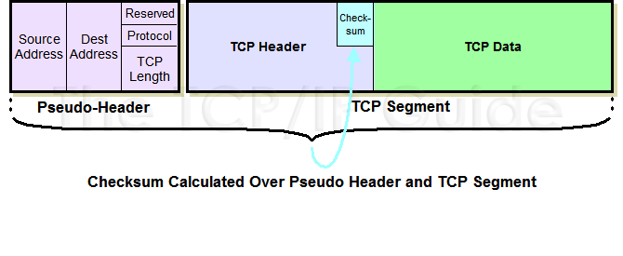
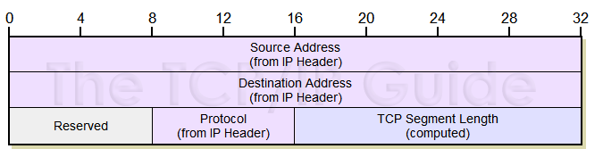
Pseudo Header
Pseudo header helps in calculating the CheckSum of TCP UDP Packets. From the TCP or UDP point of view, the TCP packet does not contain IP addresses. Thus, to do a proper checksum, a "pseudo-header" is included. It's "pseudo", because it is not actually part of the TCP/UDP datagram. It contains the most important parts of the IP header, that is, source and destination address, protocol number and data length.

Slide 11
TCP and UDP header parameters
Source port (16 bits) - Identifies the sending port.
Destination port (16 bits) -Identifies the receiving port.
Sequence number (32 bits) - Has a dual role:
If the SYN flag is set (1), then this is the initial sequence number. The sequence number of the actual first data byte and the acknowledged number in the corresponding ACK are then this sequence number plus 1.
If the SYN flag is clear (0), then this is the accumulated sequence number of the first data byte of this segment for the current session
Acknowledgment number (32 bits)
Data offset (4 bits) - Specifies the size of the TCP header in 32-bit words.
Reserved (3 bits) -For future use and should be set to zero.
Flags (9 bits) (aka Control bits) - NS,CWR,ECE,SYN,URG,ACK,PSH,RST,SYN,FIN
Window size (16 bits) - The size of the receive window.
Checksum (16 bits) - The 16-bit checksum field is used for error-checking of the header, the Payload and a Pseudo-Header.The Pseudo-Header consists of the Source IP Address, the Destination IP Address, the protocol number for the TCP-Protocol (0x0006) and the length of the TCP-Headers including Payload (in Bytes)
Urgent pointer (16 bits)-if the URG flag is set, then this 16-bit field is an offset from the sequence number indicating the last urgent data byte.
Options (Variable 0–320 bits, divisible by 32) - The length of this field is determined by the data offset field.
Padding -The TCP header padding is used to ensure that the TCP header ends, and data begins, on a 32 bit boundary.

Slide 12
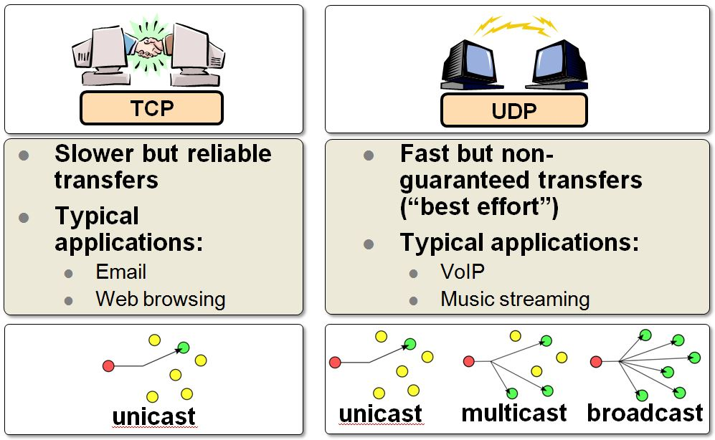
TCP vs UDP

Slide 13
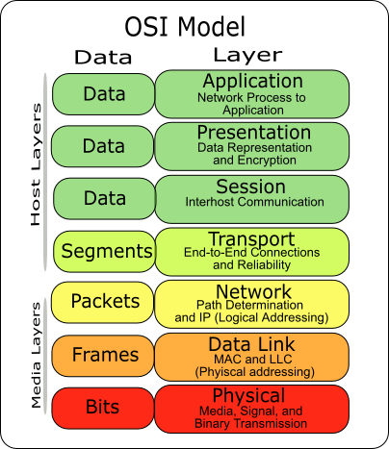
Addressing : Mac, IP, Port
A MAC(media access control ) address is a layer-2 address. It is used by some layer-2 protocols, e.g. Ethernet and Wi-Fi. There are 48-bit and 64-bit MAC addresses. Some layer-2 protocols use different addressing.
An IP address is the address of the layer-3 IP protocol. Different layer-3 protocols use different addressing, e.g. IPv4, IPX, and IPv6 each have different addressing.
A port number is a layer-4 address used by some layer-4 protocols, e.g. TCP and UDP. Some layer-4 protocols use different addressing, or none at all.

Slide 14
Port Ranges
0-1023 – Well known ports These are allocated to server services by the Internet Assigned Numbers Authority (IANA). e.g Web servers normally use port 80 and SMTP servers use port 25
1024-49151- Registered Port -These can be registered for services with the IANA and should be treated as semi-reserved. User written programs should not use these ports.
49152-65535– These are used by client programs and you are free to use these in client programs. When a Web browser connects to a web server the browser will allocate itself a port in this range. Also known as ephemeral ports.

Slide 15
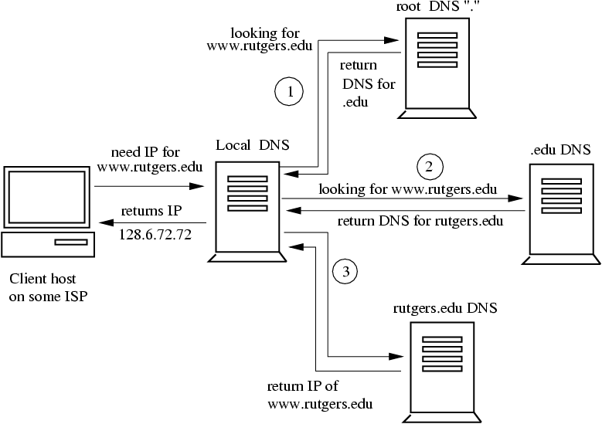
DNS(Domain Name System)
The Domain Name System (DNS) is a hierarchical and decentralized naming system for computers, services, or other resources connected to the Internet or a private network.
It translates domain names to the numerical IP addresses.

Slide 16
Usefool Network Diagnosis Commands/Tools
ping - is used to test the reachability of a host on an Internet Protocol (IP) network. Internet Control Message Protocol (ICMP) which has the ability to send an echo packet to a destination host and a mechanism to listen for a response from this host.
tracert/traceroute - returns the path to the destination host including the route the packet takes and the response time of these intermediate hosts.
Ipconfig/ifconfig - displays all current TCP/IP network configuration values
Nslookup - allows you to query DNS servers for resource records.

Slide 17
netstat - displays network connections for TCP (both incoming and outgoing), routing tables, and a number of network interface (network interface controller or software-defined network interface) and network protocol statistics
pathping/mtr - provides useful information about network latency and network loss at intermediate hops between a source address and a destination address
route - displays or modifies the computer's routing table
route print - displays the routing table

Slide 18
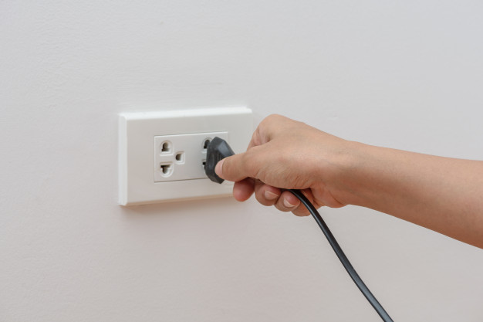


What Is a Socket?
A socket is one end-point of a two-way communication link between two programs running on the network.
Concretely, it is a representation of this endpoint in networking software (protocol stack), such as an entry in a table (listing communication protocol, destination, status, etc.), and is a form of system resource.

Slide 19
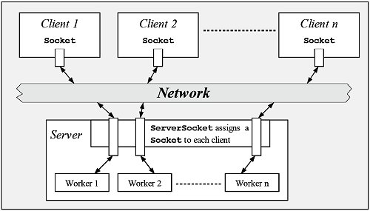
Network Sockets Architecture

Slide 20
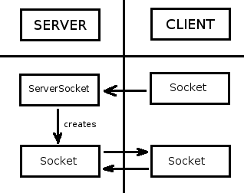
Socket Connection Establishment

Slide 21
Client Socket
Open a socket.
Open an input stream and output stream to the socket.
Read from and write to the stream according to the server's protocol.
Close the streams.
Close the socket.

Slide 22
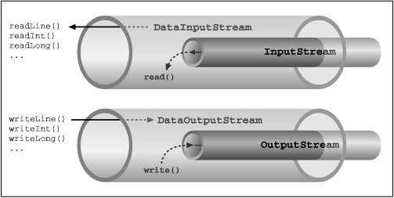
Input and Output Streams in Java

Slide 23
Server Socket
Create a new ServerSocket object to listen on a specific port.
Accept a connection from a client.
Establish the connection returning a Socket object.

Slide 24
An Example of a Server Socket in Java
package sockets;
import java.io.*;
import java.net.*;
public class Server {
public static final int PORT = 3333;
public static final String response = "Greetings from Server.";
public static void main(String[] args) {
try{
//create a server socket to listen on given port
ServerSocket serverSocket = new ServerSocket(PORT);
//accept a connection from a client
final Socket socket = serverSocket.accept();
//open an output stream to the socket writing
PrintWriter out=new PrintWriter(socket.getOutputStream());
//open an input stream to the socket for reading
BufferedReader in=new BufferedReader(new InputStreamReader(socket.getInputStream()));

Slide 25
An Example of a Server Socket in Java (cont.)
//read a line of the received message
String message=in.readLine();
//print out the received line into the console
System.out.println("<<Server>> : message received: "+message);
//write a response to the socket
out.println(response);
//force the written buffer to be sent
out.flush();
System.out.println("<<Server>>: response sent: " + response);
//close the socket
socket.close();
}
//handle exceptions
catch (IOException e) {
e.printStackTrace();
}
}}

Slide 26
An Example of a Client Socket in Java
package sockets;
import java.io.*;
import java.net.*;
public class Client {
public static final String HOST = "127.0.0.1";
public static final int PORT = 3333;
public static void send(String message) {
try {
//open a socket
Socket socket = new Socket(HOST, PORT);
//open an output stream to the socket writing
PrintWriter out = new PrintWriter(socket.getOutputStream(), true);
//open an input stream to the socket for reading
BufferedReader in = new BufferedReader(new InputStreamReader(socket.getInputStream()));

Slide 27
Client Socket(cont.)
//write a message to the socket
out.println(message);
//force the written buffer to be sent
out.flush();
System.out.println("<<Client>>: message sent: " + message);
//read a line of the response
String response = in.readLine();
//print out the response to the console
System.out.println("<<Client>>: response received: " + response);
}

Slide 28
Client Socket(cont.)
//handle exceptions
catch (UnknownHostException e) {
e.printStackTrace();
} catch (IOException e) {
e.printStackTrace();
}
}
public static void main(String[] args){
send("Hello from Client");
}
}

Slide 29
Exercise 1
Modify the Server Socket Listener to perform a simple calculation functionality:
the client will send a message containing a simple formula of the form “x*y”, where x and y are integers and * is one of the binary operations: +,-,*,/ .
The server will return the result.

Slide 30
Solution of Exercise 1
//inside existing code change the line of the output
int response = process(message);
//print out the received line into the console
System.out.println("<<Server>> : message received: "+message);
//add a function for processing messages
public static int process(String message){
String[] operators = new String[]{"\\+","-","\\*","/"};
String[] args = null;
String operator = null;
for(String op:operators){
args = message.split(op);
operator = op;
if(args.length>1)
break;
}

Slide 31
Solution of Exercise 1(cont)
int[] vals = new int[]{
Integer.parseInt(args[0]),
Integer.parseInt(args[1])
};
int val = 0;
switch(operator){
case "\\+":
val = vals[0] + vals[1]; break;
case "-":
val = vals[0] - vals[1]; break;
case "\\*":
val = vals[0] * vals[1]; break;
case "/":
val = vals[0] / vals[1]; break;
}
return val;
}

Slide 32
Exercise 2
Determine your IP address and exchange it with another student. Set another students IP address in your Socket Client to connect to her/his Server and run your Server so that her/his Client will connect to your Server.

Slide 33
Exercise 3
Run several Servers on your computer listening to different ports and run the Client to connect each of them.

Slide 34
Exercise 4
Add a History Feature.
Currently, the server processes calculations but does not store previous calculations. Modify the server so that it keeps track of all calculations and allows the client to retrieve them by sending "HISTORY".

