Slide 1
3. Java Concurrent Programming

Slide 2
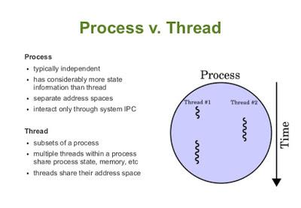
Threads vs. Processes
Process is a program which is executing some code and a thread is an independent path of execution in the process.
A process can have more than one thread for doing independent tasks, e.g. a thread for reading data from disk, a thread for processing that data and another thread for sending that data over the network.

Slide 3
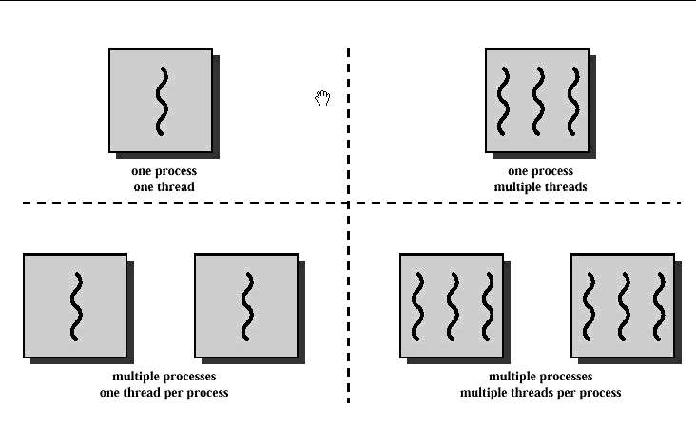
Threads vs. Processes
Threads share the address space of the process that created it; processes have their own address.
Threads have direct access to the data segment of its process; processes have their own copy of the data segment of the parent process.
Threads can directly communicate with other threads of its process; processes must use interprocess communication to communicate with sibling processes.
Threads have almost no overhead; processes have
considerable overhead.
New threads are easily created; new processes require duplication of the parent process.
Threads can exercise considerable control over threads of the same process; processes can only exercise control over child processes.
Changes to the main thread (cancellation, priority
change, etc.) may affect the behavior of the other threads
of the process; changes to the parent process does not affect child processes.

Slide 4
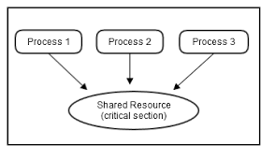
Concurrency and Synchronization
Thread synchronization is the concurrent execution of two or more threads that share critical resources.
Threads should be synchronized to avoid critical resource use conflicts. Otherwise, conflicts may arise when parallel-running threads attempt to modify a common variable at the same time.

Slide 5
Creating a Thread 1
public class MyThread extends Thread { public void run(){
while(true){ System.out.println("MyThread running");
} } }
MyThread myThread = new MyThread(); myThread.start();
System.out.println("Next line");

Slide 6
Creating a Thread 2
public class MyRunnable implements Runnable { public void run(){ System.out.println("MyRunnable running"); } }
Thread thread = new Thread(new MyRunnable()); thread.start();

Slide 7
Thread vs. Runnable
Implementing Runnable is more preferable than extending Thread because of lack of multiple inheritance in Java.

Slide 8
Thread Creation and Running
Main thread t0 running(your java main method).
Create: t1 = new Thread(s1);// A data structure created. t1 is not running yet. s1 has a code “x=0;”
Start: t1.start(); //t0 creates and starts t1
s2(); //execute s2 on t0
t1.join();// necessary in order to make sure x=0 is completed
s3();//uses variable x

Slide 9
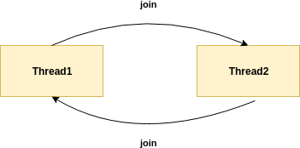
Deadlock
t1 = new Thread(s1);
t2 = new Thread(s2);
t1.start();
t2.start();
s1: t2.join();
s2: t1.join();

Slide 10
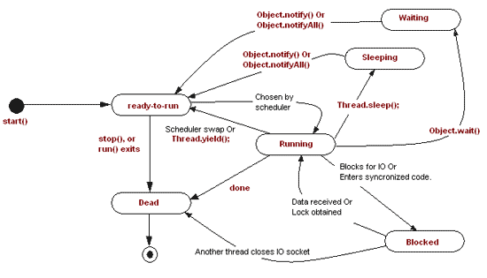
Threads Lifecycle

Slide 11
Locks

Slide 12
Structured Locks 1
void incr(A a){
…
a.count=a.count+1;
…
}
T0: incr(a);
T1: incr(a);
What we have here is called Data Race.
a.count = 0 initially.
The result is unpredictable and may be either 1 or 2.

Slide 13
Structured Locks 2
void incr(A a){
synchronized(a){//acquire a
a.count=a.count+1;
}//release a
}
T0: incr(a);
T1: incr(a);
Entering synchronized(a) the thread acquires the lock on a.

Slide 14
Structured Locks 3
public class BlockingQueue<T> {
private Queue<T> queue = new LinkedList<T>();
private int capacity;
public BlockingQueue(int capacity) { this.capacity = capacity; }
public synchronized void put(T element) throws InterruptedException {
while(queue.size() == capacity) {
wait();
}
queue.add(element);
notify(); // notifyAll() for multiple producer/consumer threads }
public synchronized T take() throws InterruptedException {
while(queue.isEmpty()) {
wait();
}
T item = queue.remove();
notify(); // notifyAll() for multiple
//producer/consumer threads
return item;
}
}

Slide 15
public class Mercedes{
Private static String name = “Mercedes”;
Private String model;
public Mercedes(String model){ this.model = model;}
Public synchronized drive(){
println(“You are driving ” +model);
}
public static synchronized getManufacturName(){
synchronized(Mercedes){
println(name);}
}
}
Mercedes c200 = new Mercedes(“c200”); c200.drive();
Mercedes s500 = new Mercedes(“s500”); s500.drive();

Slide 16
Unstructured Locks
You don't need to use a block structure for locking and can even hold a lock across methods.
Lock l = ...; l.lock();//tryLock() acquires the lock only if it is free at the time of invocation.
try { // access the resource protected by this lock } finally { l.unlock(); }

Slide 17
Read/Write Locks
ReadWriteLock readWriteLock = new ReentrantReadWriteLock();
Lock readLock = readWriteLock.readLock();
Lock writeLock = readWriteLock.writeLock();
writeLock.lock();
try{
//write something in shared resources
}finally{
writeLock.unlock();
}
readLock.lock;
try{
//read from shared resources
}
finally{
readLock.unlock();
}

Slide 18
Liveness
Liveness - means progress guaranteed.
Deadlock freedom.
Livelock freedom.
Starvation freedom.

Slide 19
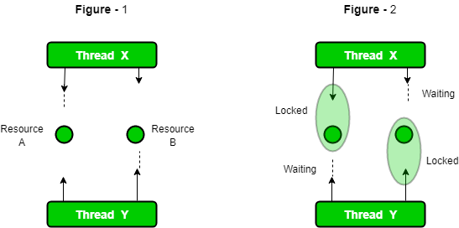
Deadlocks

Slide 20
Livelocks
Thread1:
do{
x.incr();
}
while(x<2);
..
Thread2:
do{
x.decr();
}
while(x>-2);
…
Possible outcome:
x = 0;
T1: x = 1;
T2: x = 0;
T2: x = -1;
T1: x = 0;
T1: x = 1;
...

Slide 21
Starvation
Some threads are waiting forever for resources that are used(locked) by other threads.

Slide 22
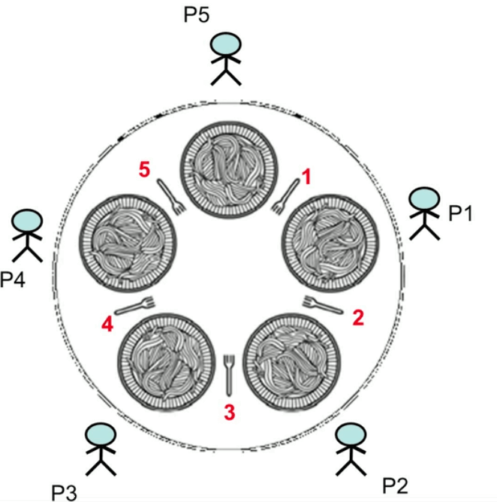
Example: Dining Philosophers 1
Each philosopher must alternately think or eat.
However, a philosopher can only eat spaghetti when they have both left and right forks.
Each fork can be held by only one philosopher and so a philosopher can use the fork only if it is not being used by another philosopher.

Slide 23
Example: Dining Philosophers 2
while(true){
think();
synchronized(leftFork){
synchronized(rightFork){
eat();
}
}
}
//Deadlock if all philosophers start simultaneously

Slide 24
Example: Dining Philosophers 3
while(true){
think();
s1 = tryLock(leftFork);
if(!s1) continue;
s2 = tryLock(rightFork);
if(!s2) {unlock(leftLock); continue;}
eat();
}
//Livelock: all try left, then all try right,...

Slide 25
Example: Dining Philosophers 3
For P5 only try right fork first then left fork.
For the rest of philosophers leave intact(try left then right).
//Starvation: may end up with one of philosophers, e.g. P3 never //getting chance to eat

Slide 26
A Solution of the Problem: Semaphores
Semaphore is simply a variable which is non-negative and shared between threads. This variable is used to solve the critical section problem and to achieve process synchronization in the multiprocessing environment.
Semaphores are of two types:
Binary Semaphore – This is also known as mutex lock. It can have only two values – 0 and 1. Its value is initialized to 1. It is used to implement the solution of critical section problem with multiple processes.
Counting Semaphore – Its value can range over an unrestricted domain. It is used to control access to a resource that has multiple instances.

Slide 27
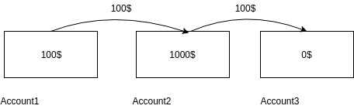
Critical Sections
Possible outcome:
r2: ac2=1000
r1: ac2=1000;
w2: ac2 =900;
w1: ac2 =1100;
As a result:
ac1=0$
ac2=1100$
ac3=100$
T1{
ac1=ac1-100;
ac2=ac2+100;//w1,r1
}
T2{
ac2=ac2-100;//w2,r2
ac3=ac3+100;
}
//ac2- srared variable

Slide 28
Isolation
Isolation guarantees that the whole block will be implemented as a transaction.
Possible outcomes:
w1,r1,w2,r2
Or
w2,r2,w1,r1
Result:
ac1=0$,ac2=1000$,ac3=100$
T1{
isolated{
ac1=ac1-100;
ac2=ac2+100;//w1,r1
}
}
T2{
isolated{
ac2=ac2-100;//w2,r2
ac3=ac3+100;
}
}

Slide 29
Thread Pools 1
ExecutorService - higher level replacement for working with threads directly.
Types of Thread Pools you can create with ExecutorService:
Single Thread Executor: Executors.newSingleThreadExecutor() - A thread pool with only one thread. All the submitted task will be executed sequentially.
Cached Thread Pool: Executors.newCachedThreadPool() - A thread pool that creates as many threads as it needs to execute the task in parallel. Old available threads will be reused for the new tasks. If a thread is not used during 60 seconds, it will be terminated and removed from the pool.

Slide 30
Thread Pools 2
Fixed Thread Pool: Executors.newFixedThreadPool() - A thread pool with a fixed number of threads. If a thread is not available for the task, the task is put in queue waiting for another task to ends.
Scheduled Thread Pool: Executors.newScheduledThreadPool() - A thread pool made to schedule future task.
Single Thread Scheduled Pool: Executors.newSingleThreadScheduledExecutor() - A thread pool with only one thread to schedule future task.

Slide 31
Thread Pools 3
Once you have a thread pool, you can submit a Runnable or a Callable to the thread pool. The method return a Future representing the future state of the task. If you submitted a Runnable, the Future object return null once the task finished.
private final class StringTask implements Callable<String> { public String call(){ return "Run"; } }
ExecutorService pool = Executors.newFixedThreadPool(4); for(int i = 0; i < 10; i++){ pool.submit(new StringTask()); }
pool.shutdown();//JVM risk to not shut down the pool because there are still threads not terminated.

Slide 32
Thread Pools 4
ExecutorService pool = Executors.newFixedThreadPool(4); List<Future<String>> futures = new ArrayList<Future<String>>(10); for(int i = 0; i < 10; i++){ futures.add(pool.submit(new StringTask())); } for(Future<String> future : futures){ String result = future.get(); //Compute the result } pool.shutdown();

Slide 33
Thread Pools 5
An even better solution:
ExecutorService threadPool = Executors.newFixedThreadPool(4);
//A CompletionService is a service that makes easier to wait for result of submitted task. It guarantees the result in the order they are //completed and you don't have to keep a collection of Future. CompletionService<String> pool = new ExecutorCompletionService<String>(threadPool); for(int i = 0; i < 10; i++){ pool.submit(new StringTask()); } for(int i = 0; i < 10; i++){ String result = pool.take().get(); //Compute the result } threadPool.shutdown();

Slide 34
Exercises
Assume there are two people standing in the same place on the plane: x=0, y=0.
Every 100 milliseconds they do a step of 1 meter on one of the directions: East, West, South, North randomly. Calculate and print their current coordinate. Write the program in one thread, then in two separate threads for each person.

Slide 35
Solution: single thread
public class CoordinatesSingleThread {
public static void main(String[] args){
int[] person1Coord = new int[]{0,0};
int[] person2Coord = new int[]{0,0};
while(true){
System.out.println(getMessage("person1",person1Coord));
System.out.println(getMessage("person2",person2Coord));
person1Coord = calculateStep(person1Coord);
person2Coord = calculateStep(person2Coord);

Slide 36
try { Thread.sleep(100l); } catch (InterruptedException e){ e.printStackTrace(); } } }
public static int[] calculateStep(int[] current){
int step = (int)Math.floor(Math.random()*4);
switch (step){
case 0: return new int[]{current[0]-1,current[1]};
case 1: return new int[]{current[0]+1,current[1]};
case 2: return new int[]{current[0],current[1]-1};
case 3: return new int[]{current[0],current[1]+1};
default: return current; } }

Slide 37
public static String getMessage(String person, int[] coord){
return person +" is standing on ["+coord[0]+","+coord[1]+"]";
}
}

Slide 38
Solution: two threads
public class Walker implements Runnable {
private String name;
private int[] coords;
public Walker(String name, int[] startingCoords) {
this.name = name;
this.coords = startingCoords; }
@Override
public void run() {
while (true) {

Slide 39
System.out.println(getMessage(name, coords));
coords = calculateStep(coords);
try { Thread.sleep(100l); } catch (InterruptedException e) { e.printStackTrace(); } } }
private int[] calculateStep(int[] current) {
int step = (int) Math.floor(Math.random() * 5);
switch (step) {
case 0: return new int[]{current[0] - 1, current[1]};
case 2: return new int[]{current[0] + 1, current[1]};
case 3: return new int[]{current[0], current[1] - 1};
case 4: return new int[]{current[0], current[1] + 1};

Slide 40
default: return current; } }
public class CoordinatesTwoThreads {
public static void main(String[] args){
Walker walker1 = new Walker("person1",new int[]{0,0});
Walker walker2 = new Walker("person2",new int[]{0,0});
new Thread(walker1).start();
new Thread(walker2).start();
}
}

Slide 41
Exercises
2. Modify the previous program, so that each person has has a different time delay between steps, e.g. 100 ms and 1000 ms.
3. Do the same for 100 persons with same time delay(1000 s).

Slide 42
Solution 2
public Walker(String name, int[] startingCoords, long timeDelay) {
this.name = name;
this.coords = startingCoords;
this.timeDelay = timeDelay;
}

Slide 43
Solution 3
public static void main(String[] args){
Walker[] walkers = new Walker[100];
for(int i=0; i<100; i++){
walkers[i] = new Walker("person"+i,new int[]{0,0},1000l);
}
for(int i=0; i<100; i++){
new Thread(walkers[i]).start();
} } }

Slide 44
Exercises
4. Modify the last solution so that whenever a person enters into the position [2,2], everybody else will wait for 3000 ms. Use a ReentrantLock object.

Slide 45
Solution
static ReentrantLock lock = new ReentrantLock();
@Override
public void run() {
while (true) {
if(lock.tryLock()){
System.out.println(getMessage(name, coords));
coords = calculateStep(coords);
if(coords[0]==2 && coords[1]==2){
System.out.println(">>>> "+name+" entered sleeping zone");
}

Slide 46
try { Thread.sleep(3000l); } catch (InterruptedException e) { e.printStackTrace(); } }
lock.unlock();
}
try {
Thread.sleep(timeDelay);
} catch (InterruptedException e) {
e.printStackTrace();
}
}

Slide 47
Exercises
5. Solve the same task as in the previous exercise but using synchronized methods.

Slide 48
Solution
@Override
public void run() {
while (true) {
coords = doStep(coords,name);
try { Thread.sleep(timeDelay); } catch (InterruptedException e) { e.printStackTrace();
}
}
}

Slide 49
private static synchronized int[] doStep(int[] coords, String name){
System.out.println(getMessage(name, coords));
coords = calculateStep(coords);
if(coords[0]==2 && coords[1]==2){
System.out.println(">>>> "+name+" entered sleeping zone");
try { Thread.sleep(3000l); } catch (InterruptedException e) { e.printStackTrace(); } }
return coords;
}
// Also make methods calculateStep and getMessage static

Slide 50
Exercise *
Suppose we have a class:
public class Foo {
public void first() { print("first"); }
public void second() { print("second"); }
public void third() { print("third"); }
}
The same instance of Foo will be passed to three different threads. Thread A will call first(), thread B will call second(), and thread C will call third(). Design a mechanism and modify the program to ensure that second() is executed after first(), and third() is executed after second().

Slide 51
Solution (semaphores)
class Foo {
Semaphore s1 = new Semaphore(1);
Semaphore s2 = new Semaphore(0);
Semaphore s3 = new Semaphore(0);
public void first(Runnable printFirst) throws InterruptedException {
s1.acquire();
printFirst.run();
s2.release();
}
public void second(Runnable printSecond) throws InterruptedException {
s2.acquire();
// printSecond.run() outputs "second". Do not change or remove this line.
printSecond.run();
s3.release();
}
public void third(Runnable printThird) throws InterruptedException {
s3.acquire();
// printThird.run() outputs "third". Do not change or remove this line.
printThird.run();
s3.release();
}
}

Slide 52
Solution (semaphores)
public void second(Runnable printSecond) throws InterruptedException {
s2.acquire();
printSecond.run();
s3.release();
}
public void third(Runnable printThird) throws InterruptedException {
s3.acquire();
// printThird.run() outputs "third". Do not change or remove this line.
printThird.run();
s3.release(); }

Slide 53
Solution (semaphores)
public static void main(String[] args) throws InterruptedException {
Runnable printFist = ()->System.out.println("First");
Runnable printSecond = ()->System.out.println("Second");
Runnable printThird = ()->System.out.println("Third");
Foo foo = new Foo();
foo.first(printFist);
foo.second(printSecond);
foo.third(printThird);
} }

