Slide 1
4. RPC Technologies

Slide 2
RPC Definitions
Remote Procedure Call (RPC) is a protocol that one program can use to request a service from a program located in another computer on a network without having to understand the network's details.
A remote procedure call (RPC) is when a computer program causes a procedure (subroutine) to execute in a different address space (commonly on another computer on a shared network), which is coded as if it were a normal (local) procedure call, without the programmer explicitly coding the details for the remote interaction.

Slide 3
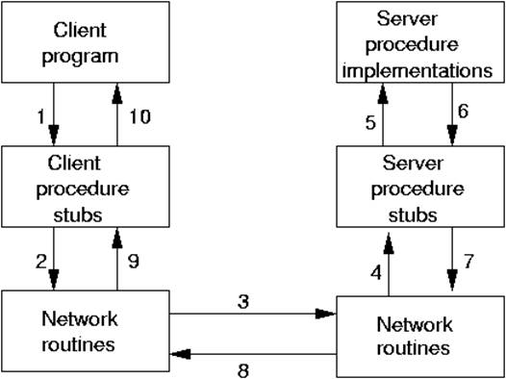
RPC in General

Slide 4
Synchronous vs Asynchronous RPC
RPC usually refers to synchronous communication, whereas messaging technologies like JMS and AMQP API-s refer to asynchronous communication.

Slide 5
RPC Categories
Language-independant
XML-RPC - an RPC protocol that uses XML to encode its calls and HTTP as a transport mechanism.
JSON-RPC - is an RPC protocol that uses JSON-encoded messages
SOAP - is a successor of XML-RPC and also uses XML to encode its HTTP-based calls.
CORBA - provides remote procedure invocation through an intermediate layer called the object request broker.
Language-specific
RMI - is a Java API that performs remote method invocation, the object-oriented equivalent of remote procedure calls (RPC),

Slide 6
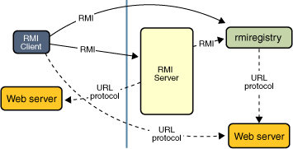
RMI

Slide 7
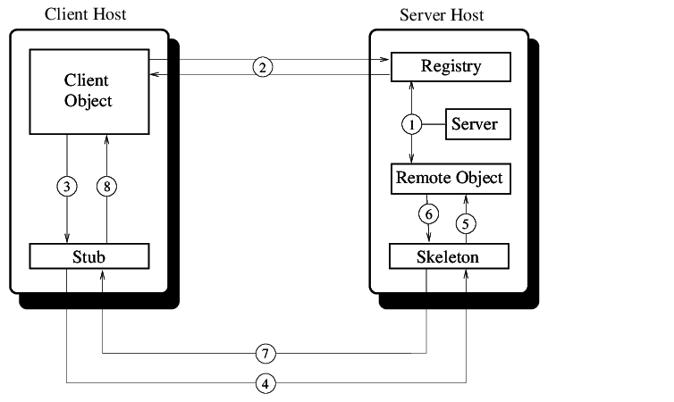
RMI Architecture

Slide 8
Remote Objects
Objects with methods that can be invoked across Java virtual machines are called remote objects.
An object becomes remote by implementing a remote interface, which has the following characteristics:
A remote interface extends the interface java.rmi.Remote.
Each method of the interface declares java.rmi.RemoteException in its throws clause, in addition to any application-specific exceptions.

Slide 9
RMI Registry
RMI registry is a particular type of remote object used for references to other remote objects. It is a simple remote object naming service that enables clients to obtain a reference to a remote object by name. It is typically only used to locate the first remote object that an RMI client needs to use. That first remote object might then provide support for finding other objects.
Registry registry = LocateRegistry.getRegistry(); registry.rebind(name, stub);

Slide 10
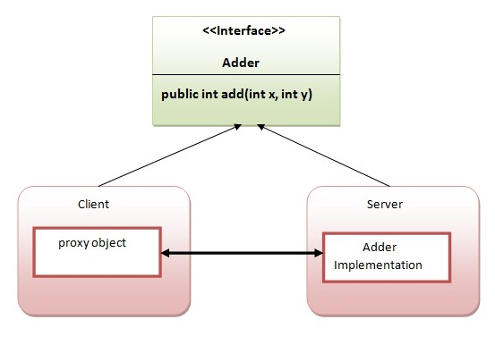
An Example of RMI Service
Create an RMI service, which allows adding two integers.

Slide 11
RMI Service Implementation Steps
Create the remote interface
Provide the implementation of the remote interface
Compile the implementation class and create the stub and skeleton objects using the rmic tool
Start the registry service by rmiregistry tool
Create and start the remote application
Create and start the client application

Slide 12
Creating the Remote Interface
import java.rmi.*;
//A remote interface extends the interface java.rmi.Remote
public interface Adder extends Remote{
//Each method declares RemoteException in its throws clause
int add(int x,int y) throws RemoteException;
}

Slide 13
2. Provide the Implementation of the Remote Interface
import java.rmi.*;
import java.rmi.server.*;
/*extend the UnicastRemoteObject class or use the exportObject() method of the UnicastRemoteObject class and implement the remote object interface*/
public class AdderRemote extends UnicastRemoteObject implements Adder{
//The constructor
AdderRemote() throws RemoteException{
super();
}
//the implementation of the method in remote interface
public int add(int x,int y) throws RemoteException{
int sum = x + y;
System.out.println("The sum of " + x + " and " + y + " is " + sum);
return sum;
}
}

Slide 14
3. Create the Stub and Skeleton Objects * Not needed anymore
Run RMI compiler to compile the remote interface into stub and skeleton objects.
>rmic AdderRemote

Slide 15
4. Start the Registry Service
Start the RMI registry on a specific port. The registry service will be called by the client.
>rmiregistry 5000
Or in java code
LocateRegistry.createRegistry(5000 );

Slide 16
5. Create and run the server application
import java.rmi.*;
import java.rmi.registry.*;
public class MyServer{
public static void main(String args[]){
try{
Adder obj = new AdderRemote();
LocateRegistry.createRegistry(65000);
// The Naming class provides methods to get and store the remote object.
//Naming.rebind binds the remote object to the new name(bind also can be used)
Naming.rebind("rmi://localhost:65000/adder", obj);
}
catch(Exception e){
System.out.println(e);
}
}
}

Slide 17
6. Create and run the client application
import java.rmi.*;
public class MyClient{
public static void main(String args[]){
try{
//Naming.lookup returns the reference of the remote object
Adder stub = (Adder)Naming.lookup("rmi://localhost:65000/adder");
System.out.println(stub.add(34,4));
System.out.println(stub.add(22,11));
}
catch(Exception e){
System.out.println(e);
}
}
}

Slide 18
Serialization/Deserialization
In Java to serialize an object means to convert its state to a byte stream so that the byte stream can be reverted back into a copy of the object(deserialized).
Java object is serializable if its class or any of its superclasses implements either the java.io.Serializable interface or its subinterface, java.io.Externalizable.
Only non-static and non-transient data members are saved via Serialization process.
Constructor of object is never called when an object is deserialized.
Associated objects must be implementing Serializable interface.

Slide 19
transient
transient is a Java keyword which marks a member variable not to be serialized when it is persisted to streams of bytes.

Slide 20
Class Student implements Serializable {
University univ;
Address address;
}
Class University implements Serializable{
City city;
transient Student bestStudent;
}

Slide 21
serialVersionUID
The serialization runtime associates with each serializable class a version number, called a serialVersionUID, which is used during deserialization to verify that the sender and receiver of a serialized object have loaded classes for that object that are compatible with respect to serialization. If the receiver has loaded a class for the object that has a different serialVersionUID than that of the corresponding sender's class, then deserialization will result in an InvalidClassException.

Slide 22
Exercise 1
Create a simple Java RMI-based online shop system with the following components:
Shop (RMI Service)
Acts as the interface for clients.
It is a remote object exposed via RMI.
Internally, it calls the Warehouse RMI service as a client.
Offers operations: listGoods(), buyGood(name, quantity)
Warehouse (RMI Server)
Stores the data (goods, quantity).
Offers operations: getQuantity(name) and extractFromQuantity(name, qty).
Client:
Provides a command line interface to the customer.
Talks to Shop RMI Service.
Offers commands: list, buy <name> <qty>
[Client] -> [Shop RMI Server] -> [Warehouse RMI Server]

Slide 23
Exercise 2
Develop the previous exercise by adding a round-robin load balancer(also an RMI Service) which distributes the requests from the client between two shop service instances:
[Client] -> [Load Balancer RMI Server] ->[Shop RMI Server1] -> [Warehouse RMI Server]
->[Shop RMI Server2]->

