Slide 1
Introduction to Apache Hive

Slide 2
What is Hive
Apache Hive is a data warehouse software project built on top of Apache Hadoop for providing data summarization, query and analysis.
Hive gives an SQL-like interface to query data stored in various databases and file systems that integrate with Hadoop.
Hive provides the necessary SQL abstraction to integrate SQL-like queries (HiveQL) into the underlying Java without the need to implement queries in the low-level Java API.

Slide 3
Brief History of Hive
Hive grew from a need to manage and learn from the huge volumes of data that Facebook was producing every day from its burgeoning social network. After trying a few different systems, the team chose Hadoop for storage and processing, since it was cost effective and met the scalability requirements.
When Facebook started gathering data and ingesting it into Hadoop, the data was incoming at the rate of 10s of GBs/day around 2006. In 2007 it grew to 1 TB/day and in few years increased to around 15 TBs/day.
Initially, they had written Python scripts to ingest data in Oracle databases. The Oracle instances were getting filled pretty fast and it was time to get a new kind of system that could handle large amounts of data. They built Hive so that most of the people who had SQL skills could use the new system with minimal changes compared to other RDBMs.

Slide 4
HiveQL/SQL statement examples
SELECT from_columns FROM table WHERE conditions;// Similar in Mysql and HiveQL
SELECT * FROM table;
SELECT * FROM table WHERE rec_name = “value”;
SELECT DISTINCT column_name FROM table;
SELECT col1, col2 FROM table ORDER BY col2;
SELECT COUNT(*) FROM table;
SELECT owner, COUNT(*) FROM table GROUP BY owner;

Slide 5
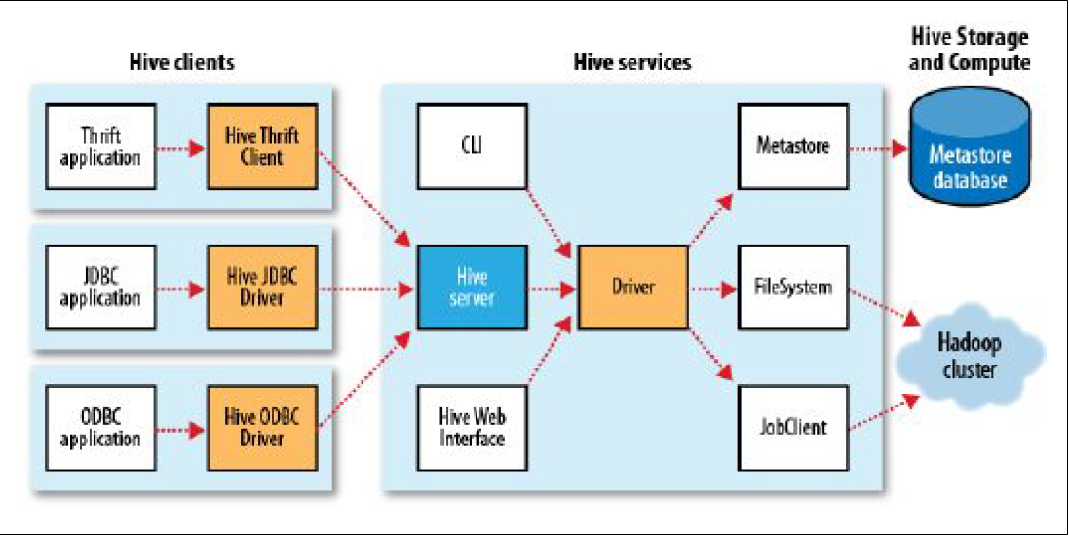
Hive Services

Slide 6
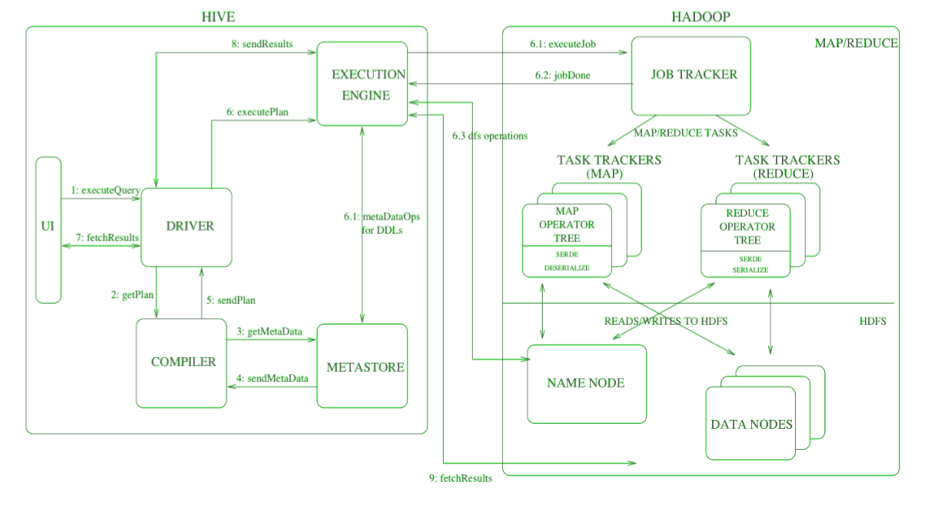
Hive and Hadoop Interaction Flow

Slide 7
Hive and Hadoop Interaction Steps
Step 1: Execute Query – Interface of the Hive such as Command Line or Web user interface delivers query to the driver to execute. UI calls the execute interface to the driver such as ODBC or JDBC.
Step 2: Get Plan – Driver creates a session handle for the query and transfers the query to the compiler to make execution plan. In other words, driver interacts with the compiler.
Step 3: Get Metadata – The compiler transfers the metadata request to any database and the compiler gets the necessary metadata from the metastore.
Step 4: Send Metadata – Metastore transfers metadata as an acknowledgment to the compiler.
Step 5: Send Plan – Compiler communicates with driver with the execution plan made by the compiler to execute the query.

Slide 8
Hive and Hadoop Interaction Steps(cont.-d)
Step 6: Execute Plan - Execute plan is sent to the execution engine by the driver.
Execute Job
Job Done
Dfs operation (Metadata Operation)
Step 7: Fetch Results - Results get fetched from the driver to the user interface (UI).
Step 8: Send Results - Result is transferred to the execution engine from the driver. Sending results to Execution engine. When the result is retrieved from data nodes to the execution engine, it returns the result to the driver and to user interface (UI).

Slide 9
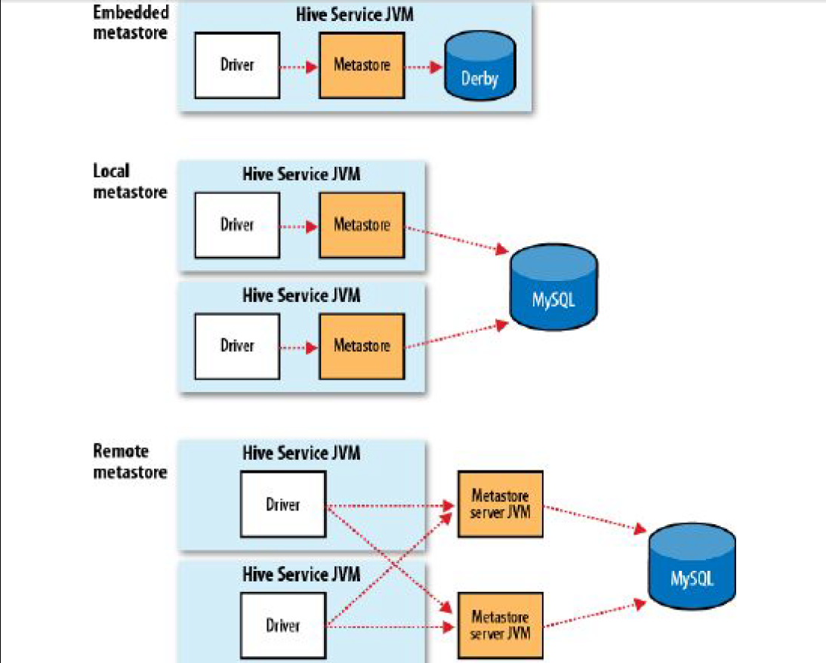
Hive Metastore

Slide 10
Hive vs RDBMS
Schema on Read vs. Schema on Write: data is verified on reading vs. on writing.
Updates - Hive supports bulk inserts from a file into a table, and since 0.14.0 finer grained inserts and updates : INSERT INTO TABLE … VALUES, UPDATE and DELETE are supported. In HDFS changes are stored in delta files and periodically merged by background MapReduce jobs.
Transactions - introduced in 0.13.0. Supports also table and partition level locks.
Indexes - There are currently two index types: compact and bitmap. Compact indexes store the HDFS block numbers of each value, rather than each file offset, so they don’t take up much disk space but are still effective for the case where values are clustered together in nearby rows. Bitmap indexes use compressed bitsets to efficiently store the rows that a particular value appears in, and they are usually appropriate for low-cardinality columns (such as gender or country).

Slide 11
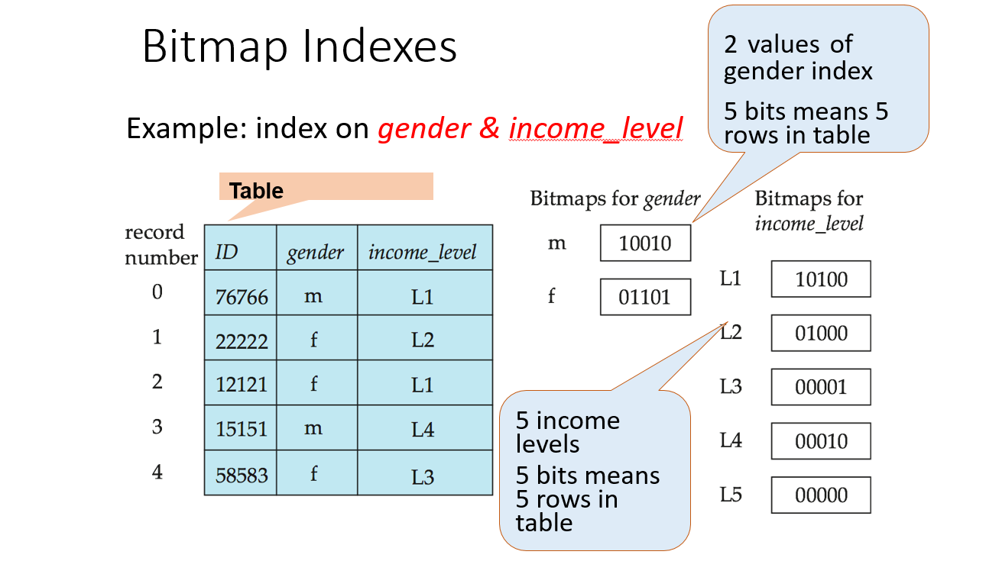
Bitmap Indexes

Slide 12
Hive Indexes Syntax
create index index_name on table(column_on_which_index_to_be_created) as 'COMPACT' with deferred rebuild;
create index index_name on table(column_on_which_index_to_be_created) as 'BITMAP' with deferred rebuild;

Slide 13
Compact vs Bitmap Indexes
Cardinality: Compact indexes are suitable for low cardinality columns, while bitmap indexes are more suitable for high cardinality columns.
Space Efficiency: Bitmap indexes can be more space-efficient for high cardinality columns compared to compact indexes.
Query Performance: Compact indexes are efficient for point queries and range queries on low cardinality columns, while bitmap indexes excel in speeding up complex queries involving high cardinality columns and multiple conditions.
Maintenance Overhead: Compact indexes generally have lower maintenance overhead compared to bitmap indexes, which may require more resources for maintenance, especially for highly dynamic data.

Slide 14
Tables
A Hive table is logically made up of the data being stored and the associated metadata describing the layout of the data in the table.
The data typically resides in HDFS, and the metadata in a relational database - the metastore.

Slide 15
Managed and External Tables
Managed Tables: Hive moves data into its warehouse directory. Dropping will delete data in the warehouse.
CREATE TABLE managed_table (dummy STRING);
LOAD DATA INPATH '/user/tom/data.txt' INTO table managed_table;
External Tables: Hive just refers to the data that is at an existing location outside the warehouse directory. Dropping an external table will leave the data untouched.
CREATE EXTERNAL TABLE external_table (dummy STRING)
LOCATION '/user/tom/external_table';
LOAD DATA INPATH '/user/tom/data.txt' INTO TABLE external_table;

Slide 16
Joins
Inner Join: SELECT sales.*, things.* FROM sales JOIN things ON (sales.id = things.id);
Outer Join: SELECT sales.*, things.* FROM sales LEFT OUTER JOIN things ON (sales.id = things.id);
Semi Join: SELECT * FROM things LEFT SEMI JOIN sales ON (sales.id = things.id);
Is similar to SELECT * FROM things WHERE things.id IN (SELECT id from sales);
Map Join: In inner join if one table is small enough to fit in memory , e.g. things, Hive can load it into memory to perform the join in each of the mappers. This is called map join.

Slide 17
Subqueries
Hive has limited support for subqueries, permitting a subquery in the FROM clause of a SELECT statement, or in the WHERE clause in certain cases.
SELECT station, year, AVG(max_temperature)
FROM ( SELECT station, year, MAX(temperature) AS max_temperature
FROM records2
WHERE temperature != 9999 AND quality IN (0, 1, 4, 5, 9)
GROUP BY station, year) mt
GROUP BY station, year;

Slide 18
Views
In Hive, a view is not materialized to disk when it is created; rather, the view’s SELECT statement is executed when the statement that refers to the view is run.
CREATE VIEW valid_records
AS
SELECT *
FROM records2
WHERE temperature != 9999 AND quality IN (0, 1, 4, 5, 9);

Slide 19
Tables vs views
 | Views | Tables
Data Storage | Do not store data themselves; instead, they are virtual tables that represent the result set of a stored query. When you query a view, Hive executes the underlying query to retrieve the data from the base tables | Date is stored physically in HDFS or another supported file system. The data is stored in files within directories corresponding to the tables.
Schema Definition | Do not have their own schema definition. Instead, they inherit the schema of the underlying tables or queries on which they are based. | Have a schema definition that specifies the structure of the data, including column names, data types, and any constraints or partitions.
Data Modification | In most cases are read-only. You cannot directly modify the data through a view. Any attempt to modify data through a view will affect the underlying tables or queries. | Data can be modified using insert, update, and delete operations. Tables are mutable, meaning you can add, modify, or remove data from them.

Slide 20
Tables vs views (cont.-d)
 | Views | Tables
Storage Overhead | Do not consume additional storage space since they do not store data themselves. They only store the metadata necessary to define the view. | Consume storage space on the file system to store the actual data files.
Usage | Are used to simplify complex queries or to provide a customized view of the data without physically copying or transforming the data. They are particularly useful for encapsulating logic, applying security restrictions, or simplifying data access for users. | Are used to store and manage data persistently. They are ideal for storing structured or semi-structured data that needs to be queried repeatedly

Slide 21
Hive vs. Pig
Hive Pig
Declarative SQL-ish language Procedural data flow language
For creating reports For Programming
Used by data analysts Used by researchers and programmers
Operates on server side Operates on client side
Defines tables beforehand(SQL DDL) Does not have a dedicated metadata DB
Similar to SQL, easy to learn Varies from SQL to a great extent

