Slide 1
MapReduce Paradigm

Slide 2
What is MapReduce
MapReduce is a programming paradigm that allows for massive scalability across hundreds or thousands of servers.

Slide 3
MapReduce History
2004: The MapReduce computation model was initially introduced by Google and aims to solve daily text-based and semantic web data analysis for the data collected by Google services.
2011: Hadoop MapReduce was presented by the open source community and was directed by Yahoo and IBM, with the main differences consisting of the changes from C++ to Java.
2011-: Thereafter, Hadoop has become MapReduce’s main track for academic research, as well as for “big data” analytic solutions for companies besides Google (e.g., Facebook).
2014: Google was no longer using MapReduce as their primary big data processing model,and had moved on to more capable and less disk-oriented mechanisms that incorporated full map and reduce capabilities.

Slide 4
MapReduce Programming Model
The computation takes a set of input key/value pairs, and produces a set of output key/value pairs.
The user of the MapReduce library expresses the computation as two functions: Map and Reduce.

Slide 5
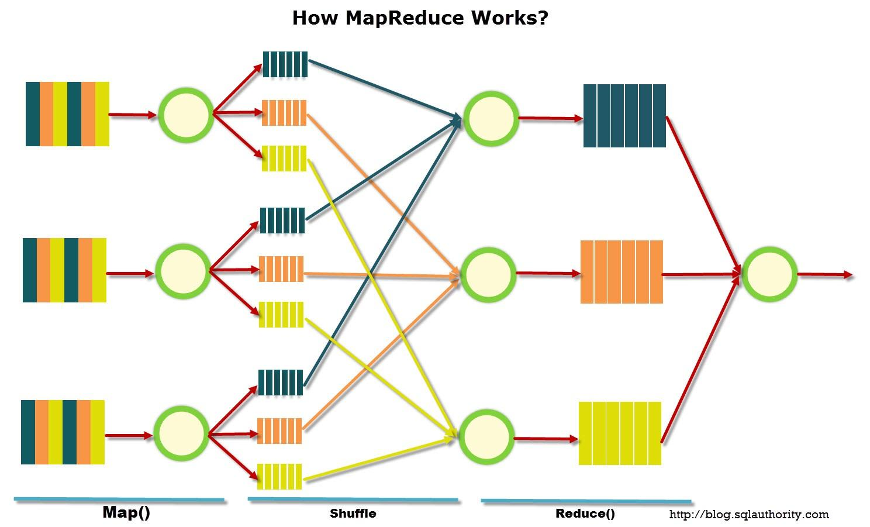
How MapReduce Works

Slide 6
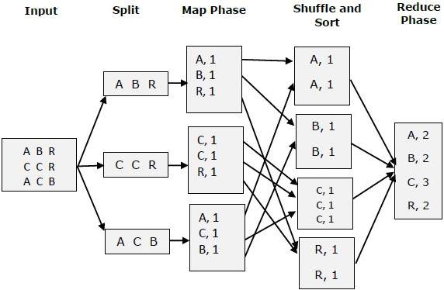
Example

Slide 7
Map Phase
Map takes an input key/value pair and produces a list of intermediate key/value pairs.
map (k1,v1) → list(k2,v2)

Slide 8
Shuffle Phase
Data from all mappers are grouped by the key, split among reducers and sorted by the key.
Each reducer obtains all values associated with the same key. The programmer may supply custom compare functions for sorting and a partitioner for data split.
E.g. h(k) - is a hash function defined on key values, and N is number of reducers,
The shuffler can send tuples with h(k)%N=n to reducer n.

Slide 9
Reduce Phase
The Reduce function, also written by the user, accepts an intermediate key I and a set of values for that key. It merges together these values to form a possibly smaller set of values. Typically just zero or one output value is produced per Reduce invocation. The intermediate values are supplied to the user’s reduce function via an iterator. This allows us to handle lists of values that are too large to fit in memory.
reduce (k2,list(v2)) → list(v2)

Slide 10
Examples
Counting the number of occurrences of each word in a large collection of documents.
E.g.
MapReduce is a programming model and an associated implementation for processing and generating large data sets. Users specify a map function that processes a key/value pair to generate a set of intermediate key/value pairs, and a reduce function that merges all intermediate values associated with the same intermediate key.

Slide 11
Map
Map the initial tuple of <k,v>, where v is the text(in lowercase and without punctuation) from previous page and k is any key ,.e.g. 1, into the following list of <K,V> pairs:
<mapreduce,1> <is,1> <a,1> <programming,1> <model,1> <and,1> <an,1> <associated,1> <implementation,1> <for,1> <processing,1> <and,1> <generating,1> <large,1> <data,1> <sets,1> <users,1> <specify,1> <a,1> <map,1> <function,1> <that,1> <processes,1> <a,1> <key,1> <value,1> <pair,1> <to,1> <generate,1> <a,1> <set,1> <of,1> <intermediate,1> <key,1> <value,1> <pairs,1> <and,1> <a,1> <reduce,1> <function,1> <that,1> <merges,1> <all,1> <intermediate,1> <values,1> <associated,1> <with,1> <the,1> <same,1> <intermediate,1> <key,1>

Slide 12
Shuffle
Shuffle by the order number of the first letter of the key:
E.g., if number of reducers is 4:
A,a->0, B,b ->1, C,c->2, D,c->3, E,e->0,...
<and,1><and,1> <an,1> <a,1,> <a,1,> <a,1,> <a,1,> --> <and,<1,1>>,<an,<1>>,<a,<1,1,1,1>
<data,1> -> <data,<1>>
<mapreduce,1> <map,1> -> <mapreduce,<1>>,<map,<1>>
<key,1>,<key,1>,<key,1> -> <key,<1,1,1>>
...

Slide 13
Reducer
Calculate the sum of values with the same key:
<and,<1,1>> -> <and,2>
<an,<1>> -> <an,1>
<a,<1,1,1,1>> -> <a,4>
<data,<1>> -> <data,1>
<mapreduce,<1>> -> <mapreduce,1>
<map,<1>> -> <map,1>
<key,<1,1,1>> -> <key,3>

Slide 14
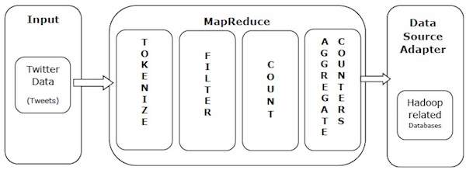
Another Example

Slide 15
Example Explained
Map:
Tokenize − Tokenizes the tweets into maps of tokens and writes them as key-value pairs.
"RT @user: Love the #AI and love the #MapReduce! " -> [("rt",1), ("user",1), ("love",1), ("the",1), ("ai",1),("and",1), ("love",1), ("the",1), ("mapreduce",1)]
Filter − Filters unwanted words from the maps of tokens and writes the filtered maps as key-value pairs.
[("rt",1), ("user",1), ("love",1), ("the",1), ("ai",1),("and",1), ("love",1), ("the",1), ("mapreduce",1)] -> [("user",1), ("love",1), ("ai",1), ("love",1), ("mapreduce",1)]
Count − Generates a token counter per word.
[("user",1), ("love",1), ("ai",1), ("love",1), ("mapreduce",1)] -> {"user": 1, "love": 2, "ai": 1, "mapreduce": 1}
Reduce:
Aggregate Counters − Prepares an aggregate of similar counter values into small manageable units.
Merge partial results across partitions, time windows, or machines, e.g. {"user": 10, "love": 5, "ai": 7, "mapreduce": 2}

Slide 16
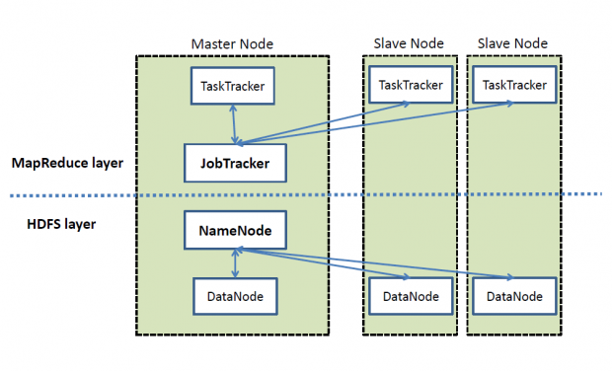
MapReduce in Apache Hadoop

Slide 17
Matrix multiplication
[1,2,3
4,23,-4
2,12,34] X
[5,-2,7
4,3,-4
21,12,3]
1x5+2x4+3x21
Reducer:
Key - <1,1>
Values - < 1,1>,<2,2>,<3,3>
<1,5>,<2,4>,<3,21>
Reducer: 1x5+2x4+3x21
Mapper:
Key - if matrix 1: <rownumber,1>, <rownumber,2>, <rownumber,3>,
If matrix 2: <1, columnumber,>,<2, column>,<3,column>
Value - < index of element, value> , example: <1,1>,<1,5>,<2,2>,...

Slide 18
MapReduce Design Patterns

Slide 19
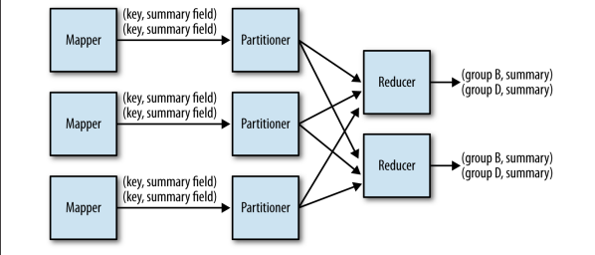
Summarization Patterns
Group records together by a key field and calculate a numerical aggregate per group to get a top-level view of the larger data set.

Slide 20
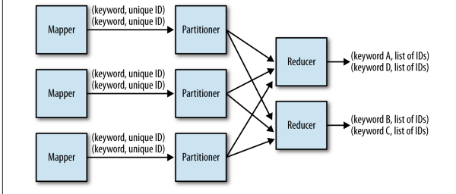
Example: Inverted Index Summarizations
Generate an index from a data set to allow for faster searches or data enrichment capabilities.
Inverted index: a mapping from content, such as words or numbers, to its locations in the storage.

Slide 21
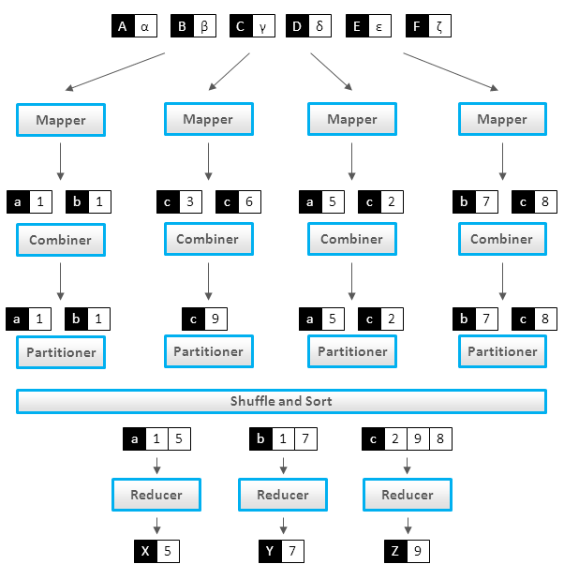
Counting Patterns
An efficient means to retrieve count summarizations of large data sets.

