Slide 1
Hadoop Ecosystem and HDFS

Slide 2
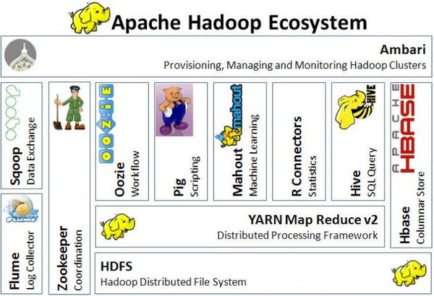
Hadoop Ecosystem

Slide 3
Hadoop Ecosystem
HDFS: Hadoop Distributed File System
YARN: Yet Another Resource Negotiator
MapReduce: Programming based Data Processing
Spark: In-Memory data processing
PIG, HIVE: Query based processing of data services
HBase: NoSQL Database
Mahout, Spark MLLib: Machine Learning algorithm libraries
Solar, Lucene: Searching and Indexing
Zookeeper: Managing cluster
Oozie: Job Scheduling
…

Slide 4
What is HDFS?
HDFS is highly fault-tolerant java-based distributed file system designed to be deployed on low-cost hardware.
HDFS has demonstrated production scalability of up to 200 PB(=10^15 B=200.000 TB) of storage and a single cluster of 4500 servers, supporting close to a billion files and blocks.
HDFS is a scalable, fault-tolerant, distributed storage system that works closely with a wide variety of concurrent data access applications, coordinated by YARN.

Slide 5
HDFS Efficiency and High Availability
Rack awareness - Considers a node’s physical location when allocating storage and scheduling tasks.
Minimal data motion - Hadoop moves compute processes to the data on HDFS and not the other way around. Processing tasks can occur on the physical node where the data resides, which significantly reduces network I/O and provides very high aggregate bandwidth.
Utilities - Dynamically diagnose the health of the file system and rebalance the data on different nodes.
Rollback - Allows operators to bring back the previous version of HDFS after an upgrade, in case of human or systematic errors.
Standby NameNode - Provides redundancy and supports high availability (HA).
Operability - HDFS requires minimal operator intervention, allowing a single operator to maintain a cluster of 1000s of nodes.

Slide 6
HDFS Concepts
Blocks
Namenodes
Datanodes

Slide 7
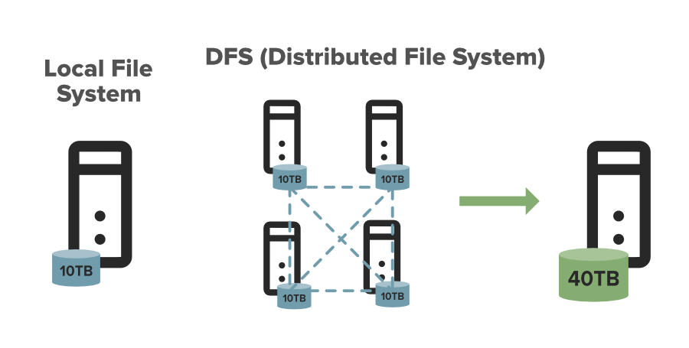
What is a DFS

Slide 8
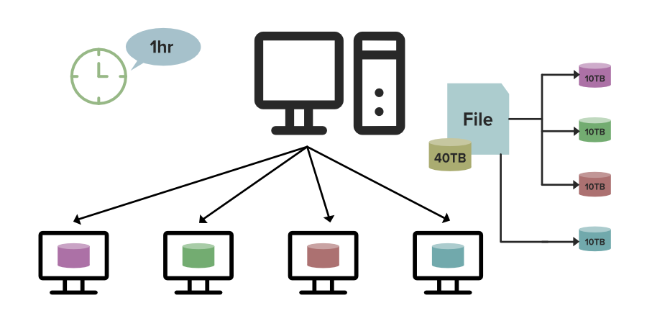
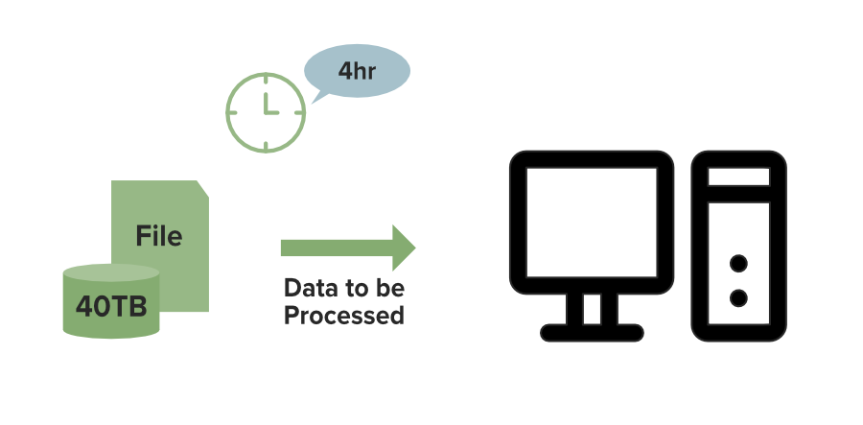
Local FS vs. DFS

Slide 9
Some important features of HDFS
It’s easy to access the files stored in HDFS.
HDFS provides high availability and fault tolerance.
Provides scalability to scale up or scale down nodes as per our requirement.
Data is stored in distributed manner, i.e. various Datanodes are responsible for storing the data.
HDFS provides Replication, no(or at least less) fear of Data Loss.
HDFS Provides High Reliability as it can store data in a large range of Petabytes.
HDFS has in-built servers in Name Node and Data Node that helps them to easily retrieve the cluster information.
Provides high throughput.

Slide 10
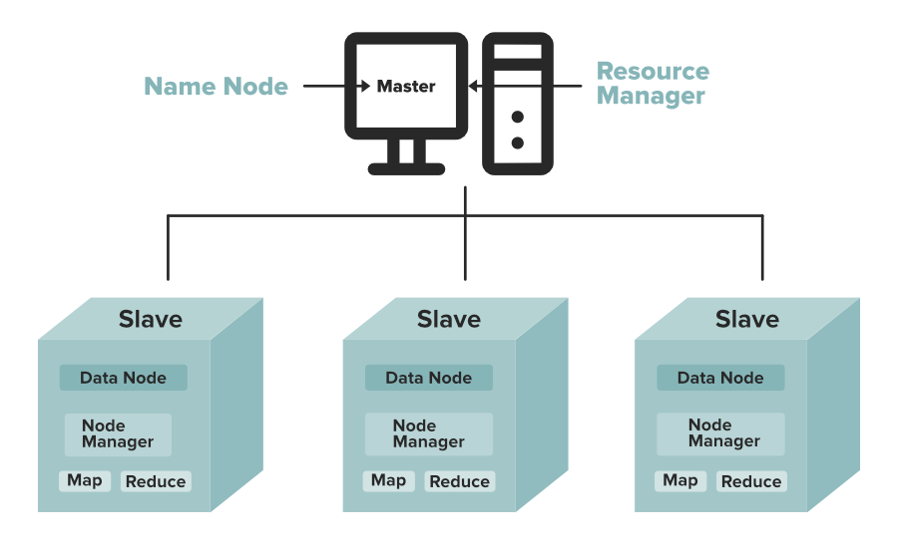
Name Node and Data Nodes

Slide 11
Namenodes
An HDFS cluster has two types of nodes operating in a master−worker pattern: a namenode (the master) and a number of datanodes (workers).
The namenode manages the filesystem namespace. It maintains the filesystem tree and the metadata for all the files and directories in the tree.
This information is stored persistently on the local disk in the form of two files: the namespace image(point-in-time snapshot of HDFS's namespace) and the edit log(changes from the last snapshot).
The namenode also knows the datanodes on which all the blocks for a given file are located; however, it does not store block locations persistently, because this information is reconstructed from datanodes when the system starts.

Slide 12
Datanodes
Datanodes are the workhorses of the filesystem. They store and retrieve blocks when they are told to (by clients or the namenode), and they report back to the namenode periodically with lists of blocks that they are storing.

Slide 13
Namenode Resilience
Without the namenode, the filesystem cannot be used. In fact, if the machine running the namenode were obliterated, all the files on the filesystem would be lost since there would be no way of knowing how to reconstruct the files from the blocks on the datanodes.For this reason, it is important to make the namenode resilient to failure, and Hadoop provides two mechanisms for this:
back up the files that make up the persistent state of the filesystem metadata. Hadoop can be configured so that the namenode writes its persistent state to multiple filesystems. These writes are synchronous and atomic. The usual configuration choice is to write to local disk as well as a remote NFS mount.
run a secondary namenode, which despite its name does not act as a namenode.Its main role is to periodically merge the namespace image with the edit log to prevent the edit log from becoming too large.

Slide 14

HDFS Architecture

Slide 15
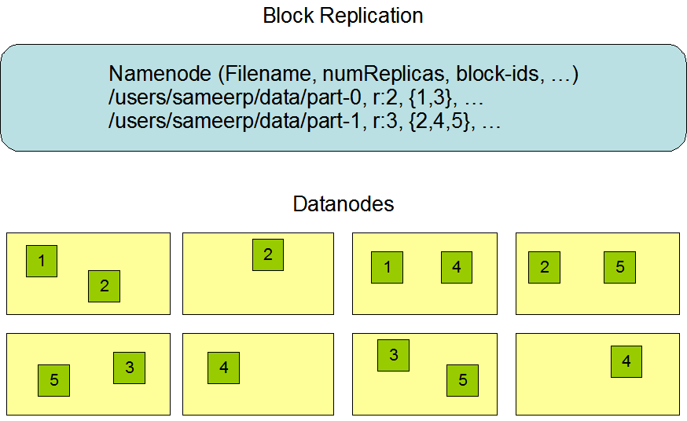
Data Replication

Slide 16
HDFS Command-Line Interface
//Create a folder in hdfs
% hadoop fs -mkdir myfolder
% hadoop fs -ls .
//Copying a file from local FS to HDFS:
% hadoop fs -copyFromLocal myfile.txt hdfs://localhost/myfolder/myfile.txt
% hadoop fs -copyFromLocal myfile.txt /myfolder/myfile.txt

Slide 17
HDFS from Java
Hadoop has an abstract notion of filesystems, of which HDFS is just one implementation. The Java abstract class org.apache.hadoop.fs.FileSystem represents the client interface to a filesystem in Hadoop.
Reading data from Hadoop URL:
InputStream in = null;
try {
in = new URL("hdfs://host/path").openStream();
// process in
} finally { IOUtils.closeStream(in);}

